Slide 1
Child Development day 4 of class
Disclosure, Human Sexuality form, Class fee slip, & Parent Interview

Slide 2
Correct Bell Quiz

Slide 3
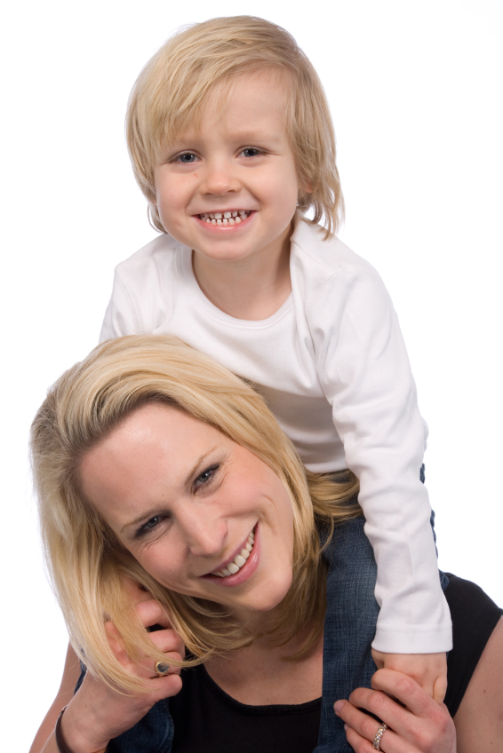
Tony Chestnut (song #2)
Tony chestnut knows I Love You!
(toe – knee) (chest – head) (nose) (eye) (cross arms) (point)
Tony Knows
Tony Knows
Tony Chestnut knows I Love You!
That’s what Tony knows

Slide 4
Tony Chestnut (song #2)

Slide 5
Song #2 Tony Chestnut
Song Title
Rating 1-5
What does this song teach a child, what can you talk about, what activities can you go and do?

Slide 6
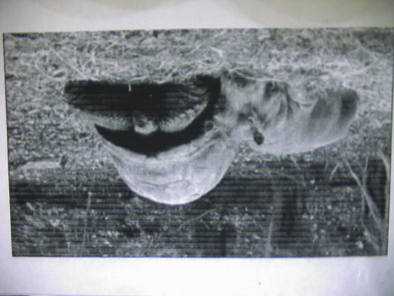
Owen and Mzee

Slide 8
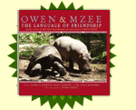
Bonding and Nurturing
http://www.owenandmzee.com/omweb/flash/mediacenter/mediacenter.html

Slide 9
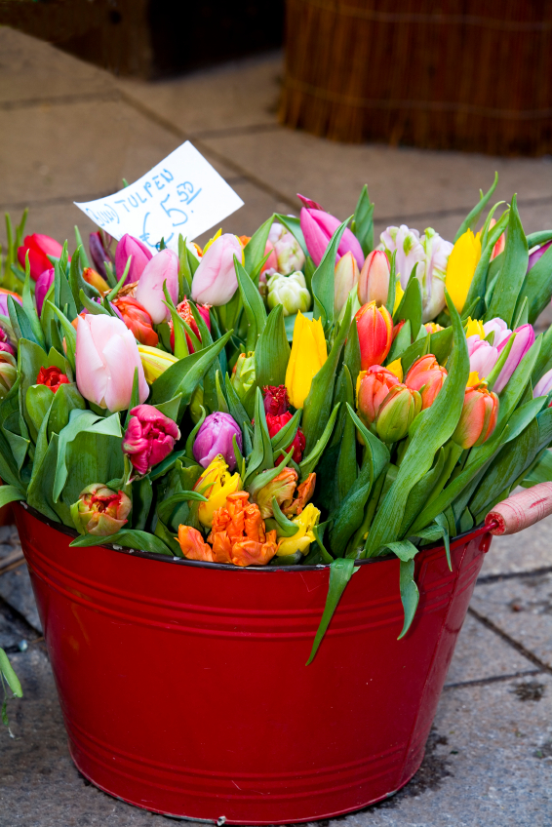
PLANT IN BAG
Write name on baggie
Get cotton ball damp
Place cotton ball and seed together in the baggie.
Zip the baggie and hang it up with your cloud picture.
Complete the assignment #4 evaluation in your workbook.

Slide 10
How are Growing and Developing a:
Seed and child the Same
Child and seed different
One more

Slide 11
3 actions you will take to Nurture and Strengthen a Bond with a child
Infants
Keep the baby close and comforted.
Take time to touch the baby
feeding, bathing, playing, massaging, ..
Be responsive to the baby
Play with the baby
Toddlers
Continue to play with the child:
Play, books, activities,..
Continue to use touch to express your affection and care
Touch, hugs, kisses
Continue to respond to the child as an individual
School Age
Continue to be physically affectionate
Kisses, touch, play
Talk to the child and encourage the child to talk to you.
Value the child’s opinion and encourage them to express it.
Play, play, play with them. Enjoy being together

Slide 12
Definitions for workbook
section B
Nature (heredity) - #2 draw conclusion from the video
Individual heredity and genetics. These explain who the person is and why they do what they do.
Nurture (environment) - #4 draw conclusion from the video
The influences of the environment through love, support, attention, and encouragement. Begins at birth.

Slide 13
Bonding - #6 draw conclusion from the video
Forming strong emotional ties between a parent and a child.
Ex: Long loving looks, loving touches, animated face and voice, consistency, responsiveness, sensitivity, being in-tune.
Failure to thrive (attachment disorder) #8 draw conclusion from the video
A condition in which the baby does not develop and grow properly due to a lack of bonding and nurturing (love, attention, and touch).
10 touches a day are needed to develop and thrive.

Slide 14
Romania: What happened to the children?
ABC: Turning point, January 16, 1997

Slide 15
Reflection #4
Agree or disagree: There are no bad children, only bad parents. Explain:

