Slide 1
Male & Female Reproduction

Slide 2
Notes from the Teacher/designer
This PowerPoint has just the color coding slides and I know it could look much better. ;0)
For the bingo review, I have a 8 1/2 x 11 card for each reproductive part with only its part colored....one card has the ovaries in red, one card has the fallopian tubes in blue, etc. You'll have to make those up if you want that part of what was shared. I only have the one hard copy I made.

Slide 3
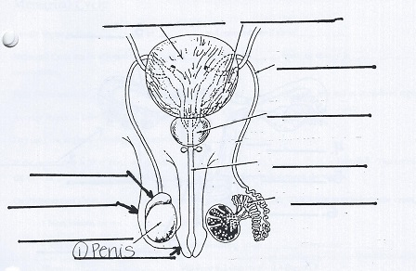
Male

Slide 4
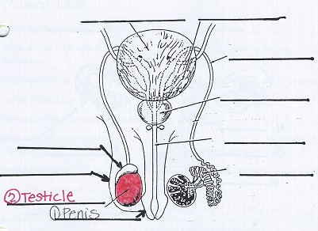
Male

Slide 5
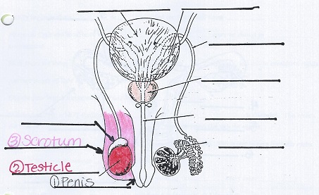
Male

Slide 6
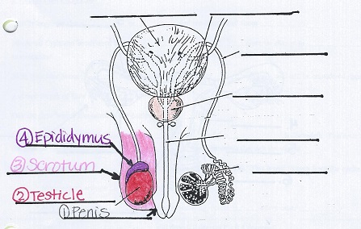
Male

Slide 7
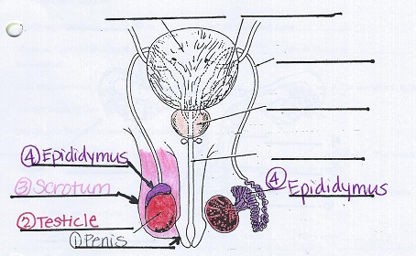
Male

Slide 8
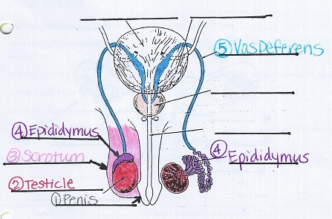
Male

Slide 9
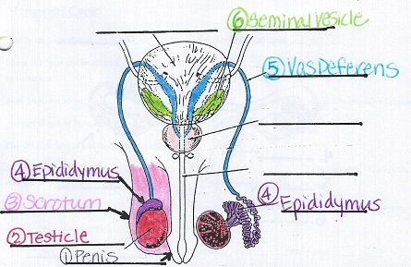
Male

Slide 10
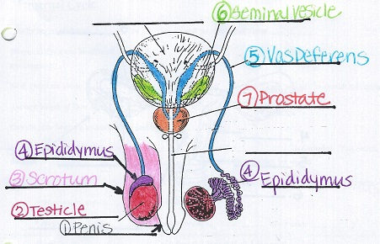
Male

Slide 11
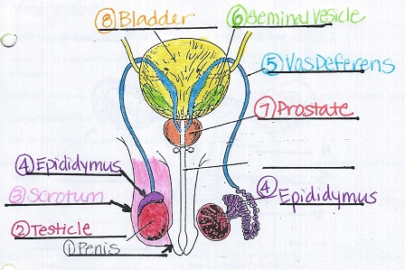
Male

Slide 12
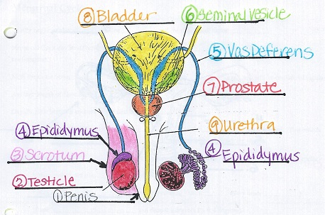
Male

Slide 13
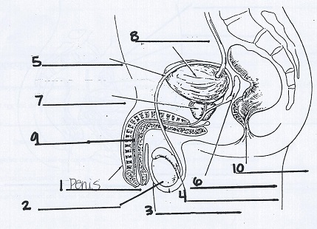
Male Reproductive Organs

Slide 14
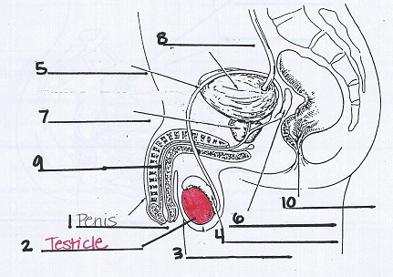
Male Reproductive Organs

Slide 15
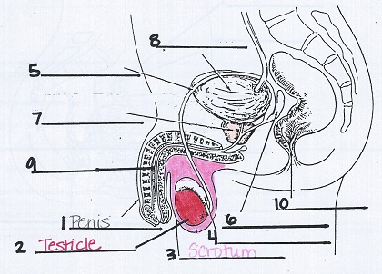
Male Reproductive Organs

Slide 16
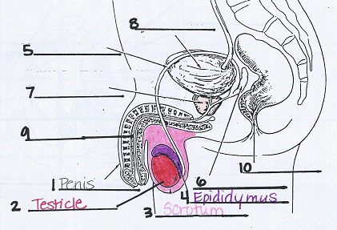
Male Reproductive Organs

Slide 17
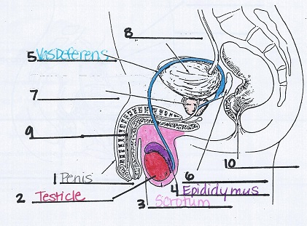
Male Reproductive Organs

Slide 18
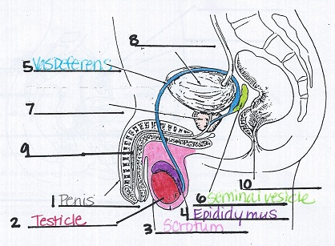
Male Reproductive Organs

Slide 19
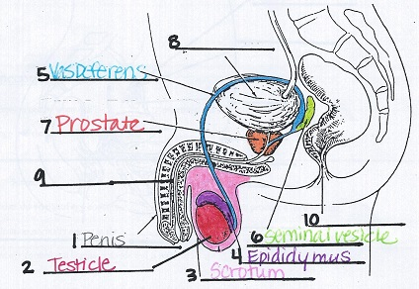
Male Reproductive Organs

Slide 20
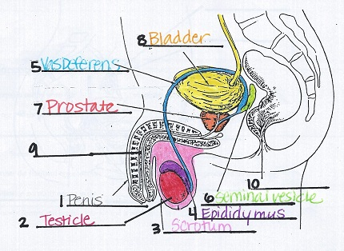
Male Reproductive Organs

Slide 21
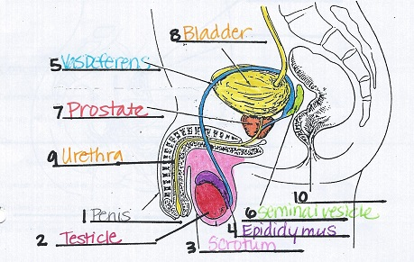
Male Reproductive Organs

Slide 22
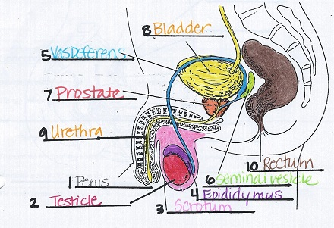
Male Reproductive Organs

Slide 23
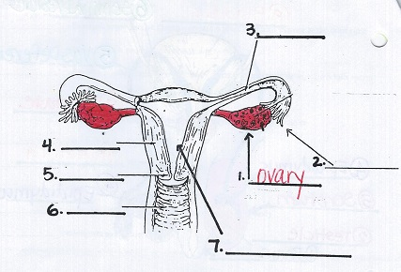
Female Reproductive Organs

Slide 24
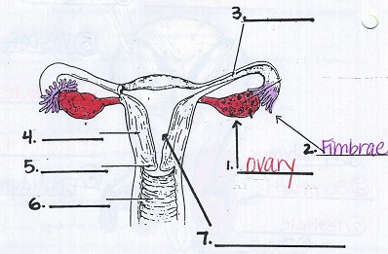
Female Reproductive Organs

Slide 25
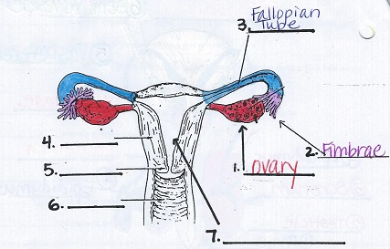
Female Reproductive Organs

Slide 26
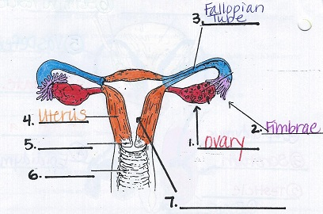
Female Reproductive Organs

Slide 27
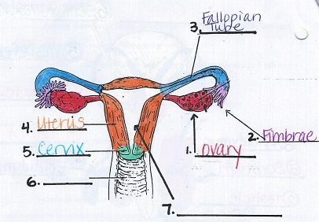
Female Reproductive Organs

Slide 28
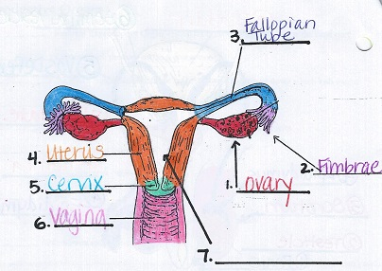
Female Reproductive Organs

Slide 29
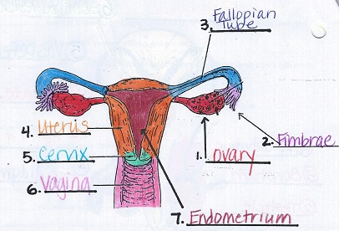
Female Reproductive Organs

Slide 30
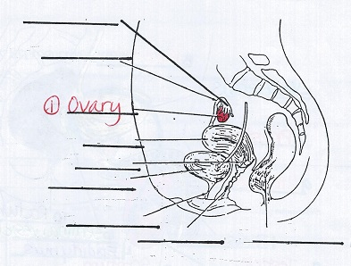
Female

Slide 31
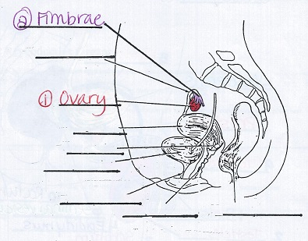
Female

Slide 32
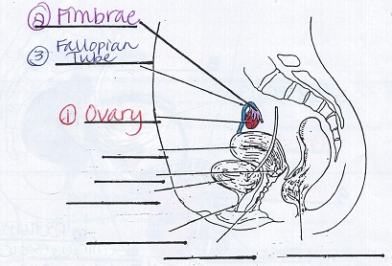
Female

Slide 33
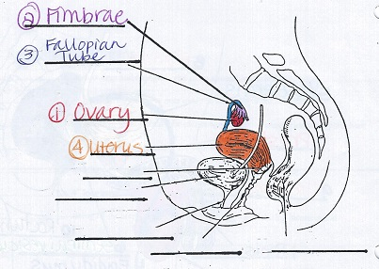
Female

Slide 34
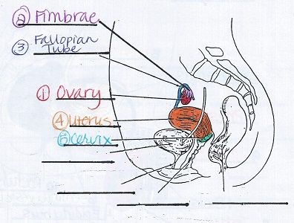
Female

Slide 35
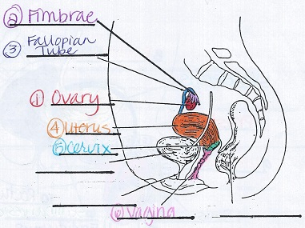
Female

Slide 36
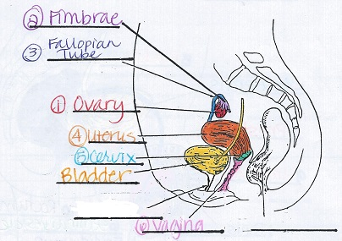
Female

Slide 37
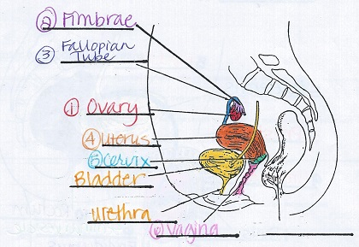
Female

Slide 38
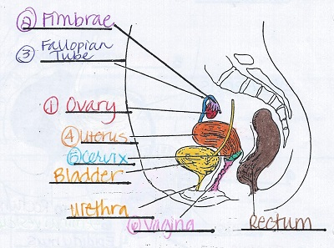
Female

