Slide 1
Human Reproduction Pictures and Diagrams

Slide 5
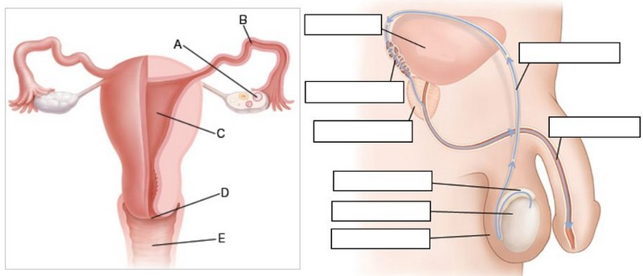

Slide 9
http://thornlea.sharpschool.com/cms/One.aspx?portalId=119587&pageId=781290

Slide 12
