Slide 1
Textiles
Apparel Design and Production 1
Created by: Amber Williams
Notes:
To be used with Textile Handbook handout.
This lesson is meant to take place over 3 or 4 class periods. Each lesson should take approx. 20 min or less. Students will be given a handout booklet to take notes in. Textiles PPT, Fashion! Textbook and a couple of hands on activities.
Day 1, Introduce the fibers. Day 2, Review Fibers and discuss application/use, Stain Removal notes and discussion. Day 3, Notes and Discussion on Woven and Knit Fabrics, Stretch activity. Day 4, Notes and Discussion on Nonwoven, wool beads felting activity, Fabric sorting activity.
See Notes in PPT slides for additional details. My students are also working on their final project during this time. They get 20 min of instruction and 60 to sew on their projects.
See Notes in PPT slides for additional details.
Amber Williams
amwilliams@dsdmail.net

Slide 2
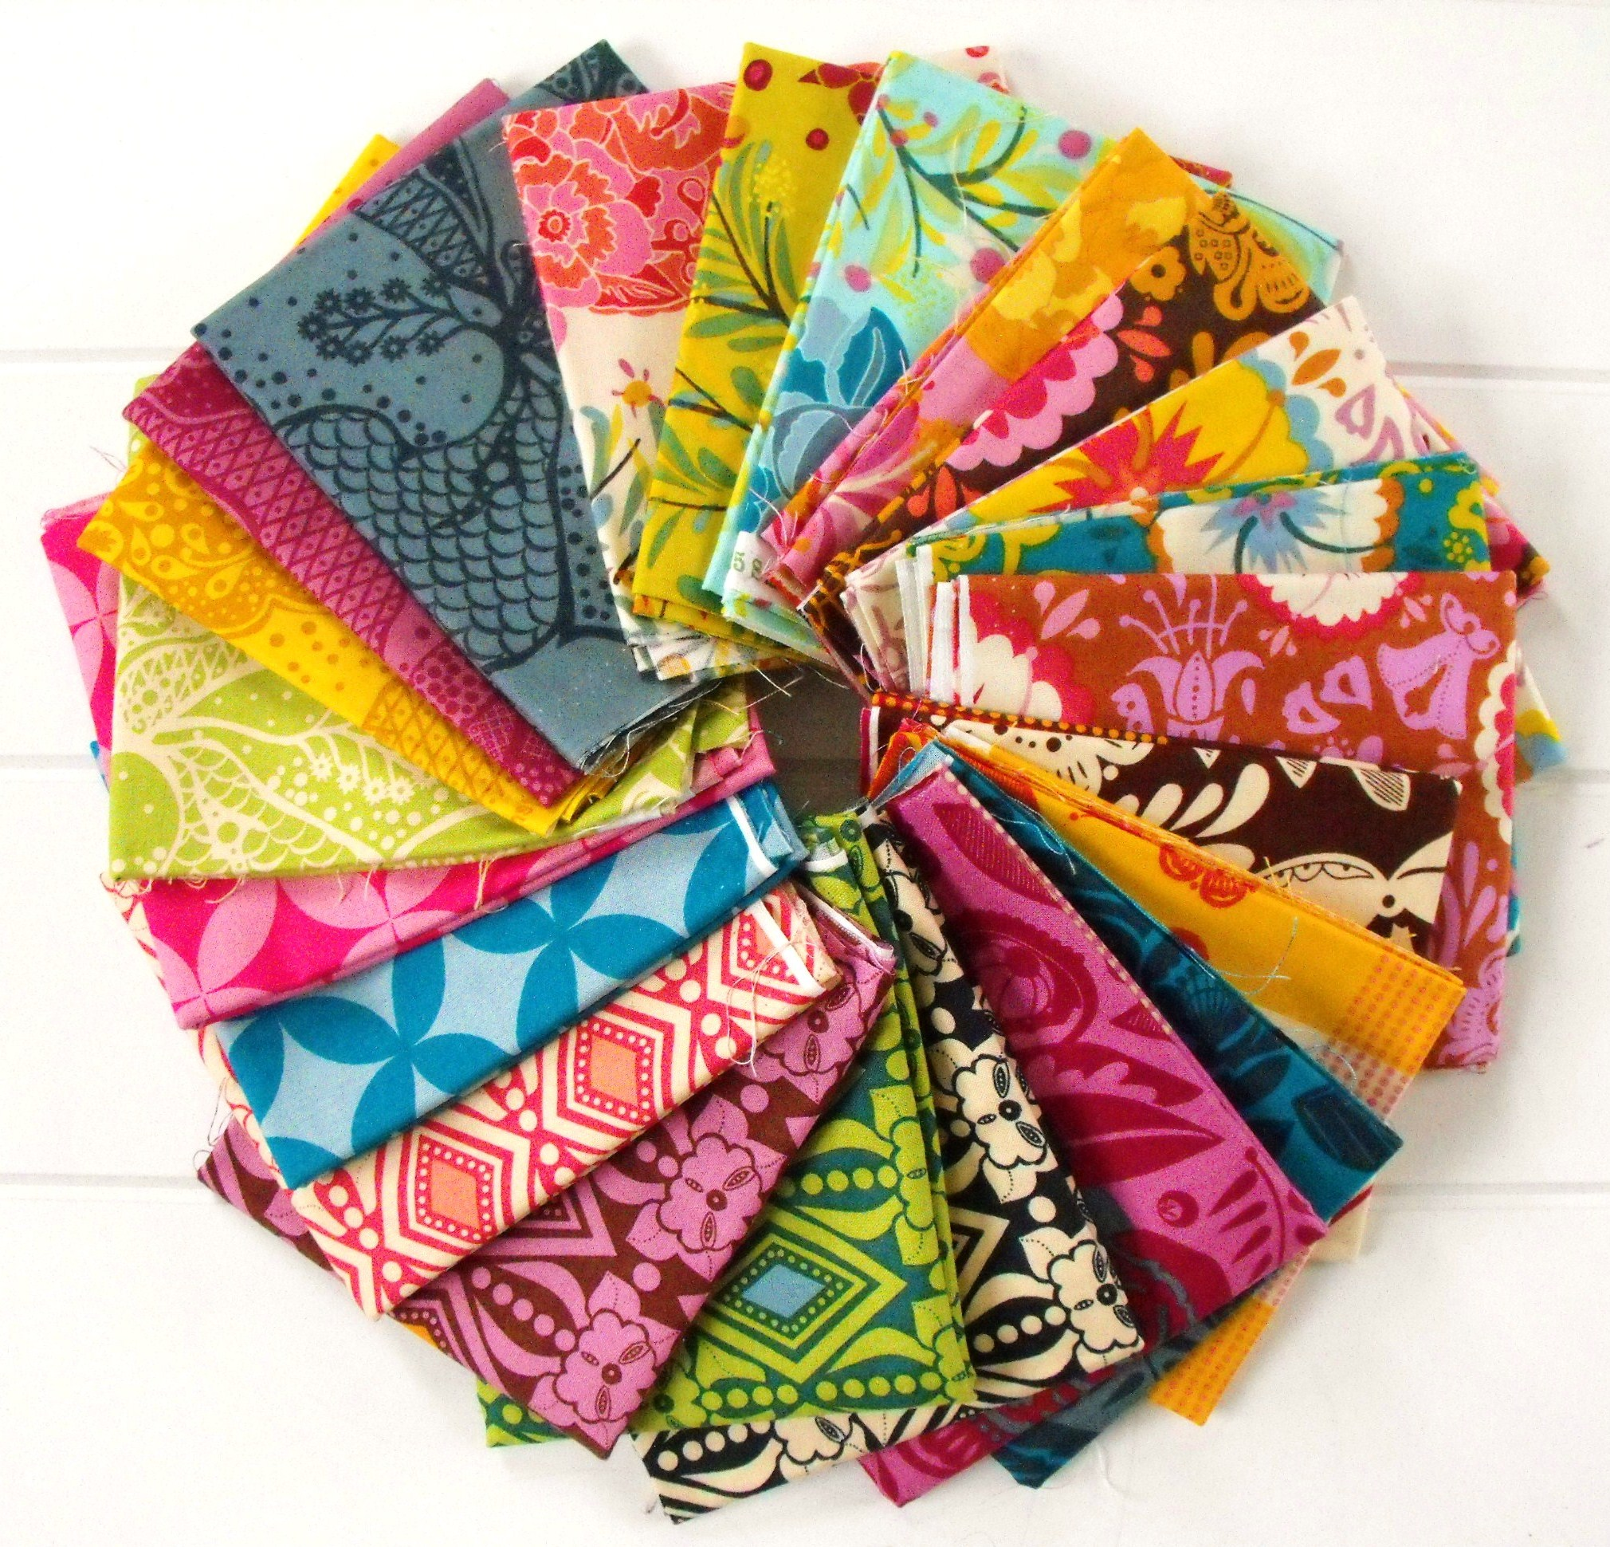
Define Textiles…..
Notes:
A type of Cloth or woven fabric

Slide 3
Natural vs Manufactured
Notes:
Have students list the following fibers in their notes as you list them.
Natural:
Wool
Cotton
Linen
Silk
Manufactured:
Nylon
Polyester
Rayon
Acetate
Acrylic
Spandex

Slide 4
Natural vs Manufactured
Notes:
Have students list the following fibers in their notes as you list them.
Natural:
Wool
Cotton
Linen
Silk
Manufactured:
Nylon
Polyester
Rayon
Acetate
Acrylic
Spandex

Slide 5
Natural vs Manufactured
Notes:
Have students list the following fibers in their notes as you list them.
Natural:
Wool
Cotton
Linen
Silk
**Pass around the fiber cards for each fiber type (card has a fiber sample, and fabric sample attached to it)***
Manufactured:
Nylon
Polyester
Rayon
Acetate
Acrylic
Spandex

Slide 6
Knowing the characteristics of each fiber type will help you choose fabric to better meet your needs
Complete the Table in your handbook
Write characteristics of each fiber in your chart
You have 20 minutes!
Notes:
Have students use the FASHION! text book to complete the chart in their notes.

Slide 7
Blended Fibers
What is the benefit of blending fibers?
Notes:
Blending fibers creates the best of both worlds.
It can decrease cost, but will give the qualities of the fibers.
Eg. Spandex and cotton blended changed how most people felt about wearing jeans.

Slide 8
Optimum Performance Choose the right fiber for the job
Function/Needs
What Fiber will provide the function/needs?
What are the characteristics?
Notes:
For each picture have students choose a fiber they would choose to make the clothing article.
Students needs to tell what the fiber characteristics that make their choose the best selection.
Fill out the information in their handout

Slide 9
Optimum Performance Choose the right fiber for the job
Function/Needs
What Fiber will provide the function/needs?
What are the characteristics?
Notes:
For each picture have students choose a fiber they would choose to make the clothing article.
Students needs to tell what the fiber characteristics that make their choose the best selection.
Fill out the information in their handout

Slide 10
Optimum Performance Choose the right fiber for the job
Function/Needs
What Fiber will provide the function/needs?
What are the characteristics?
Notes:
For each picture have students choose a fiber they would choose to make the clothing article.
Students needs to tell what the fiber characteristics that make their choose the best selection.
Fill out the information in their handout

Slide 11
Optimum Performance Choose the right fiber for the job
Function/Needs
What Fiber will provide the function/needs?
What are the characteristics?
Notes:
For each picture have students choose a fiber they would choose to make the clothing article.
Students needs to tell what the fiber characteristics that make their choose the best selection.
Fill out the information in their handout

Slide 12
Optimum Performance Choose the right fiber for the job
Function/Needs
What Fiber will provide the function/needs?
What are the characteristics?
Notes:
For each picture have students choose a fiber they would choose to make the clothing article.
Students needs to tell what the fiber characteristics that make their choose the best selection.
Fill out the information in their handout

Slide 13
Optimum Performance Choose the right fiber for the job
Function/Needs
What Fiber will provide the function/needs?
What are the characteristics?
Notes:
For each picture have students choose a fiber they would choose to make the clothing article.
Students needs to tell what the fiber characteristics that make their choose the best selection.
Fill out the information in their handout

Slide 14
Laundry Care
What sets a STAIN?
Notes:
Heat and Time set a stain

Slide 15
Stain Removal 101 Refer to your Handout
Notes:
Have students refer to the guide in their handout, discuss how to launder an item that is affected by the following item:
Gum
Grass stains

Slide 16
Stain Removal 101
Notes:
Have students refer to the guide in their handout, discuss how to launder an item that is affected by the following item:
Makeup/lipstick
Ball point pen

Slide 17
Stain Removal 101
Notes:
Have students refer to the guide in their handout, discuss how to launder an item that is affected by the following item:
Blood/Protein
Chocolate

Slide 18
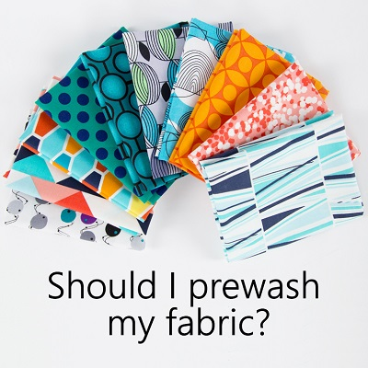
Notes:
Preshrink your fabric by washing, drying and ironing (if needed) exactly how you would care for the finished item before you begin. Knits are notorious for shrinking!

Slide 19
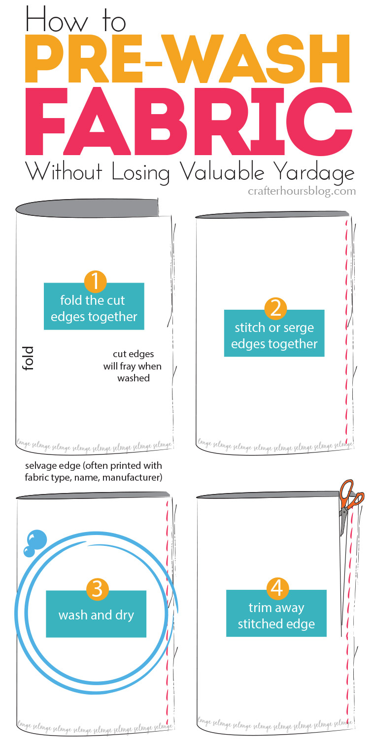
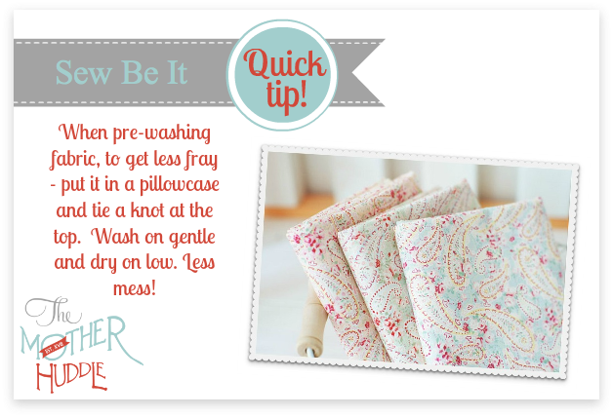
Notes:
Preshrink your fabric by washing, drying and ironing (if needed) exactly how you would care for the finished item before you begin. Knits are notorious for shrinking!

Slide 20
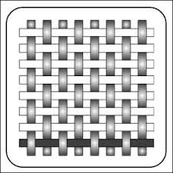
Fabric Construction
Woven Fabric
Interlacing yarns
Plain, Satin and Twill
Selvage
Lengthwise, Crosswise, and Bias
Notes:
Give students a piece of cloth and have them label the parts of the fabric (selvage, lengthwise, crosswise, bias)
Discuss how the type of weave affects the fabric types (broadcloth, denim, crepe de chine)
There are different types of weaves, Plain, satin, and twill. We go into more detail on the types of weaves in fashion strategies and clothing 2
Resource: Fabric Guide: The Ultimate Fiber Resource, by Simplicity

Slide 21
Fabric Construction
Knit Fabric
Interlocking loops
Weft and Warp Knits
Stretchy
Notes:
Knits have much more give and flexibility that its more rigid woven counsin
There are two types of machine knittibng construction: weft and warp.
Weft knits: Jersey or plain knits, Double Knits, Rib Knits (developed to copy the look of hand knitting)
Warp knits: Tricot, Raschel knits (more durable than a weft knit, and less susceptible to running)
If a knit has spandex added to it, it has even more stretch!
Show students how to check stretch capability for knit.
Resource: Fabric Guide: The Ultimate Fiber Resource, by Simplicity

Slide 22
Stretch Capabilities
Notes:
Why should one be concerned with how much a knit can or can not stretch?
Not all knit fabrics stretch the same amount, use the following ruler to determine the stretch of your fabric. We recommend fabrics that have a 2-way stretch and moderate (35% -- jersey knit and interlock) to super (75% -- rib knit and fabric with spandex/lycra) stretchability. Fold the knit perpendicular the grainline (along the direction of stretch). Place pins 4” apart. Hold knit firmly at edge of gauge and stretch without distorting the fabric. If distortion (parallel folds) appears, relax tension. Note the distance the knit stretched beyond its original length. Release the pulled end; if it returns to its original location, it has excellent recovery.
Measure on the crossgrain
http://www.jocole.net/pdf/KnitTips&Tricks.pdf
http://stitch-n-smile.com/how-to-thursday-measuring-your-fabric-stretch/
Give students a knit sample and have them measure their fabric stretch (pinsm

Slide 23
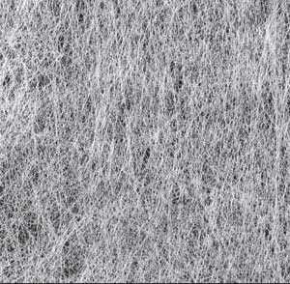
Fabric Construction
Non Woven Fabric
Netting, Bonding, Fusing, Felting
Felting forms a permanent bond between fibers
Notes:
Netting: is an ancient construction that’s been adapted to generate many types of fabrics. Lace and Tuelle are examples
Bonding: joins two separate layers of cloth, plastic or vinly together with a chemical agent. Faux leather is an example
Fusing: creates a matted web by joining fibers together with an adhesive or bonding agent. Interfacings are a good example
Felting: uses a combination of moisture, heat, and friction to produce a thick, warm fabric from wool fibers. The wool fibers are immersed in water, causing the scales on the fiber to swell; agitation or friction is then applied to entangle the scales together. Next, heat is applied to shrink the scales back down.
Resource: Fabric Guide: The Ultimate Fiber Resource, by Simplicity

Slide 24
Woolen Beads
Notes:
Have students make a woolen bead to experience felting!
Have students identify what they did to reflect the steps of the felting process:
Immerse in water---cut woolen string into small pieces and saturate in water
Agitation---pull cut pieces apart
Heat---roll pulled pieces between your palms
Tutorial link shows how to make a necklace with woolen beads.
http://www.nowimaginethis.blogspot.com/2010/01/texture-woolen-beads.html

Slide 25
Fabric Sort Activity
The student will be able to correctly identify fabric types.
Sort fabrics into 3 categories:
Woven, Knit, Nonwoven
Notes:
Have 10-12 Ziploc bags prepared with 6”x6” squares of woven, knit and nonwoven fabrics.
Give a group of 2-3 students a zip lock bag and have them sort the fabrics into the correct categories.
Have them check off their sorting when they are finished.
Questions:
Was is hard to sort the fabrics?
What were you looking for to classify woven/knit/nonwoven?
How will you use this knowledge to help you select fabrics in the future?

