Slide 1
4 Bucks a Day
Mateja Savoie MPH, RD, CD, CNP
Evaluation Coordinator, Food $ense, USU

Slide 2
Objectives
Recognize the average SNAP benefits/person/day
Discuss the SNAP challenge
Define what average American spends on food
Identify barriers to eating well on a limited income
Identify ways to overcome barriers to eating well on a limited income
Apply eating well on a budget to the FACS classroom
Notes:
Refer to slide

Slide 3
Average SNAP benefits
An average of $4.00 per person per day
Family of 4 = ~$450.00 per month
Designed to supplement food income
Most articles, blogs, websites, and other media express how difficult and almost impossible it is to eat on $4.00 a day.
SNAP-Ed is here to tell you that it can be easy!!!
Notes:
SNAP benefits do vary from state to state and person to person

Slide 4
SNAP Challenge
The SNAP challenge is an annual challenge that encourages people across the nation to live off the typical SNAP benefits of $4.00/day.
During the Challenge
All food purchases must be included in the total food expenses.
Do not eat any other foods purchased prior to the challenge
Avoid accepting free foods from family/friends
Eat as healthy as possible!

Slide 5
Food Purchases in the U.S.
Average: ~10 percent of disposable income
Top 5 most purchased foods
Cereal
Milk
Bottled water
Soft Drinks
Bread
Notes:
The USDA reported that in 2009, Americans spent 9.47% of their disposable income on food (5.55% on food at home and 3.93% on food away from home).
Average: < 10 percent of discretionary income
Discretionary income – what’s left after taxes
Upper income (taxed 35%) - $100,000 - $35,000 = $65,000
$540/month/food with 4860 left for other expenses
Middle income (22%) - $50,000 – 11,000 = $39,000
$325/month/food with $2925 left for other expenses
For low income (15%) – 20,000 – 3,000 = $17,000
140/month/food with $1260 left for other expenses
The more Americans make, the less they spend on groceries. According to Forbes, The bottom fifth of earners spend a whopping 12% of their yearly budget on food at home, compared to 9% for the middle fifth, and 6% for the top fifth.

Slide 6
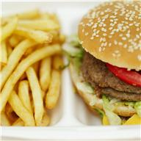
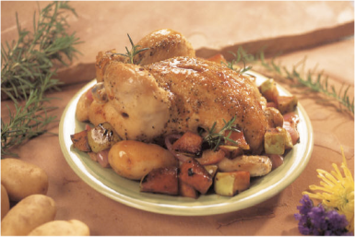
The claim
Junk food is cheaper than healthy food
Notes:
Who has heard this argument before?
“I cant afford healthy food”
Fruits and vegetables are too expensive”
Ots cheaper to eat fast food”
Does it cost less to eat fast food than to cook at home? That is what many people believe.

Slide 8
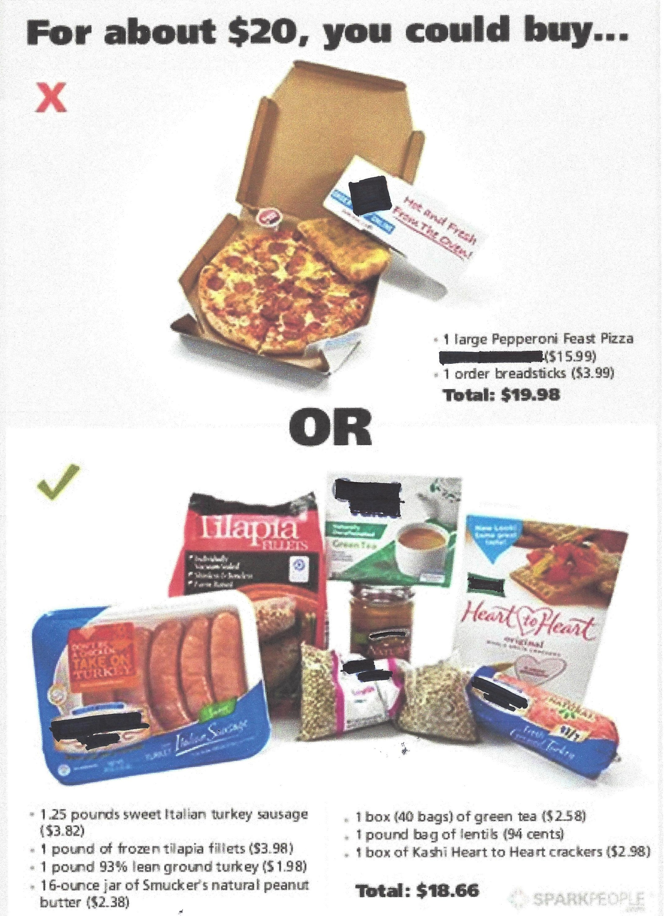

Slide 9
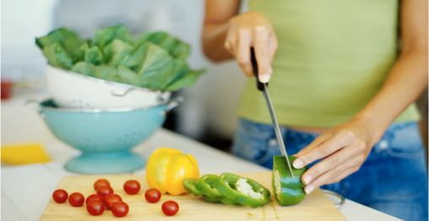
What’s the problem?
No time to cook
Too tired to cook
Don’t know how to cook
Notes:
No time, too tired - Most people claim they don’t have time to cook or they are too busy to cook. In 2010 the average American, regardless of weekly earnings, watched 1 ½ hours of TV per day (Bittman). The time is there.
- Forbes - Americans moved in recent generations from cooking at home to eating out because they think they don't have time to cook, says Sheryl Garrett, founder of the Garrett Planning Network, a network of financial advisers. But that's not a sound decision, she says. "If you think about it, if you count packing the family into the car, driving to the Applebee's, standing in line for 20 minutes, getting to your table, waiting for your food, checking out, paying the bill of 40 or 50 dollars, and then driving back home, have you saved any time at all? No, definitely not. And you've probably spent four times what you could have at home."
Cooking is work – fast food is a pleasure and a crutch. Cooking is seen as a chore that even lower income people can get out of.
Don’t know how – good thing we have Food $ense!

Slide 10
Education in Key
Teaching the basics will help kids and adults make healthier choices
Cooking
Shopping
Menu planning

Slide 11
What does $4.00 buy?
Breakfast – oatmeal with raisins and walnuts, banana
$.50
Lunch – peanut butter sandwich, apple, carrot sticks, oatmeal cookie
$1.00
Dinner – Black bean stew, corn muffin, green salad, orange slices
$1.00
Snack –yogurt with frozen/fresh fruit mixed in
$.75
Total: $3.25
Notes:
Oatmeal—rolled oats –can always make in advance and keep a container of cooked oats in the fridge to make it easier in the mornings
Remember with fruit like apples, bananas, and oranges you don’t need to eat the whole piece at one sitting. Now, apples are getting so big they are actually considered to have 2 servings of fruit. Same with bananas
Make your own stew. You can always eat extra for meals later in the week OR a great alternative is to freeze soups and stews
When buying yogurt, buy the large containers and portion it out yourself. And add your own fruit! Typically, fruity yogurt has added sugars

Slide 12
How to afford healthy choices
Choose this
Old fashion oatmeal (42 oz) for $3.18
Brown rice (1 lb) for $1.75
Black beans -dry (16 oz) for $1.47
Head of romaine lettuce for $1.60
Carrots (1 lb) for $0.79
Total--$8.79
In place of
Oatmeal packets (net wt of 11.5 oz) for $2.88
Instant minute brown rice (28 oz) for $3.84
Canned black beans (15.5 oz) for $0.74
Bag of romaine lettuce for $2.90
Baby carrots (16 oz) for $1.50
Total--$11.86
Notes:
Not only do you save money but you are also getting more for your money.

Slide 13
Tips on Keeping Down Food Costs
Eat at home
Plan a menu
Make a grocery list
Simplify recipes
Buy foods that can be used for a variety of dishes
Cook from scratch
Use coupons/Price match
Make enough to eat for meals later in the week
Buy in season
Garden

Slide 14
Healthy Foods With Low Cost
Oats
Eggs
Kale
Potatoes
Apples
Bananas
Beans
Low fat milk
Spinach
Whole grain pasta
Squash
Beets
Popcorn

Slide 15
What About Protein?
Purchase inexpensive cuts—slow cook
Make your own hamburger patties instead of purchasing premade patties
Purchase meats in bulk—freeze
Eat meatless dishes—Beans!!

Slide 16
Take the Challenge
Try the SNAP challenge
Practice living on a food budget of $4.00/day or less for 1 week.
Gain awareness of what it is like to live off of SNAP benefits
Do you homework. If your prepared, you will be able to eat healthy on a limited budget.
Notes:
Define one goal to becoming a better teacher of menu planning.

Slide 17
Applying This to Your Classroom
Most importantly, we need to get kids cooking!!!
Educate kids about eating whole foods
Emphasize budgeting especially for older students preparing for college
Create a mock SNAP challenge

Slide 18
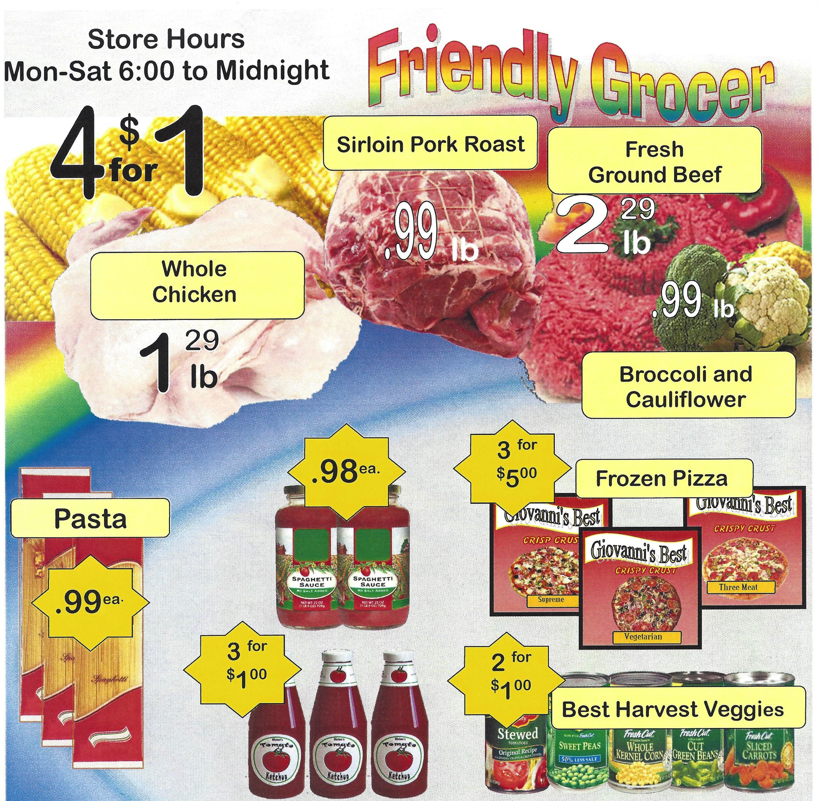

Slide 19
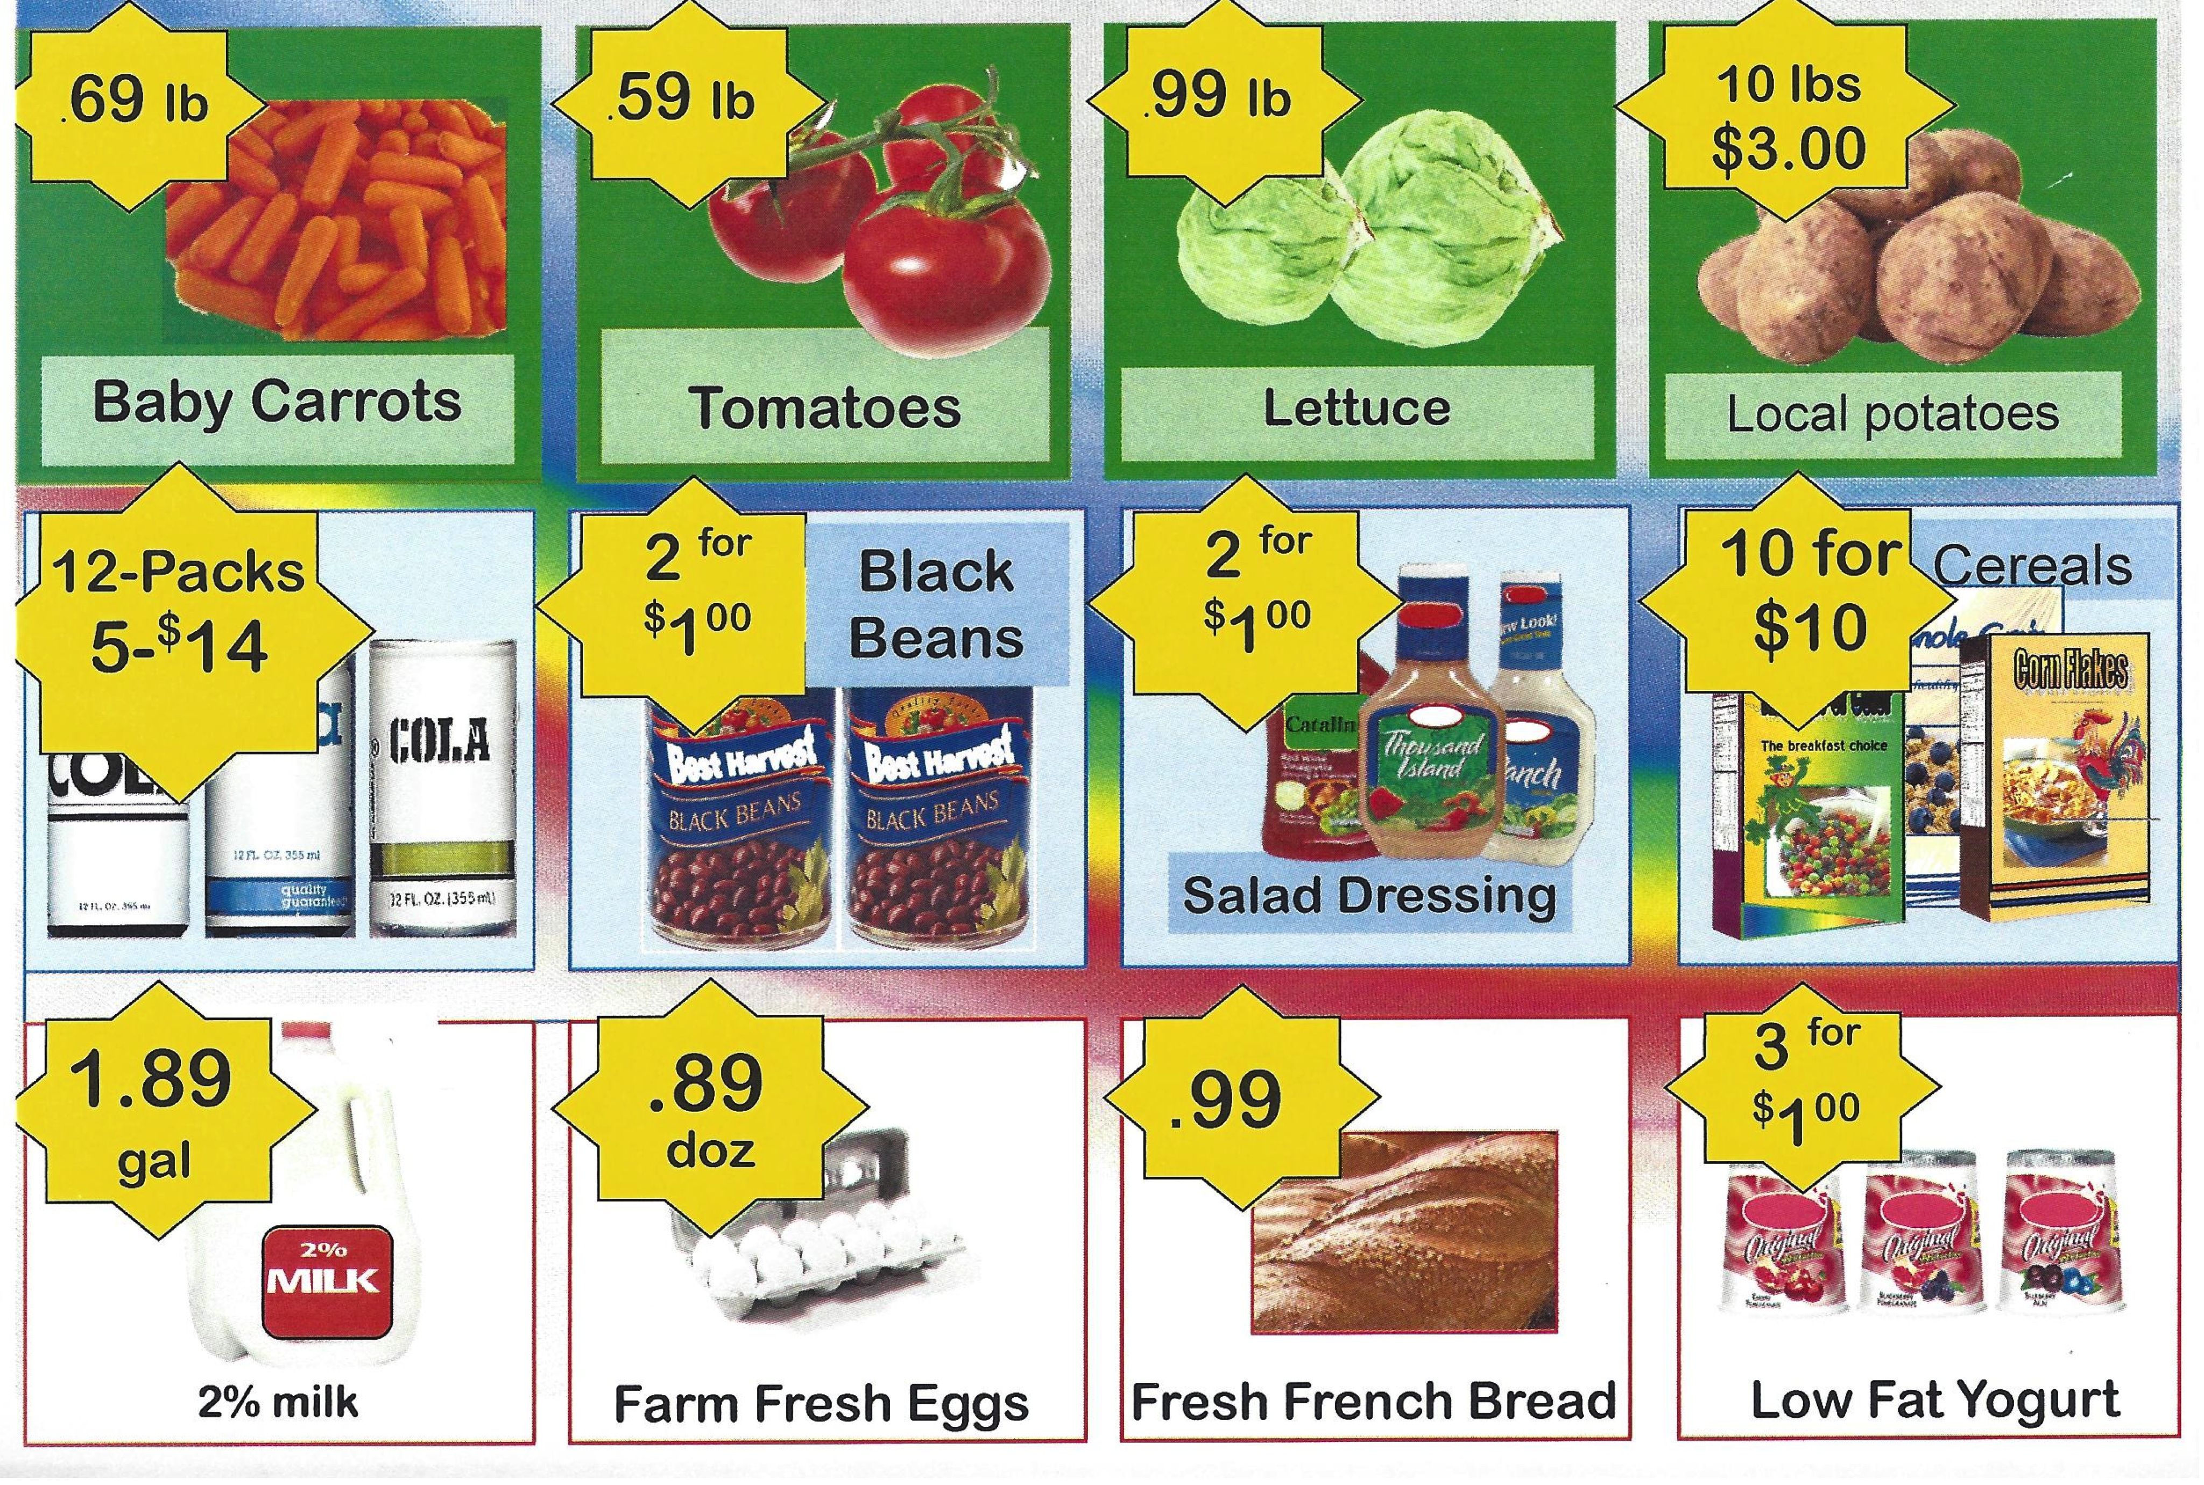

Slide 20
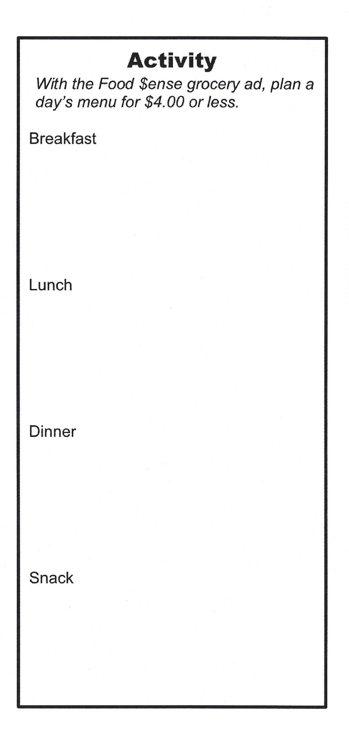

Slide 21
Questions?

Slide 22
References
http://feedingamerica.org/hunger-in-america.aspx
http://www.uahsnapchallenge.org/
http://extension.usu.edu/fsne/htm/menu
http://www.sparkpeople.com/blog/blog.asp?post=what_20_will_buy_at_the_drivethru_and_at_the_supermarket
http://www.oregonlive.com/foodday/index.ssf/2012/09/eating_on_4_a_day.html

