Slide 1
Starter
Discuss with the person sitting next to you how you reduce the fat in a recipe.
Write what you discussed

Slide 2
Calculating the FAT

Slide 3
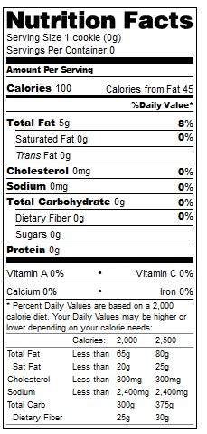
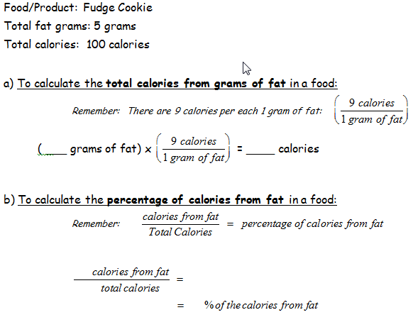
Fudge Cookie Example

Slide 4
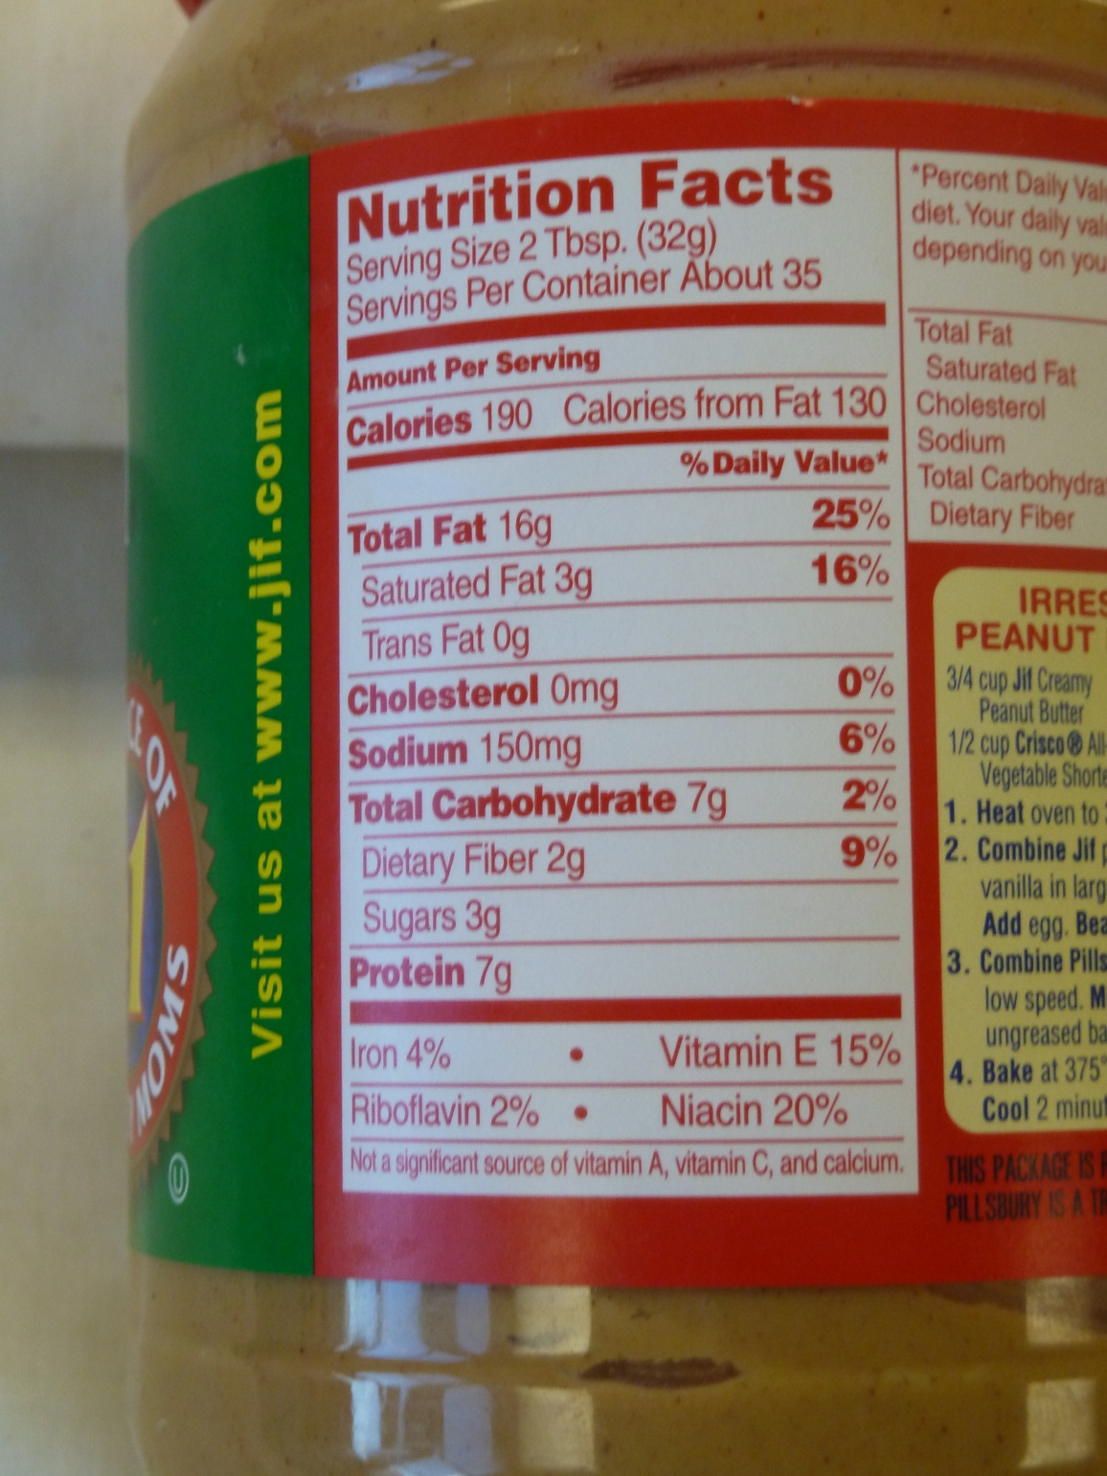
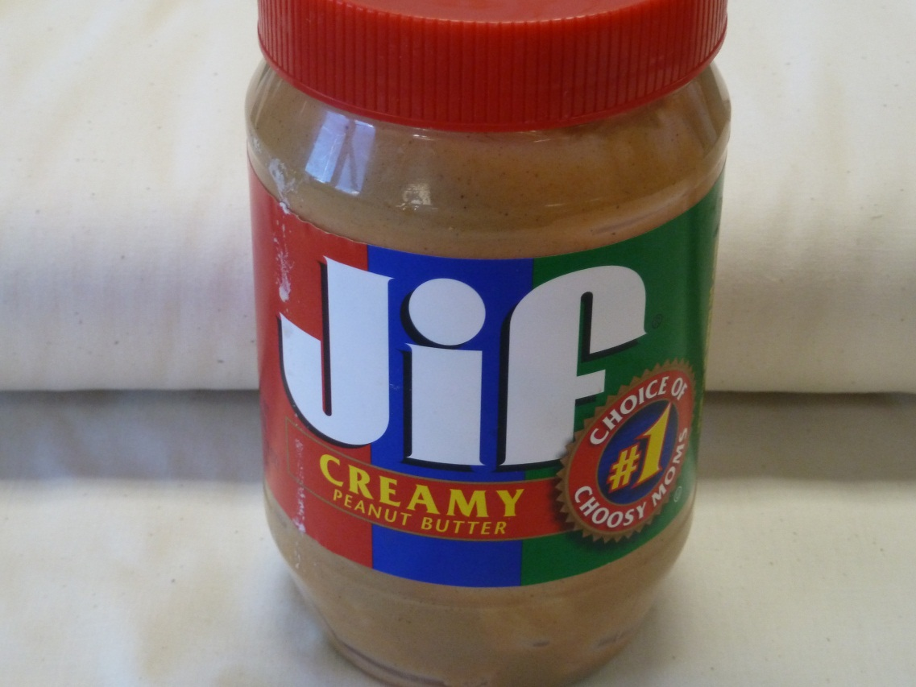
Food/ Product Name:
Peanut butter
Total Fat Grams: 16 g
Total Calories: 190
(per 2 Tbsp)

Slide 5
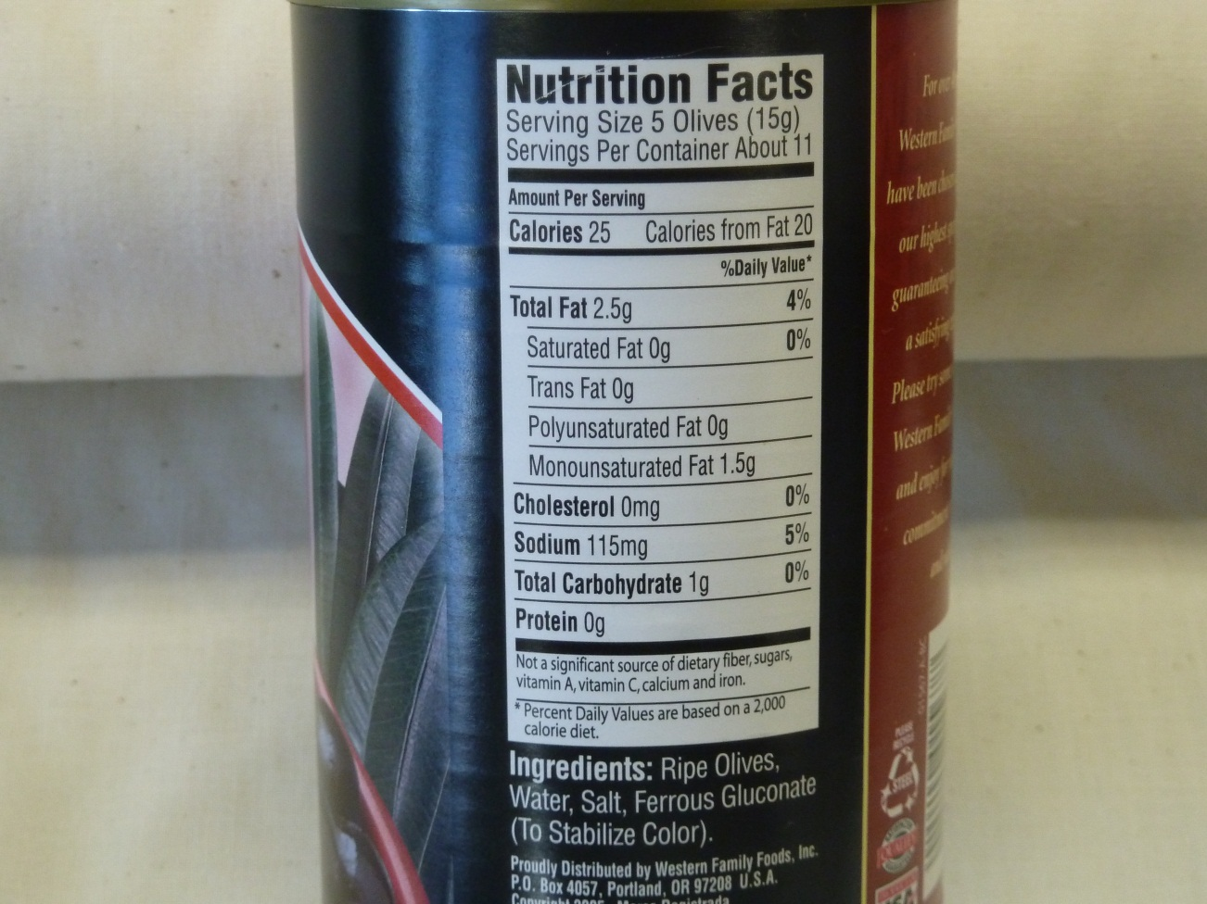
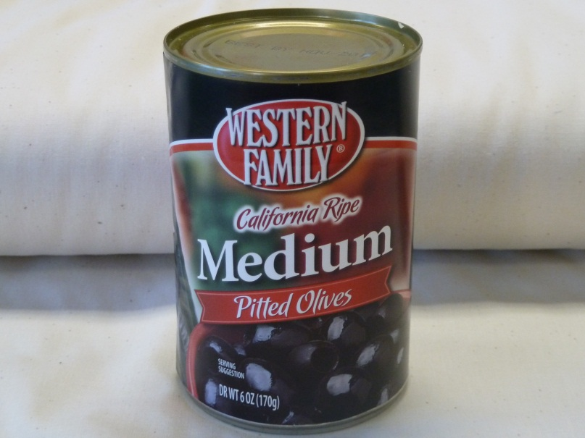
Food/ Product Name: Pitted Olives
Total Fat Grams: 2.5
Total Calories: 25
(Per 5 olives)

Slide 6
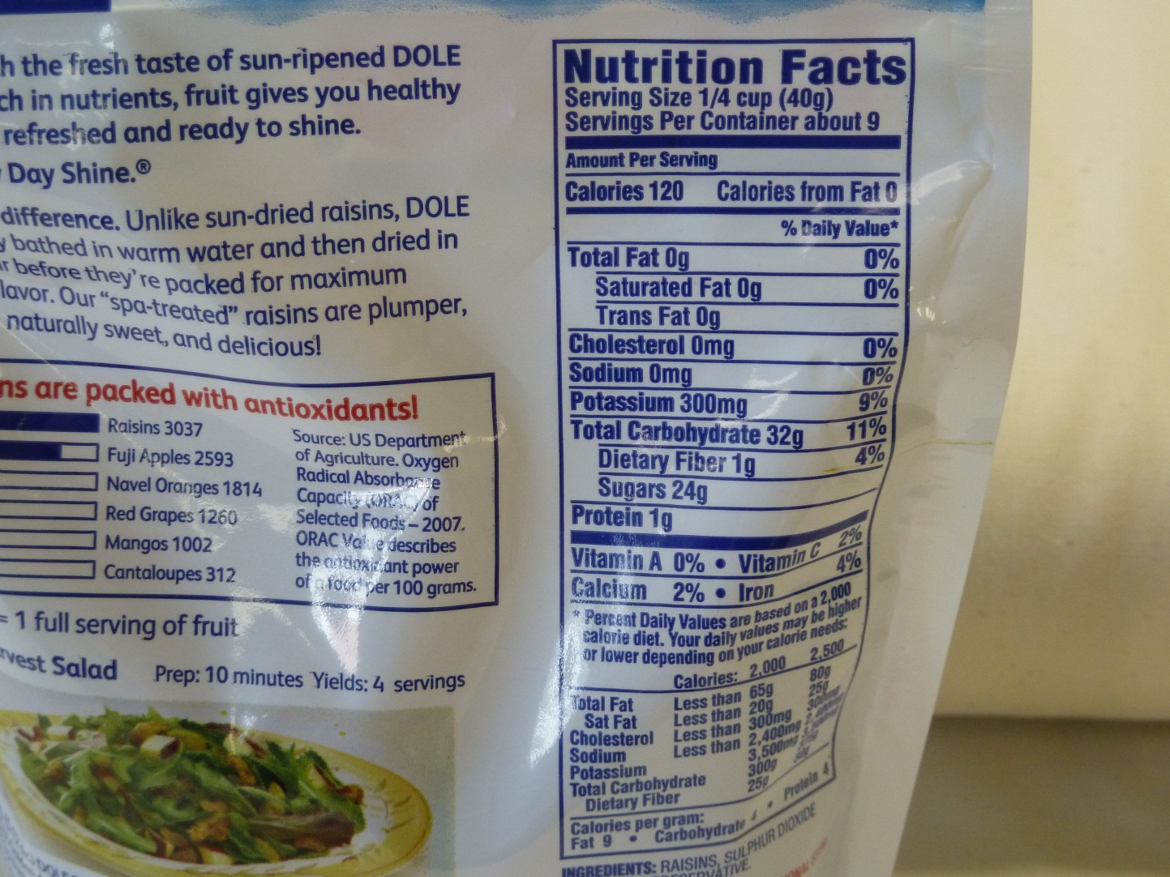
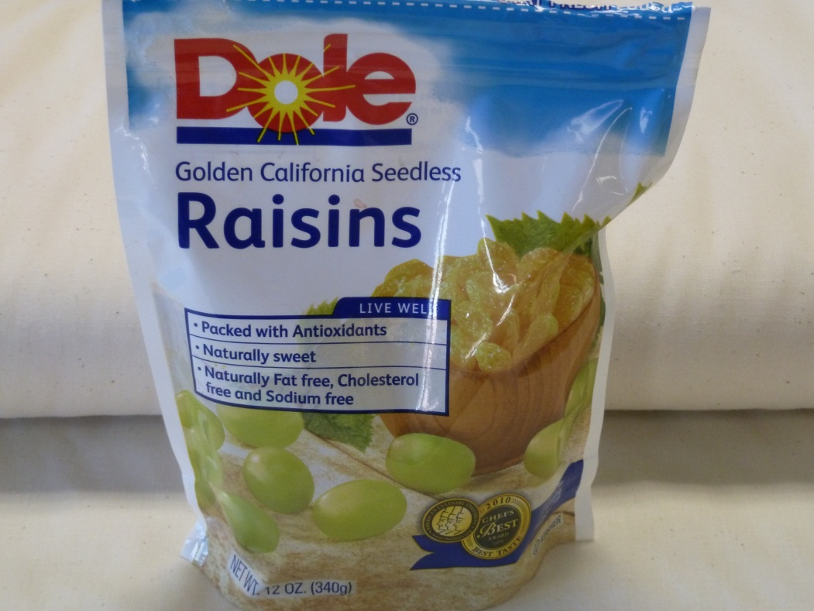
(per ¼ cup)
Food/ Product Name: Golden Raisins
Total Fat Grams: 0 Total Calories: 120

Slide 7
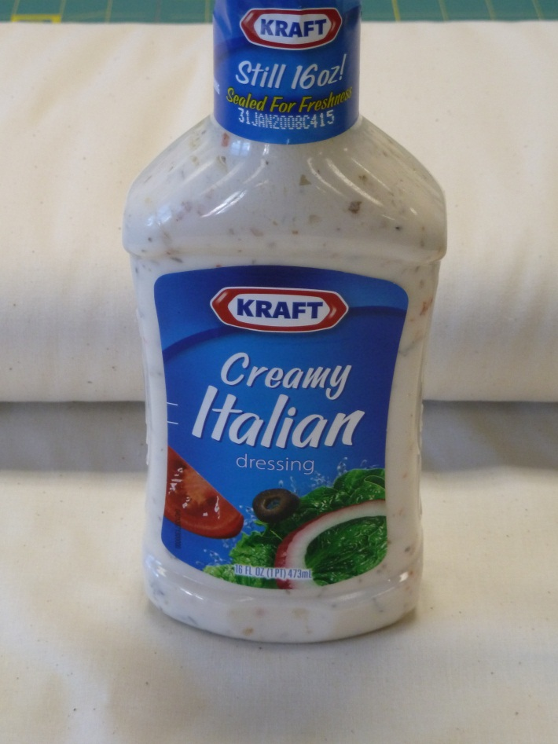
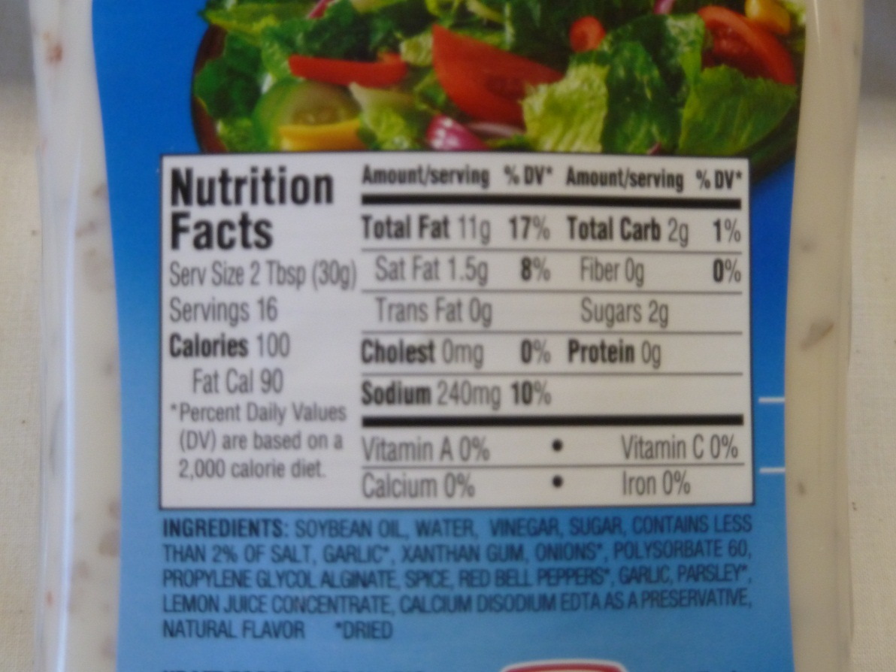
Food/ Product Name: Creamy Italian Dressing
Total Fat Grams: 11 g Total Calories: 100
(per 2 Tbsp)

Slide 8
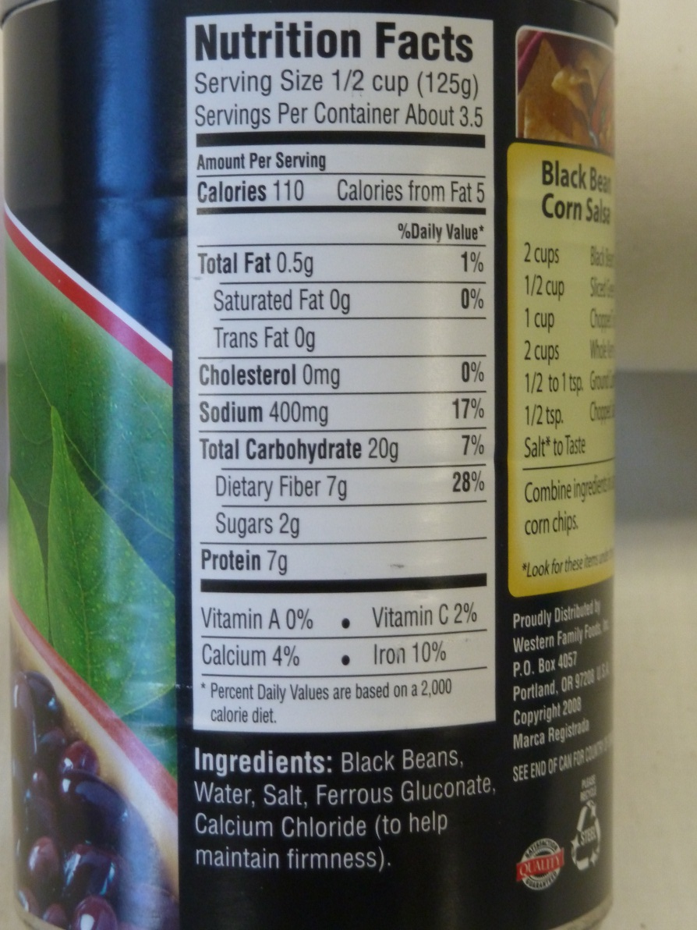
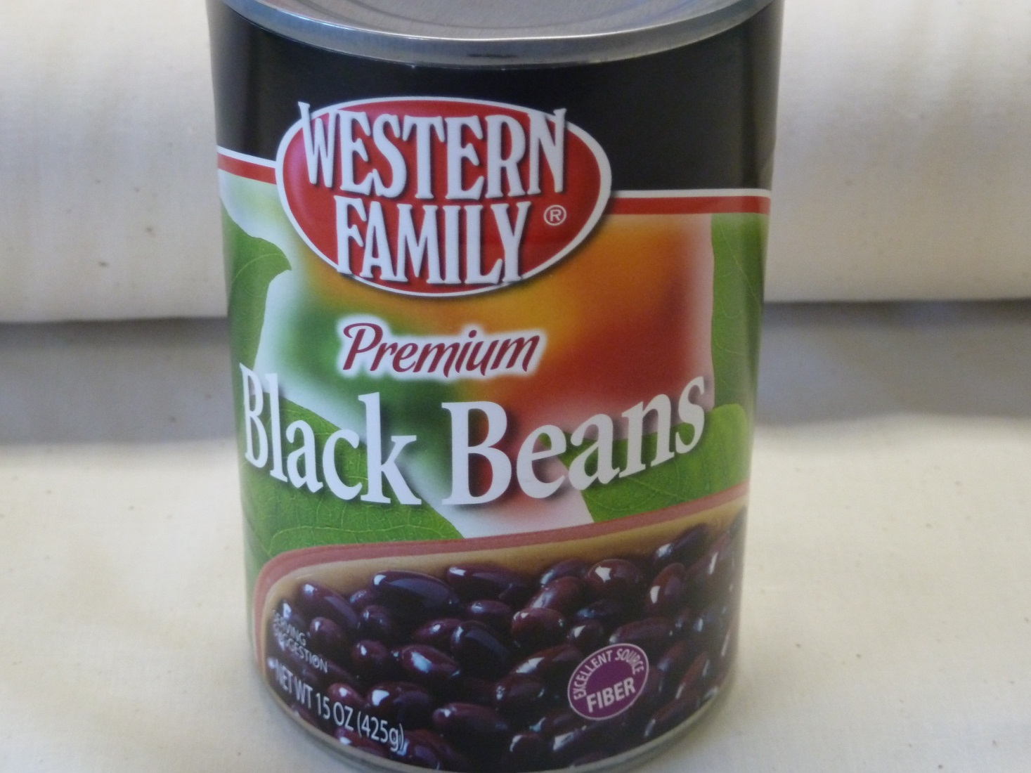
Food/ Product Name:
Black Beans
Total Fat Grams: .5
Total Calories: 110
(per ½ cup)

Slide 9
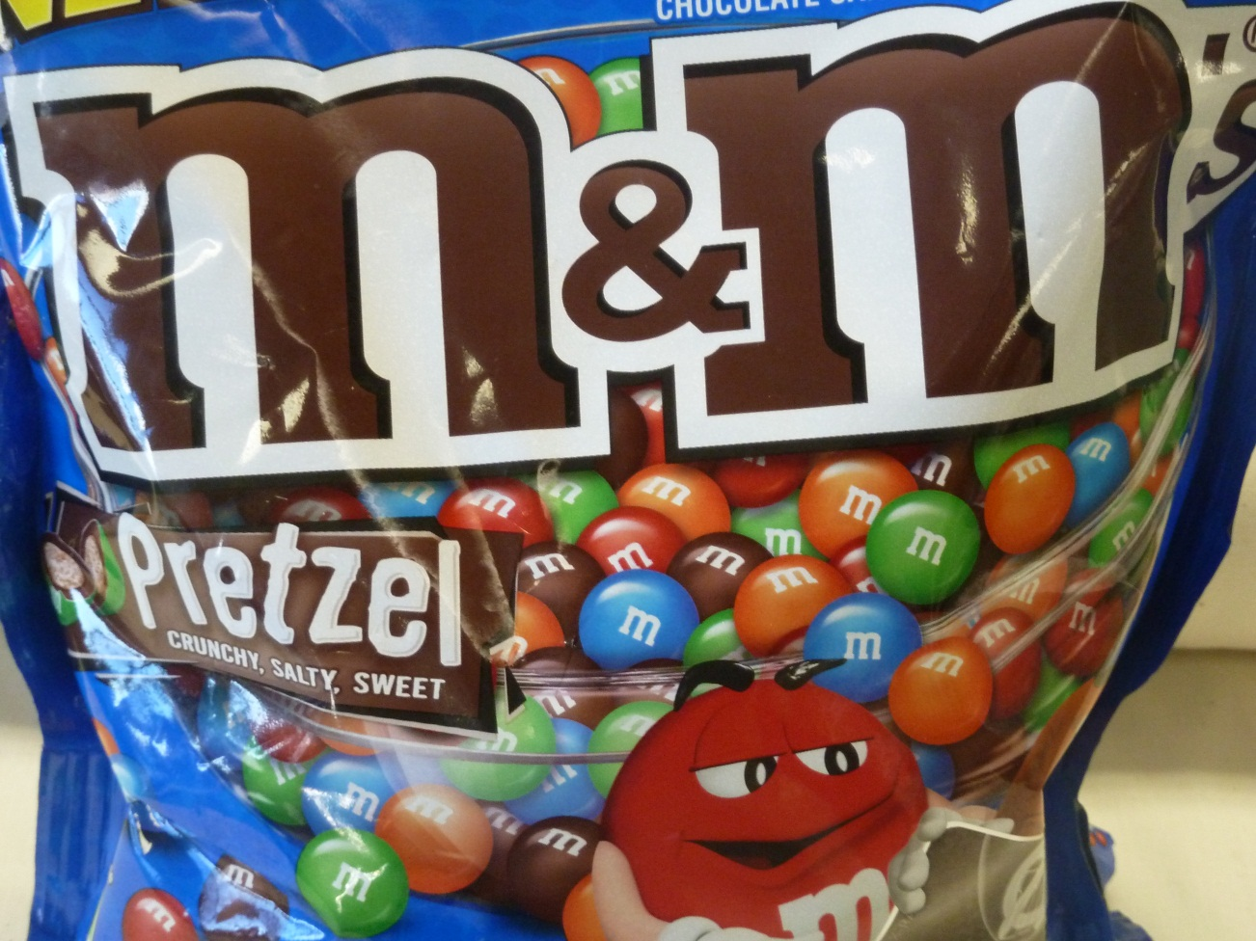
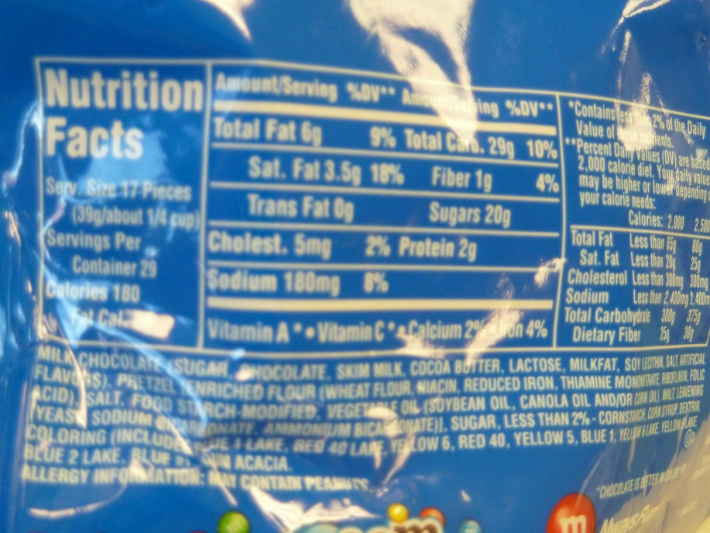
Food/ Product Name: Pretzel M&M’s (per 17 pieces or ¼ cup)
Total Fat Grams: 6
Total Calories: 180

Slide 10
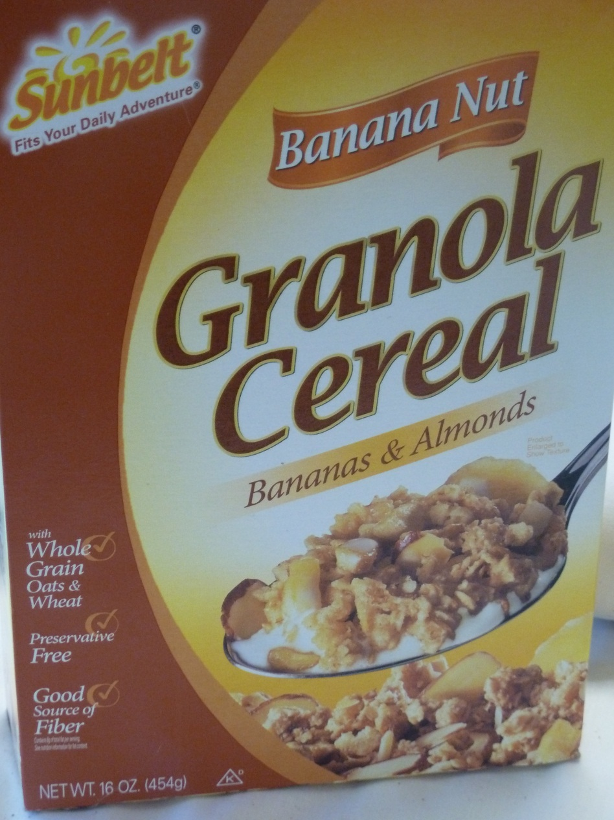
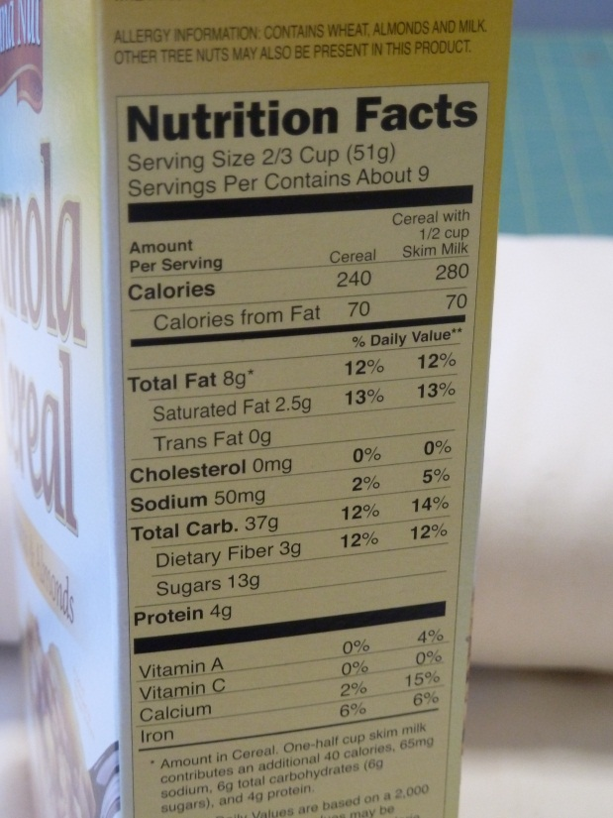
Food/ Product Name:
Banana & Almond Granola
(per 2/3 cup)
Total Fat Grams: 8 (no milk added)
Total Calories: 240

