Slide 1
Welcome to the Mediterranean Diet Test Kitchen!
Mediterranean Diet Recipes
Greek Chicken Pasta http://allrecipes.com/Recipe/Greek-Chicken-Pasta
Mediterranean Quinoa Salad http://allrecipes.com/Recipe/Mediterranean-Quinoa-Salad
Greek Salad http://allrecipes.com/Recipe/Greek-Salad-V
Green Beans and Feta http://allrecipes.com/Recipe/Aricas-Green-Beans-and-Feta
Bean Tacos
Apricot-Almond Cobbler http://www.myrecipes.com/recipe/apricot-almond-cobbler-10000001935278/
Dressings-
yogurt fruit dressing http://recipefinder.nal.usda.gov/recipes/splendid-fruit-salad
cilantro lime http://allrecipes.com/Recipe/Cilantro-Lime-Dressing
balsamic http://allrecipes.com/Recipe/Mamas-Balsamic-Vinaigrette

Slide 2
Mediterranean Diet
Martha Archuleta, PhD, RD

Slide 3
What is the Mediterranean Diet
Based on traditional diets of Crete, Greece and S. Italy around 1960
Low chronic disease and longevity observed in this population
Oldways: Health through Heritage; Harvard School of Public Health created Med Diet Food Pyramid in 1995, updated in 2008 http://oldwayspt.org
Highlighted in 2010 Dietary Guidelines as a traditional healthy eating pattern
Research ongoing over past 50+ years
Some recent research articles:
http://oldwayspt.org/resources/health-studies?tid_1=1320&tid=All

Slide 4
Understanding the Pyramid
The Mediterranean Diet Pyramid depicts the traditional foods and drinks that make up the healthy, balanced Mediterranean Diet. It contains many of the foods you will find in other dietary pyramids. The principal difference is in the frequency that some foods are eaten. Almost all foods can be part of a balanced and healthy diet – but your overall health and well-being can be greatly affected by how often you eat different foods, and the portion size you choose.
Meats and sweets These are “sometimes” foods to eat less often. If you eat meat, choose small portions of lean cuts, such as round, shoulder, tenderloin, strip, T-bone, and flank. Enjoy sweets at a celebration or as a treat.
Yogurt, cheese, poultry, and eggs form a central part of the Mediterranean Diet and are eaten in moderate portion sizes several times a week. Cheese, for example, is eaten regularly but in small amounts.
Wine and Water - Wine can be consumed regularly but moderately:
up to one glass per day for women, two for men. Water is essential for proper hydration, and contributes to health, well-being, and energy.
Fish and Seafood occupy their own section, since they are important sources of protein. Fish such as tuna, herring, salmon, and sardines are rich in heart-healthy omega-3 fatty acids, and
shellfish including mussels, oysters, shrimp, and clams have similar benefits. Enjoy at least twice a week.
Whole Grains, Fruits, Vegetables, Beans, Herbs and Healthy Fats, Such as Those Found in Olive
Oil represent the core of the diet. Base every meal on
fruits, vegetables, whole grains, legumes, and herbs and spices. Olive oil, the main source of dietary fat, is used for almost all cooking and baking, and
for dressing salads and vegetables.
Daily Physical Activity, which is important for overall good health, includes strenuous exercise such as running and aerobics, more leisurely activities such as walking and house-or-yard work, and simple changes, such as taking the stairs instead of the elevator. Add physical activity to each day.
Illustration by George Middleton
© 2009 Oldways Preservation and Exchange Trust • www.oldwayspt.org

Slide 5
The Science Behind the Diet
It has been clear for decades that the Mediterranean Diet offers one of the healthiest eating patterns on earth. But why is it so healthy?
Is it the olive oil?
The abundance of leafy greens?
The lack of 24-ounce steaks?
Live a longer, healthier life with the Mediterranean Diet
The Med Diet can help you:
✦
Lengthen Your Life Prevent Asthma
Fight Certain Cancers
Although research continues to analyze individual foods, it also repeatedly shows that a healthy diet is much more than the sum of its nutrient parts. One early study of the “whole diet” approach was published in 1995 by Antonia Trichopoulou, Walter Willett, Frank Sacks, and others, in which the original Oldways Mediterranean Diet Pyramid was given center stage.
✦
✦
✦
Protect From Diabetes Keep Depression Away
✦
✦
Prevent Chronic Diseases
✦
Nurture Healthier Babies Ward off Parkinson’s Disease
The study documented the health benefits of a diet “characterized by abundant plant foods (fruit, vegetables, breads, other forms of cereals, potatoes, beans, nuts, and seeds) fresh fruit as the typical daily dessert, olive oil as the principal source of fat, dairy products (principally cheese and yogurt), and fish and poultry consumed in low to moderate amounts, zero to four eggs consumed weekly, red meat consumed in low amounts, and wine consumed in low to moderate amounts, normally with meals.”
In subsequent years the body of scientific evidence supporting the healthfulness of the traditional Mediterranean Diet has continued to grow. See all the latest studies at www.oldwayspt.org.
✦
✦
Safeguard from Alzheimer’s Disease
✦
Aid Your Weight Loss and Management Efforts
✦
Lower Risk of Heart Disease and High Blood Pressure

Slide 6
Facts and Common Myths
Mediterranean Diet Basics
Q: Why is it called “Mediterranean?”
A: This way of eating is typical of the region surrounding the Mediterranean Sea, in countries like Spain, France, Italy, Egypt, Morocco, Syria, Malta, Tunisia, Turkey, Algeria, Albania, Greece, Israel, Croatia, Libya, and Lebanon.
Q: Is it really a “diet” – will I be hungry all the time?
A: The Mediterranean diet (or Med Diet as it’s often called) is more than a diet; it’s a lifestyle approach to healthy eating. It features fruit, vegetables, fish, beans, nuts and whole grains as well as other ingredients such as olive oil and wine that have been shown to promote good health.
Q: How can I follow the Med Diet?
A: It’s easy and filled with healthy foods that taste great. Just follow a few easy tips such as these:
Choose healthy fats like those found in olive oil, nuts, peanuts, avocados, and fish.
Base every meal around fruits, vegetables, whole grains, beans, nuts, herbs and spices.
Choose lean protein sources like fish, poultry, and beans more often than red meat.
Enjoy yogurt and small portions of cheese daily.
Drink wine in moderation (up to two glasses per day for men and one glass per day for women).
Q: Why should I follow the Mediterranean Diet?
A: Studies show that people who eat a Mediterranean Diet have lower rates of heart disease, certain cancers, diabetes, obesity, and Alzheimer's disease as well as lower blood pressure and cholesterol levels. Even better, following the Mediterranean Diet may help you live longer—
so eat up!
Common Myths
“The Mediterranean Diet is just another fad diet.”
Wrong! The Mediterranean Diet is a lifestyle; it’s a sustainable way of eating; it’s consistently found to promote good health AND decrease chronic disease risk.
“The Mediterranean Diet is a relatively new way of eating.”
Leading nutrition scientists have been intensely studying the eating habits of Mediterranean people for more than 60 years. It all started when Ancel Keys, the famous researcher and father of the Mediterranean Diet, discovered, in the 1940s, that people who ate a Mediterranean-style diet had very low rates of heart disease and were living longer than people in Northern Europe.
“The Med Diet consists of hard-to-get, foreign foods.” The Mediterranean Diet Pyramid is filled with foods most people eat every day, like produce,
yogurt, milk, cheese, and seafood. The biggest difference between the Med Diet and the typical American diet is the frequency certain foods are eaten. Foods from the plant kingdom – fruits, vegetables, grains, beans, and nuts – are at the core, while foods like sweets and meats are eaten less often and in smaller amounts.
“Meats or sweets are not allowed in the Mediterranean Diet.”
All foods fit in the healthy Mediterranean eating pattern. Moderation is key, but there’s no reason to eliminate entire food groups or completely cut out your favorite foods.
“I can eat whatever I want on the Mediterranean Diet.”
While it’s true that all foods fit in the Mediterranean Diet, portion size and balance are still key in the Mediterranean Diet – and any other healthy, balanced eating pattern for that matter.

Slide 7
Mediterranean Diet All-Stars
Meet just a few of the many nutrition powerhouses that form the foundation of the Mediterranean Diet.
Avocados
High in fiber, and filled with healthy monounsaturated fat and vitamin E, avocados are available all year. Add them to salads, use in dips, or simply eat out of the shell with a spoon.
Beans
A great source of protein and fiber, swap beans for meat to make one or two meatless meals per week. If you use canned beans, rinse them well to remove some of the sodium.
Fish
Eat fish, which contain healthy fats, twice a week. Salmon, sardines, and mackerel are great sources of heart healthy omega-3 fatty acids.
Nuts, Peanuts, Seeds
Packed with protein, fiber and heart-healthy fats, a handful of nuts makes a good snack. Or, add a small amount of sesame or sunflower seeds to salads or toss them with roasted vegetables.
Tomatoes
A source of vitamin C and lycopene, a potent antioxidant, tomatoes stimulate immune function and help fight chronic diseases.
Wine
Wine contains powerful antioxidants that come from grape skins and seeds and has been shown to reduce the risk of most diseases of aging. Enjoy up to one glass a day for women and two for men to help prevent strokes. If you’re not a wine drinker, have a glass of 100% grape juice.
Yogurt
A protein powerhouse, yogurt contains calcium to protect and strengthen bones and also has beneficial bacteria that are important for digestive health. Look for Greek yogurt, which delivers twice the protein of regular yogurt, plus a rich,
Whole Grains
Packed with nutrients, fiber and protein, whole grains contain “good” carbs and are an important choice for healthy eating. Learn to cook popular Mediterranean whole grains such as barley, brown rice, bulgur, whole wheat couscous, and farro, for salads and
tangy taste.
side dishes.

Slide 8
Make It YOUR Diet
To help you bring the gold-standard Mediterranean Diet into your daily life, try these tips to get started.
Brown Bag it To Work
Stock your pantry with versatile Med ingredients so you always have foods like olive oil, canned tomatoes, tuna, rice, pasta, and other whole grains on hand. It’s amazing how many easy Mediterranean meals you can make from a well-stocked pantry, when there’s no time to shop.
Use a blender to make Med-style smoothies for breakfast or as fuel for afternoon snacks, by combining yogurt with your favorite fruit. Frozen fruits (including berries) are especially good – they eliminate the need for any ice.
When it’s sandwich time, match better breads with better spreads. Start with crusty whole grain breads and rolls or pita pockets – tastier and healthier than standard white bread – then spread with hummus, mustard, pesto or another flavorful Med spread. Add foods such as tuna, sliced turkey or chicken, lettuce, sprouts, shredded raw carrots, thin slices of cheese, and sliced apples.
Keep pre-cooked frozen shrimp in your home freezer. Shrimp cooks quickly, making it an easy addition to one-pot sautés and pasta dishes. Canned salmon is a great choice, too.
Use meat as a flavoring instead of a main component in a meal. Add small strips of sirloin to a sauté that features lots of vegetables, or add a small amount of diced prosciutto to a dish of pasta.
Eat a vegetarian meal one night each week. When that feels comfortable, try two nights per week.
Fill a whole-grain pita pouch with Greek salad and put the dressing in a separate container; add the dressing just before eating to keep the sandwich from getting soggy.
Take a thermos of soup or vegetable stew to work. Toss in some leftover whole grains before you screw on the lid, to make your soup even healthier.
Transform leftover brown rice, quinoa, and other whole grains into lunch by mixing them with chopped raw vegetables or beans and adding a little salad dressing.
Keep whole grain bread in the freezer and make a sandwich using frozen bread and hummus, sprouts, leafy greens, sliced peppers, turkey, chicken, or smoked salmon. By lunchtime the thawed bread will taste fresh.
Top pita bread with a slice of tomato and a few tablespoons of grated cheese and broil for a minute to create a healthy mini-pizza.
Marinate olives in olive oil, lemon zest, coriander seeds and cumin seeds and enjoy as a tasty snack.
Enjoy popcorn air-popped and tossed with a bit of olive oil and Parmesan cheese.
Focus on fruit. Eat an apple or an orange, or have a peach with ricotta or cottage cheese, or spread a few apple slices with peanut butter.
Fill celery stalks with hummus or different nut butters. Or, keep string cheese on hand and enjoy a piece between meals.
Keep Snacks Simple
Pack a container of Greek yogurt, which has twice the protein of regular yogurt, and combine it with chopped fruit and a sprinkling of chopped nuts.

Slide 9
The Med Diet and Your Family
The Mediterranean Diet is all about delicious flavors, textures and colors, with something for everyone—even finicky eaters!
Try these tips for introducing the Med Diet to your family.
Exploring the Med diet gives the whole family an opportunity to discover new tastes together. Introduce a small taste of a new food each week to encourage variety.
Be patient and keep in mind that kids’ palates change over time. It can take up to
20 tries over weeks and months for them to accept a different flavor or texture. And be a role model by eating new foods yourself.
Luscious fruits at every meal are a key part of the Mediterranean Diet, so keep apples, clementines, oranges, grapes, pears, melon, peaches, dates, strawberries and other fruits in plain sight.
Encourage the whole family to eat fresh fruit rather than drink fruit juice for a better source of fiber, often lacking in our diets. Make healthy parfaits for dessert by layering Greek yogurt and sliced fresh fruit in tall glasses. Use frozen berries to make great smoothies.
Encourage your kids to play with their food! When they need an after- school snack or before supper when everyone is starving, get into the
habit of setting out small bowls of Mediterranean
Diet favorites: tzatziki, baba ghannouj, spicy muhammara, and different flavors of hummus.
Provide an ever changing variety of fresh, raw vegetables cut into pieces small enough for dipping: baby carrots, celery sticks, sliced cucumbers, sliced red, green, yellow, and orange peppers, snow peas, sliced fennel, and zucchini strips and let them dip away. Try whole grain pita for dipping too!
Almost everything tastes better with olive oil. Kids who won’t eat a steamed carrot may love them roasted (or raw!) And you may succeed in getting everyone to eat sweet potatoes if you serve them as oven- baked fries rather than mashed. Or, try making kale chips instead of steamed kale, for a whole different take on greens.
Create Med-style “variety plates” to help your kids enjoy a wide range of flavors and to serve up a well- balanced meal. Put small helpings of six or eight different foods on a colorful plate or small platter, relying on leftovers and items you have on hand.
For example: a few slices of cold turkey, a few baby carrots, a spoonful of hummus, several cubes of cheese, a helping of pasta or a whole grain roll, a small serving
of lettuce with a favorite dressing, apple slices, a few olives, and several pickles. Kids usually enjoy such a selection.
Add vegetables to the kinds of foods your kids already like. If pancakes are popular, add some grated carrots, or shredded zucchini to the batter. Toss frozen peas with hot pasta, camouflage extra veggies in a zesty spaghetti sauce, or add diced sautéed onions or peppers to scrambled eggs.
Make your own family-favorite trail mix. In a large bowl, combine peanuts, chopped walnuts, raisins or other dried fruit, some whole grain cereal and a few small pieces of chocolate if you wish. Package it in “snack- size” zip-lock bags to have on hand for car trips and lunch boxes.
Get the family involved in preparing meals. Let little kids wash fruits and vegetables at the sink; ask older kids to chop the vegetables, toss the pasta, dress the salad and set the table. Children who learn basic kitchen skills appreciate it later in life and have a legacy to pass along to their children.

Slide 10
Set Up Your Kitchen
Organize your kitchen and pantry shelves to have the important staples of the Mediterranean Diet within easy reach. Keep a variety of choices from the following key ingredients on hand so you can always make a healthy meal:
In The Pantry
In The Refrigerator
Beans: Chickpeas, cannellini, fava, and kidney beans; lentils.
Breads: Bread crumbs, foccaccia, lavash, pita, and other breads (mostly whole grain).
Canned Seafood: Anchovies, clams, salmon, sardines, tuna.
Capers: Once opened, they will keep in the refrigerator for up to six months.
Cereals: Oatmeal, plus other hot or cold cereals. The best choices list the first ingredient as whole grain, provide at least 3 grams of fiber and no more than 8 grams of sugar per serving.
Crackers: Look for labels that list a whole grain ingredient first, and that provide 2–3 grams of fiber per serving.
Dried Fruit: Apricots, blueberries, cherries, cranberries, figs, raisins, prunes.
Garlic: Keep a head or two within easy reach. Or, buy peeled garlic cloves and store in the refrigerator.
Grains: Bulgur, couscous, farro, millet, oats, polenta, rice, quinoa.
Herbs and Spices: Basil, bay leaves, black pepper, cinnamon, cloves, coriander, crushed red pepper, cumin, curry powder, dill, garlic powder, ginger, oregano, paprika, rosemary, saffron, sage, thyme, turmeric, or blends like Italian seasoning.
Honey
Nuts: Almonds, hazelnuts, peanuts, pine nuts, pistachios, walnuts
Oil: Extra-virgin olive oil, grapeseed oil, peanut oil
Olives: (all types)
Pastas: (all types, including whole grain)
Potatoes
Red Wine
Salt: Kosher, sea and iodized
Seeds: Fennel, flax, sesame, sunflower
Tomatoes: Canned, paste, sauce, sun- dried
Vinegars: Balsamic, champagne, cider, fig, red wine, white wine
Cheese
(soft and hard varieties)
Eggs
Fruit
(berries, grapes)
Poultry
Hummus and other Med dips Milk
Mustard Pesto Pickles Tapenade Vegetables
(a variety, plus salad greens)
White and Sparkling Wine Yogurt
In The Freezer
On The Counter
Fresh Fruit ~ Avocados, apricots, cherries, clementines, figs, grapefruit, lemons, limes, oranges, melons, nectarines, dates, bananas, plums, apples, peaches, pears, pomegranates, and/or tangerines. These fruits keep best at room temperature.
Tomatoes ~ Store fresh tomatoes at room temperature.
Olive oil ~ Keep an olive oil dispenser near your stovetop, and store the rest in a cool, dark place.
Frozen Fruit Frozen Poultry and Meat
Frozen Seafood Frozen Vegetables Frozen Chicken Stock Sorbet and Gelato

Slide 11
Olive Oil 101
Olive oil has been the hallmark of the healthy Mediterranean Diet for over 2,500 years. It adds vibrant flavors and textures to Mediterranean foods and is high in healthy, monounsaturated fats along with antioxidants. Simply drizzle it on cooked fish or vegetables, or use it as a dip for bread.
Vegetables roasted, grilled, or sautéed in olive oil are simply tastier – so you’ll find yourself eating more of them!
Olive Oil Flavors
Olives are the fruit of the olive tree. Soon after being picked, they’re cleaned in a water bath and then crushed into a mash. This mash has three unique parts: olive solids, olive water, and olive oil. First, the
olive solids are separated. Next, the olive water and oil are quickly separated to keep the olive water from changing the oil’s taste and odor. Finally, the oil is bottled.
The best quality olive oils are obtained from the first pressing of the olives and are “cold pressed.” This means they’re not heated during the pressing process. Heating produces larger amounts of oil, but decreases important flavor and healthy compounds, including flavenols and polyphenols, abundant in extra-virgin olive oil.
Buying and Storing Olive Oil
The four foes of olive oil are age, heat, air, and light. When you buy olive oil, make sure it is no more than 18 months old. (Look at the bottling date on the label.) At home, store olive oil in a cool, dark place.
Sauteing with Olive Oil
There’s no better way to bring out the flavor of vegetables and seafood than sautéing. It’s an easy, healthy way to prepare your favorite dishes. To sauté, pour olive oil into a cold skillet or sauté pan and heat over low heat. When the oil is heated through, add the food item. Stir, toss, or turn until cooked and enjoy!
Olive Oil Grades
Olive oil is graded on taste, acidity level, and processing method. The table below lists the main types of olive oil in order of decreasing quality.
Grade Description Taste Uses
Baking with Olive Oil
Baking with olive oil, instead of butter, cuts the amount of cholesterol and saturated fat in your favorite recipes. Olive oil produces lighter-tasting breads, brownies, biscotti, and cakes. Even more good news – You need less
olive oil than butter when baking! See chart on next page.
Extra Virgin
Highest quality oil made from first Superior pressing with no heat or chemicals
Lacks perfect taste of extra-virgin, Good but not refined
Dips, salads and drizzled on fish
Frying with Olive Oil
Frying in olive oil leaves food less greasy, and crunchier, than frying in other fats. Also, foods fried in olive oil have less cholesterol and saturated fat than foods fried in most other fats. Here are some tips when frying with olive oil:
Deep fry at 350 to 365 ºF, and heat the oil slowly.
Use enough oil to properly cover foods.
Avoid putting too much food in the oil at once.
Place food on wire racks after cooking to drain excess fat.
Virgin
Frying, grilling and roasting
Olive
Blend of virgin and refined (chemically treated) oils
Lacks Flavor
When flavor is
not needed
Lite
The word “lite” means the oil has been refined, not that it is lower fat.
Lacks Flavor
When flavor is not needed
Pomace
Lowest quality made by blending virgin and pomace
Lacks Flavor
Frying or cooking

Slide 12
Healthy New Habits
As you adopt the Mediterranean Diet, you’ll open your tastebuds to a whole new world of flavors, while improving your health.
Avocados
Try mashed avocado instead of butter, jelly or cream cheese on bagels or toast.
Enjoy guacamole instead of sour- cream dip.
Olive Oil
Dip bread into olive oil rather than spreading it with butter, or use olive oil instead of butter on cooked veggies.
Toss popcorn with olive oil and a sprinkling of Parmesan cheese or herbs instead of butter and salt.
Substitute olive oil for butter in baking for lighter-tasting breads and cakes. The chart at right shows how to make the switch.
Baking Substitutions
Butter
Olive Oil
1 tsp
3/4 tsp
2 tsp
1 1/2 tsp
Beans
Add beans to chilies and casseroles, or use half ground turkey and half beans instead of ground beef.
Puree cooked beans and use them as the base of healthy dips.
Combine hummus with herbs and use as a sandwich spread instead of butter or mayo.
1 Tbsp
2 1/4 tsp
Whole Grains
Stuff peppers with cooked whole grains instead of meat.
Cook brown rice, quinoa, whole wheat couscous, or other whole grains instead of white rice.
Try whole wheat flour in place of half the white flour in recipes for cookies, muffins,
quick breads, and pancakes.
Use whole grain pasta instead of enriched pasta to triple the amount of fiber and reduce the number of calories.
2 Tbsp
1 1/2 Tbsp
1/4 cup
3 Tbsp
1/3 cup
1/4 cup
Fruit
Eat a bowl of fresh berries and yogurt, instead of ice cream, or reach for grapes, oranges, or melon chunks instead of cookies.
Reduce the oil in muffins and quick breads by half and substitute unsweetened applesauce or mashed banana to make up the difference.
Serve a sandwich with sliced apples or pears on the side, instead of chips.
End a meal with sweet, fresh fruit.
1/2 cup
1/4 cup +1 Tbsp
2/3 cup
1/2 cup
3/4 cup
1/2 cup + 1 Tbsp
1 cup
3/4 cup
Yogurt
Use Greek yogurt instead of mayonnaise in potato and pasta salads, or use 2/3 yogurt to 1/3 mayonnaise.
Use Greek yogurt in place of sour cream in baking, or instead of cream in a dressing.
Fruit-flavored yogurt can contain up to 5 teaspoons of sugar per serving. Buy plain yogurt instead, and flavor it with a teaspoon of jam or maple syrup, or your favorite fresh fruit.
Herbs and Spices
Use fresh or dried herbs and spices to add flavor to grain dishes, soups, dressings and sauces. You’ll use less salt.
Reduce sugar by about half in baked goods and add cinnamon, cloves, ginger and nutmeg to enhance the taste.

Slide 13
The Mediterranean Foods Alliance (MFA)
The Mediterranean Foods Alliance (MFA) helps consumers and families bring the gold-standard Mediterranean Diet into their daily meals more frequently and more easily. Companies offering healthy Mediterranean products underwrite some of the MFA’s educational programs. The Oldways / MFA website lists all MFA member products that meet the MFA’s strict program criteria.
We’d like to thank the following members for supporting the MFA:
Agora Foods International
Gaea
Alwadi al Akhdar
International Collection
Balsam
Lindsay Olive Company
Bard Valley Medjool Date Growers Association
McCormick Spices
Barilla
Mooney Farms
California Avocado Commission
National Fisheries Institute
California Walnut Board & Commission
The Peanut Institute
Pompeian
Cedar’s Mediterranean Foods
President / Rondelé
Eat Well Enjoy Life
Stonyfield Organic Oikos Greek Yogurt
Egg Nutrition Center
Falafel Republic
US Potato Board
FoodMatch

Slide 14
8 Simple Steps from Oldways
Eat lots of vegetables
Change the way you think about meat
Always eat breakfast
Eat seafood twice a week
Cook a vegetarian meal one night a week
Use good fats
Enjoy some dairy products
For dessert, eat fresh fruit

Slide 15
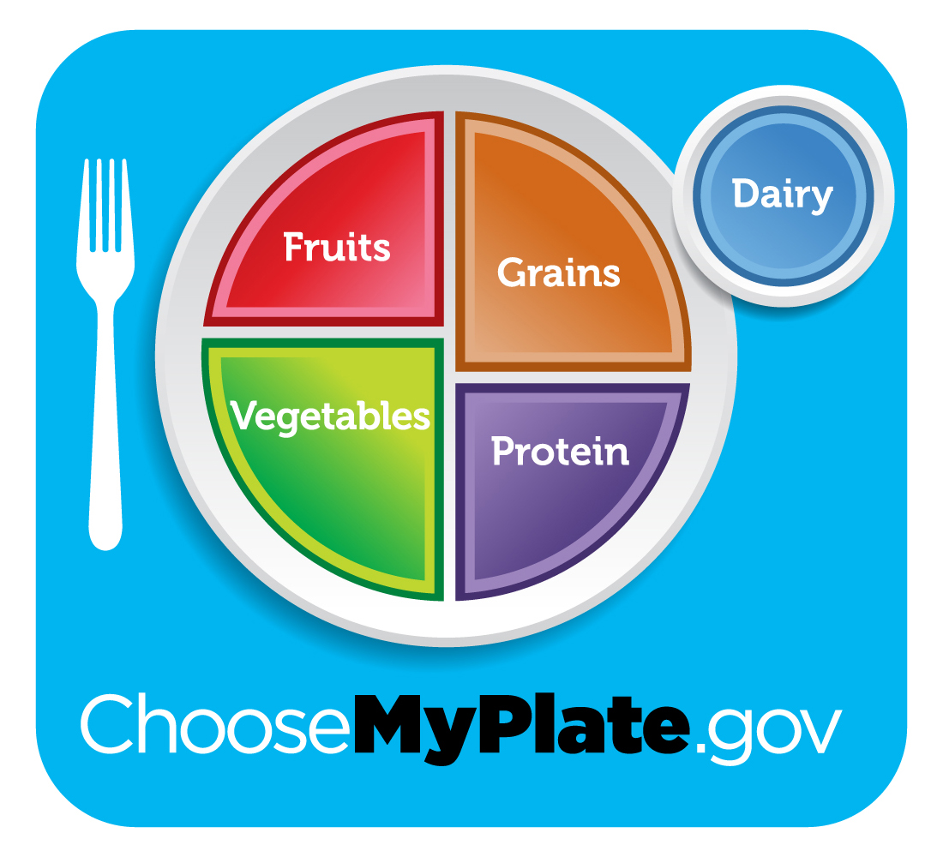
Mediterranean Diet Fits Great with MyPlate!

Slide 16
Cooking and Recipe Resources
List for Stocking Your Pantry:
http://oldwayspt.org/sites/default/files/MedDietGroceryList.pdf
Recipes:
http://oldwayspt.org/recipes
http://allrecipes.com/recipes/healthy-recipes/special-diets/mediterranean-diet/
http://www.mayoclinic.org/healthy-living/nutrition-and-healthy-eating/in-depth/mediterranean-diet-recipes/art-20046682
http://www.eatingwell.com/recipes_menus/collections/healthy_mediterranean_recipes
Mediterranean Diet Cookbook for Dummies
Modify non-traditional Med recipes to have Mediterranean ingredients

