Slide 1
Recipe Race (practices doubling and halving a recipe)
*Copy slides 7-26: “Game Cards” (back to back with it’s corresponding number 27-46) on cardstock and laminate. Make a copy of slides 2-6: “Starter Cards” (without the numbers on the back side) on a different color cardstock and laminate.
*Cut each slide into individual recipes. Place a small magnet on the recipe side of the numbered cards, and a magnet on the recipe side of the starter cards. Recipes start to repeat on # 41. Magnets would not have to be used, but it works well in my classroom.
*Break students into teams of 2, and provide each team with a dry erase marker and a starter card. Have students write their names on the blank side of the starter card. Attach the numbered cards to a magnetic surface (door).
*Playing the game- once students finish the starter card, they check it for correctness. If it is correct, student will attach their starter card to the board. If it isn’t correct, they will correct it. Once the starter card is complete, students will pick a numbered card from the door. Students compete to finish as many as possible in the time period (whatever time period you want… I did 15 minutes). Students must check their card for correctness before getting another card. Completed cards are attached to the board under their starter card. Each completed card is worth points. Cards # 2, # 15, #21, #27, #33, #44, #56, #61, #69, and #73 win 3 points each. All other cards are worth 1 point each. The team with the most points at the end of the playing period wins a treat.
*To check if answers are correct, I put several copies of the answer key (slides 48-67) on an empty table. No markers are allowed at this table… students must go back to their own seats to make corrections.

Slide 2
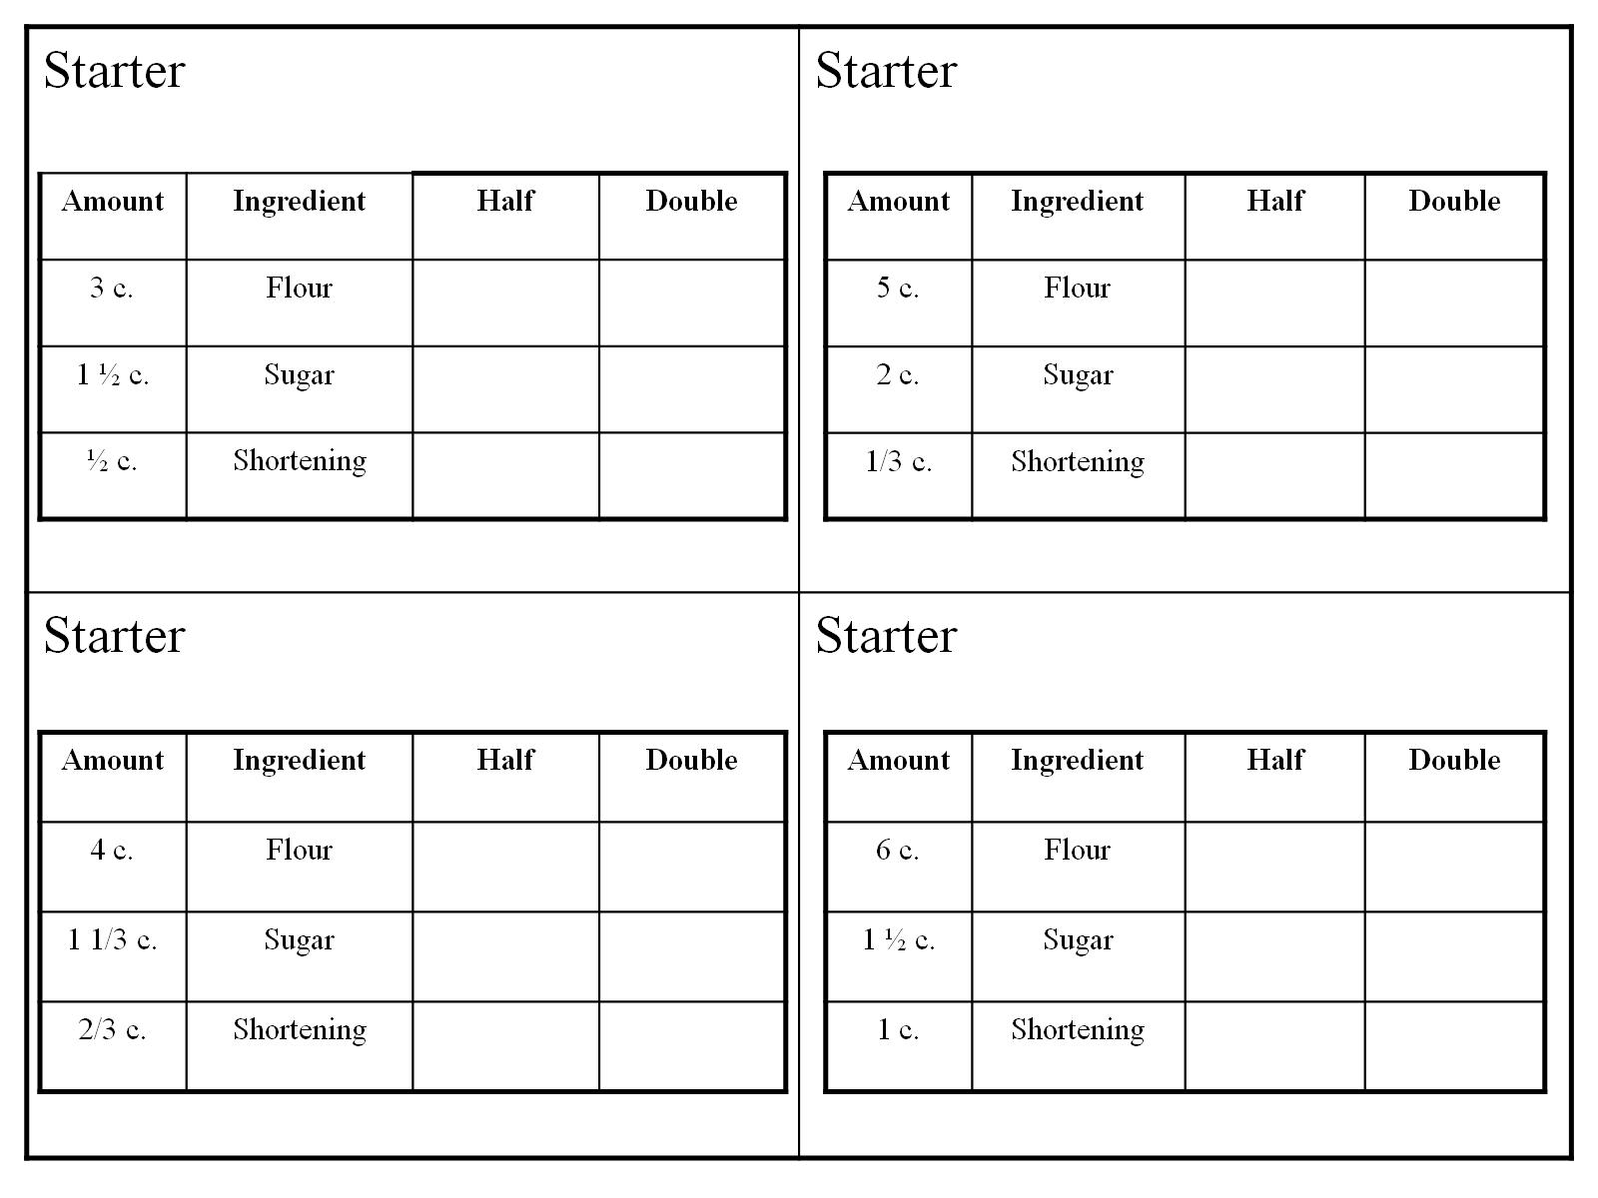

Slide 3
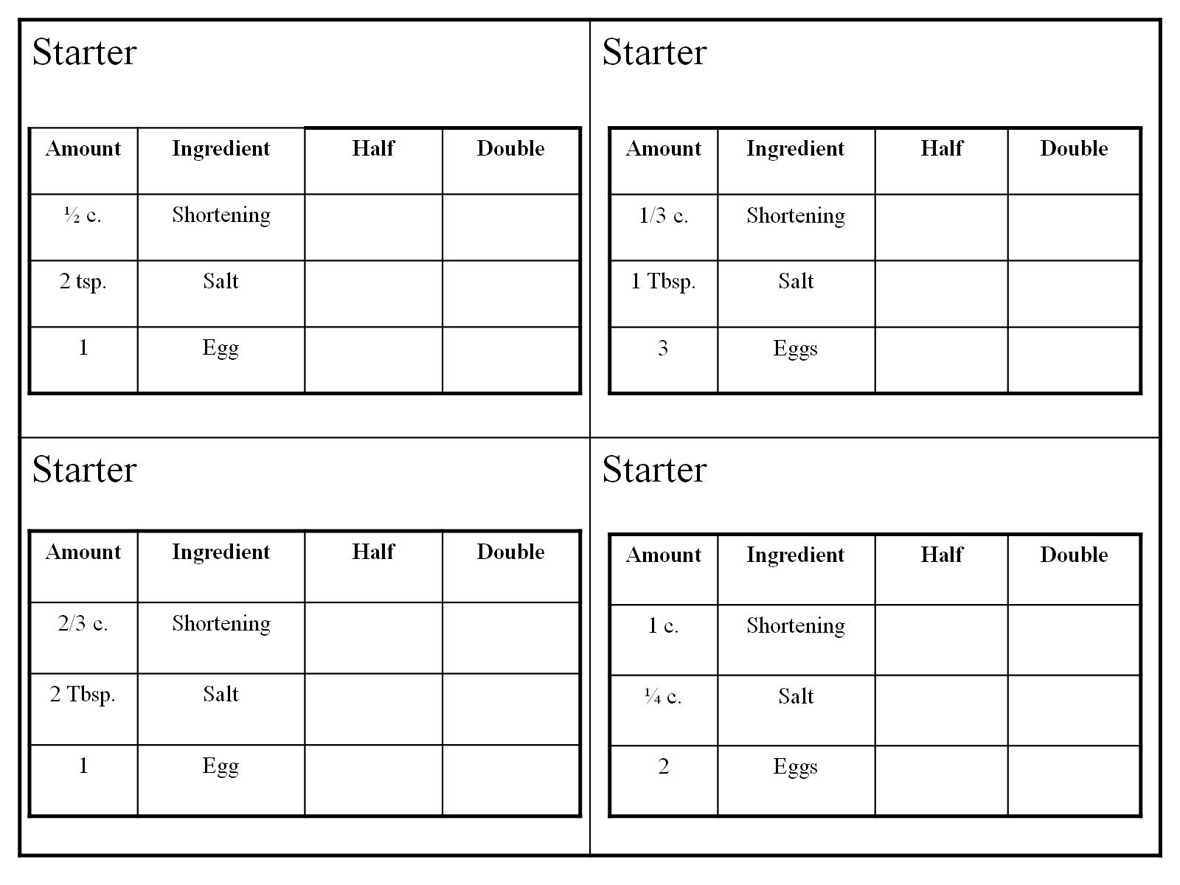

Slide 4
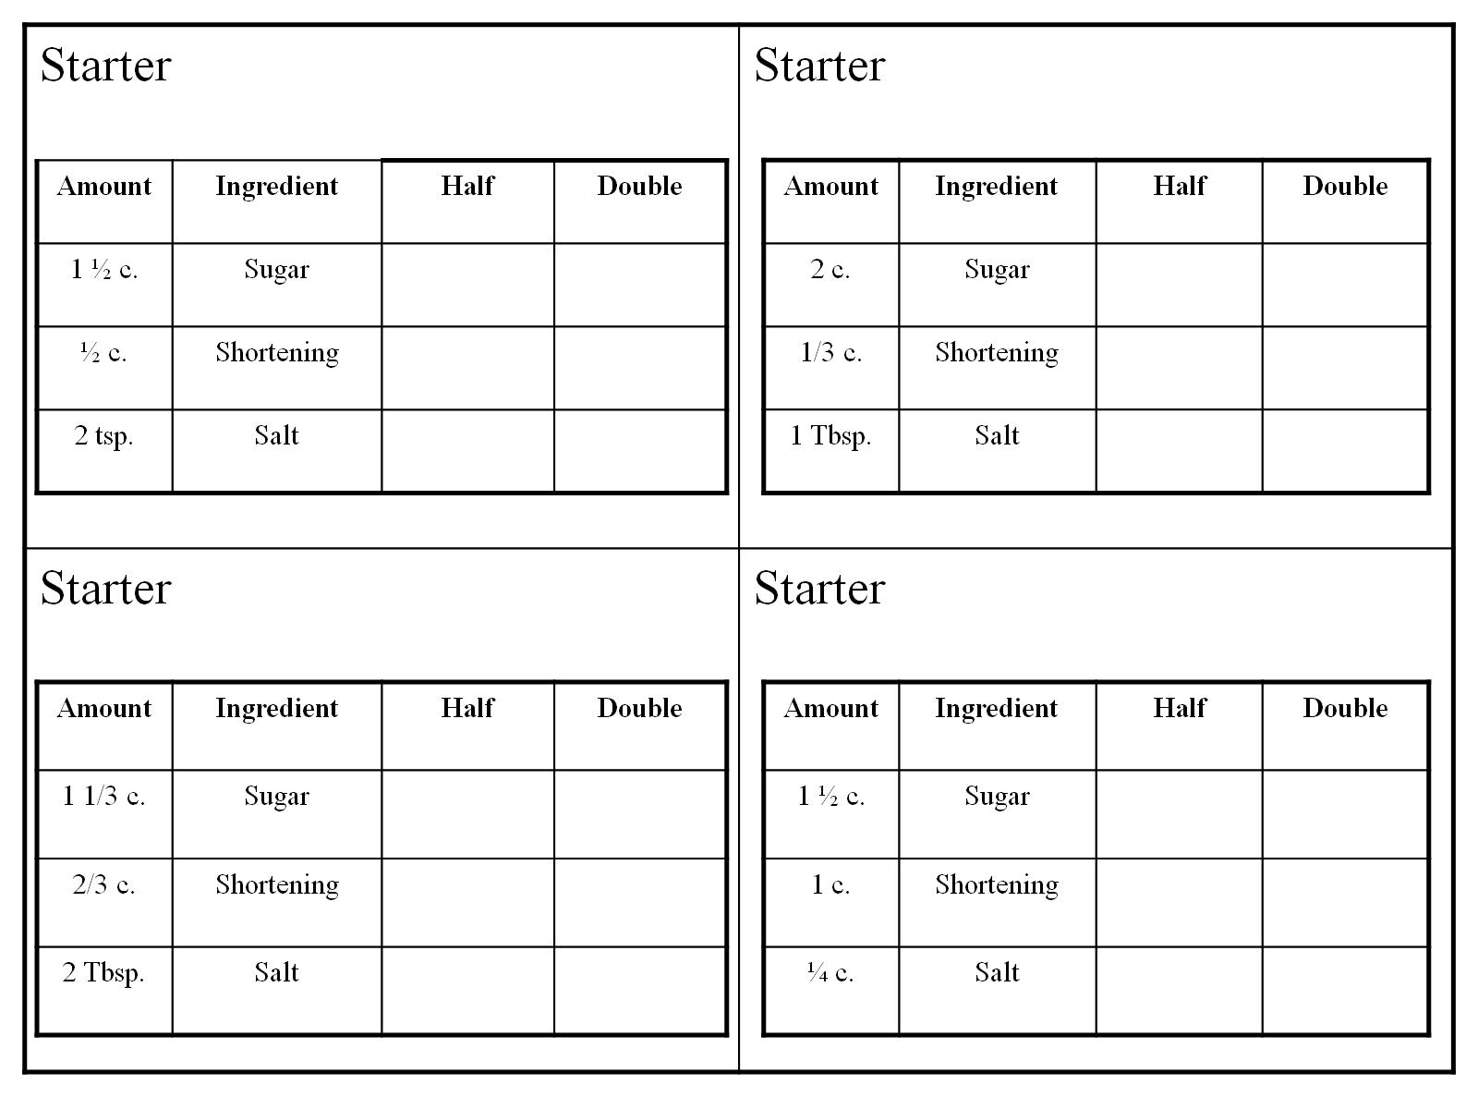

Slide 5
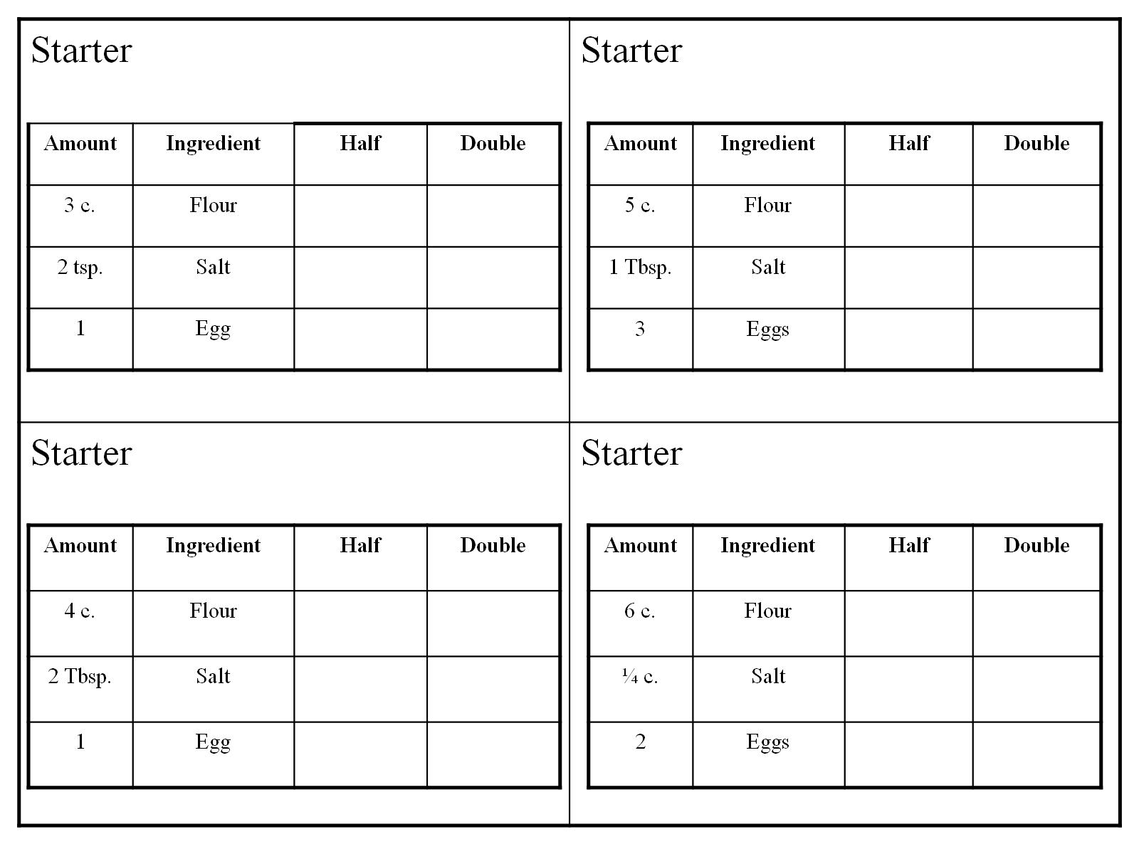

Slide 6
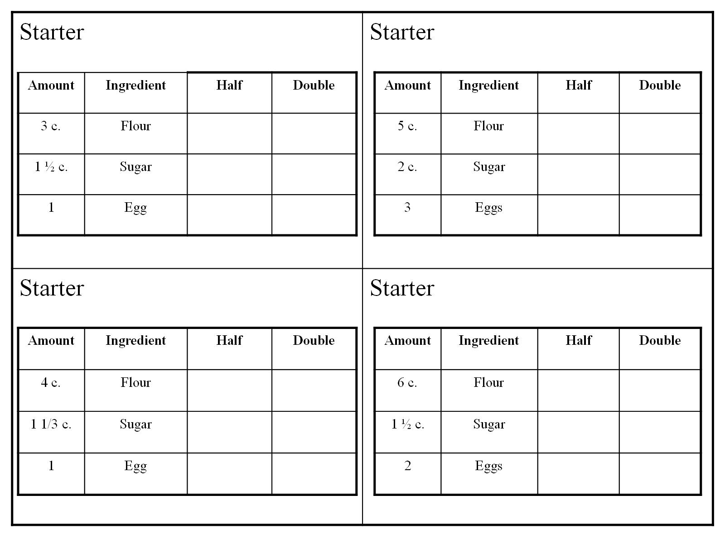

Slide 7
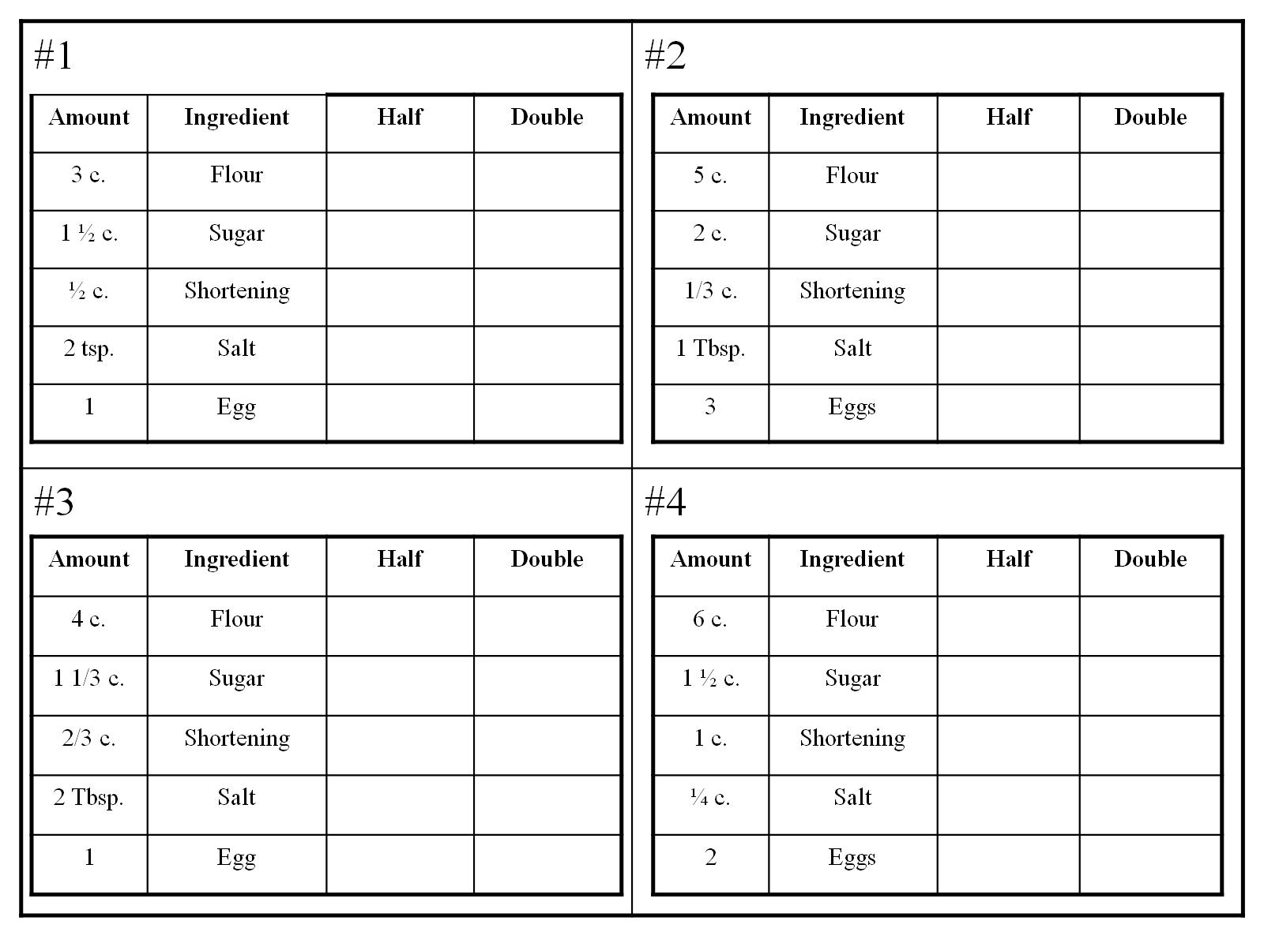

Slide 8
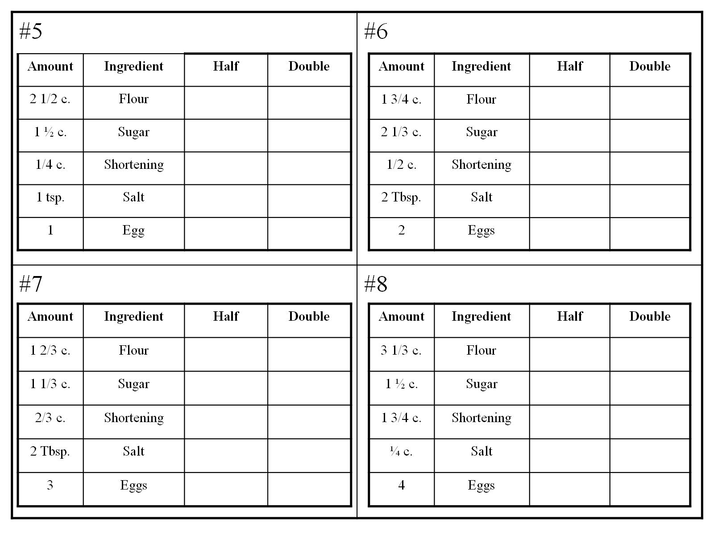

Slide 9
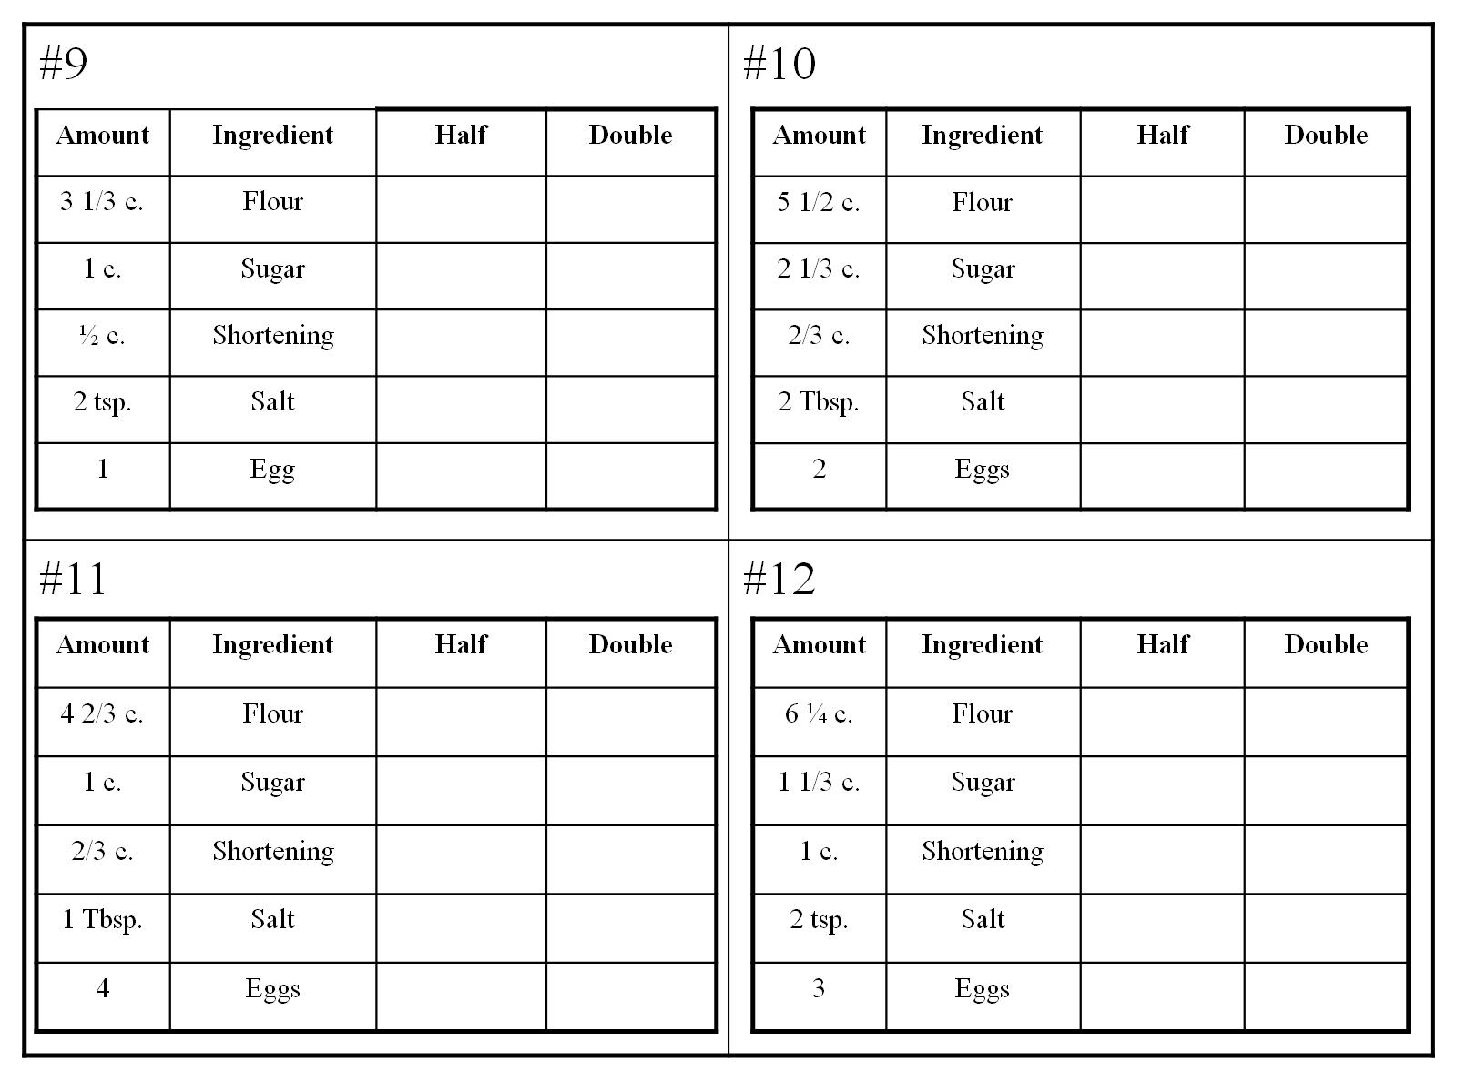

Slide 10
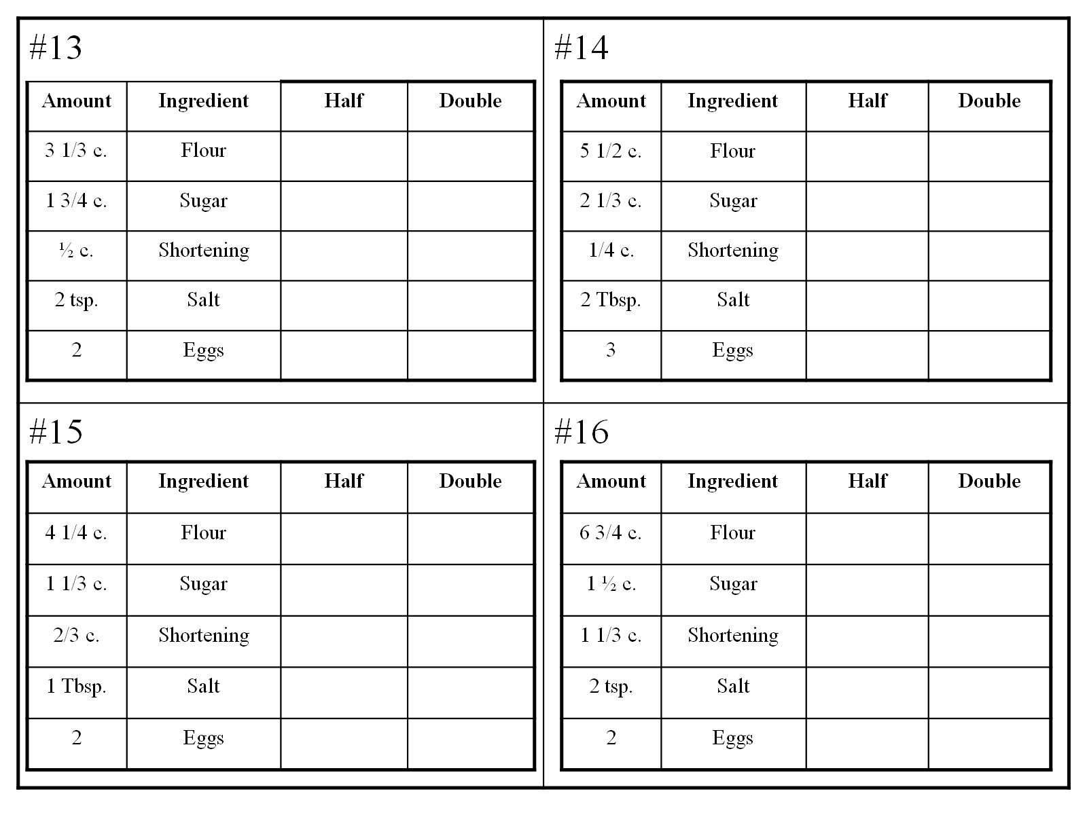

Slide 11
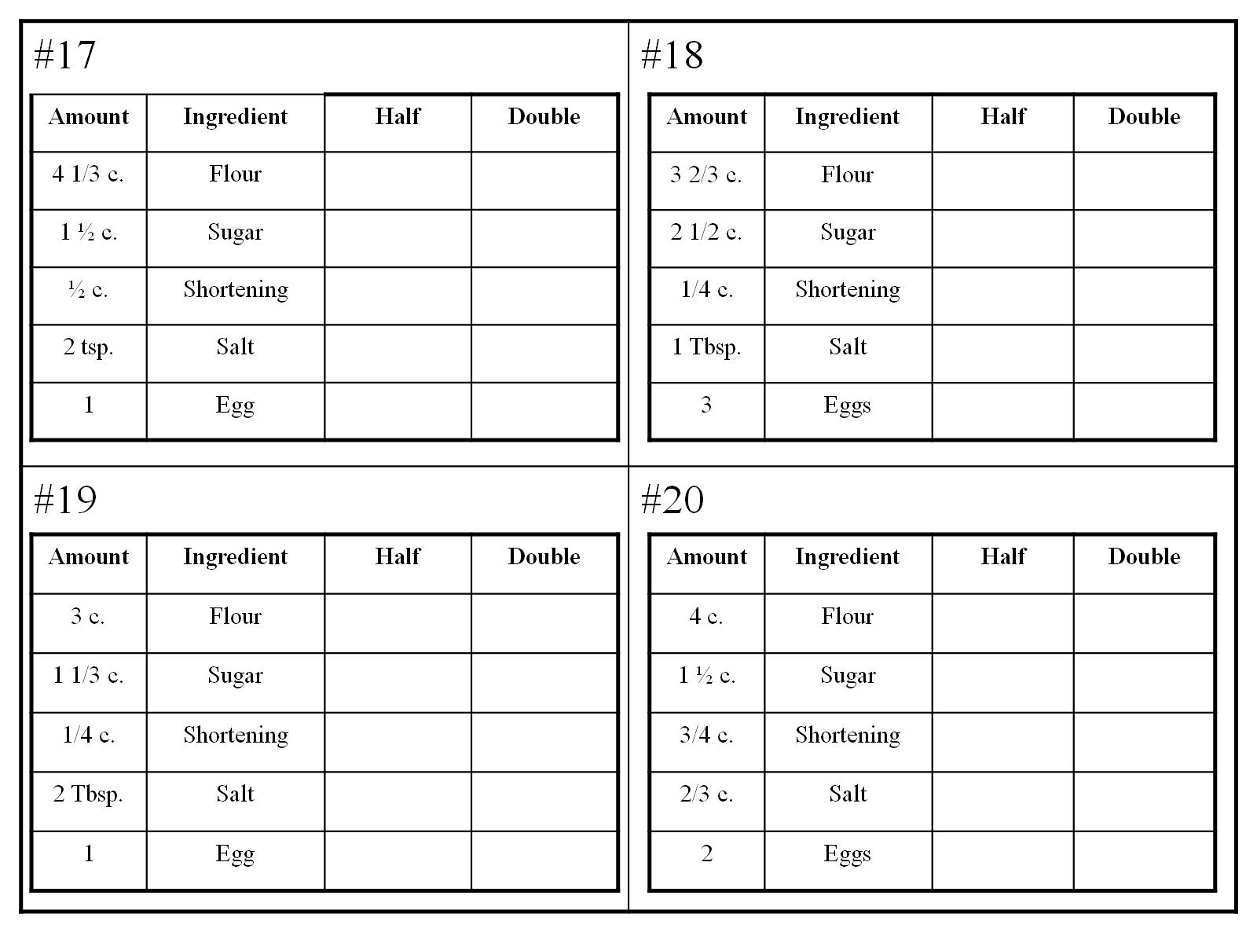

Slide 12
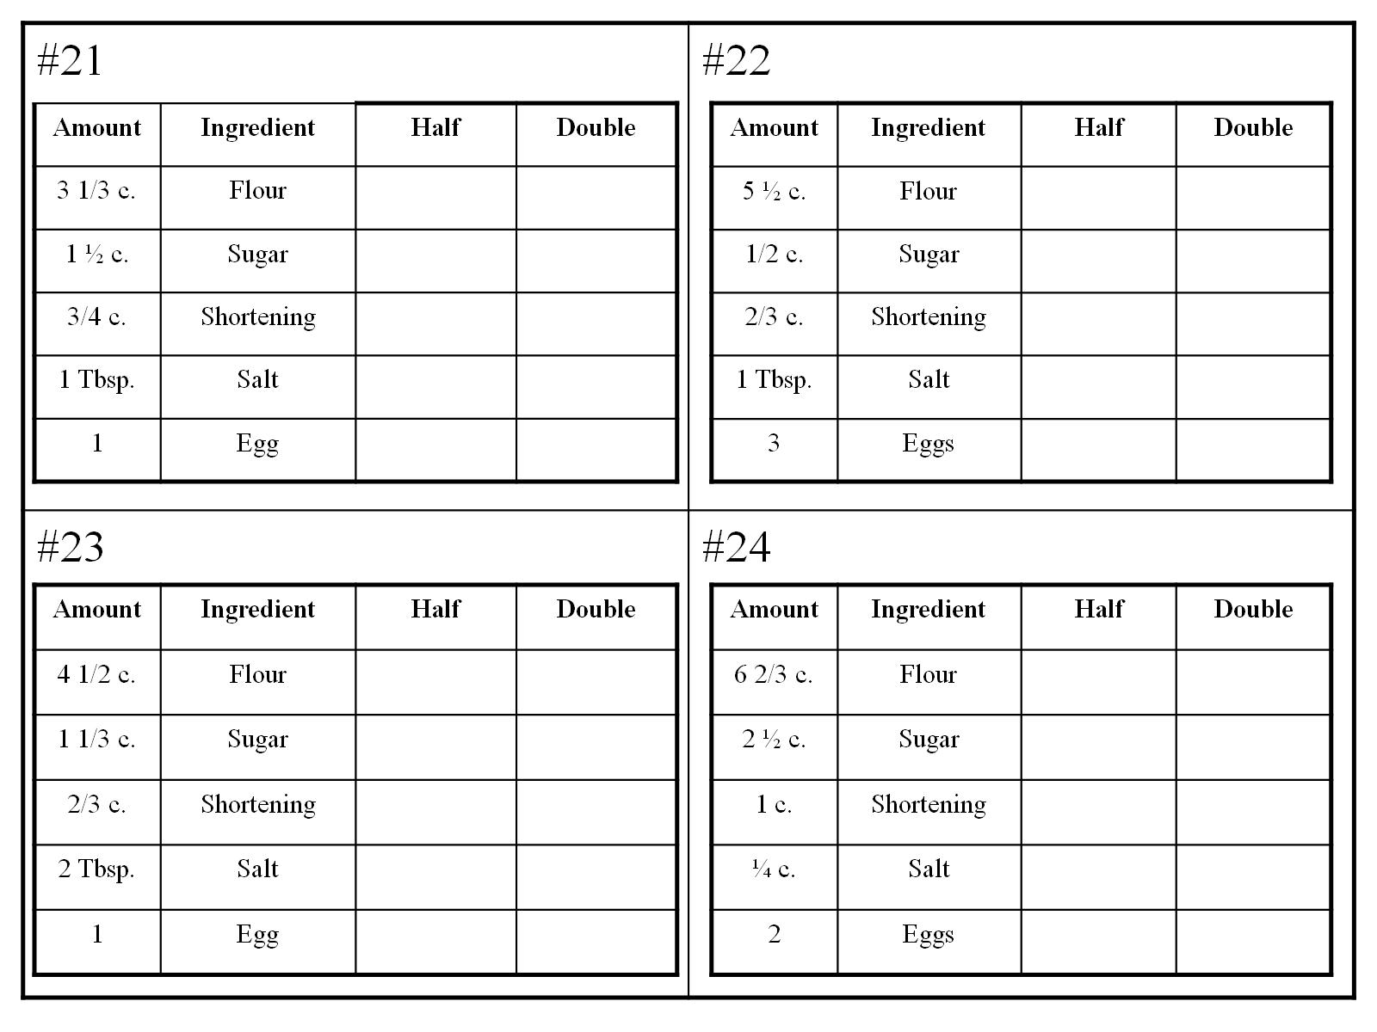

Slide 16
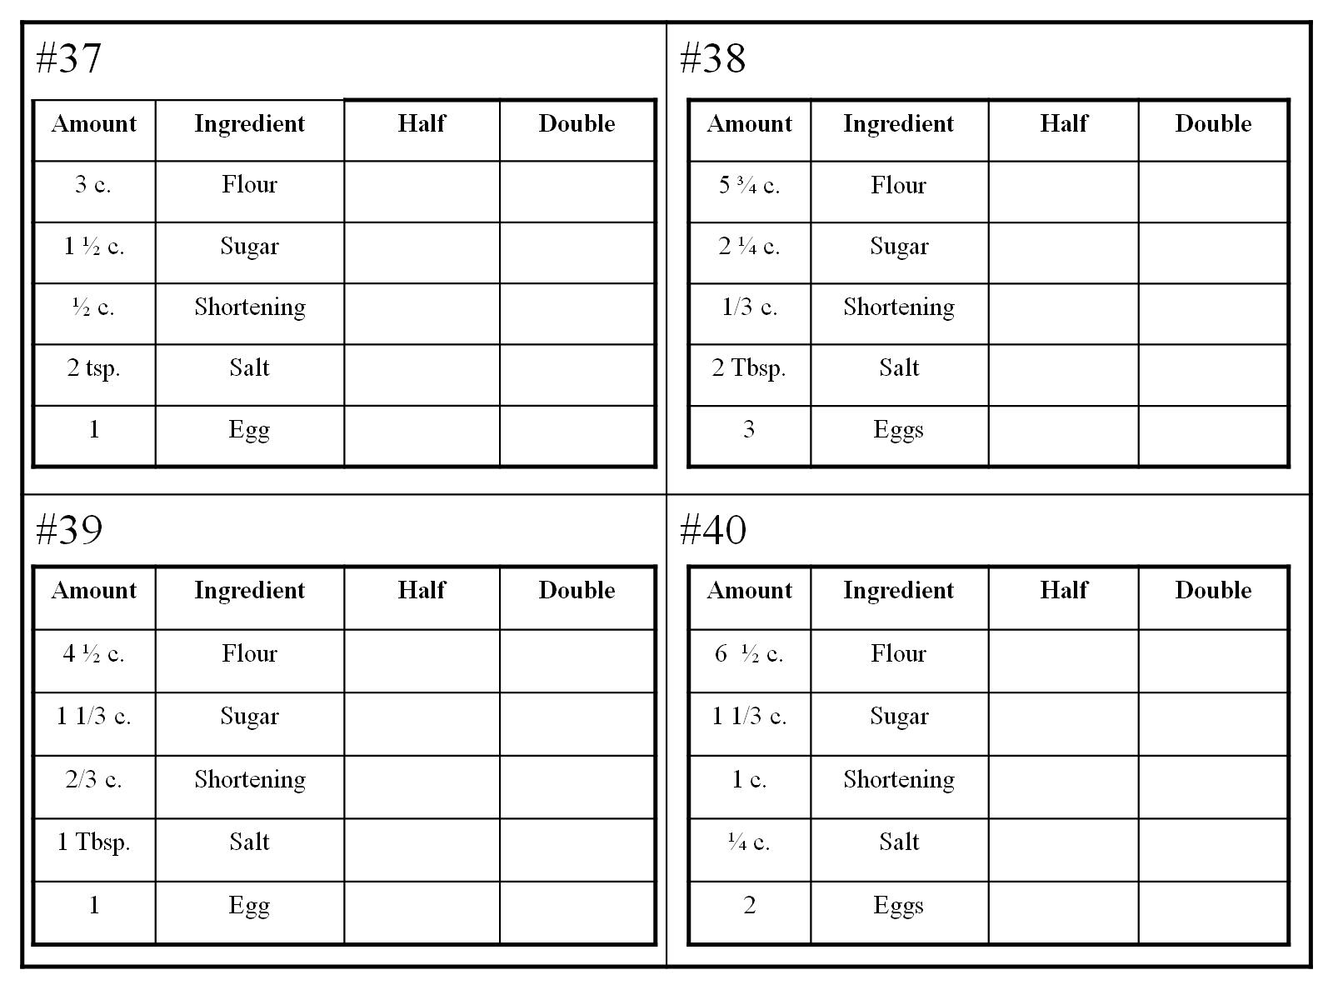

Slide 27
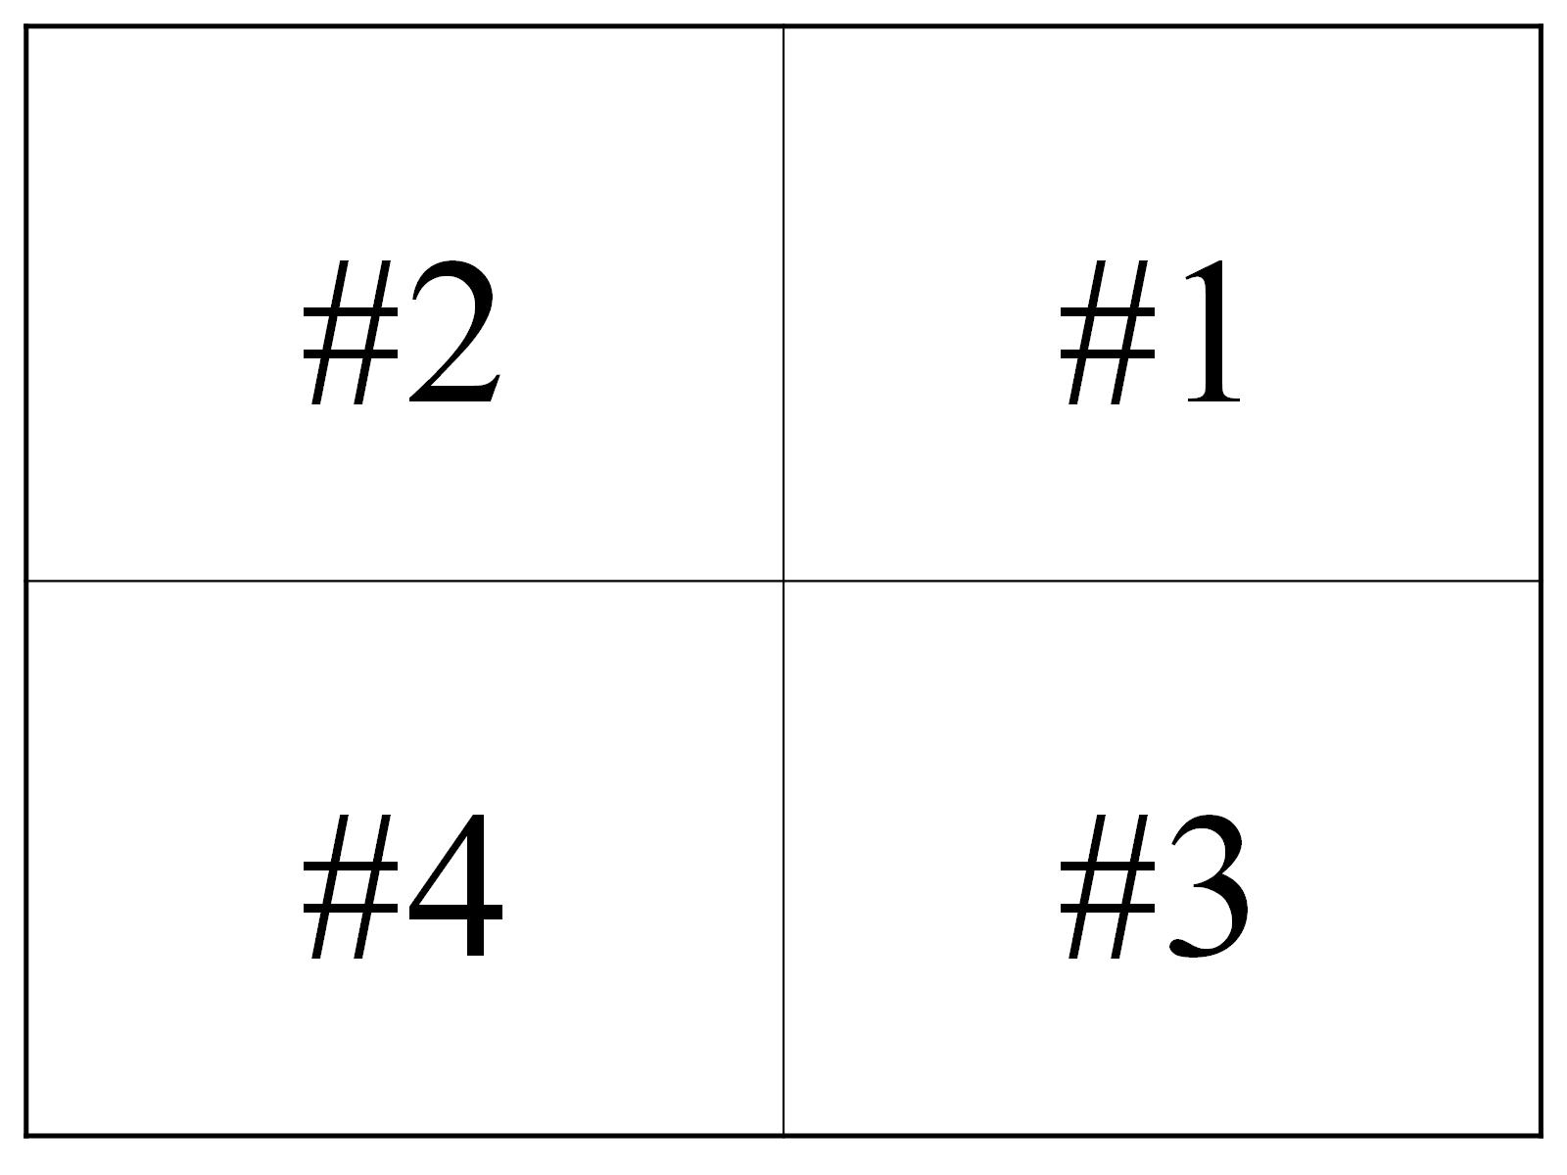

Slide 28
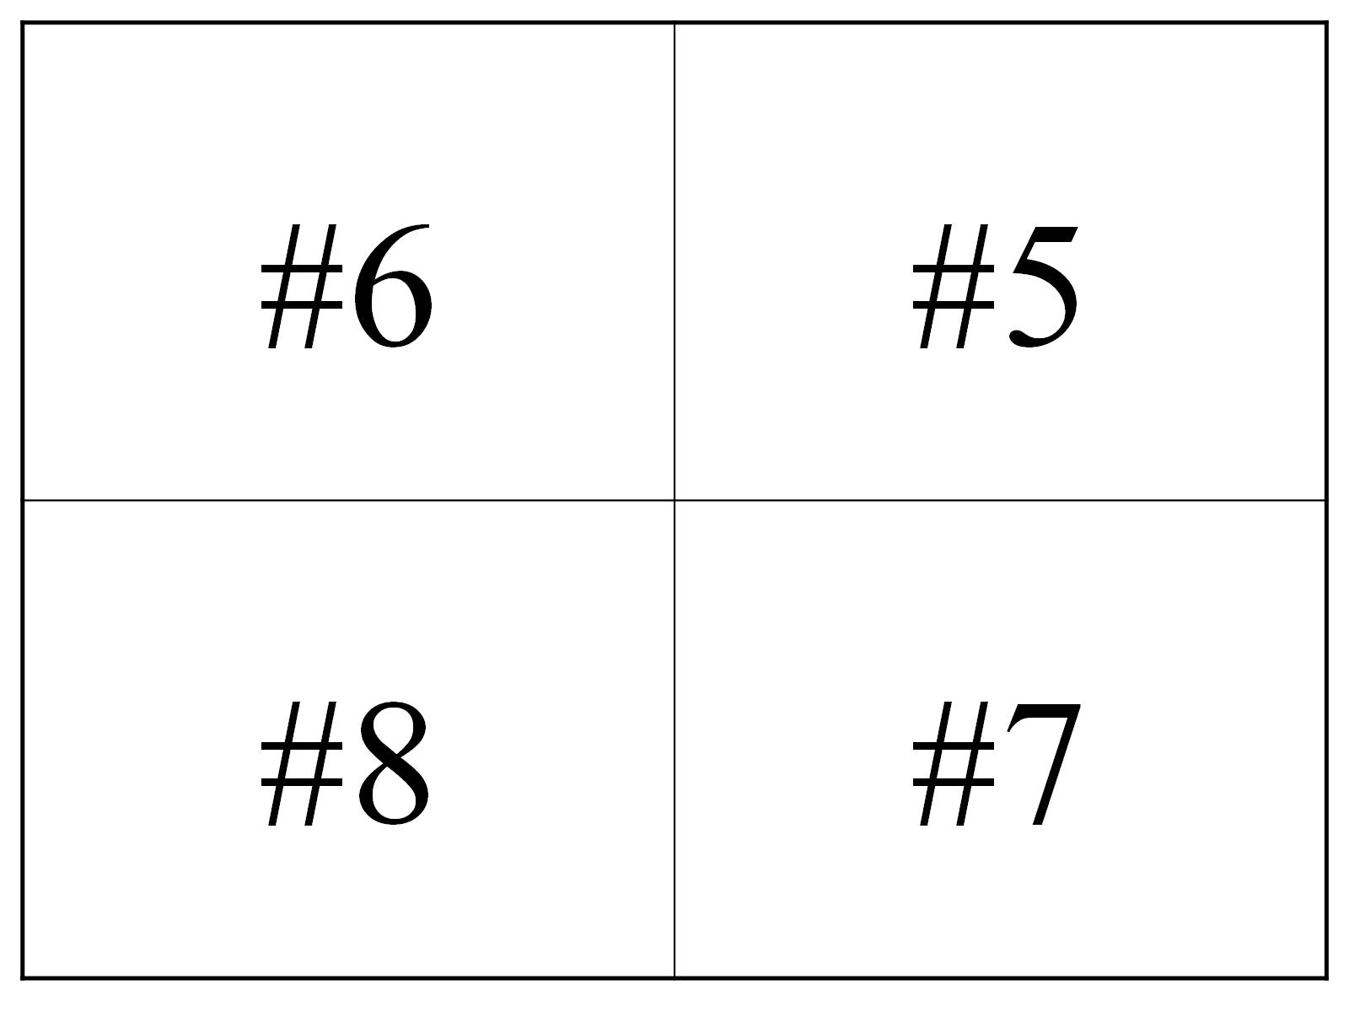

Slide 29
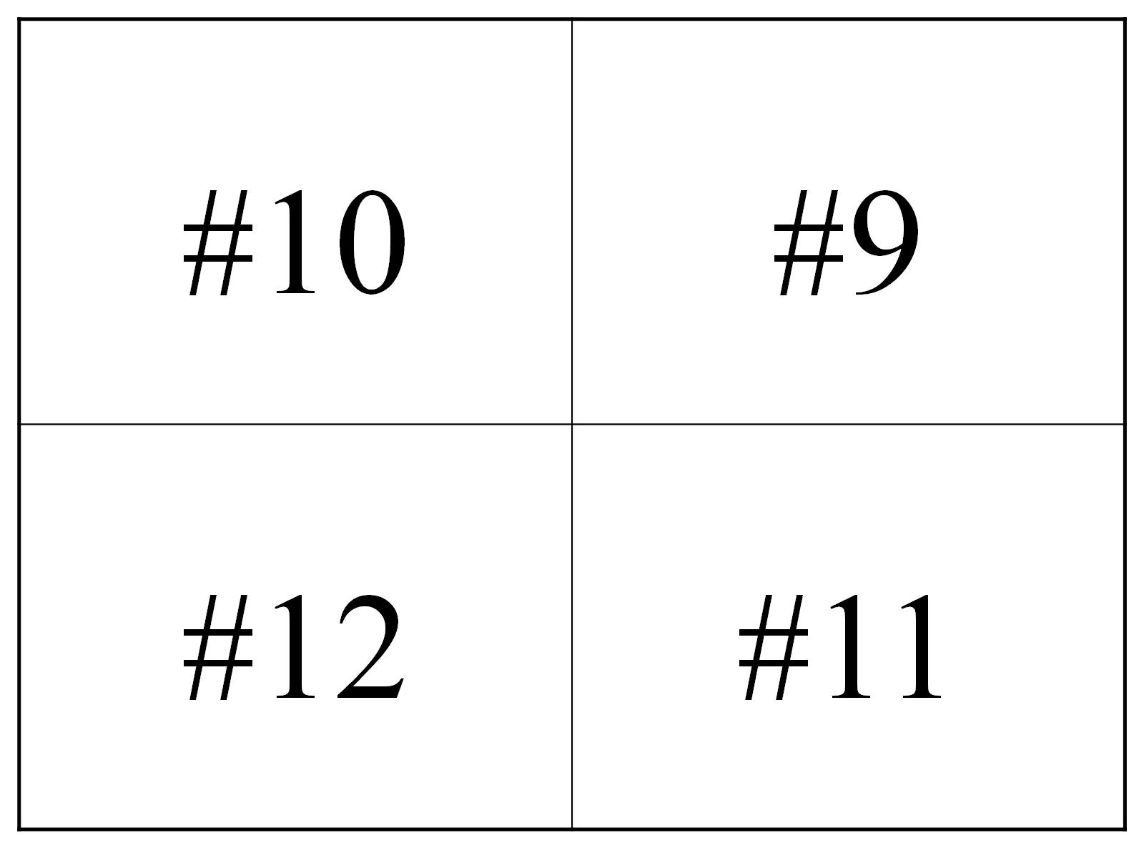

Slide 30
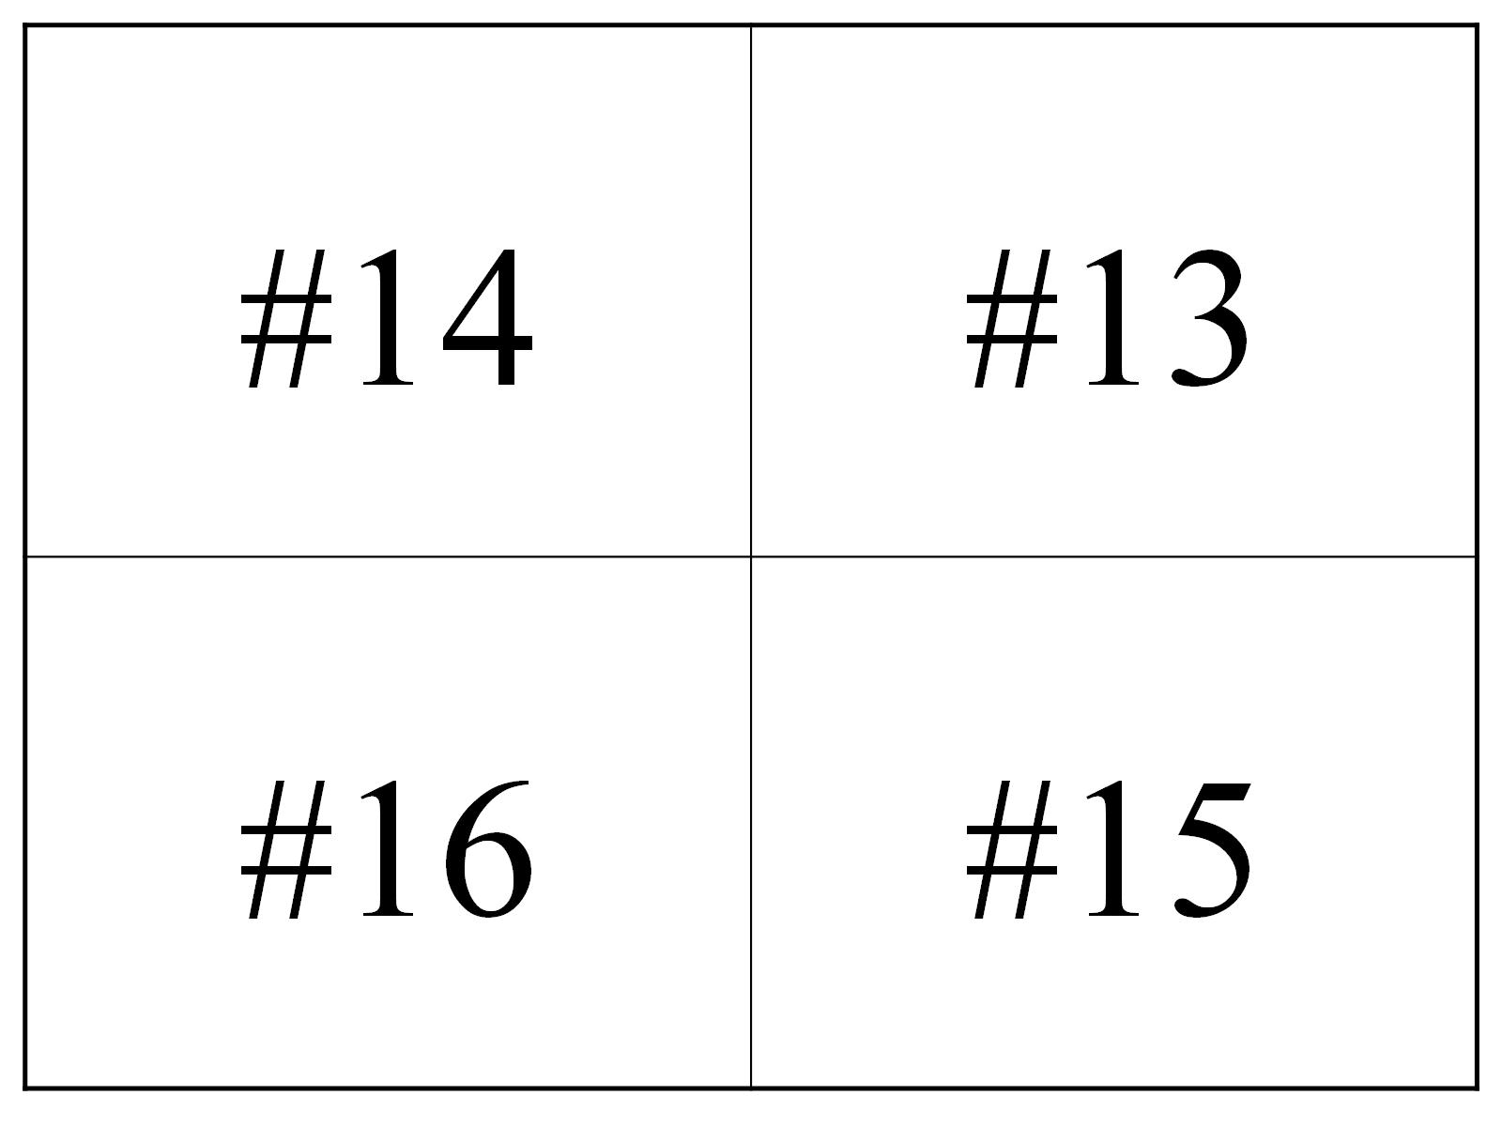

Slide 31
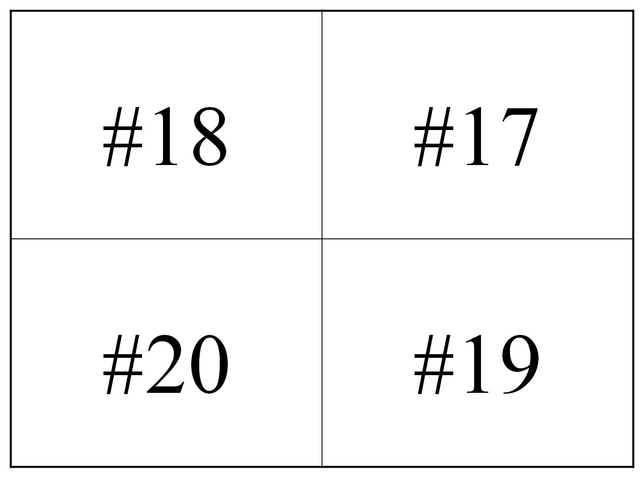

Slide 32
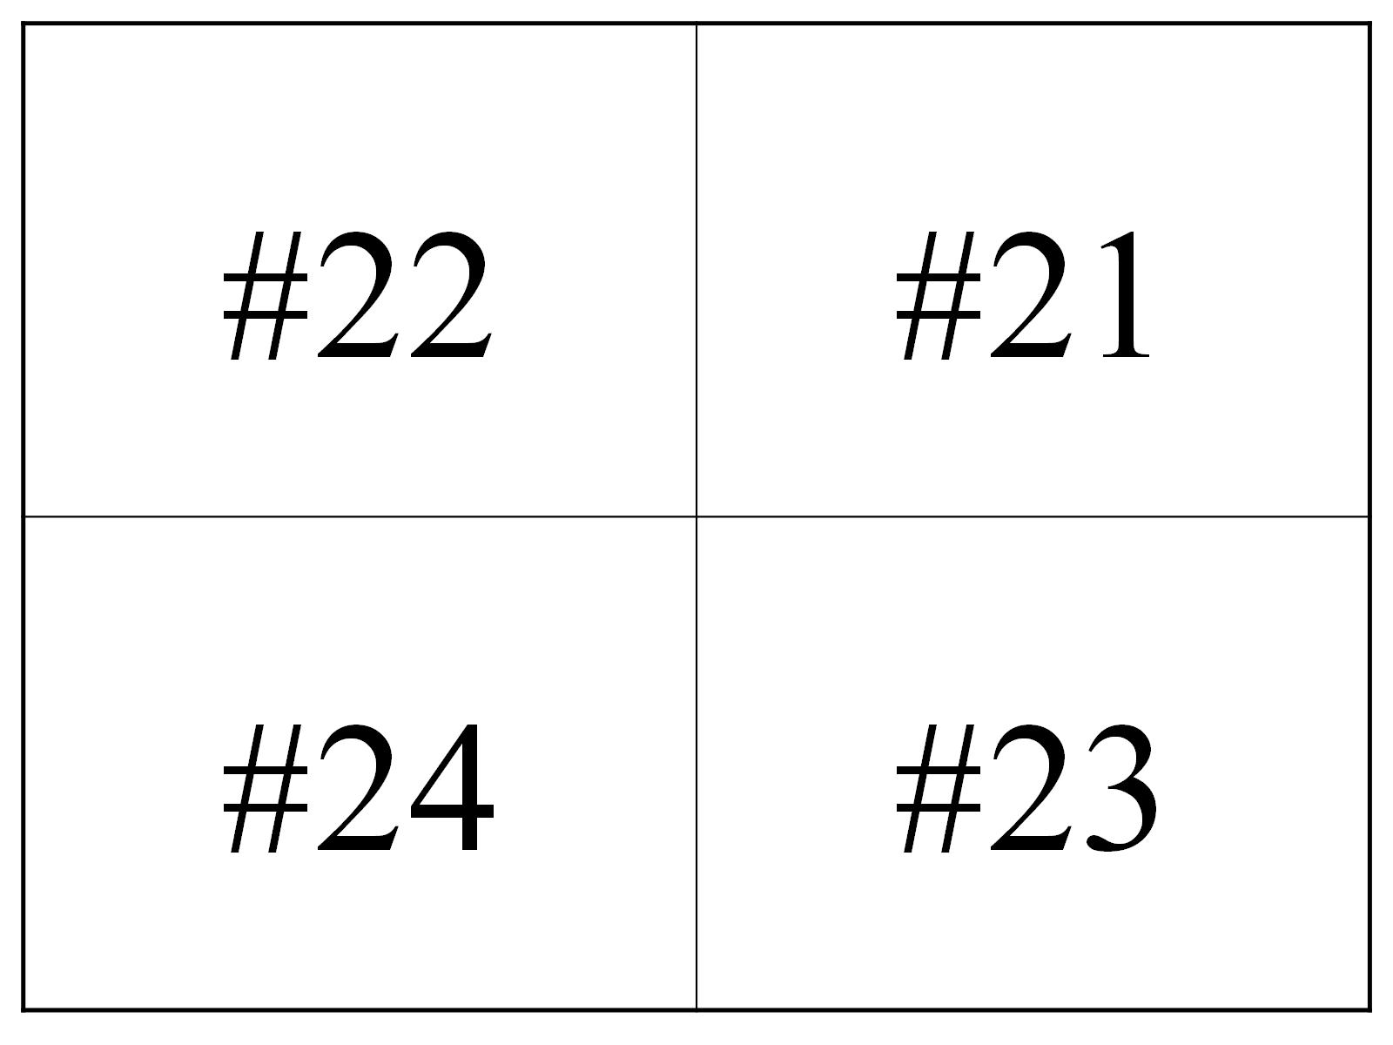

Slide 33
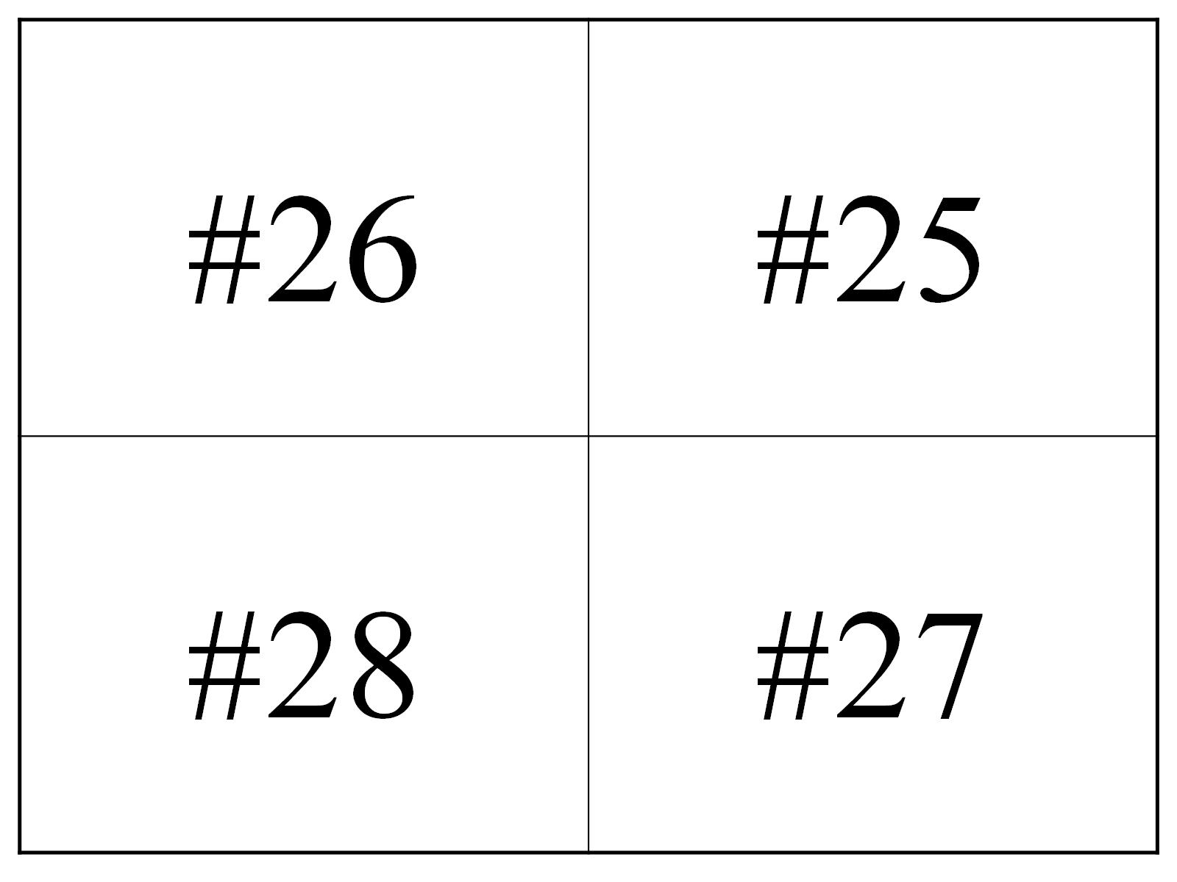

Slide 34
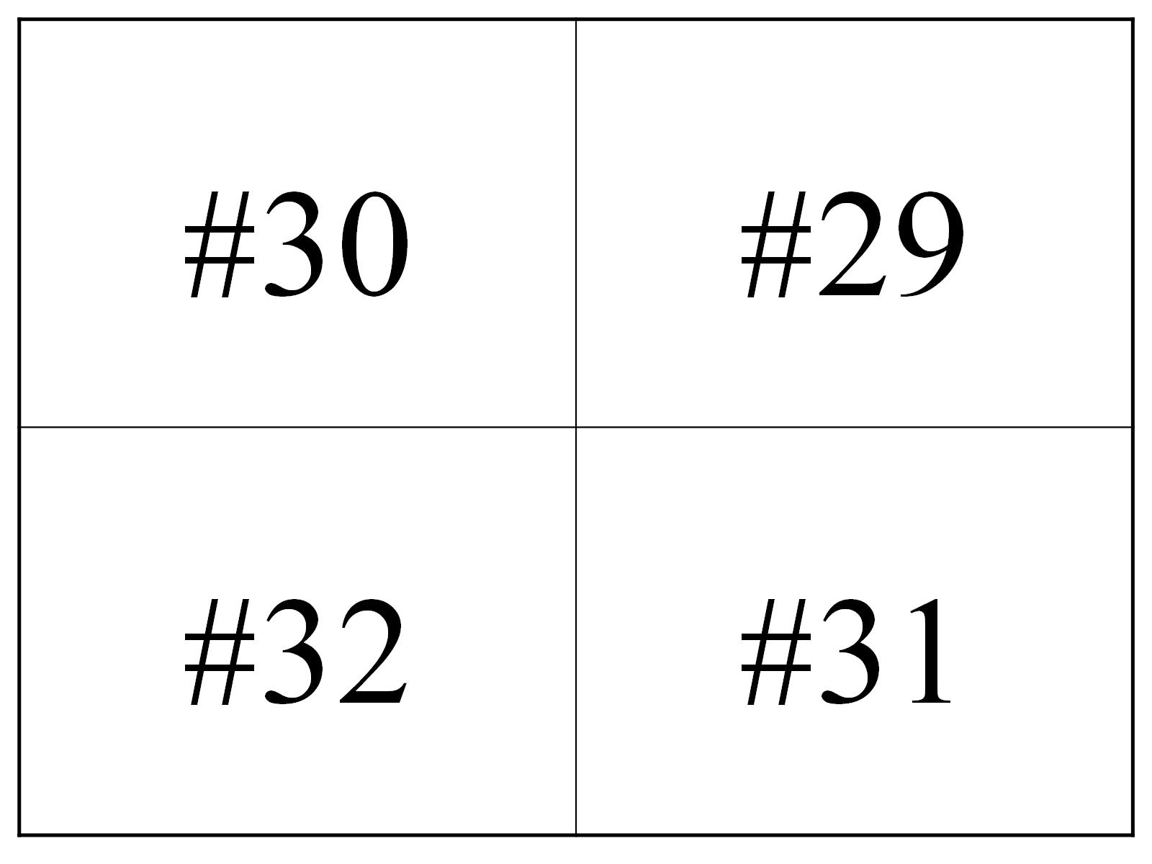

Slide 35
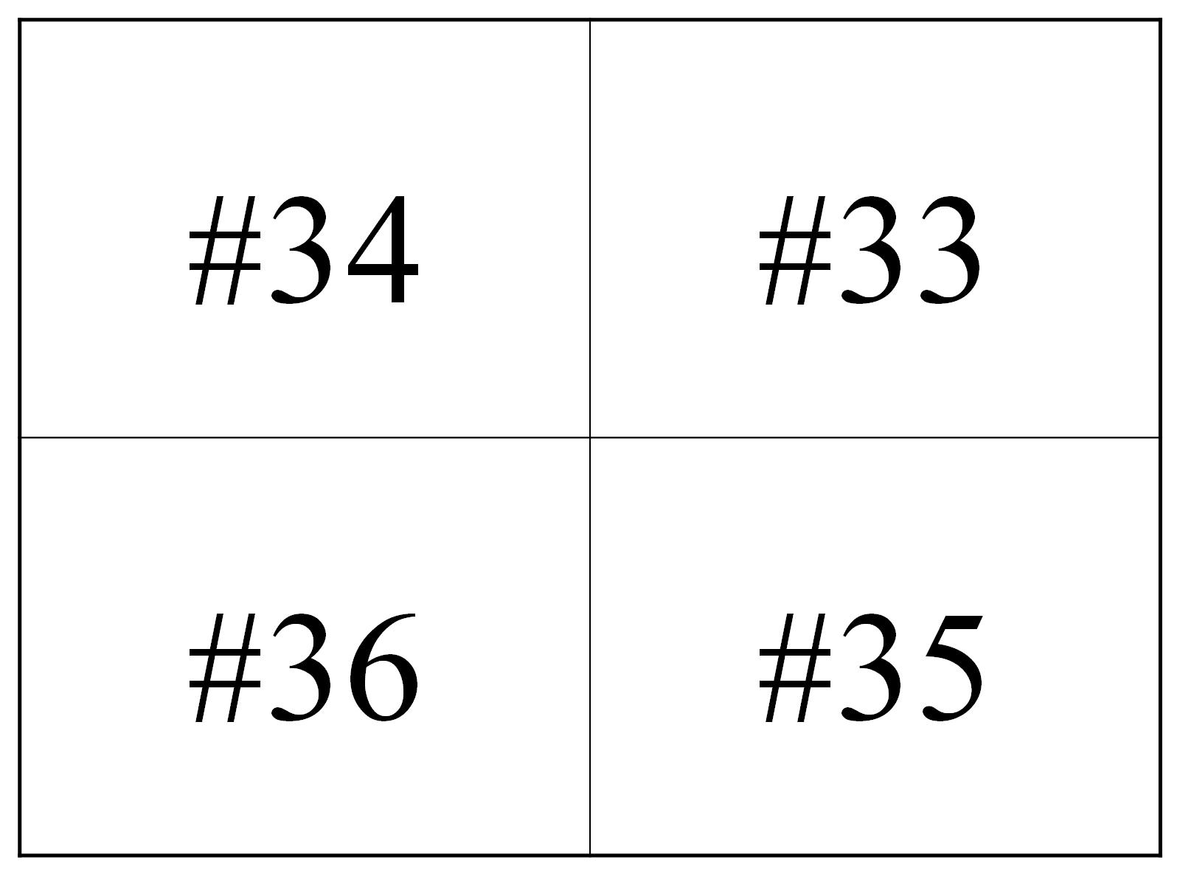

Slide 36
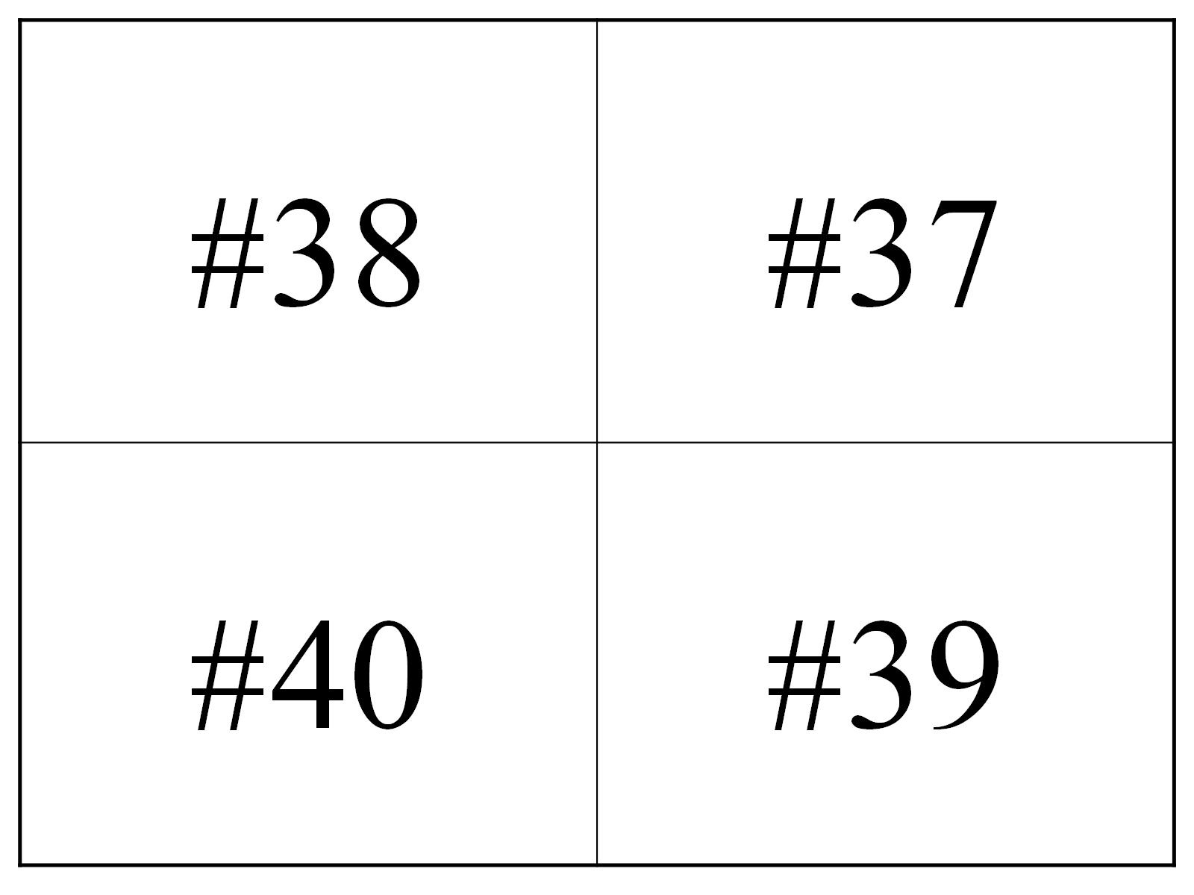

Slide 37
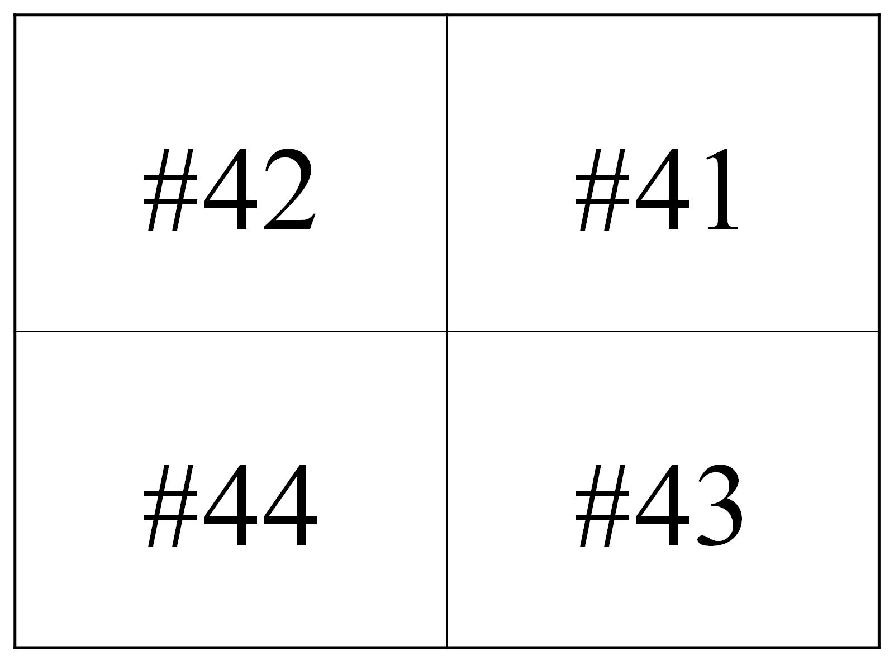

Slide 38
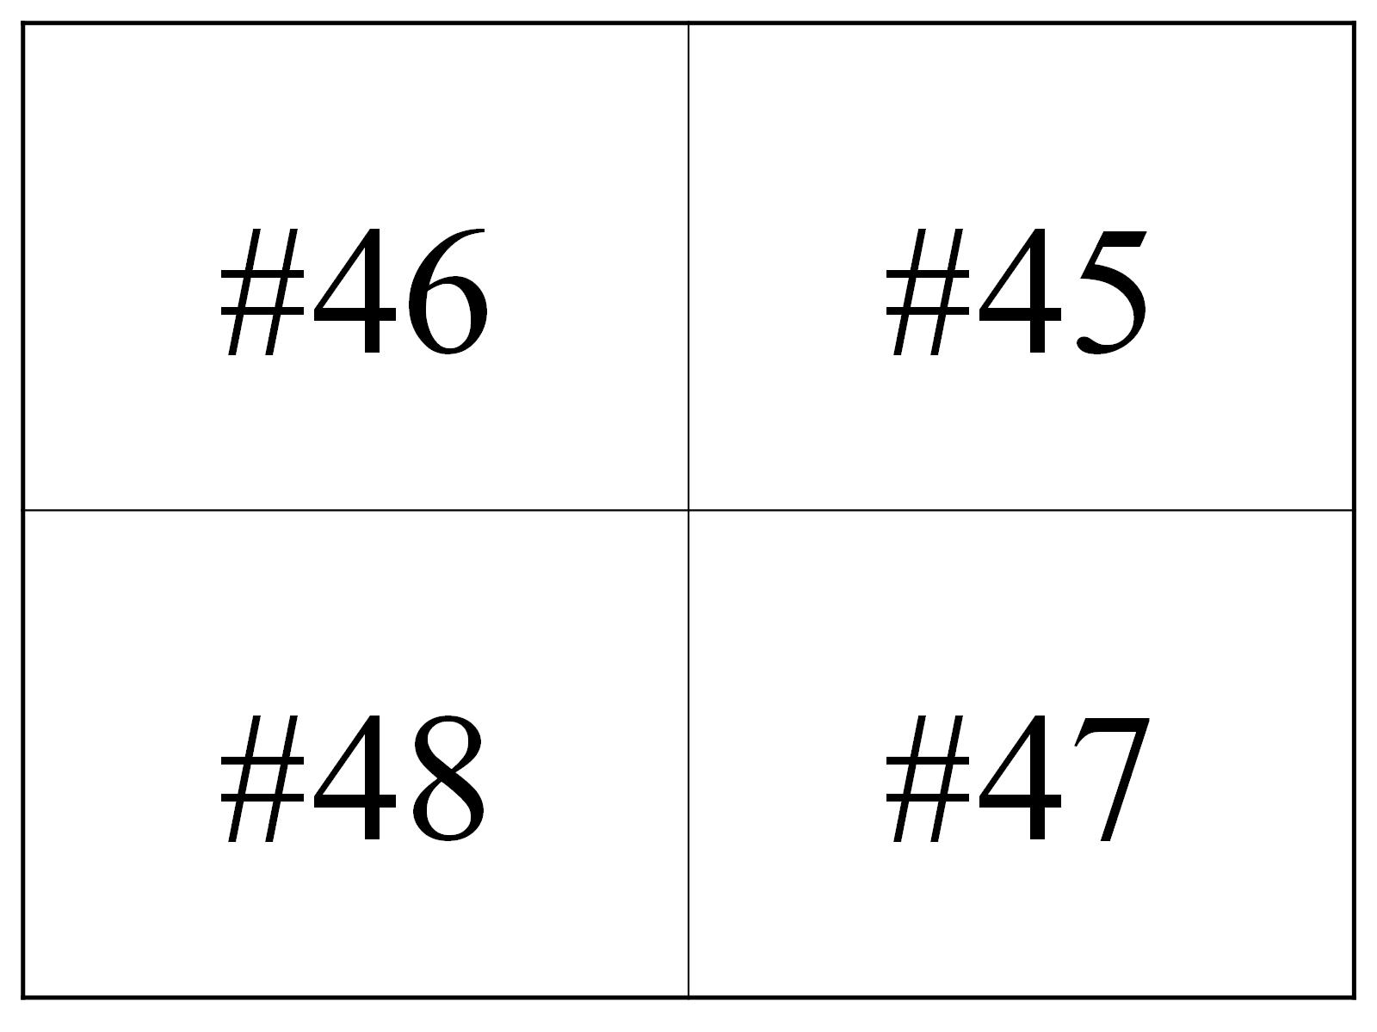

Slide 39
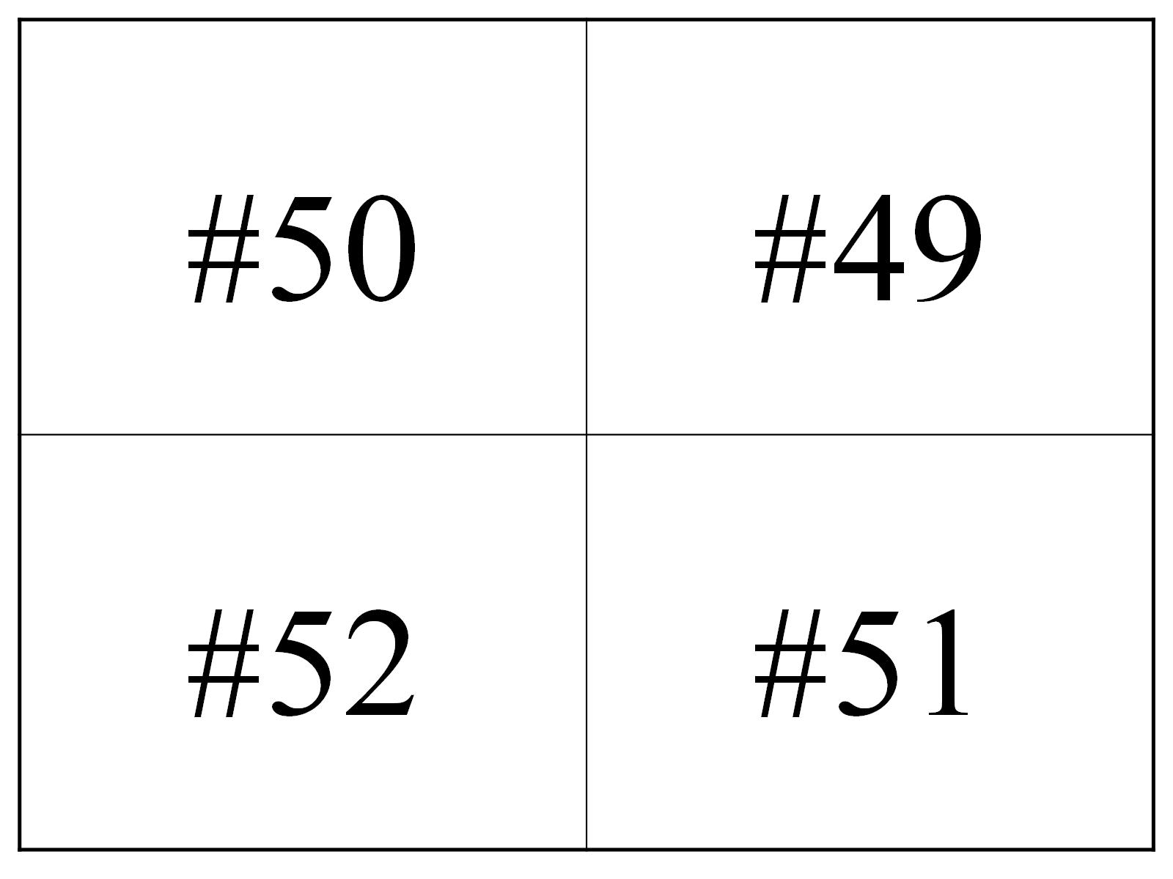

Slide 41
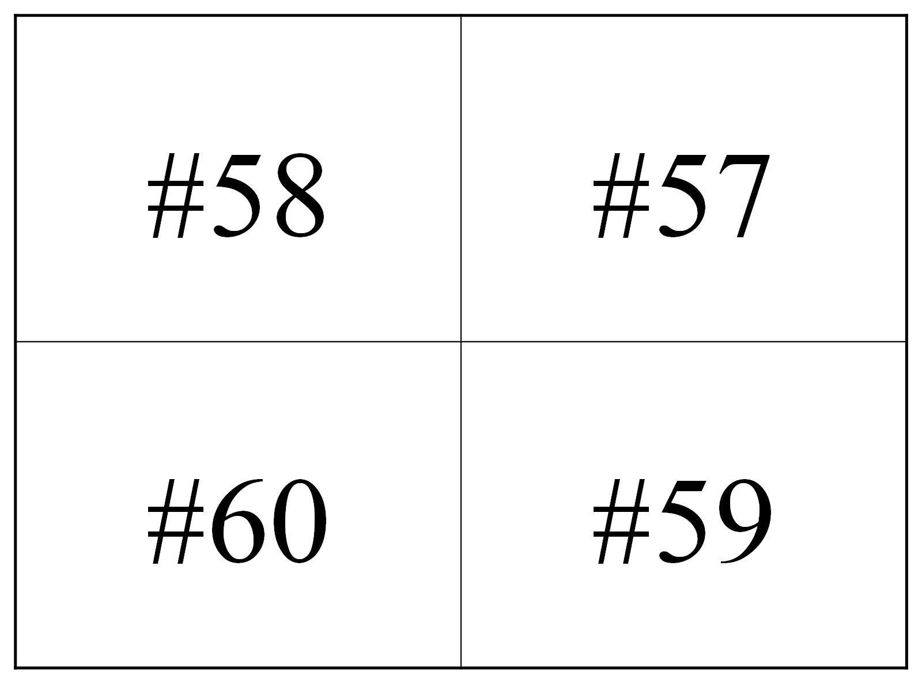

Slide 42
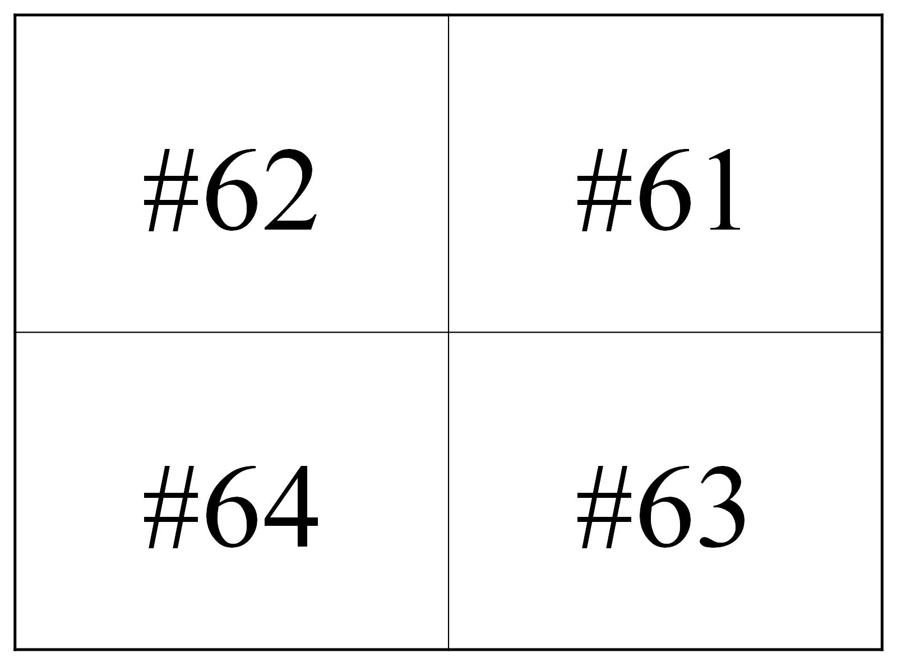

Slide 43
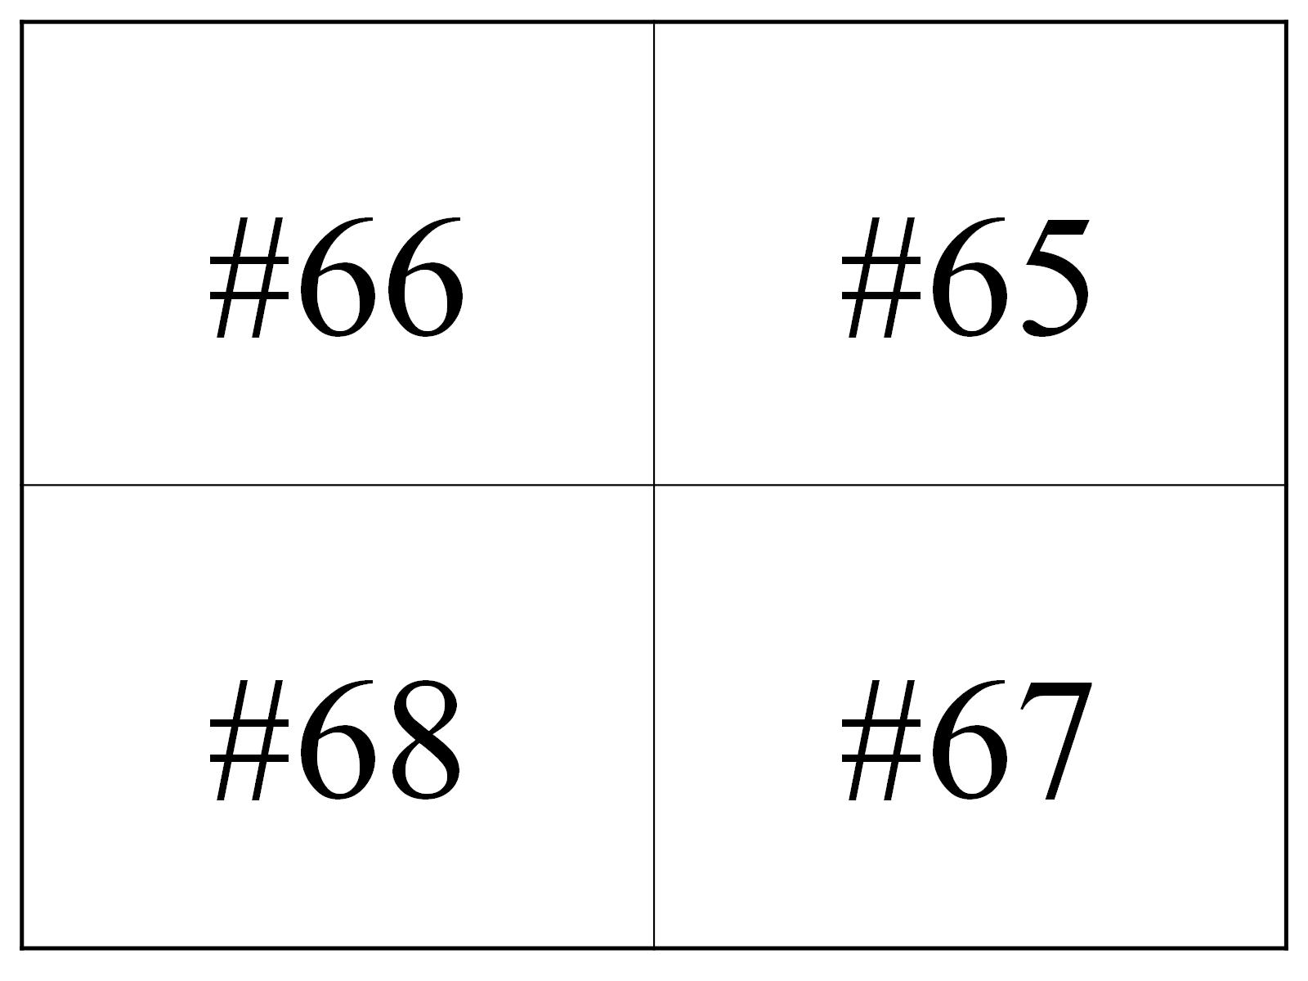

Slide 44
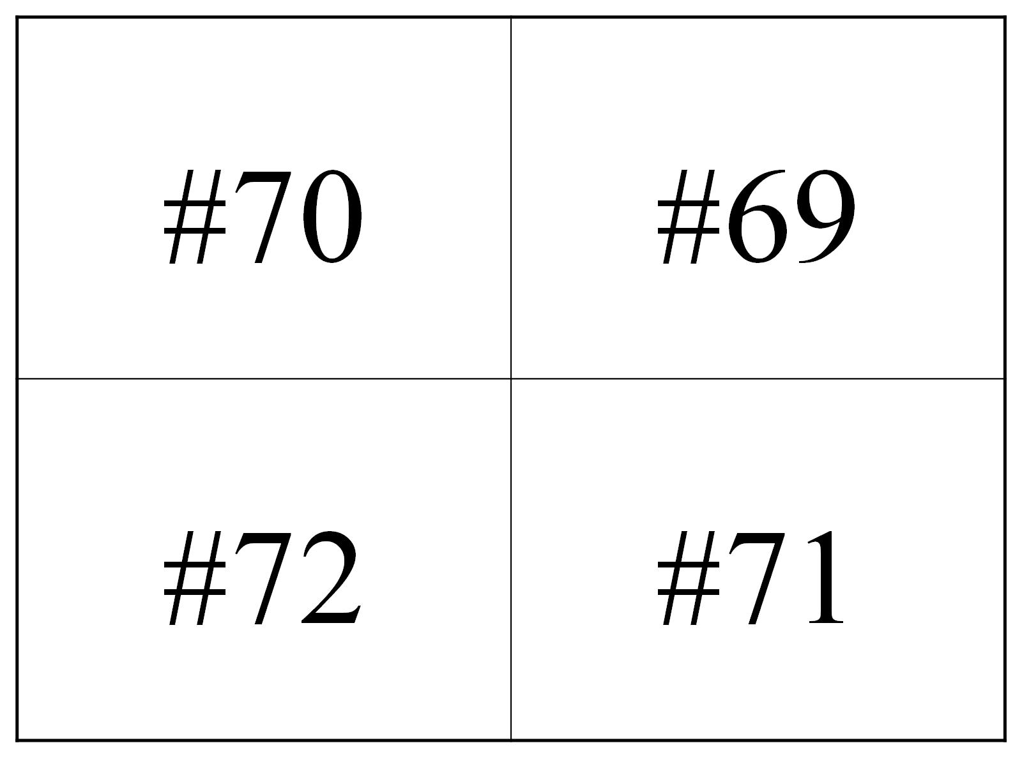

Slide 46
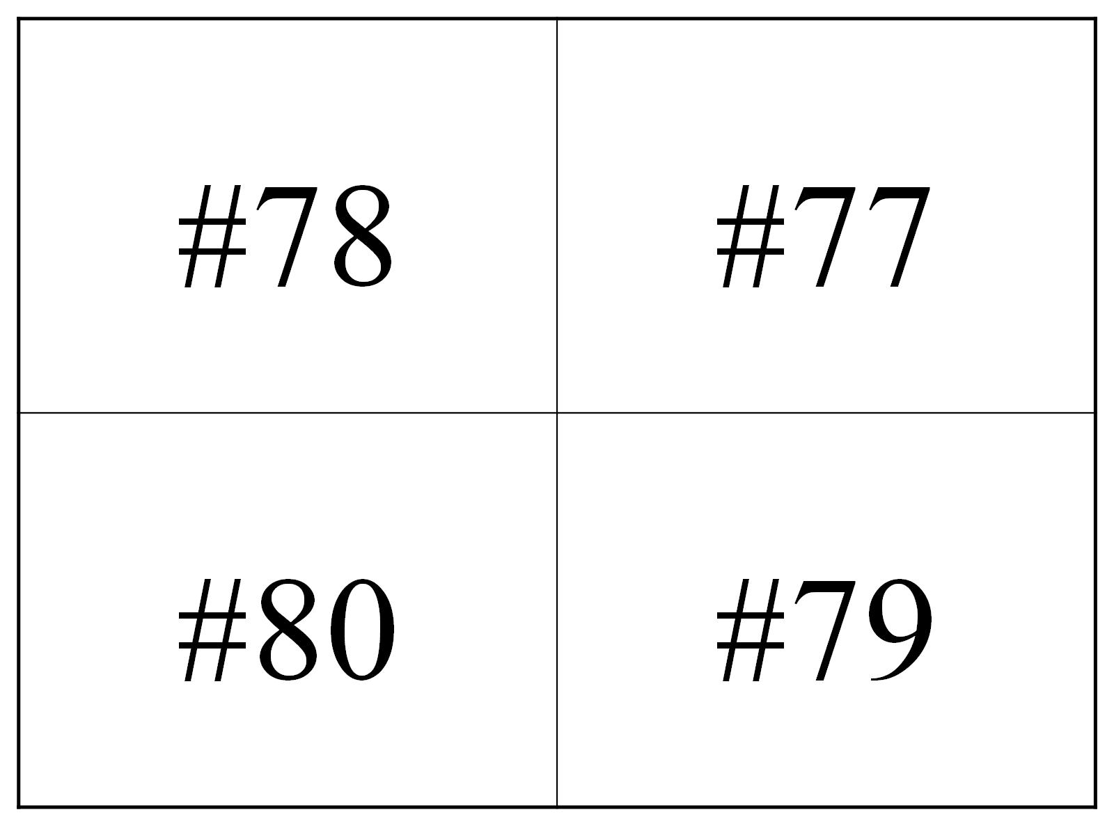

Slide 47
TEACHER KEY

Slide 48
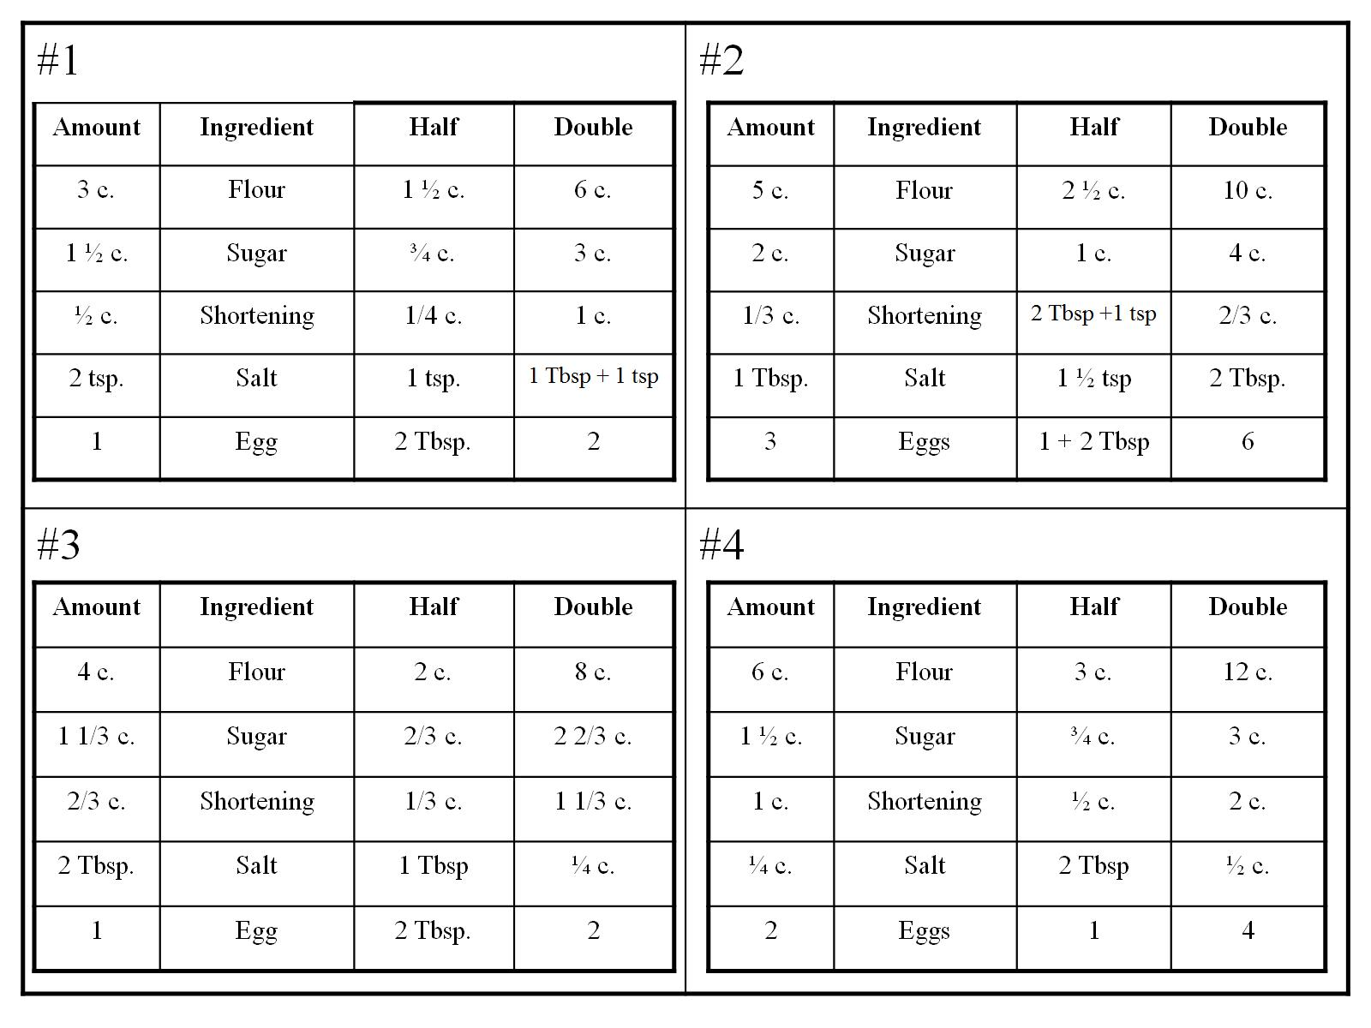

Slide 49
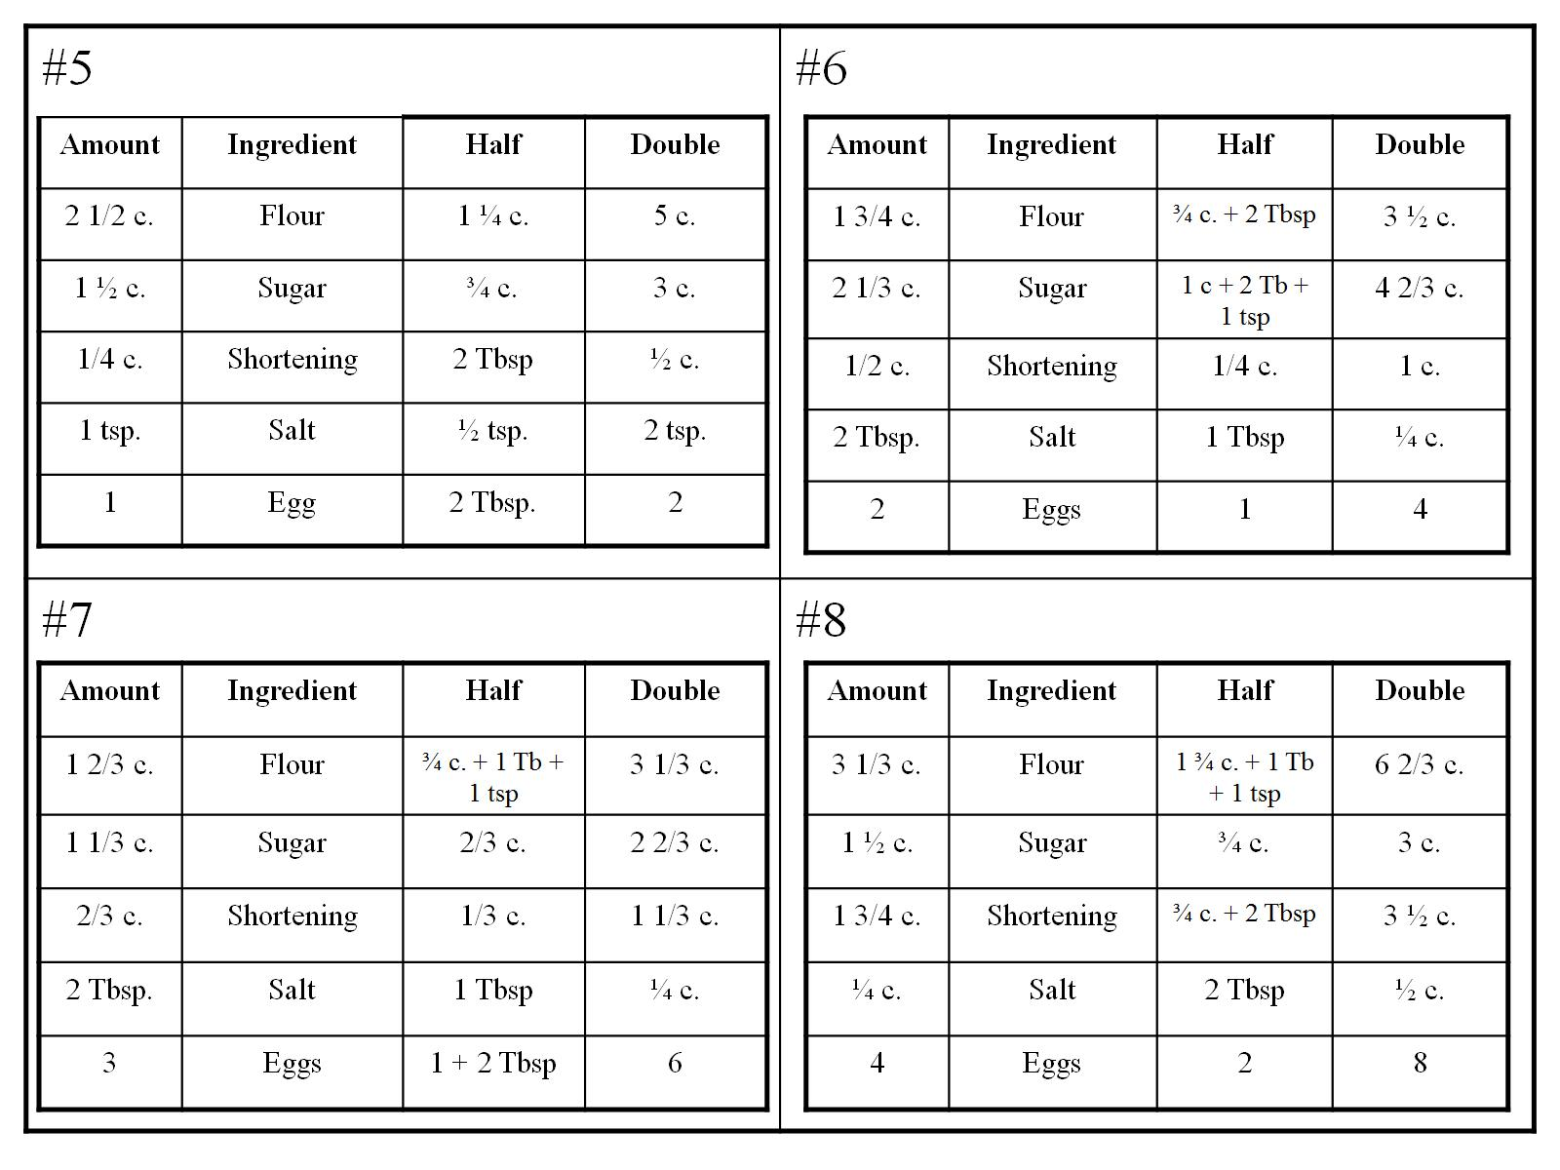

Slide 50
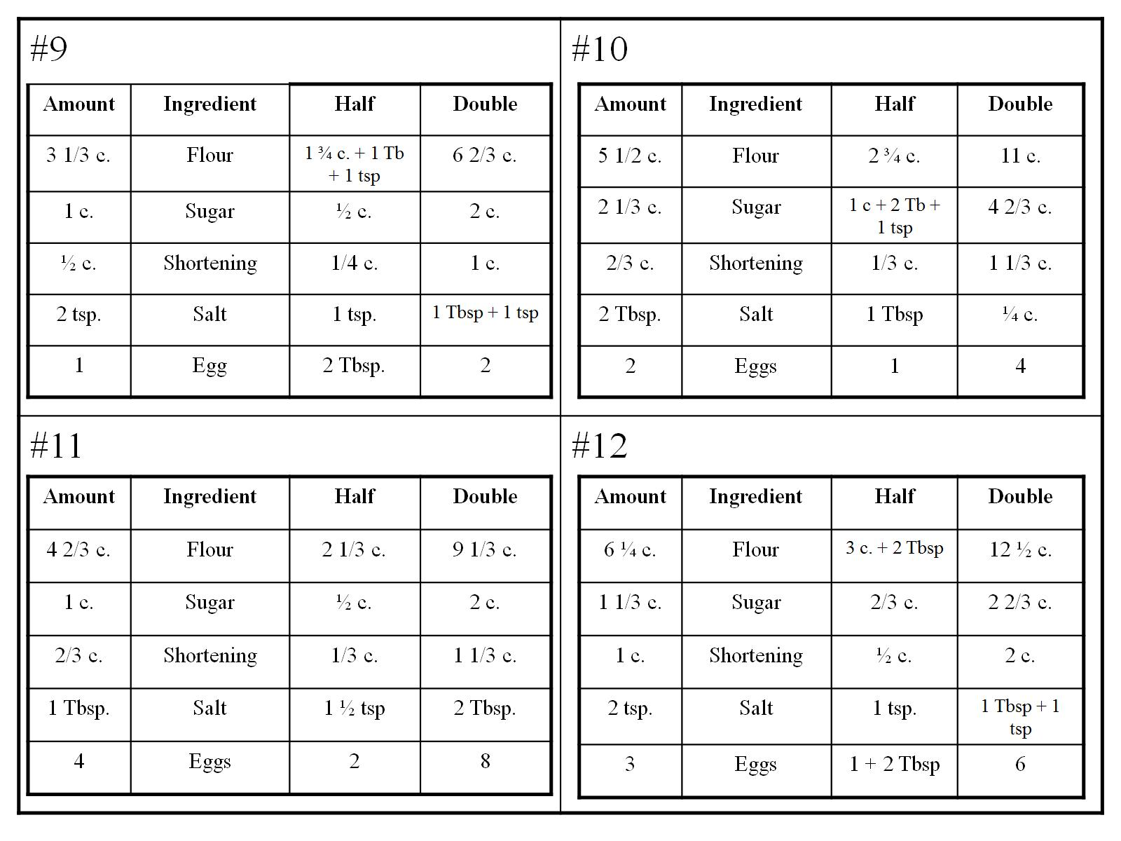

Slide 51
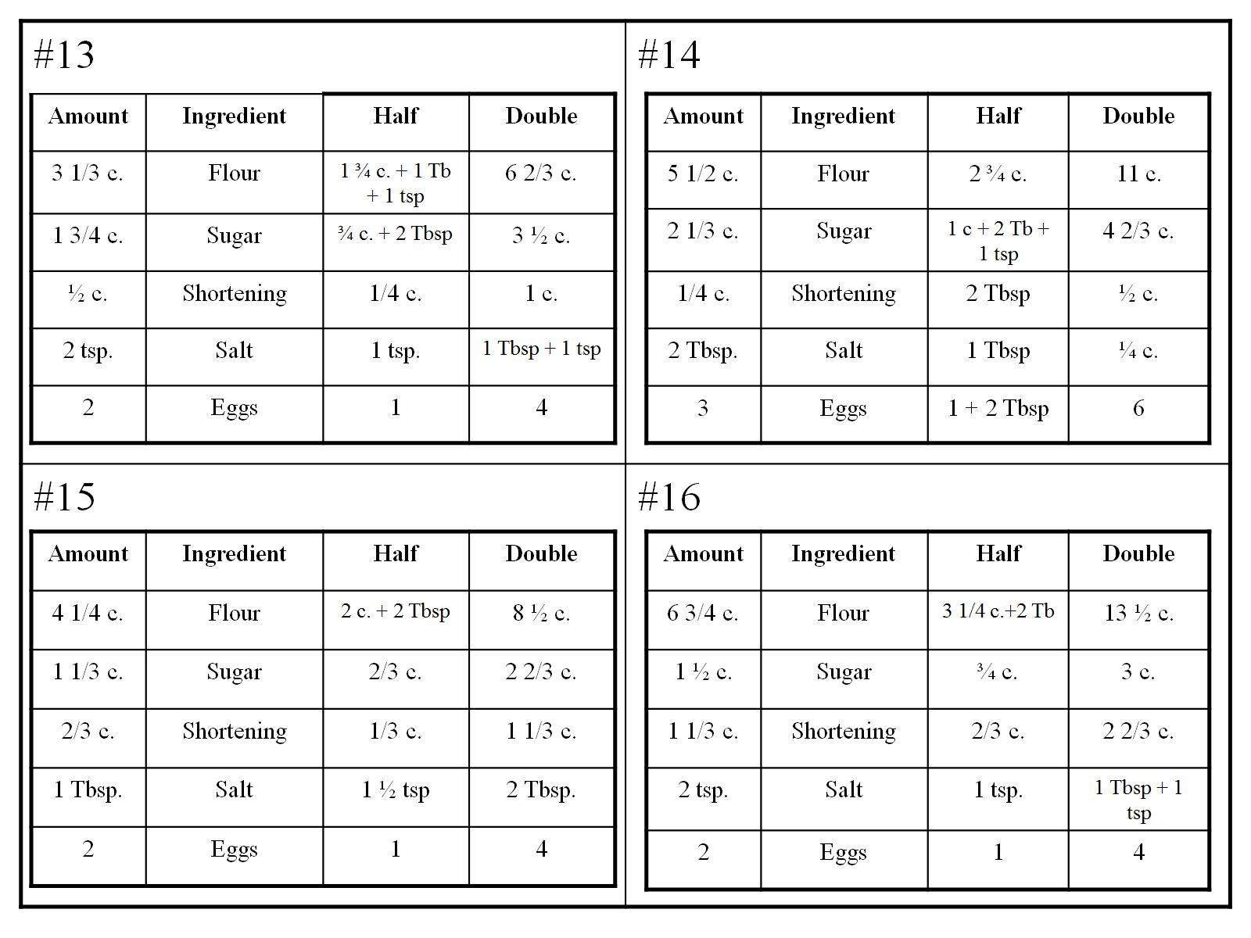

Slide 52
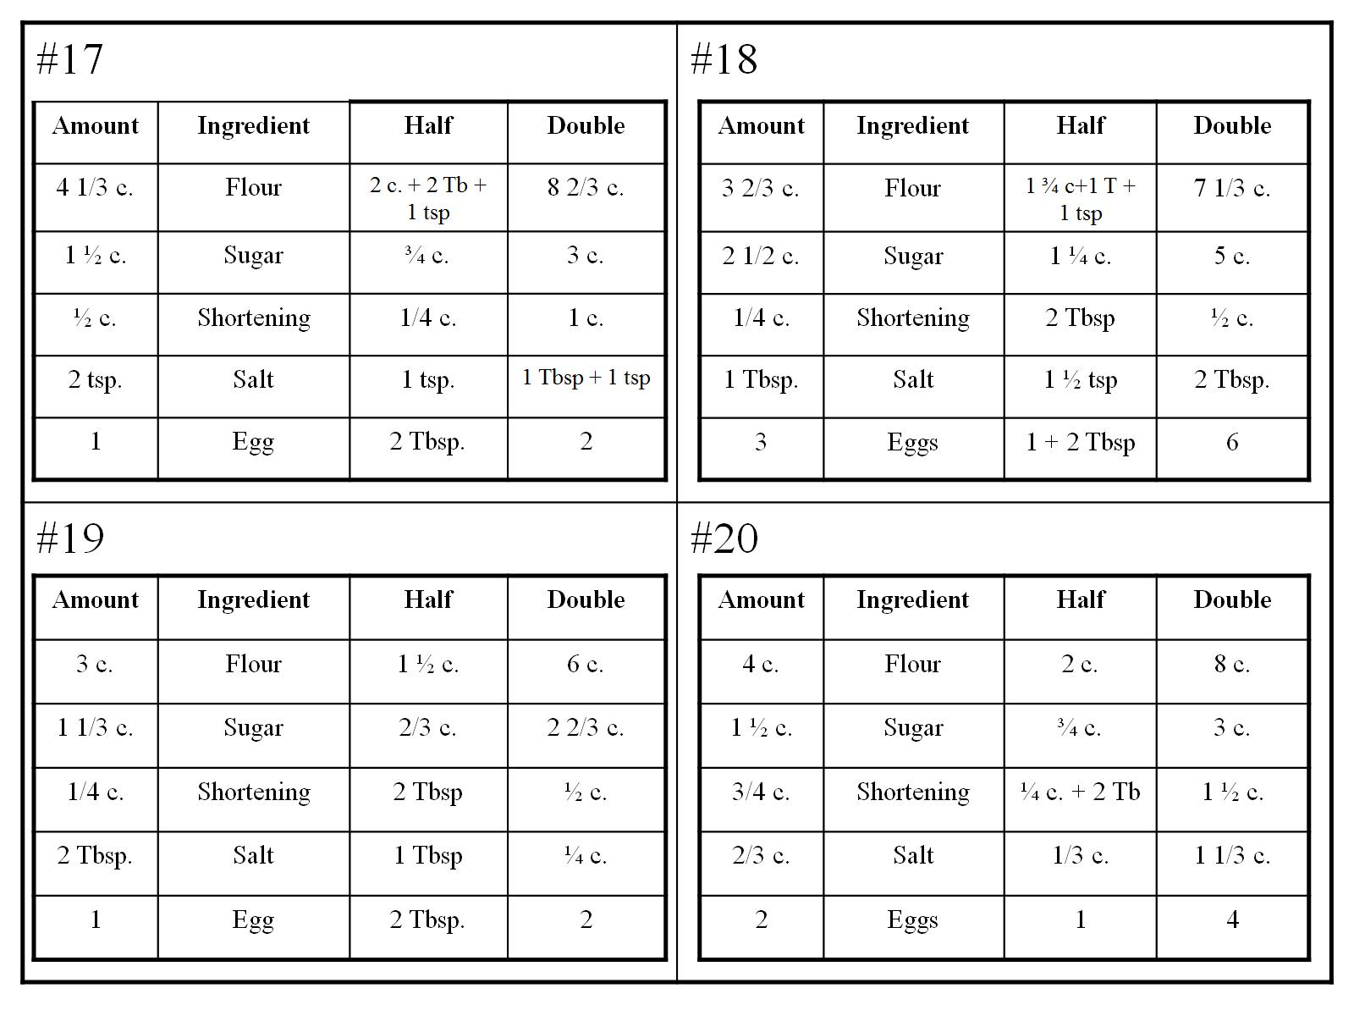

Slide 53
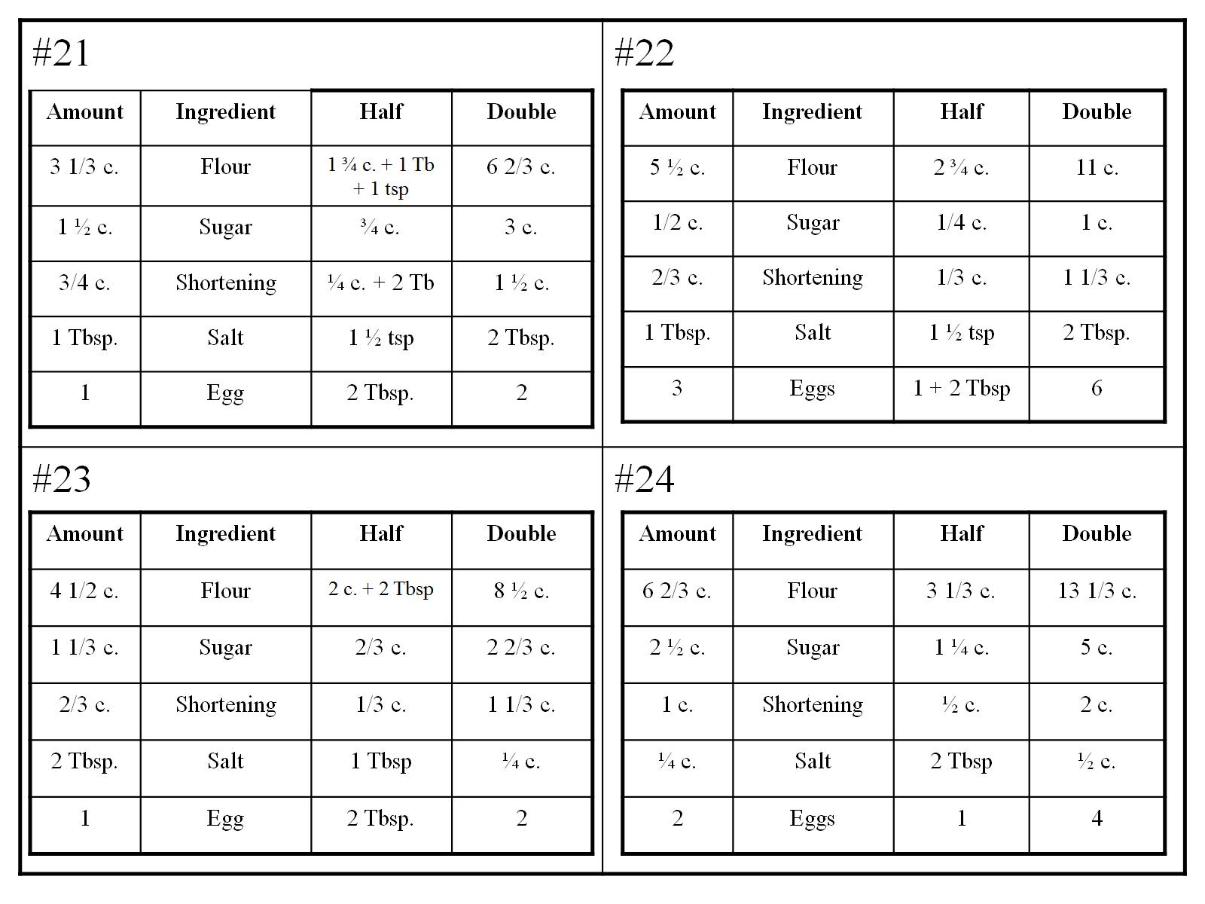

Slide 54
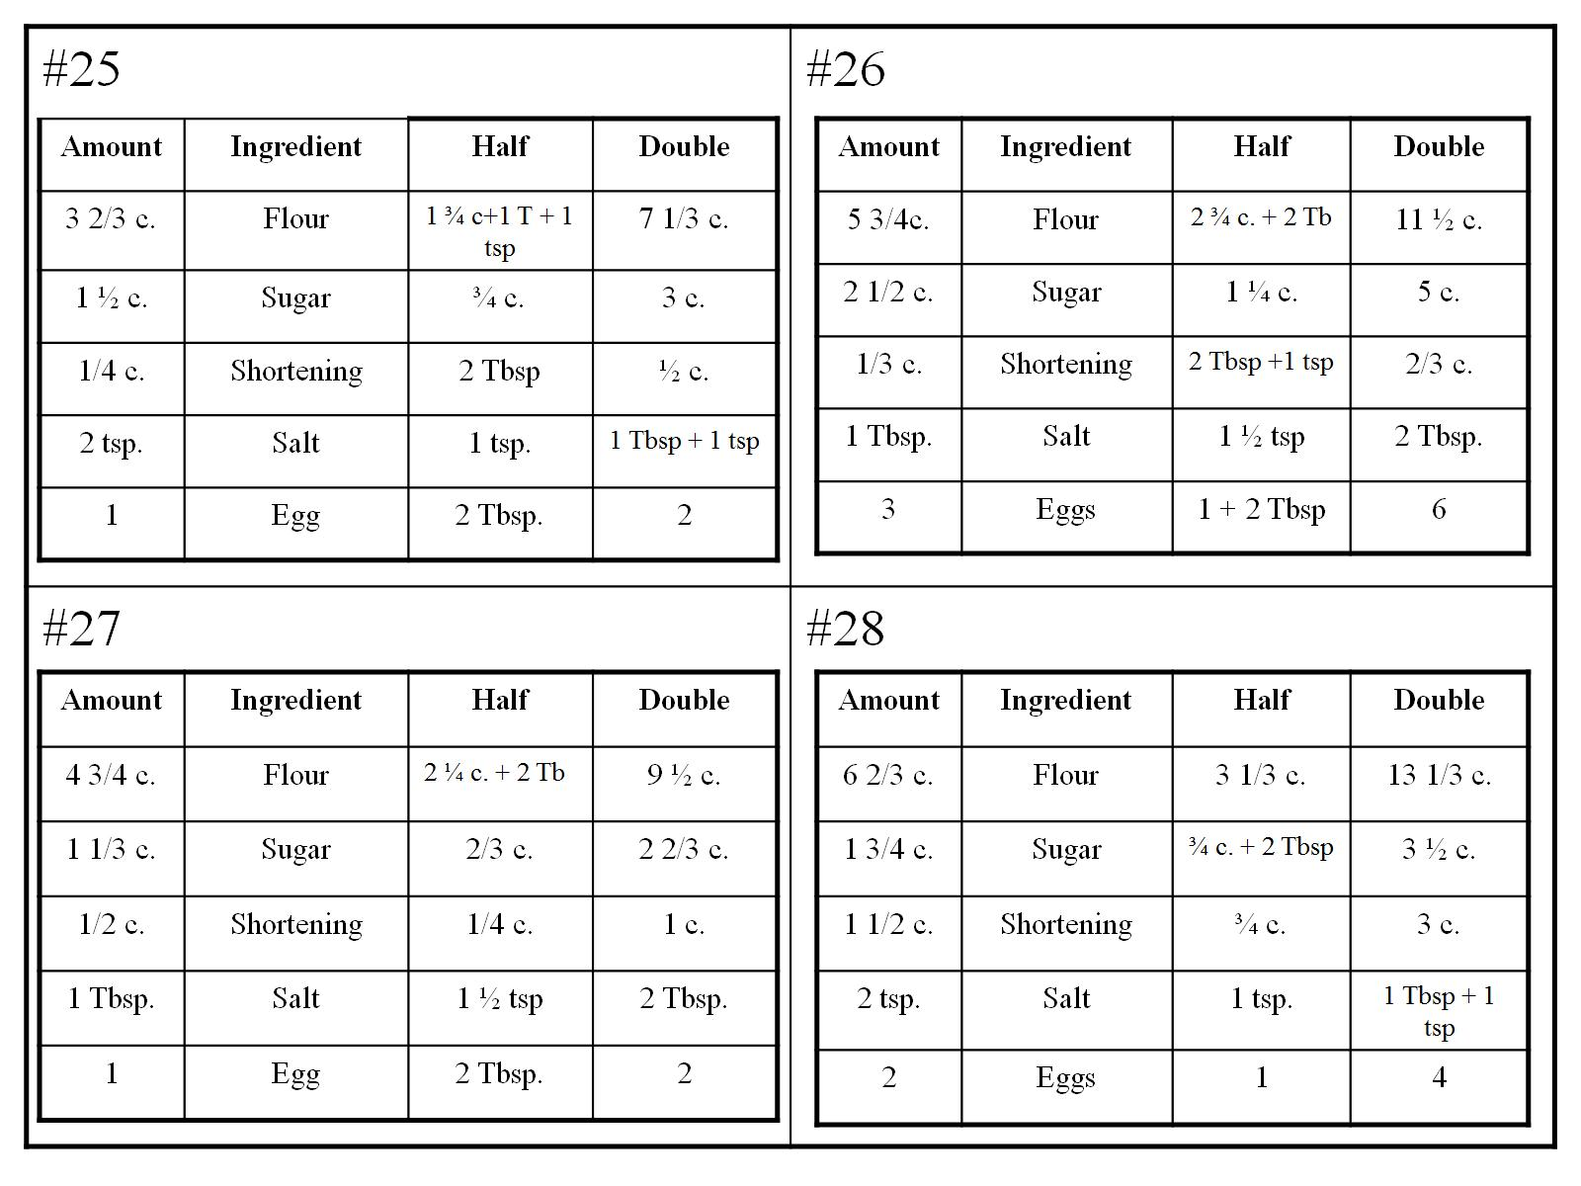

Slide 55
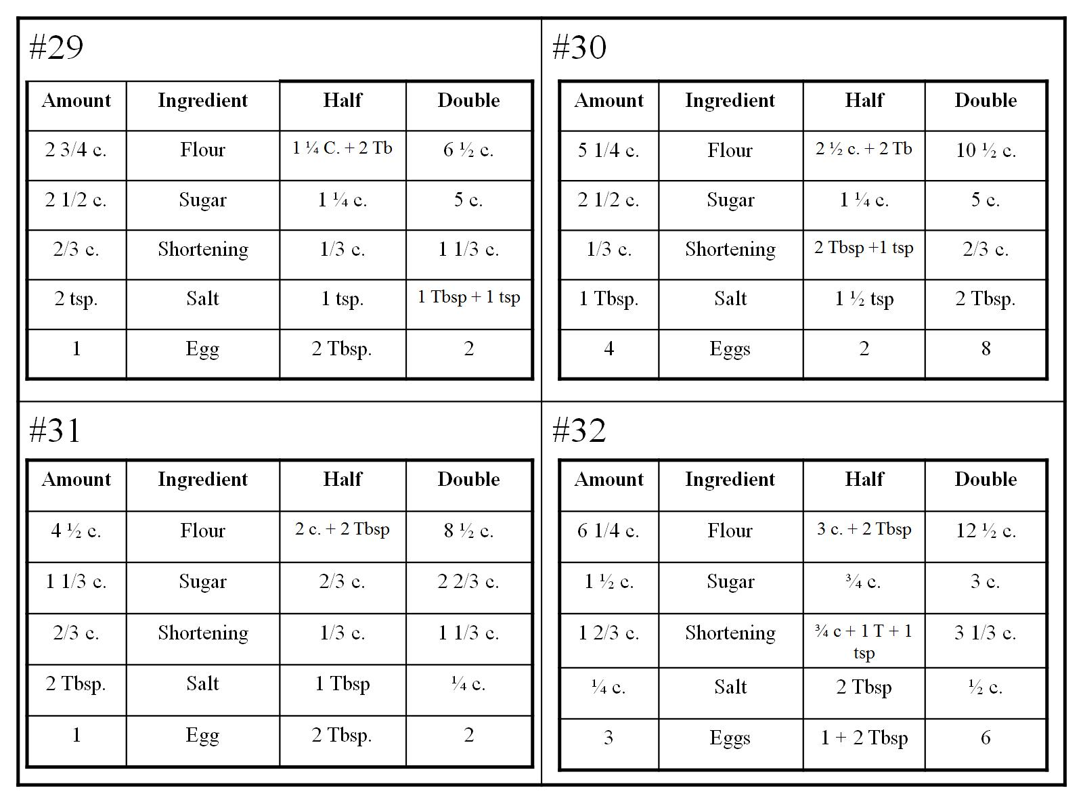

Slide 56
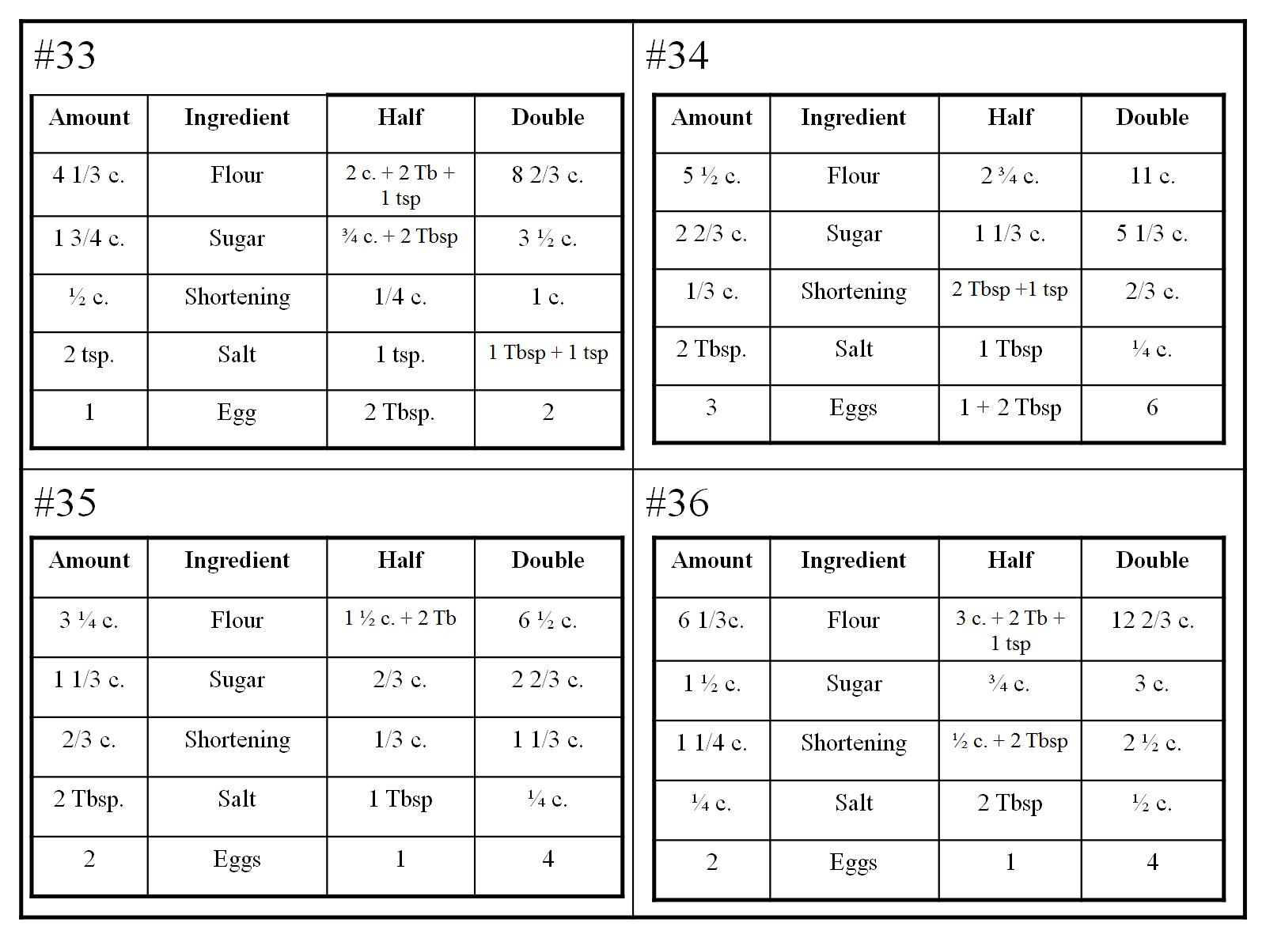

Slide 57
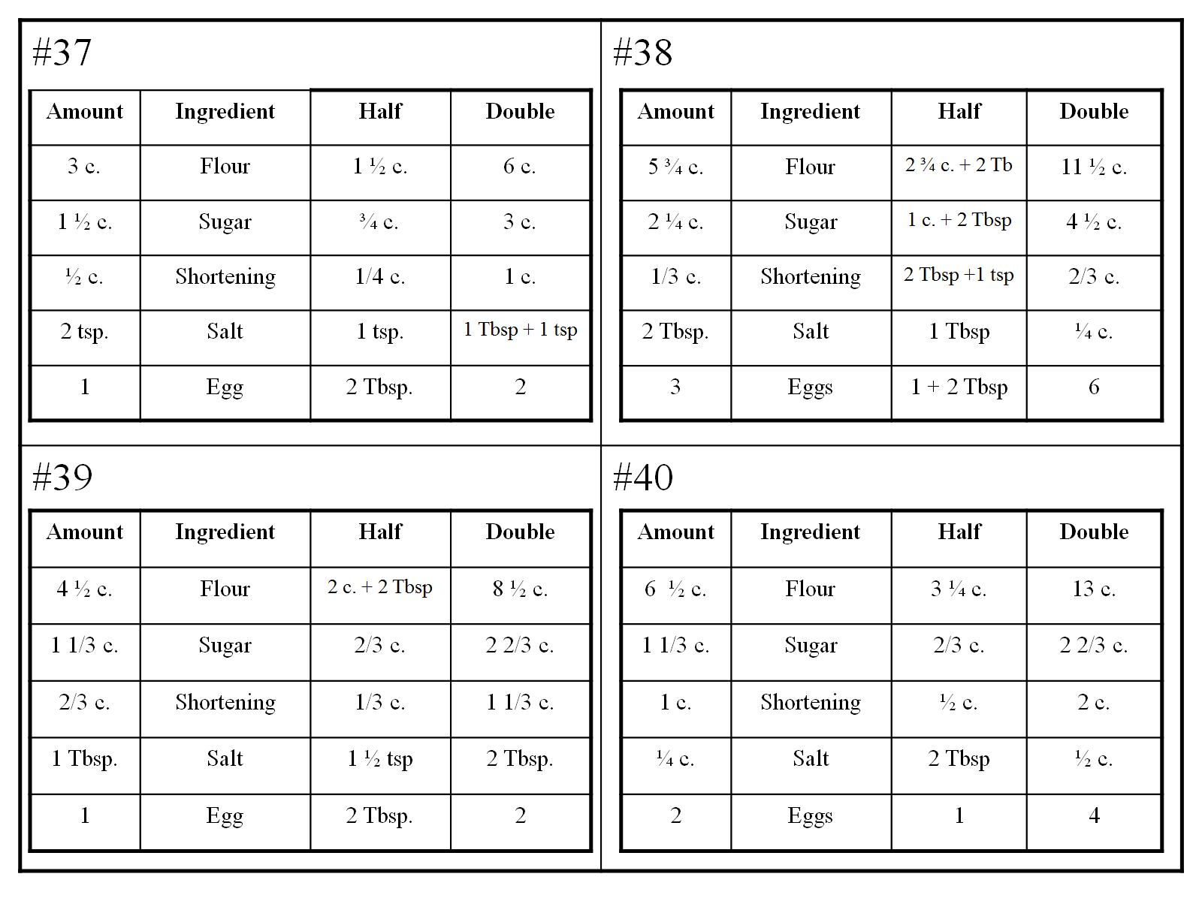

Slide 58
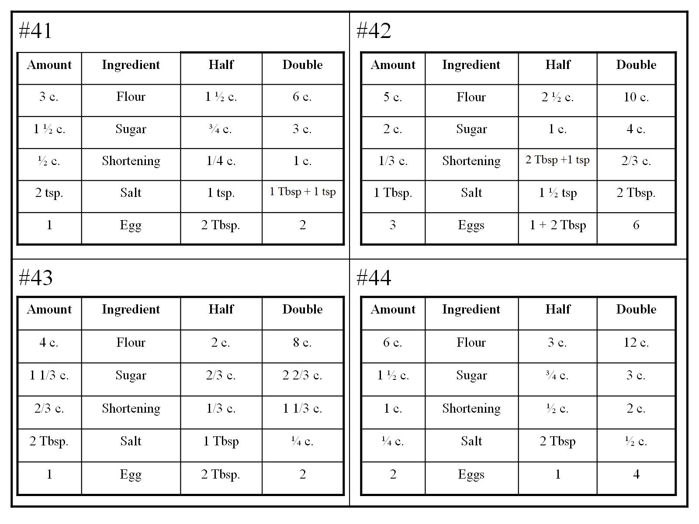

Slide 60
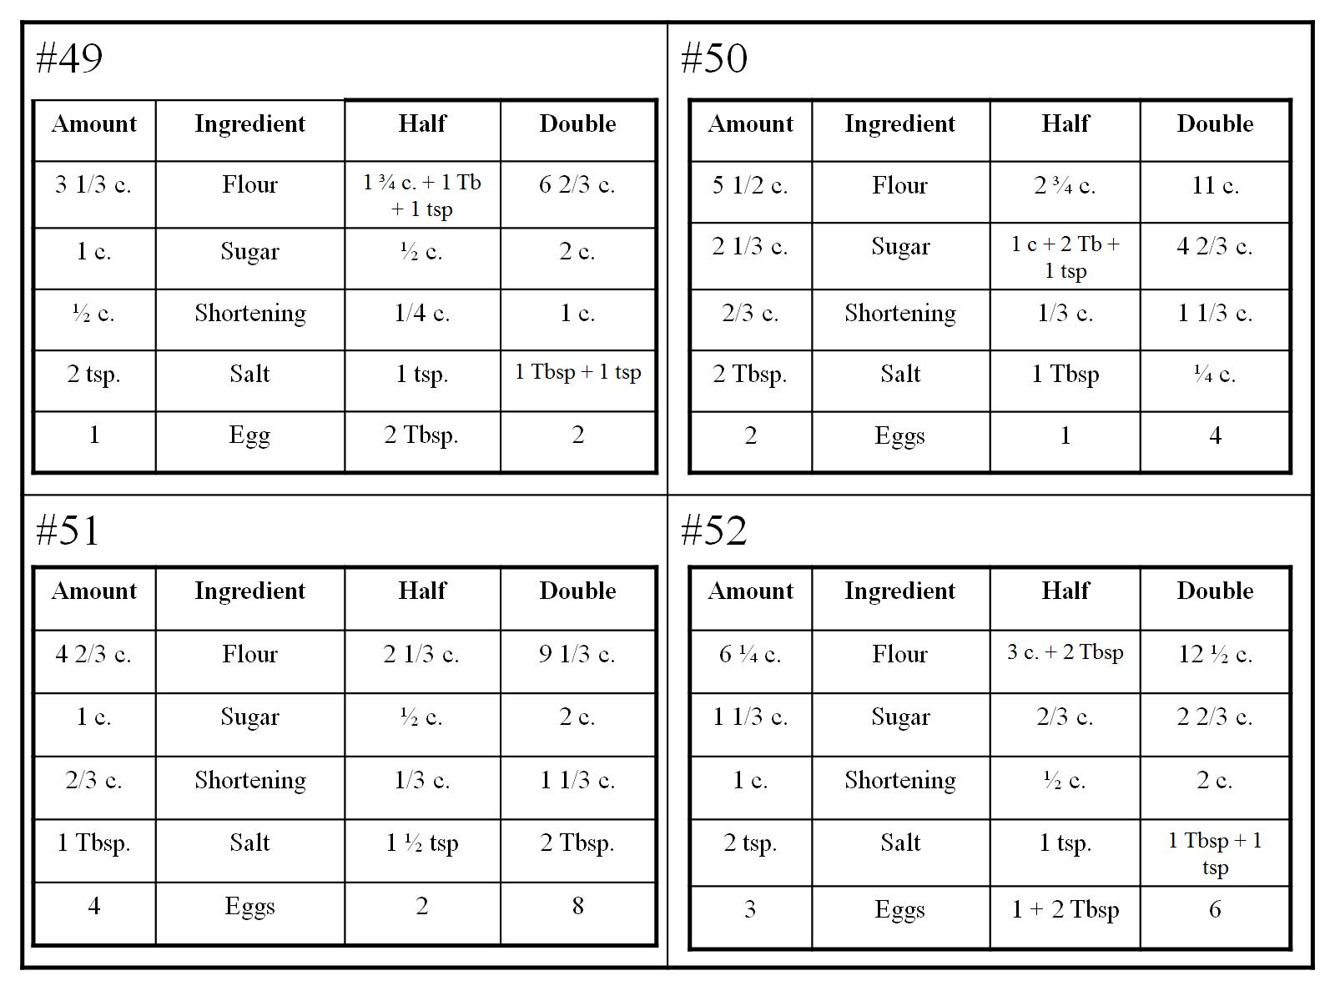

Slide 66
