Slide 1
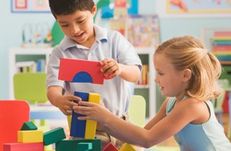
The Ultimate Block Party

Slide 2
Objectives
Setting Up For Block Play
Suggested Materials and Accessories
Block Play and Spatial Development
Cross Curricular Ideas with Blocks
Activities and Strategies

Slide 3
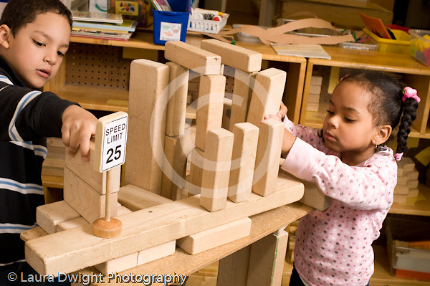
Small Group Activity
How Do Blocks Help Children Learn With?
Topics
Physical Development
Social/Emotional Development
Creativity
Cognitive Development
Math
Science
Language and Literacy

Slide 4
Physical Development

Slide 5
PHYSICAL
Coordination
Visual Perception
Motor Development
Spatial Orientation
Fine Motor Coordination

Slide 6
Social and Emotional Development

Slide 7
SOCIAL/EMOTIONAL
Competence
Success
Self Esteem
Autonomy
Initiative
Equality
Cooperation
Negotiation
Compromise
Responsibility
Leadership
Social Studies Concepts
Emotional Release

Slide 8
Creativity

Slide 9
CREATIVE
Associations
Relationships
Problem-solving
Finding New Solutions
Sensory Exploration

Slide 10
Cognitive Development

Slide 11
COGNITIVE
Symbolization and Representation
Comparisons
Classification
Concepts
Directionality
Sequence
Divergent Thinking
Logical Reasoning

Slide 12
Math Development

Slide 13
MATH
Area
Size
Order
Space
Shapes
Numbers
Mapping
Patterns
Measuring
Fractions
Operations
Estimating
Negative Space
Adding
One to One Correspondence
Seriation

Slide 14
Science Development

Slide 15
SCIENCE
Weight
Height
Gravity
Balance
Symmetry
Textures
Action/Reaction
Cause and Effect
Spatial Visualization
Simple Machines

Slide 16
Language and Literacy Development

Slide 17
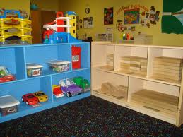
LANGUAGE/LITERACY
Labeling
Vocabulary
Recalling Stories
Creating/Dictating Stories
Sentence Structure
Making and Using Signs
Using Books as Resources
Using Writing

Slide 18
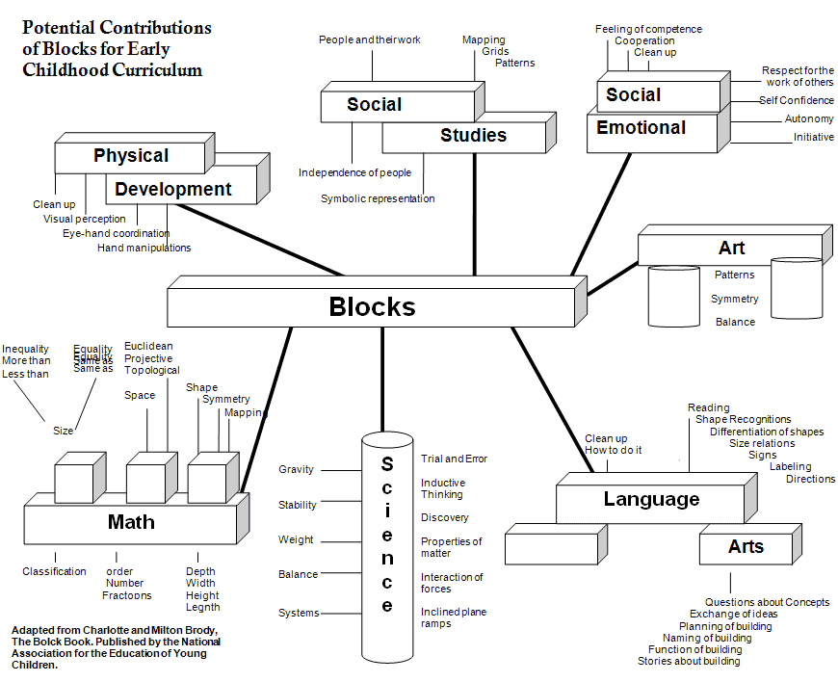

Slide 19
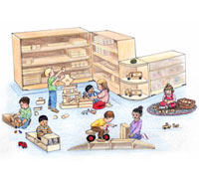
Setting up for Block Play
Materials Needed
Space Needed
Rules and Expectations

Slide 20
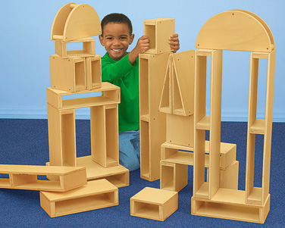
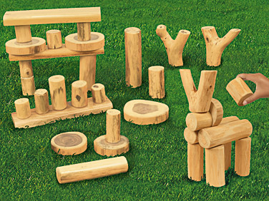
Materials Needed
Blocks
Different Sets of Blocks
Block Accessories
Block Storage and Accessibility

Slide 21
Types of Building Materials
Blocks
Accessories
Hollow Blocks
Unit Blocks (Hard or Soft)
Small Blocks (unit blocks)
Arch Blocks
Nature Blocks
Cars and Trucks
Buildings
Street Signs
Multicultural People
Animals
Trains and Tracks

Slide 22
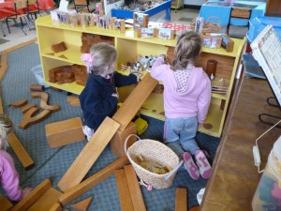
Space Needed
Is the block area in a location free from traffic?
Are the boundaries clear?
Are visual distractions minimized?
Are the blocks arranged on shelves orderly and attractively conductive to constructive play?
Is the area carpeted to reduce noise?

Slide 23
ECERS and Block Play
How does your Block Play Area Rate?

Slide 24
ECERS & Block Play
Do
Do Not
Have Enough Block Sets
Have atleast 20 Blocks per Child
Have plenty of Accessories
Enough Clean Floor Space for 3 Children
Blocks are Accessible for Daily Use
Organized and Labeled
Count Small Blocks as a Block
Anything that Links, can Velcro or is Magnetic

Slide 25
Group Activity
What Rules Do We Have in the Block Play Area?

Slide 26
Setting up Expectations
We build with blocks, not throw them.
You may knock down only the tower you build.
You may build as tall as you are.
We keep the blocks on the carpet.
We build away from the shelves.
We build away from others.
We take only what we will use.

Slide 27
Before, During & After
BEFORE
AFTER
Make sure Block area is organized
Include accessories related to current curriculum interests
Avoid setting out every accessory the school owns
Discuss their Creation
Clean Up Strategies???
Encourage Learning
Model
Make It Fun
Shelves, NOT Bins
Start Clean Up Early

Slide 28
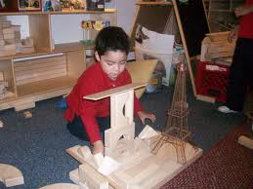
During: What’s My Role?
Facilitate
Encourage
Offer Suggestions
Avoid Taking Over
Be Patient
Document
Expand Curriculum
Language
Math
Science

Slide 29
Group Activity
What Conversations and/or Questions Are We Having in Blocks?

Slide 30
Examples of Conversations & Questions
I see that you used a lot of triangles in your building.
Your building is high in some places and low in some places.
You used some long rectangles and some short rectangles.
There’s a big square that you made with four rectangles.
How did you make this building?
How many blocks do you think you’ll need for your building?
How did it make you feel to build your structure?

Slide 31
More Examples
What did you use to make the ________?
How do you know this is a _______?
How are these ______the same?
How are these ______ different?
How did you get it to balance?
How did you make the bridge?
Can you think of a new way to ____?
Can you tell me a story about ____?
Pretend you are a ______? What would you be like? Feel like?
Which _____ do you like best? Why?
What is the best thing about ___? Why?

Slide 32
Break Time
Be back in 15 minutes

Slide 33
Partner Interview

Slide 34
Stages of Block Play
Stage 1 - Carrying Blocks, Piling
Stage 2 - Creating Rows or Towers
Stage 3 – Bridging
Stage 4 – Enclosures
Stage 5 – Building with Patterns
Stage 6 – Using Structures in Dramatic Play
Stage 7 – Building Representations

Slide 35
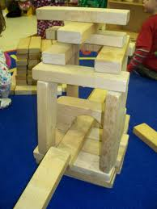
Basic Block Building Vocabulary
Rows
Patterns
Columns
Towers
Enclosures
Spaces

Slide 36
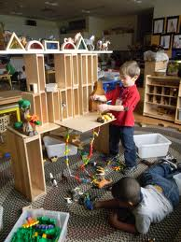
Expanding Curriculum in Block Play

Slide 37
Understanding Spatial Awareness
Spatial awareness is usually defined that child will understand his/her location and the location of objects in relation to his/her body.
The key to promoting spatial awareness in children is to allow them to explore their surroundings. As children become more mobile, they are able to crawl and later walk to objects and gain for themselves an understanding of how many steps it takes them to reach a given object or a given location.
Promoting Spatial Awareness
Discussing locations
Using comparative terms
Talking about relationships.
Measuring distances.
Giving directions

Slide 38
Blocks and Math
What Activities Are We Using Math in Blocks?

Slide 39
Math Activities
Sorting Activities
Shape and Pattern Boards
Number Boards
Tape Measure
Domino Effect

Slide 40
Science Activities
What Activities Are We Using Science in Blocks?

Slide 41
Science Activities
Scientific Method
Physics (Ramps and Pathways)
Animals
Farms
Dinosaurs
Zoo
Nature Blocks
Pulleys

Slide 42
Language Activities
What Activities Are We Using Language in Blocks?

Slide 43
Language Activities
Vocabulary, Vocabulary, Vocabulary
Traffic Signs
Labels
Oral Communication
Open Ended Questions
Follow the Directions
Creating or Retelling Stories
Drawing and/or Writing

Slide 44
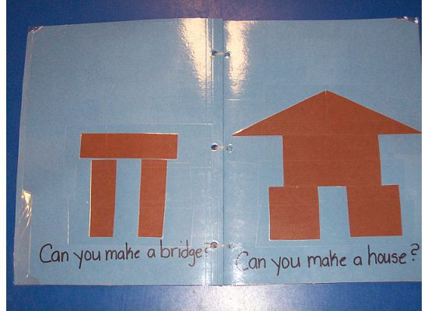
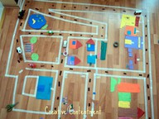
Examples
Literacy Block Book
Masking Tape Town

Slide 45
Other Curriculum Areas
What Activities Are We Incorporating Other Curriculum in Blocks?

Slide 46
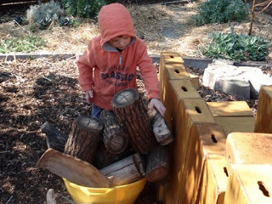
Additional Activities
Arts
Props (Dramatic Play)
Creative Insight
Paper and Crayons
Social Studies
Geography and Maps
Neighborhoods
Jobs and Careers
Outdoor Play
Gross Motor
Nature Blocks

