Slide 1
Nutrition 1020
Interactive Notebook

Slide 2
katherine.borgmeier@jordandistrict.org
I apologize for not being here to present this in person. Here is a small sample. Most of these foldables I found using a Google search, die cut available at my school or the following website:
http://www.homeschoolshare.com/lapbooking_resources.php
If you have any questions, please don’t hesitate to contact me. I am happy to share what I have created.
Thanks!

Slide 3
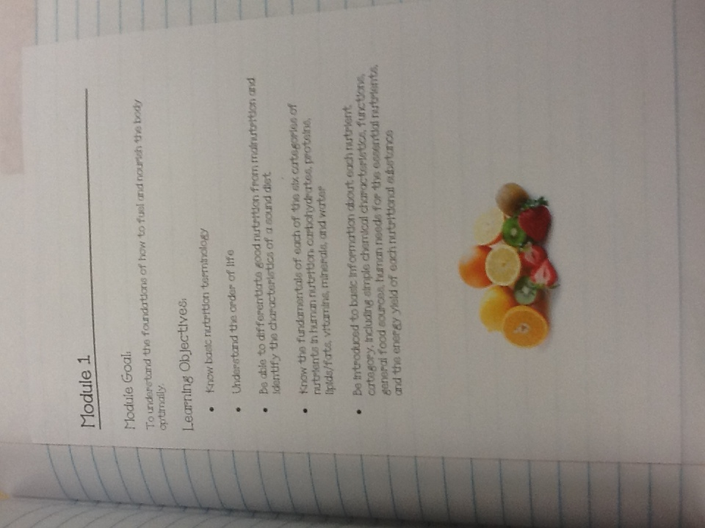
Every unit starts out with the Module Goal and Learning Objectives.

Slide 4
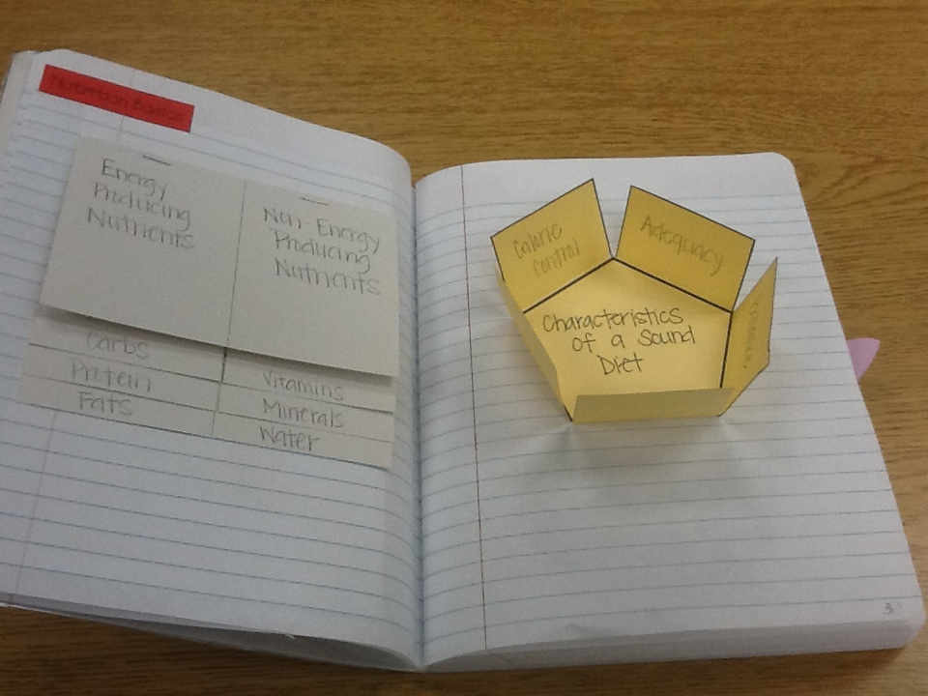
Module 1 Examples

Slide 5
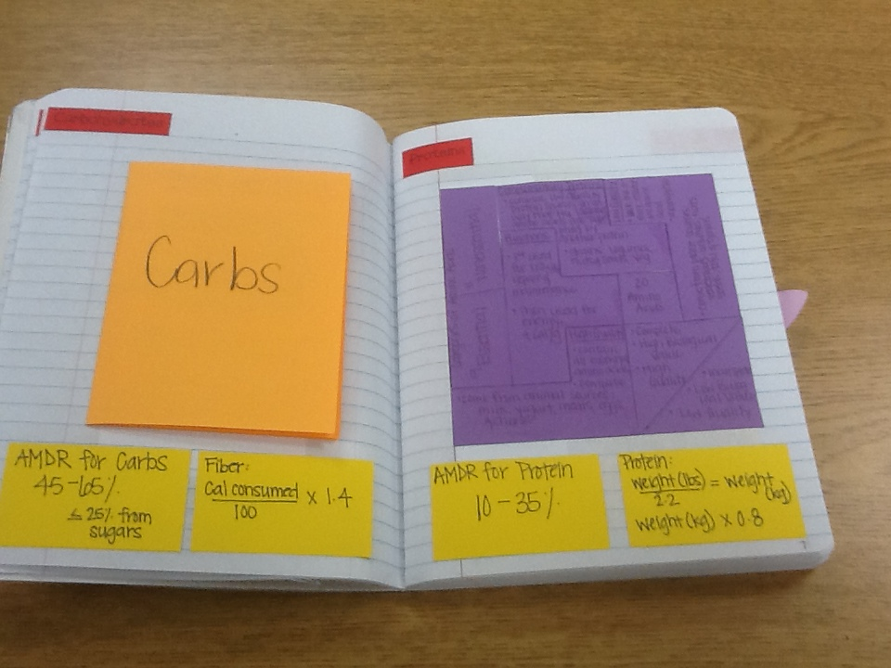
All of the important info to remember is on the yellow cards.

Slide 6
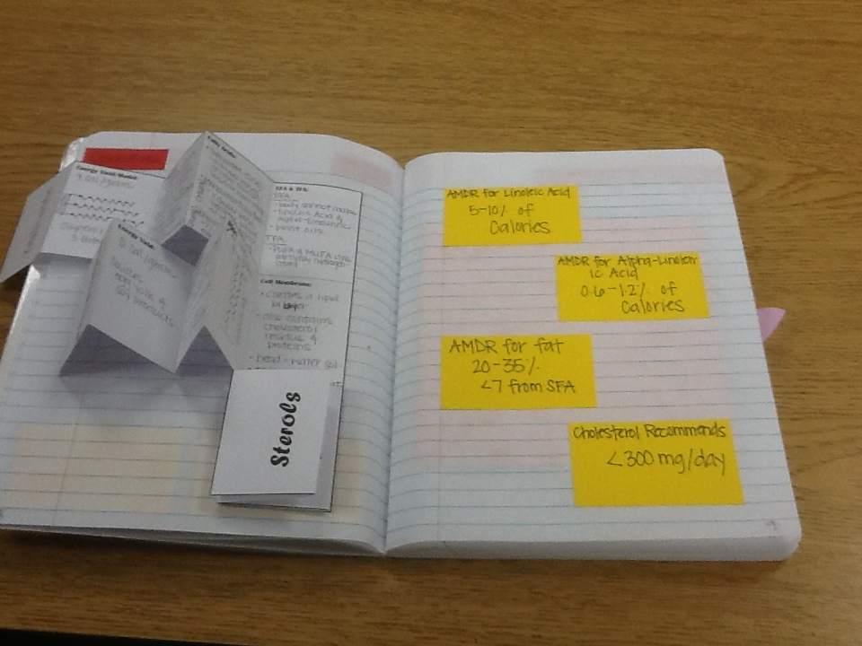
More from Module 1

Slide 7
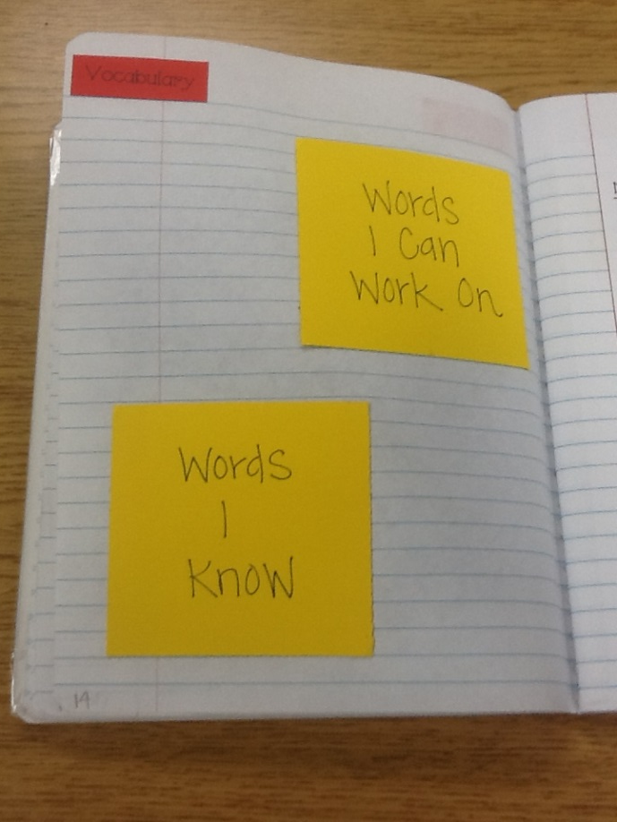
At the end of each unit is a place for student summary and vocabulary

Slide 8
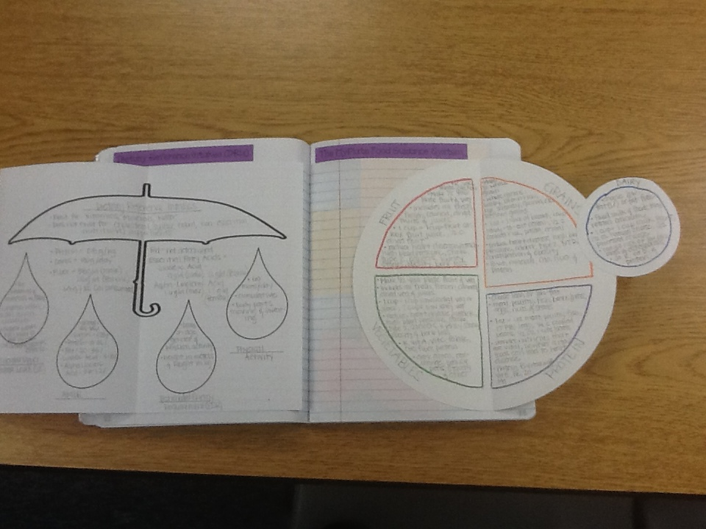
Other Examples – DRIs and MyPlate

Slide 9
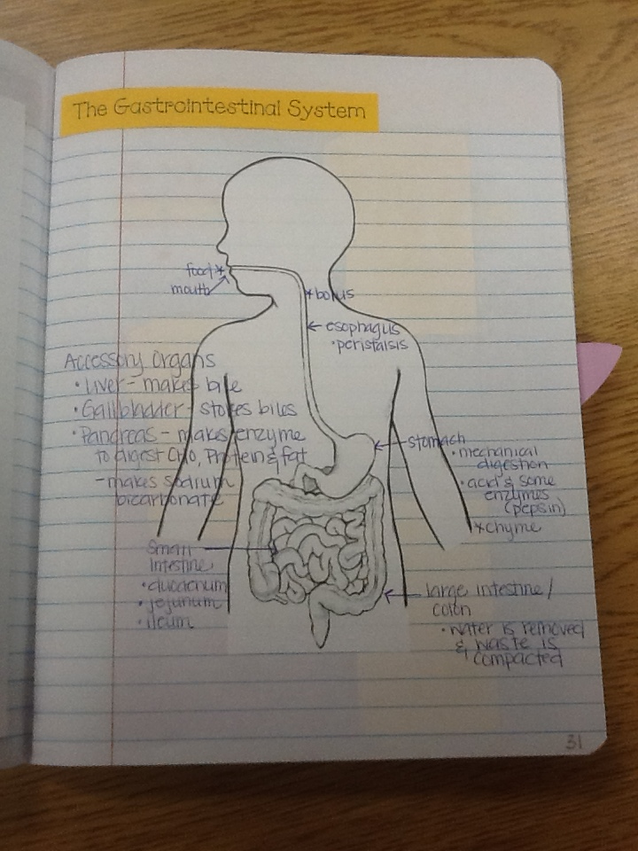
Digestion

Slide 10
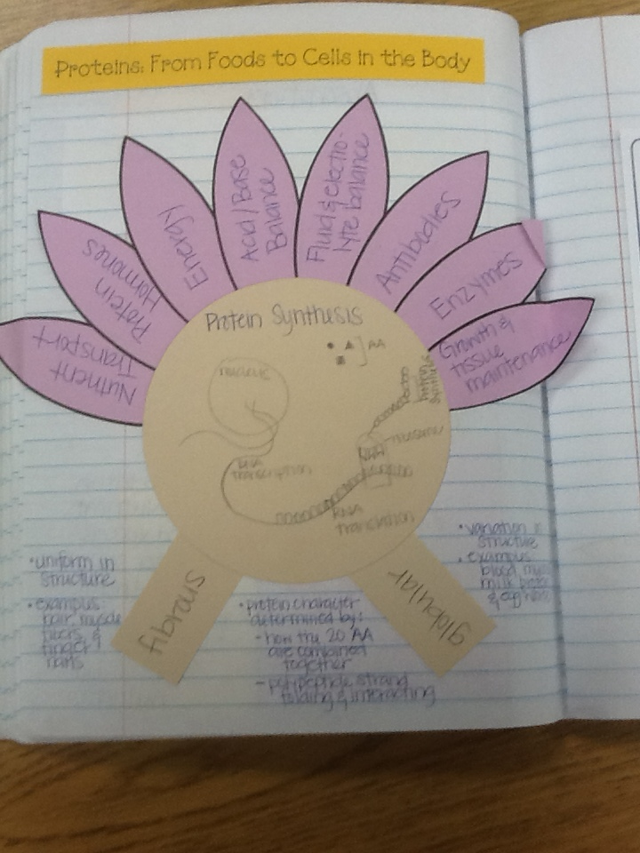
Protein Synthesis & Functions

Slide 11
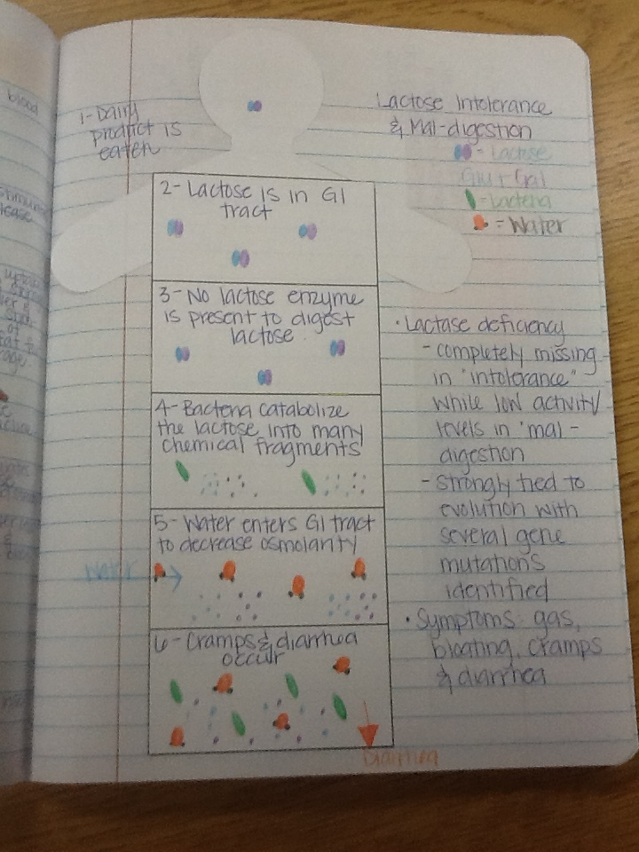
Lactose Intolerance & Mal-digestion

Slide 12
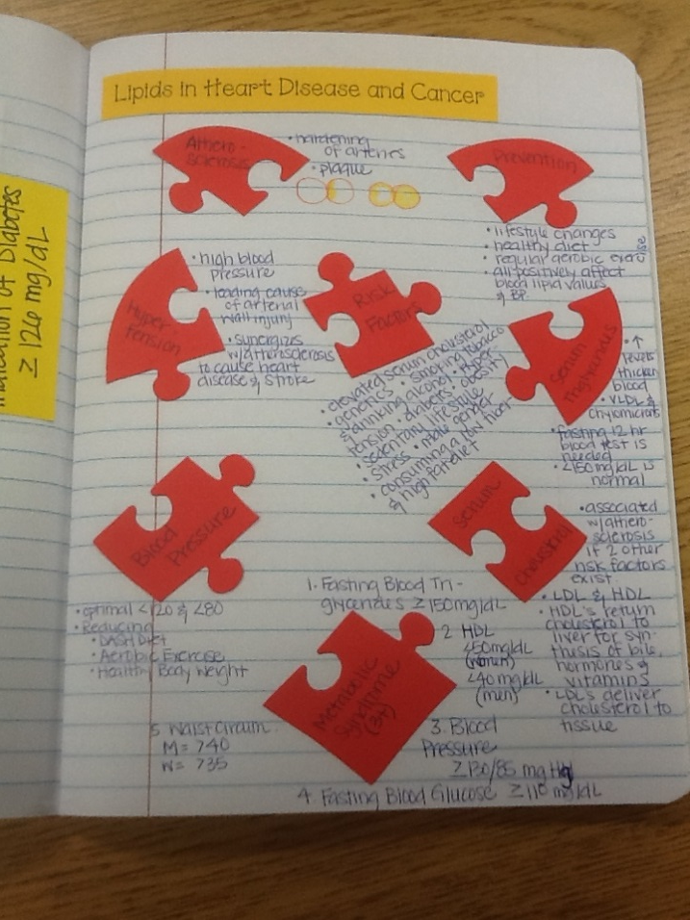
Heart Disease
This is a puzzle die cut that is shaped like a heart. On each piece is something that can lead to a “broken heart.” For example: risk factors, hypertension, atherosclerosis, etc.

