Slide 1
RENDERING
HOW DO I DO IT?

Slide 2
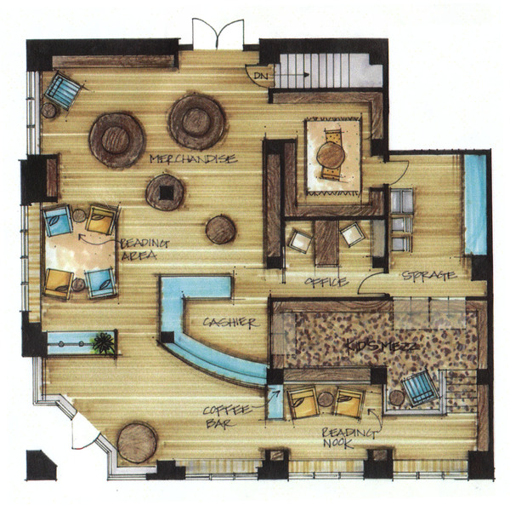
what is it?
https://www.behance.net/gallery/Interior-Design-Renderings/3043861

Slide 3
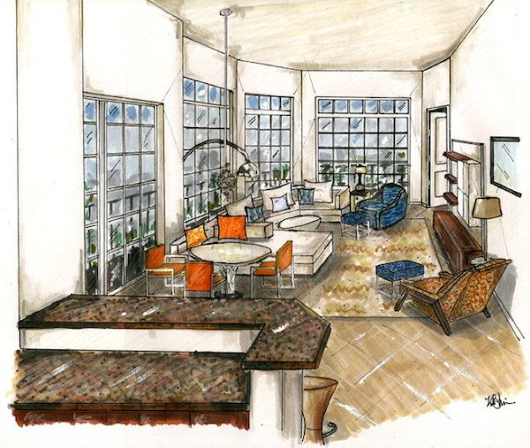
Taking your Creative thinking to Powerful images on paper
http://garrisonhullinger.com/2013/01/17/interior-design-renderings/

Slide 4
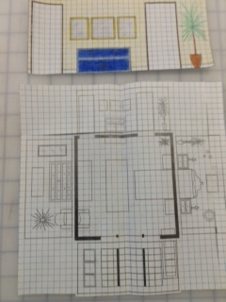
Where do I Begin?

Slide 5
Begin with tools
Tools – MARKERS
Wedge
Fine Pt., Extra Fine Pt. (.005)
Contoured
Brush
PENCILS
PENS
Taken from MARKER RENDERING by Bina Abling
from the Parsons School and Design

Slide 6
LINES

Slide 7
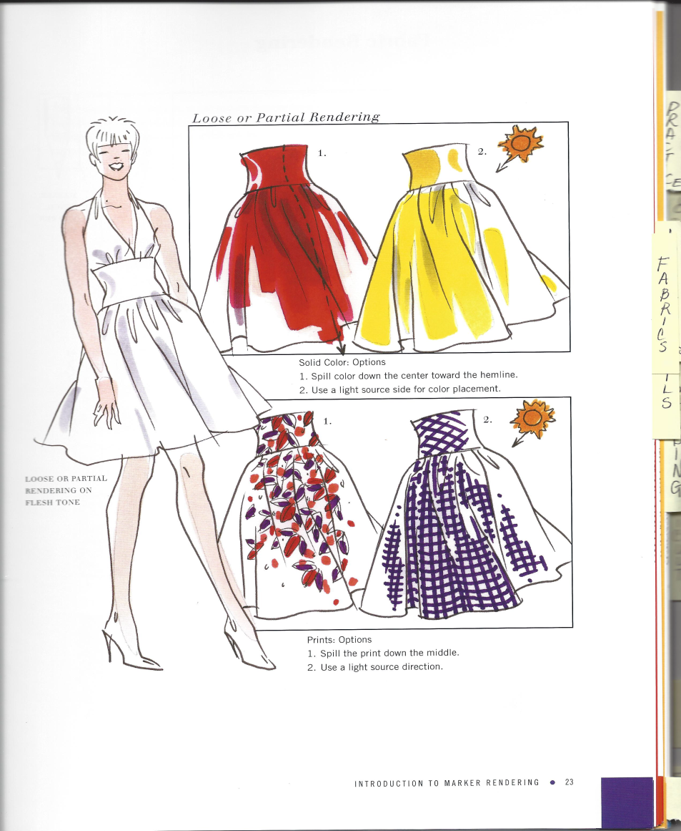
methods
TIGHT VS LOOSE

Slide 8
shading

Slide 9
Shading + Color

Slide 10
Geometric lines

Slide 11
Geometric patterns

Slide 12
And more . . .

Slide 13
Solid Fill

Slide 14
Work in sections

Slide 15
patterns

Slide 16
Partial rendering

Slide 17
Wood flooring

Slide 18
Non-resilient flooring

Slide 19
Glass and pottery

Slide 20
fabrics

Slide 21
Layered patterns

Slide 22
Heavy & sheer fabrics

Slide 23
textures

Slide 24
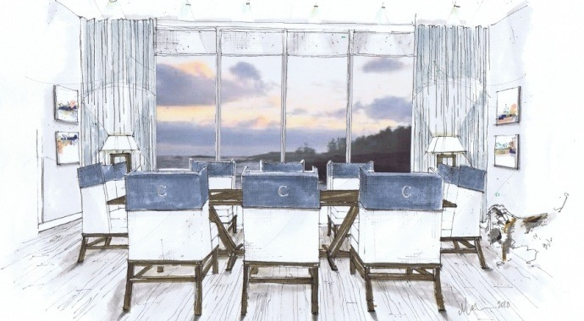
You can do it!
http://www.wsidesignermarketplace.com/content/designer/Design_Blog/2013/09/how_to_do_interiord.html

Slide 25
Helpful resources
Marker Rendering by Bina Abling
Creating a Room by Charlotte Moss
Exploring Perspective Hand Drawing
by Stephanie M. Sipp
Quick Sketch

Slide 26
Suggested Assignments
1. Measure student’s bedroom, place on ¼” graph paper. Draw in furniture with ¼” house furnishing templates, then draw and design walls. Render one wall. Transfer to 1” graph paper, build from foam core (floor and 3 walls) then design.
2. Give students 1 room, draw in furniture and render.
3. Use condo, draw in furniture, render.
(Use a magazine picture as “inspiration”)
4. Design a line of furniture – 1 room, 3 pieces of furniture. Render and indicate what materials would be used to build this furniture.

