Slide 1
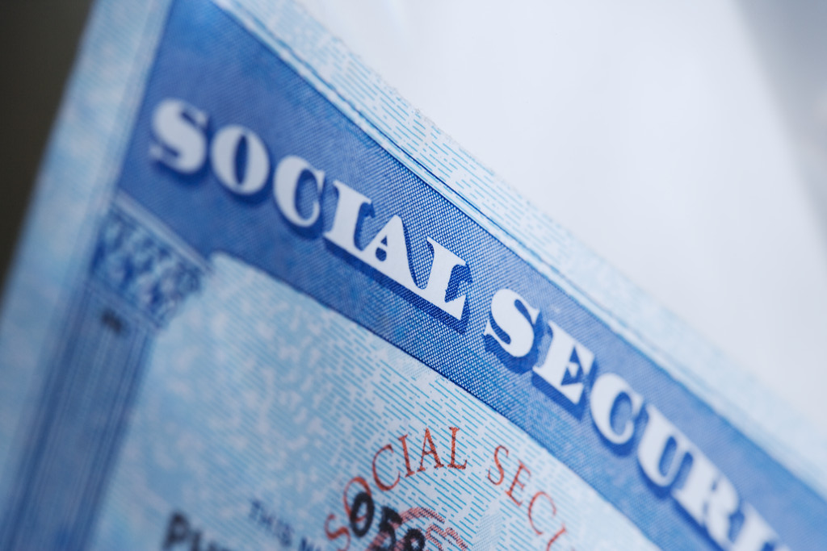
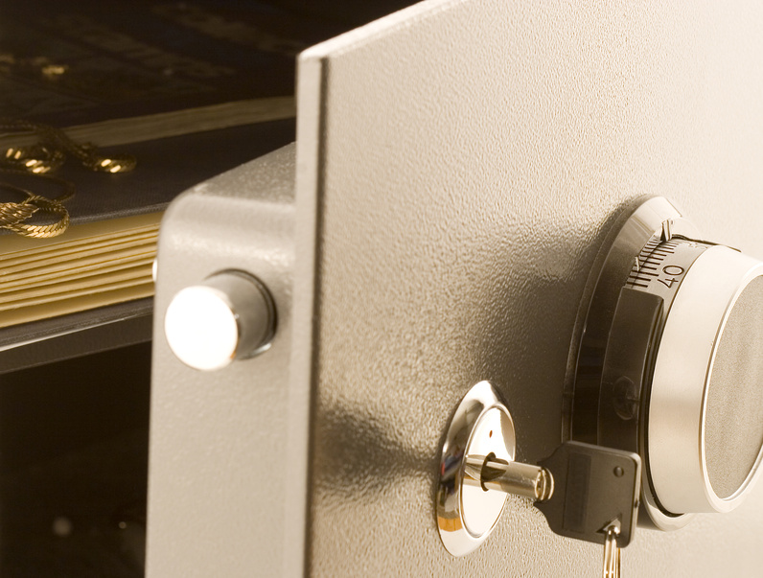
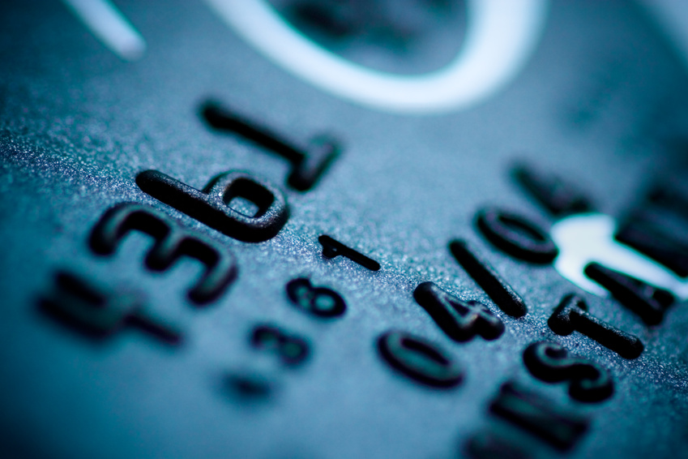
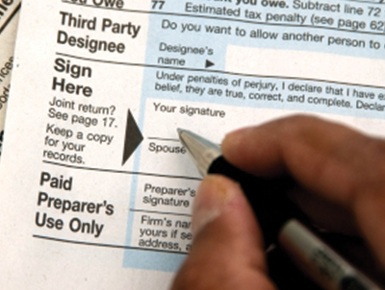
Identity Theft- Could it happen to me? Teens and ID Theft
Utah State University Extension
Presented by Marilyn Albertson
Utah State University
Extension Associate Professor – FCS/4-H Salt Lake County
Developed by Lucas Martin & Marilyn Albertson
extension.usu.edu

Slide 2
Identity Theft
What is Identity Theft?

Slide 3
What is Identity Theft?
the illegal use of someone else's personal information (such as a Social Security number) in order to obtain money or credit.
*http://www.merriam-webster.com/dictionary/identity%20theftt

Slide 4
Teens are you at risk?

Slide 5
What Identity Theft Looks Like Now
Children are 35 times more likely to be targeted as adults. 1
Nearly 78 million confirmed data breach thefts in 2014 so far. 2
25% of data breach victims become ID theft victims. 3
1. May, J. (2012). Child ID theft report 2012.
2. ID Theft Center, 2014 Data Breach Report. 3. Javelin Strategy and Research (2013). Identity fraud report 2014.

Slide 6
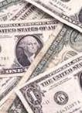
What will they do w with your identity?
Create new identities
Spend your money
Checking account
Credit
Tax returns
Obtain new credit
Cars
Homes
Rentals, utilities, phone, employment, criminal activities etc.

Slide 7
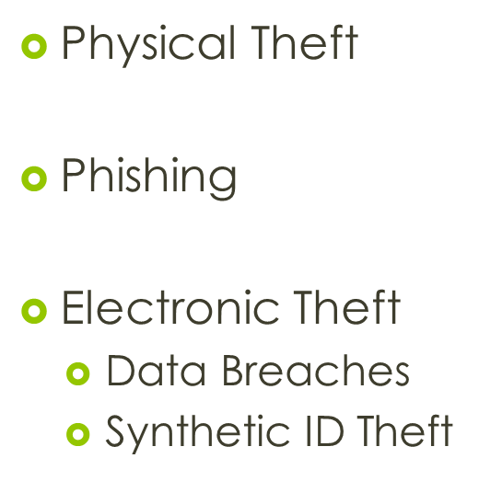
ID Theft Continuing to Evolve

Slide 8
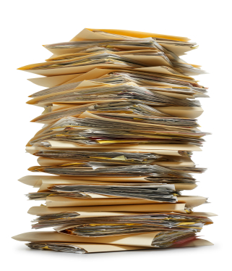
How Can your Identity be stolen ?compromised
Physical ID Theft

Slide 9
Traditionally
50% know the victim 1
In the past most ID theft took place offline. 1
13.1 million reported cases in 2013 (11 million in 2011). 2
Top FTC complaint for the last 13 years. 3
1.National Crime Prevention Council (2005). Preventing identity theft: A guide for consumers. 2. Javelin Strategy and Research (2013). Identity fraud report 2014. 3. FTC (2014). Top 10 complaint categories for 2013.

Slide 10
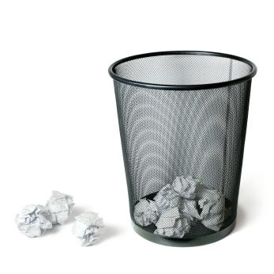
Where do they get it?
Mail Theft
Watch billing cycles for important bills
Credit card applications, insurance offers, business records
Personal details
Dumpster Diving
Personal Theft
Home
Car
Person
Work
US Department of Justice (n.d.). Identity Theft and Identity Fraud.

Slide 11
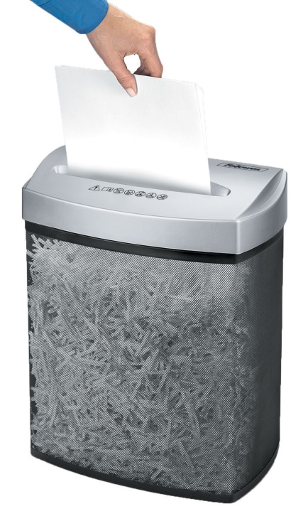
How do I protect my identity?
Physical Protection
Shred:
Name
Address
SS#
Birthdate
Account Numbers
Personal contact information (phone numbers etc).

Slide 12
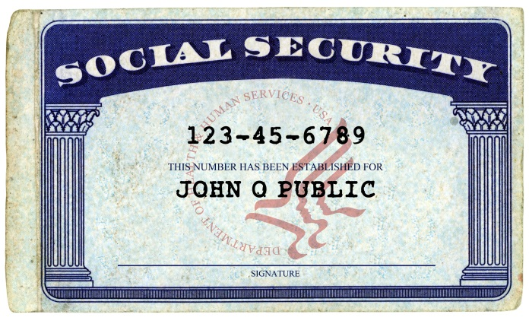
Wallet or Purse
Don’t keep in your wallet/purse:
SS Card
PIN/passcodes
Only carry essential documents
Make a copy:
Credit Cards
Identification
Insurance/Medicaid cards

Slide 13
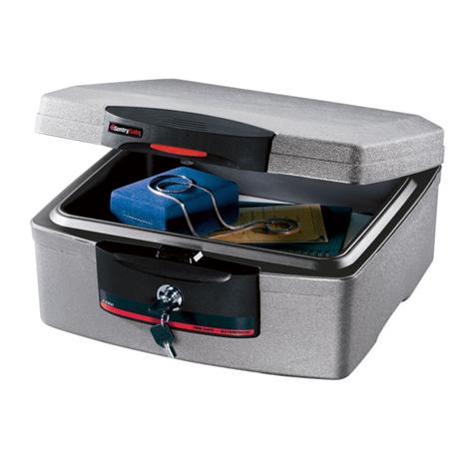
Protect in Your Home
Location, Location, Location.
Storage
Emergency Financial Binder
Out of sight, safe place
Locked
File cabinet
Room
Desk

Slide 14
Phishing

Slide 15
(Phishing) & Scams
Phishing – pretending to be financial institutions on the internet
Malware – Malicious software affects computers to capture personal information via the internet
Social Engineering – tricking a person into revealing information, memorizing access codes and passwords by shoulder surfing, pretending to be landlord, employee , loan officer to obtain your credit report

Slide 16
Mail and Computer Sources
Mail
Credit card offers
Lotteries/prizes
Fake Credit/Insurance Offers
Email
Phone
Social media

Slide 17
Social Media
Facebook
Twitter
LinkedIn
-Their purpose is to share information with others in your network – friends, relatives, etc. ID fraudsters will “like” what you are posting and make you a victim. Be careful sharing key bits of information that will make it easier for them to apply for a loan in your name or fool a customer service representative.

Slide 18
Mobile Phones
Tweat, share photos on Instagram, Facebook updates
Buy games and other apps
Handle online banking
Don’t share full address or phone number online.

Slide 19
Bank Accounts and Credit Cards
Keep your account information and pin numbers to yourself.
Example: Don’t give ATM card and pin to friend to handle transaction at ATM.
*Shred credit card numbers
*Check credit with your parents
Identify any problems on your credit report
Contact Police, bank, Attorney General’s office IRIS immediately

Slide 20
How to Prevent Identity Theft?
Vender Transactions:
Be careful when swiping debit or credit cards and signing. If it is a touch pad, rub hand over touch pad after transaction has gone through to erase signature or pin number.
Computer:
Never leave personal information on a computer without a firewall in place
Never keep passwords to financial data on computer
Be cautious what you post on public computers, on social media sites – facebook, etc.
Mail:
Always shred unused credit card offers, unused convenience checks, and other mail with identifying information

Slide 21
Prevention
Never keep ATM or credit card, debit card pin numbers in your wallet or car
Have a lock on cellphone if store pins and passwords on phone
Never use mother’s maiden name, last 4 digits of Social Security number, birthdate, pet’s name or easily recognized letter, numbers as pin or password

Slide 22
Protection on the Internet
Be very cautious when posting information online
Social Security Number
Drivers License Number
State ID number
Banking information
Student ID number

Slide 23
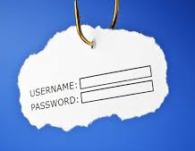
Avoid Phishing
Be a skeptic
Call them back
Research online
If you didn’t ask for it…
Don’t click links
Example: Calls about default on taxes and threats of being arrested

Slide 24
Avoid Phishing
Opt out
Mail, Insurance, Phone Calls, and Emails that use credit bureaus
www.optoutprescreen.com
National Do Not Call Registry
https://www.donotcall.gov/

Slide 25
Review Documents
Credit Cards
Review credit cards transactions every month for unusual activity or errors
Shred expired credit cards before putting in the trash
Mail
Install a locking mail box
Mail all payment and documents at the post office, not in your mailbox

Slide 26
Electronic Theft
Delete electronic computer files you no longer need, empty online trash or recycle bin.
Remove personal information from computer, cellphone or other device before disposing of it.

Slide 27
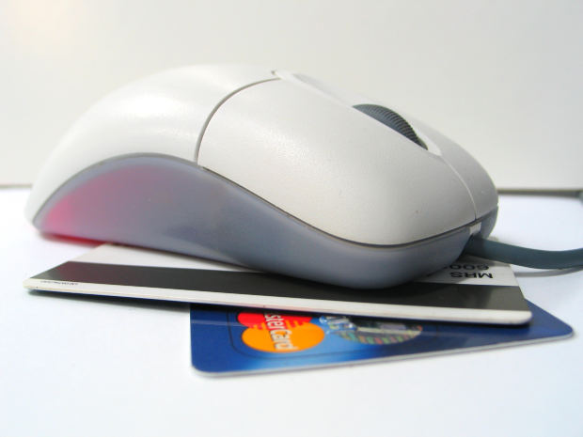
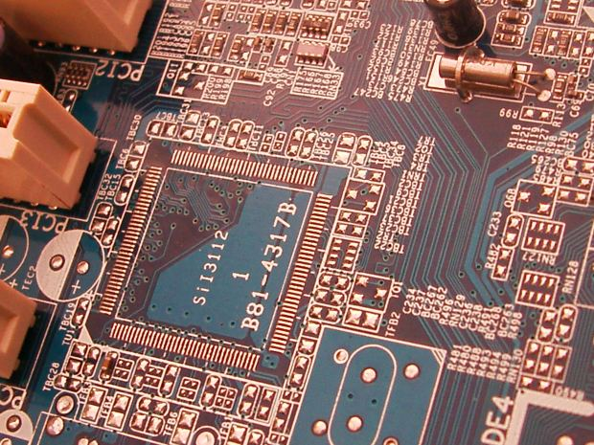
Where do they get it?
Electronic Theft
Physical Locations
Credit Card readers (number, exp date, name)
ATM
WIFI
Online Theft
Hackers
Your computer
A Business Computer
Online Purchases
Credit vs Debit

Slide 28
Electronic Protection
Internet Firewalls and Virus Detection
Run full scans weekly
Strong passwords.
Fraud Alerts
Minimize Accounts

Slide 29
How to Catch it?
Keep and reconcile receipts
Check your credit report

Slide 30
Data Breaches /Synthetic Theft
Mountain West Medical Center in Tooele
Home Depot
Albertsons
JP Morgan
Summit County Fair
American Federation of Government Employees
WHAT DO THEY ALL HAVE IN COMMON?

Slide 31
October 2014 to 2015
621 reported breaches
77,890,487 confirmed records compromised
4,000,000 current and former federal employees data breach
Identity Theft Resource Center- 2014; Data breach report, Fox News Politics Webpage June 12, 2015

Slide 32
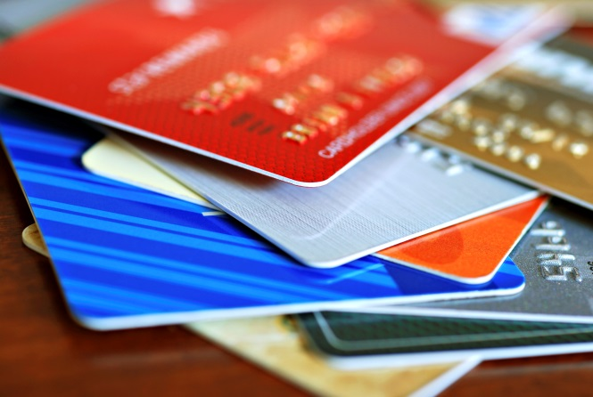
If you are a victim - Bad News
Credit Card number stolen
Act quickly to have your lender reissue compromised cards
Change:
Credit card #
Debit card #
Bank account numbers

Slide 33
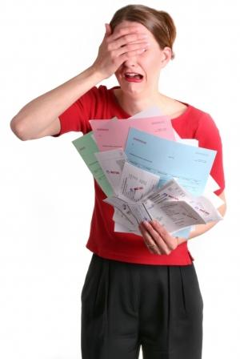
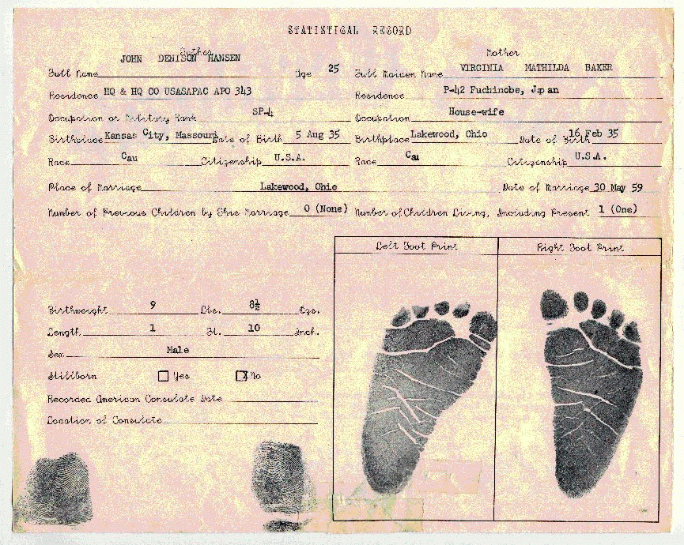
Worst News
Someone has stolen a child's or Teens:
Name
Address
Birthdate
Social Security Number

Slide 34
Why your identity – Child or Teen?
Your credit is unmonitored
Your credit is a blank slate
Your are perfect for synthetic identity theft
2012 study found 10.7% of children had been victims

Slide 35
Synthetic Identity Theft – Teens Chi
Combining real and fake information to create new identities.
For example:
Fake Name + Your SSN
Real Name + Your SSN
Synthetic ID theft is much more difficult to find and resolve.
100% growth in synthetic ID theft over last 3 years.

Slide 36
How do I know ?
How can you or your parents know if you have had your identity stolen:
Utah Attorney General
IRIS: CIP (Child Identity Protection)
Minor Credit File Check (Be sure to check by age 16)
Request from each credit bureau
Suspicious mail and phone calls asking for you

Slide 37
What if I am a victim?
Identity Theft Report
IRIS- Links to help you
FTC- complaint, affidavit
Police report
With complete ID theft report:
Credit freeze
Pull credit reports
Contact lenders/credit issuers
Contact appropriate agencies

Slide 38
If a Victim Continued
Keep a file
ID theft report
Documents from lenders on bad accounts
Proof of resolved issues
Change:
Account numbers and card numbers
Account passwords
Monitor:
Bank and credit card statements
Credit history

Slide 39
Protect Yourself
Thank You
Questions?
Contact me for more information at:
Marilyn.Albertson@usu.edu
Phone: 385-468-4836

Slide 40
Resources
http://www.foxnews.com/politics/2015/06/12/union-hackers-have-personnel-data-on-every-federal-employee/
http://www.idtheftcenter.org/id-theft/teen-space.html
Utah Office of Attorney General, http://attorneygeneral.utah.gov/ For Identity Theft Information and IRIS and CIP programs.
MoneyWatch January 13, 2014 http://www.cbsnews.com/news/target-data-breach-9-ways-to-protect-yourself/
Know How Identity Theft Occurs
http://www.smartaboutmoney.org/Your-Money/Daily-Decisions/Know-How-Identity-Theft-Occurs.aspx
Books: Stealing Your Life – Frank W. Abagnale
Video clips : Identity theft is not a joke, Jim! – Dwight from The Office * https://www.youtube.com/watch?v=Utu5SnO9PIg or short version https://www.youtube.com/watch?v=RC5imk9sG1M

Slide 41
Resources
“Protecting Your Child’s Personal Information at School” and “Safeguarding Your Child’s Future”. http://www.ftc.gov/news-events/press-releases/2012/08/ftc-advises-parents-how-protect-kids-personal-information-school
https://postalinspectors.uspis.gov/investigations/MailFraud/fraudschemes/mailtheft/IdentityTheft.aspx
http://www.consumer.ftc.gov/articles/0274-immediate-steps-repair-identity-theft
http://www.consumer.ftc.gov/articles/0171-medical-identity-theft#protecting

