Slide 1

Parenting Teens!!Are we having fun yet???
Ideas taken from
“Parenting With Love and Logic”
by
Foster Cline & Jim Fay
GaeLynn Peterson, M.S
USU Extension Assistant Professor
FCS / Youth Development
Wayne County, Utah
Notes:
This template can be used as a starter file for presenting training materials in a group setting.
Sections
Right-click on a slide to add sections. Sections can help to organize your slides or facilitate collaboration between multiple authors.
Notes
Use the Notes section for delivery notes or to provide additional details for the audience. View these notes in Presentation View during your presentation.
Keep in mind the font size (important for accessibility, visibility, videotaping, and online production)
Coordinated colors
Pay particular attention to the graphs, charts, and text boxes.
Consider that attendees will print in black and white or grayscale. Run a test print to make sure your colors work when printed in pure black and white and grayscale.
Graphics, tables, and graphs
Keep it simple: If possible, use consistent, non-distracting styles and colors.
Label all graphs and tables.

Slide 2
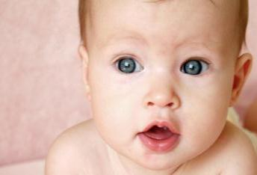
Are we having fun yet?
“We become parents with optimism oozing from every pore. During late – night feedings and stomach churning diaper changes, we know we are laying the groundwork for a lifelong relationship that will bless us when our hair turns gray. We look forward to times of tenderness and times of love, shared joys and shared disappointments, hugs and encouragement, words of comfort, and soul-filled conversations – children hanging on every word dropping from Mommy’s or Daddy’s lips.”

Slide 3
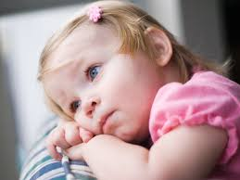
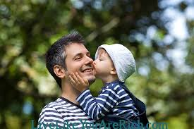
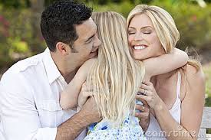
All too soon, this…………….

Slide 4
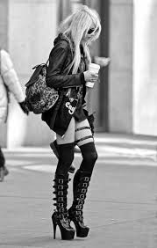
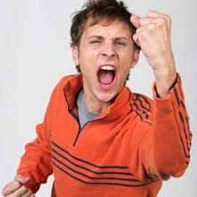
Becomes this…..

Slide 5
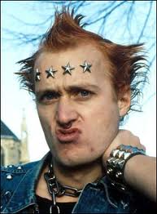
Or maybe this……………

Slide 6
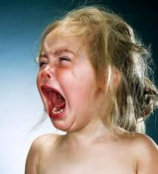
And you wish you could go back to this…………..

Slide 7

But all you can do is this…….

Slide 8

Disclaimer…..

Slide 9
Love & Logic
A Win-Win Philosophy
Parents win:
Love in a healthy way without resorting to anger and threats
Children win:
Learn responsibility and the logic of life by solving their own problems and learning how to cope with the real world

Slide 10
Supreme Goal of Parenting
Raise Responsible Children – children who have been equipped with tools that will enable them to make wise choices throughout life.
Notes:
We will remember this as we go through the slides..

Slide 11

Ineffective Parenting Styles
Helicopter Parents
  Hover, then rescue
  The perfect world is one in which their kids never have to face struggle, inconvenience, discomfort or disappointment
  Blame others for lack of success
  Kids are unable to cope with the real world
  Message to child is “You are fragile and can’t make it without me”
Drill Sergeant Parents
  Kids constantly told what to do
  You will do it or else!
  Filled with put-downs and I-told-you-so’s
  Children are more susceptible to peer pressure
  Message to child is “You can’t think for yourself so I’ll do it for you”.
Notes:
What will the audience be able to do after this training is complete? Briefly describe each objective how the audience will benefit from this presentation.

Slide 12
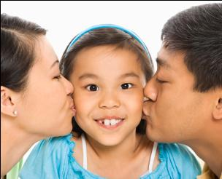
Effective Parenting Style
The Consultant Parent
  Sets and maintains enforceable limits and expectations
  Choices given within those limits
  Natural consequences with empathy are allowed
Notes:
What will the audience be able to do after this training is complete? Briefly describe each objective how the audience will benefit from this presentation.

Slide 13
So How do we do it??????
Teenagers are similar to 2 year olds – only with harmones and wheels
Want independence
Want to make choices
Change from concrete (black and white, literal) to abstract thinkers
They will be enjoyable again - if we let them live!

Slide 14
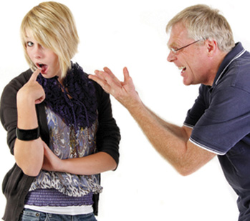
Put an end to arguing…..
Focuses on the anger
Don’t reason with arguing kids
Secret is to go brain dead
Use “one liners”
It takes two to argue

Slide 15
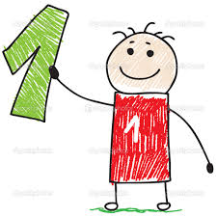
The number 1 rule for parents in Love and Logic is:
Take care of yourself!!!!
You tell the child how you are going to take care of yourself and run your life and don’t tell the kid how to run his. This will force him into a decision making mode where he starts thinking for himself – even around peers.

Slide 16
Love and Logic Theory
Use enforceable statements – set limits or expectations.
Let them make choices within those limits.
-Anybody is happier when they can make their own choices
-earlier the better
-Making good choices is like any other activity – it has to be learned! And one sure fire way of learning is by allowing the consequences of the choice to occur!

Slide 17
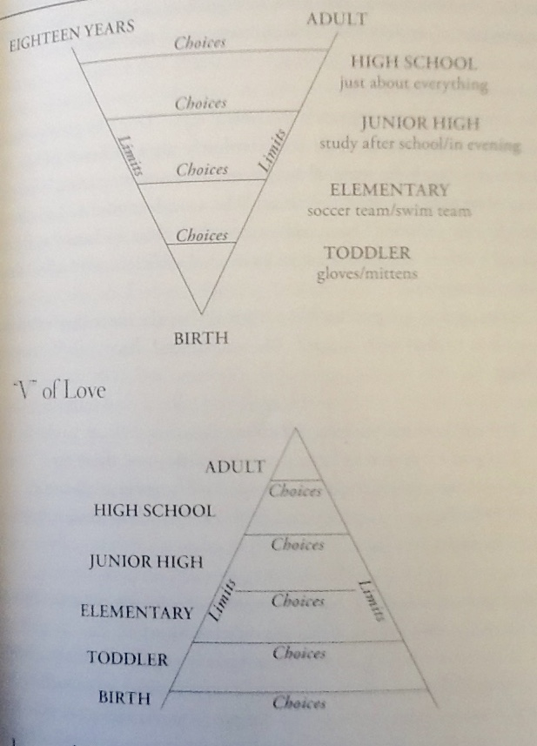
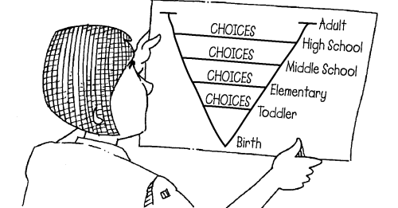
The V of Love

Slide 18
3. Let consequences accompanied with empathy teach the lessons
Lessons are internalized when accompanied with empathy
If anger is used, kid focuses on the anger – that becomes the lesson..
With empathy, the situation becomes the bad guy, not the parent

Slide 19
Situations:
Homework – grades (70%, I’ll love you anyway)
Late for school
Not doing chores (mom reading)
Picky Eaters
Curfew
Car antics
Driving (Jim’s ideas, Research)
Dating
Stealing

Slide 20
It’s Okay to Delay
“This is really upsetting - I’m not sure what to about this so I’ll get back to you – but try not to worry about it.”
Kids as well as parents learn more when they have some time to think about it

Slide 21

Too much time on devices
Set Limits
- no phones at table
- device time is from 6:00 to 8:00
- no devices at bedtime
Adjust data plan
Remove the offending object
Extra time?

Slide 22
Some Parting Thoughts……
Remember what you were like as a kid
If kids make wrong choices doesn't mean your not a good parent
Kids go through stages, have mood swings, don’t talks as much as they used to, would rather be with friends than with us, and question everything!
Listen and learn
Enjoy the ride!!!

Slide 23


And Remember…

Slide 24
No matter how crazy it gets…

Slide 25
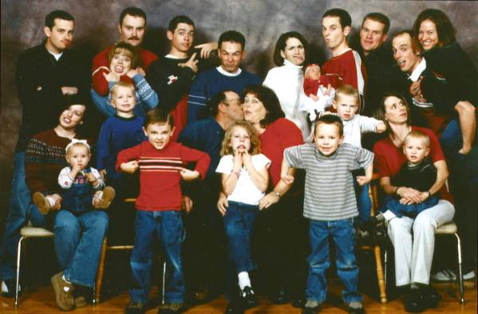
Kids are Fun!!

