Slide 1
Nutrition
CE Best Practice Session

Slide 2
BioBeat 5.1 -Nutrients, Biochemistry, Physiology, and Health (Pg. 225)
Biochemical processes in animals drive function or physiology. If the biochemical processes do not proceed normally, the physiology is disturbed, and the result is dysfunction or illness. The essential vitamins all play a critical role in biochemical reactions, because they are essential structural components of enzymes as cofactors for enzymes (coenzymes). Recall that enzymes are required to catalyze many biochemical reactions in metabolism. If too much or too little of essential vitamins is consumed, the enzymes are compromised and deteriorate. You will note that deficiency and toxicity characteristics describe the changes in physiology. Many of the essential minerals also play biochemical roles, but many are required for the structure of tissue as well. The iron molecule required in hemoglobin in a good example of the structural role a mineral plays in a biological molecule. When iron is deficient, the blood has too little hemoglobin. Without sufficient hemoglobin in re blood cells, there is not enough oxygen-carrying capacity in the red blood cells, and the individual experiences iron-deficiency anemia.

Slide 3
Lisa Jeppson
I start the beginning of the semester with an activity. 4 posters, each has a different question at the top: 1-What foods do you consider to be unhealthy? 2-What do you do for exercise? 3-What would make people become healthier by eating healthier and exercising more? 4-If it is unhealthy why do people overeat and not exercise? I put the class into 4 groups and each group has a marker. The posters are in 4 areas of the room and the group travels (with the marker) around the room--about 2 minutes each. They are to list as many things as they can without repeating previous answers.

Slide 4
Nutrition 1020
Interactive Notebook

Slide 5
katherine.borgmeier@jordandistrict.org
I apologize for not being here to present this in person. Here is a small sample. Most of these foldables I found using a Google search, die cut available at my school or the following website:
http://www.homeschoolshare.com/lapbooking_resources.php
If you have any questions, please don’t hesitate to contact me. I am happy to share what I have created.
Thanks!

Slide 6
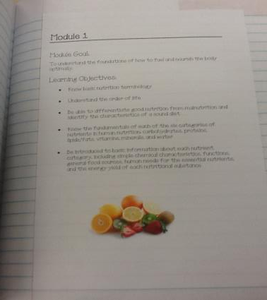
Every unit starts out with the Module Goal and Learning Objectives.

Slide 7
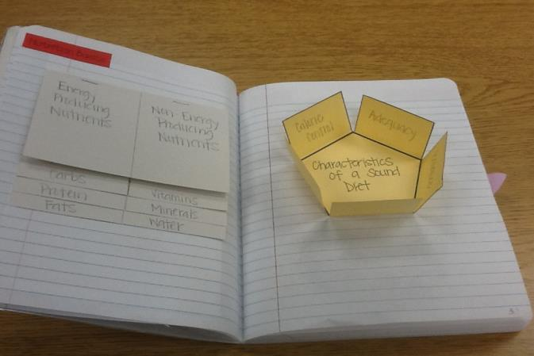
Module 1 Examples

Slide 8
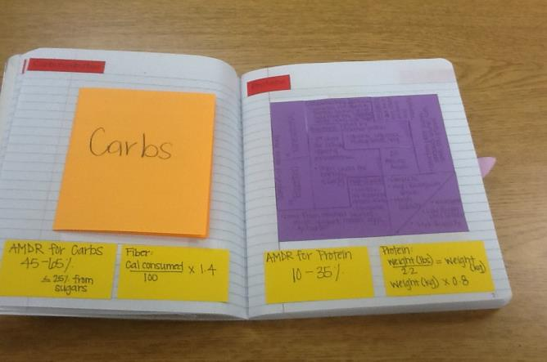
All of the important info to remember is on the yellow cards.

Slide 9
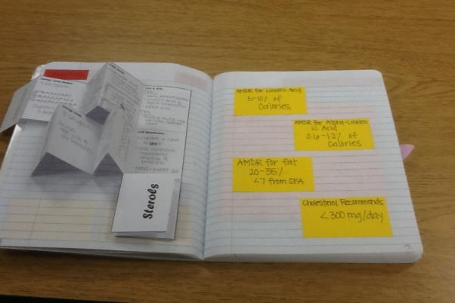
More from Module 1

Slide 10
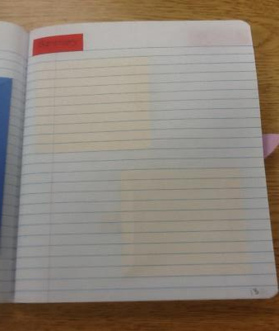
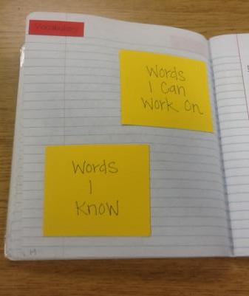
At the end of each unit is a place for student summary and vocabulary

Slide 11
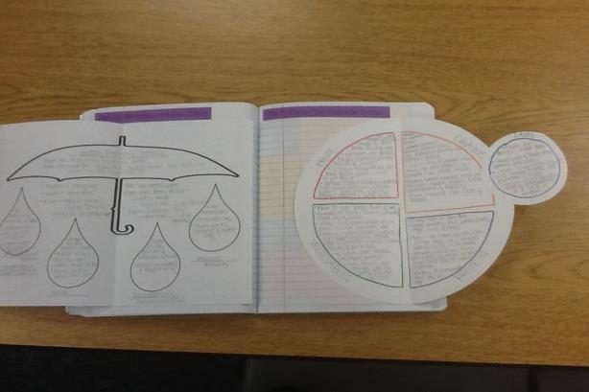
Other Examples – DRIs and MyPlate

Slide 12
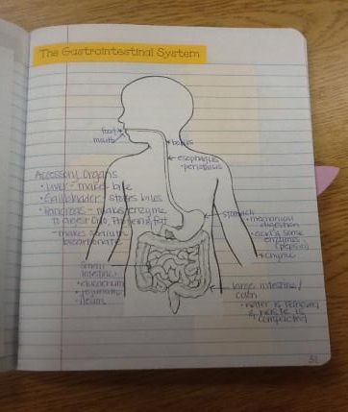
Digestion

Slide 13
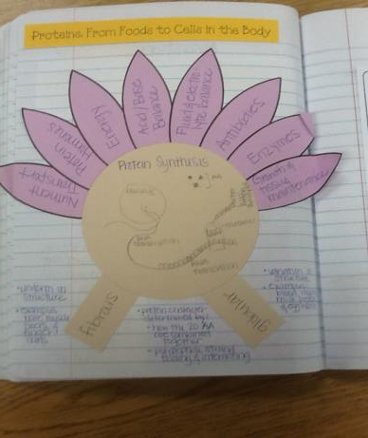
Protein Synthesis & Functions

Slide 14
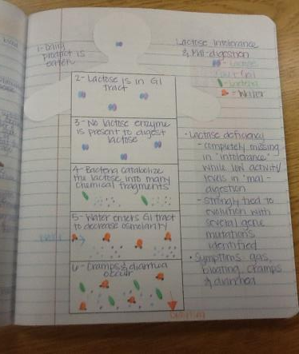
Lactose Intolerance & Mal-digestion

Slide 15
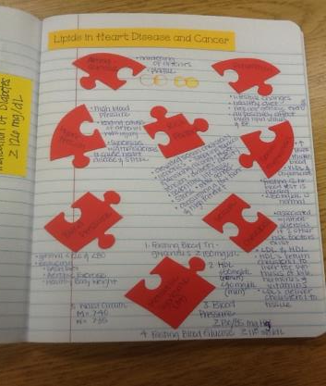
Heart Disease
This is a puzzle die cut that is shaped like a heart. On each piece is something that can lead to a “broken heart.” For example: risk factors, hypertension, atherosclerosis, etc.

Slide 16
For module 1
Lisa Jeppson
For the calories per gram carb-4 pro-4 fat-9 alco-7 I put them into groups and they have to come up with a skit, song, poem, acronym, something that helps them remember it. Then they perform for the class.

Slide 17
For module 1
Jerrie Lin
Carol and Ben made out viciously! == Calorie control, Adequacy, Balance, Moderation, Variety
Monosaccharides (First Half of the alphabet) and Disaccharides (Second Half of the alphabet).’
1st Chemistry lesson =”ose” sugar, “ase” enzyme “ine” amino acid, “ol” alcohol
1st calculations = 10 labels (Figure calories from Fat, PRO, CHO / total calories/ Fiber DRI 105, 117, 137, 159, 183)
2nd calculations = 10 labels (figure calories from SFA, PRO, Sugar / Total calories/ Fiber DRI/ PRO DRI)
H2O Soluble Vitamin = relate to nutrients that are added back Bread products.

Slide 18
For module 1
Fall Exam 1 --- Questions11, 17, 33, 34, 48
Spring Exam 1 ---- Questions 14, 43, 44

Slide 21
For module 2
Lisa Jeppson
I have lots and lots of food labels that we look at and do math with

Slide 22
For module 2
Jerrie Lin
Appendix C --- Have students highlight Headings (includes, servings, Health Benefits, Nutrients) important for Exam 4. Highlight the beta-carotene (pro-vitamin A and Vitamin C), Amounts bar.
More calculations
Vocabulary, pg 53, Health Claims by disease,
Patterning practices using MyPlate and the Exchange List.
Compare AHA, ACS, DG, MyPlate, Exchange List, and then use them analyze diet to find if it meets the recommendations.

Slide 23
For module 2
Fall Exam 2 --- Questions 12, 23, 30, 31
Spring Exam 2 --- Questions 19, 37, 43

Slide 26
For module 3
Lisa Jeppson
I show the magic school bus digestion episode--it's about 30 minutes
Jerrie Lin
Catabolic (Cat tears apart a mouse/ CAT machinery tears down a mountain) and Anabolic (aunt Bell gives you compliments to build up your confidence / Ant builds up and keeps building up his ant mountain.)

Slide 27
For module 3
Fall Exam 3 --- Questions 26, 28, 31, 50
Spring Exam 3 ---- Questions 6, 10, 24, 32,

Slide 30
For module 4
Lisa Jeppson
I have my school website helps for exam 4. I also do the corn starch experiment I got from Lisa Gardner for hypothesis.

Slide 31
For module 5
Lisa Jeppson
I put them into groups and they make a poster about a vit/min. Their poster has to include name (other names), function, food sources (with pictures), deficiency symptoms, and toxicity symptoms. I then have them present in class and follow up with the PPT if anything was missed. Then we hang the posters up.

Slide 32
For module 5
Jerrie Lin
Vit/Min Presentation- The students have to read and watch the T-takes about their vit/min and then make a presentation including all the information from book and T-talks plus new information about their vit/min. The also bring a food item to share with the class that contains their vit/min. 4 days of food=yum!

Slide 33
For module 5
Fall Exam 5 --- Questions 15, 26, 38
Spring Exam 5 --- Questions 6, 10, 32

Slide 36
Module 6
Lisa Jeppson
I show the terrible but funny music videos about food safety from ucdavis.edu. "don't get sicky with it" and "you better wash your hands"
Jerrie Lin
Show the Logan, Handling Food correctly video.

Slide 37
Module 6
Fall Exam 6 --- Questions 2, 6, 12, 22
Spring Exam 6 --- Questions 14, 18, 21, 38, 39,

Slide 39
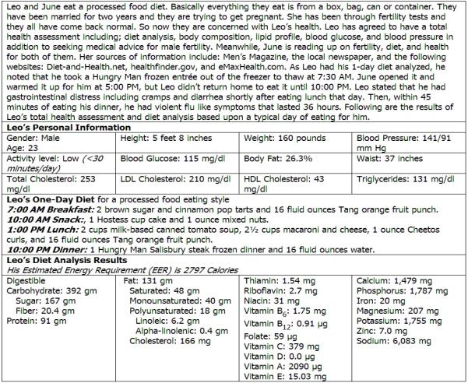

Slide 42
End of Semester:
Lisa Jeppson
Then at the end of the semester if I have time and money I do a food lab--which food is healthier? I usually do canned pears (light and heavy syrup), chips (regular, baked, kettle), jerky (beef and turkey), popcorn (94% fatfree and butter), peanuts (honey roasted and salted). The point of this is to discuss what it means to be healthy--that depends on what your definition of healthy is--what is your purpose? are you watching calories, additives, sodium, fiber, protein, types of fat? So when people say something is healthy--you have to question what they mean by that. It also helps the students really look the food label because they always think honey roasted peanuts has more calories than the salted peanuts but because of the honey (4 cal/g) it has less (fat has 9 cal/g). It's a nice way to end the semester because they get to eat.

Slide 43
Jerrie Lin – videos

