Slide 1
FAMILY MEAL TIME
Cindy Nelson-USU Extension Assistant Professor
Beaver County

Slide 2
Family Meal Time
What if there was one thing you could do to keep your kids from using drugs, alcohol, or tobacco, improve their behavior and attitudes, improve their nutrition, and help them make good grades?
Would you do it?

Slide 3
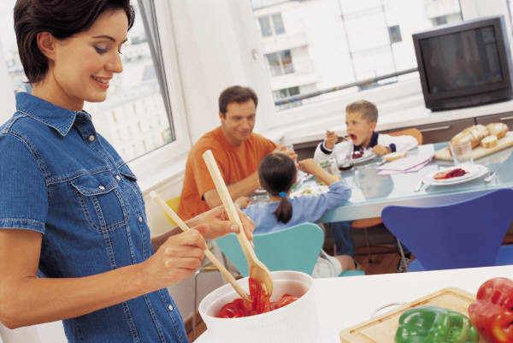
Family Meal Time
Self-evaluation
How many of you have family mealtime (can be any meal):
None
1-2 times per week
3-4 times per week
5-6 times per week
7 times per week

Slide 4
Family Meal Time
FAMILY MEAL TIME!!!
Eating a family meal at least 4 times a week can result in:
Notes:
It sounds too good to be true, but believe it or not, research shows there really is one thing you can do to ensure your children will have a greater chance in succeeding in all areas of life.
Benefits of family mealtime.
The benefits of regular family mealtimes are endless. Who knew such a simple act could impact so many areas of your developing children’s lives. Family mealtimes are certainly an easy way to help ensure that your children will have the tools and support necessary to be successful in life. And don’t forget that preparing meals at home is often less expensive and healthier than eating meals on the run.

Slide 5
Nutrition and Physical Development
kids eat more fruits and veggies
get a wider variety of nutritious foods
have lower rates of childhood obesity
consume less fried foods and soft drinks
make healthier choices when they are on their own.
Notes:
When family meals occur frequently, your child will have a greater variety of nutritious foods and will consume more fruits and vegetables than children who do not regularly eat with their families. Children who grow up in homes with regular family meals often consume less fried foods, soft drinks and less fatty foods than peer that do not have family mealtime at home. Meals prepared in the home tend to be more nutritious and less contributory to an obesogenic environment. Lead by example-if you as a parent or caregiver, provide nutritious, low-fat foods for your child, and frequently introduce them to new foods, your children will be more inclined to make healthier food choices on their own.

Slide 6
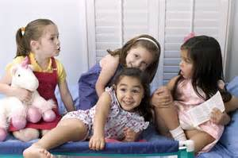
Emotional Development
better able to manage negative emotions
less risk of developing eating disorders
improved communication skills
have more positive interactions with others
Notes:
Frequent family meals have been shown to lower children’s risk for the development of eating disorders in youth/pre-teen years. Children who frequently eat with their family improve communication skills, are able to manage negative emotions more appropriately, and have the opportunity to positively interact with others. Family mealtimes may promote the psychological wellbeing of adolescents.

Slide 7
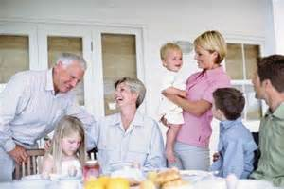
Social Development
learn social norms of family and culture
learn to take turns when speaking
improved communication skills
learn appropriate ways to share thoughts, feelings and opinions
Notes:
While gathered around the dinner table, children have the opportunity to learn social norms of family and societal culture. They learn these social norms by observing and interacting at the dinner table during mealtimes. For example, by participating in conversations, your child will learn to take turns when speaking if that is unacceptable in your family culture to interrupt others when they are talking. It is at family meals that our children may learn about sharing personal thoughts, feelings, and opinions with others in an appropriate manner. To demonstrate, if your child does not like a food that is offered, the child can learn to express this dislike in a way that is not offensive to others.

Slide 8
Academic Development
more likely to receive A’s and B’s in school
effectively build communication skills
develop larger vocabularies
higher reading
level in
elementary school
Notes:
Children that receive A’s and B’s in school are more likely to be consuming meals with family on a regular basis rather than children that do not eat meals with their family frequently. Experts have stated that mealtimes may more effectively build communication skills than activities such as reading together. The amount of time spent having family meals while children are in the preschool years is correlated to the level of reading and vocabulary achievement while attending elementary school. Children will develop a larger vocabulary.

Slide 9
Behavioral Outcomes
less likely to use marijuana, tobacco, and alcohol
less likely to have friends who use these substances
less likely to engage in other risky behaviors such as pre-marital sex
Notes:
Sitting down with children at the dinner table has been shown to reduce the risk for substance use in children. Children raised in families who regularly eat together will be less inclined to use marijuana, tobacco, and alcohol. Also, they will be less likely to have friends using these substances and less likely to easily access marijuana, tobacco, and alcohol.

Slide 10
Family Connection
create a unique family identity
establish traditions
share feelings and experiences
enjoy a sense of security and belonging
provide a safe family environment
Notes:
Want to create a unique family identity? Spend some family time around the table. This is a place where traditions are established, experiences and feelings are shared, and laughter and joking takes place. Children will enjoy a sense of security and belonging when parents and family are intent on providing a safe and joyful family mealtime.

Slide 11
Family Meal Time

Slide 12
Family Meal Time
Making Family Mealtimes Realistic AND Enjoyable
Plan meals ahead of time.
“What’s for dinner?”
“Do you hate to cook,
or do you hate not knowing what to cook?”
Notes:
It takes some effort and planning to make mealtime happen, but the rewards are well worth the work. As with anything, in order for family mealtime to be a priority in your house you have to make it work for your family’s needs and circumstances. There is not a single recipe for success when it comes to family mealtimes. But, there are a few steps everyone can take to help make family mealtime in your house an enjoyable reality.
Plan meals ahead of time. Did you ever go to the grocery store, load up your cart, spend $100 or more, come home put all the food away, and then realize you still have nothing to make for dinner? How do you feel when it’s 5:00pm, everyone is starving, and someone asks, “What’s for dinner?” Did you know that you can spend about 30 minutes or more every night trying to figure out what to eat for dinner or you can spend 30 minutes or less per week? If you think you hate to cook, you may find that what you actually hate is not knowing what to cook. When the plan is in place and you have all the ingredients you need to create a fast, easy, delicious, and nutritious meal, you may decide you actually like to cook.
Activity Page 5

Slide 13
Family Meal Time
Making Family Mealtimes Realistic AND Enjoyable
Plan meals ahead of time.
Schedule a set time for meals.
Start young.
Plan when to eat.
Consistency is important.
Notes:
Start eating meals together as a family when your kids are young. This way, it becomes a habit. Plan when you will eat together as a family. Write it on your calendar. You may not be able to eat together every day, but try to have family meals most days of the week.

Slide 14
Family Meal Time
Making Family Mealtimes Realistic AND Enjoyable
Plan meals ahead of time.
2. Schedule a set time for meals.
Involve all family members in the meal prep and clean up.
Depending on age,
your child may be able to:
Notes:
Have participants make a list of things children can do help with the meal. Examples: set the table, put pets, toys, or books in another room, turn off the TV, pour the drink, put down place mats, hand out napkins and silverware, pick flowers for the table, clear the table, wipe the table, etc.

Slide 15
Family Meal Time
Making Family Mealtimes Realistic AND Enjoyable
Plan meals ahead of time.
2. Schedule a set time for meals.
3. Involve all family members in the meal prep and clean up.
4. Turn off the TV and all other electronic devices, including phones.
Notes:
TV and other electronic devices distract family members form engaging in meaningful conversation and prevents forming and strengthening family connections during mealtimes. Leaving electronic devices in another room allows for families to have meaningful dialogue and the undivided attention of family members. Consider having a basket that everyone can drop off their devices in during meal time and can easily find later.

Slide 16
Family Meal Time
Making Family Mealtimes Realistic AND Enjoyable
Plan meals ahead of time.
2. Schedule a set time for meals.
3. Involve all family members in the meal prep and clean up.
4. Turn off the TV and all other electronic devices, including phones.
5. Have pleasant conversation and leave discipline and other negative emotions for another time.
Notes:
Talk about fun and happy things. Try to make meals a stress-free time. Encourage your child to try foods, but don’t lecture or force your child to eat. Consistently discussing tense topics like school performance, previous disobedience, or financial problems can make children resistant to making mealtime a priority.

Slide 17
Family Meal Time
Set a realistic goal. Eating just a few meals together a week is better than none at all.
Family mealtime doesn’t just count for dinner.
Make it FUN!!!
Notes:
If you are new to family mealtimes set a realistic goal for your family. If it seems impossible to have meals together everyday, set a more realistic goal of 2 or 3 times per week. Family mealtimes do not have to be all or nothing. Eating just a few meals together a week is better than none and you may find you enjoy it so much it becomes a priority to do it more often.
Family mealtime doesn’t just count for dinner. If dinner is not a realistic goal to eat together try having breakfast or lunch as a family. Again, in order for family mealtime to be realistic and enjoyable it has to work for your family. Breakfast together can be just as rewarding as dinner.

Slide 18
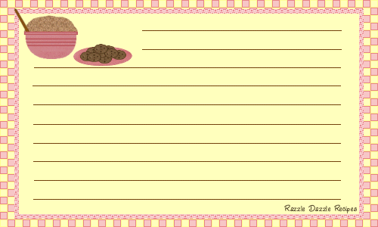
Recipe for Pleasant Family Mealtimes
Start with one busy family.
Add a strong commitment to regular family mealtime.
Blend in time for family discussion and planning.
Sprinkle with compliments and pleasant conversation topics.
Yield: Strong family bonds and effective communication.

Slide 19
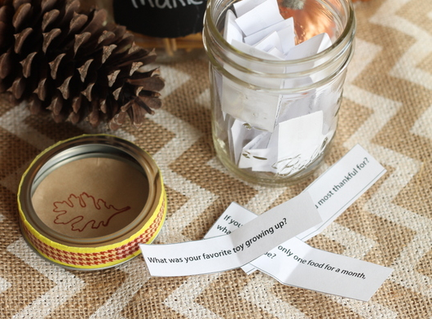
Family Meal Time
Table Talk Conversation Jar

Slide 20
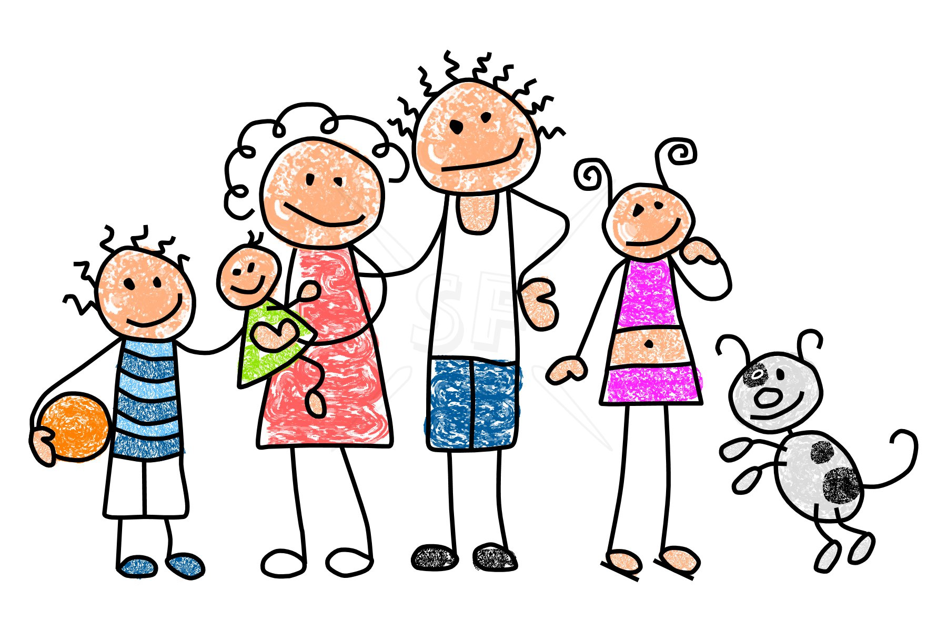
Family Meal Time
Why do you care?
What will you do?
Notes:
Write down one goal/behavior that you would like to do to make your family meal times more successful.

