Slide 1
Cuisine of North and South America
Culinary Arts Standard 12

Slide 2
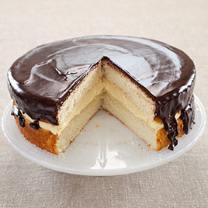
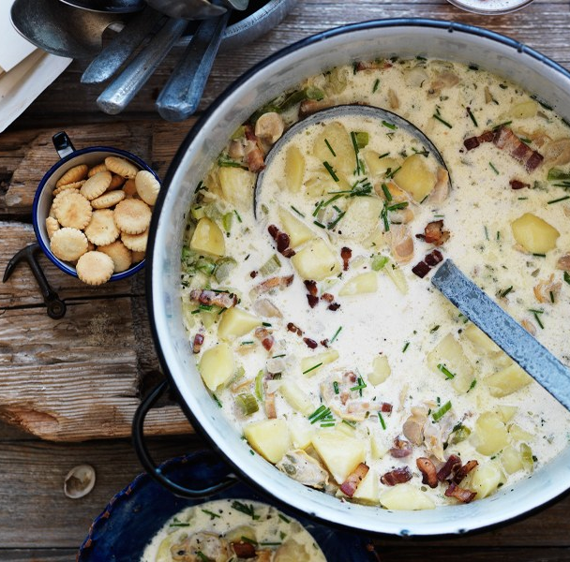
Common Foods from the North Atlantic (CT, ME, MA, NH, RI, VT)
Boston Cream Pie, Clam Chowder, Lobster, Lobster Rolls, Oysters, Johnny Cakes, Maple Syrup, Whoopie Pie

Slide 3
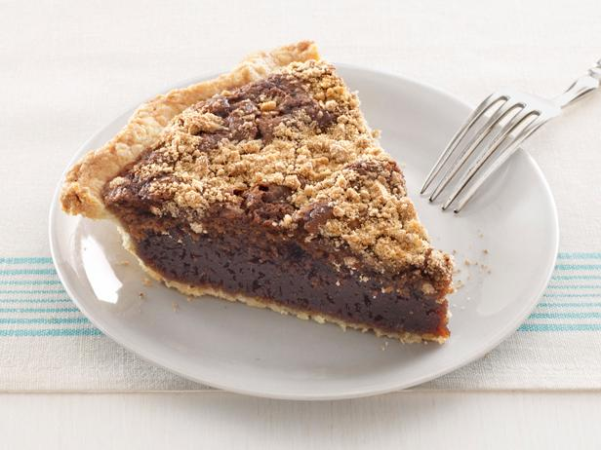
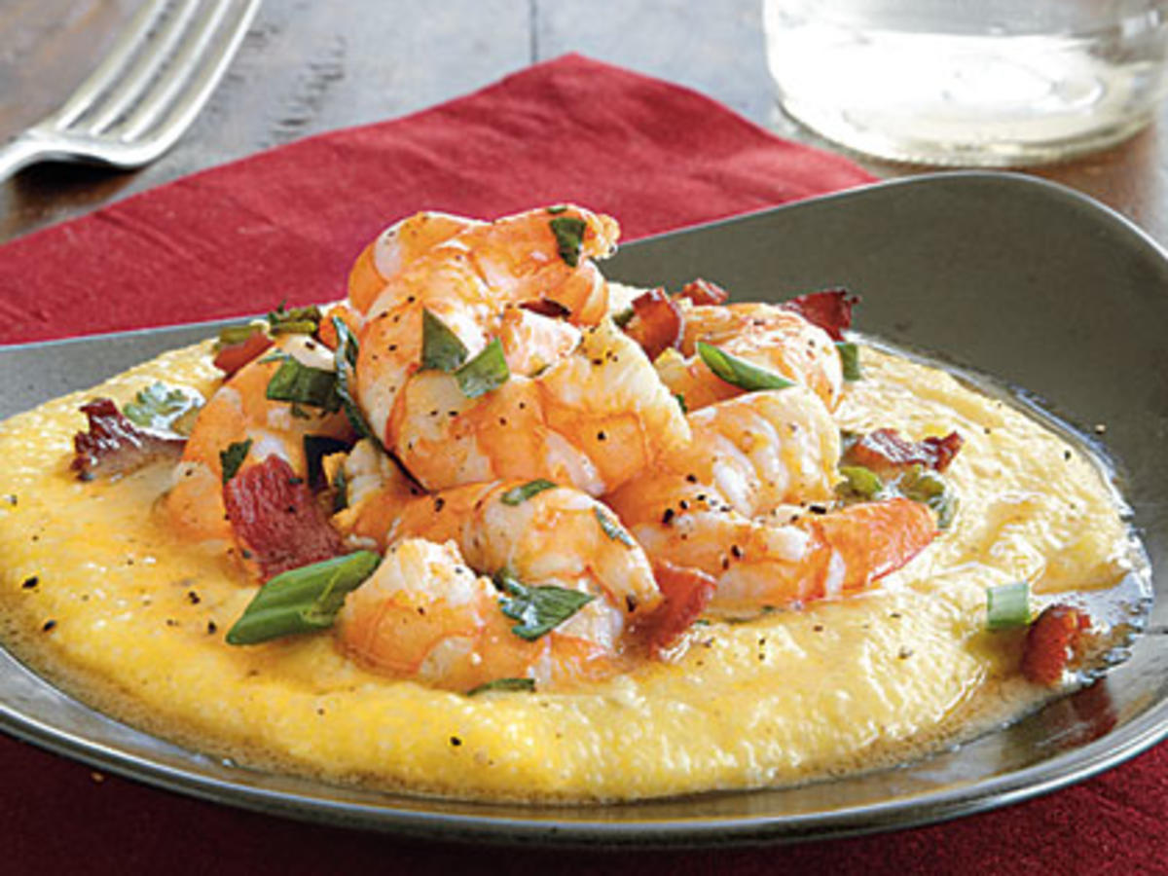
Common Foods of the Mid Atlantic (DE, MD, NJ, MY, PA, D.C., NC, SC)
Philly Cheese Steak Sandwich, Shoofly Pie, Manhattan Clam Chowder, Hush Puppies

Slide 4
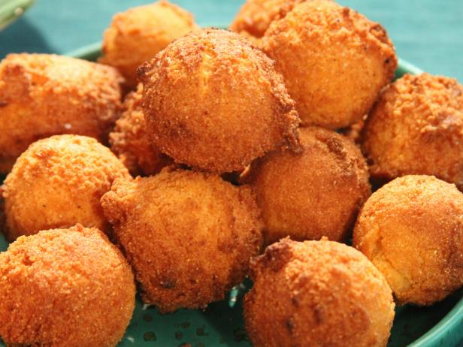
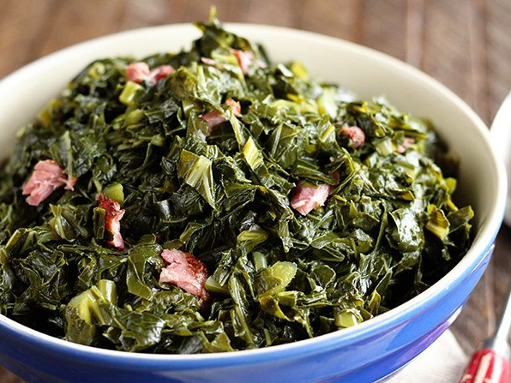
Common Foods of the South Atlantic (AL, AR, FL, GA, MS)
Hush Puppies, Sweet Tea, Catfish, Collard Greens, Fried Chicken

Slide 5
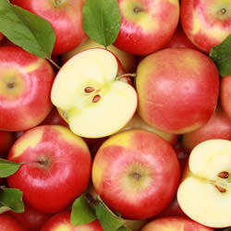
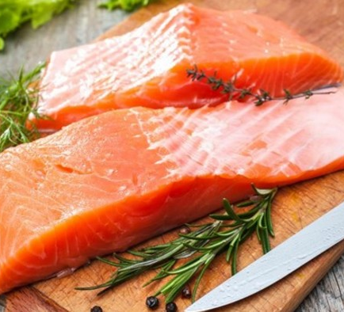
Common Foods of the Northwest (AK, OR, WA, ID, MT)
Salmon, berries, crab, oysters, clams, apples, cherries, pears

Slide 6
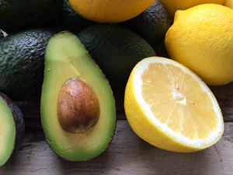
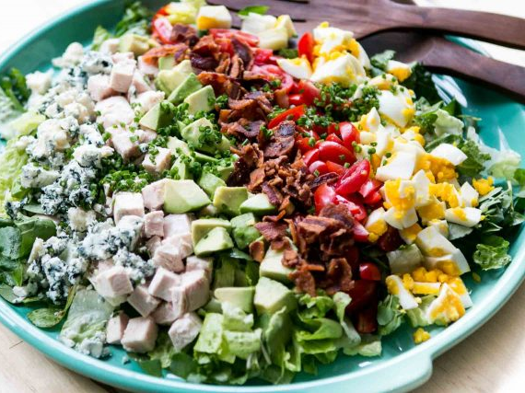
Common Foods of the West Coast (CA)
Cobb Salad, Fish, Citrus, Avocado, Cilantro, Poultry

Slide 7
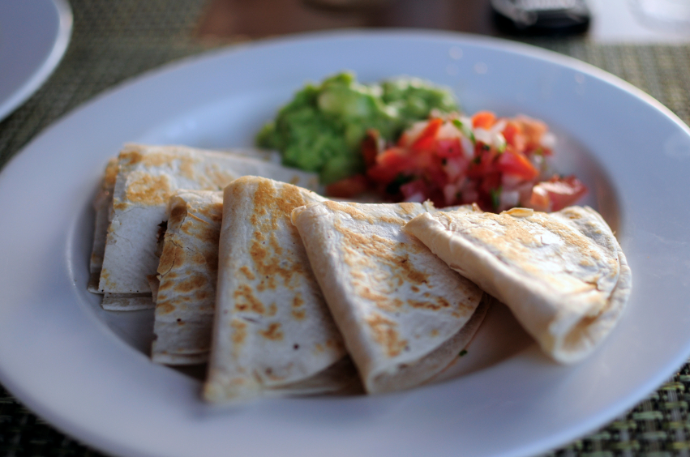
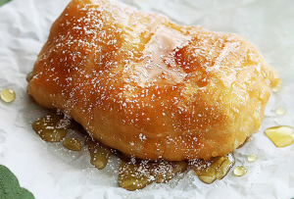
Common Foods of the Southwest (AZ, NM, UT, TX)
Chili, Quesadillas, Guacamole, Salsa, Enchiladas, Scones, Brisket, Tortillas

Slide 8
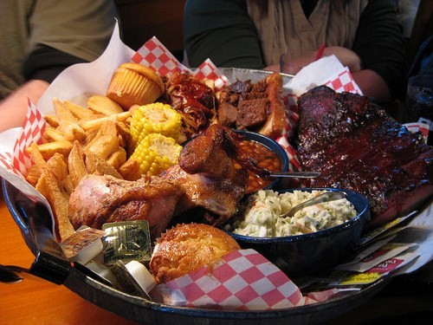
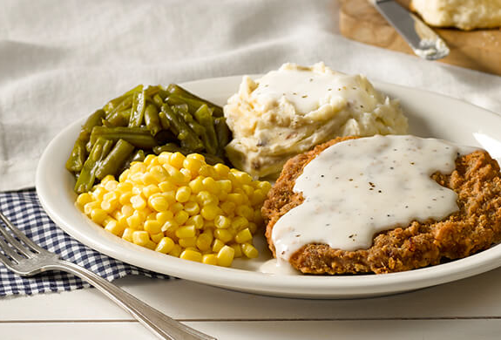
Common Foods of the Midwest (CO, IA, KS, MO, NE, ND, SD, OK)
Beef, Corn, Country Fried Steak, Soybeans, Barbeque

Slide 9
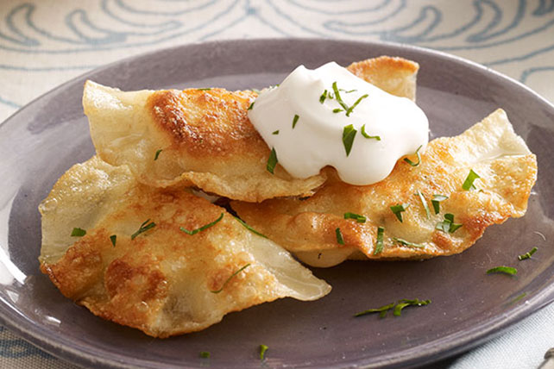
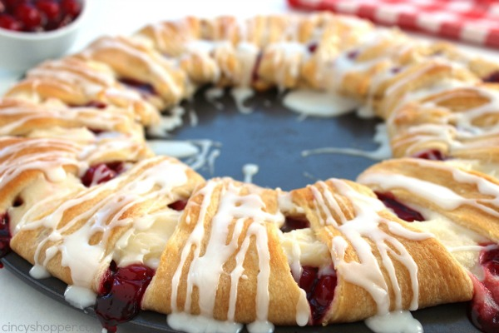
Common Foods of the Great Lakes (WI, MI, OH, IN, IL)
Cheese, German Sausage, Popcorn, Pierogis, Chili, Danish Kringle

Slide 10
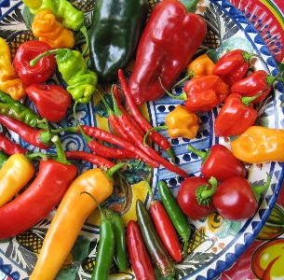
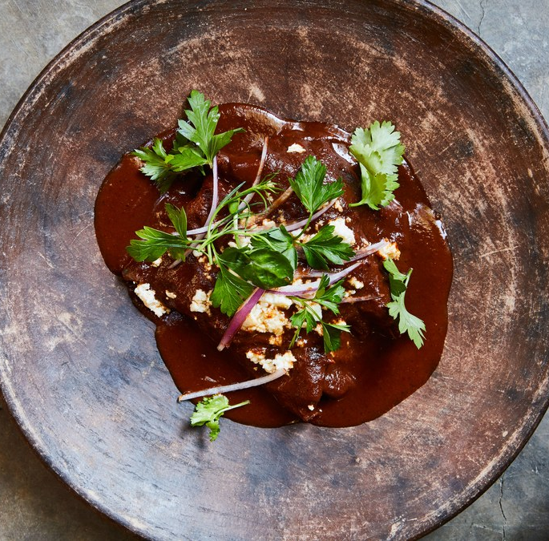
Influences, Foods and Tools used in Mexico
Influence: Spain
Common Foods: Corn, beans, avocado, tomato, chili peppers, rice, tortillas, guacamole, salsa, chocolate, mole (complex sauce)
Tools: Tortilla press, Molcajete (mortar and pestle)

Slide 11
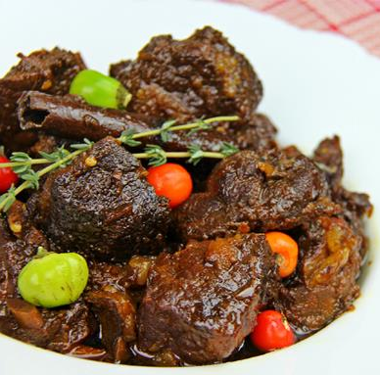
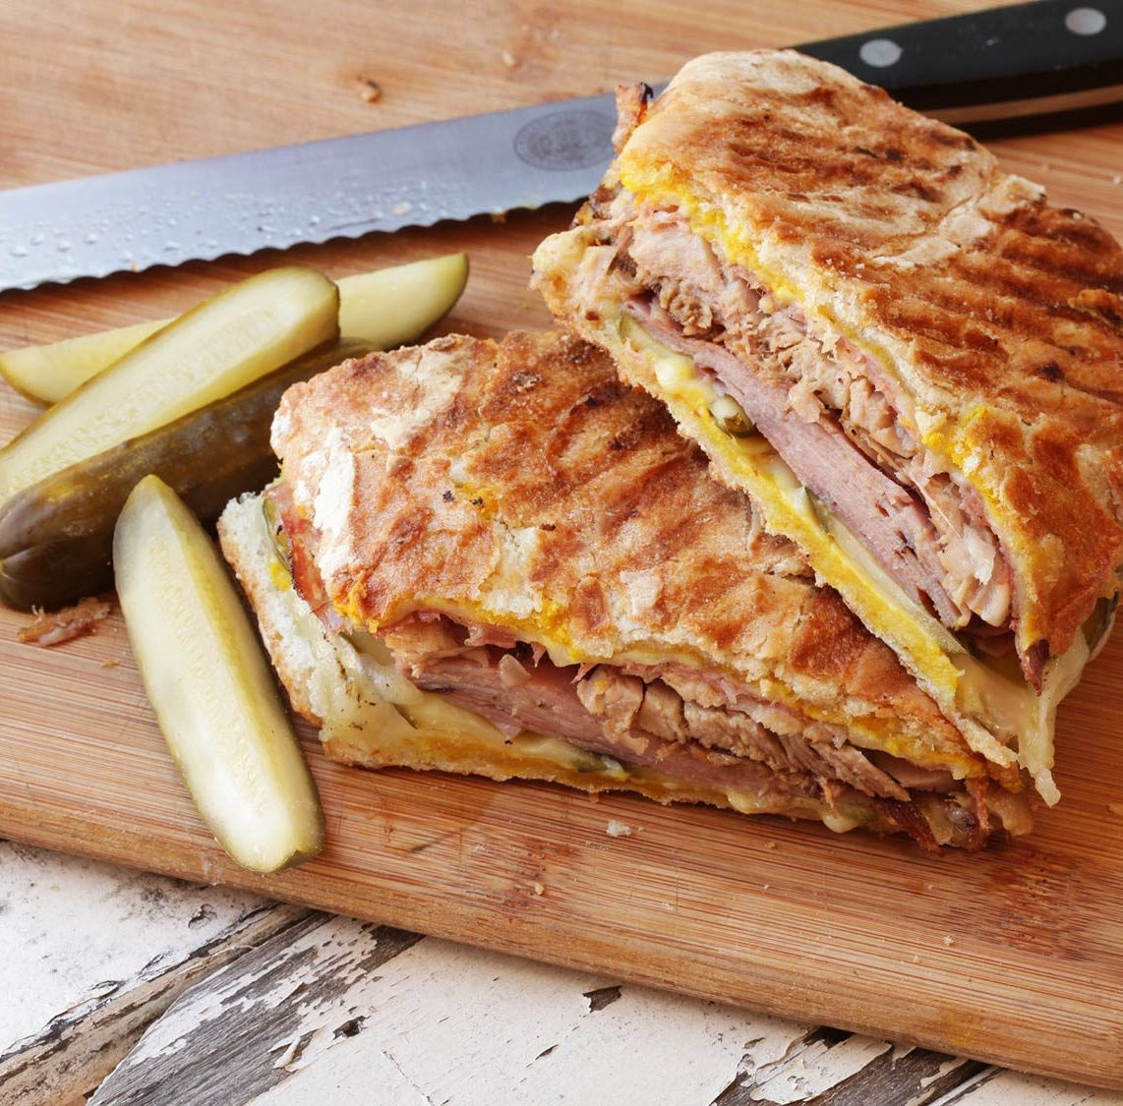
Influences, Foods and Tools used in the Caribbean
Influence: Indian, Dutch, French, Spanish
Common Foods: Pepperpot, conch, Cuban sandwich, goat stew, keylime pie, garlic, seafood, jerk spice
Tools: Caldero (cast iron pot) Plantain press, Flan Mold

Slide 12
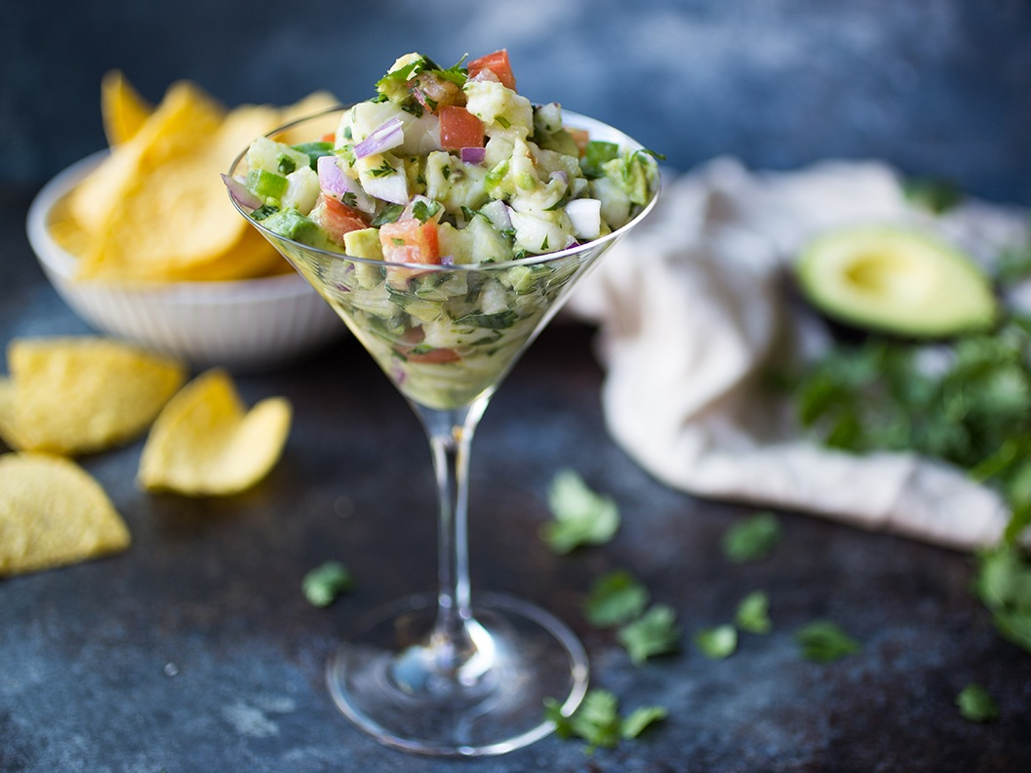
Influences, Foods and Tools used in Central America
Influence: Afro-Caribbean and Spanish
Common Foods: Rice, beans, fresh fruit and vegetables, mondongo, ceviche, pupusas, horchata
Tools: Wooden stoves, plantain leaves

Slide 13
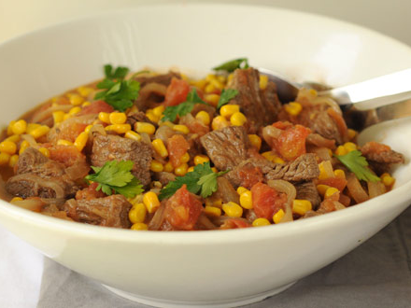
Influences & Foods used in Argentina & Chile
Influence: European, Italian and Spanish
Common Foods Argentina: Beef, chimichurri, provoleta, milanesa, empanada, tarta
Common Foods Chile: Seafood, empanadas, olives, chirimoya, tomatican, ensalada chilena

Slide 14
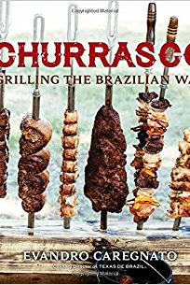
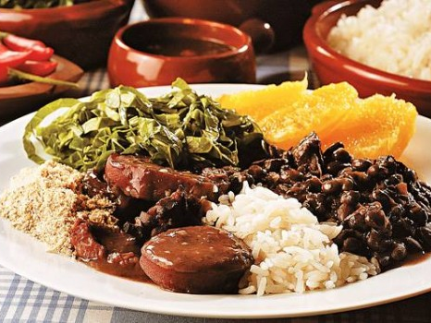
Influences, Foods & Techniques from Brazil
Influence: European, Portugal, Italy, Germany
Common Foods: Feijoada, Feijao, lemon, shrimp, plantains
Techniques: Churrasco (BBQ)

Slide 15
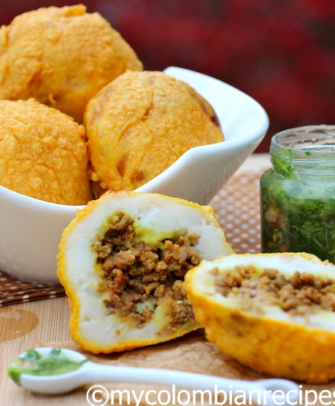
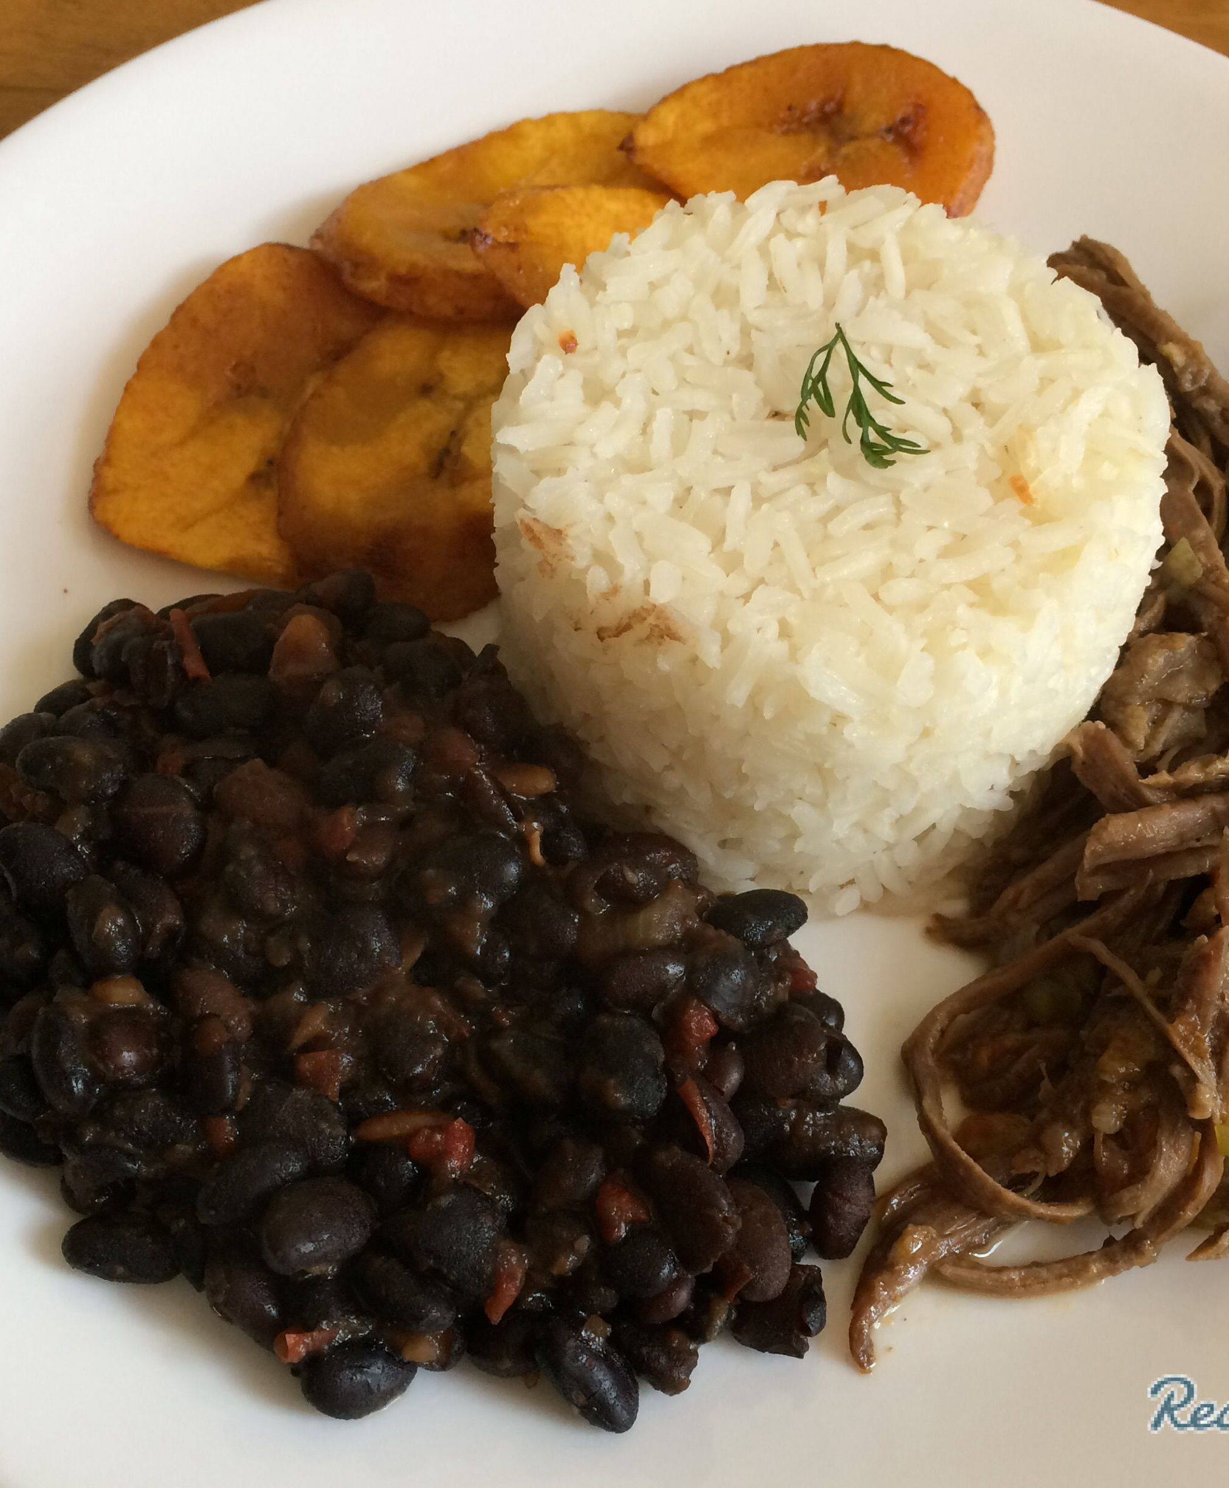
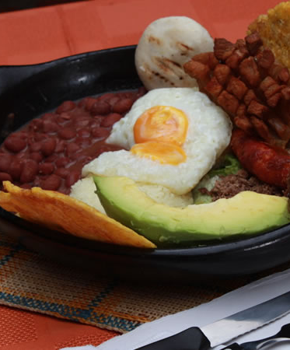
Influences & Foods from Columbia, Ecuador, Peru, Venezuela
Influence: Spanish, African, Arab, Inca, Spanish
Common Foods Columbia: Bandeja paisa (steak, sausage, fried egg, avocado), tubers, coffee
Common Foods Ecuador: Ceviche, hornado, bananas
Common Foods Peru: Ceviche, papa rellena (mashed potatoes stuffed with olives, meat, eggs and deep fried), pollo a la brasa
Common Foods Venezuela: Empanadas, cachitos, pabellion criollo (rice, beans, shredded beef)

