Slide 1
Pricing Mini Pies
Applied Math for Culinary Management

Slide 2
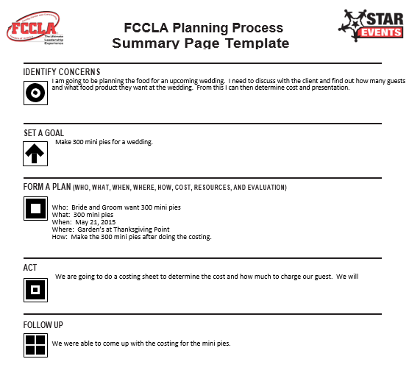

Slide 3
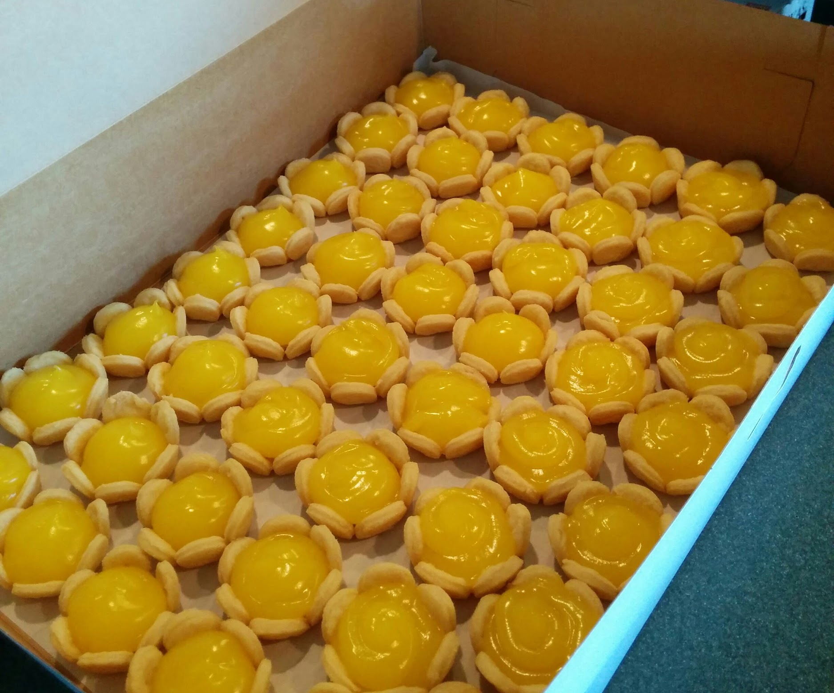
Calculating Quantity
We are catering for a wedding reception
The order is for 300 mini pies
The client ordered 150 lemon pies
The client also ordered 150 raspberry pies
150 lemon pies / 25 pies per batch = 6 batches of mini lemon pies
150 raspberry pies / 25 pies per batch = 6 batches of mini raspberry pies

Slide 4
Recipe
Crust:
2 c Flour
1 c Butter Flavor Shortening
1 t Salt
½ c Water
Yield: 25 mini pie shells
Lemon/Raspberry Fillings (Pre-made): Yield- 50 mini pies per tube

Slide 5
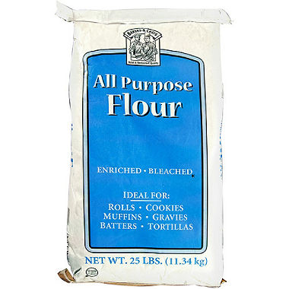
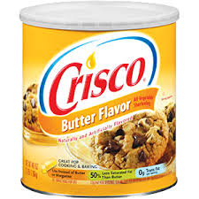
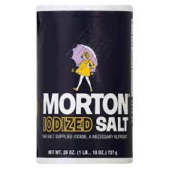
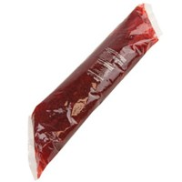
Cost of Ingredients
Flour: $6.25 / 90 cups = $0.07 per cup
Butter Flavor Shortening: $5.50 / 6 cups = $0.92 per cup
Salt: $0.85 / 156 teaspoons = $0.08 per teaspoon
Filling: $4.99 / 50 mini pies = $0.10 per mini pie

Slide 6
Cost Per Unit
Cost per batch of 25 :
2c flour x $0.07 = $0.14
1c shortening x $0.92 = $0.92
1t salt x $.08 = $0.08
Filling for 25 pies x $0.10 = $2.50
Total cost per batch: $0.14 + $0.92 + $0.08 + $2.50 = $3.64
Cost per pie: $3.64 / 25 pies = about $0.15

Slide 7
How Much To Buy
Amount of flour: 2c per batch x 12 batches = 24c flour
Price of flour: $0.14 x 12 batches = $1.68
Amount of shortening: 1c per batch x 12 batches = 12c shortening
Price of shortening: $0.92 per batch x 12 batches = $11.04
Amount of salt: 1t per batch x 12 batches = 12t or ¼ c salt
Price of salt: $0.08 x 12 batches = $0.96
Amount of filling: 300 pies / 50 pies filled per bag = 6 bags
Price of filling: $4.99 x 6 bags = $29.94

Slide 8
Pricing To Make a Profit
Total cost for 300 pies:
$1.68 + $11.04 + $0.96 + $29.94 = $43.62
Goal for food cost percentage: 30%
cost / .30 = price $0.15 / .30 = $0.50 per pie
Total profit: $0.50 x 300 pies = $150.00 - $43.62 = $106.38

