Slide 1
Food Costing

Slide 2
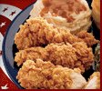
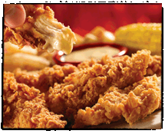
Pricing of Food
Why is one more expensive than the other?
KFC Fried Chicken Dinner $2.99
and
Chili’s Chicken Crisper Dinner $9.39 + tip

Slide 3
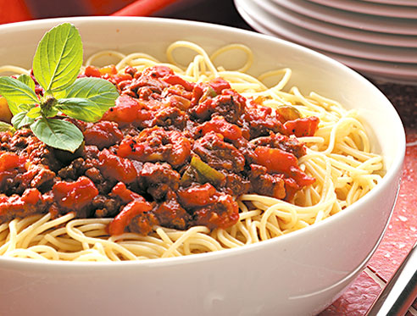
Why so much?
On the menu a meal is $10.00 – the food to prepare that meal costs $2.00. What is the other $8.00 for?
What % of the total meal is the food cost? $2.00/$10.00
Notes:
20% food cost. Others costs: labor, insurance, utilities, rent, marketing, equipment costs

Slide 4
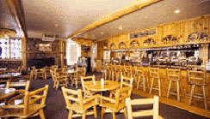
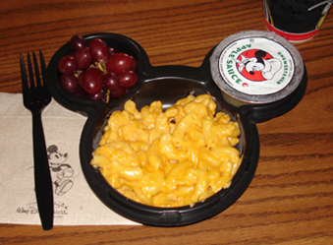
Where are food costs low?
Places you are “captive” – they can make a fortune!!
Disneyland
Recreation locations (Yellowstone, Lake Powell, etc… high food cost might be because of location)
Movie Theaters
College and Professional Athletic Events

Slide 5
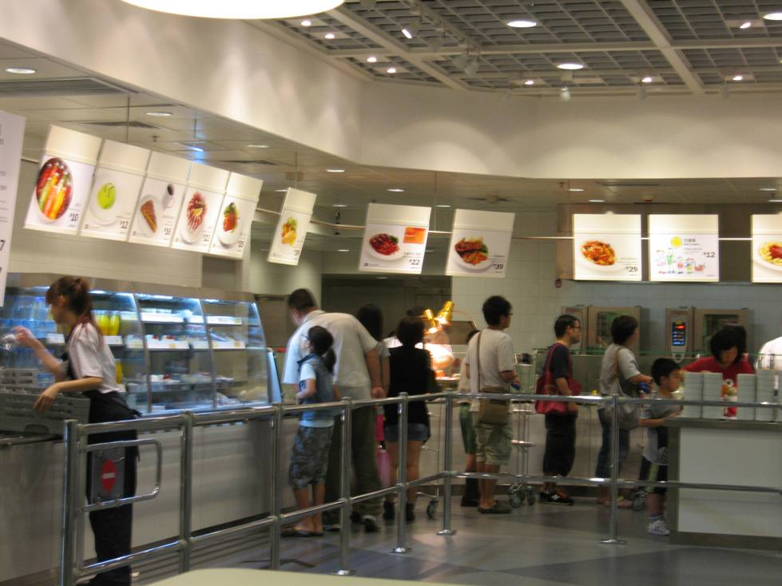
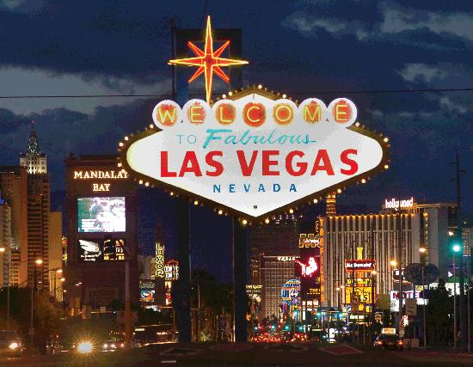
Where are food costs high?
Places where they make more money other ways but they need to get you to come – so the food is cheap. They make little or no money from the food, but when you’re there you’ll spend money in other ways.
Las Vegas
Ikea

Slide 6
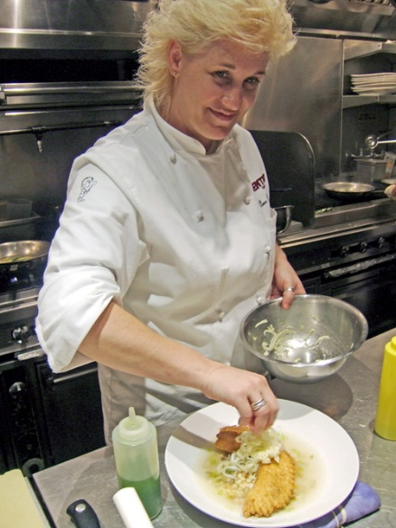
Food Cost Average
What is food cost percentage? It is the percentage of sales an operation budgets to spend on food products.
Why does it matter? You want to make a profit so you have to charge the correct price to insure you don’t lose money.
The Average Food Cost is 28-35% and depends on the food establishment, location, and so many other factors.
Most restaurants have a specific percent and manager and chefs must work hard to meet that percent and not exceed it.
Some meals like pasta might be less than 28% and some with lots of protein like steak might be higher than 42%, but it will average out.

Slide 7
The Formula for Costing
Cost Per Portion
(this is why you need to know how to determine portion or unit cost)
÷
Food Cost Percentage
(determined by establishment)
=
Menu Cost

Slide 8
Other factors that impact food cost
Spoilage is a major factor in purchasing, receiving, and storage. How can it happen at each of the above mentioned steps in the flow of food.
Employee theft. Is it always malicious or apparent? How to check it?
When preparing food you can cut down on food cost. What are some things you can be mindful of?
Waste. Can you use some waste in other ways?
Employee training. What do employees need to know?
In food service restaurant learn to forecast sales. How does proper forecasting save a restaurant money?
Notes:
Purchasing: bad supplier, poor quality food. Receiving: not checking for proper temperature on arrival, leaving out too long. Storage: not storing at the correct temperature, or storing too long. Theft: Monitor employees and inventory. Preparation: Training employees on waste AP/EP, training them properly, how long does food sit out Waste: Trimming, how much is too much AP/EP, not following recipes – ruining it. Using waste – stock, soups, sauces, repurposing food. Employee Training: Use standardized recipes (always the same, written correctly), using waste, proper kitchen technique, company policy. Forecast sales: Like Mother’s Day there might be more families eating out for the holiday, Christmas might be slow, etc… Proper forecasting prevents over purchase of food.

Slide 9
Food Cost by Unit or Serving
Total cost of an item
÷
Unit or serving
=
Cost per unit or serving
When would you use this?
Notes:
To make the best decision in purchasing, to get the best price or to determine the cost per serving for food costing.

Slide 10
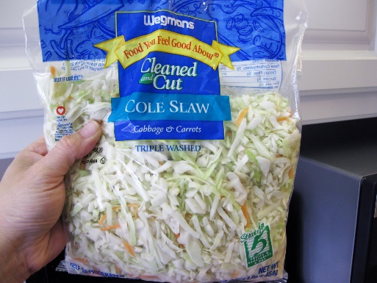
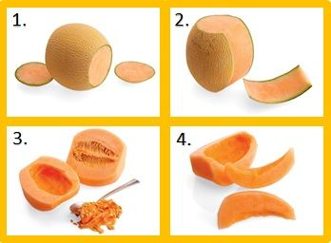
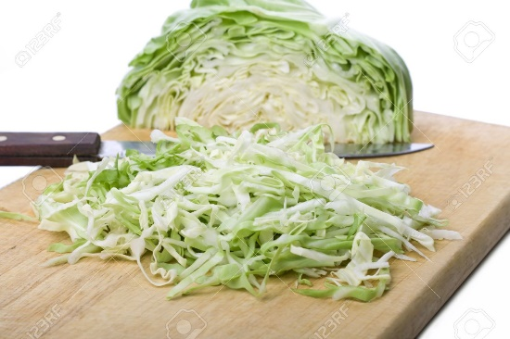
AP/EP As purchased/Edible portion
When fruits and vegetables are trimmed and prepped you lose some to waste. AP/EP helps you determine how much to purchase to get the desired outcome. Sometimes you can save money (on labor) by purchasing already prepped items such as shredded cabbage. If you purchase if already prepped you can typically use 100% so no loss, but on some items you lose freshness.
VS

Slide 11
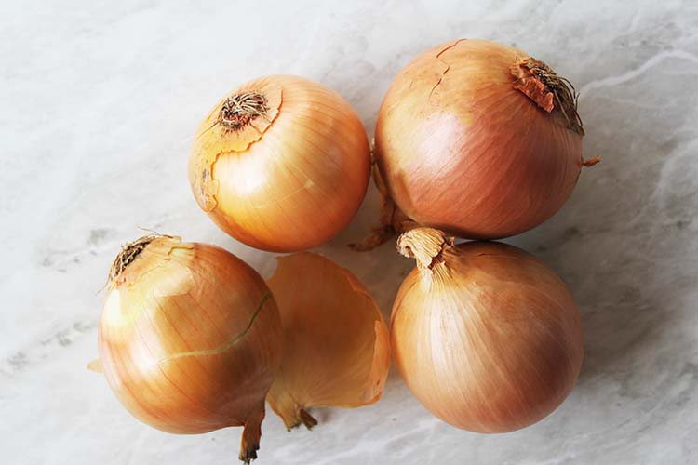
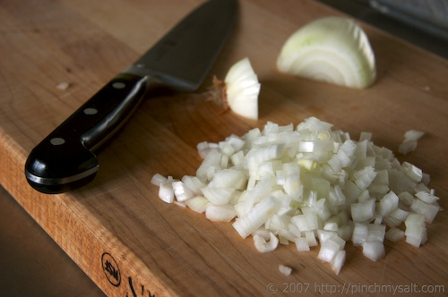
The Terminology
As Purchased: The product before any trimming, cutting or cooking.
Edible Portion: The product after it has been trimmed or cut.
Percentage Yield: The percentage of food left after cutting, trimming or cooking

Slide 12
The Formulas
Percent Yield: There are industry standards for this, but some establishments determine their own percent.
Edible Portion ÷ As Purchased = Percent Yield
As Purchased: This is the most common formula establishments use to determine how much to purchase.
Edible Portion ÷ Percent Yield = As Purchased (Amount Needed to Purchase)
Edible Portion: If you have food already and want to know how much edible food you have, use this formula.
As Purchased x Percent Yield = Edible Portion (Food you can serve)

