Slide 1
Menu Pricing and Design
Explore menus, different menu types and keys in menu planning and pricing
Notes:
All video links in presenter notes.

Slide 2
Types of Menus
Static, fixed – still or unchanging
Cycle - non-commercial segment
Market – Food available in the market
Table d’ hote - complete meal at one price (banquet) - set menu
Prix Fixe – complete meal at one price (buffet) – a la carte
A la Carte – ordered and priced separately
California – all items offered all day

Slide 3
Building a menu
Important things to think about
Menu layout and organization
what do you want it to look like and how do you want your customer reading it?
what order are things typically written in?
Food descriptions and photos
good or bad?
Themes, colors and fonts
does it go with with your restaurant concept?

Slide 4
Menu Planning
Important things to think about
Consider target market
where are you building your restaurant? who will be coming?
Analyze competition
what other restaurants are around?
Create a theme
Current trends
what are the trends and do you want to keep up with them?
link
Nutritional content
do you want to include calories and other nutritional information?
Notes:
http://www.restaurant.org/News-Research/Research/What-s-Hot

Slide 5
Menu Planning
More important things to think about
Variety and balance
nutritional balance, plating and serving size
Pricing
does the price reflect the type of restaurant?
Food availability
can you get the foods that you want? geography and culture.
Staff skill level
Labor cost
Truthfulness
is your menu misleading? if you say it, you serve it.

Slide 6
Notes:
https://www.youtube.com/watch?v=regMLfLIYec

Slide 7
Menu Pricing
Pricing psychology – odd cent, pricing by the ounce
Notes:
https://www.youtube.com/watch?v=aZ_G2gQr8Uw

Slide 8
Menu Pricing
Price on menu covers:
Food
Labor
Additional operating costs (rent, utilities, equipment etc.)
Perceived value
Revenue
Competition

Slide 9
Menu Descriptions
What words should you use?
What words should you avoid?
How long should it be?
Do pictures sell food?

Slide 10
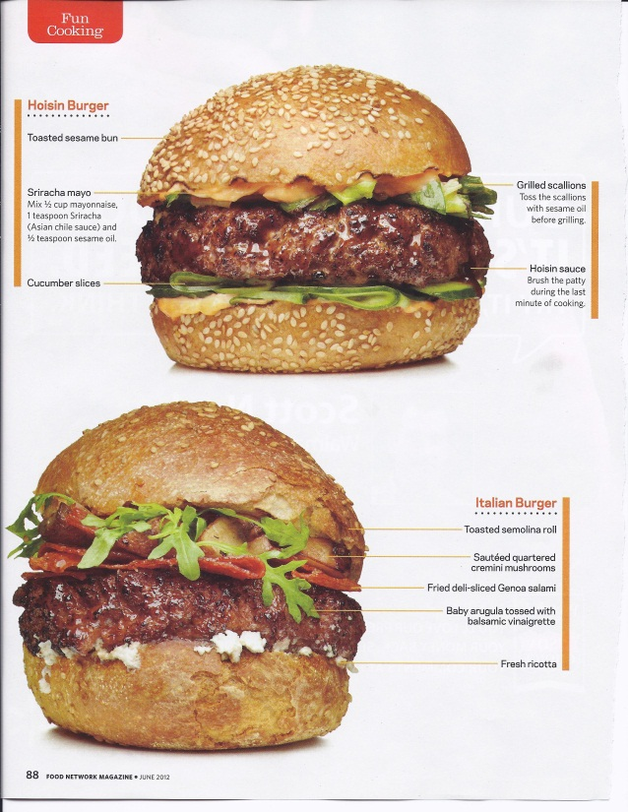
Your Turn
Mexican Torta, Beer-Cheese, Hoisin, Italian
Now, create your hamburger…and no bacon cheeseburgers, too easy!! Evaluated on menu description!!

Slide 11
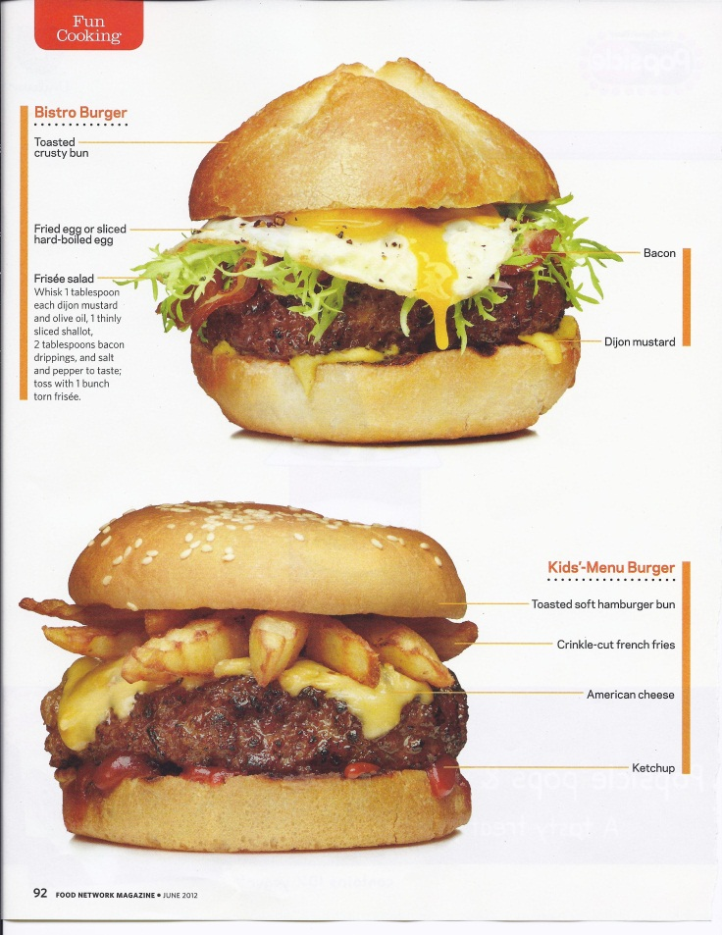
Few others??
Garden, Loaded Chili,
Bistro, Kids’ Menu

Slide 12
And a few more!!
Stroganoff Burger
Chicken Parmesan
Surf and Turf

Slide 14
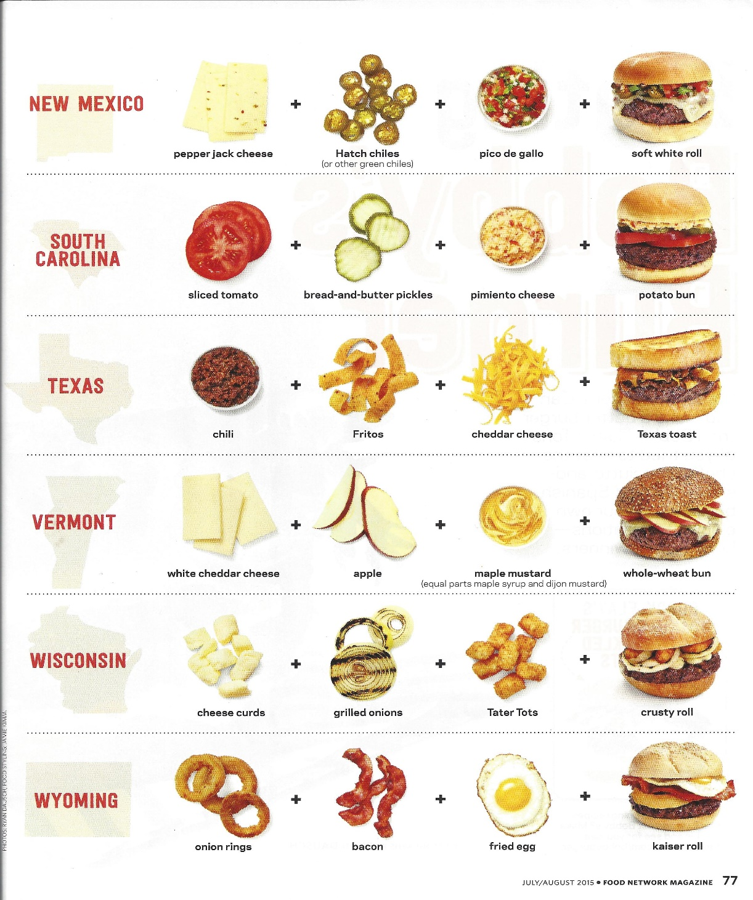

Slide 15
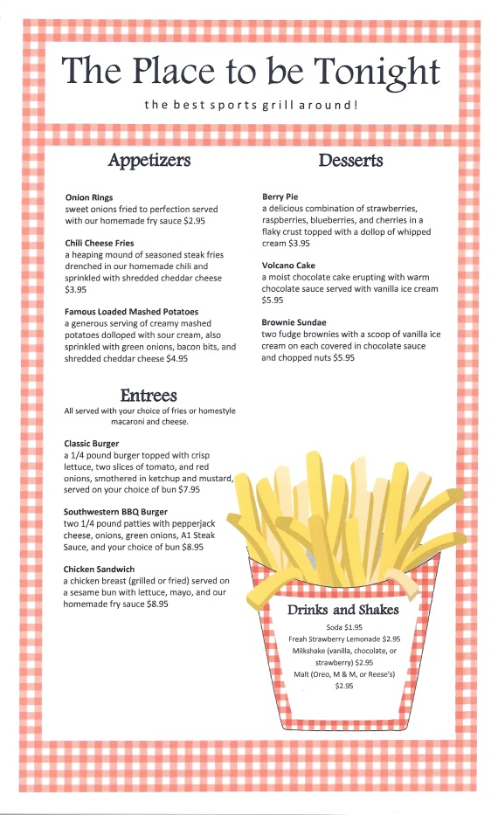
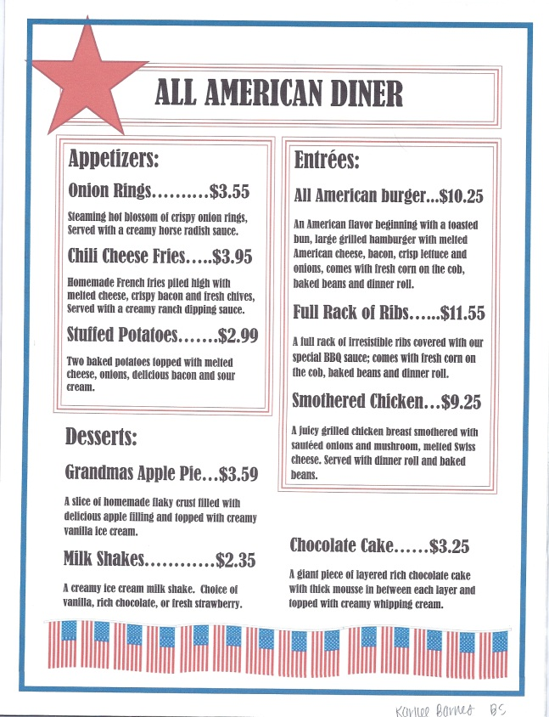
Your Turn

