Slide 1
CAREERS IN THE INDUSTRY

Slide 2
Why do people eat out?
Celebrations, traveling, try different foods, don’t want to cook, socializing, enjoy the food, relaxing.
How many Americans eat out?
60% eat out at least once a week
45% eat out one-two times a week
18% eat out 3 or more times a week

Slide 3
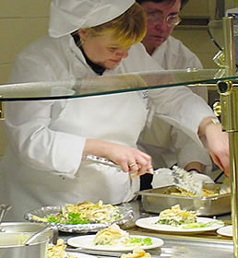
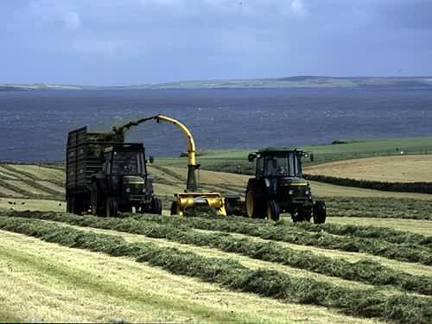
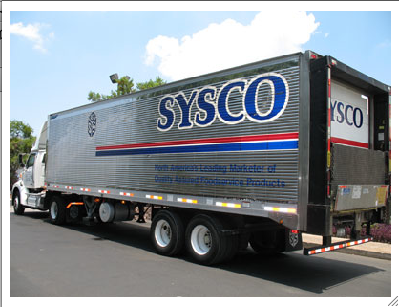
Employment Opportunities
13 million people or 9% of the workforce are in food related jobs.

Slide 4
Restaurants
Corporate groups- multiple concepts
Chains- same concept
Franchise- let other purchase name and product
Independents

Slide 5
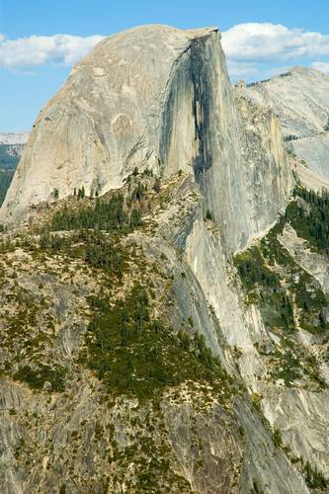
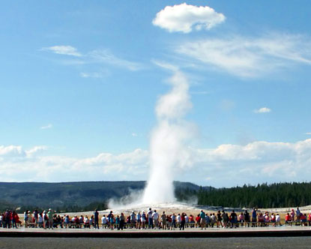
National and State Parks
Operated by the National Park Service.
Yellowstone, Glacier, Sequoia, Everglades, Yosemite, Grand Canyon.
Natural wonders, camping, hiking, boating, swimming.

Slide 6
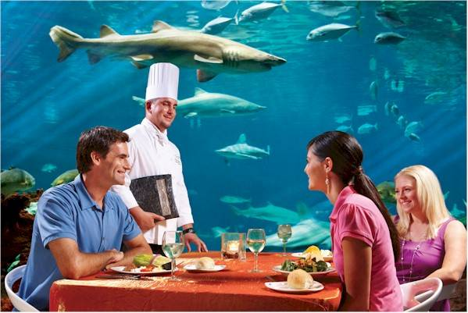
Theme Parks
Exhibits, rides and other attractions.
Foodservice, lodging and transportation.
Sometimes national chains are in the park – McDonalds.
Fine Dining, Theme Restaurants

Slide 7
Shopping
Malls and outlet malls – quick serve food and casual dining.
Mall of America 80 + food establishments.
Department Stores – cafes or full service dining.
Discount Chains – Quick service food

Slide 8
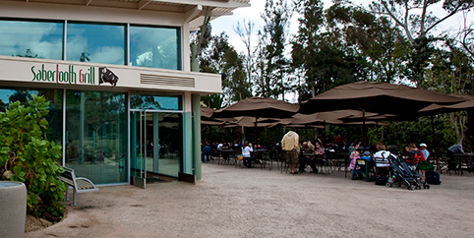
Monuments, Museums and Zoos
Monuments – concessions, restaurants
Museums – Fine dining, cafeterias
Zoos – variety of food service

Slide 9
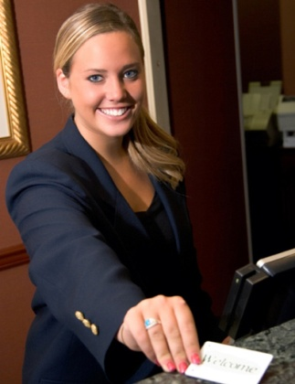
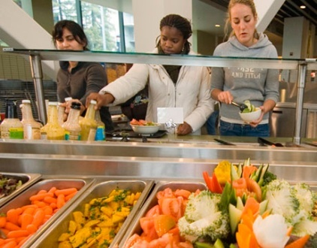
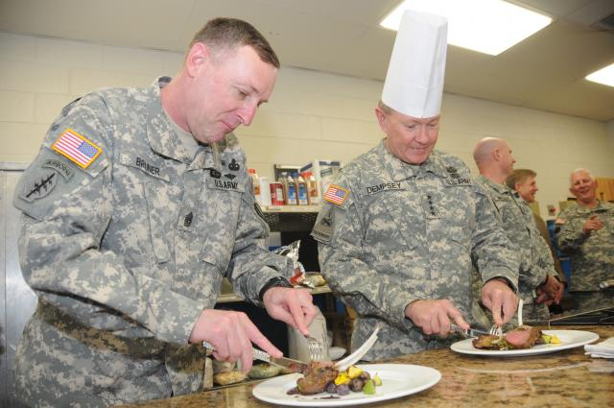
Other Career Opportunities
Health Services
Schools and Universities
Military
Corrections
Lodging

Slide 10
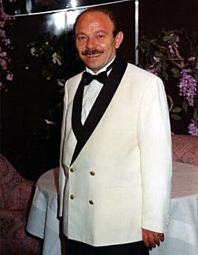
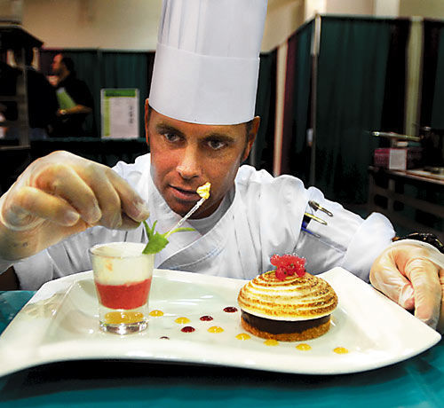
Foodservice Careers
Front-of-the-house
Back-of-the-house
Managers, assistant managers, banquet managers, maitre d’s, hostesses, bar staff, serving staff, busers.
Chefs, line cooks, pastry chefs, sous chef, dishwashers, menu planner, bookkeepers, dietitians.

Slide 11
Careers we will explore
Executive Chef
Event Planner
Food Stylist
Pastry Chef
Dietitian
Food Scientist/product developer

Slide 12
Culinary Professionalism

Slide 13
What is Professionalism?
To be professional is to be courteous, honest and responsible in your dealings with customers and co-workers.
A professional’s responsibility is to themselves, to co workers, to the business and to the guest.

Slide 14
Applied Knowledge
Critical thinking
Applied academic skills – like math, science

Slide 15
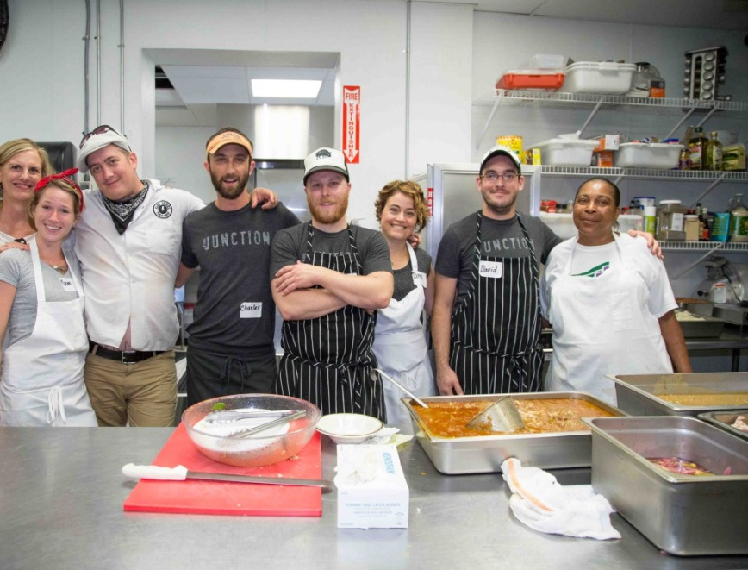
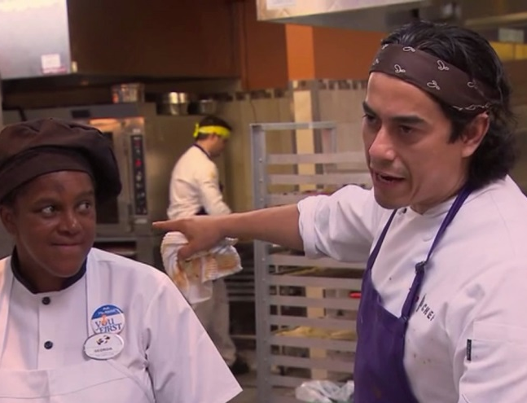
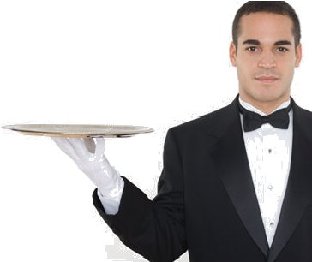
Effective Relationships
Interpersonal skills – teamwork, communication
Personal qualities – honesty, integrity, initiative, positive attitude, punctuality, pride, creativity, passion, accept constructive criticism

Slide 16
Workplace skills
Technology use
Business sense
Continuing education and training

Slide 17
Tools for jobs

Slide 18
How to get a job…
Job application – most on line now
Job portfolio – really makes an impression
Resume – easy to read, bullets
Letter of request or cover letter – concise, might be online
Job interview – be on time, look good, body language, relax
Follow-up – Thank you, email or written note

Slide 19
Resume – you make one
1- Format, clean, sleek, pop of color
2- Make the top count, they look at it for 3 seconds to see if you matter
3- Promote your brand, qualification summary
4- Emphasize key skills
5- Highlight achievements
6- Work experience but weave a story
7- Control the time line, don’t go too far back
http://time.com/money/4621066/free-resume-word-template-2017/

