Slide 1
Culinary Measurements

Slide 2
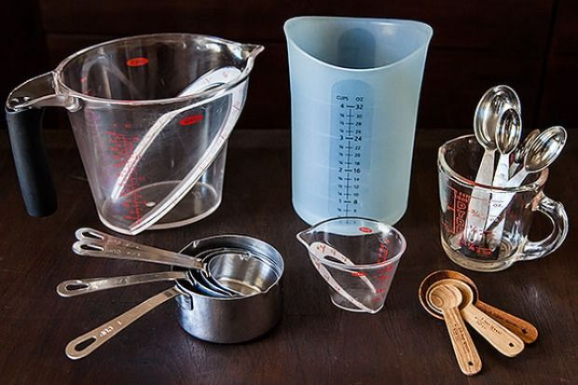
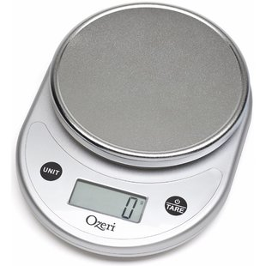
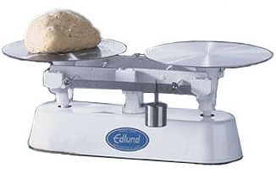
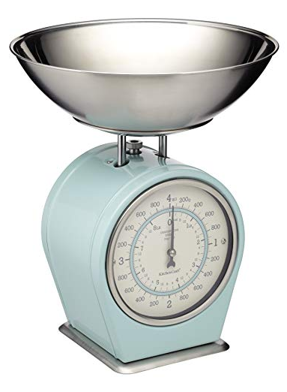
Volume vs. weight
Volume
Weight
Measure by filling something
Use dry or liquid measuring cups
Use teaspoons, tablespoons, ladles and scoops
Includes fluid ounces
Not the most accurate
Measure by weighing something
Use a scale
Digital
Balance/baker scale
Spring Scale
Pounds, Ounces, or Grams
Most accurate way to measure

Slide 3
Measuring equivalents
Tool | Quarts | Pints | Cups | Tablespoons | Fluid Ounces
Gallon Equals | 4 | 8 | 16 | 256 | 128
Quart Equals | 1 | 2 | 4 | 64 | 32
Pint Equals |  | 1 | 2 | 32 | 16
1 Cup Equals |  |  | 1 | 16 | 8
1 Tablespoon Equals |  |  |  | 1 | .5
1 tablespoon = 3 teaspoons
1 lb. butter = 2 cups or 4 cubes
16 ounces = 1 lb.

Slide 4
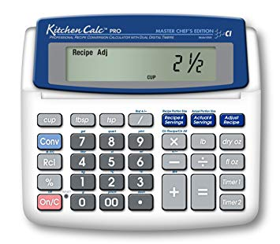
Recipe Conversion
New Yield ÷ Original Yield = Conversion Factor
Multiply every ingredient by the conversion factor to get the new quantity needed
Original ingredient quantity x Conversion Factor = New Quantity
For Example: Recipe makes 8 servings and you need 30 servings
30 ÷ 8 = 3.75
All ingredients will be multiplied by 3.75

