Slide 1
Produce
Culinary Management STRAND 7 Standard 1

Slide 2
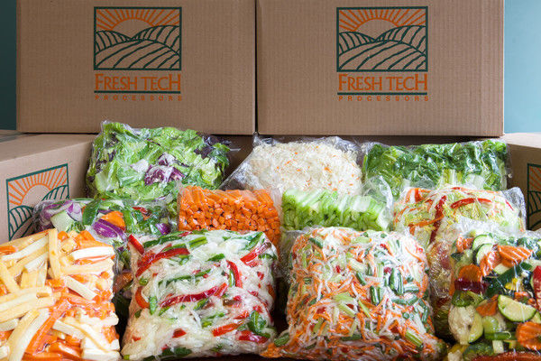
Quality of Produce
Fresh, Canned, Frozen, Dried, Preserved
Some fresh produce is purchased cleaned, peeled or cut.
Generally more $$$ and less flavor

Slide 3
Purchasing Fruit Consider
Cost
Is it in season?
Quality
Is it in season?
Storage
How can I best store this to keep the quality? Do I have space?
Use
How will I use it and when will I use it.

Slide 4
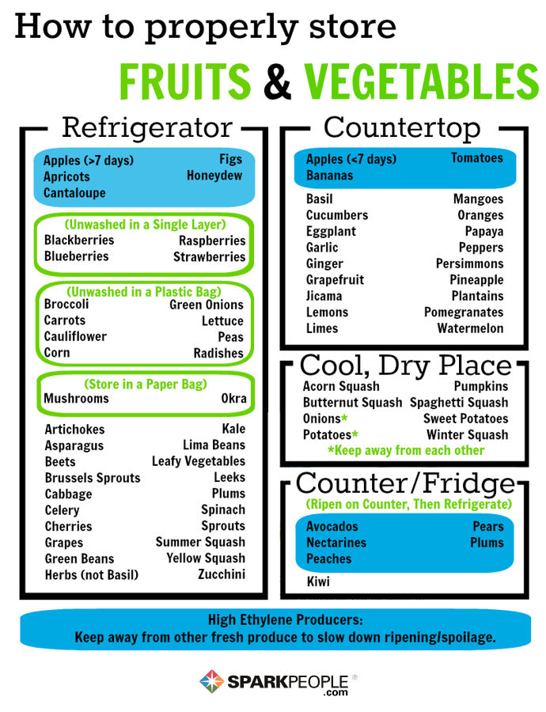
Storage of Produce
Temperature will vary depending on the produce.
To finish ripening fruits, store at room temperature.
To slow the ripening process, chill fruits.
Starchy vegetables (potatoes, squash, onions) should be stored between 60-70 degrees in a dry location.

Slide 5
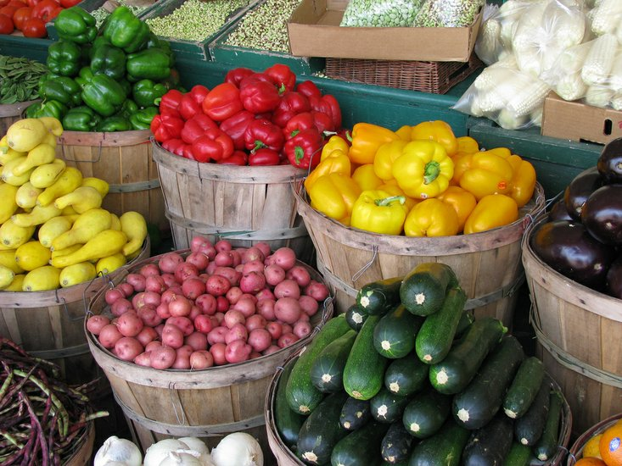
Produce Storage
Most produce will last about a week if properly stored.

Slide 6
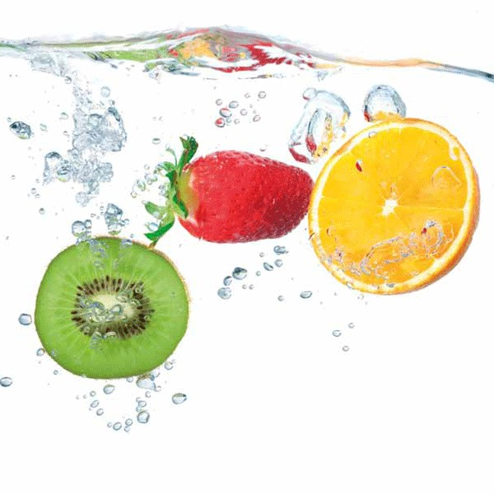
All produce needs to be washed before use.
Some produce can be washed before storing, but should be dried and stored.
Herbs are stored with their stems in water.
Some produce like berries and mushrooms should not be washed until just before using.

Slide 7
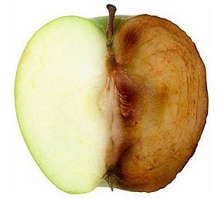
Enzymatic Browning
The process of food, mainly produce, turning brown from the exposure to oxygen and/or cell damage.
Apples, potatoes, bananas, avocadoes, peaches, and pears.

Slide 8
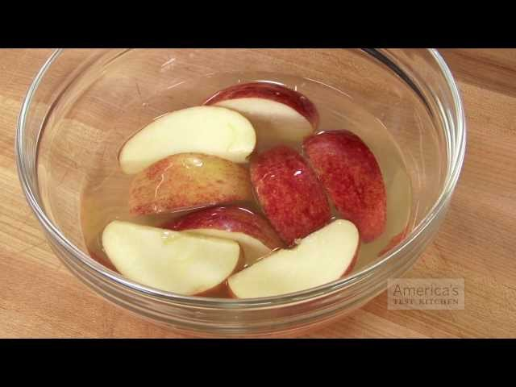
Preventing Enzymatic Browning
Submerge in water.
Lemon juice or other acids lower the pH.
Blanching or other forms of cooking denature the enzymes.
Lower temperatures can slow the rate of reaction.

Slide 9
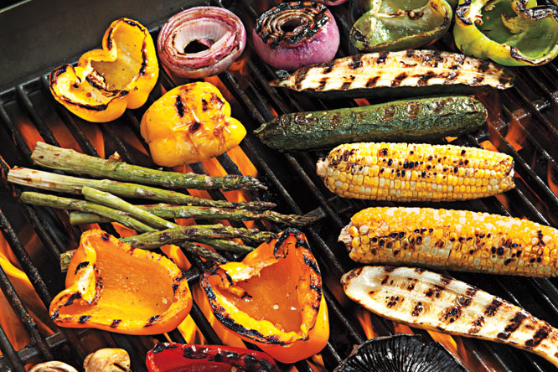
Cooking Techniques
Dry Heat (preserves the nutrients and flavors)
Grilling/broiling, roasting/baking, deep frying (adds more calories and makes the food less nutrient dense), sautéing

Slide 10
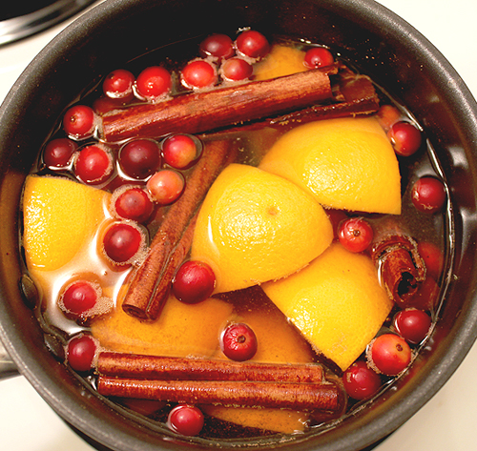
Cooking Techniques
Moist Heat (can result in significant nutrient loss)
To help prevent nutrient loss, cook for a minimum about of time and use as little water as possible.
blanching/par boiling, steaming, simmering, braising, boiling

