Slide 1
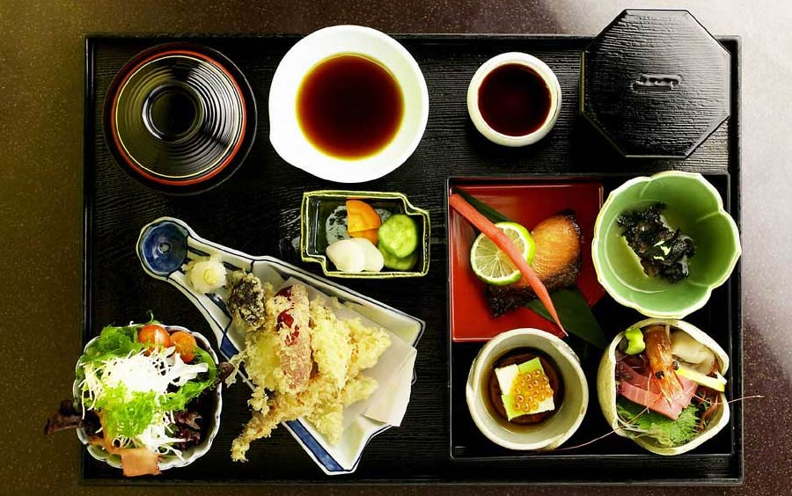
Traditional Bento Boxes

Slide 2
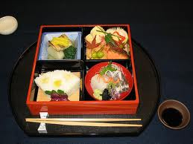
Bento Box

Slide 3
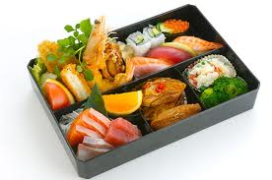
Traditional bento box

Slide 4
What is a Bento Box?
Main Entry: | bento box
Part of Speech: | n
Definition: | a partitioned lacquered or decorated box made of wood or other material in which ameal consisting of various types of Asian food (bento) is served; also called obento
Etymology: | late 20th c; Jap
Usage: | cooking

Slide 5
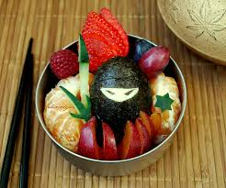
Vegetable Bento Boxes

Slide 6
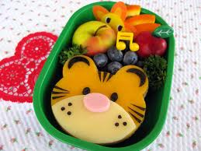
Vegetable and Protein

Slide 7
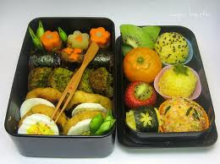
Fruit and Vegetable bento

Slide 8
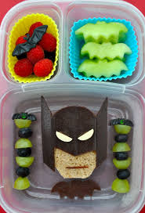
Batman; Fruit and Protein

Slide 9
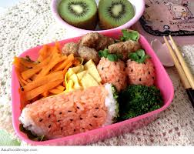
Rice and Vegetable Bento Box

Slide 10
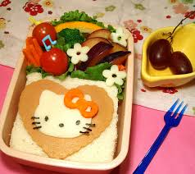
Hello Kitty; Fruit and Protein

Slide 11
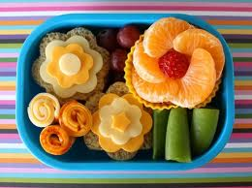
Flowers

Slide 12
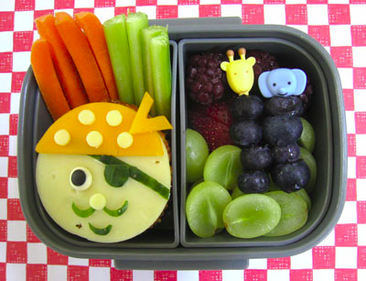
Fruits, Vegetables and protein

Slide 13
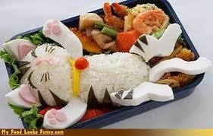
What foods do you see here?

Slide 14
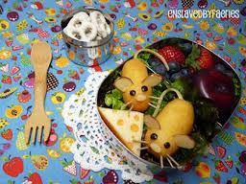
And what foods do you see here?

Slide 15
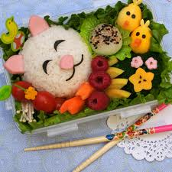

Slide 16
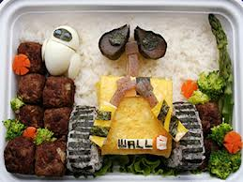
Wall-E

Slide 17
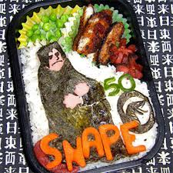
Can you do this?

Slide 18
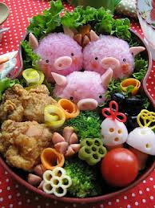

Slide 19
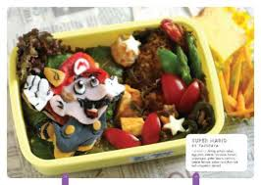
Mario

Slide 20
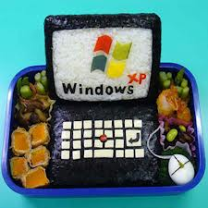
Bento Box Example

Slide 21
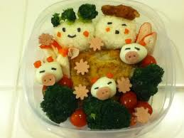
Mrs. K’s family??

Slide 22
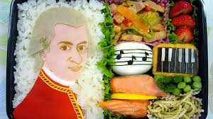
Composer theme

Slide 23
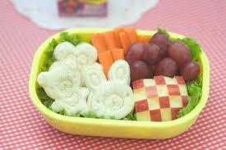
Yes, it is an apple on the right

Slide 24
What theme will you choose?
How creative can you get?
Let’s “play” with our food!

Slide 25
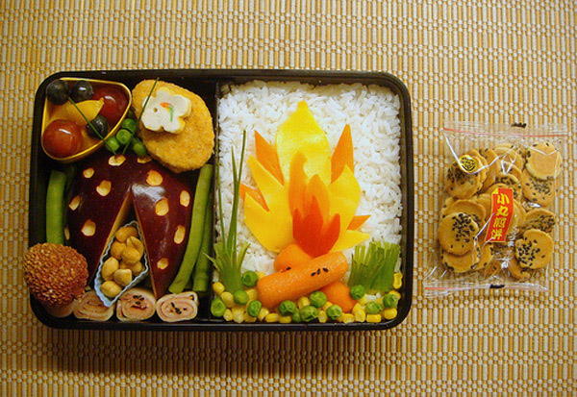
What will you make?

Slide 26
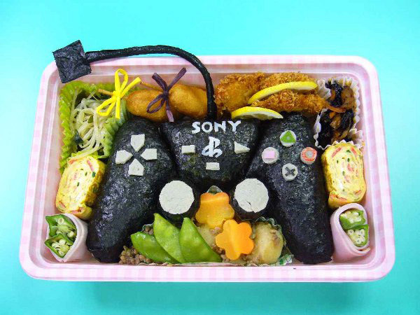
Are you a gamer?

Slide 27
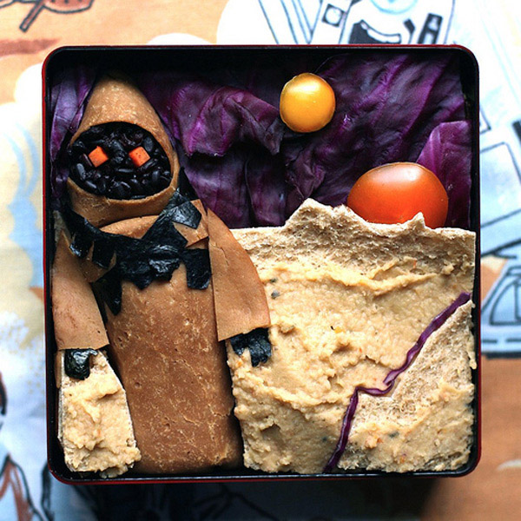
Star Wars Fan?

Slide 28
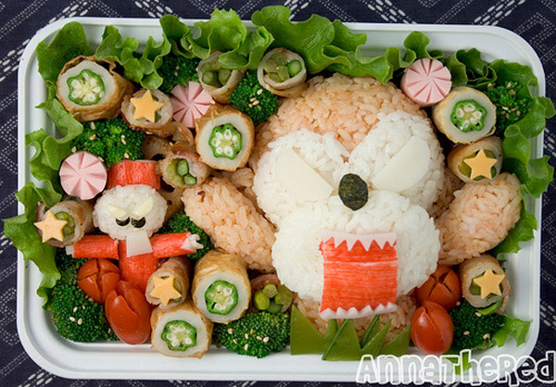
Monkey Magic?

Slide 29
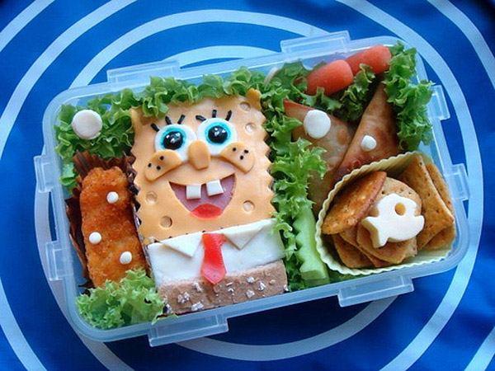
Sponge Bob

Slide 30
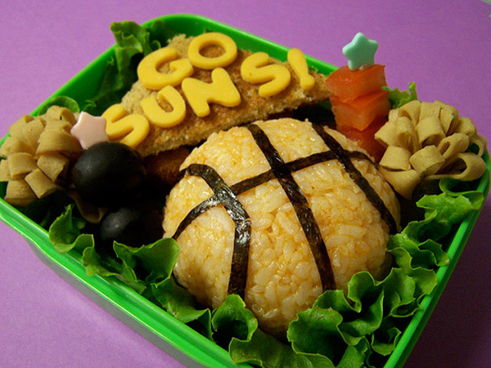
NBA

Slide 31
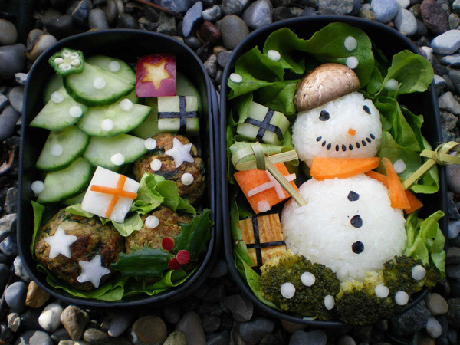
Winter is Coming

Slide 32
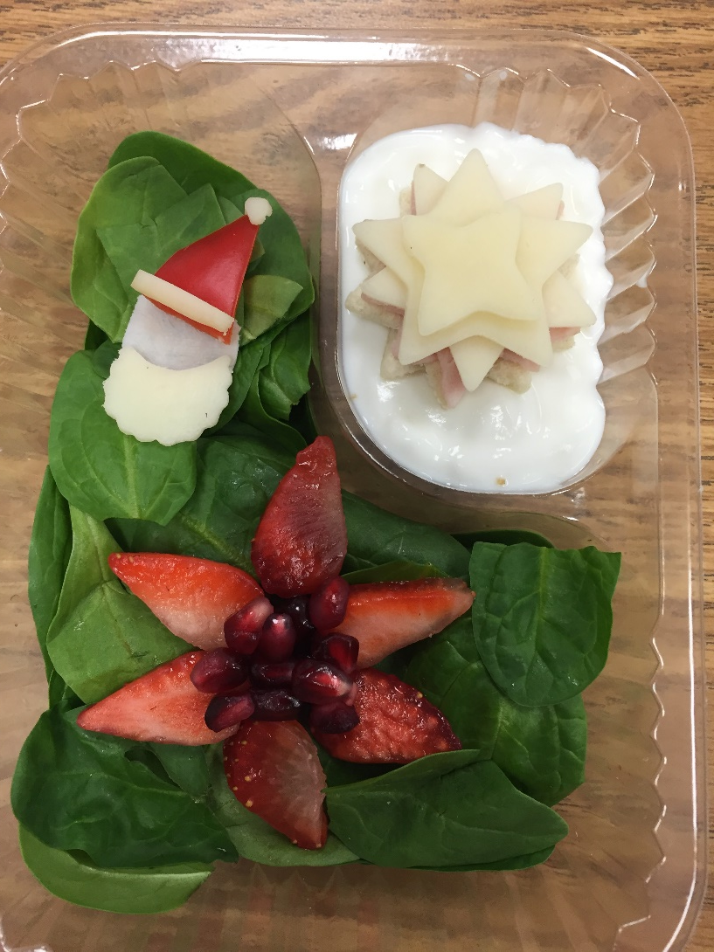

Slide 33
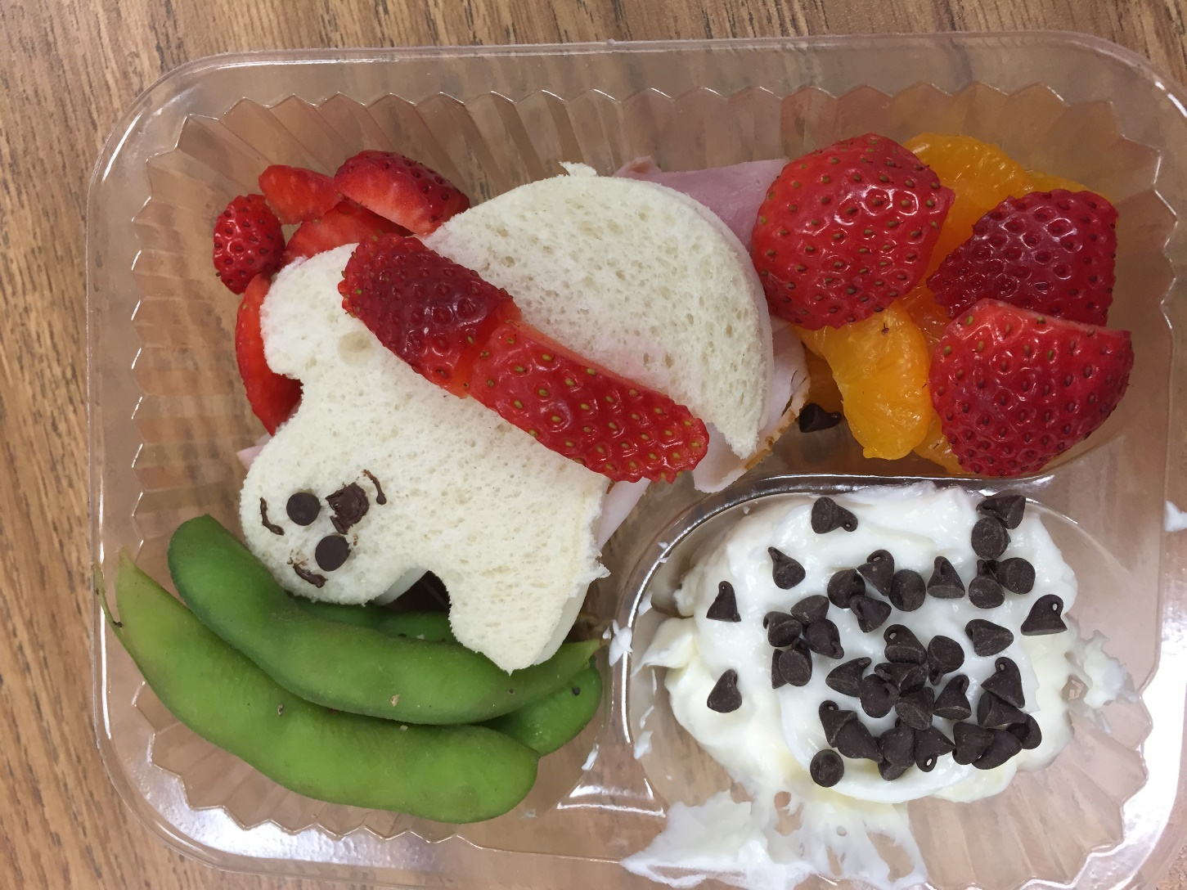

Slide 34
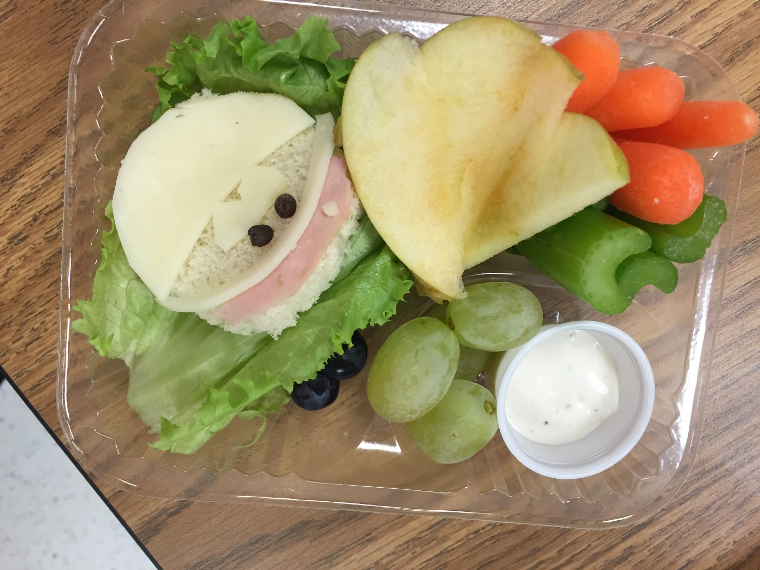

Slide 35
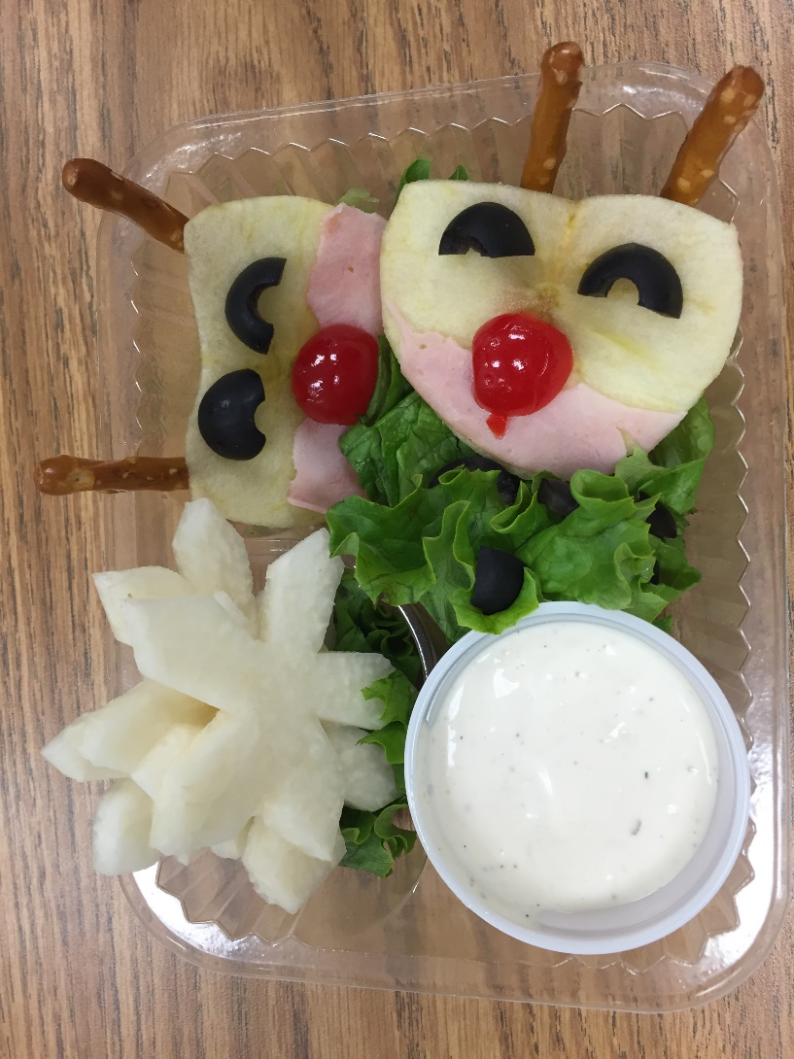

Slide 36
Bento Box
Almost anything you can thing of can become a Bento Box theme.
For most Japanese mothers, lunch is not just simple food preparation and packing meals for their love ones, they spend their time arranging the meal in aesthetically pleasing way. These lunch boxes are known as “Bento.” Bento is a Japanese word for a meal served in a box. Today, they are a vibrant art form admired around the world.

