Slide 1
Cooking Techniques, Seasonings and Flavorings

Slide 2
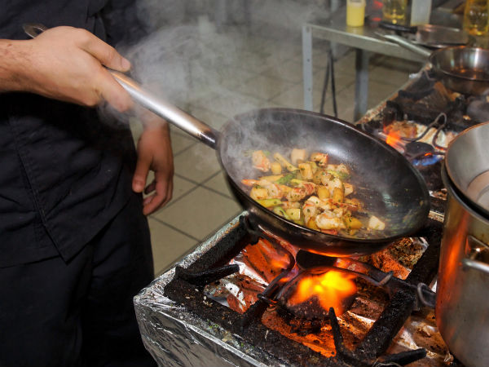
Cooking
Cooking is the transfer of energy from a heat source to food. Cooking affects nutritional value, texture, color, aroma and flavor.

Slide 3
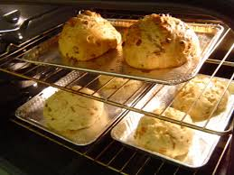
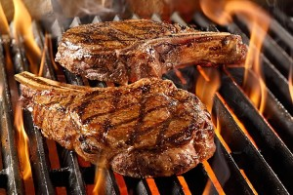
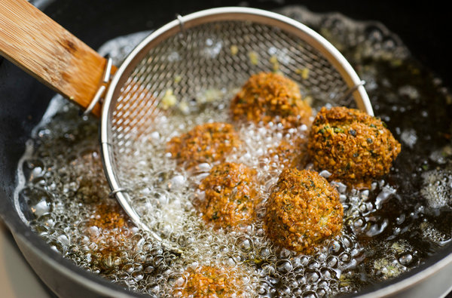
Dry Heat
Applies heat directly with flame or indirectly by surrounding food with heated air or fat.
Techniques include:
Baking
Grilling – heat below
Broiling – heat above
Roasting
Sautéing/Stir-Frying
Pan Frying
Deep Frying

Slide 4
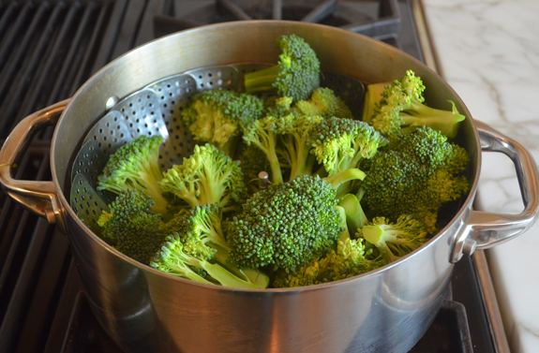
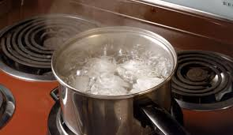
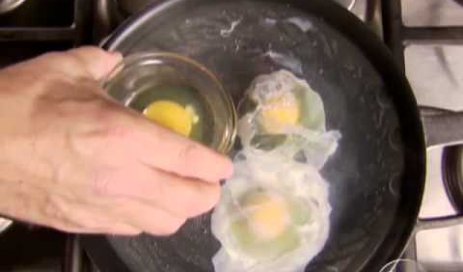
Moist Heat
Applies heat to food by submerging it directly in hot liquid or steam. Can tenderize less tender foods. Flavor and nutrients can be lost when moist heat is used.
Techniques include:
Poaching 160-180
Simmering 185-205
Boiling 212
Steaming 212 or higher
Blanching – boiled for a short time to partially cook food
*Adjust temperatures for altitude

Slide 5
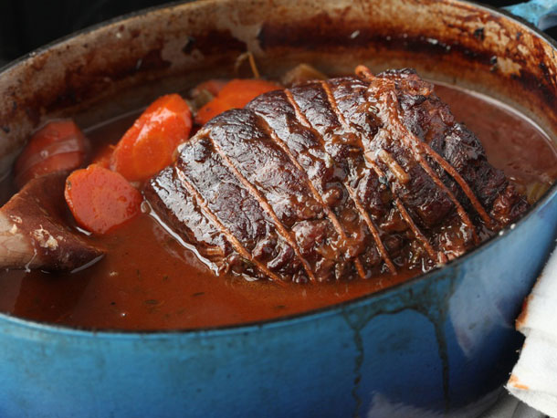
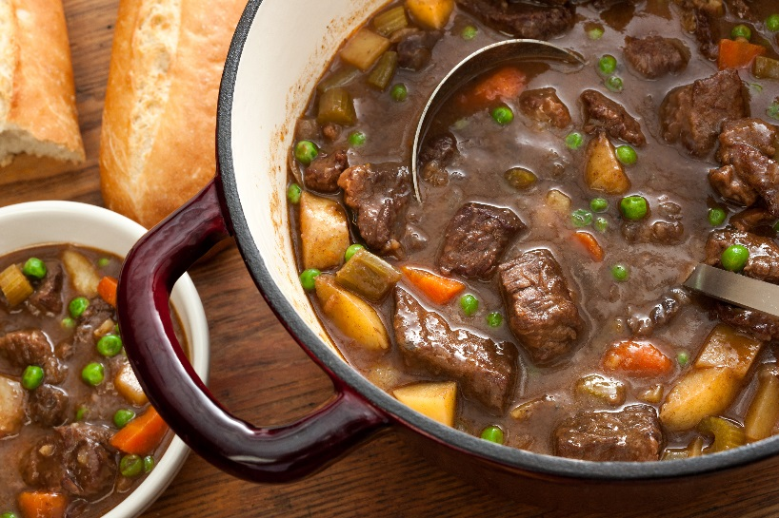
Combination
First step is to brown the food using a dry heat method. The second step is to complete cooking by simmering the food in a liquid.
Use for less tender cuts of meat, poultry and vegetables.
Creates a richness in the flavor.
Techniques include:
Braising – large pieces of food
Stewing – small pieces of food

Slide 6
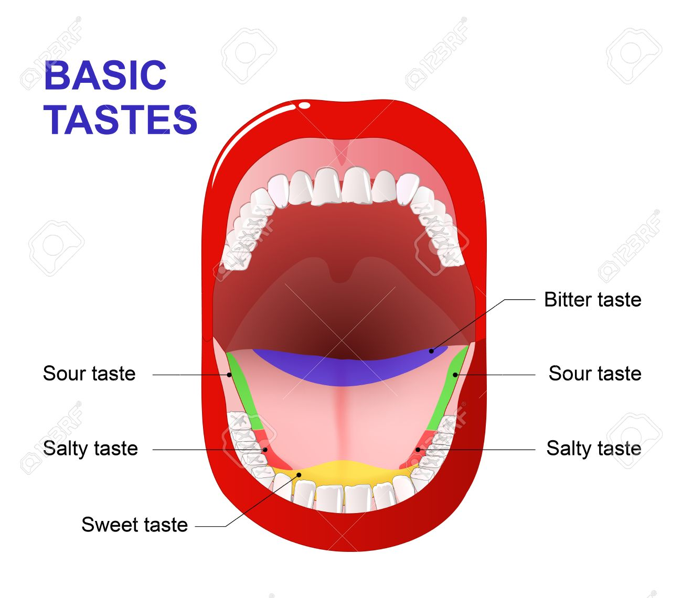
Flavor
Flavor can be defined as the sensory properties of food. These are perceived with taste, aroma, temperature, appearance and texture.
Tastes: sweet, sour, salty, bitter
Chinese include hot/spicy as a fifth taste
Umami (from Japan) has recently been accepted by western cultures as a 5th taste - savory

Slide 7
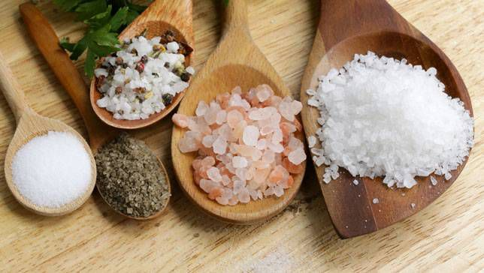
Seasoning
Ingredients that enhance the flavor of food without changing the natural flavor.
Salt is the most basic and most commonly used seasoning.
Monosodium Glutamate (MSG) – comes from seaweed, intensifies the natural flavor of most foods it’s added to. (No effect on milk or fruit)

Slide 8
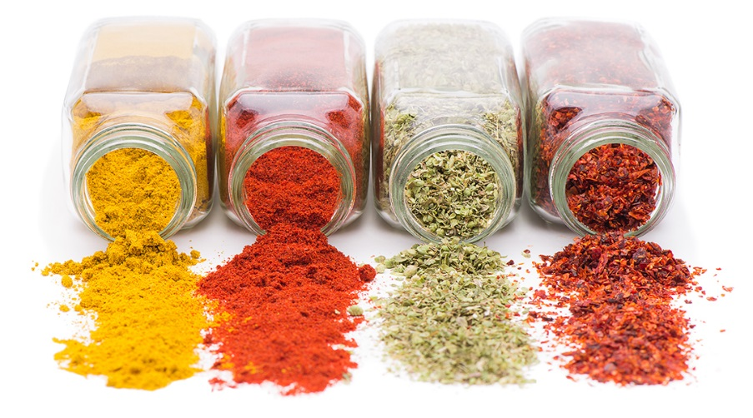
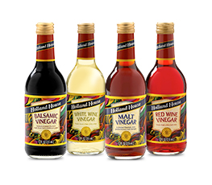
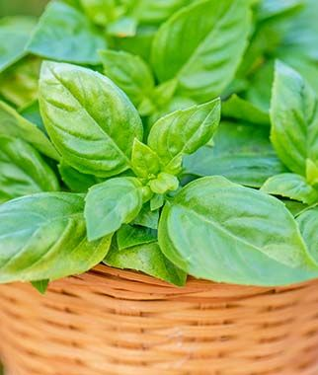
Flavoring
An item that adds a new taste to food and/or alters its’ natural flavors.

Slide 9
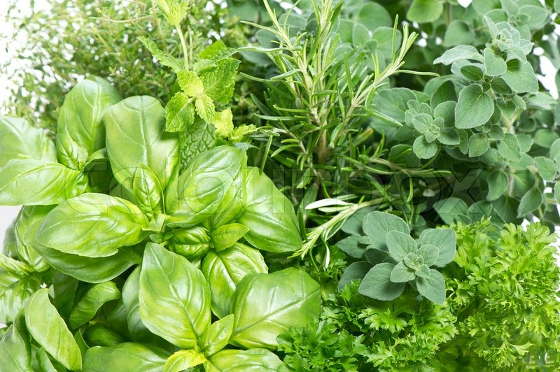
Herbs
The leaves, stems and flowers of aromatic plants.
Available fresh and dry.
When using dry, use half as much as fresh.
Fresh herbs are added at the end of cooking
Dried herbs are added at the beginning of cooking
Store dried in airtight containers away from heat and light
Store fresh herbs in the refrigerator

Slide 10
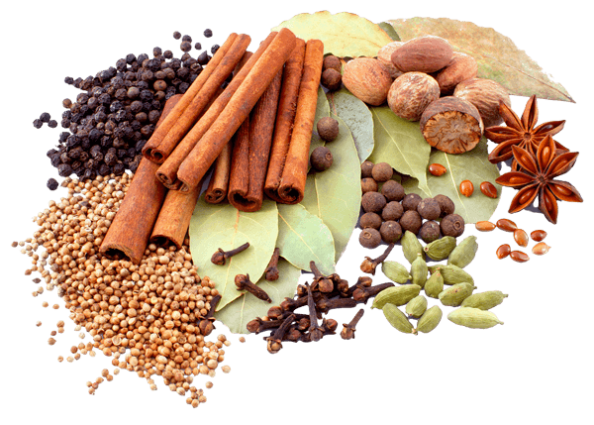
Spices
Bark, buds, fruit, roots, seeds or berries
Usually in dry form, available whole or ground.
Store in airtight container and avoid light
Pepper is the most common spice used

Slide 11
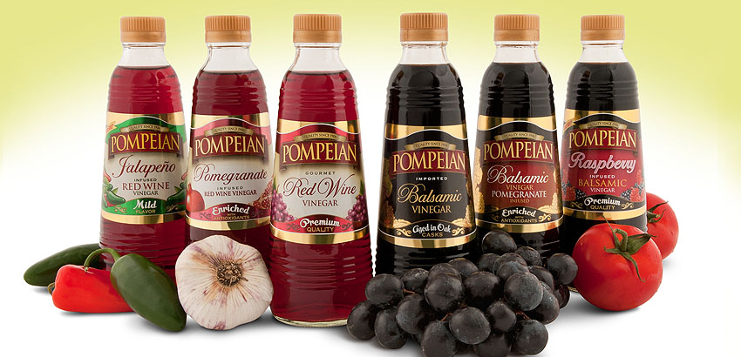
Vinegars
Thin, sour, acidic liquid that can be used to add flavor during cooking or as a condiment
Vinegar was alcohol
Vinegar is often named for the ingredient it is made from
Wine vinegars were made from wine
Cider vinegar from apple cider (alcohol type)
Rice wine vinegar from rice wine
Balsamic is from grapes (wine) reduced and aged in wooden barrels 4-50 years high acid level, but sweet

Slide 12
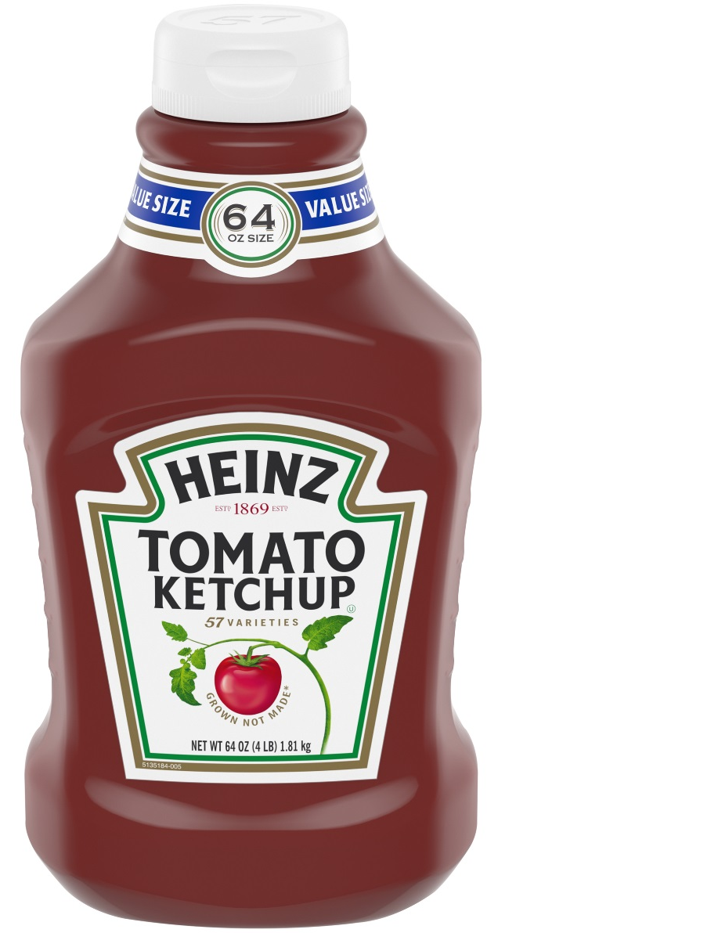
Condiments
Sauces that are served as an accompaniment to foods. May be used to alter or enhance flavor
Common condiments
Ketchup
Mustard
Salsa
Soy Sauce
BBQ Sauce
Hot Sauce
Pickled Foods

Slide 13
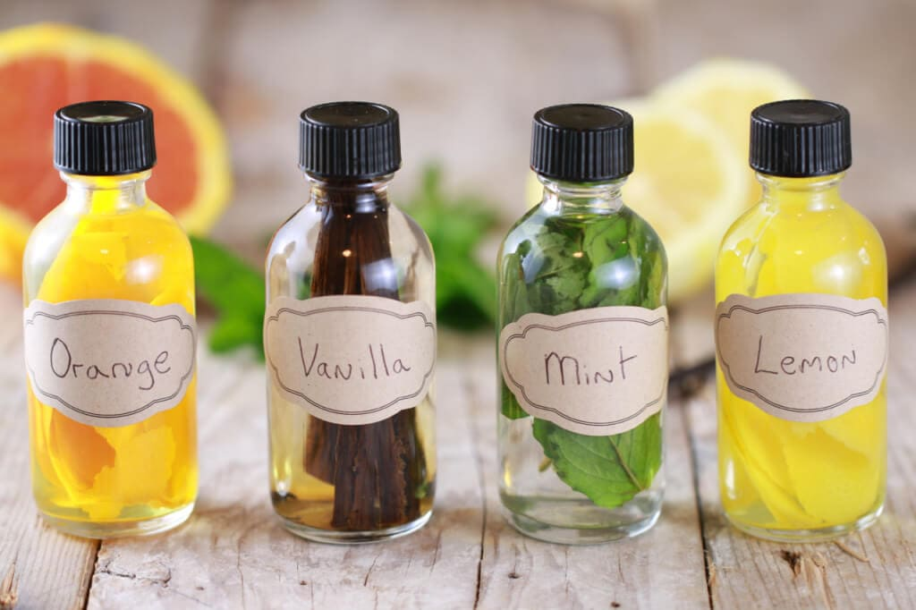
Extracts
Concentrated flavors most often used in baking.
Vanilla, lemon, almond, etc.

Slide 14
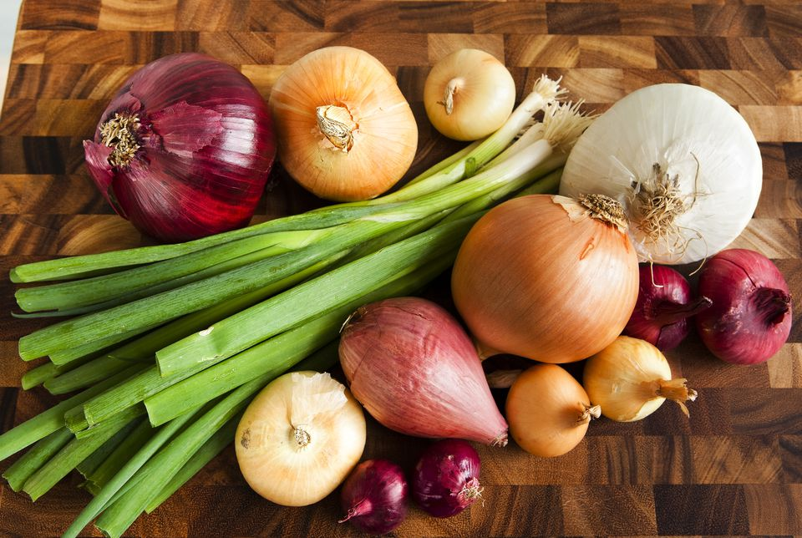
Onions
Includes
Scallions
Leeks
Shallots
Chives
Garlic

Slide 15
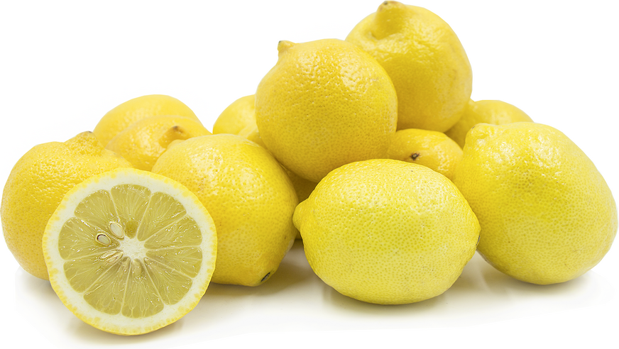
Lemons
Use only the zest or juice
Use fresh when ever possible

Slide 16
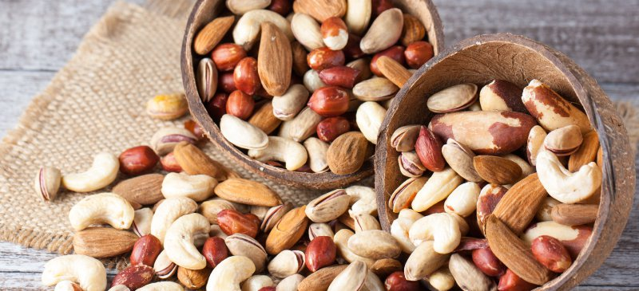
Nuts
Adds flavor, texture and color

