Slide 1
Culinary Management Vocabulary Words

Slide 2
Strand 1
Equipment

Slide 3
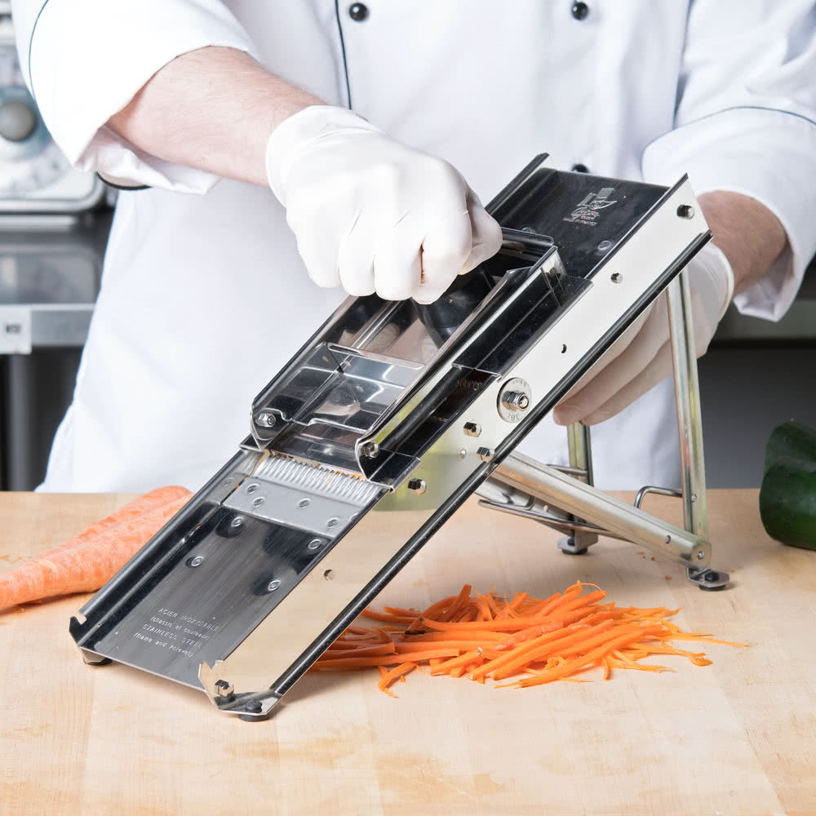
Mandoline
Definition: Used for slicing and for cutting juliennes
Tip: Make sure to use the finger guard

Slide 4
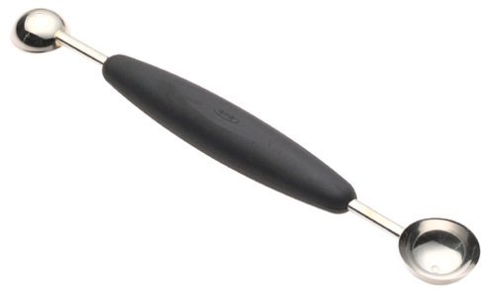
Parisian Scoop
Definition: Used for cutting spheres out of fruit and vegetables.
Tip: Parisian scoops are sometimes called melon ballers.

Slide 5
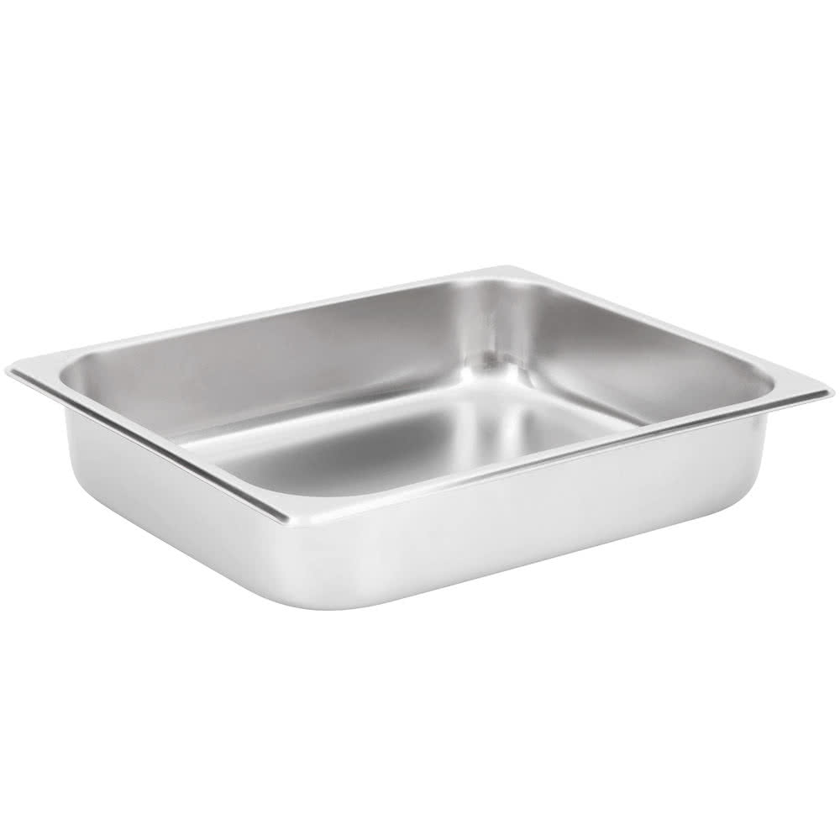
Hotel pan
Definition: Large rectangular pans that food is cooked in and served from
Tip: Hotel pans come in large variety of sizes depending on the need.

Slide 6
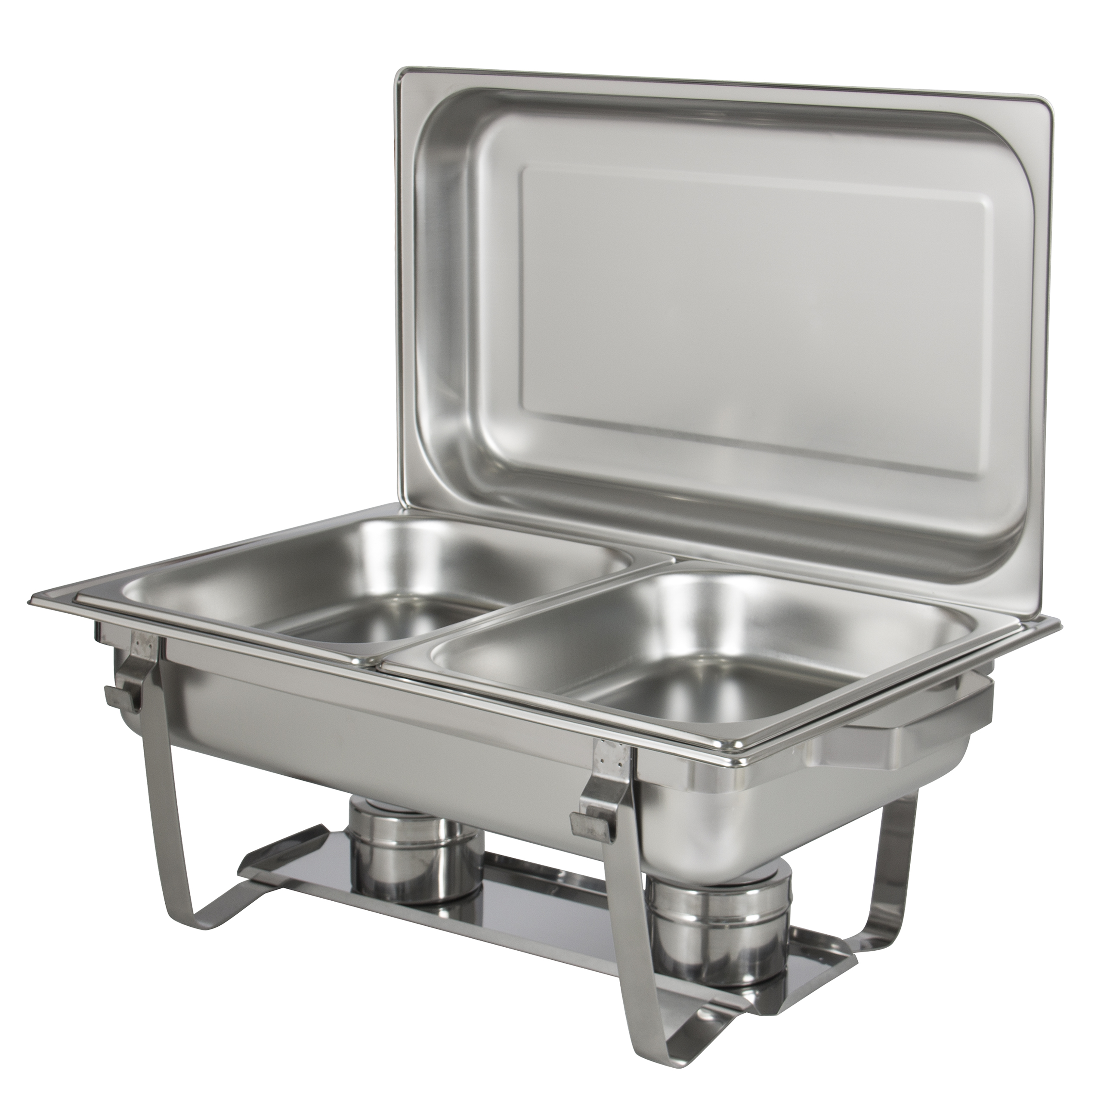
Chafing Dish
Definition: a metal dish with a lamp or heating appliance beneath it, for keeping food hot
Tip: These hold hotel pans to keep food hot at a buffet line.

Slide 7
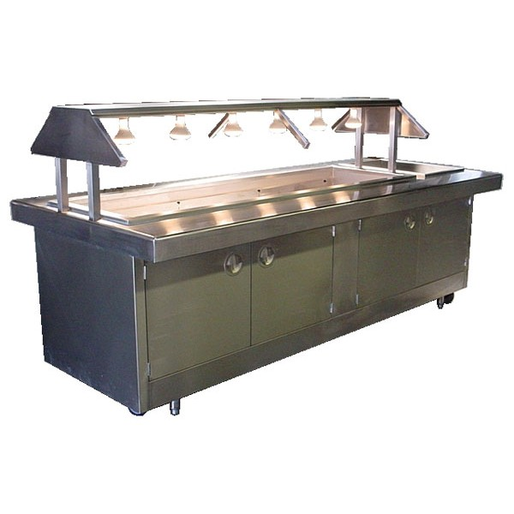
Steam Table
Definition: table with slots to hold food containers which are kept hot by steam circulating beneath them
Tip: This is where you get your hot food from restaurants like Chuck-a-Rama

Slide 8
Convection Oven
Definition: a convection oven has a fan and that blows hot oven air over and around the food
Tip: When using a convection oven lower the temperature 25 degrees.
Notes:
http://www.thekitchn.com/whats-a-convection-oven-and-when-do-i-use-it-appliance-guides-from-the-kitchen-216549

Slide 9
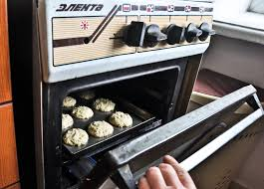
Conventional Oven
Definition: The heat source in a conventional oven is stationary, usually radiating from the bottom
Tip: Conventional ovens are better for baking.
Notes:
https://www.chowhound.com/food-news/176267/whats-the-difference-between-a-conventional-and-a-convection-oven-2/

Slide 10
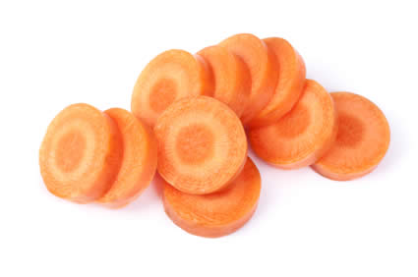
Rondelle
Definition: Round cut, also called a coin cut.
Tip: Keep thickness even to make sure that cooking is even.

Slide 11
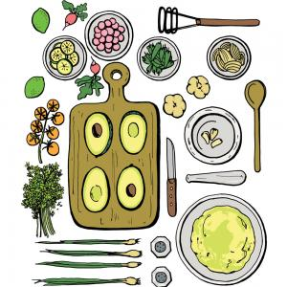
Mise En Place
Definition: a French term for having all your ingredients measured, cut, peeled, sliced, grated, etc. before you start cooking
Tip: Put in place

Slide 12
Strand 2
Safety and Sanitation

Slide 13
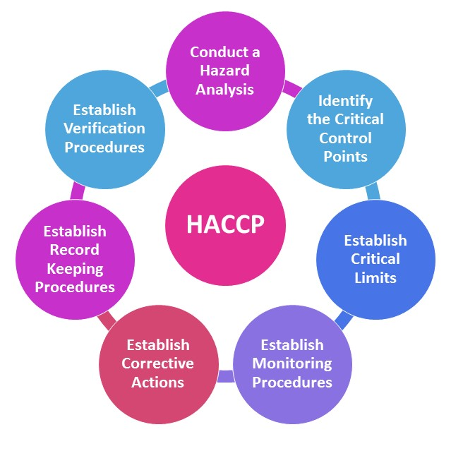
haccp
Definition: Hazard analysis and critical control points or HACCP is a system used to keep food safe by identifying and monitoring critical control points
Tip: Some food service establishments have a HACCP plan in place

Slide 14
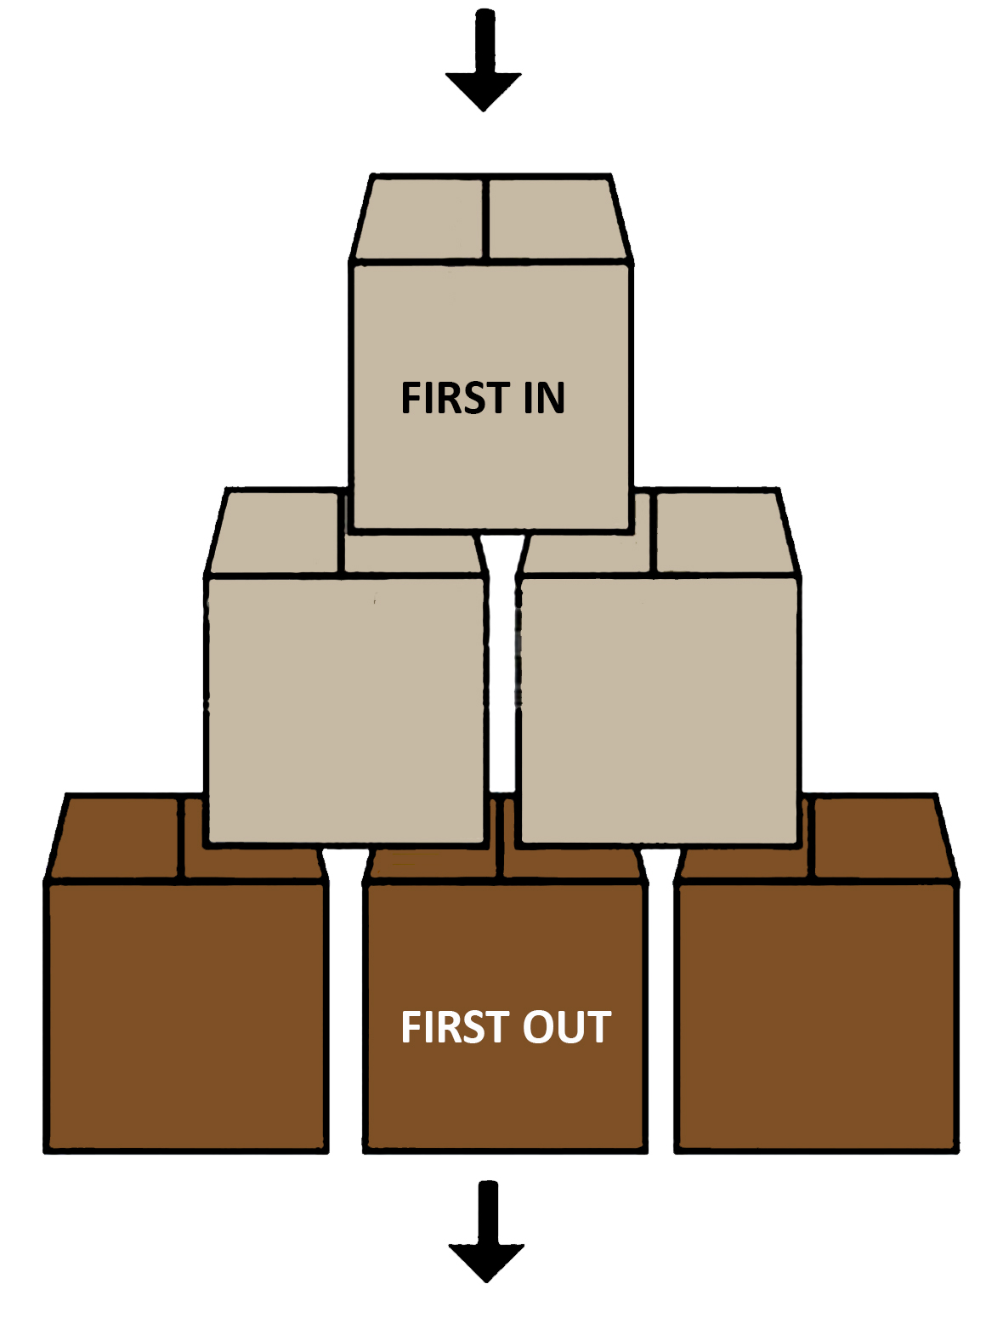
FIFO
Definition: Refers to a method of rotating the oldest stock out before using newer food. First in, First Out
Tip: rotate newer items to the back of the shelf

Slide 15
Cross-contact
Definition: When one food containing allergens comes in contact with a surface or food, thereby posing a hazard for persons having that allergy.
Tip: Food labels remind customers of the possibility of cross contact.

Slide 16
Cross-contamination
Definition: the human transfer of pathogens from one surface or food to another.
Tip: Cross-contamination can be avoiding by washing hands, knife and cutting station between tasks.

Slide 17
FATTOM
Definition: General conditions for bacterial growth include food, acidity, time, temperature, oxygen, moisture.
Tip: Not all of these conditions have to be present for bacteria growth, but combined, they ensure bacteria growth.

Slide 18
Bacteria
Definition: tiny single cell micro-organism.
Tip: Think Salmonella and E-coli

Slide 19
Virus
Definition: simple organism responsible for majority of foodborne illness .
Tip: Think Norovirus and Hepatitis A.

Slide 20
parasite
Definition: organism that must live in or on a host to survive
Tip: Think Giardia.

Slide 21
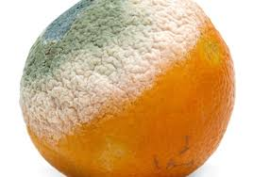
Fungi
Definition: spore producing organism including yeast and mold. Typically, visible on spoiled food.
Tip: some fungi can be eatable like mushrooms. .

Slide 22
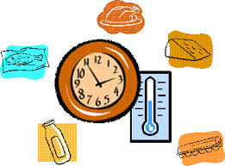
TCS
Definition: Refers to foods that are need time and temperature control for safety.
Tip: These are foods that have to be refrigerated before or after preparation.

Slide 23
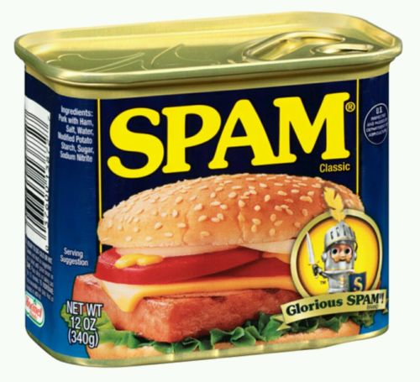
RTE
Definition: Refers to foods that are ready-to-eat.
Tip: These are foods that do not need any preparation to eat, like baby carrots or spam.

Slide 24
Clean
Definition: Free from visible dirt.
Tip: Just because there is no dirt on it does it mean that you would eat food off of it.

Slide 25
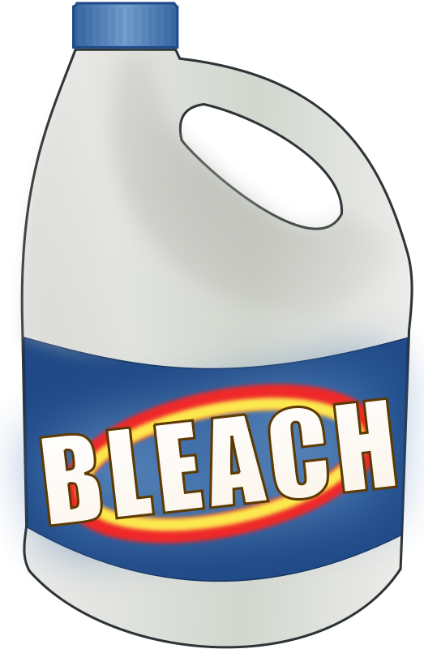
Sanitize
Definition: Free of bacteria.
Tip: You can buy sanitized dirt to eat!

Slide 26
SDS
Definition: Safety Data Sheets (SDSs) are summary documents that provide information about chemicals and advice about safety precautions.
Tip: Every place that has chemicals, will have a binder with SDS sheets for each chemical.

Slide 27
Strand 3
Culinary Math

Slide 28
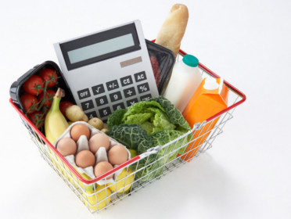
Food Cost
Definition: The cost of just the food
Tip: Food cost divided by food cost
Percentage = Menu price

Slide 29
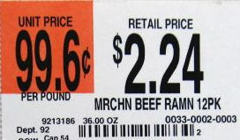
Unit Cost
Definition: cost per unit of an item.
Tip: Cost/Unit = Unit cost
Unit can be anything. It can be serving, a certain amount or each.
Look at the label, it is often on the shelf label next to the price.

Slide 30
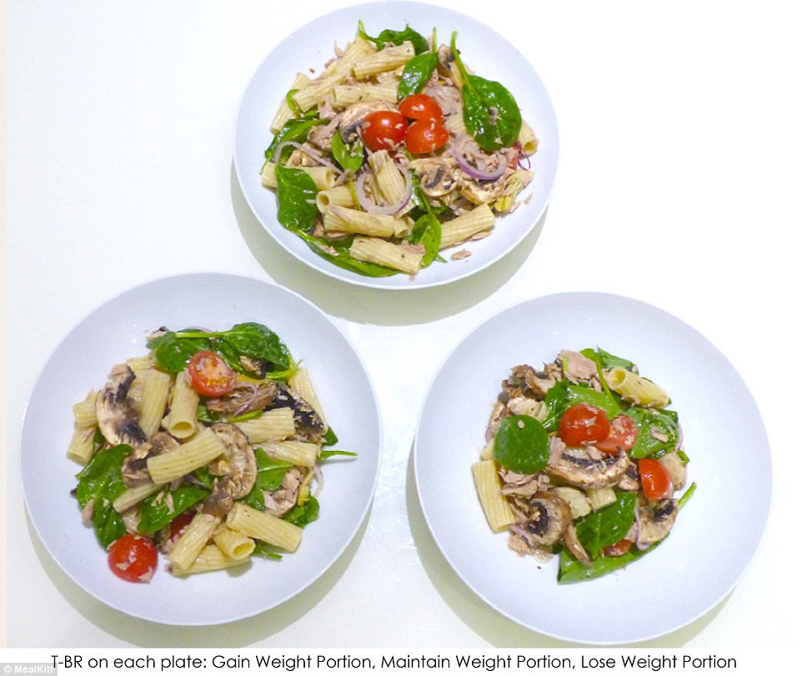
Portion
Definition: a part of a whole; an amount, section, or piece of something.
Tip: Portion sizes vary at restaurants depending on the price point and the cost of ingredients.

Slide 31
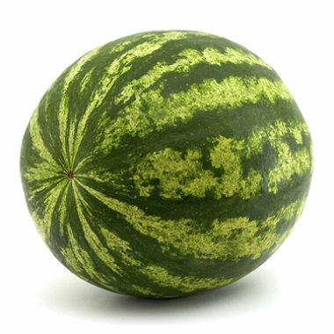
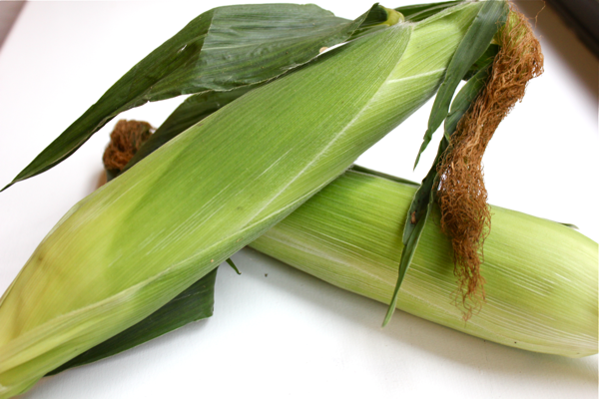
As Purchased
Definition: What an item weighs when it is purchased from the store or a supplier.
Tip: This would be like the whole watermelon or the whole unshucked ear of corn.

Slide 32
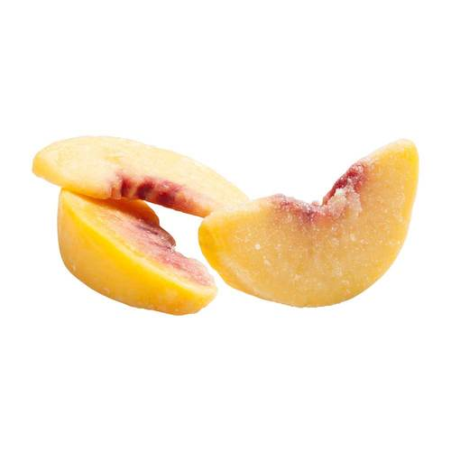
Edible portion
Definition: Edible portion is the amount (measured by weight) of food that is left after cutting and trimming.
Tip: This would be the weight of the peach after the pit and peel have been removed.

Slide 33
Percent yield
Definition: The percent of food you have after you have trimmed and peeled it
Tip: Edible portion/As purchased = Percent Yield (don’t forget to convert the decimal to a percentage)

Slide 34
receiving
Definition: The procedure for physically and legally accepting a shipment of product.
Tip: When receiving food, make sure that all the food is fresh, was shipped safely and that it is at the correct temperature.

Slide 35
Strand 4
Nutrition and Menu Design

Slide 36
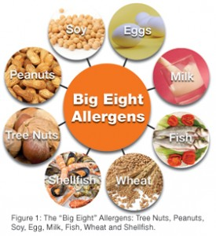
Food allergy
Definition: Food allergies produce histamine when a particular food is eaten.
Tip: Avoid cross-contact through proper food handling.

Slide 37
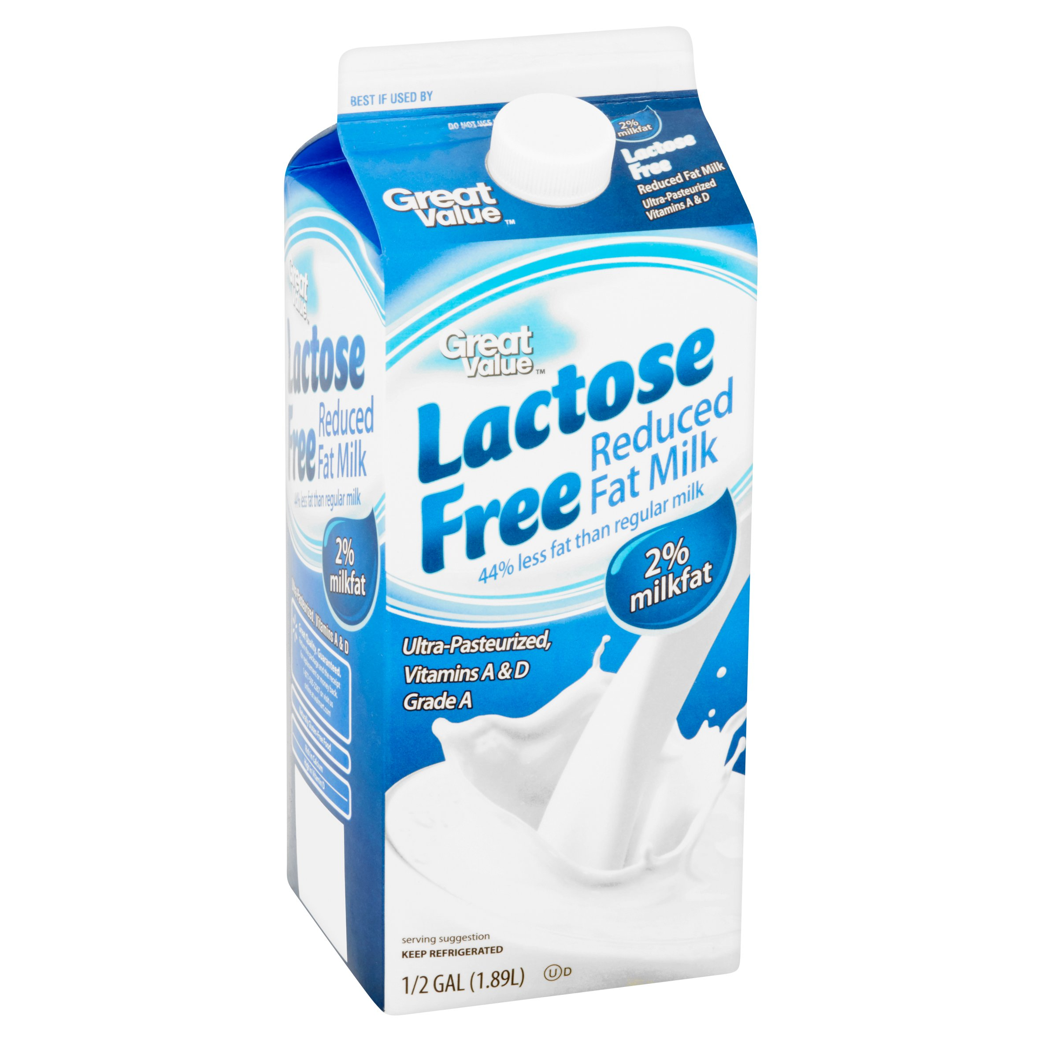
Food intolerance
Definition: A food intolerance is the body’s inability to process or breakdown.
Tip: Lactose intolerance is an example of a food intolerance.

Slide 38
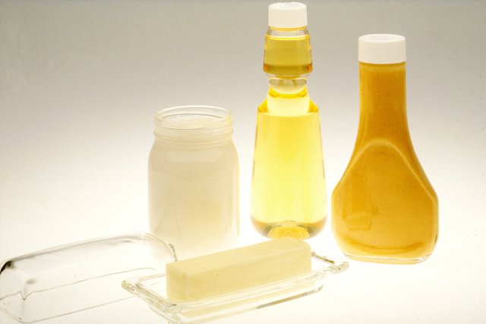
lipid
Definition: The classification of both fats and oils.
Tip: No more than 30% of your calories should come from lipids.

Slide 39
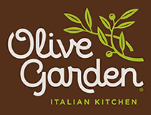
Static or Fixed
Definition: Menu that is fixed, still or unchanging; offers the same items everyday
Tip: Examples: McDonalds or Olive Garden

Slide 40
Cycle
Definition: Non-commercial – a series of menus that is repeated over a specific period of time.
Tip: Think: School cafeteria or hospitals.

Slide 41
Market
Definition: Food available in the market on any given day.
Tip: Think: Market Street Grill or Slapfish. Menu is printed everyday

Slide 42
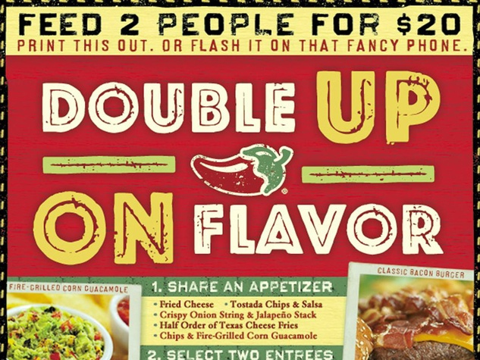
Table d’ hote or Prix Fixe
Definition: Complete meal at one price
Table D’ Hote – Set Menu
Prex Fixe – a la Carte
Tip: Think: Buffets or Chili’s 2 for $22

Slide 43
A LA carte
Definition: All items priced and ordered separately.
Tip: Think: PF Changs

Slide 44
California (menu)
Definition: All items offered all day
Tip: Think: Denny’s or IHop

Slide 45
Strand 5
Marketing

Slide 46
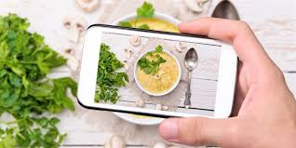
Trend
Definition: General direction in which something is developing or changing.
Tip: Think: Food trucks or farm to table.

Slide 47
marketing
Definition: The action or business of promoting and selling products or services.
Tip: Social media plays a HUGE role in marketing i.e. Waffle Love

Slide 48
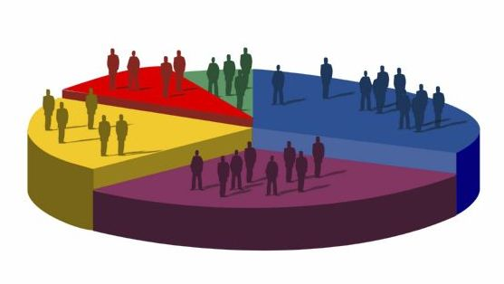
demographics
Definition: Data relating to a population or structure within it.
Tip: Restaurants often set their menu based on the demographics of their location.

Slide 49
advertising
Definition: Paying to present or promote an operation’s products, services or identity.
Tip: Advertising can be conducted through multiple mediums.

Slide 50
outreach
Definition: Donating time or materials to a cause for marketing purposes.
Tip: This is a marketing strategy.

Slide 51
Strand 6
Breakfast Foods

Slide 52
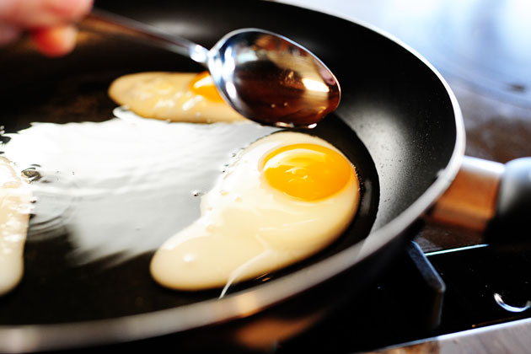
basted
Definition: a type of sunny side up in which the white is cooked by spooning hot butter over the egg while frying, or adding a little water to the pan/grill and covering the egg to steam it.
Tip: Makes the perfect sunny-side up because it cooks the membrane above the yolk.

Slide 53
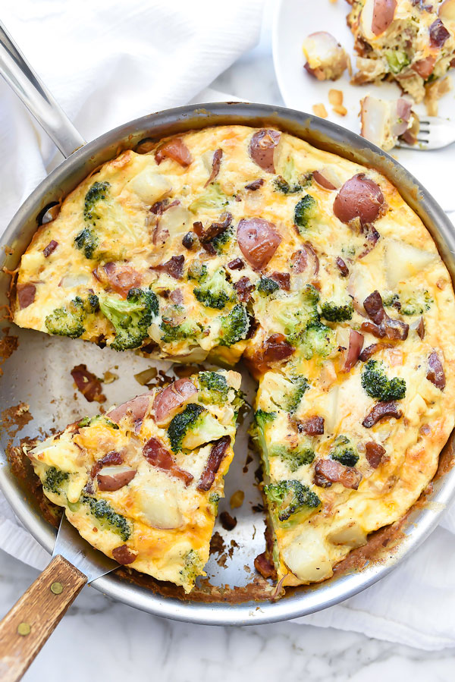
frittata
Definition: open faced omelets of Spanish origin, the hearty fillings are mixed directly into the eggs, cooked on the stove and transferred to oven or broiler to finish cooking through.
Tip: Usually served in wedeges.

Slide 54
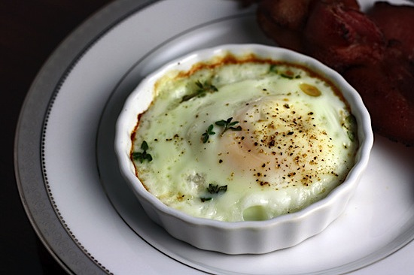
shirred
Definition: Baked egg in individual ramekins and often topped with grated cheese, fresh herbs or a sauce.
Tip: The whites should be set while the yolks are soft and creamy.

Slide 55
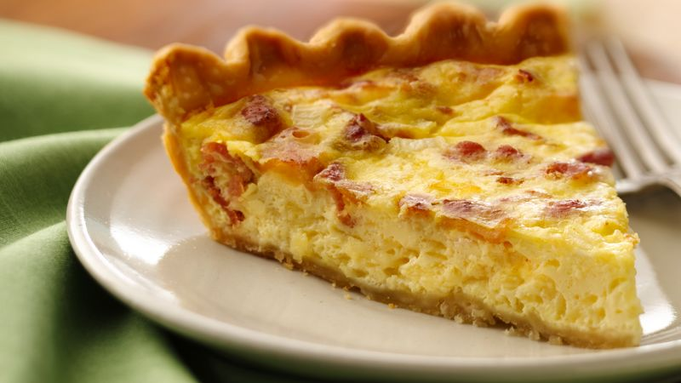
quiche
Definition: an egg custard and fillings baked in a crust
Tip: Can be made in larger crusts or bite-sized crusts.

Slide 56
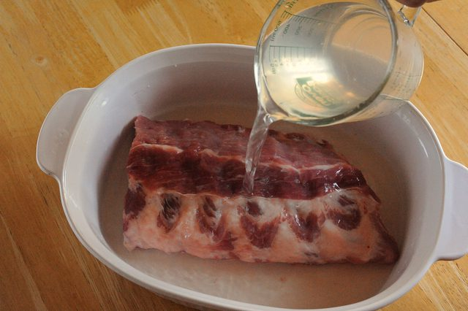
brining
Definition: is a process similar to marination in which meat is soaked in a high-concentration solution of salt in water.
Tip: You can add flavors to your brining liquid to make your meat more flavorful.

Slide 57
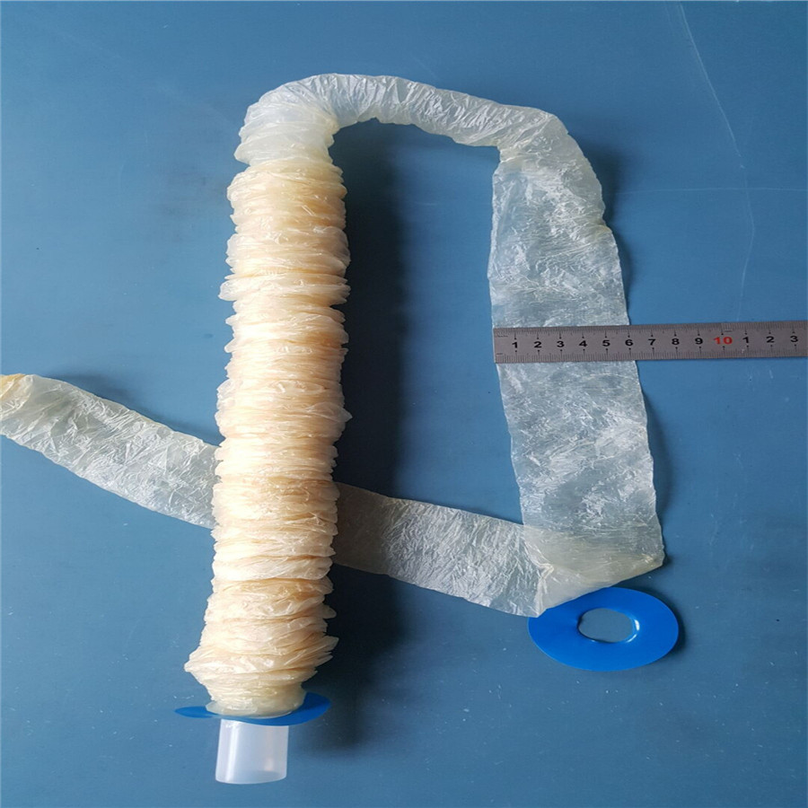
casing
Definition: the material that encloses the filling of a sausage
Tip: Casings can be natural or artificial. Natural casings are animal intestines.

Slide 58
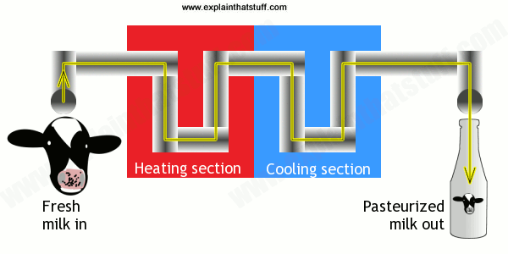
pasteurized
Definition: the process of heating milk to destroy pathogens.
Tip: You can buy unpasteurized or raw milk, but you have to sign waver.

Slide 59
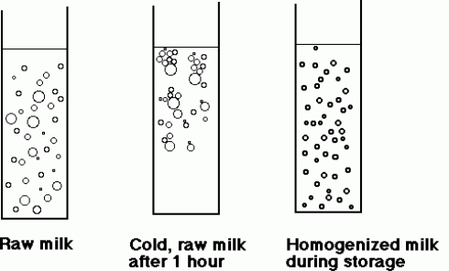
homogenized
Definition: the process in which the fat particles in milk are reduced in size and dispersed throughout the liquid.
Tip: the dots in the picture represent the fat in the milk.

Slide 60
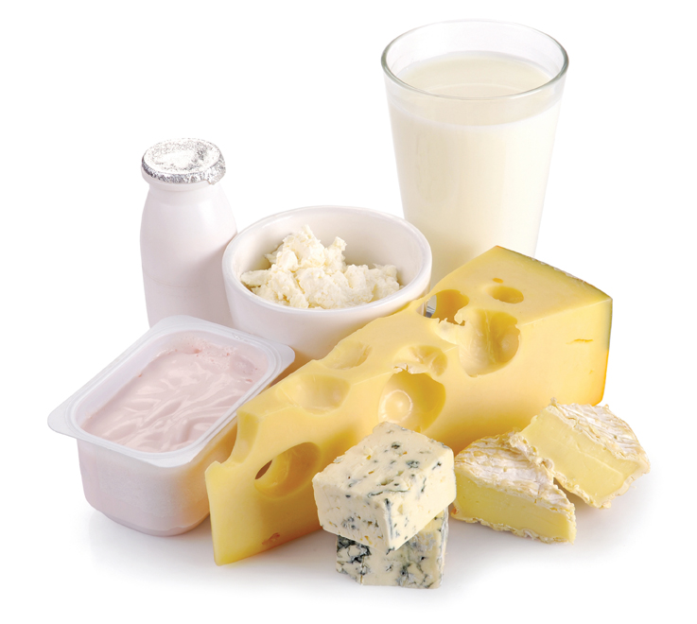
Culture (micro-organism)
Definition: a specific bacteria added to fluid dairy products.
Tip: cultures are added to foods like yogurt, buttermilk, cheese and sour cream.

Slide 61
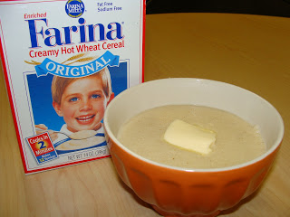
farina
Definition: is a form of milled wheat most often used to prepare hot cereal for breakfast
Tip: This is Creamed Wheat or Malt-o-Meal.

Slide 62
Strand 7
Fruits and Vegetables

Slide 63
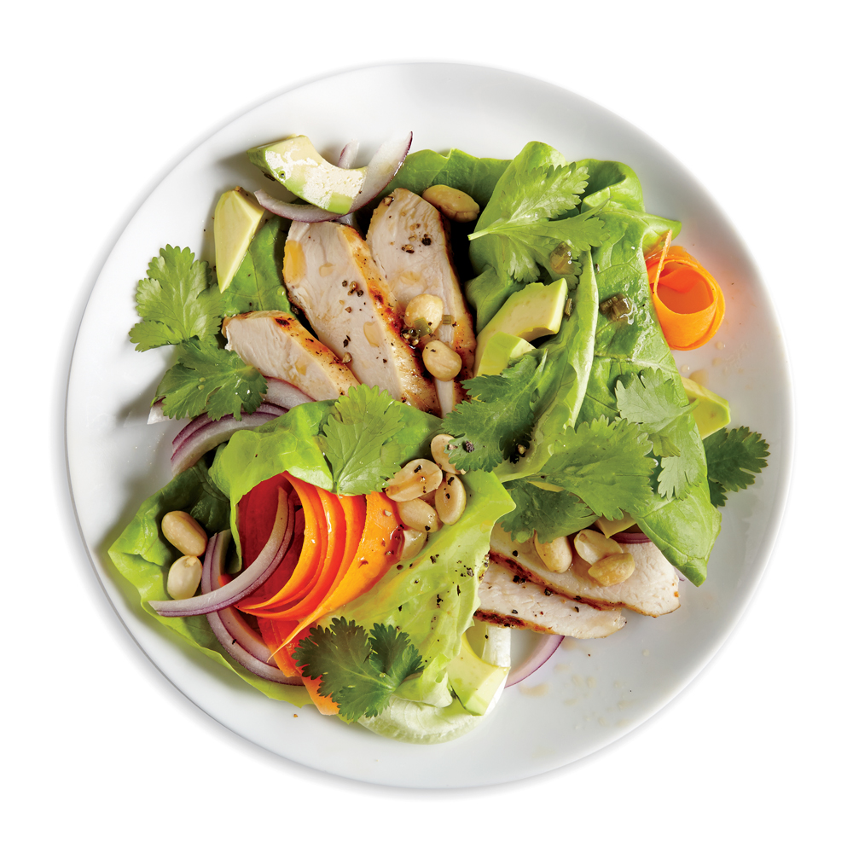
Garde Manger
Definition: category of cold food, including salads, dressings, fruit plates, and many other types of cold appetizers and buffet platters.
Tip: This term also refers to a chef who prepares those types of foods along with a cold room to prepare cold food.

Slide 64
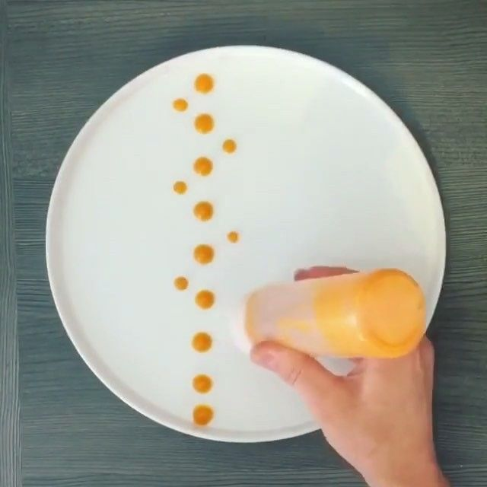
garnish
Definition: a decorative piece of an edible ingredient used as a finishing touch to a dish or drink.
Tip: garnishes should complement the food they are served with and should be edible.

Slide 65
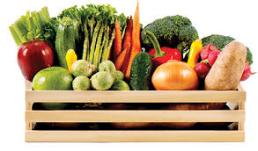
produce
Definition: Fresh fruits and vegetables
Tip: Buying produce in season helps ensure that you get the best quality food.

Slide 66
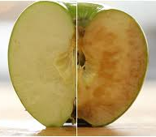
Enzymatic Browning
Definition: Typically produce that turns brown from exposure to oxygen and/or cell damage.
Tip: You can use ascorbic acid (vitamin C) or water to slow enzymatic browning of cut fruits and vegetables.

Slide 67
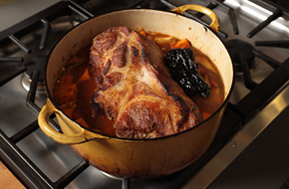
braising
Definition: a long, slow cooking process; meat is first seared and the pan is deglazed before the moist cooking technique is used.
Tip: Braising is an excellent way to tenderize super tough cuts of meat.

Slide 68
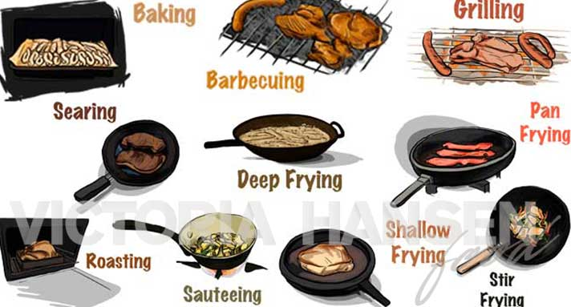
Dry heat
Definition: it uses fats, oils, radiation of hot air or metal to transfer heat.
Tip: This method helps maintain nutrients and flavors

Slide 69
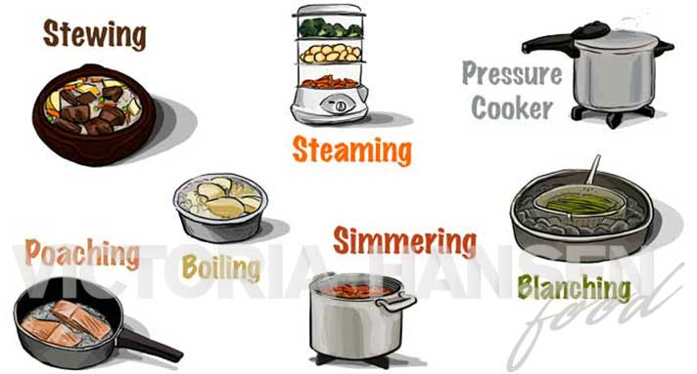
Moist heat
Definition: using hot liquids to create the heat that is needed to cook food.
Tip: This cooking method is great for tough cuts of meat.

Slide 70
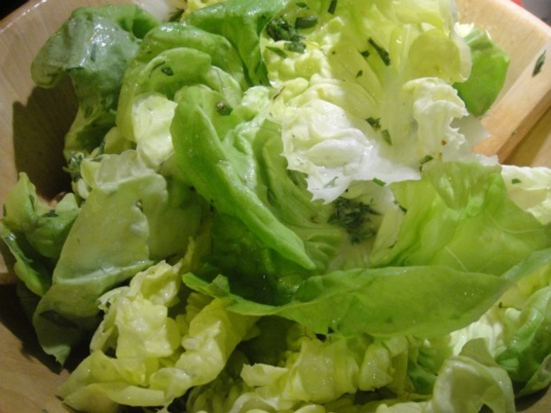
intermezzo
Definition: A light salad served after the main course to refresh the palate.
Tip: Usually lettuce with a very light dressing on it.

Slide 71
Strand 8
Baking

Slide 72
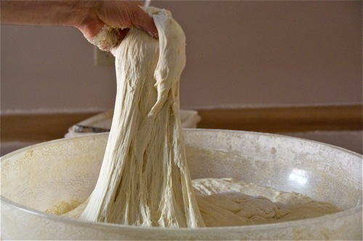
gluten
Definition: an elastic protein that is responsible for giving baked goods structure.
Tip: Needed for proper bread formation

Slide 73
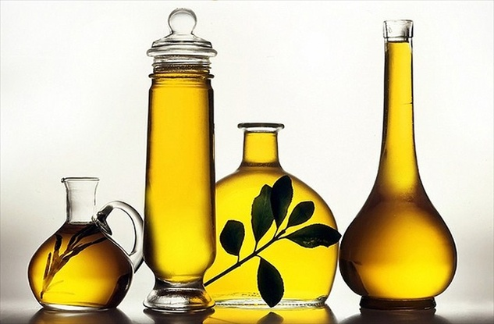
Rancid
Definition: term generally used to denote unpleasant odors and flavors in foods resulting from deterioration in the fat or oil
Tip: If it smells bad throw it out

Slide 74
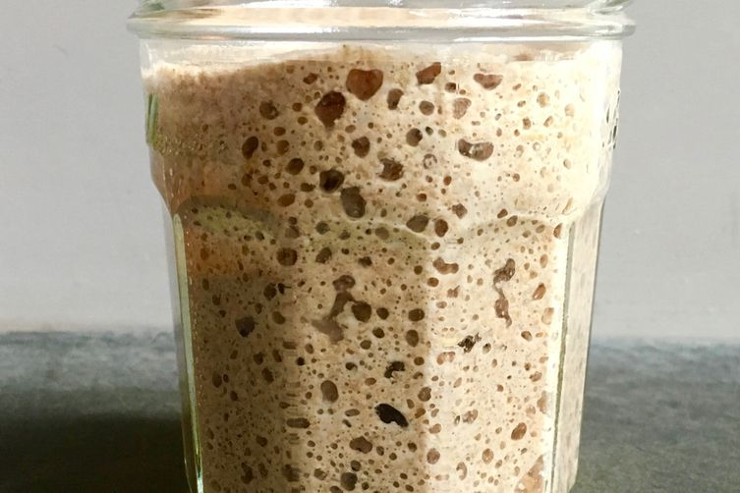
Starter (sour dough)
Definition: a mixture of flour, yeast, sugar and liquid. It gives bread a unique, mildly sour taste
Tip: You have to feed the starter

Slide 75
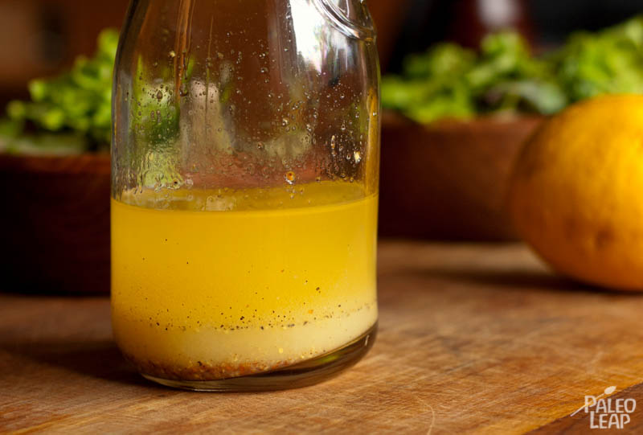
emulsification
Definition: the process of mixing two or more liquids that are unmixable
Tip: Eggs make a great emulsifier

Slide 76
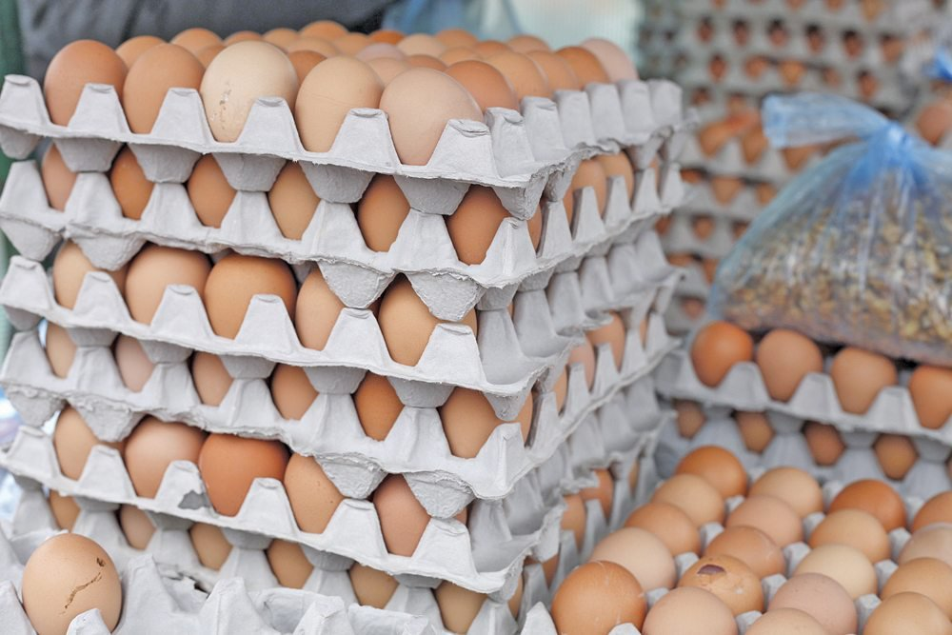
Flats (Egg)
Definition: Usually sold in cardboard carton that hold 30 eggs and in packages of 2 or more.
Tip: when buying check the edges for broken eggs

Slide 77
leavening
Definition: gasses trapped in dough, creating small bubbles that give baked goods a light and airy texture.
Tip: Yeast, baking soda, baking powder, steam and eggs are all types of leavening.

Slide 78
Chocolate liquor
Definition: is a thick, gritty, dark brown paste comprised of roughly half cocoa butter and half cocoa solids.
Tip: This has nothing to do with alcohol.

Slide 79
Cocoa butter
Definition: pale-yellow, edible vegetable fat extracted from the cocoa bean. It is used to make chocolate.
Tip: When chocolate blooms, it is the cocoa butter coming to the surface.

Slide 80
nibs
Definition: bits of fermented, dried, roasted and crushed cacao bean.
Tip: These are bitter, there is no sugar in them

Slide 81
ratio
Definition: the relationship between two or more ingredient amounts in a recipe.
Tip: Baking recipes are often in ratio format like pie dough is 3:2:1

Slide 82
Blind bake
Definition: Shells that are baked empty before filling
Tip: You can bake the shell empty but is turns out better if you weight it with dry beans or ceramic weights

Slide 83
Chiffon (pie)
Definition: based on a cooked fruit or cream pie that is stabilized with gelatin. When the filing is cooled a meringue is folded into the filing and then placed in a blind-baked pie shell.
Tip: Lemon or Raspberry Chiffon is nice, it’s very fluffy.

Slide 84
custard
Definition: a filling made with eggs that firm the pie when baked.
Tip: Examples are pumpkin and pecan.

Slide 85
creaming
Definition: used for high-fat cakes. Cream fat, sugar and salt, add the eggs and other liquids mixing to fully incorporate; add the sifted dry ingredients.
Tip: Used when making cookies as well.

Slide 86
fondant
Definition: a thick paste made of sugar and water and often flavored or colors. Used in the making of candy and the icing and decoration of cakes.
Tip: Fondant doesn’t usually taste very good.

Slide 87
ganache
Definition: a glaze, icing, sauce, or filling for pastries made from chocolate and cream.
Tip: When used as an icing it is usually poured.

Slide 88
Strand 9
Grains and Starches

Slide 89
Legume
Definition: a group of vegetables that included bean, peas and lentils.
Tip: Dried legumes must be soaked for a long period of time before cooking.

Slide 90
risotto
Definition: : This method cooks rice while stirring in warm, flavorful liquid a little at a time.
Tip: An Italian dish.

Slide 91
fortified
Definition: adding nutrients to a food that would otherwise would not be there.
Tip: Rice is often fortified, especially when sent to third world countries.

Slide 92
Al Dente
Definition: an Italian term meaning tender with a little firmness in the center.
Tip: Bite the pasta to check if it is al Dente.

Slide 93
Lentils
Definition: small, round, lens-shaped legume that come in many colors and sizes
Tip: Like legumes lentils need to be soaked.

Slide 94
Strand 10
Protein

Slide 95
Fabrication
Definition: the process of cutting or breaking down the meat/poultry into its usable parts.
Tip: Great way to learn how to carve a turkey.

Slide 96
tenderizing
Definition: make meat more tender by chemical, mechanical or cooking methods.
Tip: Fresh pineapple has natural meat tenderizers.

Slide 97
Mollusks
Definition: a shellfish with no internal skeletal structure.
Tip: Includes squid, octopus, mussels and scallops.

Slide 98
cephalopods
Definition: a category of mollusks that are known for their long arms that are covers with suckers.
Tip: Over cooking makes cephalopods tough to eat.

Slide 99
Bivalves
Definition: an aquatic mollusk that has a compressed body enclosed within a hinged shell, such as oysters, clams, mussels, and scallops.
Tip: Purchased with shells closed tight. If open they are dead.

Slide 100
viscera
Definition: the internal organs in the main cavities of the body, especially those in the abdomen
Tip: Fish viscera often has toxins and should not be eaten.

Slide 101
Strand 11
International Foods

Slide 102
Cuisine
Definition: A style or method of cooking specific to a country, region, or establishment.
Tip: Cuisine is influenced by ingredients available in a particular area.

Slide 103
cassoulet
Definition: a stew made with meat and beans
Tip: This dish is named after a cooking vessel.

Slide 104
lutefish
Definition: lyed fish - dried cod or ling that has been steeped in lye. Preservation method.
Tip: Has a gelatinous texture.

Slide 105
pierogies
Definition: a dough dumpling stuffed with a filling such as potato or cheese, typically served with onions or sour cream.
Tip: From Eastern Europe.

Slide 106
Trifle
Definition: multi layered dessert including cake, custard, and cream.
Tip: Common Birthday Treat in England.

Slide 107
curry
Definition: spiced vegetable and/or meat dish with a hearty sauce
Tip: Usually served with Jasmine Rice and sometimes thin breads.

Slide 108
falafle
Definition: spiced mashed chickpeas formed into fritters and deep fried
Tip: Used as a meat substitute.

Slide 109
Al forno
Definition: culinary technique meaning in the oven
Tip: Penne al Forno is an example of this cooking technique.

Slide 110
moussaka
Definition: ground lamb and eggplant or potatoes layered in a dish.
Tip: A Greek shepherds pie.

Slide 111
tangine
Definition: a spicy stew cooked in a shallow earthenware cooking dish with a tall, conical lid.
Tip: Traditionally from North Africa.

Slide 112
paella
Definition: shellfish, rice and saffron
Tip: Wonderful main dish from Spain usually cooked in a special pan.

