Slide 1
Writing The Effective Resume
The First Step Toward Landing Your Next Job

Slide 2
Find a Job…
Early Childhood Teacher Brighton Center, Inc. - Ogden, UT
Are you interested in a career in Early Childhood Education? Do you have a passion for working with young children in a quality learning environment? If so, Bright Days Child Development Center in Ogden, Utah is looking for you! Three star-rated Bright Days currently has full time Teacher openings. Our teachers engage children during all activities, and individualize classroom instruction to prepare children to be successful in school. Our teachers also ensure licensing and center guidelines are met with all federal and state laws and regulations. Requirements Our teachers are passionate, caring, flexible and energetic! A good candidate for this position will have a Child Development Associate (CDA) and/or degree in Early Childhood Education, and approximately 1 year of previous experience working with children. Benefits include health insurance, dental and vision insurance, retirement plan, paid time off, and professional development opportunities. To apply, qualified candidates should submit a cover letter and resume with salary requirements. Please include the title “ECE Teacher" in the subject line. To learn more about Brighton Center, including culture and additional open positions, please visit our website: http://www.brightoncenter.com/careers/ Required experience: Prior experience working with children in a childcare facility: 1 year

Slide 3
Look a little deeper…
Early Childhood Teacher Brighton Center, Inc. - Ogden, UT
Developmental or Custodial or Comprehensive??
Are you interested in a career in Early Childhood Education? Do you have a passion for working with young children in a quality learning environment? If so, Bright Days Child Development Center in Ogden, Utah is looking for you! Three star-rated Bright Days currently has full time Teacher openings. Our teachers engage children during all activities, and individualize classroom instruction to prepare children to be successful in school. Our teachers also ensure licensing and center guidelines are met with all federal and state laws and regulations. Requirements Our teachers are passionate, caring, flexible and energetic! A good candidate for this position will have a Child Development Associate (CDA) and/or degree in Early Childhood Education, and approximately 1 year of previous experience working with children. Benefits include health insurance, dental and vision insurance, retirement plan, paid time off, and professional development opportunities. To apply, qualified candidates should submit a cover letter and resume with salary requirements. Please include the title “ECE Teacher" in the subject line. Required experience: Prior experience working with children in a childcare facility: 1 year

Slide 4
Writing An Effective Resume
What information should be in a resume?
Characteristics of a successful resume.
Functional or Chronological.
Scannable resume.

Slide 5
What Information Should Be In A Resume?
Identify Yourself
Education
Continuing Education
Work or Professional Experience
Volunteer Experience
Computer Skills
Professional Associations
Optional Sections
Objective
Special Skills and Abilities

Slide 6
Characteristics Of A Successful Resume
Focuses on skills. Uses action words to define the
responsibilities of your job-related experience.
Easy to read and understand.
Visually powerful and free of gimmicks.
One page, or at most 2 pages long.

Slide 7
Characteristics Of A Successful Resume
Must always be 100% truthful.
Contains no inappropriate personal information.
Produced on a computer.

Slide 8
Basic Checklist
No spelling or grammar errors.
Neat, clean, and professional looking.
Length should be 1-2 pages.
Margins at sides and bottom.
Layout makes reading easy. Use of white space is effective.

Slide 9
Basic Checklist
Important titles should be emphasized. Experiment
with fonts & styles; bold, italic, and underlines. No
more than 2 or 3 different sizes.
Information is logically recorded. (Most current job first to past)
Use Action Verbs for accomplishments & results.

Slide 10
Basic Checklist
Bullet points when possible for accomplishments.
Quantify your results whenever you can.
Format - chronological

Slide 11
Opening Statements
Include one only if you have a
compelling reason for doing so
Objective Statements
Used to clarify intent to an audience who values them (i.e., internship vs. job; dates available to work, intended contributions for a specific position, etc.)
Be specific, rather than general
Make it powerful, rather than redundant

Slide 12
Opening Statements . . .
Not-so-good Example:
I like children and I work well in a team environment. I am capable of helping children accomplish goals and objectives without supervision. I connect well with children.

Slide 13
Opening Statements . . .
Good Example:
Passionate early childhood educator with a proven track record of facilitating optimal learning, goal achievement, and positive relationships with children.

Slide 14
Opening Statements . . .
Redundant Objective:
To obtain employment as a McDonalds server
Powerful Objective:
To obtain a part-time server position with McDonalds, where my ability to pleasantly multi-task and maintain composure in a fast-paced environment will guarantee happy customers

Slide 15
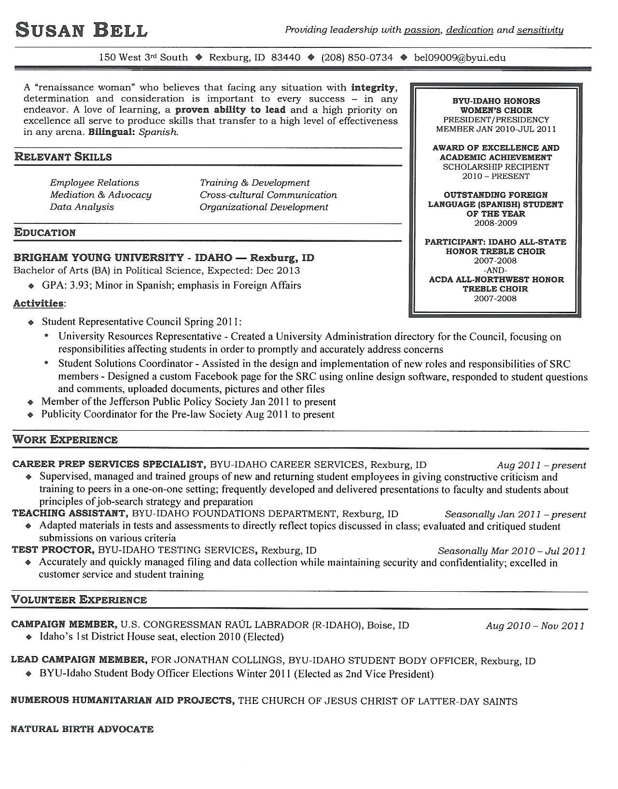
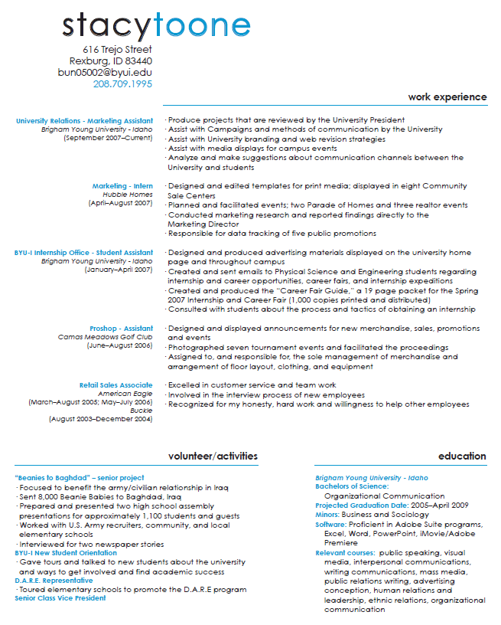

Slide 16
BEFORE
Arctic Circle, Ogden, Utah
Supervisor over employees, counted change
Cooked the food for guests
Took orders on the register
took out orders to the guest

Slide 17
What did I accomplish for company? My co-workers? Clients? Customers? | What skills did this require?

Slide 18
AFTER
Supervisor, Arctic Circle, Ogden, Utah Sep 2012 - Present
Prepared high-volume food orders for hundreds of customers a day
Maintained quality of food orders through efficient multi-tasking, adapting well under pressure, and adhering to safety and sanitization standards
Ensured customer satisfaction through ability to assess and meet customer needs when issues arose
Supervised 8 employees daily and organized work schedules for entire 24-person crew
Obtained food handler’s permit to teach and enforce standards with other employees

Slide 19
Spelling has been checked.
Language is grammatically correct.
Formal Style

Slide 20
Resume Faux Pax
Typos and Grammar Slips
“Great attention to detail.”
“Proven ability to track down and correct erors.”
“Am a perfectionist and rarely if ever forget etails.”
Accomplishments: Completed 11 years of high school.”
Don’t use “I” or “me”

Slide 21
BEFORE
Joann Fabric & Craft Dec 2012-Feb 2014 Ogden, Utah
Put inventory away
Created different crafts for ideas to display for the customers

Slide 22
What did I accomplish for company? My co-workers? Clients? Customers? | What skills did this require?

Slide 23
AFTER
Craft Designer Dec 2012 - Feb 2014
Joann Fabric & Craft Ogden, UT
Increased department revenue through creation of appealing craft items for customer displays
Maintained organization of store while shelving inventory

Slide 25
What did I accomplish for company? My co-workers? Clients? Customers? | What skills did this require?

Slide 26
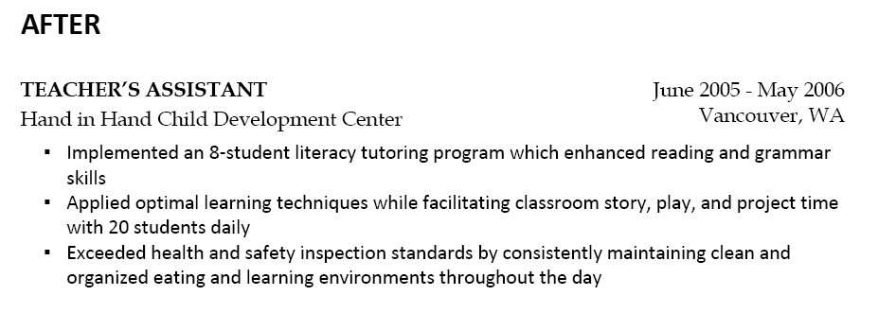

Slide 31
Networking
70% of jobs are found through networking, so 70% of job-search time should be spent developing a professional network.
Informational interviews are a great way to network while you are a student.
Consider LinkedIn, among other tools, to track your professional network.
Keep accomplishments updated in LinkedIn.

Slide 32
Networking
WATCH WHAT YOU PUT ON FACEBOOK!!!

Slide 33
Tell Me about Yourself:
“One of my greatest strengths is helping others grow and progress. While in High School, I volunteered with several organizations and schools to increase my capacity to work well with at-risk youth, juvenile delinquents, and also education professionals. As a result of my efforts, I have been able to gain strong classroom and behavior management skills, while helping many students to turn the stumbling blocks of their lives into stepping stones. I was also able to observe the ‘ins’ and ‘outs’ of effective instructional design and student engagement. This prepared me to build positive and productive relationships with the students and staff I served during my student teaching experience. As a result, I earned the highest evaluation ratings possible during my student teaching experience. This is the kind of teacher I would like to be for the students, parents, and teachers at Heritage High School.”

Slide 34
Writing An Effective Cover Letter
How to write a cover letter.
Rules
Contents

Slide 35
How To Write A Cover Letter - Rules
Give enough information to interest the reader, don’t
overwhelm.
Research the company. Address the letter to a
specific person.
Answer an ad if you have 50% of the skills or background that the ad requires.
Mention the person who referred you if appropriate.

Slide 36
How To Write A Cover Letter - Contents
Your address, city, state, zip, and telephone number.
Date
Name, title, company, address, city, state, and zip of
person you’re writing to.
Greeting, followed by a colon.

Slide 37
How To Write A Cover Letter - Contents
Paragraph 1:
What you want.
How you know about the organization.
Mention enclosure of your resume.
Paragraph 2:
Concise overview of work history and skills
that will help you perform the job.
Paragraph 3:
State confidence in your ability.
Give information on how you can be contacted.

Slide 38
How To Write A Cover Letter - Contents
Paragraph 4:
Express appreciation
Closing, signature, and typed name

Slide 39
Successful Interviewing Skills
Surviving and Excelling in a Behavioral Based Interview
Notes:
Welcome to our presentation on Successful Interviewing Skills
Introduce yourself and that you are from Abbott Laboratories
This presentation will provide you with information on how to survive and excel in a behavioral based interview. Feel free to ask any questions.

Slide 40
First Impressions Count …
Do You Make The Best Impression You Can?
On-Time
Dress
Physical Contact
Eye Contact
Smile
Fidgeting
Notes:
As much as we would all like first impression not to count they actually do.
So you want to make the best impression you can.
You can do that by being on-time, the way you dress, how you shake someone’s hand, do you make eye contact, are you smiling, or are you fidgeting for example playing with your pen in the interview.

Slide 41
Characteristics of a Successful Interview
Preparation
Presentation
Content
Notes:
There are three characteristics of a successful interview. Those are your preparation, presentation, and content.

Slide 42
Preparation
Research the Job and company
Review the Job Requirements
Know your Resume
Know Where You Are Going
Be Prepared to Give Behavioral Based Examples
Anticipate Questions
Be Prepared to Sell Yourself!
Notes:
I’ll start with discussing how you prepare for an interview. With today’s accessibility to the internet makes it easy to locate information about the company and sometimes information about the position. I recommend that you do your research before your interview so you present yourself well educated on the company which shows the interviewer that you took the initiative to do research.
Make sure you know what’s on your resume. You don’t want to be in a position where you can’t describe something that you put on your resume.
I understand that with a limited job market currently people are willing to take other opportunities. However interviewers like to see someone that knows where they’re going. They have a career plan.
Prepare yourself to give behavioral based examples which we will go over in more detail later in the presentation.
Anticipate questions again which we’ll go over sample questions a little later.
And most importantly be prepared to sell yourself! This is your time to show the interviewer why you’re the best candidate for the position.

Slide 43
Preparation
Visualize Yourself In the Interview
Know this:
There is no question you cannot answer
You are well suited to the position
You will be an asset to the department
Bring:
Extra copies of resume
Paper and pen
A list of potential questions
Breath mints
Notes:
Some people prepare themselves by visualizing themselves in the interview. This is common for athletes to do but for some it also works well for an interview.
Remember that you have already made the first selection for the position since the manager has asked you to interview. With that confidence know that there is no questions you cannot answer. If you need time to formulate your thoughts that is fine, just take your time. Also since were selected for the interview you know that you are well suited for the position. And you also know that the qualities you bring will be an asset to the department.
Always remember to bring extra copies of resume. Resumes may be misplaced by the interview and you look prepared with extra copies. You can always bring pen and paper to take notes have questions listed that you want to ask. I do suggest that if you bring pen and paper that you use it so the interviewer feels that they had something important to say during the interview. Finally if you tend to get nervous you can always bring breath mints to have while waiting for your interview but remember to finish it before the interview starts!

Slide 44
Interview Presentation
Be Prepared and Responsive For Questions
Take Time to Organize Your Thoughts
Make Effective Eye Contact and Smile
Express Confidence in Your Abilities
Consider Each Interview An Adventure!
Be Attentive to Body Language
No gum
Watch those pens
Notes:
We’re now moving into presentation. First make sure you are prepared and responsive for the interviewer’s questions.
If you are stuck on a question or feeling nervous take time to organize your thoughts.
Make effective eye contact and smile. Sometimes when we get nervous we become serious and forget to smile. Other times we start looking out the window or around the room and forget to make eye contact with the interviewer. This can be perceived that you are not being truthful.
Remember this is your time to tell the interviewer why you are the best candidate so express confidence in your abilities. If the interviewer was in a position to chose between two candidates with the same skill sets and one said that I have excellent computer skills which I feel will be valuable for your positions and the second said I know how to use the computer who would you chose?
Consider each interview as an adventure!
Be attentive to your body language. Make sure you don’t have any gum or candy. Watch those pens! Make sure you’re not clicking or playing with them. That can be distracting for the interviewer.

Slide 45
Leave The Baggage At The Door
Shut the Door to Personal Trouble
Don’t Slam Organization
Notes:
Leave the baggage at the door. An interview is not the time to bring in your personal troubles. And definitely don’t slam an organization or past boss. The interviewer will think if they can speak so poorly about an old boss what will they say about me if I give them this position.

Slide 46
Interview Content
Listen Carefully to the Question
Rehearse Your Answers
Sell Yourself!
Silence is Golden, Know When to Stop Answering
Tie Your Background to the Position
Focus on Your Accomplishments
Notes:
So I’ve already discussed interview preparation and presentation. Now let’s discuss interview content.
Make sure you listen carefully to the question so that you give the appropriate answer.
Understand behavioral based interviewing which we will focus on next.
Rehearse your answers. You want to feel comfortable with your examples.
Sell Yourself! This is your time to tell the interviewer what you can bring to this position and why they should hire you.
Silence is golden, know when to stop answering. When people get nervous they have a tendency to start telling the interviewer things they never wanted them to know.
Tie your background to the position. Give examples that demonstrate that you have the qualifications to do the job.
Focus on your accomplishments. Show the interview what you have done in school, an internship, or a past position.
Turn your weaknesses into strengths. Some interview questions are set up to ask about negative situations. The reason we ask these types of questions is to see how you have handled yourself. We know everyone makes mistakes we just want to see if you learned from your mistakes. Another common question will be tell me your greatest weakness. I usually say I work too much or I’m too dedicated. Well in this example working too much can be a weakness but what employer wouldn’t want someone that works too much. So I’ve changed my weakness into a strength for the employer.

Slide 47
Behavioral Based Interviewing
Prepare your STAR’S
Situation or Task
Action Taken
Result of Your Action
Notes:
You’ve heard me refer to behavioral based interviewing throughout this presentation. Now I’ll spend sometime going through it.
In behavioral based interviewing you want to prepare STAR’s. That means think of examples where you describe a situation or task the actions you took and the result of your action.

Slide 48
Behavioral Based Questions
Can You Tell Me About A Time…
Think Specific
Don’t Say “Usually, Always, Or Never”
Say “I”
Be Prepared to Answer the Negative Question
Was The Result Positive? Measurable?
Don’t Forget To Smile
Be Concise
Notes:
You know you are in a behavioral based interview when the questions start with can you tell me about a time..
Think specific when your answering. Don’t say usually, always, or never because you aren’t be specific enough in your examples.
Say “I”. The interviewer wants to know what your role in the example was.
Be prepared to answer the negative question. As we stated earlier the interviewer understands you may have made a mistake but what did you learn from that and how did you handle yourself.
When you give a result try to make it measurable. For example you might tell me about a group project you worked on. Instead of telling me you received a passing grade, tell me what grade, was it the highest in the class. If the example is from an internship did you save the company money, or did you receive an award?
Don’t forget to smile and be concise!

Slide 49
Sample Questions
Tell Me About A Time…
You Persuaded Someone To Do Something
You Solved a Small Problem Before It Turned Into Something Large
You Interacted With Someone And Wished You’d Interacted Differently
You Worked Well in a Team
You Worked in a Team Where Not Everyone Was Putting Forth The Same Amount Of Effort
Notes:
These are just a few sample questions to practice.
Give an example answer to some if time allows.

Slide 50
Technical Skills Are Important
Attention To Detail
Computer Skills
Analytical Skills
Technical Skills Specific to Your Degree
Notes:
I’ve talked a lot about the soft skills in a interview but technical skills are also important. Your degree and your resume should give the interviewer a good idea of your technical skills, but you can also describe them through your examples.
Of course attention to detail, computer skills, analytical skills, and technical skills specific to your degree will be assessed during your interview as well.

Slide 51
Soft Skills Are Just As Important
Adaptability
Teamwork
Initiative
Innovation
Integrity
Notes:
Sometimes we forget that soft skills are just as important.
An employer wants to see that you are adaptable because in an industry things are always changing.
They want to see that you’re a team player. There are very few positions where you don’t have to interact with other people.
They want to see that you show initiative, innovation, and integrity.

Slide 52
Interview Follow-Up
Common Interview Mistakes
Coming Unprepared
Not Smiling or Showing Enthusiasm
Negativity
The Thank You Note
References
Notes:
Some common mistakes people make are that they come unprepared for the interview. For example they may not know anything about the position or company, they may not have prepared questions, or they forgot to bring extra resumes. Some other mistakes are that they don’t smile or show enthusiasm for the position and if it comes down to two candidates with equal skills the employer will most likely chose the candidate that has shown interest in their position.

