Slide 1
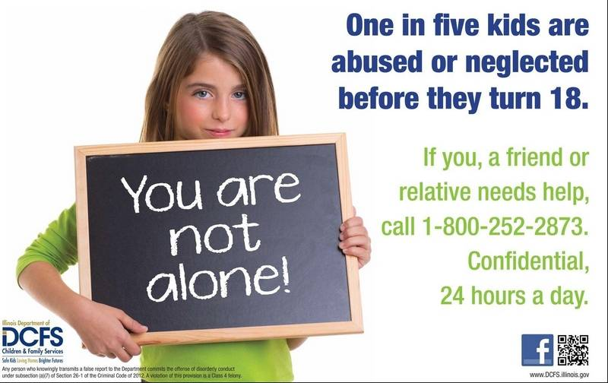
Department of Children and Family Services (DCFS)
Toll Free call

Slide 2
Is this child abuse?
A girl is slapped for screaming at her mother; the slap stings, but leaves no lasting mark or pain.
A boy is punished in a way that requires stitches.
A father burns his daughter’s palms with a lighted cigarette when he finds her smoking.
A mother is careless and spills scalding coffee on her daughter, who is seriously burned.
A boy’s arm is broken after wrestling with his father for sport.
A girl is spanked so hard she is badly bruised, but the father says he did not mean to hurt her.
A boy is grounded for a week for a minor offense.
A father takes away his son’s driver’s license for getting a parking ticket.

Slide 3
Discussion
What do you consider child abuse?
Is there a difference between child abuse and discipline?
Where do we draw the line?

Slide 4
What is abuse?
Any behavior that results in the mistreatment of another.
What is the difference between an abuser and one who is not an abuser?
ABOUT 10 seconds!
Child Abuse
Abuse that happens to a person under the age of 18.

Slide 5
Fatalities and who might abuse
Each day in the United States, more than 3 children die as a result of child abuse in the home.
Most of the children who die are younger than six years of age.
More children (age four and younger) die from child abuse and neglect than any other single, leading cause of death for infants and young children.

Slide 6
In 2000, more than 17,000 Utah children were reported to Child Protective Services as alleged victims of child maltreatment.
About 8,500 of those cases were substantiated.
More than three children die each day in the
United States from child abuse and neglect.
In 1991, 838 children died as a result of physical abuse by a parent (Daro & McCurdy, 1992).
By age 18, one of every four girls and one of every six boys has been sexually abused.
It is estimated that 100,000-500,000 children are sexually abused each year.

Slide 7
Eighty-five percent of sexual assaults on children are committed by someone the child knows and usually trusts
Child abuse is a very serious problem in every community nationwide.
Child abuse knows no boundaries. It happens in every class, race, ethnic group, educational, and economic group. No family is immune.
A report of child abuse is made – on average - every 10 seconds.
More children (age four and younger) die from child abuse and neglect than any other single leading cause of death for infants and young children. This includes accidental falls, drowning, choking on food, suffocation or fires in the home.
Each day in the United States, more than three children die as a result of child abuse in the home.

Slide 8
ABUSE RISKS
CHILD + STRESS = ABUSE
(Remove child or stress to avoid the abuse)
Potential abuser
Characteristics

Slide 9
Parental Risk Characteristics
Parent is under stress.
Parents who tell you they were abused as children.
Often single parent (overstressed)
Parents who are very rigid in disciplining their child.
Belief in corporal discipline
May have spouse violence
Belief that father should dominate
Low self-esteem
Unrealistic expectations of children
Role reversal, uses child to gratify their needs
Unconcerned about seriousness of abuse
Parents who abuse drugs or alcohol.
Parents who are very critical of their child.
Parents who show too much or too little concern for their child.
Parents who feel they have a difficult child.

Slide 10
Influence of Substance Abuse
Nearly one-half of substantiated cases of child neglect and abuse are associated with parental alcohol or drug abuse.
It is estimated that one in every four children in the United States (28 million) are living in a household with an alcoholic adult.
Men and women serving time in the nation’s prisons and jails report a higher incidence of abuse as children that the general populations.

Slide 11
Family Risk Characteristics
Sibling to sibling violence is the most common form of family violence.
Families who are isolated and have no friends, relatives, church or other support systems.
Families who are often in crisis (have money problems, move often).
Unemployment
Low income, economic stress
Unsafe neighborhood
Home is crowded, dirty, unhealthy
One or more family members has health problems
Larger family

Slide 12
Child Risk Characteristics
Child doesn’t match well with parent. (emotional or developmental disabilities)
“Normal” but born out of wedlock or unplanned
“Abnormal” – low birth weight or serious illness
“Difficult” – may be fussy

Slide 13
Reporting of Abuse
Approximately 3 million reports of possible maltreatment are made to child protective service agencies each year. In calendar year 2000, these referrals concerned the welfare of approximately 5 million children.
The actual incidence of abuse and neglect is estimated to the three times greater than the number reported to authorities.
Child abuse is reported – on average – every 10 seconds.
An estimated 879,000 victims of maltreatment were substantiated after investigation by child protective service agencies in 2000.
Nine in 10 Americans polled regard child abuse as a serious problem, yet only 1 in 3 reported abuse when confronted with an actual situation.

Slide 14
Reporting
Document suspected or confirmed abuse by taking pictures, writing down all information, tell the center director, and report it to the authorities or an organization like CPS (Child Protective Services)
All reports of abuse remain anonymous. The information may become public knowledge, but the reporter’s name remains anonymous whether it is substantiated (proven) or not.

Slide 15
TO REPORT CHILD ABUSE:
Local Police
Division of Child and Family Services (DCFS) & Child Protective Services (CPS) 1-855-323-3237
STOP Child abuse 1-800-482-5964
Prevent Child Abuse Utah 801-393-3366

Slide 16
Department of Children and Family Services (DCFS)
Toll Free call

Slide 17
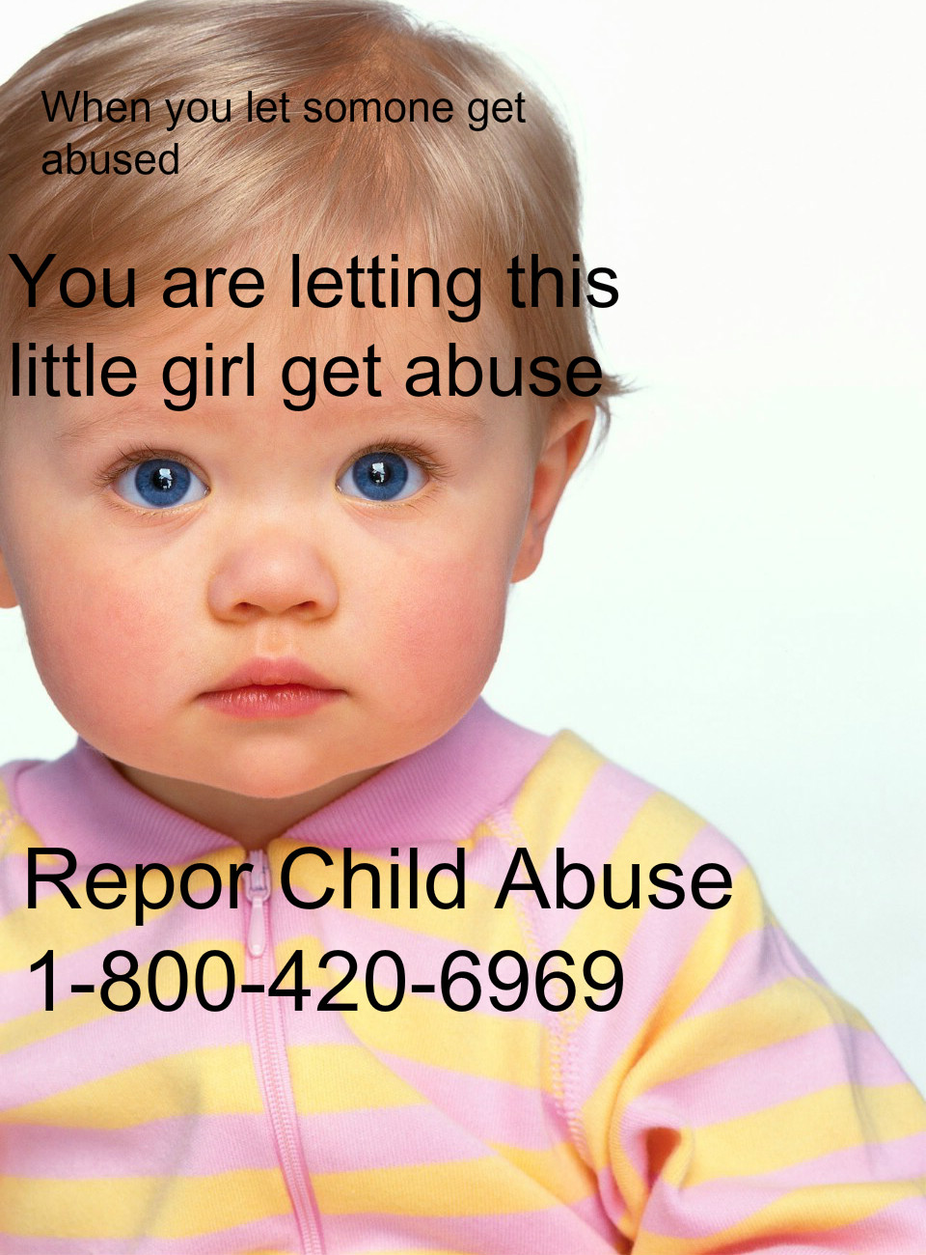
Recognize signs and symptoms of abuse
d
t

Slide 18
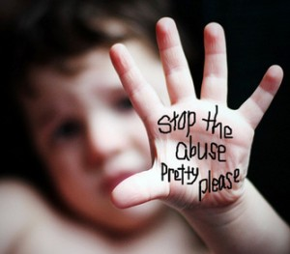
Types of Child Abuse
Neglect – 63%
Physical – 19%
Sexual – 10%
Emotional – 8%

Slide 19
Non-accidental physical injury
Physical abuse inflicted on purpose.
Symptoms might include: Children often come with bruises, bites, burns, or other injuries.
Most NORMAL ACCIDENTAL injuries occur on the front of the body.
Primary target zone for abuse is the back, the elbows, and the knees, or possibly the face, hands, & wrists.
Wrist and upper arms may have finger bruises.
The back of the arms may have bruises where the child put their arm in front of their face to protect themself.
Most abuse injuries occur in multiples. The parent was out of control.

Slide 20
Neglect
When children are not given the basic needs of life which includes being deprived of proper food, medical care, shelter, clothing, or they are left unsupervised.
Symptoms might include: Wearing clothing inappropriate for weather conditions, lack of cleanliness of clothing and body, acting hungry, etc.

Slide 21
Emotional
Emotional abuse of a child is commonly defined as a pattern of behavior by parents or caregivers that can seriously interfere with a child’s cognitive, emotional, psychological or social development. This can include:
Ignoring
Either physically or psychologically, the parent or caregiver is not present to respond to the child. He or she may not look at the child and may not call the child by name.
Rejecting.
This is an active refusal to respond to a child’s needs (e.g.refusing to touch a child, denying the needs of a child, ridiculing a child).
Isolating
The child from having normal social interactions with peers, family members and adults. This also may include confining the child or limiting the child’s freedom of movement.

Slide 22
Exploiting or corrupting
In this kind of abuse, a child is taught, encouraged or forced to develop inappropriate or illegal behaviors. It may involve self-destructive or antisocial acts of the parent or caregiver, such as teaching a child how to steal or forcing a child into prostitution.
Verbally assaulting
This involves constantly belittling, shaming, ridiculing or verbally threatening the child.
Terrorizing
Here, the parent or caregiver threatens or bullies the child and creates a climate of fear for the child. Terrorizing can include placing the child or the child’s loved one (such as a sibling, pet or toy) in a dangerous or chaotic situation, or placing rigid or unrealistic expectations on the child with threats of harm if they are not met. Symptoms might include: refusal to talk, bullying, withdrawn, destructive behavior, and excessive clingy, crying, or fear.

Slide 23
Symptoms of emotional abuse might include
Refusal to talk
Bullying
Aggressive, destructive, or withdrawn behavior.
Shying away from physical contact with parents or adults or excessive clinginess
Crying or fear
Not wanting to go home

Slide 24
Sexual
Forcing a child to observe or engage in sexual activities with an adult or to view sexually explicit content.
Physical Symptoms might include: Problems sitting or walking; complains about itching, pain, uncomfortable, or swelling in the genital area; bruises on their mouths/throats/genitals; pain urinating; and withdrawn.
Child has behavioral and emotional signs such as: difficulty eating or sleeping. soiling or wetting pants or bed after being potty trained. acting like a much younger child. excessive crying or sadness. withdrawing from activities and others. Children’s conversations may include sexual information more advanced than a child of that age should know.

Slide 25
Sexual Assault of Children
Convicted rape and sexual assault offenders serving time in state prisons report that two-thirds of their victims were under the age of 18.
Among rape victims less than 12 years of age, 90% of the children knew the offender, according to police-recorded incident data.
Frequently, the person who sexually molests a child is also a child.

Slide 26
Prevention
Never discipline your child when your anger is out of control.
Participate in your child’s activities and get to know your child’s friends.
Never leave your child unattended, especially in the car.
Teach your child the difference between “good touches,” “bad touches” and “confusing touches.”
When your child tells you he or she doesn’t want to be with someone, this could be a red flag. Listen to them and believe what they say.
Be aware of changes in your child’s behavior or attitude, and inquire into it.
Teach your child what to do if you and your child become separated while away from home.
Teach your child the correct names of his/her private body parts.
Be alert for any talk that reveals premature sexual understanding.
Pay attention when someone shows greater than normal interest in your child.
Make certain your child’s school or day care center will release him/her only to you or someone you officially designate.

Slide 27
What to do.
Be open and understanding.
Don’t try to conduct an investigation, yourself.
If the child tells you of the sexual abuse immediately after it occurred, DO NOT bathe the child, or wash or change his or her clothes.
Let the child talk as much as he or she wishes.
Understand that the child is probably having mixed feelings.
Believe the child.
Explain what you will do next to help them.

Slide 28
SHAKEN BABY SYNDROME NEVER SHAKE A BABY
Head trauma due to the violent shaking is the leading cause of disability and death among infants and children.
25-50% of the American public does NOT know that shaking an infant can cause brain damage or death.
Effects
The brain keeps vibrating within the skull cavity after shaking occurs.
The brain swells, creating pressure, leading to retinal bleeding and can lead to blindness.
Veins feeding the brain are torn away, leading to brain damage or brain visual disability, speech disability, and seizures.

Slide 29
TECHNIQUES FOR SOOTHING A CRYING BABY:
TOUCH: Cuddling, swaddling, warm water bottle, warm bath
MOTION: Rocking, walking, stroller, car ride, rhythmic patting
SOUND: Rhythmic chants, ticking clock, singing, recording of heartbeat or womb sounds
When you get frustrated, just put the BABY DOWN and walk away.

Slide 30
Never Shake A Baby
https://secure.dontshake.org/buymaterials/detail.php?id=38&cid=3
http://www.dontshake.org/sbs.php?topNavID=254&subNavID=319&navID=341

Slide 31
COMPLETE ABUSE SORTING ACTIVITY:
Sort each abuse into its type of abuse. Check yourselves on the next slides.

Slide 32
EMOTIONAL ABUSE
Taunting you in the name of “fun”
Ignoring you and/or your feelings
Insulting you repeatedly
Telling you that you will fail
Blaming you for his/her faults
Threatening you with violence or retaliation
Threatening to hurt your pets
Threatening to abuse the children and/or get custody of them
Telling you that you must stay because you can’t make it alone
Accusing you of being violent when you protect yourself in any way
Labeling you as crazy, stupid, ugly, etc…
Blaming you for things that go wrong
Holding back approval as a form of punishment

Slide 33
PHYSICAL ABUSE
Destroying your belongings
Throwing objects at you
Touching you in ways that hurt or scare you
Twisting your arm, slapping, or biting you
Pushing or shoving you
Depriving you of food, shelter, money, or clothing
Threatening you with weapons
Hitting, punching, or kicking you
Choking or throwing you
Hitting or kicking you in a series of blows
Abusing you to the point you need medical treatment
Breaking your bones and/or causing internal injuries
Causing miscarriage or injuries that require a therapeutic abortion
Denying you medical treatment
Inflicting permanent disabling and/or disfiguring injuries

Slide 34
NEGLECT
Abandonment
Unattended physical problems or medical needs
Lack of supervision
Child is consistently hungry, poor hygiene, has inappropriate dress

Slide 35
SEXUAL ABUSE
Talking about you or others as sexual objects
Forcing you to have sex, including sex after a beating or when you are ill
Criticizing your sexual performance
Withholding affection to punish you
Accusing you of looking at, talking to, or having sex with another
Forcing you to engage in sexual activities that are uncomfortable for you
Inflicting harm or mutilation to you genitals
Hurting you during sex

