Slide 1
What colors do I choose to decorate with and how much of each looks good?
Resources and pictures from http://www.stlouishousepainting.com/stlouis_painting/interior-painting/the-classic-color-rule-60-30-10/

Slide 2
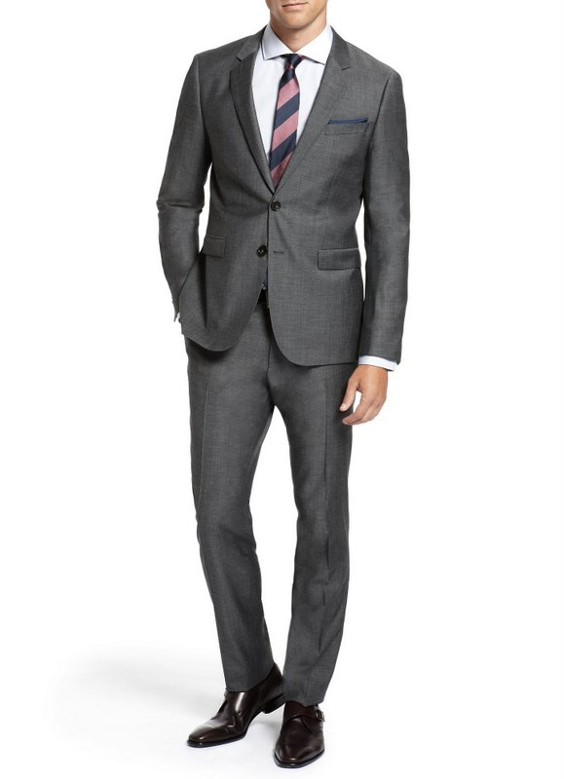
Use the 60-30-10 rule
When deciding on a color scheme for a room, follow the style of a man in a business suit:
60% of his outfit’s color is the slacks and jacket
30% of his outfit’s color is the shirt
10% of his outfit’s color is the tie

Slide 3
For a room this roughly translates as:
60% of the room’s color is the walls
30% of the room’s color is the furniture
10% of the room’s color is an accent piece or decorative pieces
This color scheme works well because it provides a sense of balance and allows the colors to visually flow in a room.

Slide 4
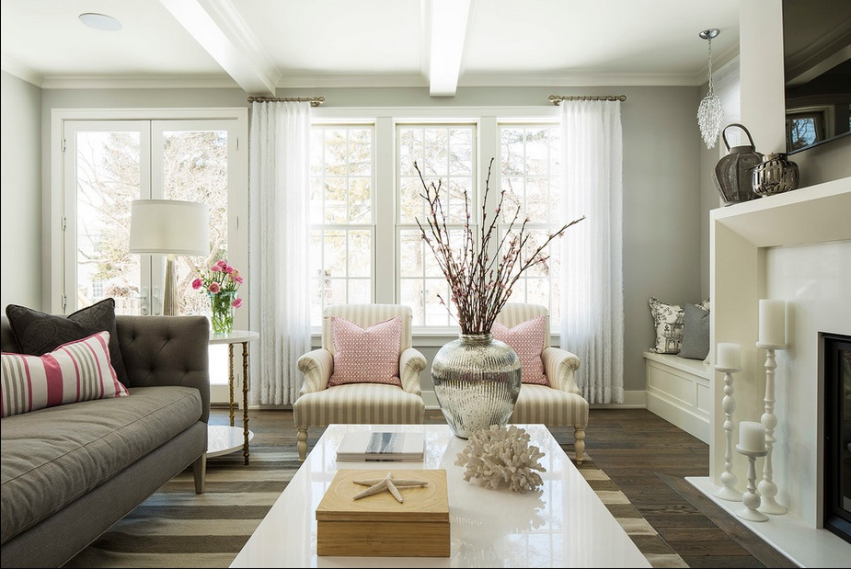
60 percent should be the dominant color It should be visually appealing and compliment the style and personality of the room.

Slide 5
30 percent should look appealing with the dominant color

Slide 6
And 10 percent should be a bold accent color displayed through decorations like throw pillows and blankets or a floral arrangement.

Slide 7
Not everyone has the luxury of starting from scratch
“I already have furniture that I can’t easily change, so what will look best with my furniture?”
TIPS: Furniture is usually your 30% so think of colors that will look good with your upholstery or furniture materials.
TIPS: What feeling do you want? A dark or light or bold color for walls will change the feeling of the room dramatically.

