Slide 1

Creating
Success
with
Notes:
Switch to this slide just before starting the presentation part of the session.

Slide 2

2 types of events
STAR Events
Online STAR Events
Students may enter only ONE STAR Event per year (either online or not online but not one of each)

Slide 3

Students
Taking
Action
with
Recognition
Notes:
Can you guess what the letters STAR mean for STAR Events?

Slide 4


are competitive events in which members are recognized for proficiency and achievement in
chapter and
individual projects,
leadership skills, and
occupational preparation.
Notes:
Read Slide
Stress that STAR Events meet the needs of incorporating lessons for rigorous teaching activities –reaching and striving for greatness.

Slide 5
offer individual skill development and application of learning through the following activities:
cooperative – teams work to accomplish specific goals
individualized – an individual member works alone to accomplish specific goals
competitive – individual or team performance measured by an established criteria.
Notes:
Read Slide -
Stress again that these work with the new guidelines for teaching with individual needs

Slide 6
3 Levels:
JUNIOR – Up to 9th grade
SENIOR – 10th - 12th grades and who are identified as comprehensive members on the national affiliation form.
OCCUPATIONAL – grades 10–12; who have been or are currently enrolled in occupational FACS coursework; and who are identified as occupational on the national affiliation form.
Notes:
Read Slide –
Make sure the students understand this and that they are not talking about Junior or Senior in high school.

Slide 7
3 Levels of Ratings for Recognition:
Gold – 90 – 100
Silver – 70 – 89.99
Bronze – 69.99 and below
Participants must receive 50 and above at region conferences in order to compete at state conference.
Notes:
Read Slide

Slide 8
How can STAR Events
relate to the FACS subjects
you teach?
Notes:
Read Slide -

Slide 9

Fit into every topic, class, task, and standard of FACS.
Allow for personal growth and leadership development.
Some school districts are requiring that student be in “competition” to attend events, sessions, conferences, etc.
Can be completed by all students as well as members and used for assessment/evaluation.
Link perfectly with the national programs.
Notes:
Read slide-

Slide 10

Are divided into 3 categories of events:
Foundational Events
Leadership Events
Career Preparation Events

Slide 11


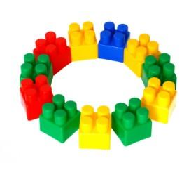
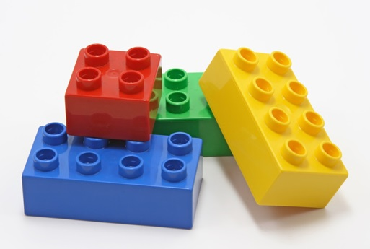
Career Investigation
Entrepreneurship
Environmental Ambassador
Focus on Children
Illustrated Talk
Interpersonal Communications
Job Interview
Leadership
Notes:
Foundational events
Are events which build basic leadership and life skills, are for FCCLA members who want to get involved and improve upon themselves.
The Louisiana events to be held in this area are: (read slide)

Slide 12
Life Event Planning
Nutrition and Wellness
Parliamentary Procedure
Recycle and Redesign
Notes:
Foundational events
Are events which build basic leadership and life skills, are for FCCLA members who want to get involved and improve upon themselves.
The Louisiana events to be held in this area are: (read slide)

Slide 13


Advocacy
Chapter Service Project Display
Chapter Service Project Portfolio
Chapter in Review Display
Chapter in Review Portfolio
National Programs in Action
Promote and Publicize FCCLA!
Notes:
Leadership Events
Provide an opportunity for leaders to gain recognition for their work in their chapters.
The event content is designed to be a chapter project lead by the team who takes it to competition.
The Louisiana events to be held in this area are: (read slide)

Slide 14

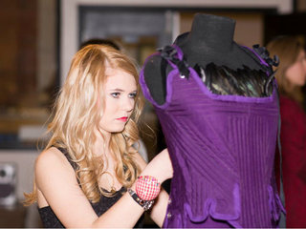
  Applied Math for Culinary Management
  Culinary Arts
  Early Childhood Education
  Fashion Construction
  Fashion Design
  Food Innovations
  Hospitality, Tourism and Recreation
  Interior Design
  Sports Nutrition
  Teach and Train
Notes:
Career Preparation Events
Are for students interested in a specific career area.
Most events are for only senior and occupational participants who have spent time building career specific skills and knowledge, but a few events are open to junior participants who want to explore a specific career path.
The Louisiana events to be held in this area are: (read slide)

Slide 15
Online Events
  FCCLA Chapter Website
  Digital Stories for Change

Slide 16
Foundational
STAR
Events
Notes:
Foundational events
Are events which build basic leadership and life skills, are for FCCLA members who want to get involved and improve upon themselves.
The Louisiana events to be held in this area are: (read slide)

Slide 17

Career Investigation
An individual event
Participants perform self-assessments, research and explore a career, set career goals, create a plan for achieving goals, and describe the relationship of FACS coursework to the selected career.
Participants must prepare a portfolio and an oral presentation.
Notes:
Read slide
You could easily use this as an assignment in Journey to Careers or FACS I

Slide 18

Entrepreneurship
An individual or team event
Participants develop a plan for a small business using FACS skills and sound business practices.
The business must relate to an area of FACS education or related occupations.
Participants must prepare a portfolio containing a written business plan, which they are not required to have implemented, and an oral presentation.
Notes:
Read slide

Slide 19
Environmental Ambassador
An individual or team event
Participants address environmental issues that adversely impact human health and well-being and who actively empower others to get involved.
Participants will research one of the five 2015-2016 topics, investigate areas where they can make a difference, develop and carry out a project for their home, school, or community, and educate others in their school or community about the problems, effects, and solutions regarding the environmental concern.
Participants must prepare a portfolio and an oral presentation.
Notes:
Read slide

Slide 20
Focus on
Children
An individual or team event
Participants use FACS skills to plan and conduct a child development project that has a positive impact on children and the community.
Child development encompasses birth through adolescence.
Participants must prepare a display and an oral presentation.
Notes:
Read slide
This project could easily relate to any child development courses.

Slide 21

Illustrated Talk
An individual or team event
Participants make an oral presentation about issues concerning FACS and/or related occupations.
Participants must prepare a file folder, an oral presentation, and visuals.
Notes:
Read slide
This contest would work perfectly with any course you would like reports to be given on specific topics.

Slide 22

Interpersonal
Communications
An individual event or team event
Participants use FACS and/or related occupations skills and apply communication techniques to develop a project designed to strengthen communication in a chosen area: community, employment relationships, family peer groups, or school groups.
Participants must prepare a file folder, an oral presentation, and a response to a related case study.
Notes:
Read slide
This event could be used in Education for Careers or Adult Responsibilities

Slide 23
Job Interview
An individual event
Participants use FACS and/or related occupations skills to develop a portfolio, participate in an interview, and communicate a personal understanding of job requirements.
Participants must prepare a portfolio, including a job application, and express their communication skills and job knowledge through an interview.
Notes:
Read slide
This event could be used in Education for Careers or Adult Responsibilities

Slide 24

Leadership
An individual event
Participants who actively evaluate and grow in their leadership potential.
Participants investigate their leadership ability, assess leadership and employability skills, and develop and implement a plan to further their leadership development.
Participants must prepare a portfolio and an oral presentation.
Notes:
You could use this and relate it to a project for any financial planning section of any course you teach.

Slide 25

Life Event Planning
An individual or team event
Participants apply skills learned in FACS courses to manage the costs of an event. An event is defined here as any upcoming occasion that will bring changes and/or new experiences and accompanying financial challenges.
Planning events for the FCCLA chapter, school, or other organization are not appropriate for this event.
Participants select an upcoming event in their lives, determine the amount they can budget for the event, and prepare in advance an event portfolio.
At the event site, participants present the portfolio to the evaluators.
Notes:
You could use this and relate it to a project for any financial planning section of any course you teach.

Slide 26
Life Event Planning (cont’d)
Examples of events include, but are not limited to:
  Preparing to move into a dormitory room
  Hosting a party or celebration
  Operating a vehicle for one month
  Talking a school or personal trip
  Hosting a family reunion
  Paying initial costs of a new job
  Managing personal costs of attending the prom
  Paying school expenses for one grade level
Notes:
Read slide
Examples could be but are not limited to:
preparing to move into a dormitory room
hosting a party/other celebration
operating a vehicle for one month
taking a school or personal trip
preparing to move into a dormitory room
hosting a party/other celebration
operating a vehicle for one month
taking a school or personal trip
You could use this and relate it to a project for any financial planning section of any course you teach.

Slide 27
Nutrition and
Wellness
An individual event
Participants track food intake and physical activity for themselves, their family, or a community group and determine goals and strategies for improving their overall health.
Participants must prepare a portfolio, visuals, and an oral presentation.
Notes:
Read slide
Would fit in perfectly with a Nutrition course or the section for nutrition in FACS I, etc.

Slide 28

Parliamentary
Procedure
An team event
Chapters develop a working knowledge of parliamentary law and the ability to conduct an FCCLA business meeting.
Participants must take a Parliamentary Procedure Knowledge Test, present a demonstration meeting using provided planning materials, and prepare minutes of the meeting.

Slide 29

Recycle and
Redesign
An individual event
Participants apply recycling and redesign skills learned in FACS and create a display using a sample of their skills.
Participants select a used fashion, home, or other post consumer item to recycle into a new product - not simply embellish an old one. However, participants may use additional materials if needed to redesign and creatively embellish the new product.
At the event site, participants set up their displays and present the results of their projects to evaluators.
Notes:
Read slide
Perfect for a clothing and textiles project in class.

Slide 30
Leadership
STAR
Events

Slide 31

Advocacy
An individual or team event
Participants demonstrate their knowledge, skills, and ability to actively identify a local, state, national, or global concern, research the topic, identify a target audience and potential partnerships, form an action plan, and advocate for the issue in an effort to positively affect a policy or law.
Participants must prepare a portfolio, an oral presentation, and complete a case study.
Notes:
Read slide

Slide 32
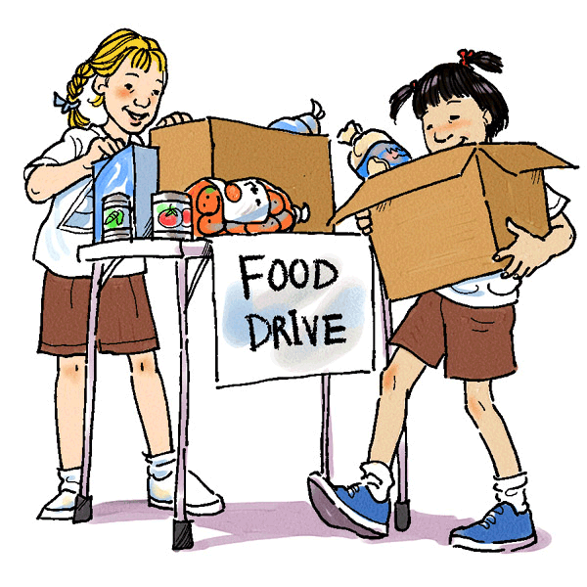
Chapter Service Project Display or Portfolio
A team event
Chapters develop and implement an in-depth service project that makes a worthwhile contribution to families, schools, and communities.
Students must use FACS content and skills to address and take action on a community need.
Present as a display or a portfolio
and an oral presentation.
Notes:
Read slide

Slide 33
Chapter in Review Display or Portfolio
A team event
Chapters develop and implement a well-balanced program of work and promote FCCLA and FACS and/or related occupations and skills to the community.
Present as a display or a portfolio
and an oral presentation.
Notes:
Read slide

Slide 34

National Programs in Action
An individual or team event
Participants explain how the FCCLA Planning Process was used to implement a national program project.
Participants must prepare a file folder, an oral presentation, and visuals.
Notes:
Read slide

Slide 35

Promote and
Publicize FCCLA!
An individual or team event.
Participants develop an FCCLA promotion and publicity campaign to raise awareness and educate the school, parents, and members of the community about the importance of FCCLA and FACS education.
Participants must create a portfolio and portfolio
Notes:
Read slide
The goal of this event is to provide FCCLA members with communications experience to make a difference by increasing membership, developing partnerships, gaining Alumni & Associate involvement, promoting FACS education, gathering school and community support for their chapter, and contributing to the longevity of the organization and the relevance of its opportunities for members. Additionally, this event will increase member awareness of careers in communications and public relations.
This project could relate to projects in the communications section of Journey to Careers or Adult Repsonsibilities.

Slide 36
Career Preparation
STAR
Events

Slide 37

  Applied Math for
  Culinary Management
An individual or team event
Participants who use FACS skills to demonstrate the application of mathematical concepts in the culinary arts industry.
Prior to competition, participants must prepare a file folder, oral presentation, and visuals. On site, participants respond to a case study.
Notes:
Read slide

Slide 38
  Culinary Arts
A team event
Participants enrolled in occupational culinary arts/food service training programs for their ability to work as members of a team to produce a quality meal using industrial culinary arts/food service techniques and equipment.
Teams of participants must develop a plan for the time allotted, prepare menu items given to them at the time of the event, and present their prepared items to evaluators.

Slide 39
  Early
  Childhood
  Education
An individual event
Participants demonstrate their ability to use knowledge and skills gained from their enrollment in an occupational early childhood program.
Participants must prepare a portfolio and a resource container.
On site, participants must plan and present to evaluators an activity related to the theme in response to a case study provided during the event and an oral presentation describing the activity.

Slide 40
  Fashion
  Construction
An individual event
Participants apply Fashion Construction skills learned in FACS courses and create a display using samples of their skills.
Using new materials, participants construct in advance a garment or ensemble that dresses both the upper and lower body of a child or adult. Garment/ensemble must include at least eight fashion construction techniques.
Participants must prepare a display, sample garment, and an oral presentation.

Slide 41

  Fashion
  Design
An individual event
Participants apply Fashion Design skills learned in FACS courses to design and market clothing styles.
Participants will develop a clothing label. Research the intended audience, design the label’s first 4-piece collection, and construct one collection sample using an original flat pattern designed by the participant.
Participants must prepare a portfolio, sample garment, and an oral presentation.

Slide 42

  Food
  Innovations
An individual or team event
Participants demonstrate knowledge of the basic concepts of food product development by creating an original prototype formula, testing the product through focus groups, and developing a marketing strategy. Participants will demonstrate their knowledge of food science, nutrition, food preparation safety, and product marketing.
Participants must prepare a display, suggested product packaging, and an oral presentation.

Slide 43

  Hospitality,
  Tourism
  and Recreation
An individual or team event
Participants demonstrate knowledge of the hospitality, tourism, and recreation industries and ability to translate their knowledge into a hypothetical or real business.
Participants must prepare a display, suggested product packaging, and an oral presentation.

Slide 44

  Interior
  Design
An individual or team event
Participants design interiors to meet the living space needs of clients. In advance, participants will create a floor plan, an elevation and a furniture/interior plan addressing the specifics of the design scenario.
Participants must prepare a file folder, an oral presentation, and visuals.

Slide 45

  Sports
  Nutrition
An individual or team event
Participants plan and develop an individualized nutritional plan to meet the needs of a competitive student athlete in a specific sport. In advance, participants will prepare a sample nutrition and hydration plan based upon nutritional and energy needs of the athlete.
Participants must prepare a file folder, visuals, an oral presentation and demonstrate a method to be used by the athlete to assist with nutrition management..
Notes:
Read slide
Could be a perfect match with Food Science or Nutrition and Food courses.

Slide 46

  Teach and Train
An individual event
Participants demonstrate their ability to explore and experience the career of teaching or training.
Participants must prepare a portfolio of the teaching/training career, prepare and execute a complete lesson/workshop plan and an oral presentation.
Senior and occupational participants will also complete a shadowing experience of a “best practices” educator.

Slide 47

ONLINE STAR EVENTS:
Conducted by national, not state.
  Submit to National office by Feb.1
Have two participation levels.
In Level I, participants submit their online, digital project for evaluation
In Level II, the twenty (15) highest scoring entries are invited to present their chapter website, plus an oral presentation, at the National Leadership Conference.

Slide 48
  FCCLA Chapter
  Website
An individual or team event
Participants use a chapter website to educate, inform, and involve members and the general public about the importance of the FACS program and the FCCLA chapter.
Level I: Participants must prepare a website.
Level II: Fifteen (15) entries will be invited to present their chapter website, plus an oral presentation, at the National Leadership Conference.

Slide 49
  Digital Stories
  for Change
An individual or team event
Participants demonstrate their knowledge, skills, and abilities to actively identify an issue concerning families, careers, or communities; research the topic; and develop a digital story to advocate for positive change.
The topic for 2015-2016 is “STOP the Violence-Students Taking on Prevention” which may include, but is not limited to topics, units, or activities related to the STOP the Violence national FCCLA program.
Level I: Participants must prepare a digital story and project components to be submitted online.
Level II: Fifteen (15) entries will be invited to present their digital story, plus an oral presentation, at the National Leadership Conference.

Slide 50
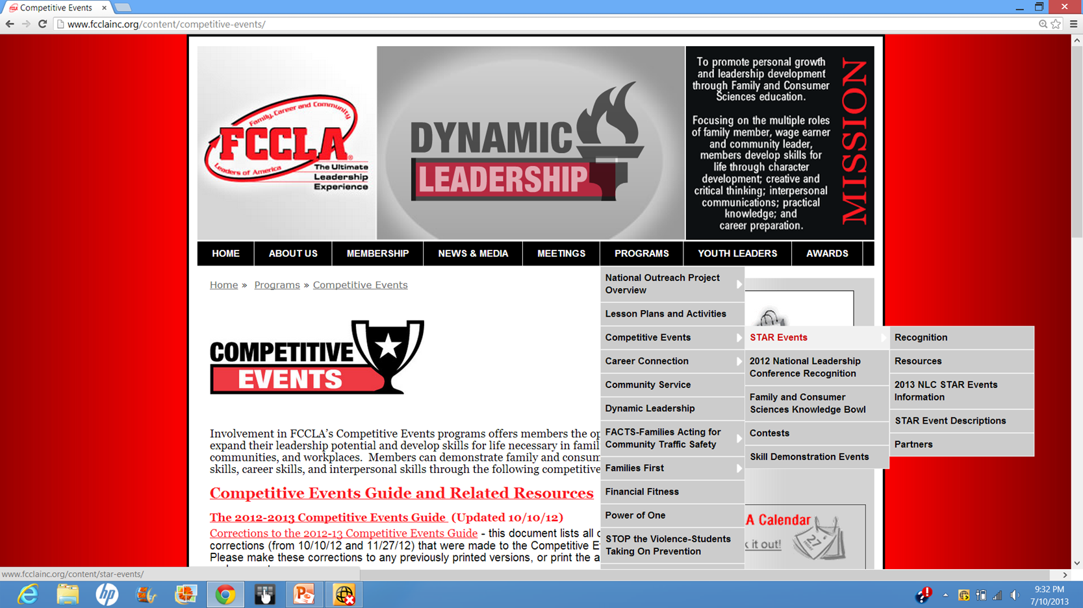
Notes:
For online events, go to the national FCCLA website (www.fcclainc.org)
Programs>competitive events>STAR Events>Online STAR Events are on the STAR Events page on this link.
(explore hyperlink) including explaining one event’s rules/rubrics

Slide 51
Coaching
Participants
Notes:
Now you are set, you have the contests, the rules, rubrics and all the information, how do you coach your students during their preparation for the event?
You are an adviser, however, an adviser should remember, students are NOT adults, they need guidance. You should never expect them to understand how to do something right. They need to be guided to learn how to plan, how to think about the unexpected, how to make sure things are straight on a display board, etc. In essence, you are their coach for these activities. Your job is to advise, not do it for them.
Give them guided questions to make them think of the answers they need and when all else fails, you might have to point blank tell them when they don’t get it. Once they “get it” this will be new learning they can grow with and help mentor other students who may be doing something similar.

Slide 52
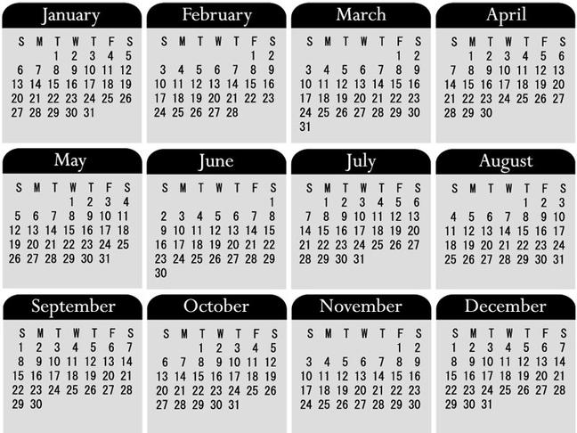
Make sure students understand the time period involved
STAR Events is a year long commitment.
The end goal is national competition.
Can they get along and commit to that person all year?
Have them choose their team members wisely.
Have a commitment agreement and give them a copy to keep as a reminder.
Notes:
Read slide
Also add make sure they realize events that may need to take place during school vacation time, etc.

Slide 53
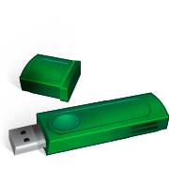

SAVE, SAVE, SAVE
Save everything for the event on a flash drive only for their group’s files.
Get them in the habit of saving often while working on it “just in case.”
You may need to have a lesson on file names!
Have a working area to keep all materials for their event including their flash drive. Make them leave everything in the designated area so they can work in case someone in the group is absent (who probably has the “stuff”).
Notes:
Read slide
Flash drives are also convenient for you to take home to check things without student interruptions.
File names – like speech, planning process, etc. not amy, lulu, etc.
Also make them understand that they can use a file then replace the file with the same name they don’t have to rename it every time.

Slide 54
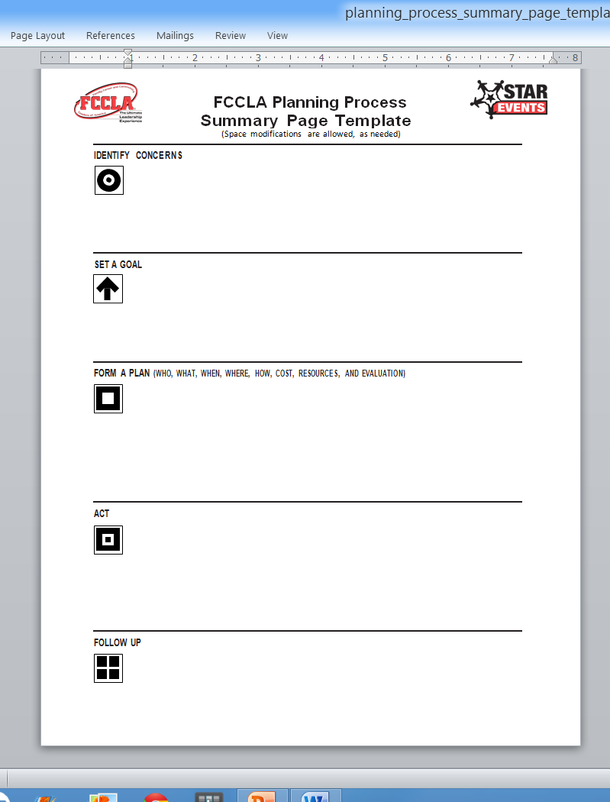
Use the FCCLA Planning Process to plan the event.
Word and pdf version templates and instructions are found in the Resources section of the STAR Events section on the national website.
Notes:
Read slide
I suggest using Word version so it can be saved. Also, margins and sections can be moved to make documentation fit.

Slide 55
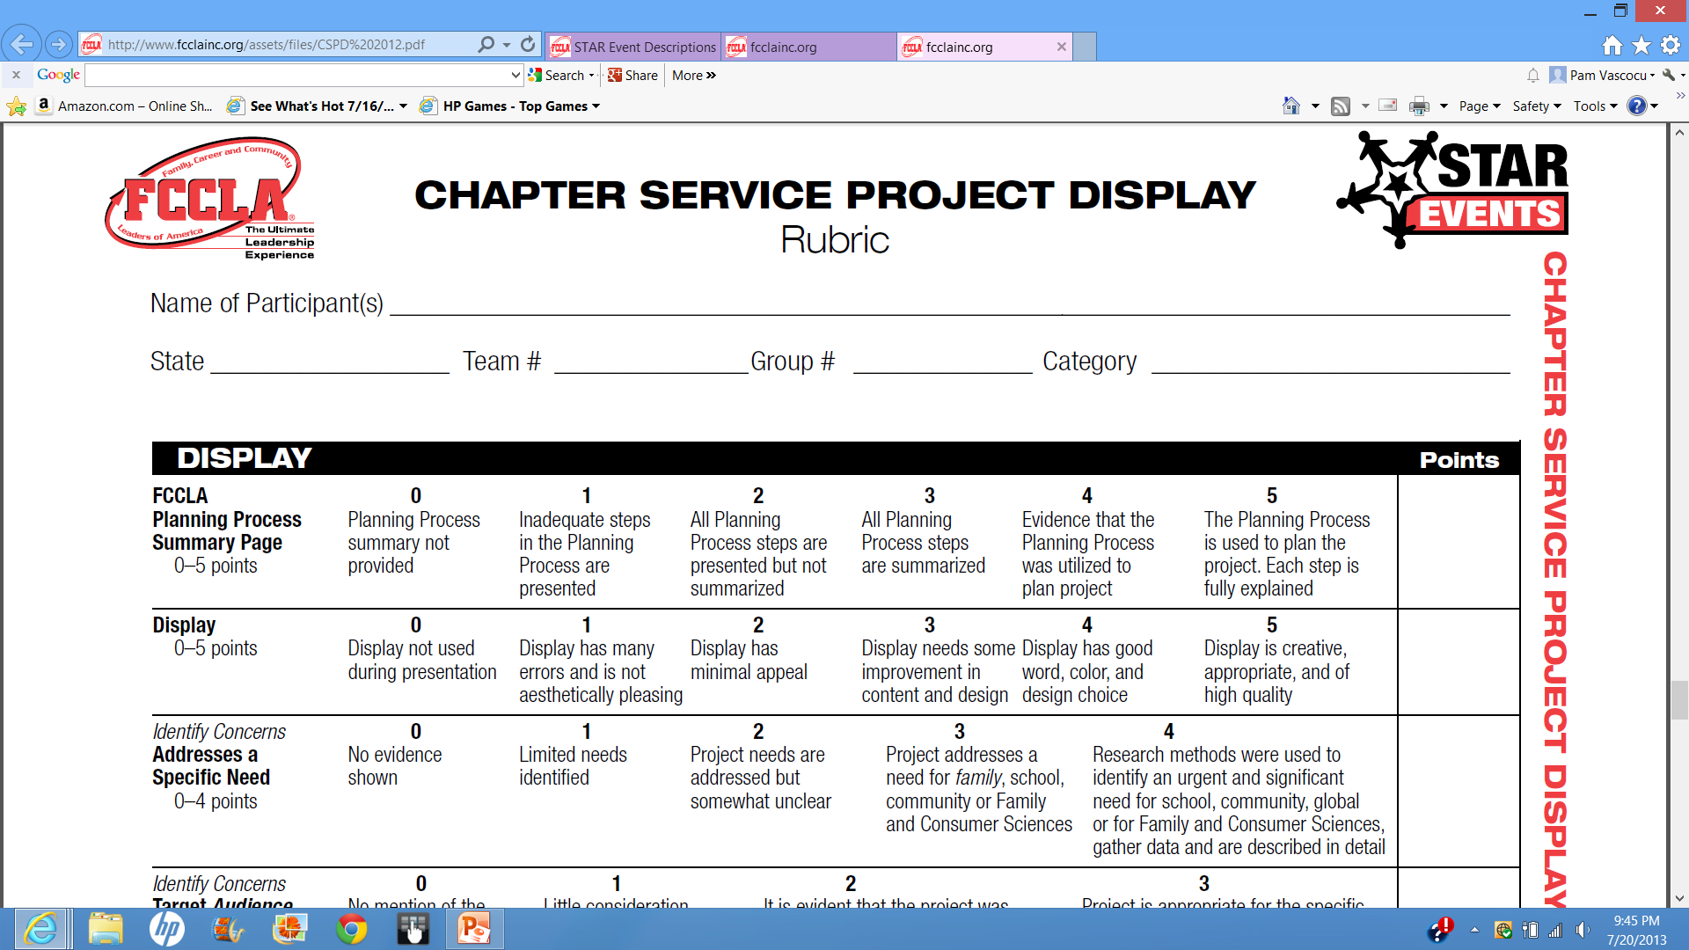
Use the event rules and rubric as a guide to ensure nothing is left out.
Notes:
Read slide.
Follow the STAR Events guidelines – we conduct our events like national.
While they plan the project, have them check what they have to prove to the judges to get the score they want.

Slide 56
Students should include one or more of the FCCLA Purposes that relate to their project.
8 Purposes
Pick at least ONE
Notes:
Read slide.
Follow the STAR Events guidelines – we conduct our events like national.
While they plan the project, have them check what they have to prove to the judges to get the score they want.

Slide 57

Explain how the project relates to Family and Consumer Sciences.
Notes:
Read slide.
Follow the STAR Events guidelines – we conduct our events like national.
While they plan the project, have them check what they have to prove to the judges to get the score they want.

Slide 58
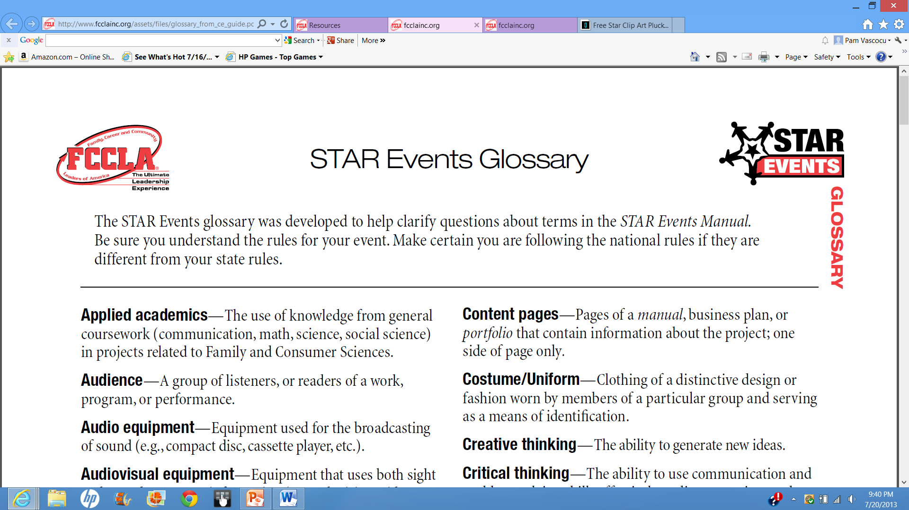
Check all italicized words in the STAR Event Glossary for clarification of terms.
Found in resources section of STAR Events on national website.

Slide 59
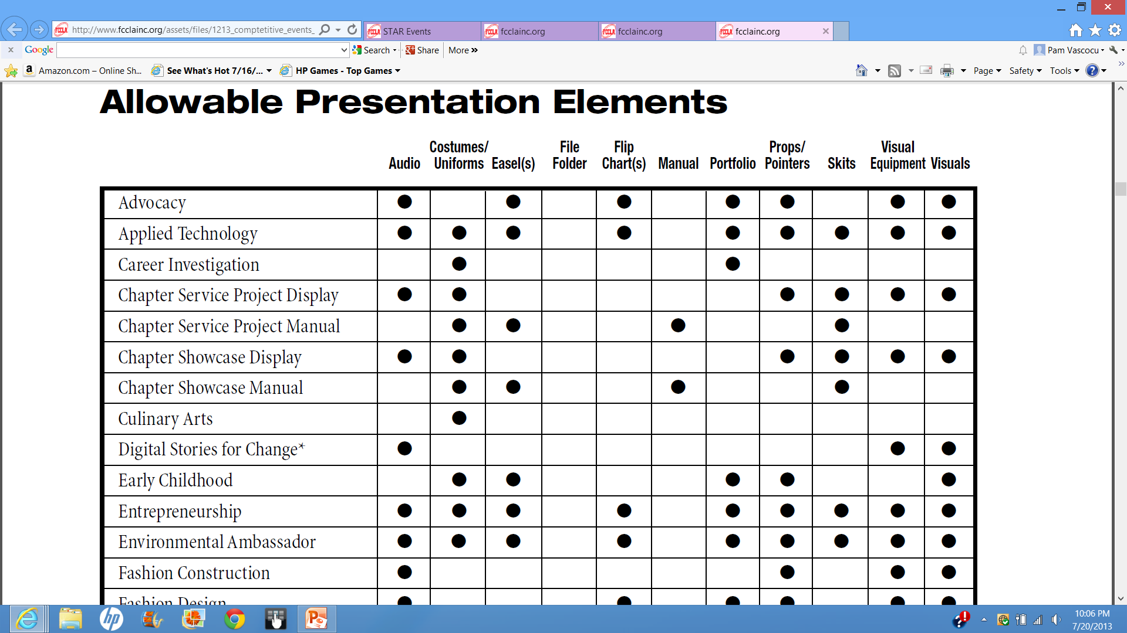
Check to see what is allowed for the event .
Notes:
Check allowable presentation element page in the STAR Events Manual.
(show example of uniforms/costumes and skits, etc. in a few contests)
If a theme can be carried out, plan for it.

Slide 60

Plan a timeline for the event for you to check their work.
Remember they are students and not adults, they need guidance with time management.
Have deadlines you have coordinated with them. Be consistent in keeping these deadlines and giving consequences of not having things done for you to check.
Meet with them after you check their work for critique and feedback.
Notes:
Read slide

Slide 61

Have them keep a detailed journal about what they did each day on their project. This will help them when they begin to organize their presentation for the judges.
Notes:
Read slide
This also helps keep them see how much they have or have not worked on the project and gives them ownership of the project.

Slide 62
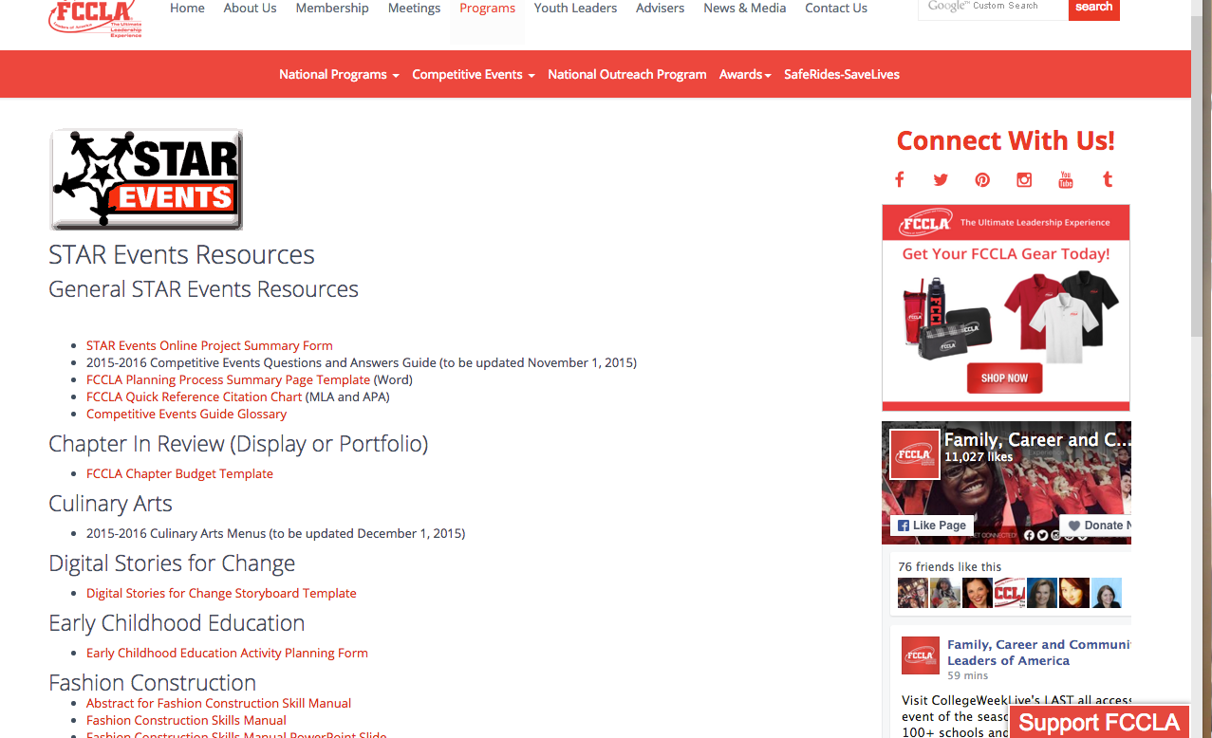

Project Summary Form
All STAR Events Participants must complete a Project Summary Form and include the proof of submission available at the end of the form in the competition display, file folder, or portfolio.
Notes:
Read slide
This also helps keep them see how much they have or have not worked on the project and gives them ownership of the project.

Slide 63

Make them write a detailed lesson plan including what they are going to say for each step if they are going to teach a class.
Notes:
Read slide
This helps them to think through their plan and avoid mistakes to make things go smoother.
They are not teachers and have had no training to think through the steps of how to avoid down time which could lead to chaos in the classroom.
Example: “Come make a circle on the floor” then tell them to fill out the paper you give them without telling them to bring a pencil, then they have to get bac up and get a pencil and return to the floor.
Make them do this and proof read it in time for them to make the changes needed to make things go smoother.
This also helps with PR with the teachers.
I also made them make the arrangements with the teachers for when to come to class, etc. and ask for their feedback on the students after the lesson had been taught.

Slide 64
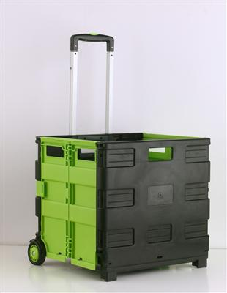

Get their things organized in a box or cart the day before the presentation to a class, etc.

Slide 65
After their lessons or presentations have been completed, get them to do a self evaluation on their performance.
Notes:
Read slide
This will give them something to help them improve their performance the next time and will help them write the follow-up section of the planning process.
It also helps them be more responsible for their own actions.
It could be a checklist or answering a few questions.

Slide 66
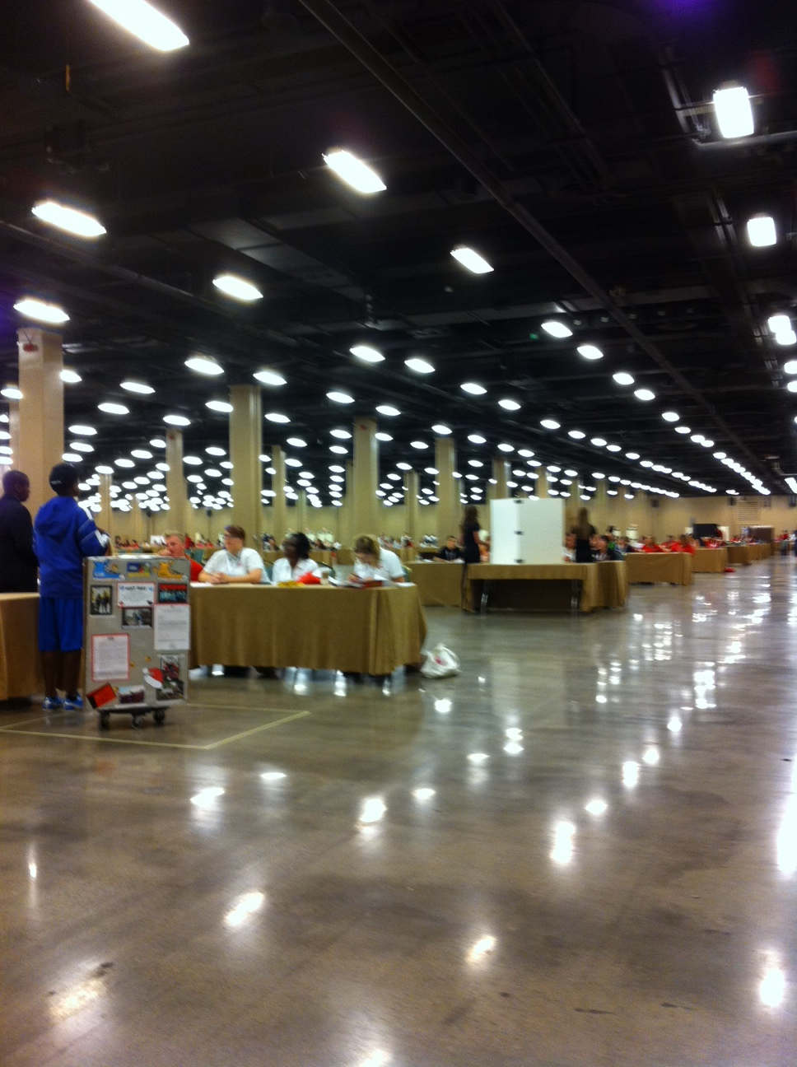
Make sure they know they may be in a room with many events going on at one time.
Notes:
Read slide
Only judges room consultant will be listening and watching them for judging.
This picture is from the setup for this year’s national competition in Nashville.

Slide 67
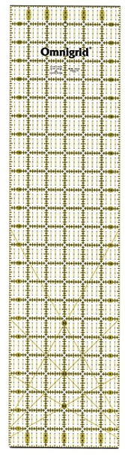
A tool to help get things straight on a display board
6” x 24”
Fits perfectly inside the board’s fold
Notes:
Read slide
Helps get things square on the board inside the fold to make sure things are straight.
Remember when you are getting a board for them to use, this may have to be shipped to national competition if they make it through, so avoid heavy boards that are expensive to ship to the hotel.
Here are some examples of boards at a national event. All of these were NOT STAR Events boards but were boards used to show national program projects. They are not all perfect examples by any means.

Slide 68
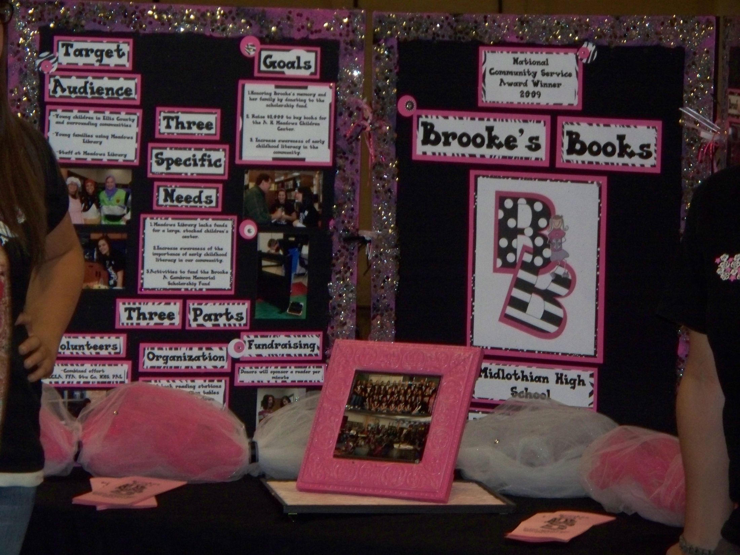

Slide 69
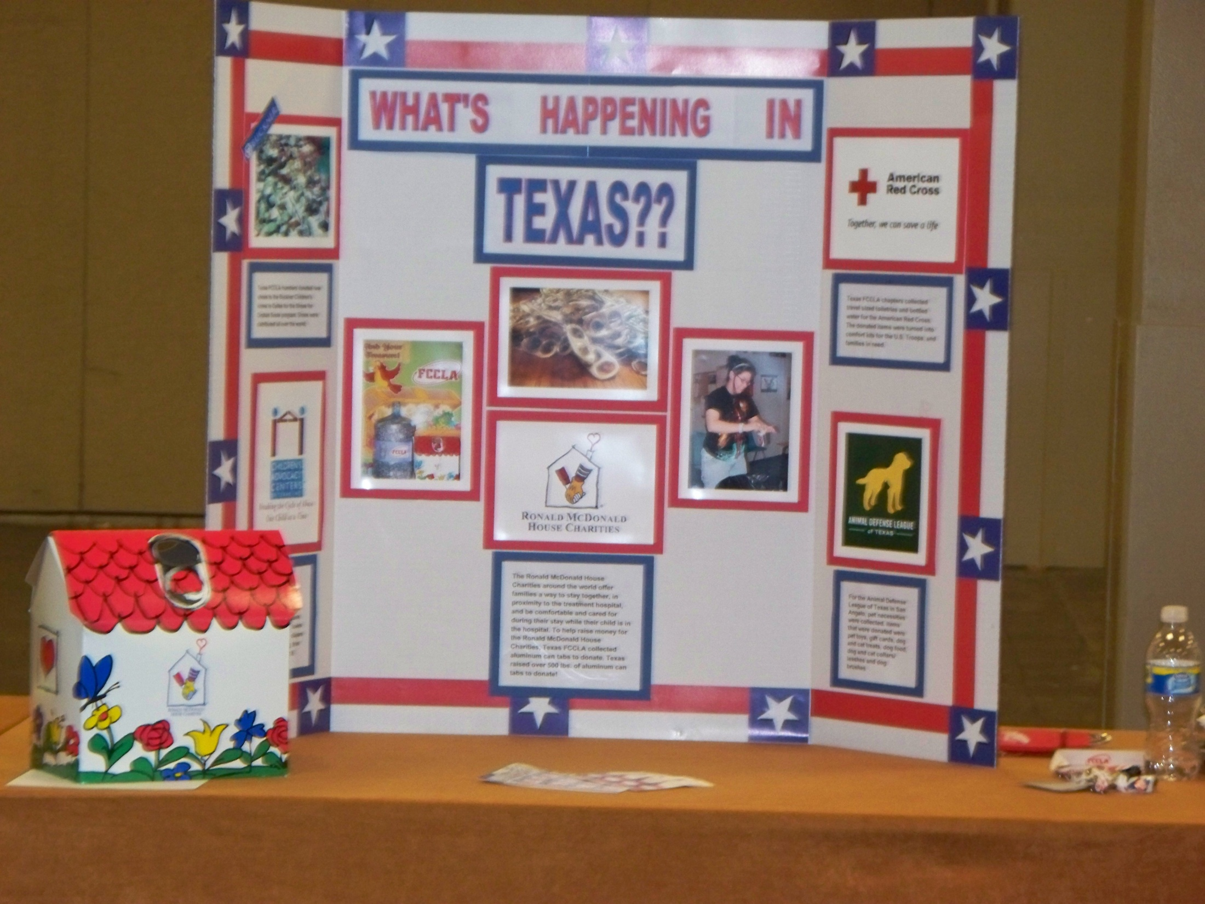

Slide 70
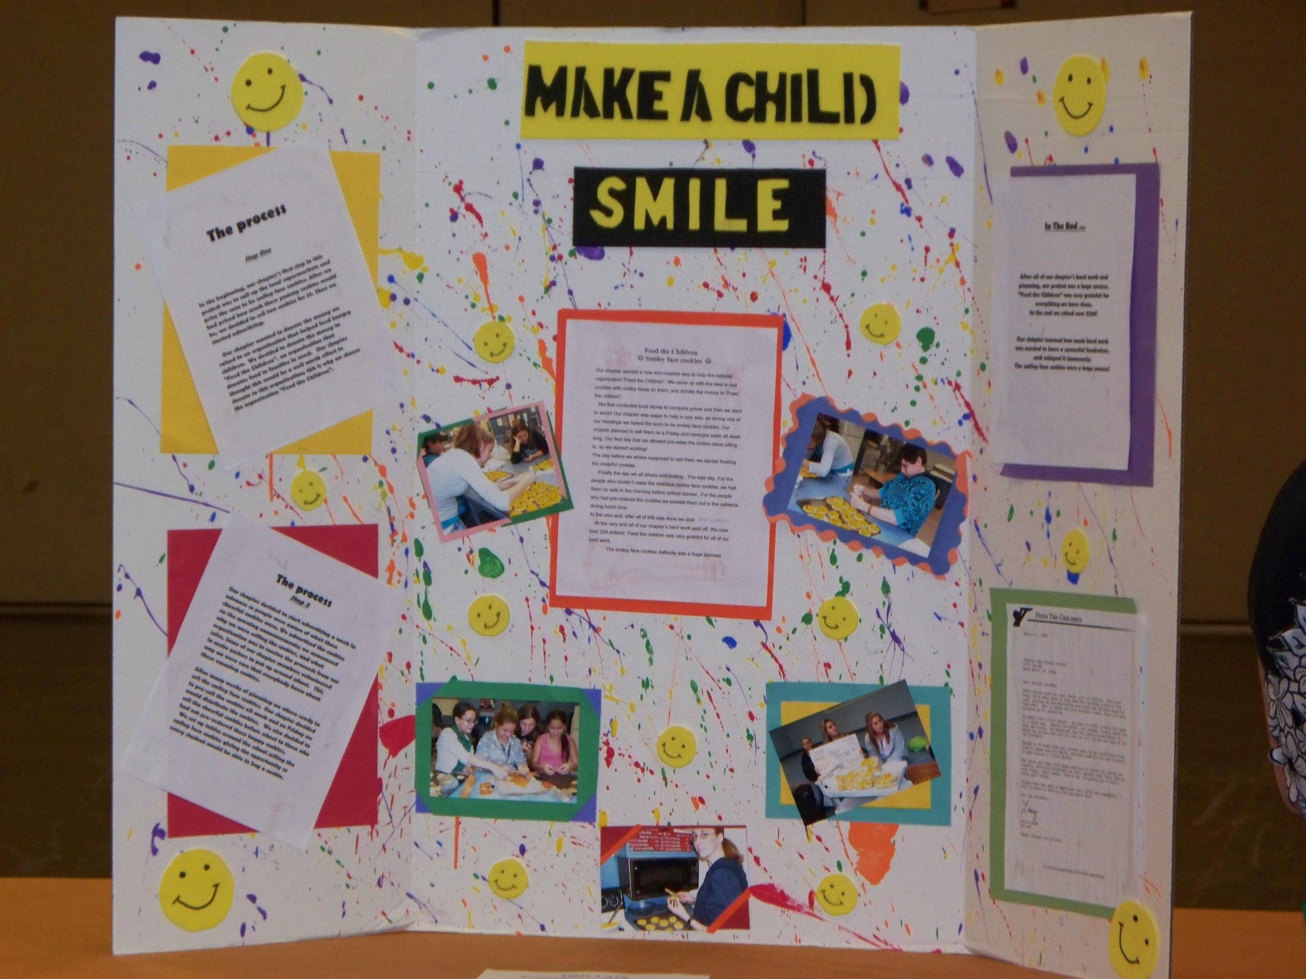

Slide 71
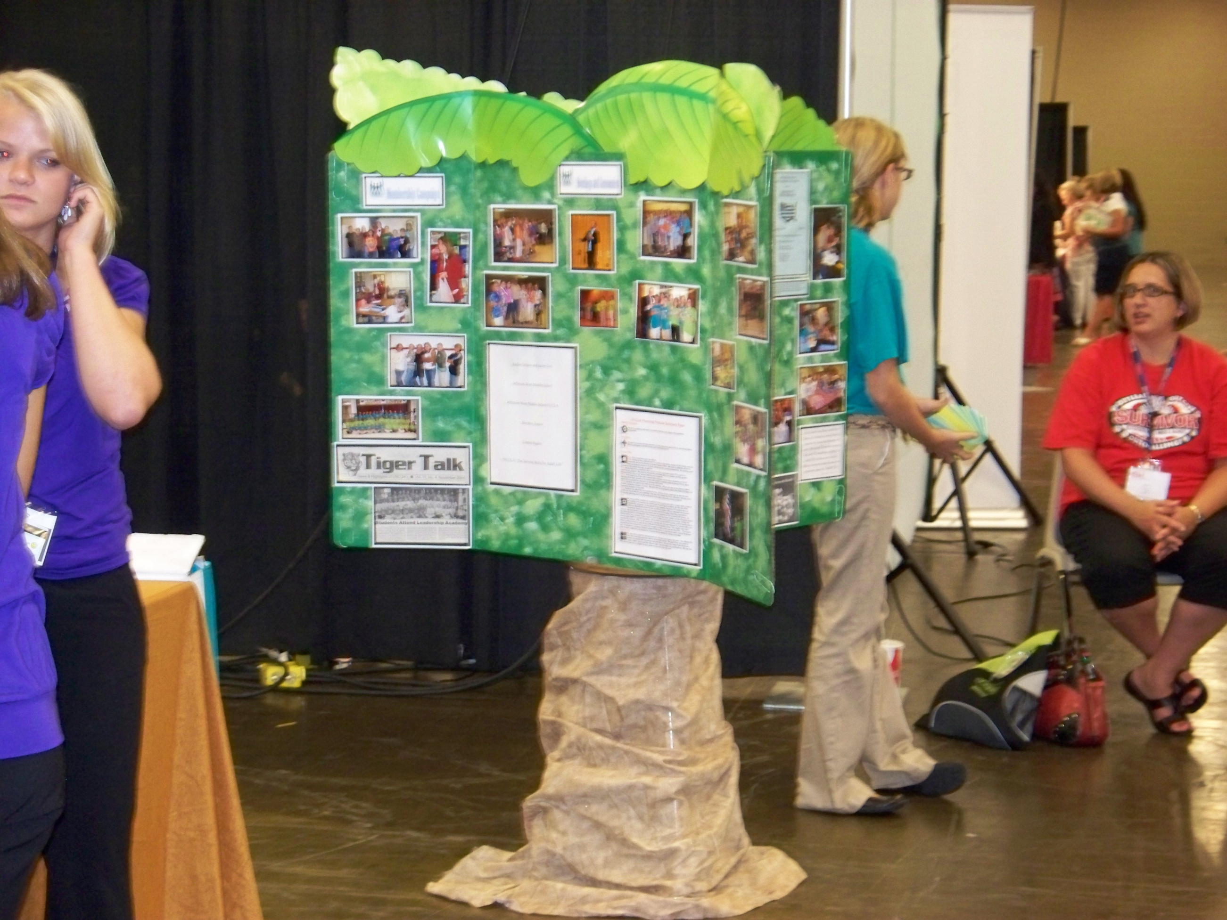
Notes:
An example of a free standing board

Slide 72
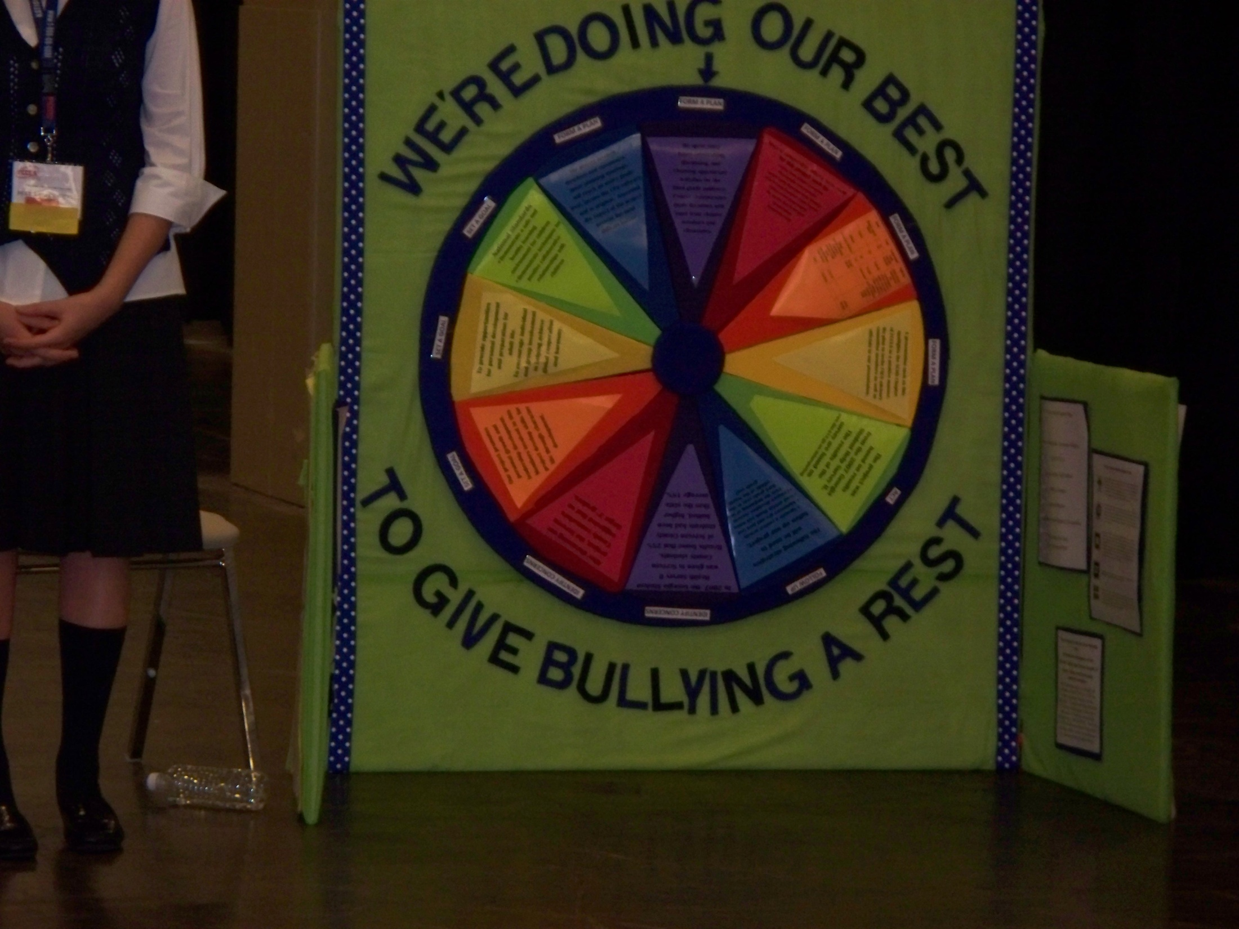

Slide 73
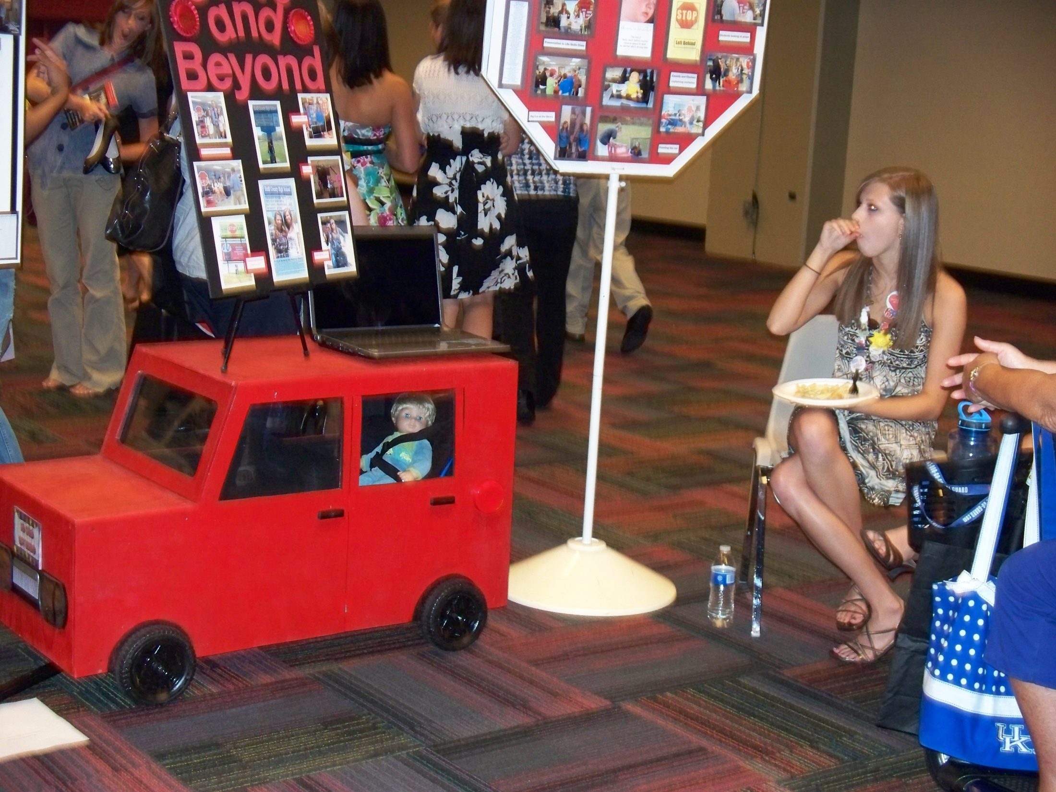
Notes:
Another freestanding display

Slide 74
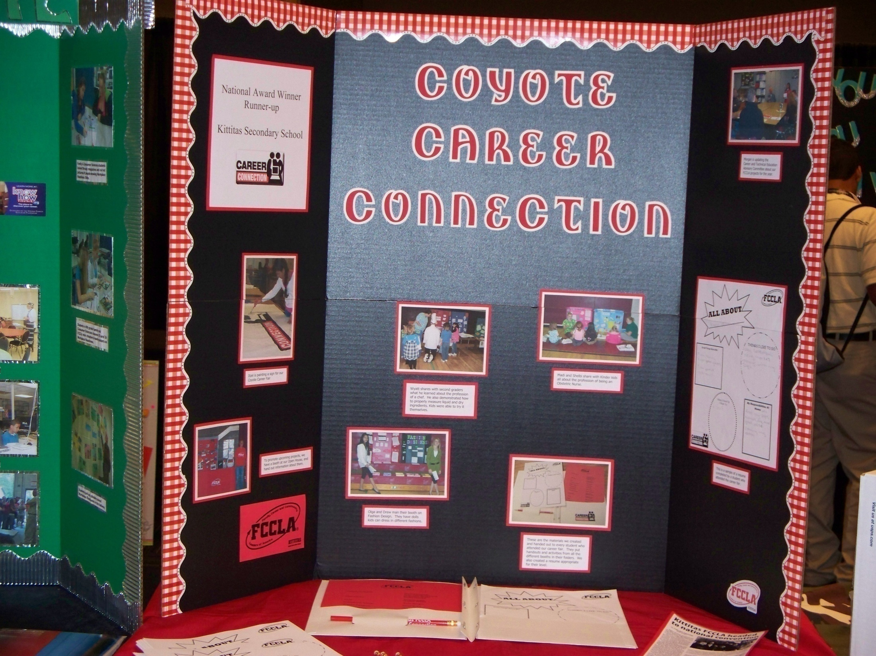

Slide 75
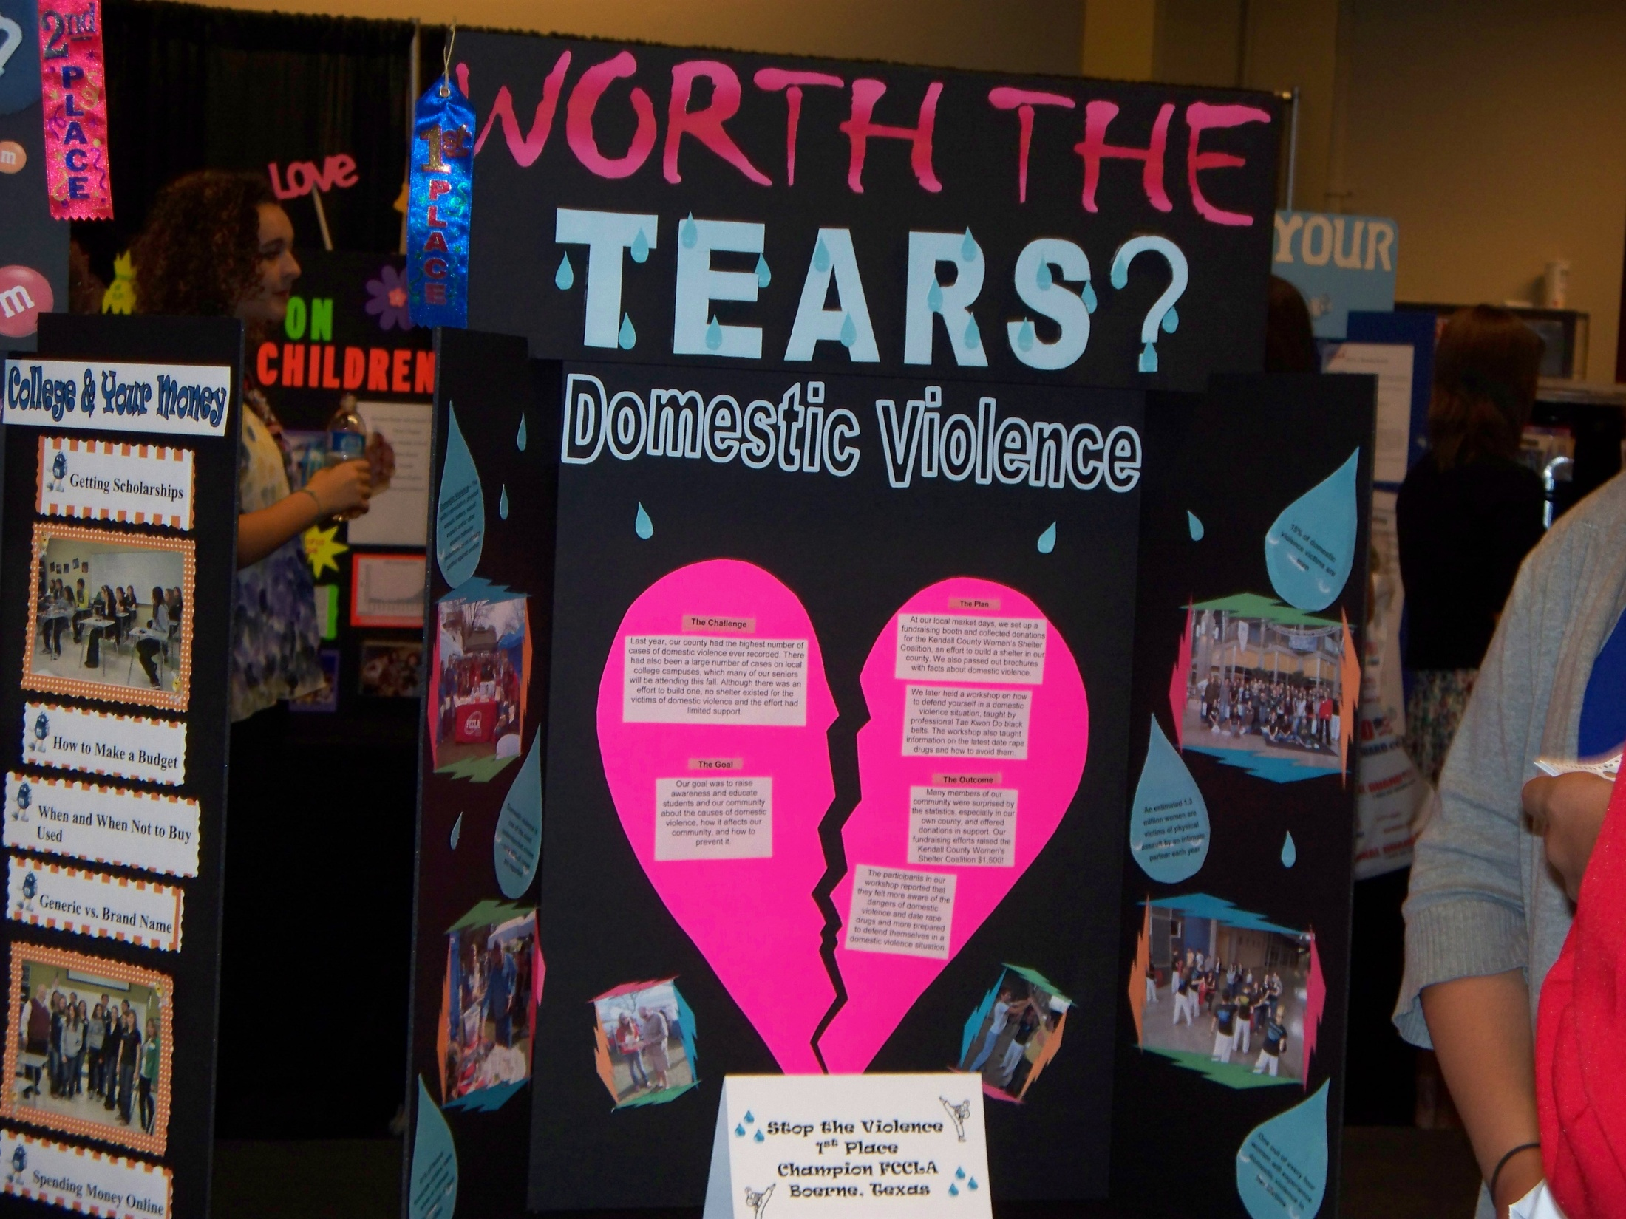

Slide 76
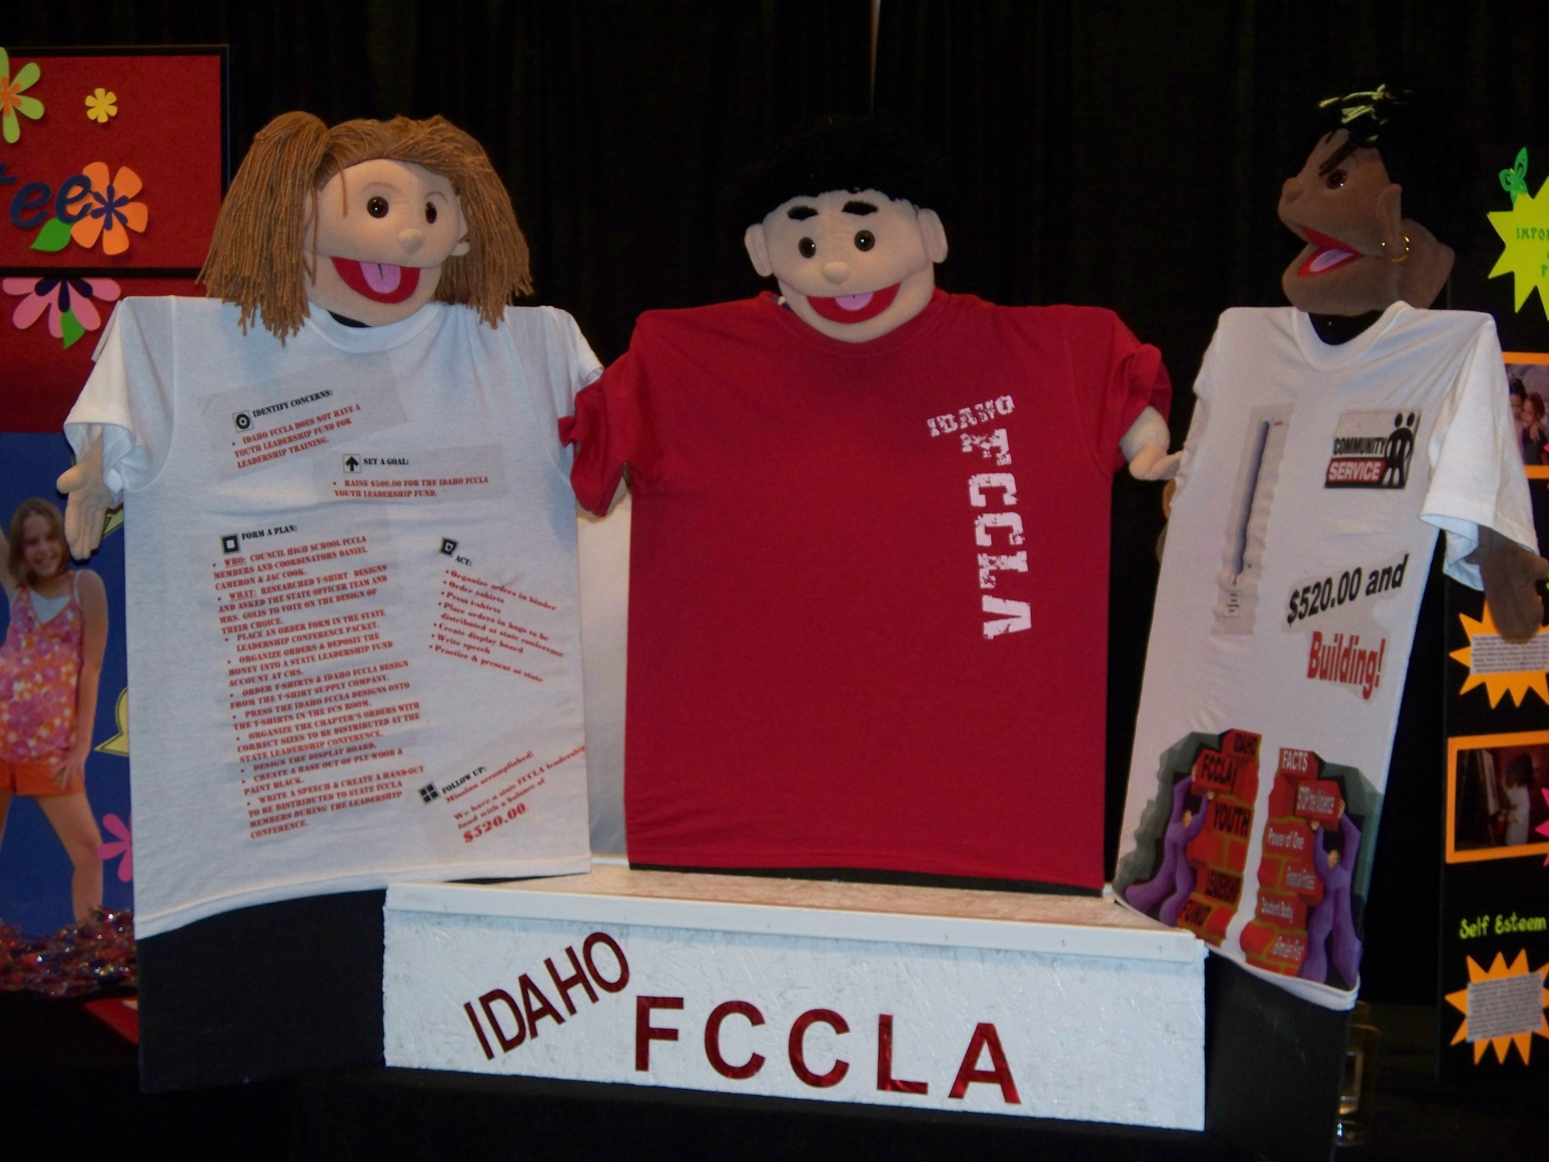

Slide 77
We are in the PACIFIC
National Region
X

Slide 78
Prepare them for competition by practicing their presentation for the judges in front of people or have a mock judging session.
Have them answer
“judges” questions for practice.

Slide 79
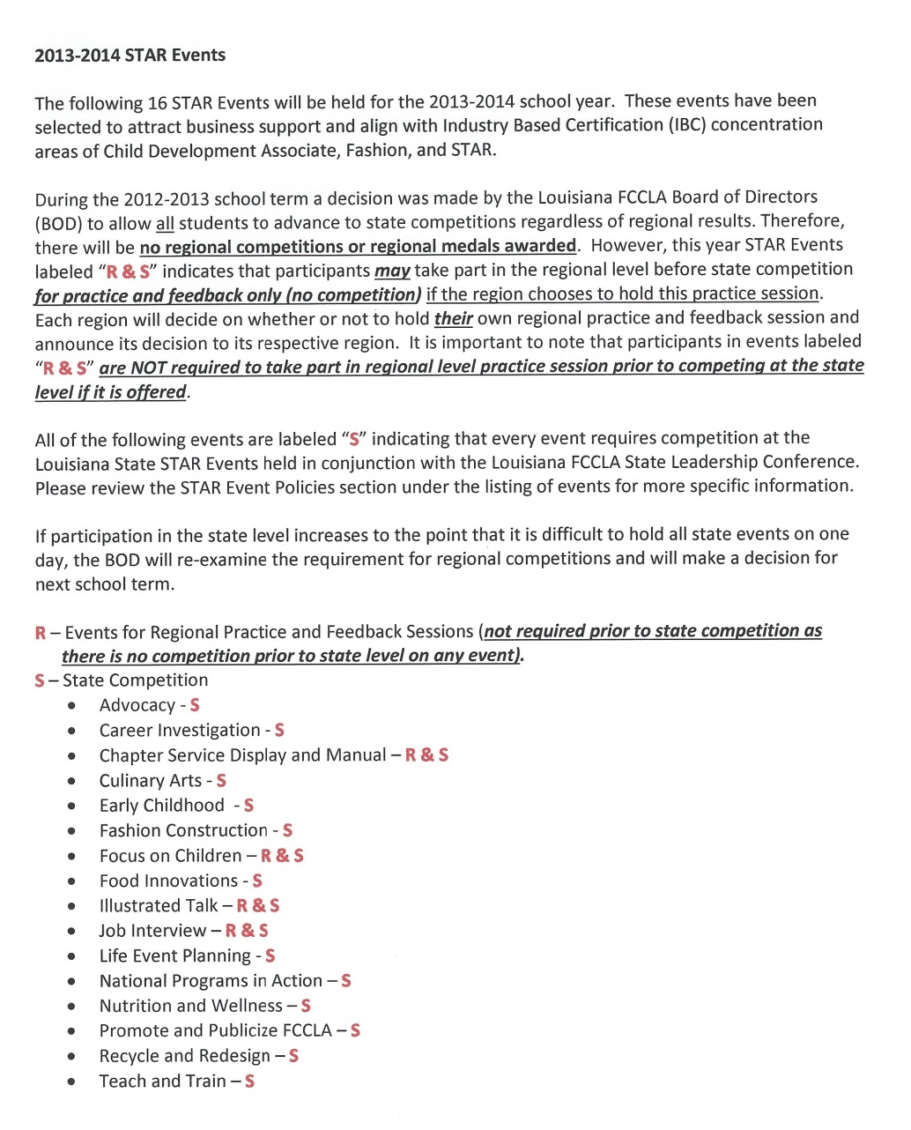
Also, consult the STAR Event guidelines for Louisiana
Notes:
Read slide.
There is a copy of these in your packet. Tonight, please read over them and see if you have any questions for the parking lot.
One change for this year is that there will be no regional competition (Read rules for regional practice on 2nd paragraph.)

