Slide 1
Build Your Wardrobe
Fashion Strategies

Slide 2
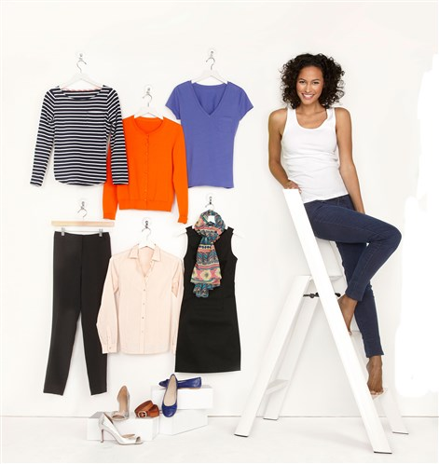
The 8 basic pieces
Have these key pieces in your closet and create more than two dozen new outfits.
Long sleeve T-shirt
Short sleeve T-shirt
Tank top
Button down shirt (tailored)
Jeans
Dress pants
Light weight cardigan
Little black dress

Slide 3
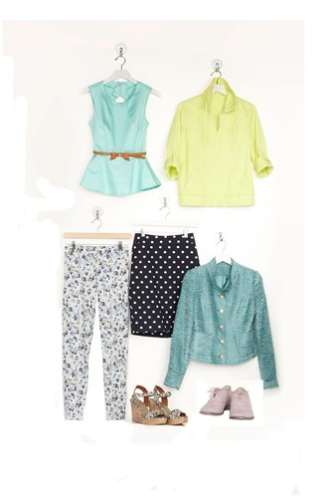
The trendy additions
Add these 6 pieces current in style and patterns, colorful, fun, fad to mix & match.
Woven shirt
Skirt
Patterned jeans
Dressy jacket
Casual jacket
Patterned scarf

Slide 4
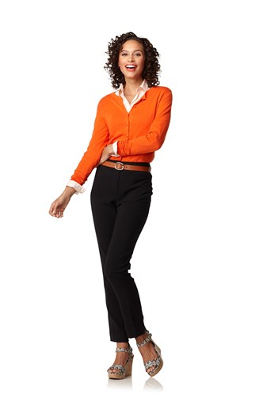
4
7
6
Accessories:
Leather belt
Wedge shoes

Slide 5
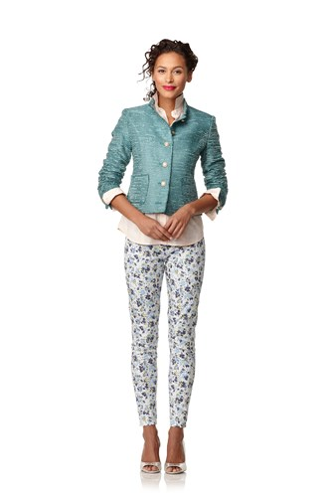
4
D
C
Accessories:
Wedge Shoes

Slide 6
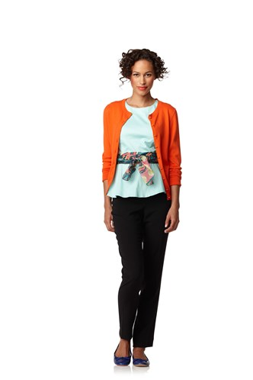
A
7
F
6
Accessories:
Ballet Flats

Slide 7
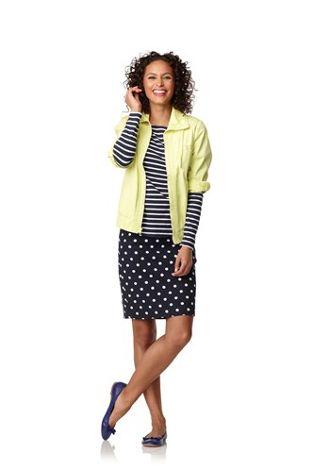
E
1
A
Accessories:
Ballet Flats

Slide 8
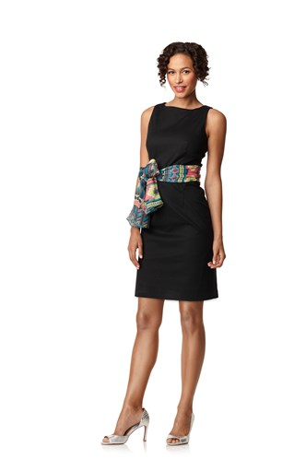
8
F
Accessories
heels

Slide 9
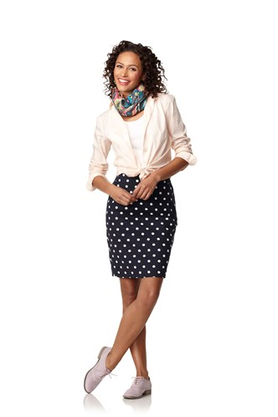
F
2
B
7
Accessories
Lace up bucs

Slide 10
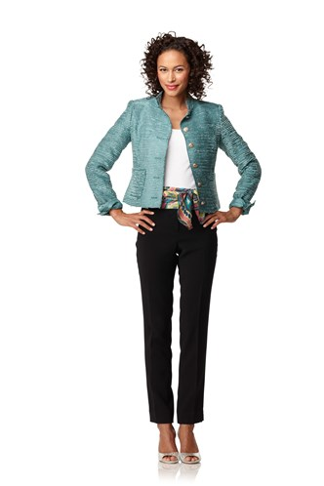
D
2
F
5
Accessories
Wedge shoes

Slide 11
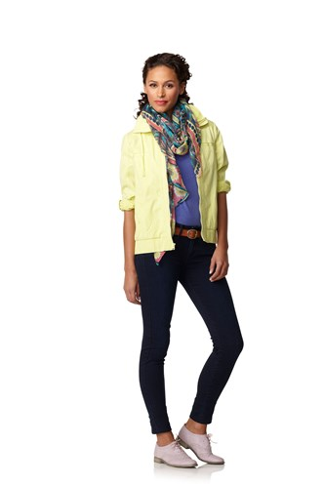
F
2
C
5
Accessories
Lace up bucs
Leather belt

Slide 12
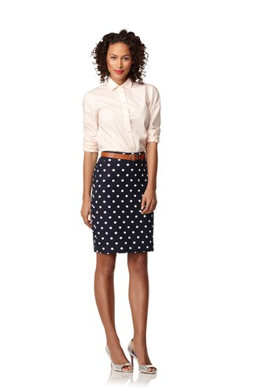
4
B
Accessories
Heels
Leather belt

Slide 13
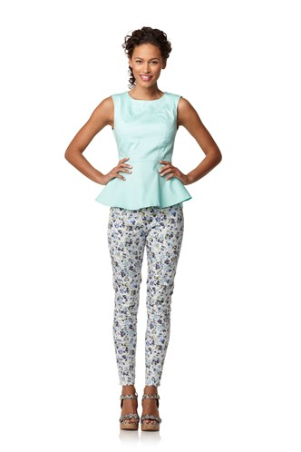
2
C
Accessories
Wedge shoes

Slide 14
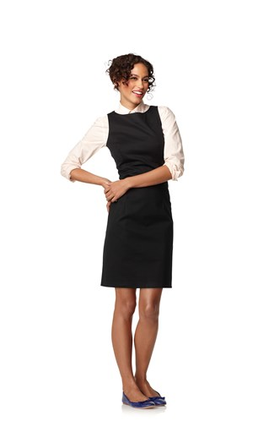
4
8
Accessories
flats

Slide 15
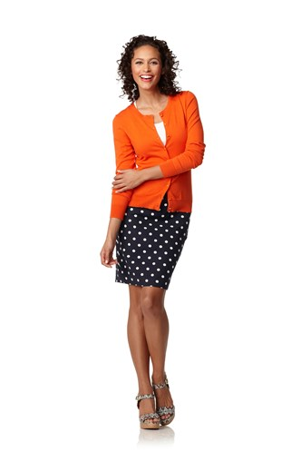
2
4
B
Accessories
Wedge shoes

Slide 16
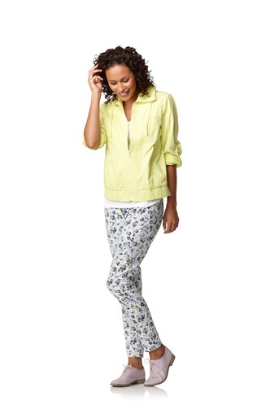
E
C
Accessories
Lace up bucs

Slide 17
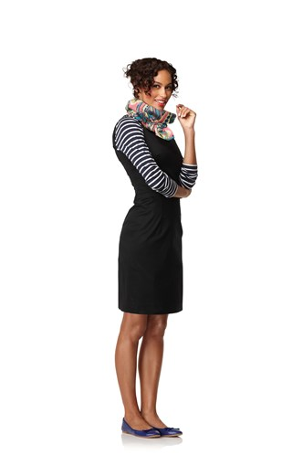
F
1
8
Accessories
flats

Slide 18
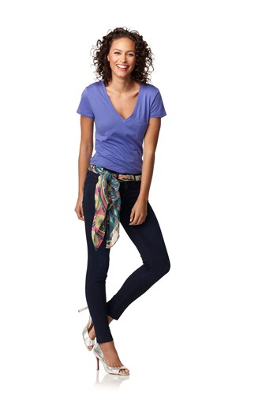
2
F
5
Accessories
heels

Slide 19
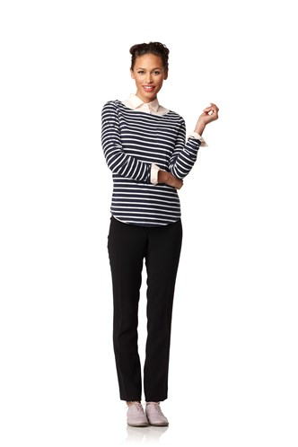
4
1
6
Accessories
Lace up bucs

Slide 20
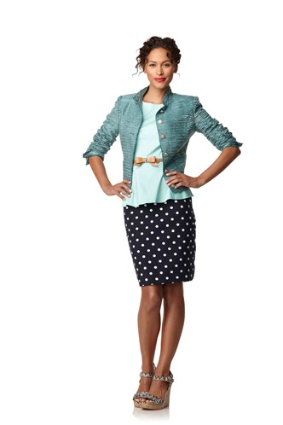
D
2
B
Accessories
Wedge shoes
Bow belt

Slide 21
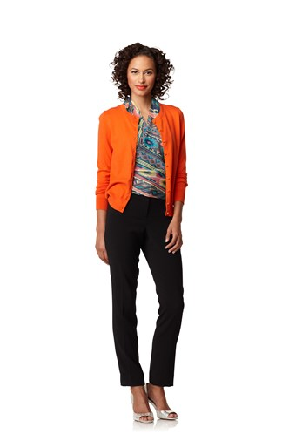
4
F
6
Accessories
heels

Slide 22
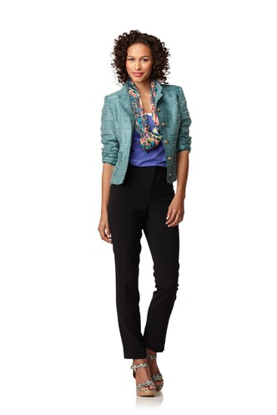
D
F
2
6
Accessories
Wedge shoes

Slide 23
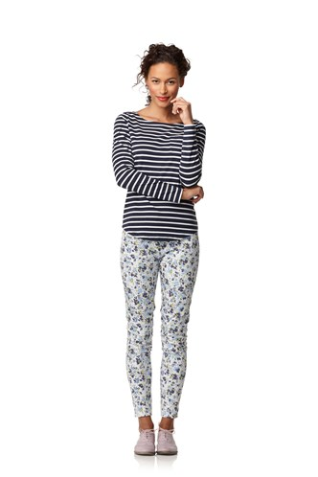
1
C
Accessories
Lace up bucs

Slide 24
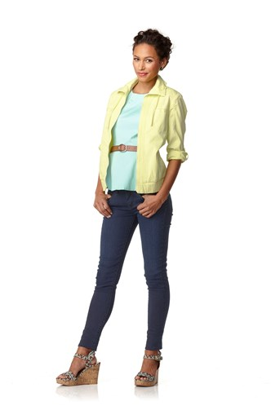
E
2
5
Accessories
Wedge shoes
Leather belt

Slide 25
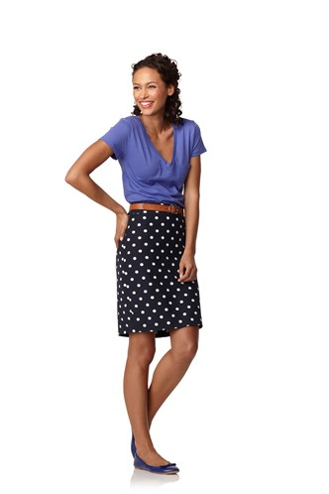
2
B
Accessories
Flats
Leather belt

Slide 26
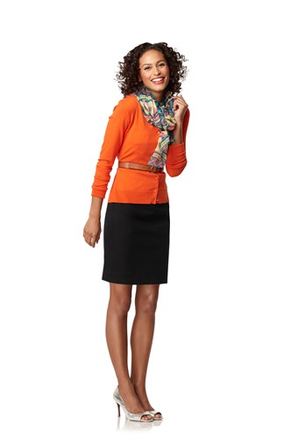
4
F
B
Accessories
Heels
Leather belt

Slide 27
2
F
5
Accessories
heels

Slide 28
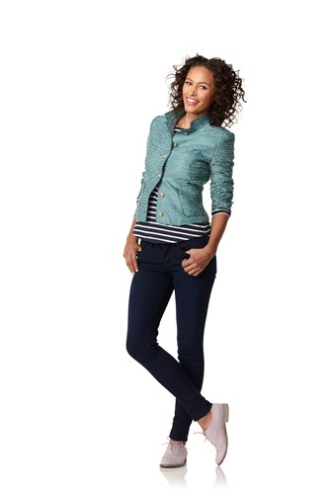
D
2
5
Accessories
Lace up bucs

Slide 29
Resources
MSN Lifestyle, “Remix Your Closet”, April 29, 2013 http://lifestyle.ca.msn.com/beauty-fashion/fashion/remix-your-closet-2#scpshrjmg

