Slide 1

FOOD-BORNE ILLNESS & FOOD SAFETY with
®

Slide 2
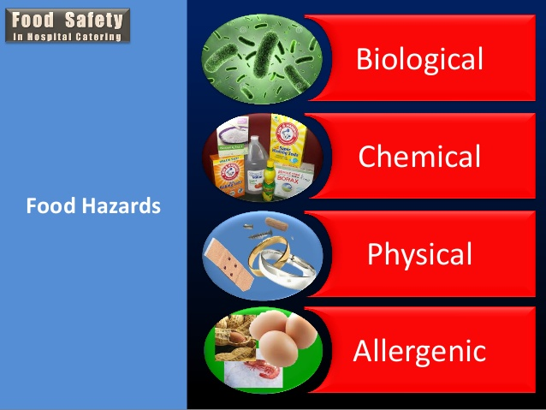
Hazards in Food Safety
Three types of hazards that make food unsafe:
  Biological
    Pathogens that cause illness
  Chemical
    Cleaners, sanitizers, polishes
  Physical
    Bandages, dirt, glass/metal shavings

Slide 3
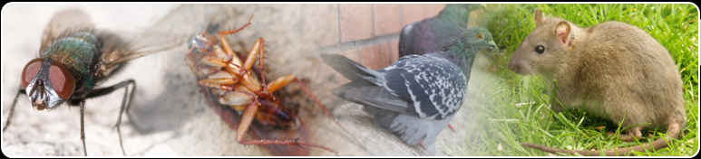
Pests in Food Safety
Pests can cause two types of contamination:
  Biological & Physical
If you spot these signs, alert the manager:
  Droppings, nests or damage to products, packaging and the facility due to pests.

Slide 4
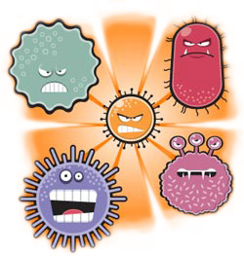
Food-Borne Illness
Results from eating contaminated foods containing poisonous toxins.
Three microbes (PATHOGENS) that cause food-borne illness:
  Bacteria
  Viruses
  Fungi (Yeast and Mold)

Slide 5
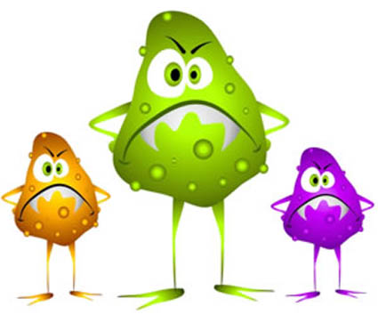
Bacterial Growth
General conditions for bacterial growth are:
  Warmth
  Moisture
  Food
  Time

Slide 6
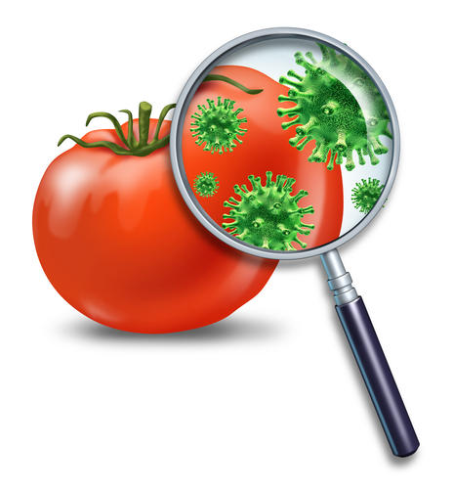

Causes of Food-Borne Illness
Food from unsafe sources
Inadequate cooking
Improper holding temperature
Contaminated equipment
Poor personal hygiene (not washing hands)
Sick employees- Notify manager
  Vomiting, diarrhea, jaundice, sore throat with a fever
Any food can cause food-borne illness

Slide 7
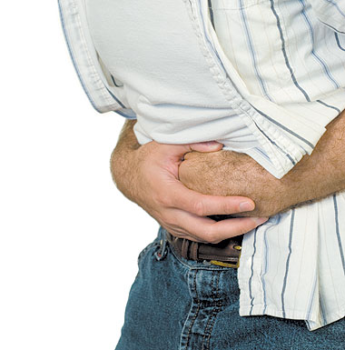
Symptoms of Food-Borne Illness
Nausea
Vomiting
Abdominal Cramps
Diarrhea
Headaches
Fever
Fatigue & Body Aches
Digestive Problems

Slide 8

Populations In Danger
Y: Young Children
O: Older Adults
P: Pregnant Women
I: Immune-Compromised

Slide 9

Types of Food-Borne Illnesses
BOTULISM
  Most Common Source:
    Improperly Canned Foods/Bulging Cans

Slide 10
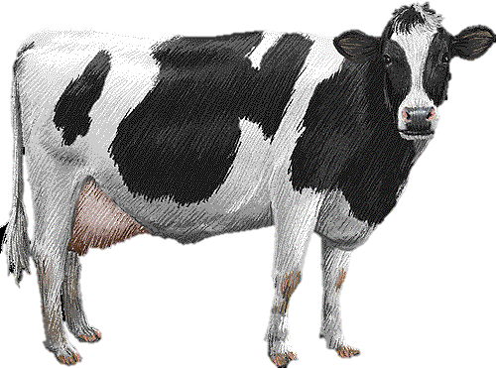
Types of Food-Borne Illnesses
E. coli
  Most Common Source:
    Undercooked Ground Beef

Slide 11
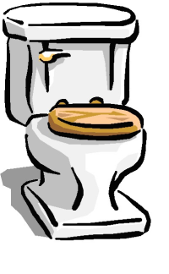
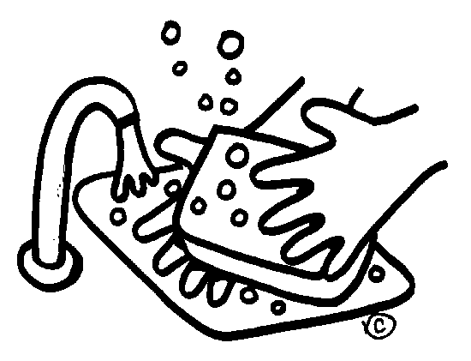
Types of Food-Borne Illnesses
Hepatitis A
  Most Common Source:
    Feces (Human Waste) from Improper Hand Washing

Slide 12

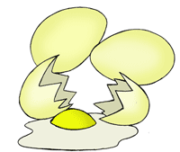
Types of Food-Borne Illnesses
Salmonella
  Most Common Source:
    Raw Poultry and Eggs

Slide 13
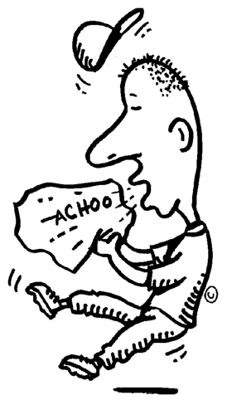
Types of Food-Borne Illnesses
Staphylococci (Staph)
  Most Common Source:
    Human Mucous (Coughing/Sneezing)

Slide 14
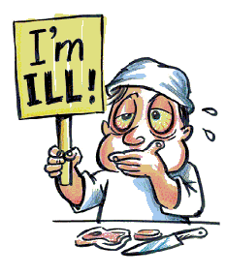
Types of Food-Borne Illnesses
Norovirus
  Most Common Source:
    Infected Food Handler

Slide 15
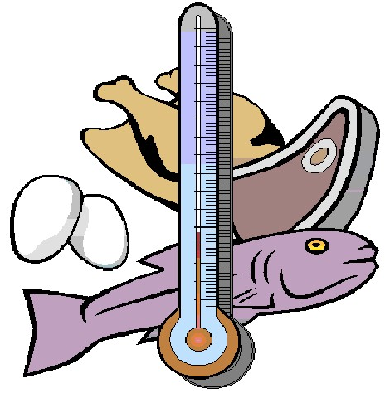
Types of Food-Borne Illnesses
Clostridium Perfringens
  Most Common Source:
    Time & Temperature Abused Foods

Slide 16
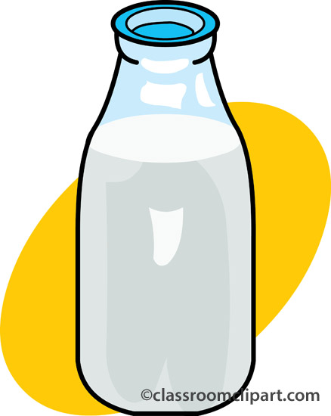
Types of Food-Borne Illnesses
Campylobacter SPP
  Most Common Source:
    Unpasteurized Milk and Contaminated Water

Slide 17
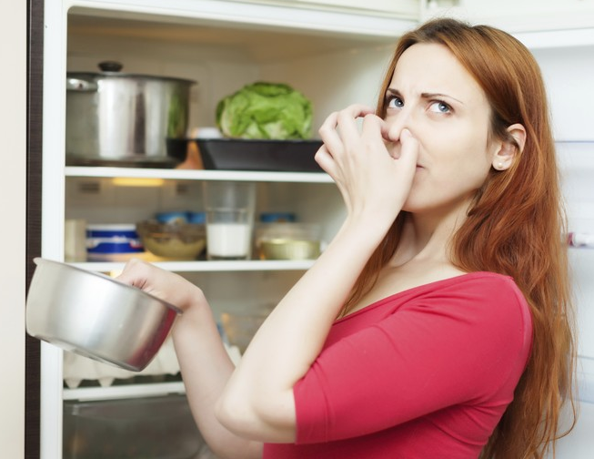
Preventing Food-Borne Illness
When in doubt… throw it out!
Keep hot foods hot and cold foods cold.
Use proper hand washing techniques.
Keep foods out of the Temperature Danger Zone.
Cook, reheat and serve foods to the proper internal temperatures.
Avoid cross-contamination

Slide 18
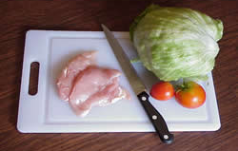
Avoiding Cross-Contamination
Never place cooked food on a plate which has previously held raw meat, poultry or seafood.
Always wash hands, cutting boards and food prep surfaces with hot soapy water after they come in contact with raw meat, poultry or seafood.
If food becomes cross-contaminated, set the food aside and ask the manager what to do.

Slide 19
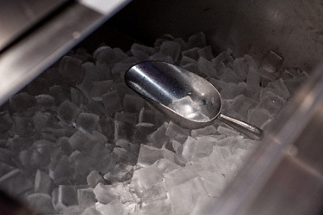
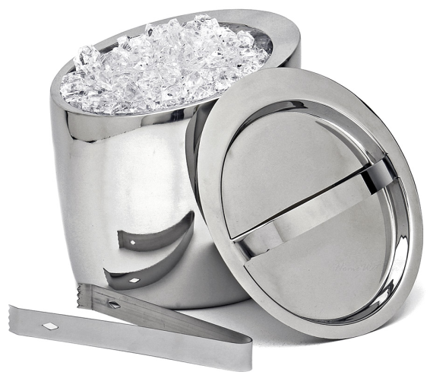
Avoiding Cross-Contamination
Never scoop ice with your bare hands or a glass. Always use ice scoops or tongs to get ice.
Do NOT hold utensils by the part that comes into contact with food.
Use tongs, gloves or deli-sheets to serve ready-to-eat foods like bagels.

Slide 20
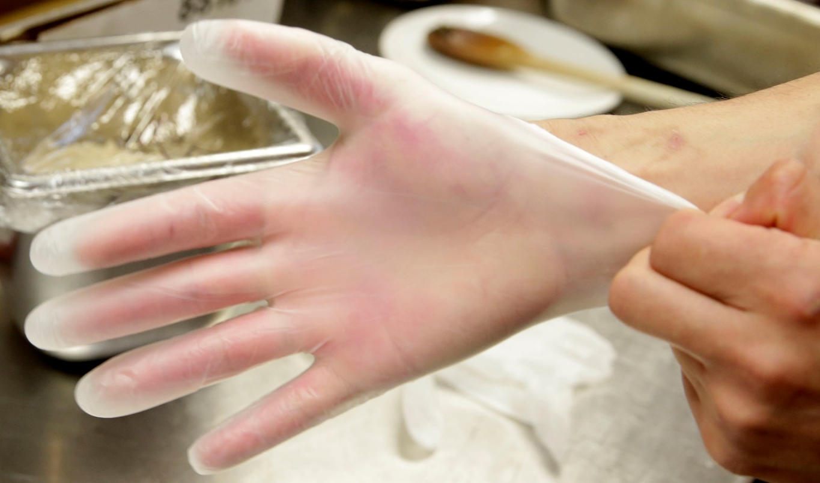
Avoiding Cross-Contamination
Change gloves after handling raw meat, poultry and seafood.
Change gloves after they get dirty or torn.
Wear bandages over wounds and use a water-proof finger cover over bandages and under gloves.

Slide 21
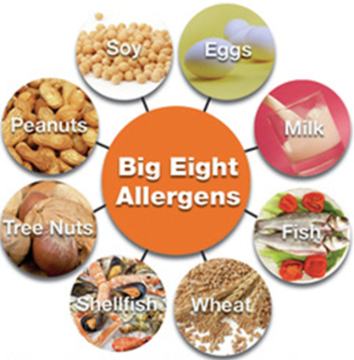
Allergens
Proteins that cause allergic reactions are called allergens.
Cross-Contact is when one food allergen comes into contact with another food item and their proteins mix.
The BIG 8 refer to the allergens that cause the most reactions:
  Milk, Soy, Eggs, Fish, Tree Nuts, Peanuts, Crustaceans Shellfish and Wheat.

Slide 22
Temperature Controls for Safety (TCS)
Some foods have a greater risk for microbe (PATHOGEN) growth.
The best way to control this growth is to control the factors of time and temperature.
Foods Most At Risk:
  Milk/Dairy
  Meat
  Fish
  Eggs
  Poultry
  Shellfish
  Baked Potatoes
  Tofu
  Sprouts
  Cooked Rice
  Beans
  Vegetables
  Sliced Melons
  Tomatoes
  Lettuce

Slide 23
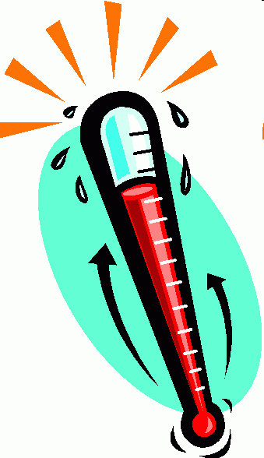
Temperature Danger Zone (TDZ)
Any temperature between 41°F and 135°F.
  Cold foods should be kept lower than 41°F and hot foods should be kept higher than 135°F.
Foods should not be in the TDZ for more than 2 hours.
Foods in the TDZ for more than 4 hours should be thrown out.
Temperature Control Safety (TCS) abuse is allowing food to stay in the danger zone.

Slide 24
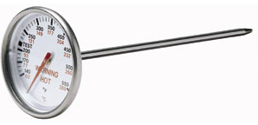
Important Temperatures
Always check the INTERNAL temperature of foods with a food thermometer. Always check the THICKEST part of the food.

Slide 25
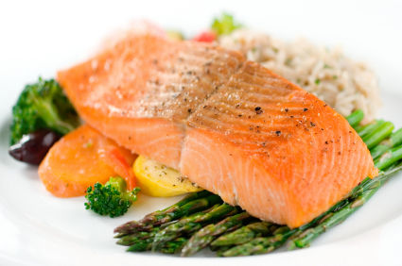
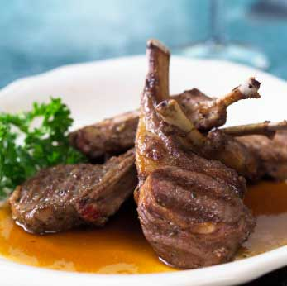
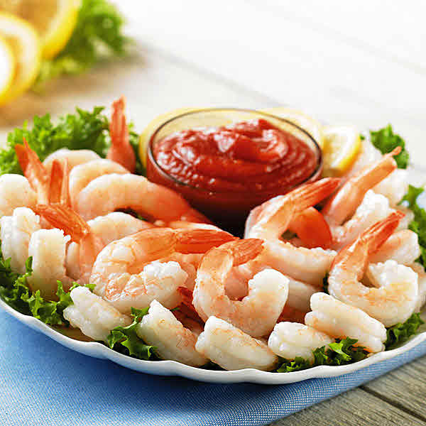
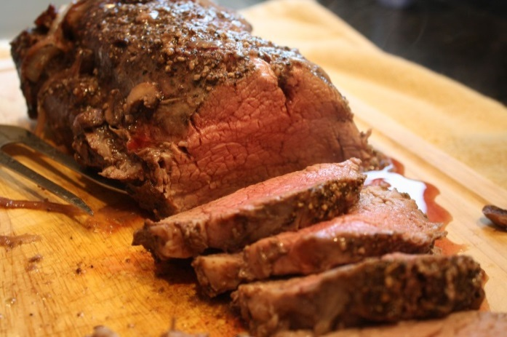
Important Temperatures
Seafood, beef, veal, lamb and pork
145°F

Slide 26
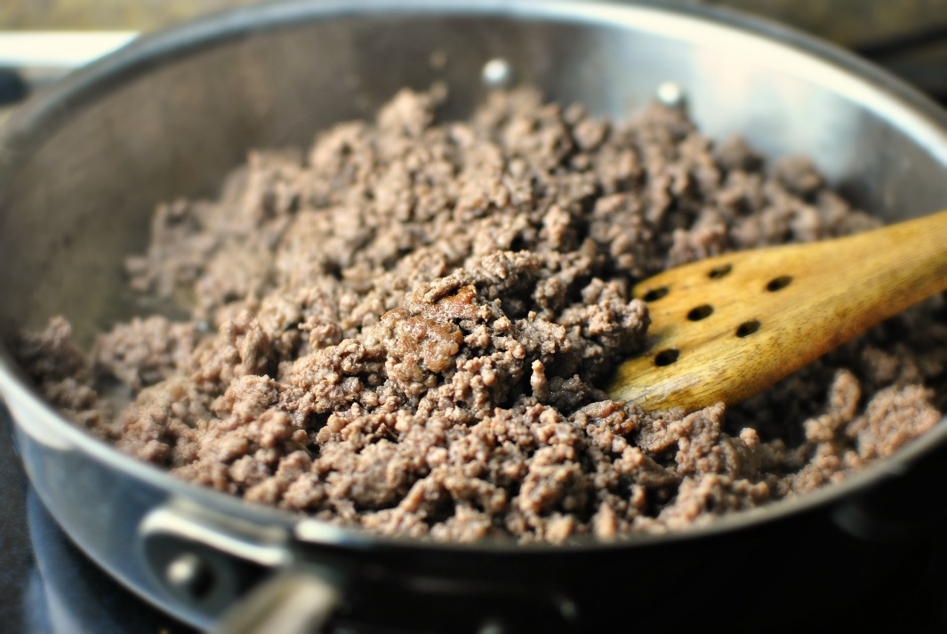
Important Temperatures
Ground Meats
155°F

Slide 27
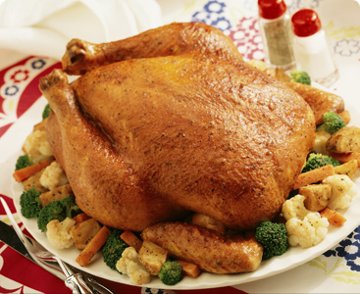
Important Temperatures
Poultry
165°F

Slide 28
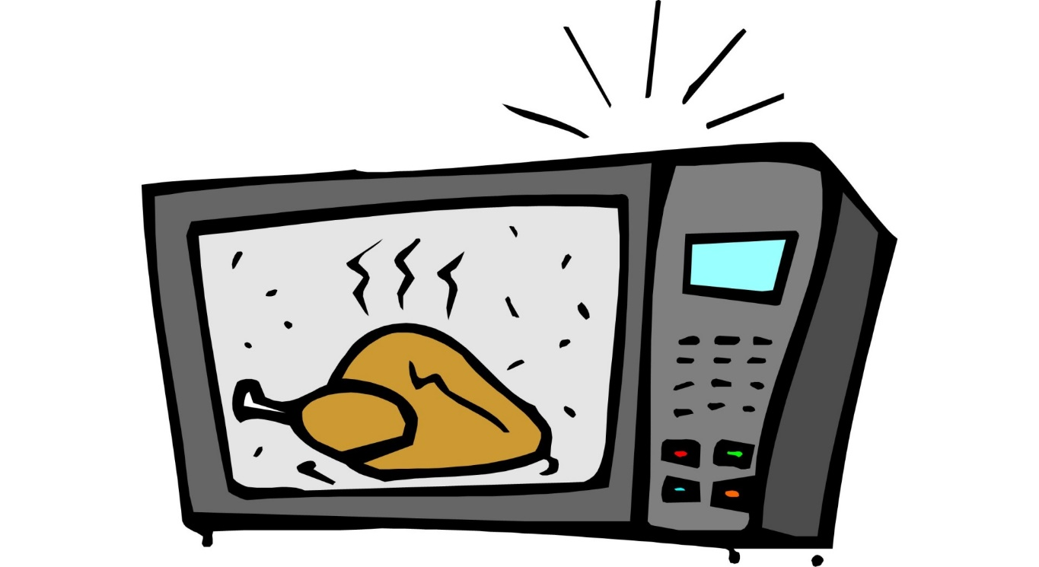
Important Temperatures
Reheating Foods (Leftovers)
165°F

Slide 29
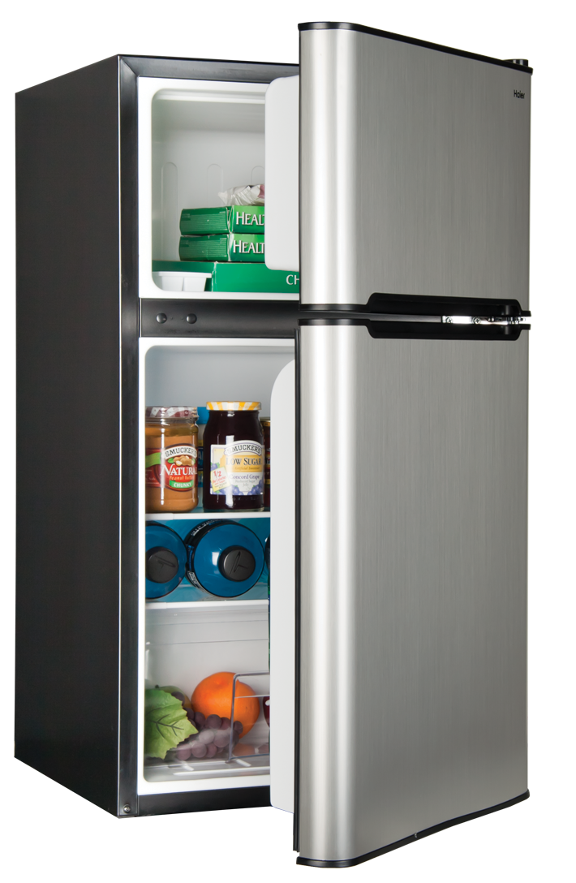
Food Storage
Refrigerators should be 40°F or below.
Freezers should be 0°F below.
Separate food into smaller containers to cool more rapidly.
Mark and date food properly.

Slide 30
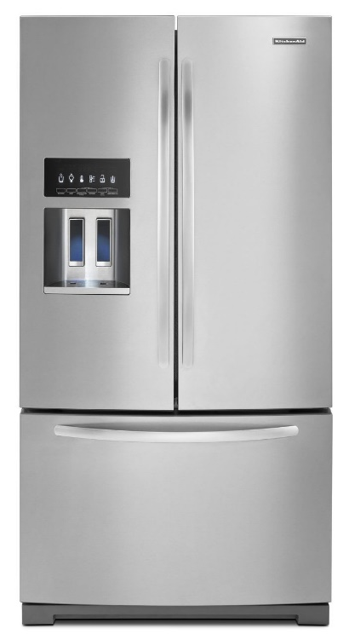
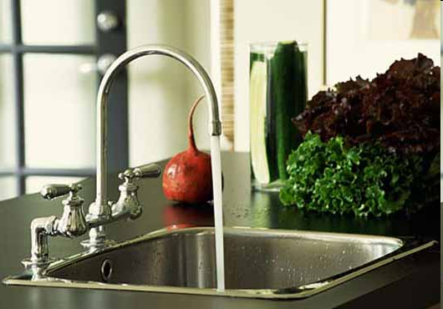
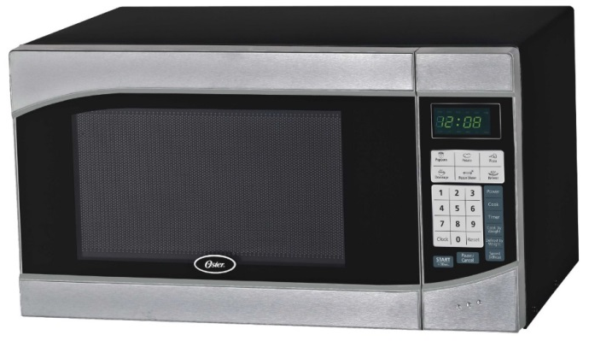
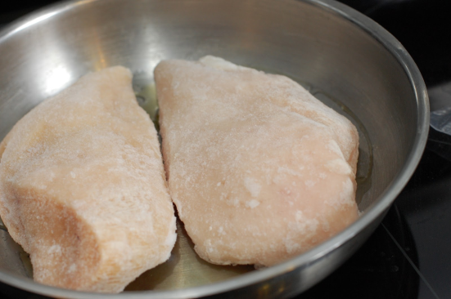
Thawing Foods Safely
In the refrigerator for 2-3 days. This is the safest method.
Under cold, running water.
In the microwave if used immediately.
As part of the cooking process
NEVER defrost frozen food at room temperature.

