Slide 1
Kitchen safety!
Standard 1
Objective 1-5

Slide 2
Avoiding Kitchen Accidents

Slide 3
ELECTRIC SHOCK
Prevention | First Aid | Extra Notes
NO WATER! | Disconnect main power source before helping person Check for breathing and heart beat (begin compressions if necessary) 911! | Don’t be stupid ☺
Dry hands
Stand on a dry floor
Attach accessories before plugging into the wall
Plug cord into appliance before plugging into power source

Slide 4
CUTS
Prevention | First Aid | Extra Notes
Knife handling | Wash it APPLY PRESSURE! | If the sight of blood makes you faint, make sure you sit down!
Sharp knives only
Remove and discard can lids properly

Slide 5
SPILLS/FALLS
Prevention | First Aid | Extra Notes
Clean up spills immediately | Pick up a person who falls Unless they hit their head…..then get help first! (head/neck injuries) | Oil spills can only be cleaned with soap and water (surfactants!)
Use a step stool for high objects

Slide 6
BURNS
Prevention | First Aid | Extra Notes
Turn handles away from the front of the range | Cool running water Cool damp cloth | Loose clothing/jewelry should be removed or secured No ice!
Lift lids away from you
Oven mitts/ hot pads
Keep clothing away from direct heat

Slide 7
LIFTING TECHNIQUES
Prevention |  | Extra Notes
Lift with your knees! |  | Ask for help!
Store heavy items on lower shelves

Slide 8
CHEMICAL STORAGE
Prevention | First Aid | Extra Notes
Do not mix chlorine (bleach) and ammonia= toxic fumes! | If chemicals touch skin, rinse thoroughly with water Call poison control | READ THE LABELS!!!
Cleaning supplies = away from food
Use gloves

Slide 9
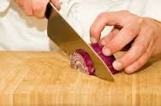
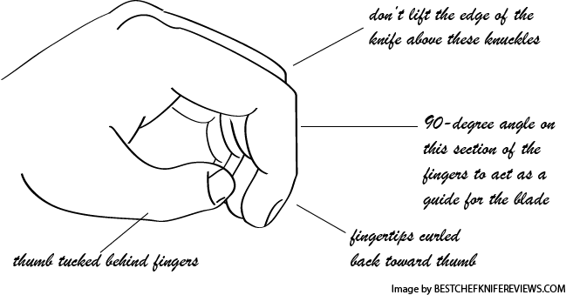
KNIFE HANDLING
The Claw & Flat Hand

Slide 10
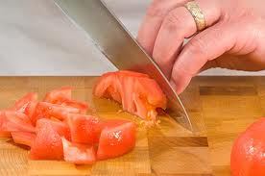
What’s the Best Knife?
Always use a SHARP knife!
More efficient
Dull knives are dangerous!

Slide 11
Food-Borne Illness
A food-borne illness is an illness caused by infected food.
Eating contaminated foods containing poisonous toxins can cause food borne illness
The best prevention of food-borne illness is WASHING YOUR HANDS!

Slide 12
BACTERIAL GROWTH
Bacteria reproduce through a process called binary fission. This occurs rapidly when food is left in the danger zone.
Bacteria need 6 things to grow:
F= Food source (especially high protein foods)
A= Acidity (low acid, over 4.6 pH)
T= Time
T= Temperature (danger zone)
O= Oxygen (though some are anaerobic)
M= Moisture

Slide 13
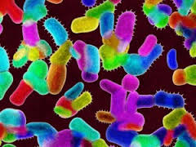
VOCABULARY
Microbes: anything too small to be visible to the naked eye. The 3 types of microbes in food are:
Bacteria
Viruses
Fungi (yeast and mold)

Slide 14
NDV’s= the common symptoms of most food-borne illness
NAUSEA
DIARRHEA
VOMITING

Slide 15
FBI’s: the most UNWANTED
FBI | Source | Symptom
Botulism | Improperly canned food (low-acid) *Honey = babies | Lockjaw Neurotoxin Blurry vision Slurred speech
E-Coli | Undercooked ground beef Unpasteurized milk and juice | NDV’s
Hepatitis A | Human fecal matter | Jaundice NDV’s
Salmonella | Raw poultry and eggs | NDV’s

Slide 16
FBI’s: the most UNWANTED
FBI | Source | Symptom
Staphylococci (Staph) | Human mucous contact on food | Flu-like symtoms NDV’s
Norovirus | Raw produce, contaminated water, foods in contact with an infected handler | NDV’s Muscle pain Fever
Clostridium perfringens | Meats, poultry, gravy TIME/TEMP-ABUSED foods | Abdominal pain Diarrhea Nausea *rarely fatal
Campylobacter SPP (spp=species) | Unpasteurized (raw) milk Contaminated water Raw and undercooked poultry | Diarrhea (w/blood) Abdominal pain Fever NDV’s

Slide 17
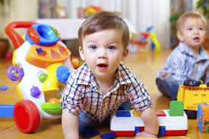
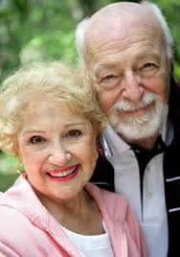
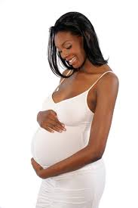
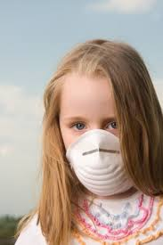
Can I get a Food-Borne Illness?
Anyone could be susceptible to food-borne illness, particularly if your immune system is weak. But there are special populations of people who are most vulnerable to FBI’s:
I=Immuno-compromised
(allergies, chronic illness, etc…)
Y= Young
(children under 5)
O= Old
(over age 65)
P=Pregnant

Slide 18
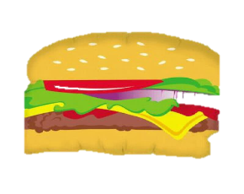
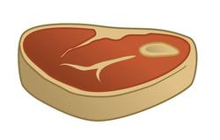
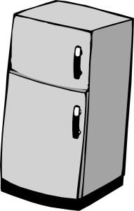
The DANGER ZONE
165 ˚F=Poultry, leftovers
155 ˚F=Ground meats
145˚F=Seafood, solid cuts
DANGER ZONE
41-135˚F
40˚F and below=cold storage
0˚F = Freezer temperature

Slide 19
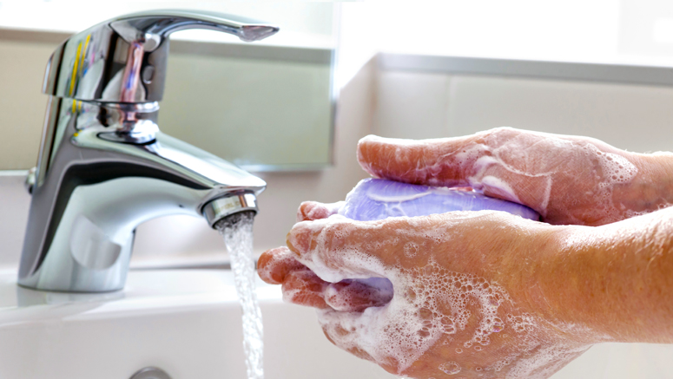
Handwashing!
CLEAN HANDS SAVE LIVES!

Slide 20
Handwashing
20 seconds
Hot, soapy water
Hot, soapy water is essential because:
“Using soap to wash hands is more effective than using water alone because the surfactants in soap lift soil and microbes from skin, and people tend to scrub hands more thoroughly when using soap, which further removes germs”
http://www.cdc.gov/handwashing/show-me-the-science-handwashing.html

Slide 21
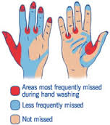

Slide 22
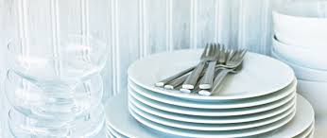
Dishwashing
Use hot, soapy water
Follow an order:
Glassware is first, then silverware
Plates, bowls, serving tools
Mixing and cooking tools
Pots, pans and baking sheets
Cutting boards
ALWAYS WASH KNIVES SEPARATELY!

