Slide 1
Fiber
Powerpoint Templates

Slide 2
Fiber
The average American does not get enough fiber in their diets.
The National Cancer Institute recommends that the average person gets 20-35 grams of fiber every day.
Two other common names for fiber are: Roughage or Cellulose.

Slide 3
Fiber
Fiber is important because it attracts water to the intestines and helps move food through your system faster. You have to have water along with fiber or it is not as effective
Benefits of fiber include a lowered risk of constipation, diverticulitis, hemorrhoids, and colon or rectal cancer.

Slide 4
Two Types
The two types of fiber and their functions are:
1. Soluble: Helps to lower total blood cholesterol
2. Insoluble: Helps move food through the body- will NOT digest or dissolve. (Cellulose)
Fiber only comes from plant food sources. You cannot get fiber from animal food sources.

Slide 5
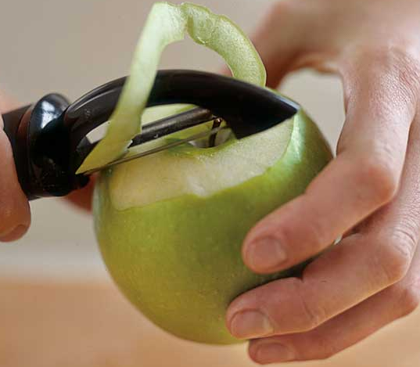
High in Fiber
Foods that are high in fiber include:
a. Fruits and Vegetables (especially the skins!)
b. Whole Grains
c. Beans/Legumes
d. Bran Cereals

Slide 6
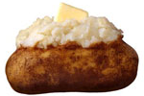
Increase Fiber
Ways to increase fiber in the diet:
1. Add whole grains
2. Use whole wheat flour
3. Eat the skins

Slide 7
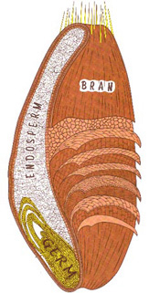
Wheat Kernel
Wheat is milled to produce flours that are used in pasta, crackers, cereals and other high fiber foods.
Endosperm
Provides:
Starch
Protein
*This is the LEAST beneficial part.

Slide 8
Wheat Kernel
Germ
Provides:
Iron
Zinc
“B” Vitamins
Vitamin E
Unsaturated
Fatty Acids
Other Trace
Minerals
*This is the MOST beneficial part.

Slide 9
Wheat Kernel
Bran
Provides:
Fiber
Vitamins
Minerals

Slide 10
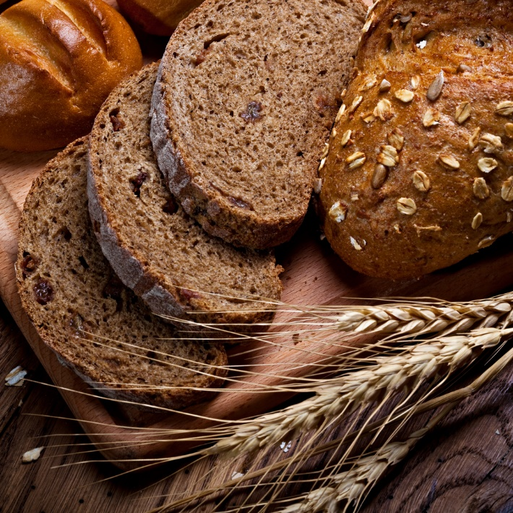
When a product claims that it is “Whole Wheat” or “Whole Grain”, it must use the entire wheat kernel, or all three parts
Other products, like white bread, usually only use the endosperm which is the least beneficial part of the wheat kernel.

Slide 11
Fortification: some of the nutrients that were lost in processing are added back into the product.
Enriched: 10% more of the Daily Value for the nutrient is being added.

