Slide 1
Types of FAtTY ACIDS

Slide 2
FATTY ACIDS
Organic acid units that make up fat. There are 3 types.

Slide 3
THREE TYPES
Saturated
Polyunsaturated
Monounsaturated

Slide 4
Saturated
Raises HDL’s
Raises LDL’s
Food Sources:
Meat / Animal Sources
Poultry Skin
Whole Milk & Dairy Products
Butter
Shortening

Slide 5
Polyunsaturated
Lowers HDL’s
Lowers LDL’s
Food Sources:
Most Vegetable Oils
Corn Oil
Soybean Oil
Safflower Oil

Slide 6
Monounsaturated
Raises HDL’s
Lowers LDL’s
Food Sources:
Olives / Olive Oil
Avocados
Peanuts / Peanut Oil
Canola Oil

Slide 7
FATTY ACIDS & CHOLESTEROL LEVELS
Each type of fatty acid has a different effect on cholesterol levels.

Slide 8
GOOD RULE OF THUMB
Fats that are solid at room temperature are made up mainly of saturated fatty acids.
Fats that are liquid at room temperature are made up mainly of unsaturated fatty acids.

Slide 9
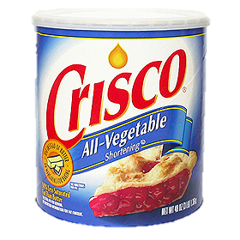
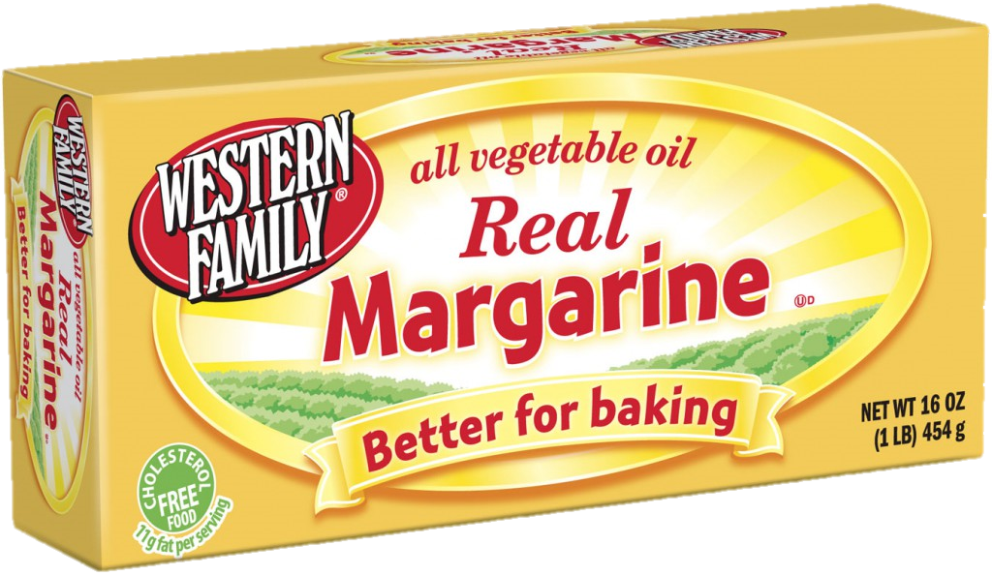
HYDROGENATION
When hydrogen atoms are added to an unsaturated fat to make it firmer in texture.
(It turns liquid oil into solid fat like shortening or margarine.)

Slide 10
TRANS-FATTY ACID
Hydrogenation creates a new type of fatty acid called trans-fatty acid or “man-made” fat.
Trans-fatty acid have many of the same properties as saturated fats.

Slide 11
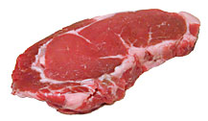
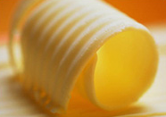
VISIBLE FAT
Fat that is easily seen
Examples: Butter on a baked potato, layer of fat around a pork chop, etc.

Slide 12
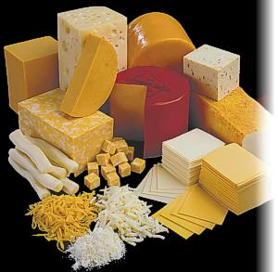
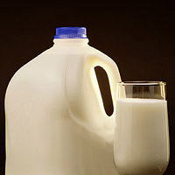
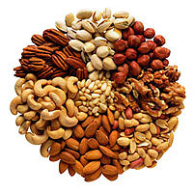
INVISIBLE FAT
Fat that cannot be seen
Examples: whole milk, some cheese, egg yolks, nuts, avocados, etc.

