Slide 1
Fats and Oils
Mrs. Milburn

Slide 2
Food Fact
Fats protect internal organs from shock and injury, insulate the body, and promote healthy skin.
Fats provide 9 calories per gram.

Slide 3
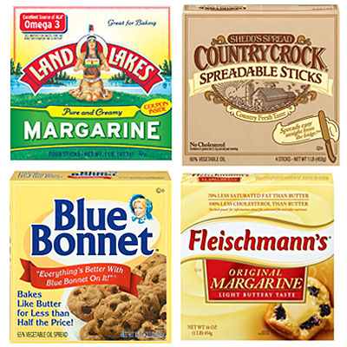
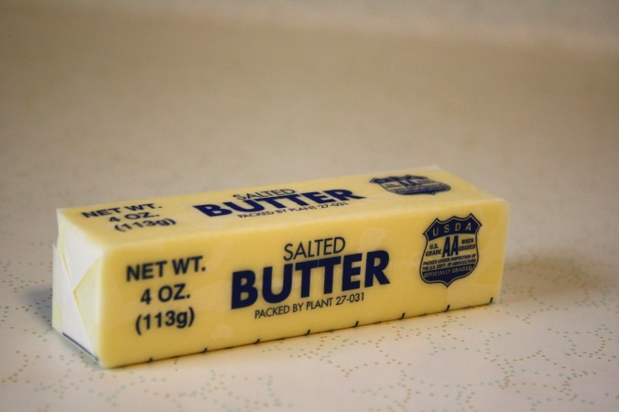
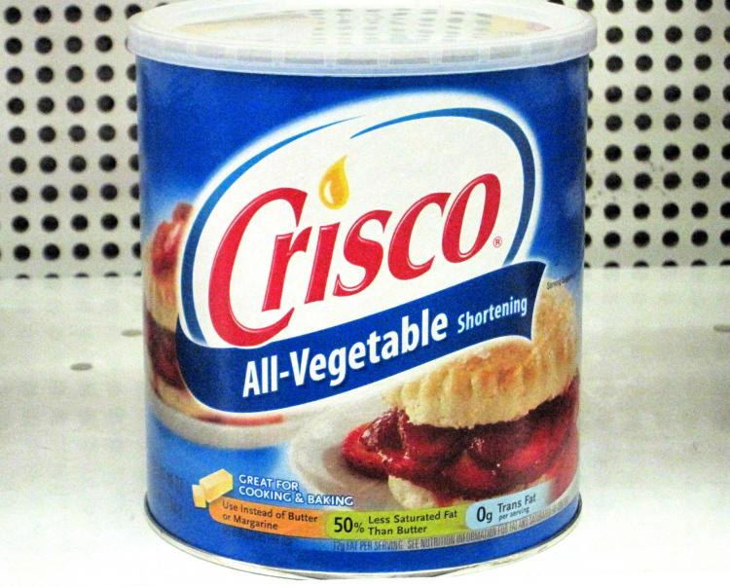
Definitions
Fat: A nutrient that is essential for body energy, insulation and protection

Slide 4
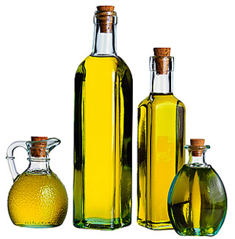
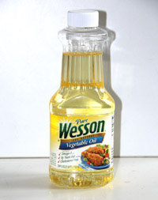
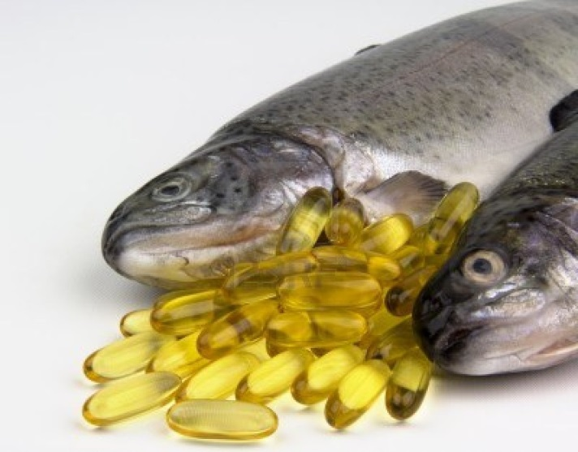

What are oils?
Oils are fats that are liquid at room temperature.
  Oils come from different plants and from fish
Notes:
Oils are fats that are liquid at room temperature, like the vegetable oils used in cooking. Oils come from many different plants and from fish. What are some of the common vegetable oils you use in cooking? (wait for responses, then go onto the next slide)

Slide 5
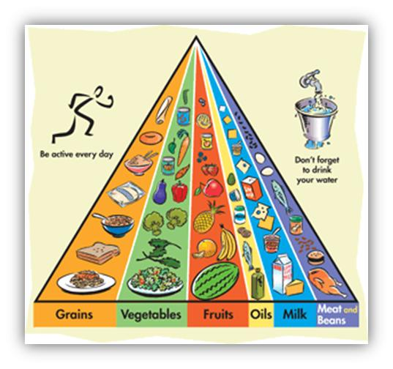
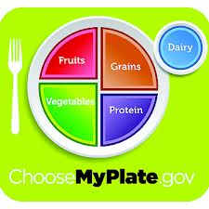
MyPyramid vs. MyPlate
HAS AN OILS GROUP
NO OILS GROUP!
Notes:
We do not have an “oils” group because “oils” are not a food group. We cook with them, they naturally occur in the food and we don’t have a “daily allowance” of them.

Slide 6
Definitions
Lipids: A family of chemical compounds, which include fats and oils
Cholesterol: a fat-like substance made of glucose or saturated fat (in our blood)

Slide 7
The SKINNY on FATS
Fat is a great source of back-up energy. Should be secondary to carbohydrates.
Fats are the most CONCENTRATED source of energy.
Fats provide 9 calories per gram.

Slide 8
FUNCTION OF FAT
FAT FUNCTIONS:
Supplies heat (insulation)
Carries Vitamin A,D,E,K (the fat soluble vitamins)
Adds flavor to food
Satisfies hunger, feel fuller longer
Protects organs from shock and injury
Promotes healthy skin

Slide 9
A,D,E,K
Fat soluble vitamins (ADEK) can ONLY dissolve in Fat
  Only 4 VITAMINS are fat-soluble: meaning, they can only move around in your bloodstream and HELP YOU with the assistance of fat molecules.
They protect the body’s organs from injury and insulate the whole body
This means you have to EAT FAT to have the FAT SOLUBLE vitamins work in your body!
But don’t worry…..you’re probably getting enough fat ☺

Slide 10
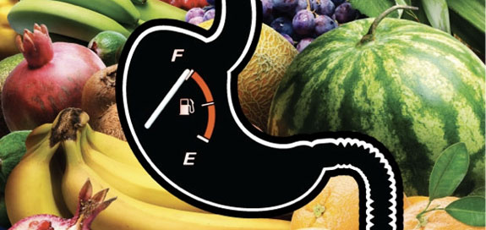
Fat Functions
Fat keeps you from being hungry because it remains in the body longer than other foods and gives you a “full” feeling.

Slide 11
Fatty Acids
Fatty Acids are the chemical chains that make up fats. They have 2 categories:
The body needs fatty acids to transport other molecules such as fat-soluble vitamins (ADEK).
Vitamins ADEK=only dissolve in fatty acids (NOT WATER!)
All other types of vitamins=dissolve in water
SATURATED | UNSATURATED
Saturated | Polyunsaturated Monounsaturated

Slide 12
3 Types of Fatty Acids
Saturated
Polyunsaturated
Monounsaturated

Slide 13
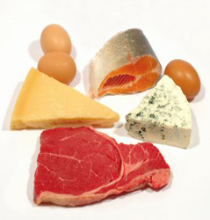
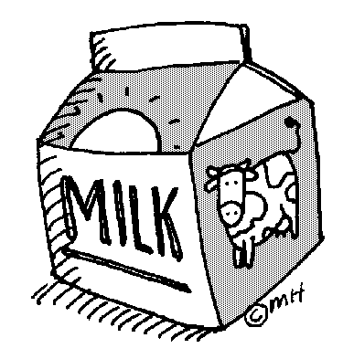
Saturated Fatty Acids
Fats that usually come from ANIMAL sources, solid at room temperature. (cheese, milk, meat, palm oil, coconut oil)

Slide 14
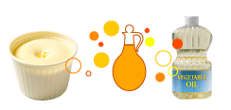
Polyunsaturated Fats…
Found in veggies, fish,
**semi-liquid at room temperature
Corn oil
Cottonseed oil
Safflower oil
Soybean oil
Sunflower oil
Walnuts
Pumpkin or sunflower seeds
Soft (tub) margarine
Mayonnaise
Salad dressings
Notes:
Polyunsaturated fats are also “healthy” fats that help lower LDL “bad” cholesterol and contain essential fatty acids. Some of the sources include corn oil, cottonseed oil, safflower oil, soybean oil, sunflower oil, walnuts, pumpkin or sunflower seeds, soft (tub) margarine, mayonnaise, salad dressings.

Slide 15
Monounsaturated Fats…
(Semi solid) or liquid at room temperature
Sources:
  Canola, olive, and peanut oils
  Avocado and olives
  Almonds, cashews, pecans, and peanuts
  Sesame seeds
  Vegetable oil
Notes:
Monounsaturated fats, or MUFAs, are called “good or healthy” fats because they can lower your LDL “bad” cholesterol. High levels of LDL cholesterol in the blood can increase your risk for heart disease.
Sources of monounsaturated fat are canola, olive, and peanut oils; avocado and olives; almonds, cashews, pecans, and peanuts; and sesame seeds.

Slide 16
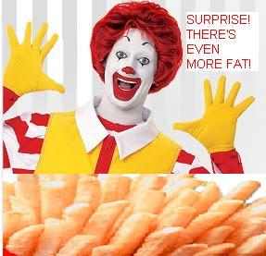
Trans Fat
Trans fat is an unsaturated fat molecule chemically changed to be a solid fat.
It lasts longer on the shelf and is less expensive
Trans fats can cause HEART DISEASE.
Examples: partially hydrogenated vegetable oil like CRISCO

Slide 17
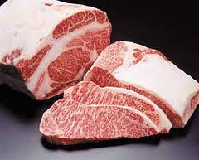
What is VISIBLE fat?
You can see the fat with your eyes, like the fat around meat.

Slide 18
All about CHOLESTEROL
Is cholesterol good
Or bad?
ANSWER: It depends…

Slide 19
What is cholesterol?
It’s the fat-like substance in our blood.
Found in animal tissues, but NEVER present in plants.
Cholesterol is ESSENTIAL for many body processes.
Cholesterol produces hormones and bile acids (which aid in digestion).
However, too much cholesterol is linked to heart disease and obesity.

Slide 20
THERE ARE 2 TYPES OF CHOLESTEROL:
HDL cholesterol (HAPPY/HEALTHY!)
HDL Cholesterol is “High Density Lipoprotein”
This is the “good” kind of cholesterol.
It moves excess cholesterol from the blood to the liver.

Slide 21

THERE ARE 2 TYPES OF CHOLESTEROL:
2. LDL Cholesterol
(“L” for LOSER!!!)
LDL cholesterol is low-density lipoprotein
This is the “bad” kind of cholesterol.
LDL cholesterol takes the cholesterol from the liver to the blood when it is needed.
IT’s BAD because too much LDL cholesterol in the bloodstream means BUILDUP in the arteries and increased chance of HEART ATTACK!

Slide 22
So how does it all relate?
CHOLESTEROL and FATTY ACIDS affect each other!
Saturated Fats
Raise both HDL and LDL cholesterol levels in the blood

Slide 23
So how does it all relate?
CHOLESTEROL and FATTY ACIDS affect each other!
2. Polyunsaturated Fats
LOWER both the LDL and HDL cholesterols in the blood

Slide 24
So how does it all relate?
CHOLESTEROL and FATTY ACIDS affect each other!
3. Monounsaturated fats
Raise the HDL and Lower the LDL cholesterol in the blood.

Slide 25
Do the FATS DANCE!
Show me “monounsaturated”
Show me “polyunsaturated”
Show me “saturated”

Slide 26
Definitions:
Hydrogenation: chemical process making liquid fat a solid fat (NOT GOOD!)
Butter- fat extracted from milk and churned into a solid
Margarine: butter substitute made with fat from plants
Lard—extracted from animal fats

Slide 27
Definitions
Vegetable Oils: oils extracted from plant sources
Vegetable Shortenings: a blend of oils HYDROGENATED to become a solid
Rancid: Fats that have begun to decompose (you can smell it)

Slide 28
Fat-Soluble Vitamins (again)
A
D
E
K
(KADE)

Slide 29
Fat adds flavor!
MOST FLAVOR
Animal and fish fats
Olive Oil
**This is why olive oils or fish oils are the “finishing flavors” instead of what we cook with
LEAST FLAVOR
Vegetable oil
**This is why we use vegetable and canola oil to cook stir fry…it doesn’t change the flavor

Slide 30
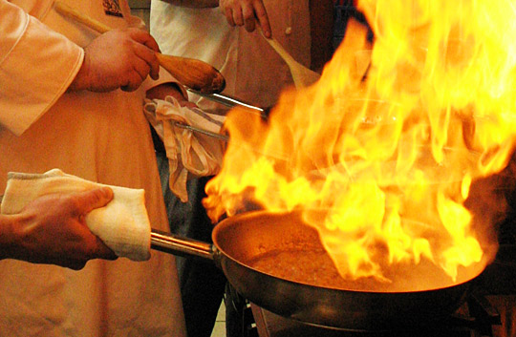
Fats Info…
Store fats in tightly covered containers so they do not go rancid
Fats at high temperatures can overheat and combust (light on fire)
BEWARE OF GREASE FIRES!!!
-steps to put it out?
-what do we NEVER put on a grease fire?

