Slide 1

Welcome to Foods 2
Foods and Nutrition II
Mrs. Woodward

Slide 2

First Quarter Topics
Your Description Goes Here
Standard 1: Review and apply the skills of kitchen management, safety and
sanitation
1. Identify food safety and sanitation rules and guidelines
to maintain a safe working environment.
2. Review and apply culinary terms and abbreviations,
equivalents, recipe yields, and proper measuring
techniques.
3. Select and explain the appropriate use and care of small
appliances and equipment for specific product preparation
and culinary applications.

Slide 3
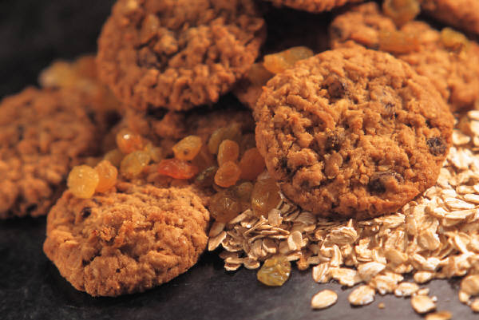
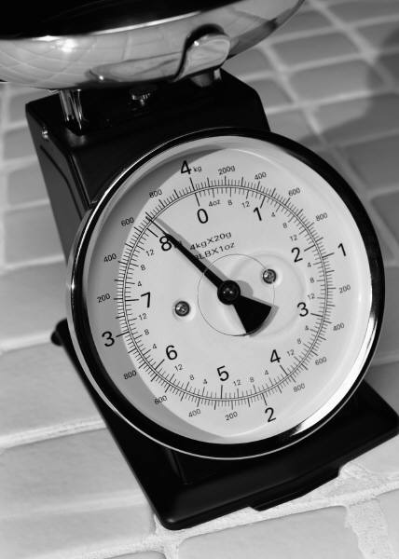
Activities for Standard 1
Monster Cookies
Double and Half Mystery recipe
Practice simple recipes using 4 small appliances

Slide 4

Standard 2
Demonstrate Food Preparation techniques and nutrition of
  Yeast Breads
  Prepare Yeast bread using a scale

Slide 5
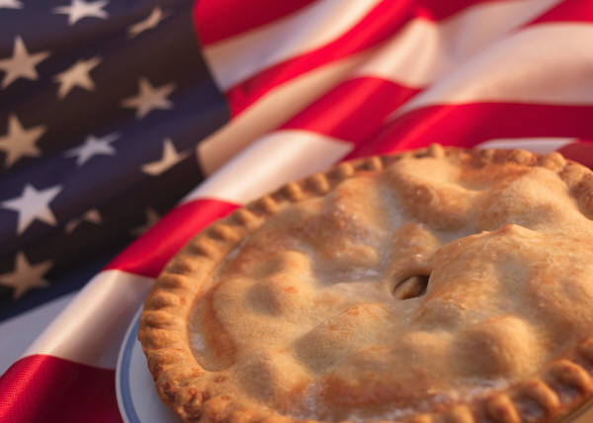
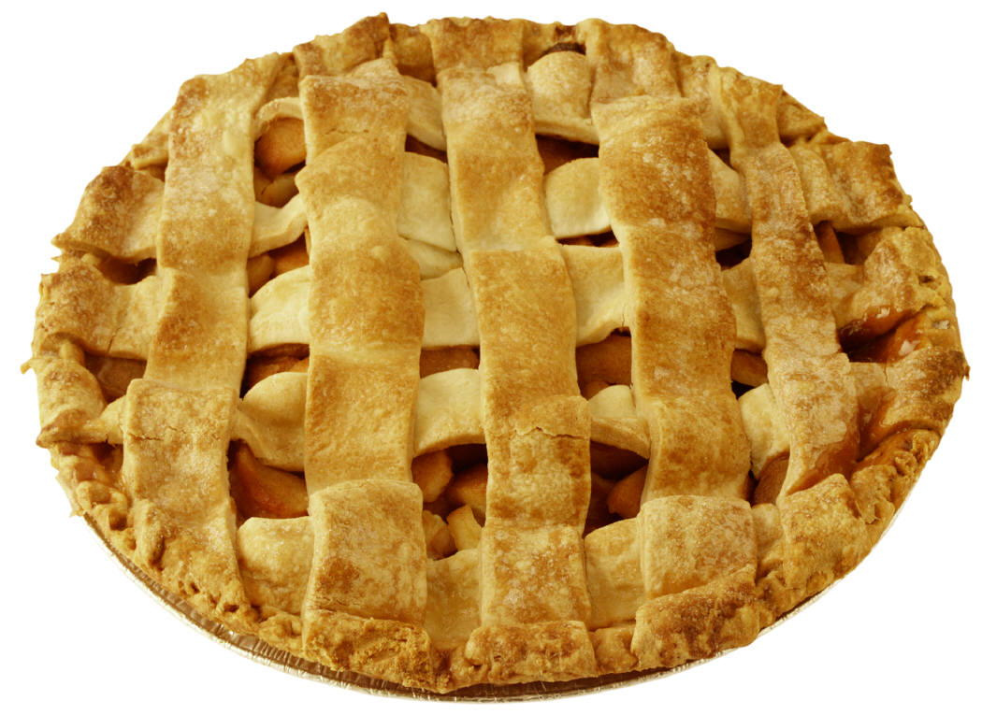
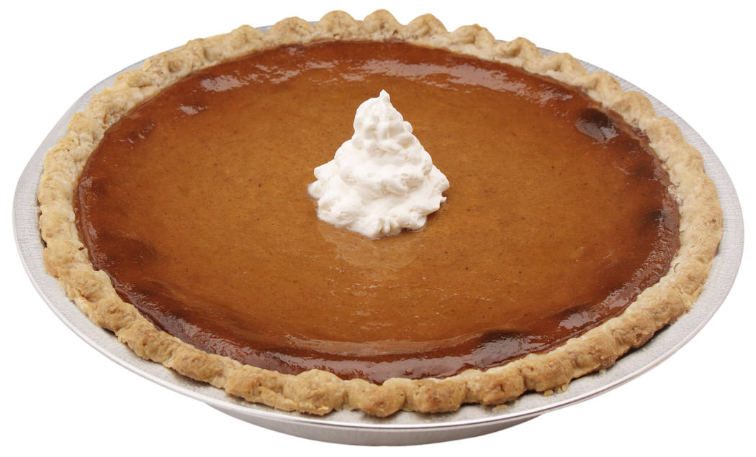
Standard 10
Demonstrate food preparation techniques and nutrition of pies and tarts.
  Fruit Turnover
  Variety of Pies

Slide 6
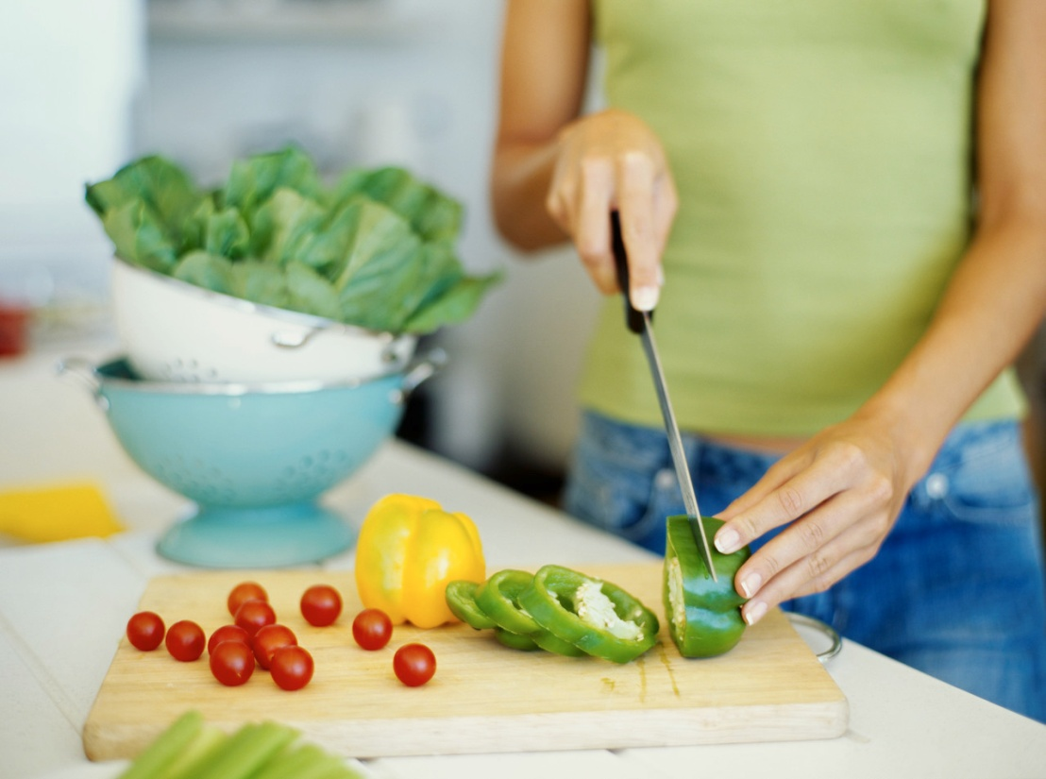
Standard 5
Apply proper procedures for knives and knife cuts
  Roasted Vegetables
  Lettuce Wraps

Slide 7
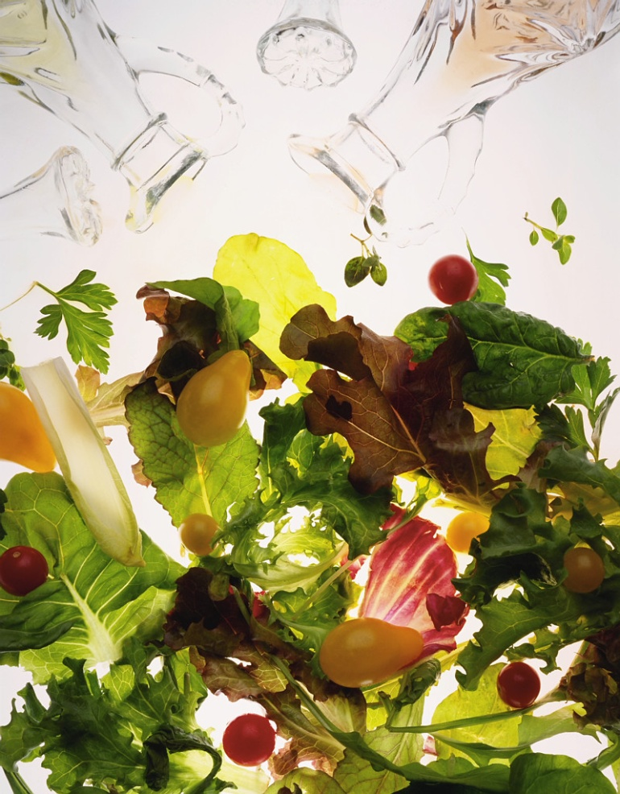
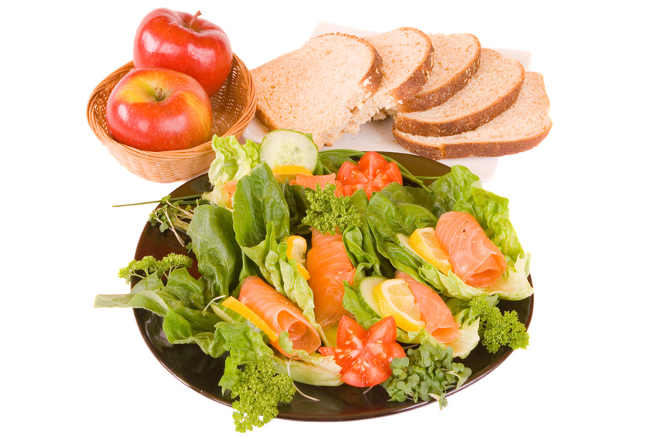
Standard 6
Students will demonstrate food preparation techniques and nutrition of salads.
  Mandarin Salad
  Different varieties of salads

Slide 8
Standard 8
Students will demonstrate food preparation and nutrition of soups and sauces:
  Mother Sauces
    Bechamel
    Veloute
    Espagnole
    Tomato
    Hollandaise
    Cream based soup
    Potato Parmesan Soup Lab

Slide 9

Second Quarter
Your Description Goes Here
Apply budgeting and consumerism skills to manage
food costs
Demonstrate food preparation techniques and nutrition
of meats, poultry and seafood
Explore health concerns incorporating guidelines from
MyPlate and current dietary guidelines
throughout the life span.
Identify the elements of meal planning, management
and service
Discuss career options and employment skills in the
food service industry.

Slide 10


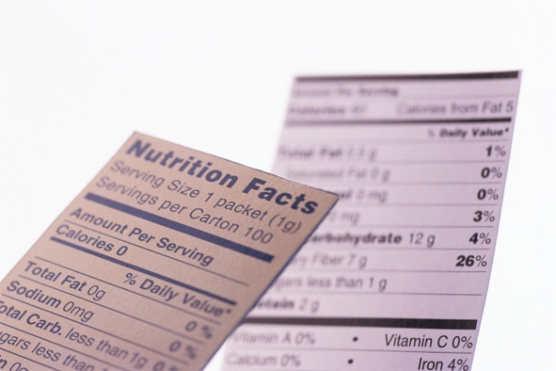
Standard 3
Apply Budgeting and consumerism skills to manage food Costs.
Make and compare scratch and convenience foods.
Shopping Strategies and calculating cost per serving
Reading labels and comparing nutrition.

Slide 11
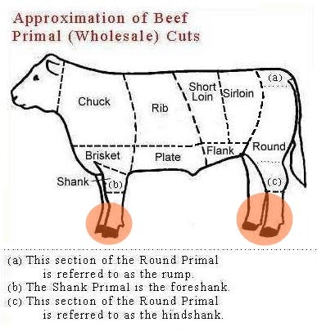
Standard 4
Food Preparation techniques and nutrition of Meats, Poultry and Seafood
Pepper Steak Lab

Slide 12
Standard 7
Students will explore health concerns incorporating guidelines from MyPlate and current dietary guidelines throughout the life span.
  Children’s snacks
  Teen and athletic Nutrition
  Elderly concerns lab
  Health concerns report
  Health concerns lab

Slide 13
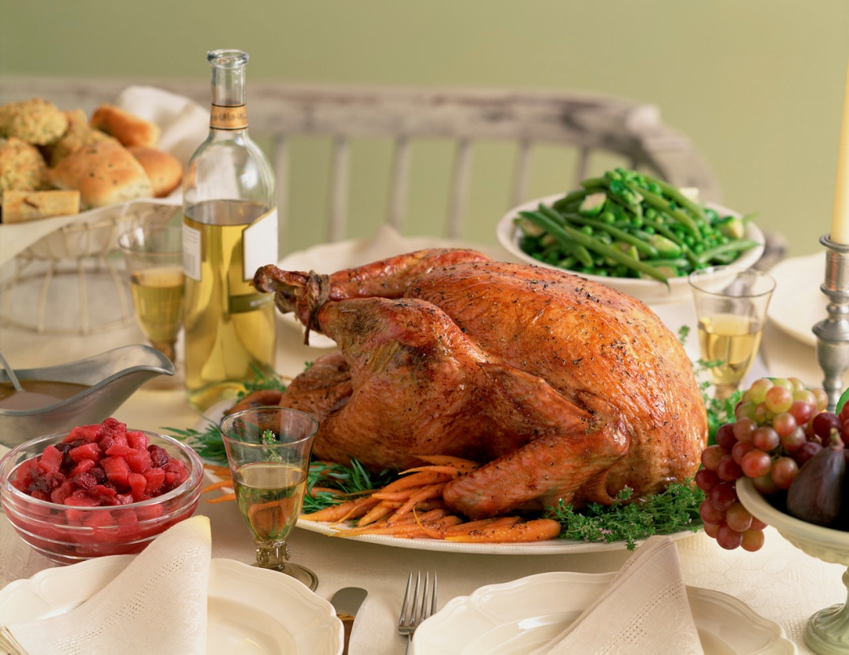
Standard 9
Identify and apply the elements of meal planning, meal management and meal service.
  Plan, prepare and evaluate a meal using meal planning elements.

Slide 14

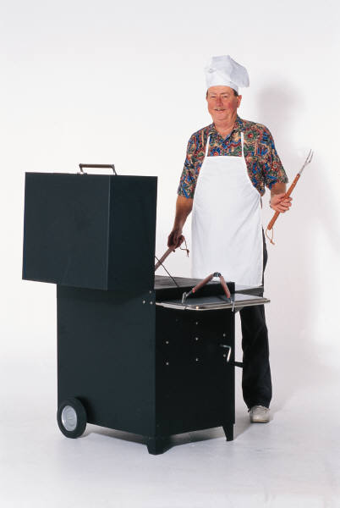
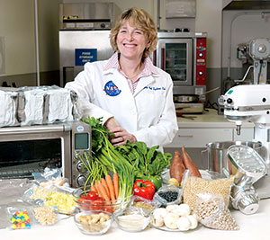
Standard 11
Students will discuss career options and employment skills required in the food service industry.

Slide 15

End of Semester
Where do I go from here?
*State Competency Test
Guest Meal
*Prepare for ProStart
*Prepare for FCCLA Star Event

