Slide 1
Cooking Terms
Foods 2

Slide 2
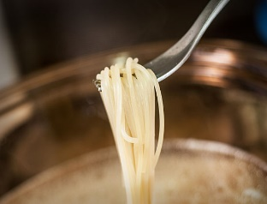
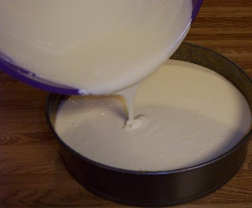
Cooking Terms A-Z
Al Dente - To cook pasta until it has a slight resistance to the bite “firm to the tooth”.
Baste - To moisten meat with a liquid, such as melted butter or a sauce, while cooking.
Batter - A mixture of flour & liquid, thin enough to pour & coat food.
Beat - To make a mixture smooth by mixing rapidly to incorporate air through the mixture.

Slide 3
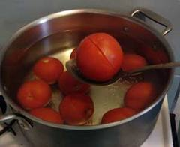
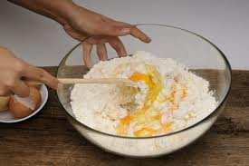
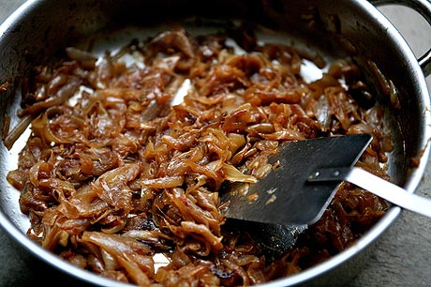
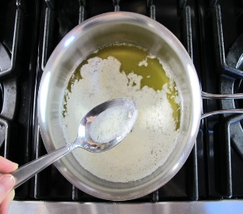
More Terms-2
Blanch - To immerse food quickly into boiling water, then removing & placing in ice water to cause the peel of the food to be removed.
Blend - To combine or mix two or more ingredients together thoroughly.
Caramelize - To heat sugar, vegetables, or fruit in order to turn them brown & give them a specialized taste.
Clarify - To separate & remove solids from a liquid making it clear such as skimming fat solids from butter.

Slide 4
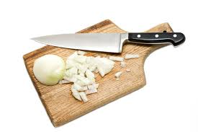
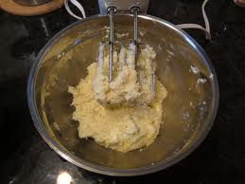
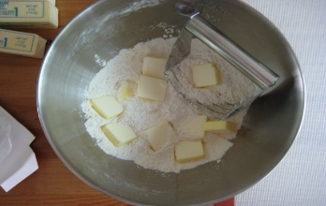
More Terms-3
Chop - To cut into small pieces with no particular sizing.
Cream - To beat sugar & fat together until smooth & fluffy.
Cube - To cut food into small cubes about ½” by ½” by ½”
Cut-in - To cut fat into flour with a pastry blender, until distributed in small pebbles throughout the mixture.

Slide 5
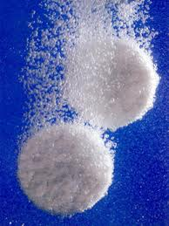
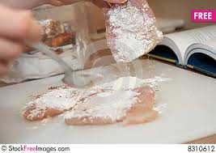
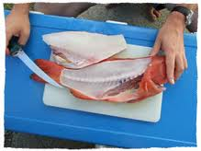
More Terms-4
Dissolve - To cause a dry substance to pass into a solution & become liquid.
Dredge – Dipping into an egg mixture then in a flour mixture so flour adheres to food.
Fillet - To remove the bones from meat or fish.
Fold-in - To mix ingredients by gently turning one part over another with a rubber scraper.

Slide 6
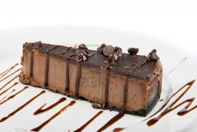
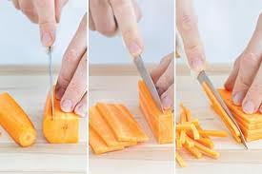
More Terms-5
Garnish - To decorate a dish by enhancing the appearance of the food, using other foods.
Julienne - To cut into thin strips 1/8” x 1/8” x 2”, similar to a “Matchstick”.
Knead - To work dough with the “heel” of the hands, using a pressing motion, accompanied by folding & stretching until dough is smooth & elastic.
Marinate - To immerse foods in an acidic-based liquid or dry rub, to tenderize & flavor before cooking.

Slide 7
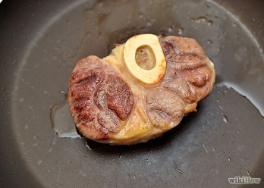
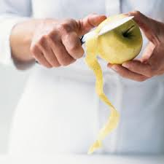
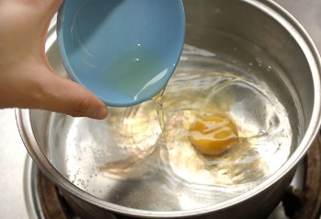
More Terms-6
Mince - To cut or chop food as finely as possible.
Pan-Broil – To cook uncovered in a hot fry pan, pouring off fat as it accumulates.
Pare - To remove the outer covering of a food with a knife.
Poach - Cooking food in a liquid which is brought to, & maintained just below the boiling point.

Slide 8
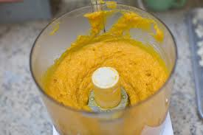
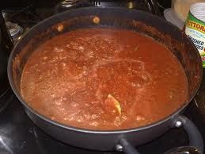
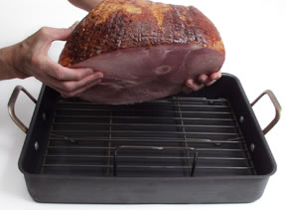
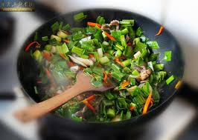
More Terms-7
Puree - To mash foods until smooth through a sieve, food mill or blender.
Reduce - To boil down to reduce the liquid & volume and make thicker.
Roast - To cook food in an oven dry in an uncovered pan.
Sauté - To cook in a small amount of hot fat.

Slide 9
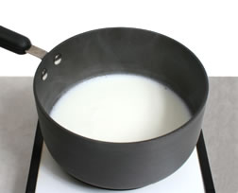
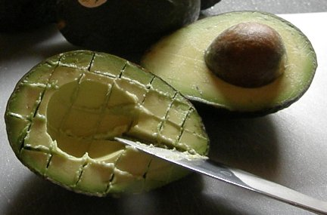
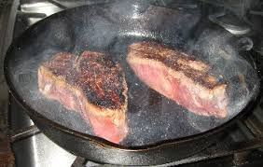
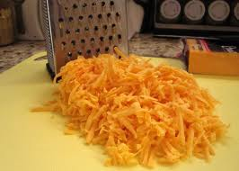
More Terms-8
Scald - To heat milk almost to boiling point.
Score - To make shallow cuts (usually in a diamond pattern) in the surface of certain foods, such as meat or fish.
Sear - To brown the outside of meat very quickly with an intense heat.
Shred - A long irregular strip that is cut or torn off using a grater with sharp projections or a knife.

Slide 10
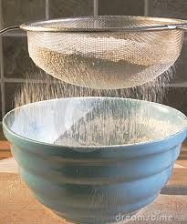
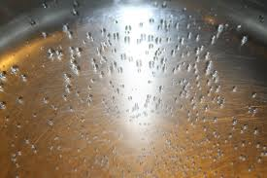
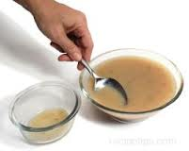
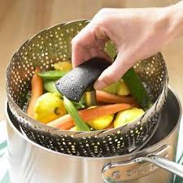
More Terms-9
Sift - To put flour through a sieve to separate the coarse particles & add air.
Simmer - To cook below the boiling point, bubbles form slowly around edges of pan and break on the surface.
Skim -To remove floating matter or fat from a liquid, such as “skimming fat to make a gravy.
Steam - To cook in a small amount of boiling water or a basket that sits above the water, allowing the food to be cooked by the steam.

Slide 11
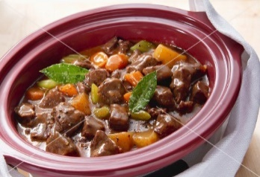
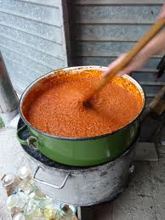
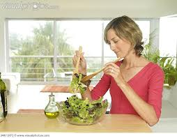
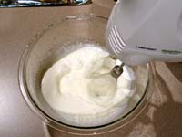
More Terms-10
Stew – To simmer slowly in a small amount of liquid to tenderize the meat, cook the vegetables and thicken the liquid.
Stir - To mix ingredients with a circular motion until well blended.
Toss - to combine ingredients with a lifting motion so as to not crush.
Whip - To beat rapidly to introduce air bubbles into food. Applied to cream, eggs, and gelatin.

Slide 12
ADDITIONAL Cooking Terms
Foods 2

Slide 13
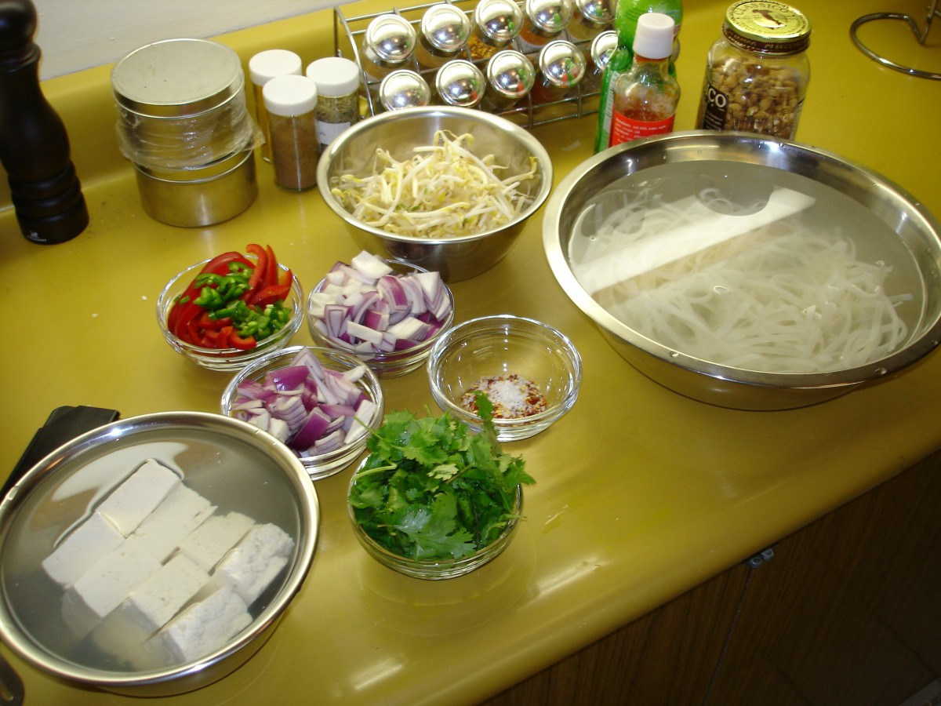
Mise En Place
Put in place, get everything out and ready to cook

Slide 14
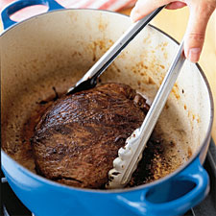
Braise
To brown in fat and then simmer in a liquid.

Slide 15
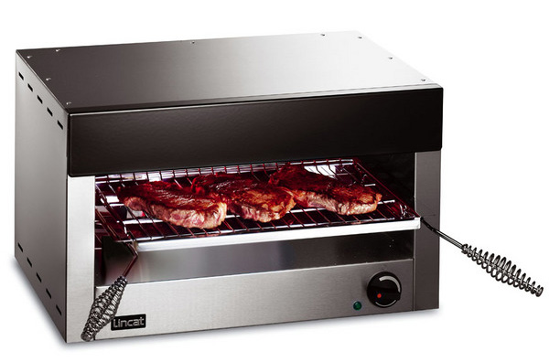
Broil
To use a direct heat source, very high heat, located above the food.

Slide 16
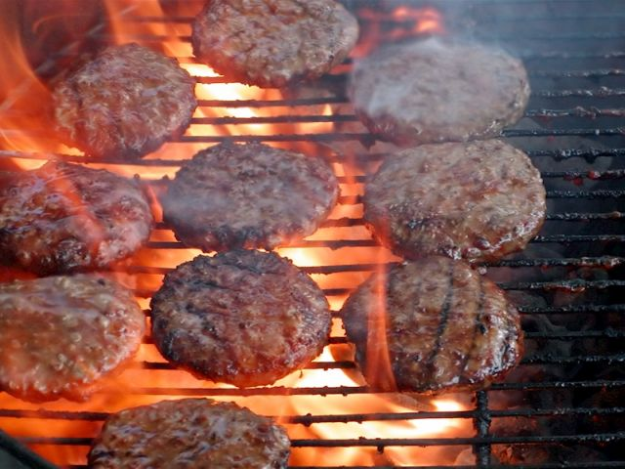
Grill
To cook on a rack with the heat source below the food.

Slide 17
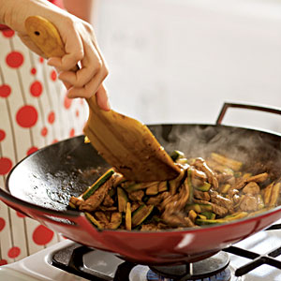
Stir-Frying
Stirring constantly in lightly oiled pan over a high heat.

