Slide 1
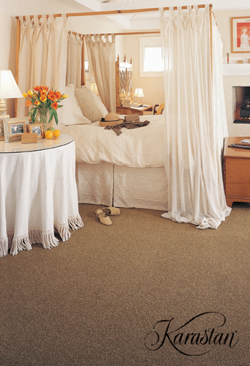
6 Elements of Design
1- Pattern
2- Form/Shape
3- Space
4- Line
5- Texture
6- Color

Slide 2
4- Pattern = a repeating design
4 types of Pattern
Naturalistic/Realistic
Conventional/Stylized
Geometric
Abstract

Slide 3
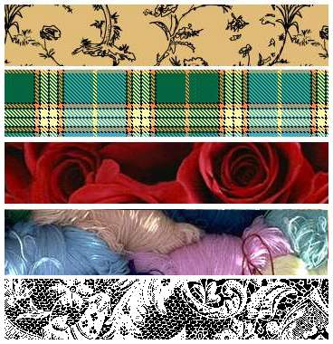
Patterns
Repetition of line, shape, form, texture and/or color
Reflects the mood of the elements used
Can be formal, informal, calm, playful.....

Slide 4
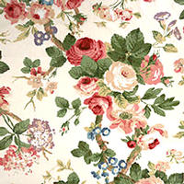
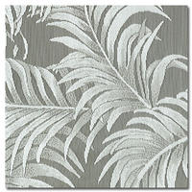
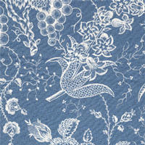
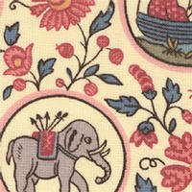
Naturalistic/Realistic Patterns
Looks like things found in nature or in real life.

Slide 5
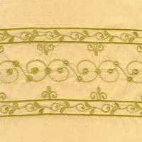
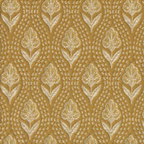
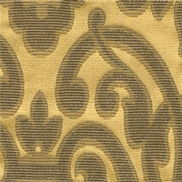
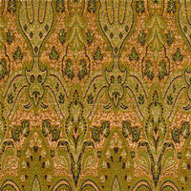
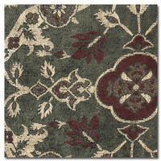
Conventional/Stylized Patterns
Inspired by nature, but changed in some way, like fitting the design into to a shape or simplifying it.

Slide 6
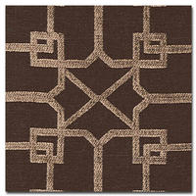
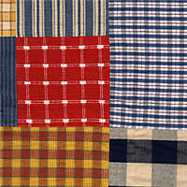
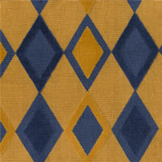

Geometric Patterns:
Composed of
geometric shapes and lines

Slide 7
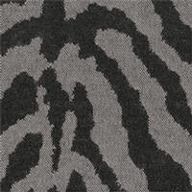
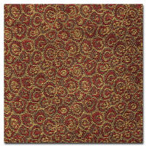
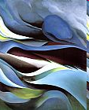
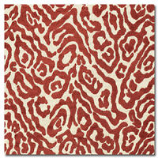
Abstract Patterns:
Random design:
can’t tell what inspires it or object is very distorted—Think “splatter paint” or an abstract painting.

Slide 8
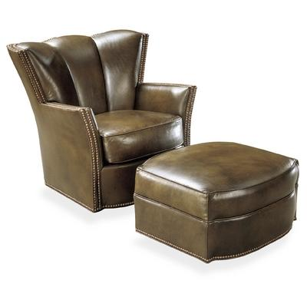
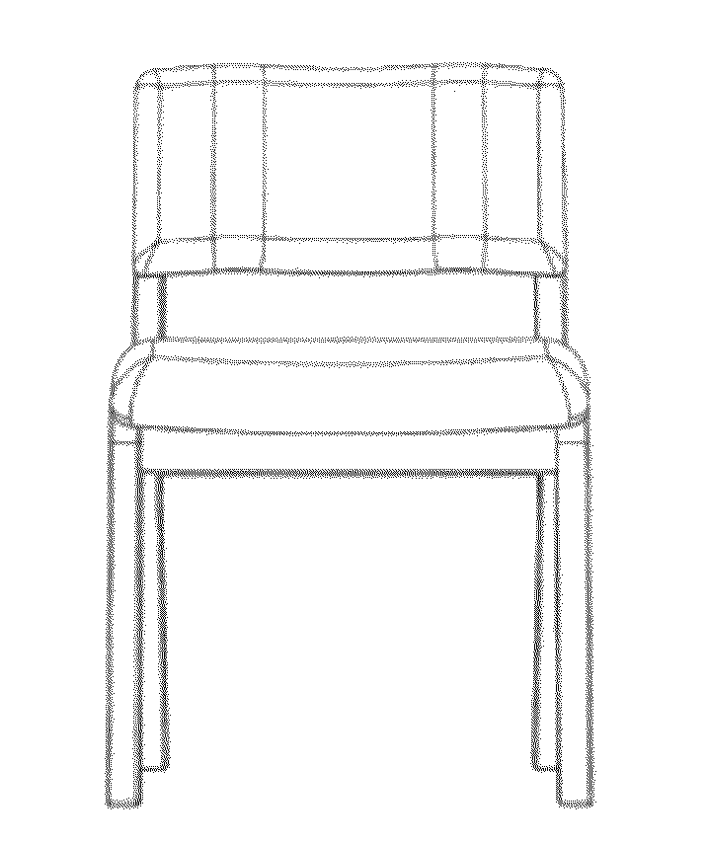
5- Form/Shape
Form (3D)
Shape (2D)

Slide 9

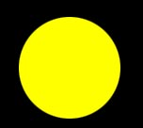
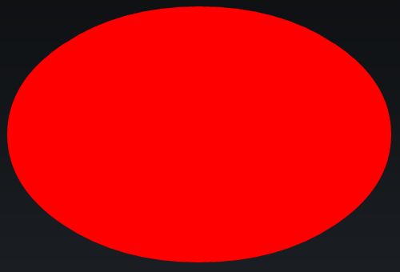
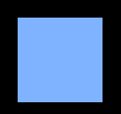


Shape
Two dimensional
Made by connecting lines
Circles, squares, rectangles, triangles, ovals, diamonds....

Slide 10
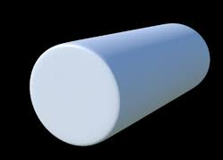
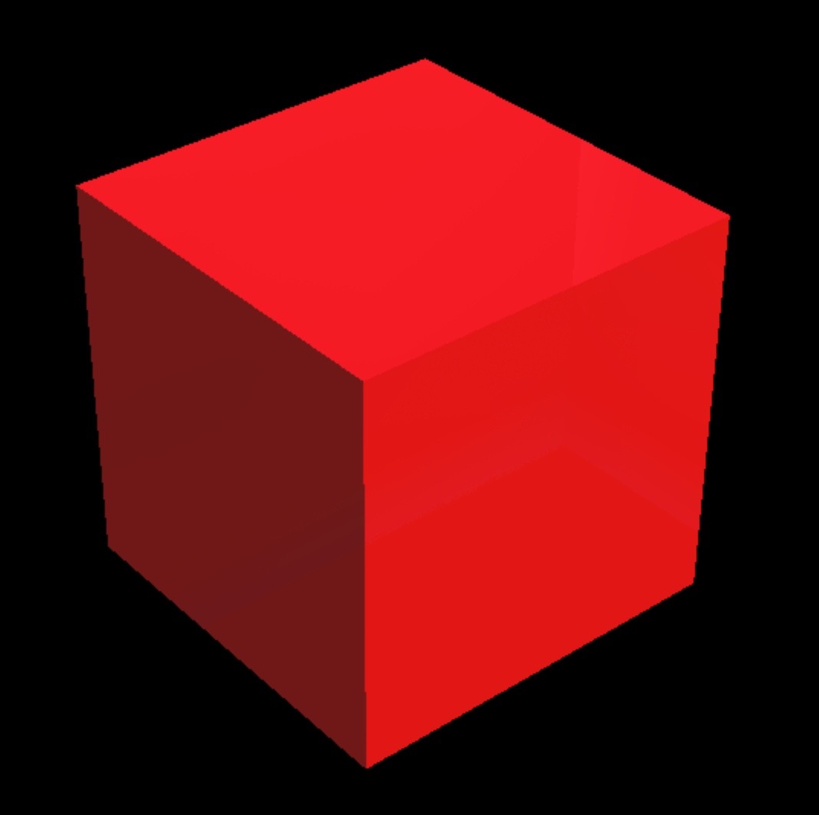
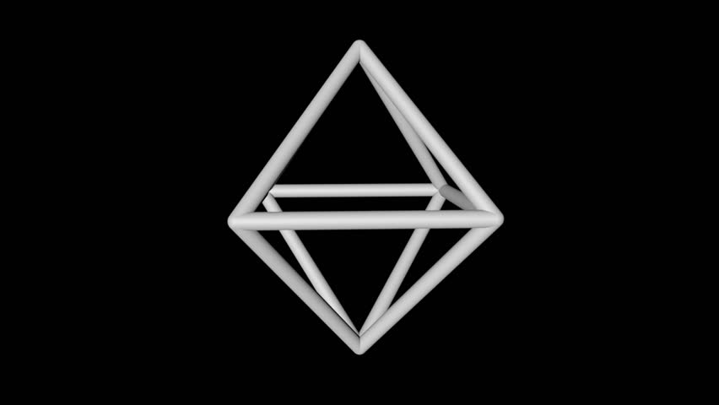
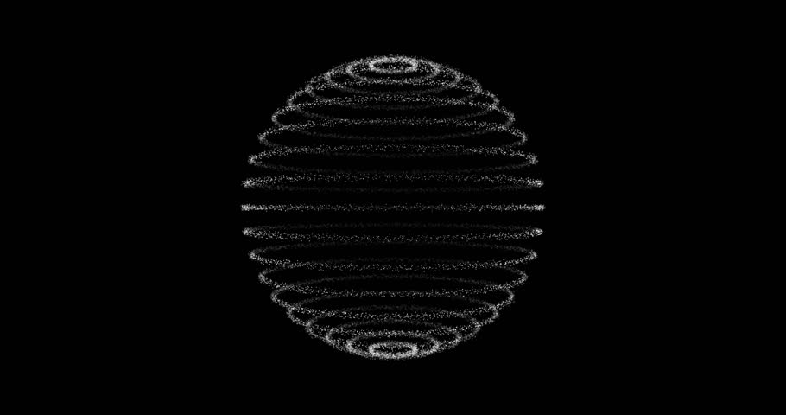
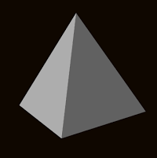
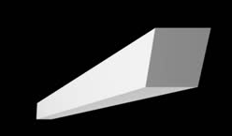
Form
Three dimensional
Encloses space
Spheres, cylinders, cones, cubes, pyramids....

Slide 11
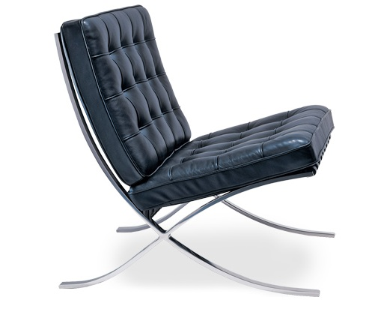
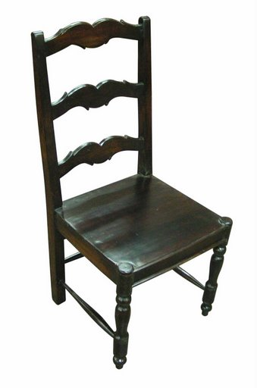
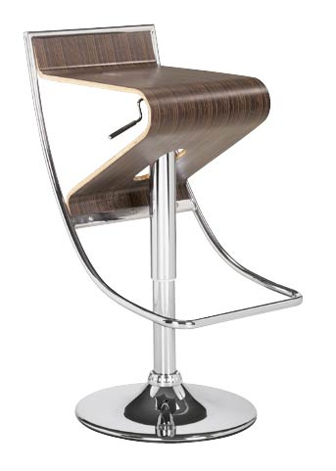
Shape/form
The solid form or structure of an object.

Slide 12
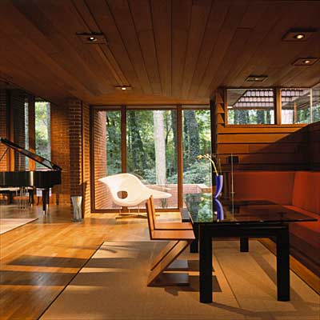
6- Space = area between lines and objects
2 types of Space
Positive Space= filled
the object is there
Negative Space= empty-area beneath and around the object

Slide 13
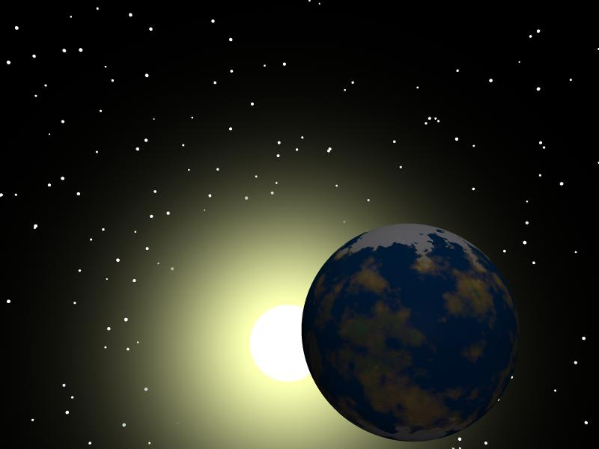
Space
“The Final Frontier” - Jon Kirk “Star Trek”

Slide 14
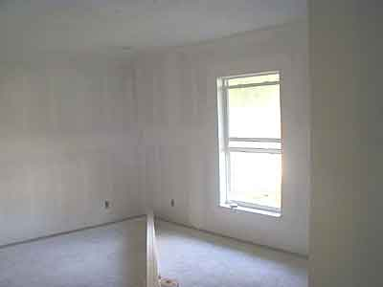
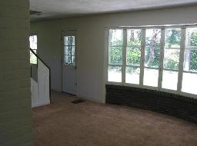
Space
The three dimensional expanse that a designer is working with- the empty room

Slide 15
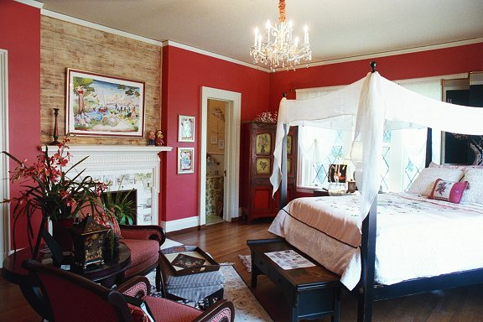
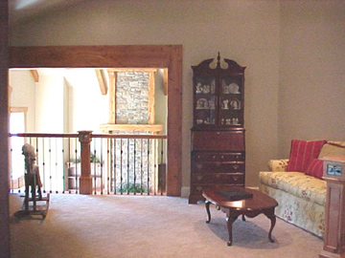
Space cont.
The area between objects and lines in a room

Slide 16
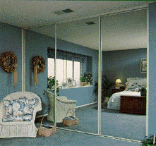
To help a small area feel spacious-
Allow for large open areas and empty space
Use mirrors
Use small prints, patterns, and textures
Use light, cool colors

Slide 17
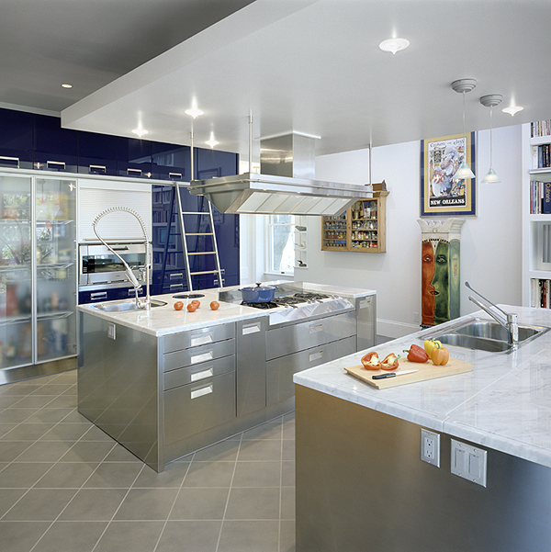
Illusions of Increased Space

Slide 18
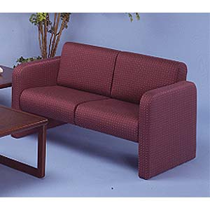
To help a small area feel spacious- cont.
Allow as much floor to show as possible
Place large pieces of furniture near walls
Furniture should be up off the floor and not bulky

Slide 19
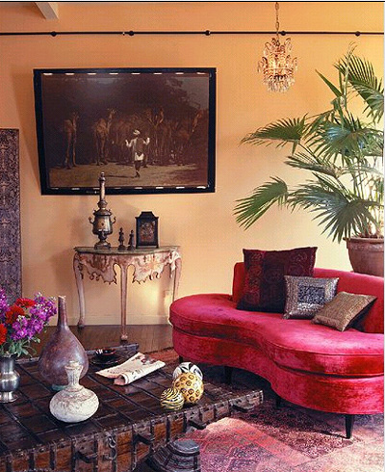
Illusions of Decreased Space

Slide 20
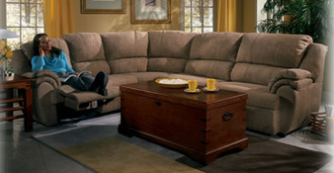
To make a large area feel intimate
Place furniture perpendicular to walls
Group furniture according to areas of activity
Use large furniture that sits directly on the floor

Slide 21
7- Line: 2 connected points
4 Types of Line
Vertical
Horizontal
Curved
Diagonal
All rooms contain all of the types of lines. When looking at room pictures, look at the predominant line. The predominant line is what will contribute to the overall feeling of the room.

Slide 22
Lines
horizontal
Long and narrow
Connects two points
Leads the eye from one point to another
vertical
curved
diagonal

Slide 23
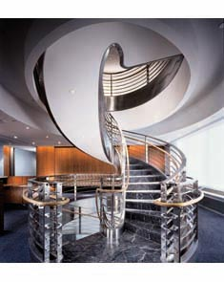
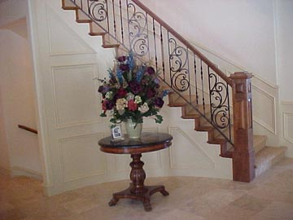
Line
The outline of an object
2 points that are connected
They give direction and divide space.
Types
  Horizontal
  Vertical
  Diagonal
  Curved

Slide 24
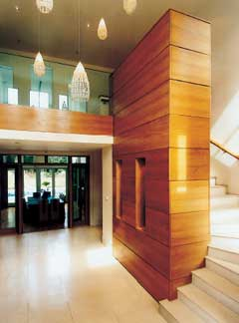
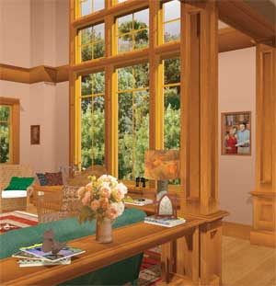
Vertical Lines
Vertical lines– feeling of power, dignity and masculinity, height

Slide 25
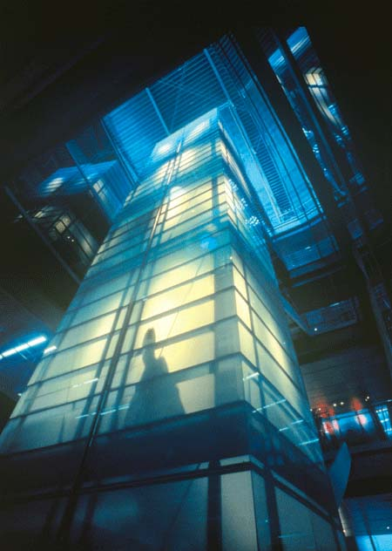
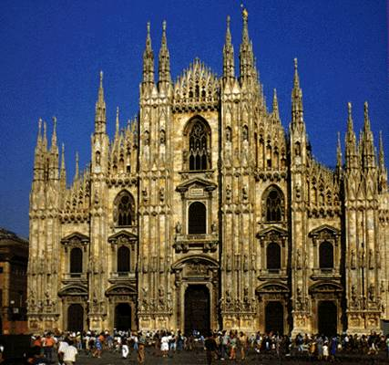
Vertical Lines cont.
Lends dignity and formality
Creates feelings of aspiration & ascension

Slide 26
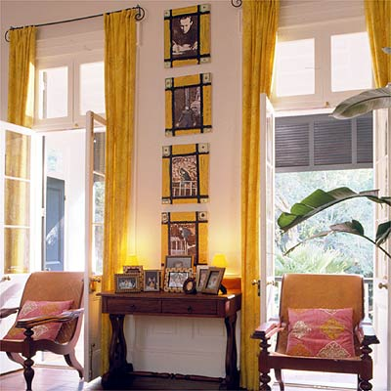

More Vertical Lines

Slide 27


Horizontal Lines
Horizontal lines—sturdy, calm, restful

Slide 28

Horizontal
Line

Slide 29

More Horizontal Line
Restful - Relaxing - Informal

Slide 30


Diagonal Lines
Diagonal lines - create activity and motion

Slide 31


More Diagonal Lines

Slide 32


Even More Diagonal Line
Active
Suggests movement

Slide 33

Curved Lines
Curved lines—soften objects

Slide 34


Curved Line

Slide 35

More Curved Line
Upward – lifts and inspires
Horizontal – relaxed and gentle
Downward – sadness and seriousness
Small - playful

Slide 36
8-Texture:
How an object feels or looks like it feels
2 Types of Texture
Visual = SEE Tactile = TOUCH
Casual/Rugged look = rough, heavy, hard, and dull textures
Elegant/Formal look = light, soft, shiny, and smooth textures

Slide 37
Texture
The surface quality of an object or item
Tactile
  How the object feels to the touch
  Can feel the variation in the surface
Visual
  An illusion - how the object appears to feel
  Applied using line, color, & shading

Slide 38
SOME TEXTURE WORDS ribbed rough crinkled smooth soft bumpy satiny silky fluffy hard flat abrasive nubby shines plush fuzzy ridged spiky course gritty slick scratchy

Slide 39


More
Texture
The way an object feels and looks.
May be rough, smooth, shiny, hard, soft, etc.
Formal
  Smooth texture
Informal
  Rough texture

Slide 40

Texture - Rough
Make color look darker and less intense
Generally less formal

Slide 41


Casual/Rugged Textures

Slide 42

Texture - Smooth
Make colors appear lighter and brighter
Generally considered more formal

Slide 43

Texture - Shiny- Visual
Reflective

Slide 44


Elegant/Formal Texture

Slide 45



Textures

Slide 46

9-Color
Reflected light
Most important element
Creates the
most impact

Slide 47

Color
One of the most important tools
Influences how people feel and the mood of the room

Slide 48

Color Example 1

Slide 49

Color Example 2

Slide 50

Color Example 3

