Slide 1
Builder Plans
Amber Williams
IDT 1010
Notes:
Use the Builder Plan Note guide to take notes with this PPT

Slide 2
Site Plan
Where building will be placed on the land.
It will usually show:
Building footprint
Travel ways
Legal boundaries
Parking
Drainage facilities
Sanitary sewer lines
Water lines
Trails
Lighting
Landscaping and garden elements

Slide 3
Site Plan cont.
Building footprint, Travel ways, Legal boundaries, Parking, Drainage facilities, Sanitary sewer lines, Water lines, Trails, Lighting, Landscaping and garden elements
Notes:
Identify where the terms listed on the slide are on the site map.

Slide 4
Building footprint, Travel ways, Legal boundaries, Parking, Drainage facilities, Sanitary sewer lines, Water lines, Trails, Lighting, Landscaping and garden elements
Notes:
Identify where the terms listed on the slide are on the site map.

Slide 5
Floor Plan
A 2D scaled drawing that shows the layout of the rooms with blue print symbols
Show:
Relationship between rooms
One level shown at a time
Room dimensions
Uses Blueprint symbols to show appliances and built ins

Slide 6
Floor plan cont.
Scale for most plans is ¼” = 1 foot
‘ = foot
“ = inches
12’4” = 12 feet 4 inches
Walls
Exterior walls are 6”
Interior walls are 4”
Furniture templates should always match the scale of your drawing

Slide 7
Floor Plan Symbols
Notes:
Fill in on the note guide the blueprint symbols
http://www.recentlydesigned.com/tag/house-plan-symbols/

Slide 8
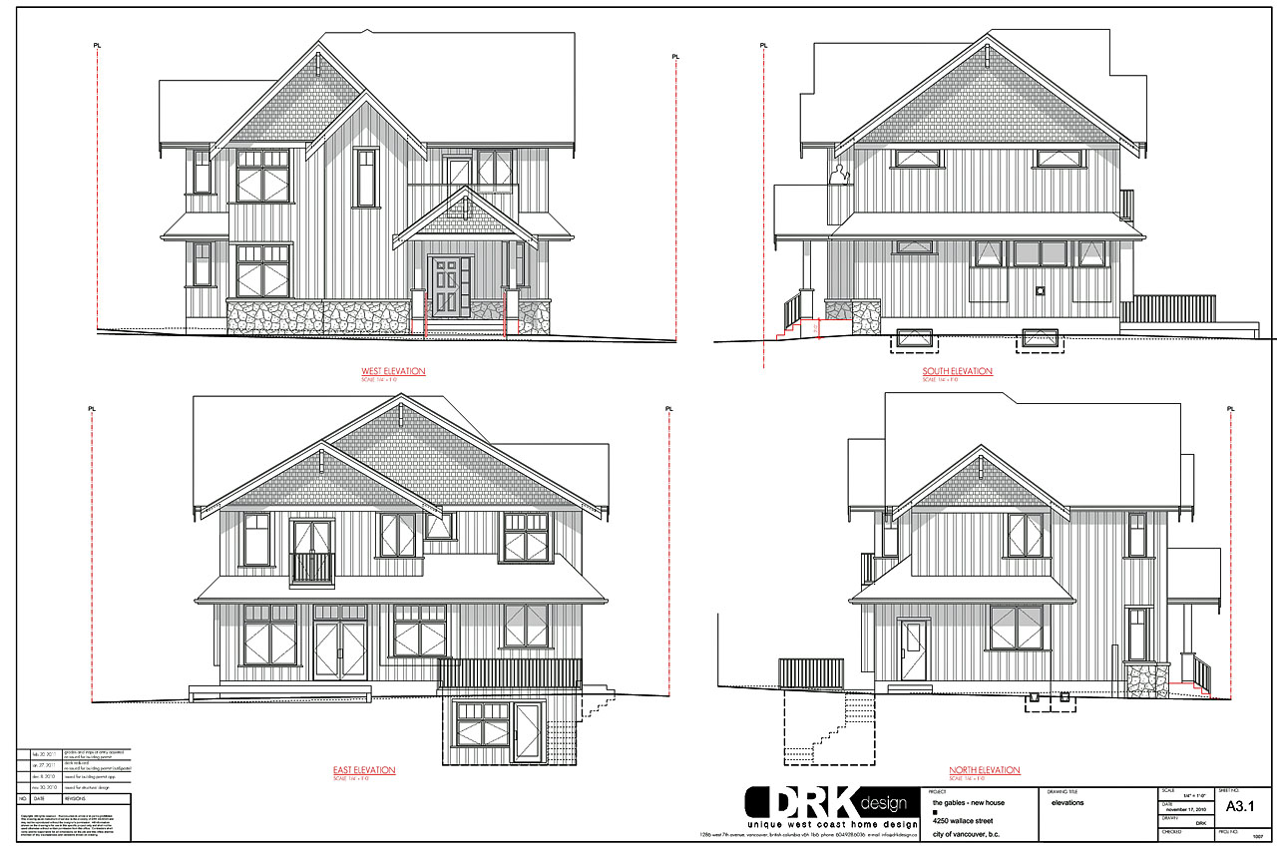
Elevations
2D Representation of a given side or front of a building or built in cabinetry design.
Show:
Details like size and location of windows, drawers, doors,

Slide 9
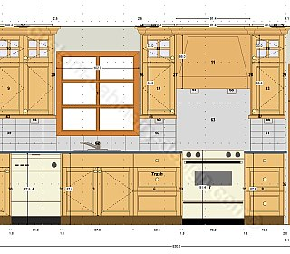
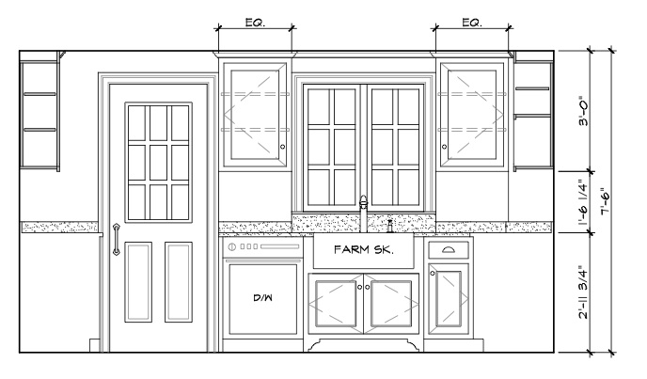
Elevations Cabinetry

Slide 10
Utility Plans Electrical and Lighting
Show electrical and telecommunication plans for design and construction.
Shows:
Lighting
Switches
Plugs
TV
Phone
Computer outlets
Look for these symbols on the next slide:
CEILING MOUNTED LIGHT RECESSED DOWN LIGHT EMERGENCY LIGHT DUPLEX RECEPTACLE OUTLET NURSE CALL TELEPHONE OUTLET TV OUTLET SMOKE DETECTOR SWITCH TV 5' 0" 9' 0" 1' 10" 3' 0" 2' 10"
Notes:
https://www.smartdraw.com/electrical-plan/examples/electrical-plan-patient-room/

Slide 11
Electrical Plans
CEILING MOUNTED LIGHT RECESSED DOWN LIGHT EMERGENCY LIGHT DUPLEX RECEPTACLE OUTLET NURSE CALL TELEPHONE OUTLET TV OUTLET SMOKE DETECTOR SWITCH TV 5' 0" 9' 0" 1' 10" 3' 0" 2' 10"

Slide 12
In each of the following slides, identify the type of plan:
Site
Floor plan
Elevation plan
Utility plan

Slide 13
13 a.

Slide 14
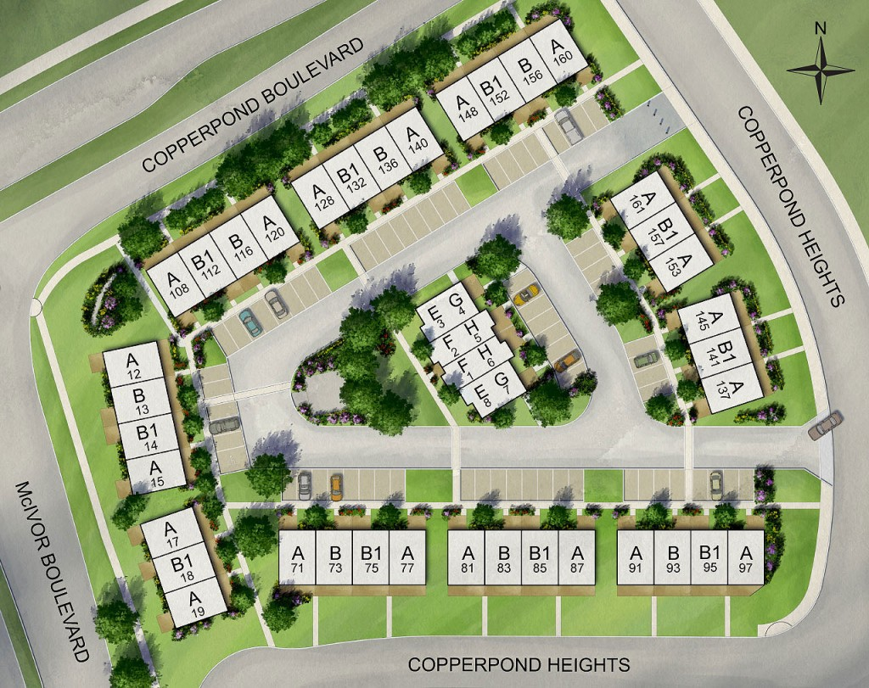
13 b.

Slide 15
13 c.

Slide 16
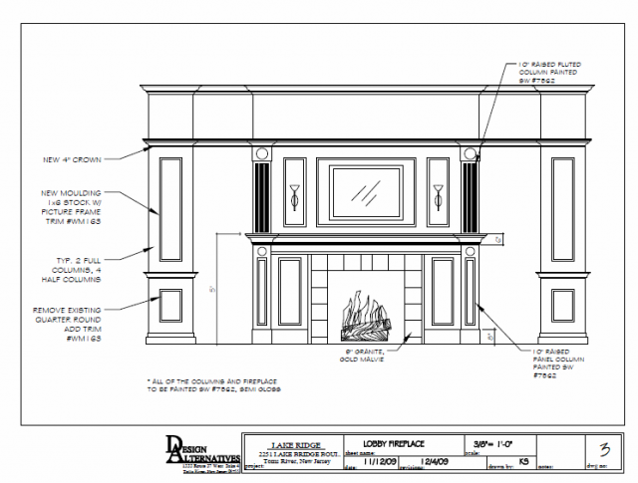
13 d.

Slide 17
identify
13 e.

Slide 18
13 f.

Slide 19
13 a. Floor plan

Slide 20
13 b. Site plan

Slide 21
13 c. Side Elevation plan

Slide 22
13 d. Elevation plan for cabinetry

Slide 23
13 e. Electrical & Lighting Plan

Slide 24
13 f. Rear Elevation plan

Slide 25
Next step:
30-35 minutes
Look through the floor plan packet.
Choose 1 floor plan you would reside in over the next five years.
Answer the 12 questions from our notes on a separate sheet of paper. (you can access the article we referred to in class on Canvas (dsd.instructure.com)
Answer the questions based on your likes and dislikes now.
Be very thorough, this is what you will be sharing with your designer assigned to you next week.
THEN: (20 min)
Picture piles: Find a minimum 12 pics you love and 12 pics you hate, organize them into Pinterest or Houzz.
DUE: TUES MARCH 15, 2016

