Slide 1
GROUP TREASURE HUNT
Choose a scribe to keep track of your group’s running totals for each of the following statements.

Slide 2
1.
One point for each member living in your home.

Slide 3
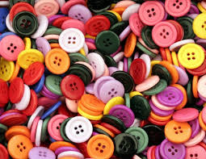
2.
One point for each button on your clothing.

Slide 4
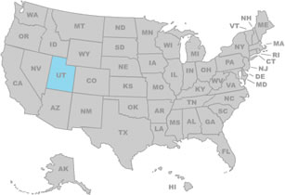
3.
One point for each team member born outside the state.

Slide 5
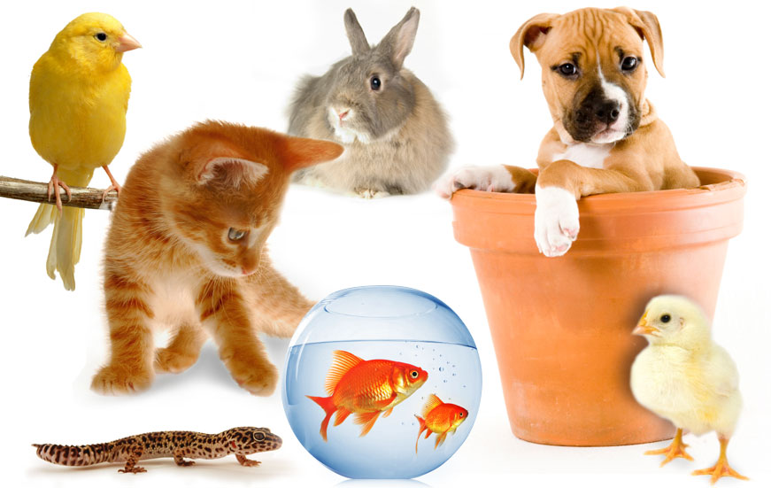
4.
One point for each pet in your family. (Fish only count as one.)

Slide 6
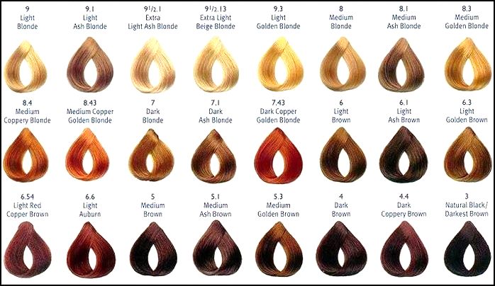
5.
-One point for brown hair.
-Two points for blond hair.
-Three points for black hair.
-Four points for red hair.
-Five points for hair color not listed above.

Slide 7
6.
One point for each shoelace hole or hook on one shoe for each team member.

Slide 8
7.
One point for each team member who has been in a state other than this one.

Slide 9
8.
One point for each team member who has flown in an airplane.

Slide 10
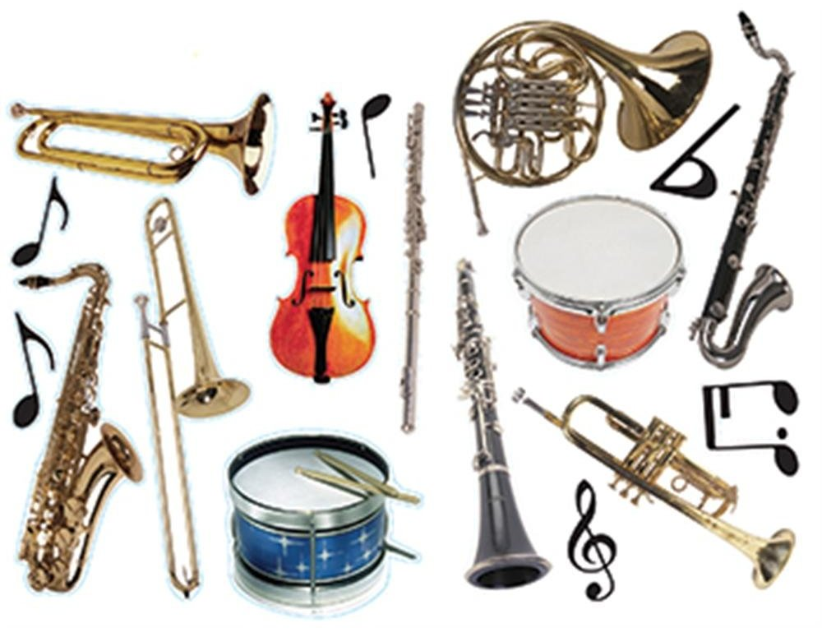
9.
One point for each musical instrument each team member knows how to play.

Slide 11
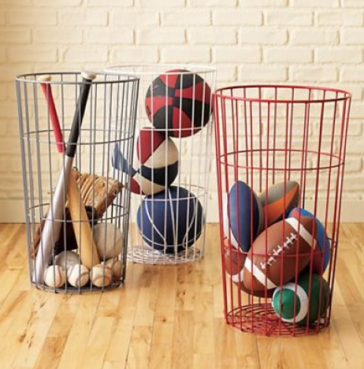
10.
One point for each organized sport or club you have participated in this year.

Slide 12
11.
One point for each team member who has a cell phone.

Slide 13
12.
One point for each piece of jewelry each team member is wearing. (Earrings count as one.)

Slide 14
13.
One point for each letter in each player’s first name.

Slide 15
14.
One point for each team member who has been to a different country.

Slide 16
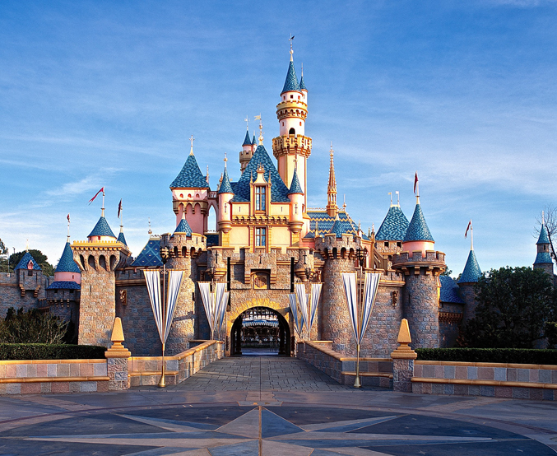
15.
One point for each team member who has been to Disneyland.

Slide 17
16.
One point for each team member who has a birthday in December.

Slide 18
17.
One point for each team member that is wearing pink.

Slide 19
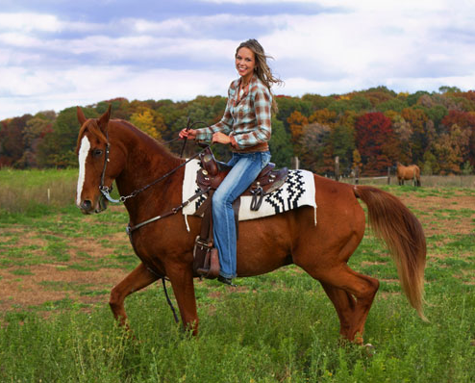
18.
One point for each team member who has ridden a horse.

Slide 20
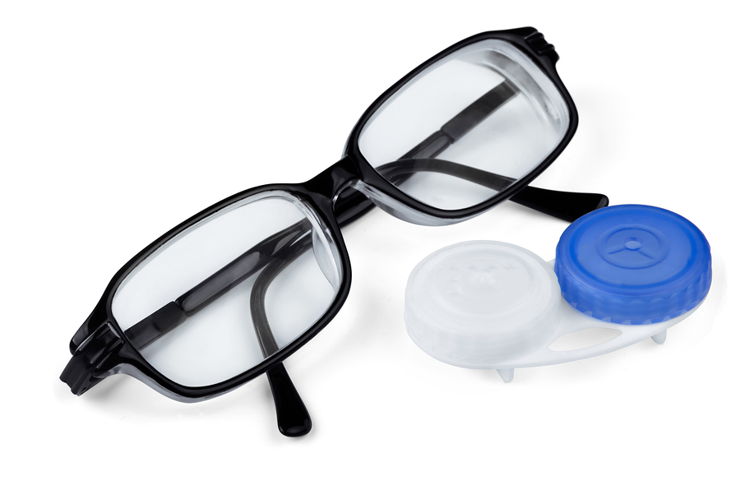
19.
One point for each team member who wears glasses or contacts.

Slide 21
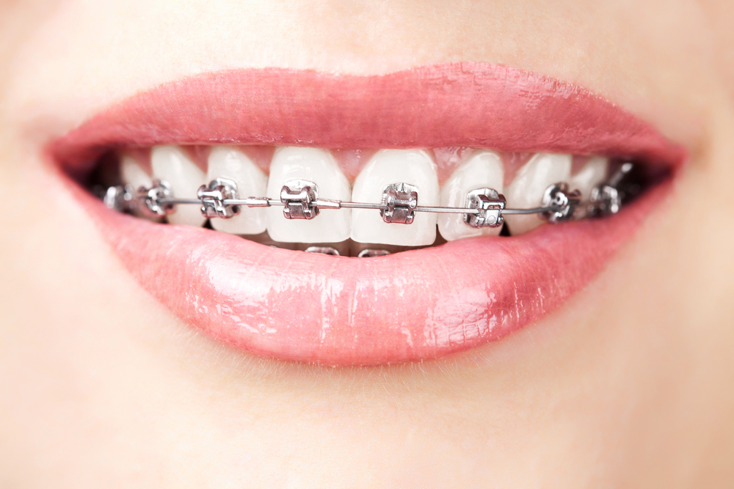
20.
One point for each team member who has braces.

Slide 22
What can we learn about ourselves and others from this activity?

Slide 23
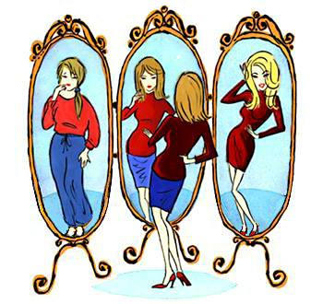
What is Self-Concept?
The combination of self-image and self-esteem. It is the way we perceive our whole selves.
Self-Image: the way we see ourselves physically.
Self-Esteem: the way we think or feel about ourselves.
*This can change from moment to moment.

Slide 24
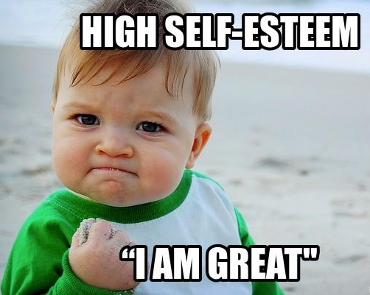
Two Types of Self-Esteem:
High Self -Esteem:
Feeling positively about yourself, your actions and your future.
Low Self-Esteem:
Feeling negatively about yourself, your actions and your future.

Slide 25
Question:
What things prevent us from having a positive self-concept or high self-esteem?

Slide 26
Self-Talk
Did you know that almost
77%
of everything we say and think about OURSELVES is negative?

Slide 27
Our toughest critic is ourselves! Have you ever said or thought the following:
I’m so stupid!
I can’t do anything right!
I shouldn’t even try because I’ll just mess up!
I look so ugly today!
I’m such a loser!
STOP!

Slide 28
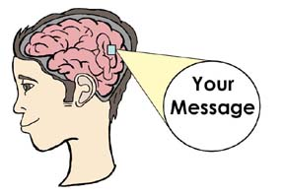
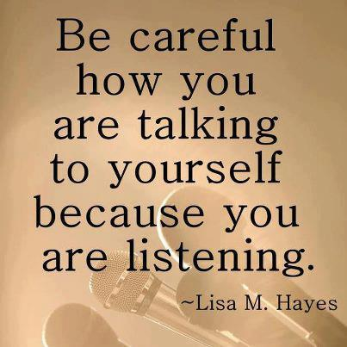
The brain will believe what we tell it most!
We will become what we tell ourselves we are.
Thoughts lead to action.
We have to “re-program” what we say to ourselves!

Slide 29
10 Things I Love About Me
Your assignment is to list the TOP TEN things you love about yourself!
Whenever you catch yourself saying something negative, look at this list and say all ten things out loud!
Replace your bad habit with a good one!

Slide 30
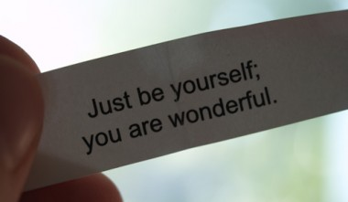
What is self-Confidence?
Believing in yourself and your abilities.
When you trust yourself to do what’s right no matter what!
Take things step-by-step to build self-confidence.
Nobody is born with self-confidence. It grows from taking risks and trying new things.

Slide 31
What do YOU do when someone puts you down? Do you agree that you have a choice in deciding what kinds of message you accept?

Slide 32
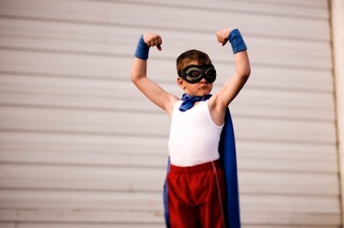
What can YOU do when you start putting yourself down or when you start using negative self-talk?

Slide 33
What are some tips we can use to build Self-Esteem and self-confidence?
Accept yourself for who you are and recognize your strengths.
Forgive yourself for mistakes.
Get outside your “comfort zone” and try new things. Start small and don’t give up.
Speak up! Let your opinion be heard.
Reach out to others and make new friends/improve friendships.
Choose friends that help build your self-confidence/self-esteem.
Stop giving yourself negative messages and use positive self-talk.
Ignore put-downs or labels from others.

Slide 34
More Tips…
Stop comparing yourself to others!
Learn a new skill.
Set and accomplish realistic goals.
Be positive.
Be assertive.
Don’t give up. Building positive self-esteem is not easy.
Get healthy (eat right/ exercise/good hygiene, etc.).
Take some time for yourself to meditate or relax.
Make decisions that help you stick to your values.
Remember….nobody is perfect so stop trying to be!
Live within your value system.

Slide 35
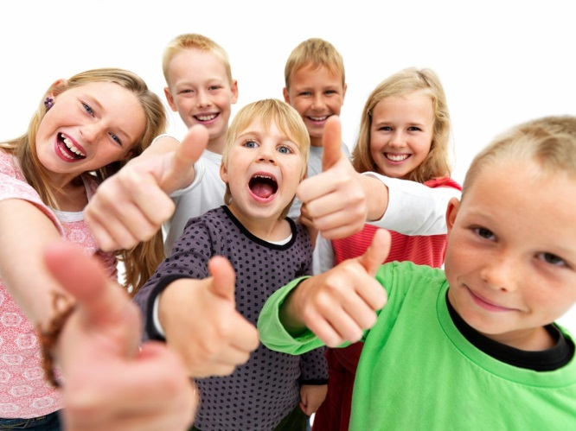
Even More Tips…
Be kind to others. (What goes around comes around.)
Remember who you really are and who you want to be.
View mistakes as learning opportunities.
Recognize what you can change and what you can’t change. Then, learn to accept it.
Learn to NOT accept negative messages from others.

