Slide 1
“I” Messages & Conflict Resolution

Slide 2
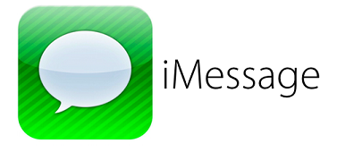
What are “I” Messages?
NOPE!
“I” Messages are a helpful way of communicating how you feel and why you feel that way without losing control of your emotions.
They allow you to resolve conflicts without others feeling blamed or attacked.
They do take time and practice to use effectively.
There are 4 parts of an “I” Message….

Slide 3
Parts of an “I” Message
I feel... (Identify the Feeling)
When you... (Describe the behavior)
Because… (How the behavior affects you)
What I need... (Action/behavior you need instead)

Slide 4
Examples of “I” Messages
I feel frustrated when you interrupt me because I’m trying to talk. What I need is for you to listen.
I feel worried when you don’t call home because I don’t know where you are. What I need is for you to call if you’re going to be late.

Slide 5
Examples of “I” Messages
I feel happy when you share your emotions because then I know how you’re really feeling. What I need is for you to do that more often.
I feel upset when you copy my homework because it took me a long time. What I need is for you to do your own work.

Slide 6
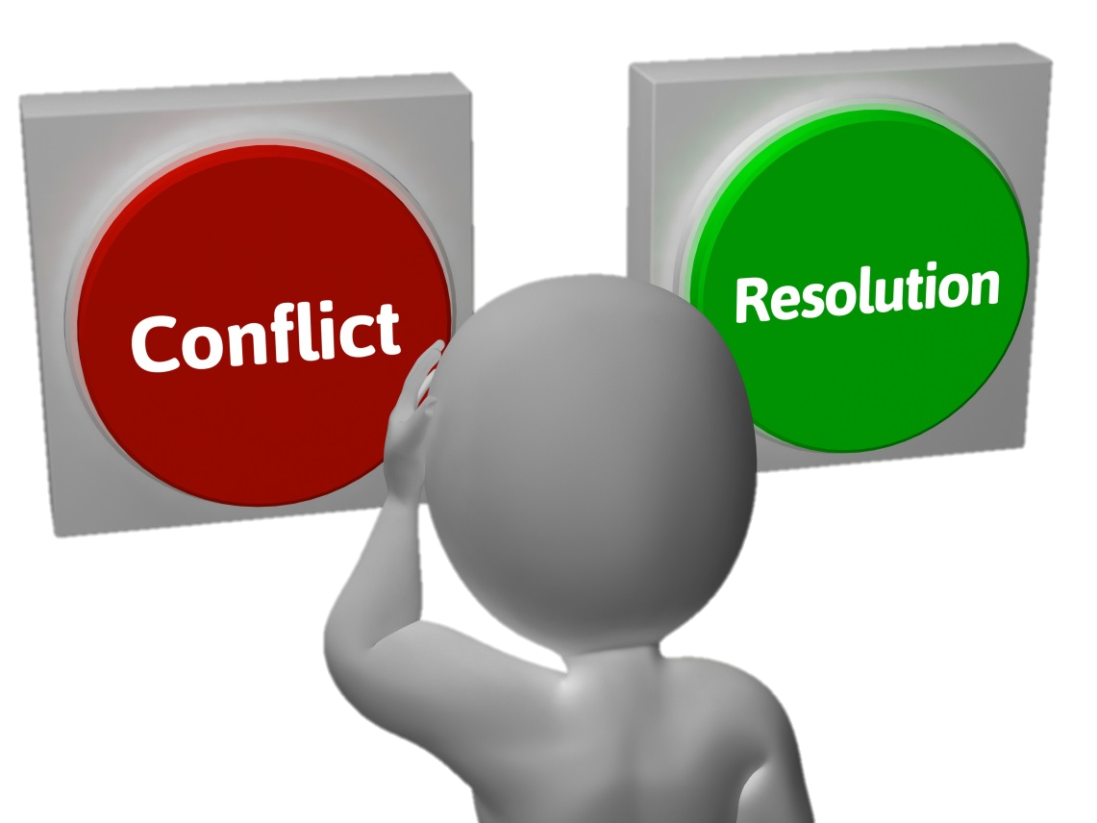
Conflict Resolution
A conflict is a disagreement, argument or misunderstanding.
There are 3 types of Conflict Styles or Behaviors:
Avoidance
Confrontation
Problem Solving

Slide 7
Avoidance
This style tries to avoid the problem all together rather than face it.
Changing the subject
“Giving in” to avoid confrontation
Avoiding the issue in hopes it will go away
Communicating through the “grapevine”

Slide 8
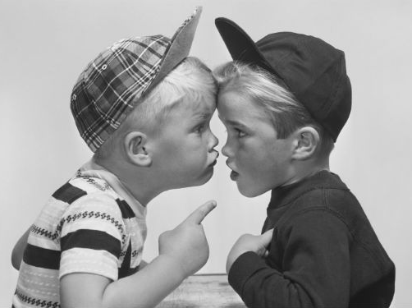
Confrontation
This style is aggressive and sometimes hostile.
“My way or the highway”
Very confrontational and competitive
Used to gain power and control
“You” Messages
Can damage relationships

Slide 9
Problem Solving
This style shows a willingness to compromise to solve the problem positively.
Uses collaboration to solve the problem
Win-Win Attitude
Two-way communication
“I” Messages

Slide 10
Positive Conflict Resolution Skills
Try to stay positive and calm
Be aware of your emotional triggers
Use active listening skills to understand
Focus on cooperation instead of winning
Ask questions
Use appropriate body language / non-verbal communication
Use “I” Messages
Be specific about what is bothering you

Slide 11
Review of Active Listening Skills
Pay attention.
Look at the speaker / eye contact.
Stop other tasks and listen.
Listen with appropriate body language.
Give verbal clues that show you are listening.
Don’t interrupt.
Don’t shift your attention to your own problems.
Don’t let your emotions get in the way.
Don’t rush the conversation.
Put the phone away!

