Slide 1
Textile Design Entreprenuership
Amber Williams
June 8-9, 2016
FACS Summer Conference, West Lake High School

Slide 2
Standard 1- Analyze careers and explore the design industry.
www.bls.gov
www.utahfutures.org
www.fwordfashion.com
Job Description
Education and or training needed
Salary
I have my students use a graphic organizer to complete the information.
We discuss interesting facts as a class when we are finished finding information

Slide 3
Standard 2- Students will identify technology used in Fashion Design\Interior Design Fabrication.
What is CAD, what is Vector?
What is output, outsourcing and grading?
Designing and Printing your own fabric

Slide 4
What is CAD?
Notes:
CAD is Computer Aided Design

Slide 5
What is Vector
Notes:
Vector is a graphic that can be scaled and layered. Vector programs are draw programs rather than paint programs.
Point out that some software programs are both CAD and Vector, some app programs will only be the paint programs.
If a designer is going to purchase software they should be aware of the different types of technology and choose the one that will allow them the most creative freedom.
Here is another link that better explain vector but I don’t have the ability to download and embed it in the presentation.
https://www.youtube.com/watch?v=TswPqn5bdeI

Slide 6
Output Files
.doc
pdf
jpeg
gif
png
.ppt
tiff
pcb
psd

Slide 7
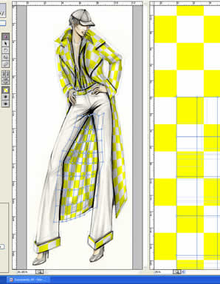
What About……..
Output files
Outsourcing Capabilities
Grading Capabilities
Notes:
Ask students:
1- Think about your computer technology classes. What is an output file? (have them list some examples: .doc pdf jpeg gif png .ppt tiff pcb psd)
Explain that when shopping or looking for a software program the user wants to know what the output files are. Are the files ones that can be shared with other users? Or does the output file only open with that particular software program. (eg. If I create a design with Bernina My Label I can only open it with My Label. I cannot share it with another person and expect they can open the file on their computer if they do not have My Label installed on their computer.)
2- What do you think out sourcing means? (the ability to share with others)
Explain that outsourcing capabilities as it relates to a software determines whether or not the designer can use their designs for personal or commercial use. If a designer makes a pattern using Wild Ginger or My Label they can use the designs for personal use only. The designer would not be able to sell their designs for profit.

Slide 8
www.wildginger.com
Can I sell patterns created in PatternMaster or Wild Things?
You CANNOT under any circumstances sell patterns created with any PatternMaster or Wild Things program or module including the Style Editor, the Pattern Editor, and the Yardage Calculator in any form or format including, but not limited to, printed and digital forms.
Please see the End User License Agreements for additional details.

Slide 9
What About……..
Output files
Outsourcing Capabilities
Grading Capabilities
Notes:
Ask students:
3- Grading refers to changing the sizing on a pattern.
Grading can be a very complicated process in the pattern making industry. There are people who’s job with a pattern company is just grading patterns. They have to be very good at figuring proportions—math.
Pattern software can have grading capabilities, but they are expensive.

Slide 10
Pattern Grading
Notes:
Briefly explain that grading is more than just adding length to a garment. For it to be done correctly the increase or decrease in measurements should be dispersed equally across the width and length of a garment.

Slide 11
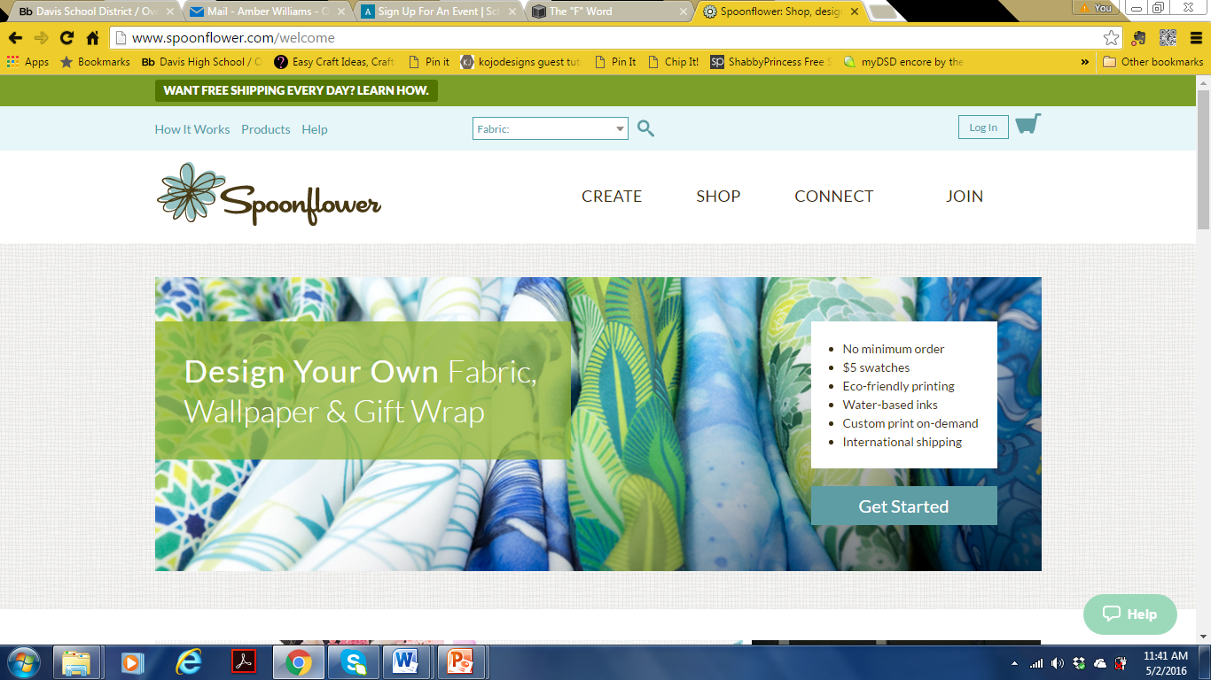
Create your own design

Slide 12
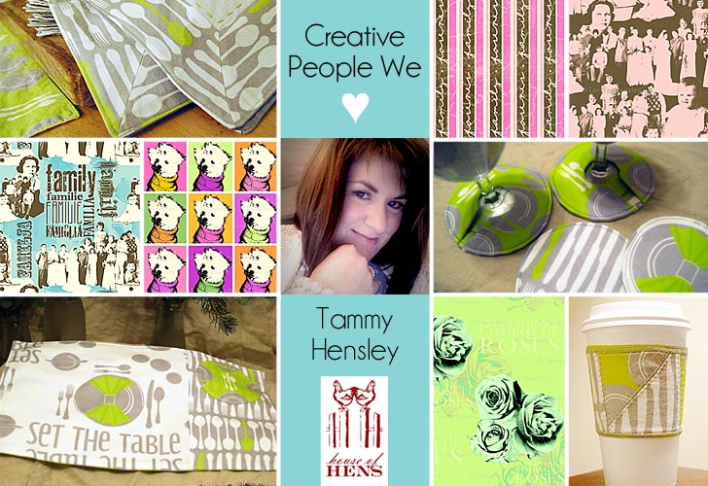
http://www.sew4home.com/tips-resources/interviews-inspirations/creative-people-we-love-tammy-hensley

Slide 13
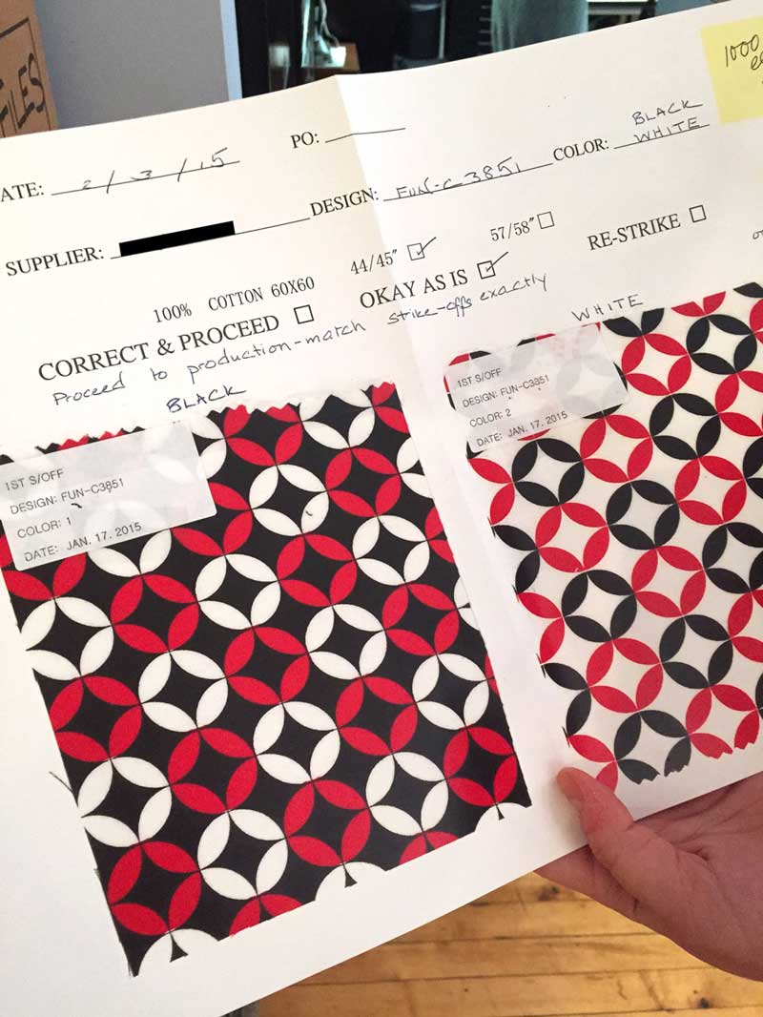
http://www.sewmamasew.com/2015/05/all-about-the-fabric-design-printing-process-plus-a-fabric-giveaway/

Slide 14
Standard 3- Identify and choose appropriate fabrics as it relates to an end product.
Textile Analysis handout
I use this to review and go over what we already know about fabric construction.

Slide 15
Fabric Finishes/Fabric Technologies
Stain resistant
Fire resistant
Wrinkle resistant
Waterproof
Antimicrobial
Wicking
Notes:
Fashion! Pg 161-164
Students write definitions behind the term for smash book

Slide 16
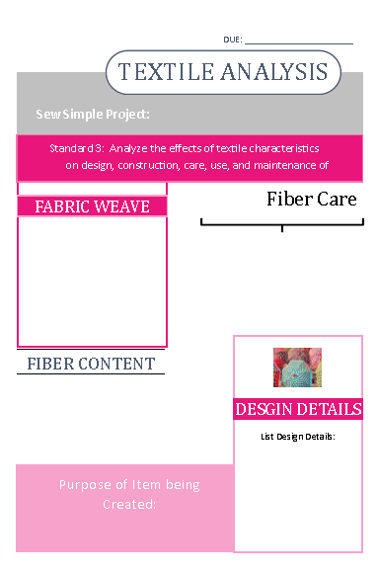
Sew Simple
Take an existing pattern or design and add your own design details to it.
Create your design.
Share your design in class.
Analyze the effects of textile characteristics on design, construction, care, use, and maintenance of products created in class.

Slide 17
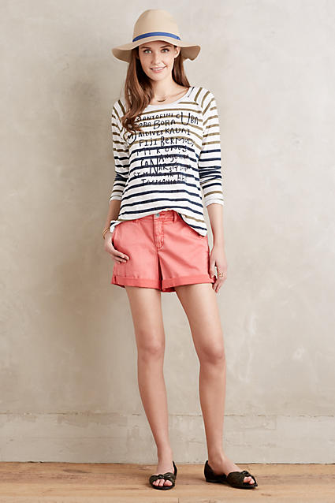
Look at Ready to Wear
Anthropologie
Cotton chinos, abridged for warm weather. From Pilcro, an Anthropologie-exclusive.
Stretch cotton twill
Five-pocket styling
Machine wash
Imported
Style No. 37551272
Dimensions
Regular: 4" inseam
Petite: 3.25

Slide 18
What is Sustainability?
Notes:
Define sustainability and ethical practices as they relate to the textile industry.

Slide 19
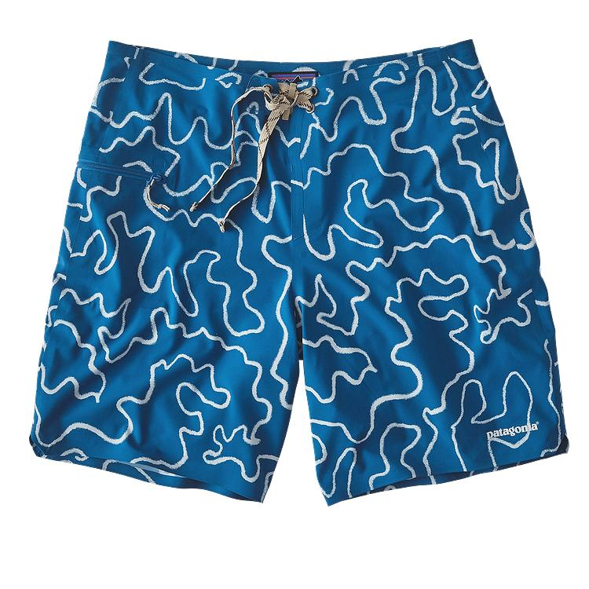
Look at Ready to Wear
Pantagonia
Featuring original art inspired by Gerry Lopez Surfboards, these are the lightest and highest-performing board shorts in our line. Made from 100% recycled polyester with 2-way mechanical stretch, a low-drag waistband and fully glued seams, they let you push your limits in fast and barreling surf.
he razor-sharp reefs of Java were at the outer limits of surfing in the ‘70s, and they still test the most hardened barrel hunters today. Made from durable, fast-drying and superlight 2.8-oz 100% recycled polyester, the Stretch Hydro Planings are the lightest and highest-performing board shorts in our line. Finding inspiration from camo prints used by Gerry Lopez Surfboards, they have 50+ UPF sun protection, a DWR (durable water repellent) coating and highly functional 2-way mechanical stretch that offers maximum flexibility in fast, top-to-bottom surf. Fully glued seams, a low-drag, waistband and a slim profile through the thigh and leg provide elevated functionality; the flat-lying gasket fly is optimized for comfort while paddling; a bartacked ladderlock drawstring closure adds long-lasting durability and keeps the shorts secure. The self-draining pocket on the right thigh has a noncorroding, recyclable plastic zipper with added zipper pull for ease of use. Outseam is 19".
Made of a super lightweight and quick-drying recycled polyester with 2-way mechanical stretch, a DWR (durable water repellent) finish and 50+ UPF sun protection
Glued seams; grown-on waistband; flat-lying gasket fly; ladderlock drawstring closure; bartacked drawstring is durable and adds security
Self-draining pocket on right thigh has a noncorroding, recyclable plastic zipper; with internal key loop and zipper pull for ease of use
Trim silhouette on thigh and leg opening for ease of movement and better dry time
19" outseam
2.8-oz 100% recycled polyester with 2-way mechanical stretch, a DWR (durable water repellent) finish and 50+ UPF sun protection
96 g (3.4 oz)
Made in Vietnam.

Slide 20
eth·i·cal ˈeTHək(ə)l/ adjective
Is it ethical for magazines to have their photos altered?
Is it ethical for stores to have their mannequins all be the same size?
Is it ethical to produce a knock-off of a designer’s work?
What is an ethical wage?
What are the ethics surrounding environmental impact?
Notes:
http://www.watchmojo.com/video/id/7291/
http://itaaonline.org/?page=5

Slide 21
Protecting those who make our clothes
www.truecostmovie.com
Netflix, iTunes, or buy it from the website ($10)

Slide 22
Standard 4-Students will explore entrepreneurial options in the fashion and interior design industry.
Objective 1: Students will explore the steps of establishing a business plan. (1. Introduction, 2. Marketing, 3. Finance & Management, 4. Operations and 5. Concluding statement)
Objective 2: Analyze how to price a product for sell.
Material Costs: the amount of money you spend on raw materials needed to create a product.
Labor Costs: the number of hours required to make your product and the hourly rate associated with those hours.
Overhead Costs: any further expenses required for the operation of your business.
Objective 3: Students will be able to explain the basics of the 4P’s of marketing.
Product (package) 2. Place (where to sell) 3. Price (material, labor, & overhead costs) 4. Promotion (method of advertisement)
Objective 4: Understand the basics for using credit for business financing. (Interest rate, personal guarantee, loan term, ability to repay)

Slide 23
Standard 4-Students will explore entrepreneurial options in the fashion and interior design industry.
www.sba.gov
Business Plan Lesson Plan with Shark Tank (season 5 week 15—download it on iTunes $3.99)
Slogan and Hang Tag
Make a prototype of your item to represent your product.

