Slide 1
Prevention Dimensions
Introduction to Lessons

Slide 2
PD Lessons Overview Video

Slide 3
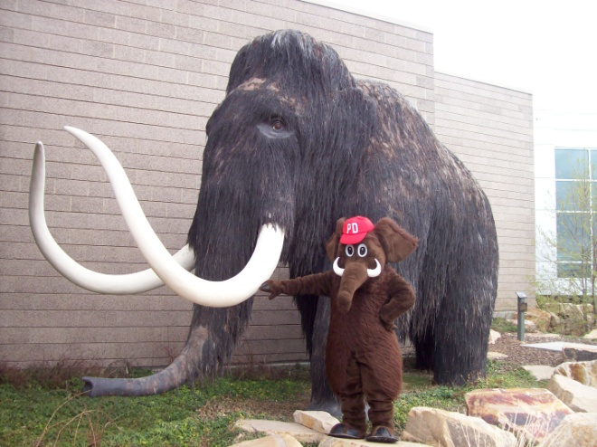
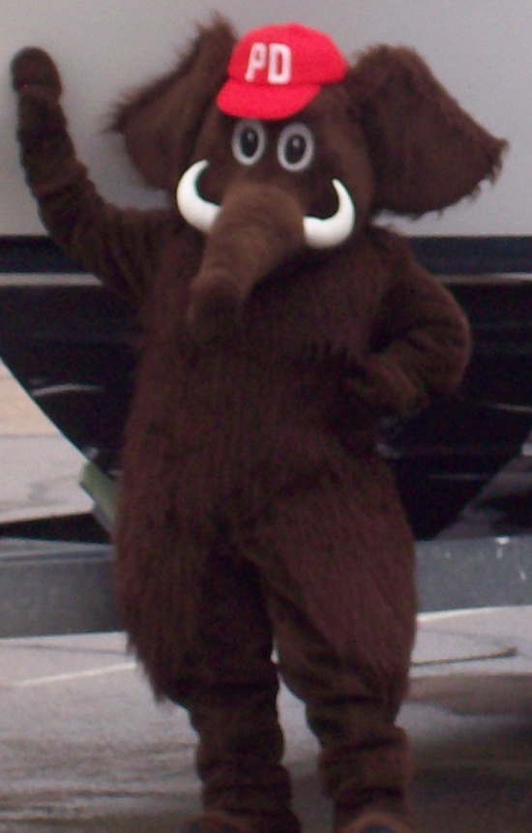
To request PD for your activity, call Verne:
801-538-7713

Slide 4
PD Logos

Slide 5
The Three Cs Video

Slide 6
The 3 Cs
Rights
Responsibility

Slide 7
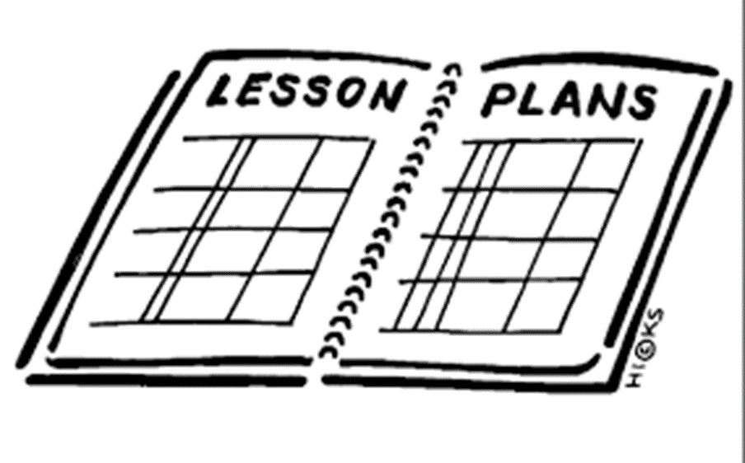
Review First Few Lessons.

Slide 8
Increasing Your Value Video

Slide 9
Discuss What Increasing Your Value Means to You.

Slide 10
Prevention Dimensions
Thank You

