Slide 1
Prevention Dimensions
Lesson 2 – Bugs or Rocks

Slide 2
King Tut Shuffle Video

Slide 3
Bugs Introduction Video

Slide 4
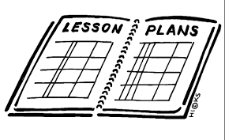
Model a Learning Objective from Lesson #2

Slide 5
Bug Fixes Video

Slide 6
Review Video Clip
How does developing life skills students away from negative behaviors?

Slide 7
Helpful Heroes!!!!

Slide 8
Bugs in Classroom Video

Slide 9
Rocks in Classroom Video

Slide 10
Review Lesson
2

