Slide 1
Prevention Dimensions
Lesson 2 – Builders and Breakers

Slide 2
Builder Introduction Video

Slide 3
Learn About Bullying Video

Slide 4
Review Video Clip
Thoughts/Comments

Slide 5
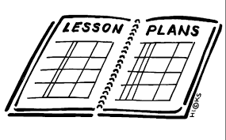
Model a Learning Objective from Lesson #3

Slide 6
Activity

Slide 7
Impact Team “Rumors” Video

Slide 8
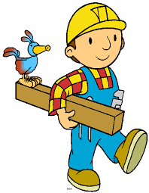
Thoughts/Comments
What strategies would work best in my classroom to help students be a builder, not a breaker?

Slide 9
Fox Hollow Elementary

Slide 10
IALAC Video

Slide 11
Builder Booklet Video

Slide 12
Discussion
How your school could use this lesson to be better builders.

Slide 13
Review Lesson
3

