Slide 1



Prevention Dimensions
Welcome

Slide 2
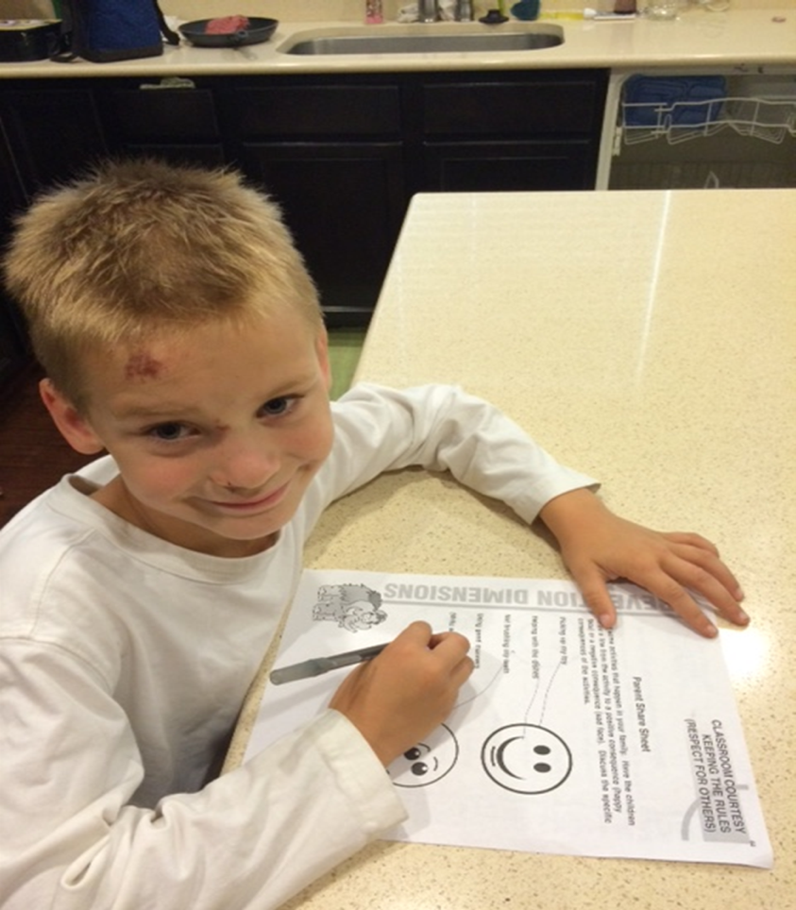
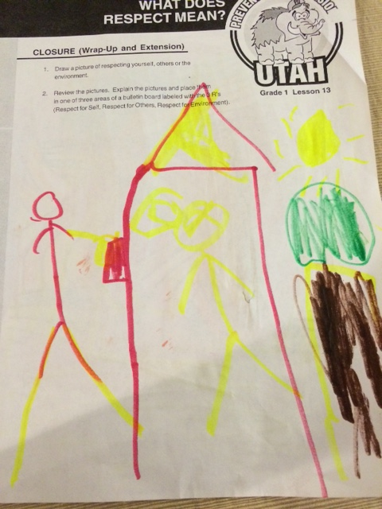
This is How it Works!!!!
Notes:
This is Verne Larsen’s grandson doing a Prevention Dimension lesson at his school.
The picture on the right is a picture that another grandchild brought home from his school classroom.
Prevention Dimensions is taught in Utah schools and matter to Utah families.

Slide 3
PD Training Introduction Video

Slide 4


Review Information
in Video

Slide 5
Training Objectives
Champion Trainers will..
Understand the “WHY” of Prevention Dimensions as a Foundation of Prevention.
Learn how to and be committed to motivating faculty at their schools.
Experience games, activities, music and discussions as strategies to motivate others at local level.
Train Others to use PD in Classroom
Discuss challenges and barriers and develop ways of overcoming them and being successful in helping colleagues to implement PD.
…………………………………………………
Notes:
There is a PD Committee which consists of a variety of people representing various agencies which give input to the direction of PD. This is not just a brainstorm of one individual but key people with an interest in prevention moving things forward.

Slide 6
Optimal Functioning
Academic
Competence
Social
Competence
Notes:
Emphasize that we not only need to support students and help them understand Academically but the importance of social competence, This adds to the resilience of a student helping them toward being an optimal functioning individual. If we are not doing both of those we are not doing the best we can in prevention.

Slide 7
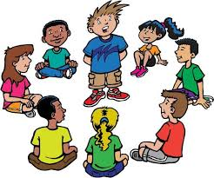
Discussion/Activity
Combining Academic Achievement
and Social Competency.

Slide 8
Prevention Dimensions Overview Video

Slide 9
Utah’s School-based
Prevention Foundation
Prevention Dimensions
Notes:
Prevention Dimensions is our Foundation of School-Based Prevention. It won’t solve all of the world’s social issues, but it gives a nice foundation of effective prevention principles which help prevention a variety of issues….Bullying, substance abuse, suicide, etc. etc.

Slide 10
It’s Utah Law
53A-13-102
The State Board of Education shall adopt rules provide for instruction at each grade level on the harmful effects of alcohol, tobacco and other drugs.
Assistance from the State Division of Substance Abuse and Mental Health.
Substance Abuse
…………………………………………………
Notes:
It’s the law that we need to instruct on the harmful effects of alcohol, tobacco and other drugs. Assistance from the Division of Substance Abuse and Mental Health was part of the effort as well.

Slide 11
History and Beginnings
Partnership (1982-83)
Statewide PTA survey
Utah Legislature: one-time appropriation
Interagency partnership: education, health, substance abuse and PTA
…………………………………………………
Notes:
State PTA did a school survey in 1982 that showed the second biggest concern besides literacy was the rising use of tobacco, alcohol and other harmful chemicals. State legislature provided a one time appropriation to assist in helping with that. Interagency partnership was established.

Slide 12

Gang Prevention
53A-17a-166
(ii) Money for the gang prevention and intervention program shall be distributed to school districts and charter schools through a request for proposals process.
Gangs
…………………………………………………
Notes:
It’s the law that we funds from the Enhancement of At Risk Funds that district receiving funding provide a Gang Prevention/Intervention effort.

Slide 13
Rule R277-609. Standards for School District, School and Charter School Discipline Plans.
…………………………………………………
(f) include strategies for providing students and staff, including aides, custodians, kitchen and lunchroom workers, secretaries, paraprofessionals, and coaches, with awareness and intervention skills such as social skills training.
Bullying
Notes:
A few years ago, when bullying legislation came about Rule R277-609 was revised. New rule also requires training for all school personnel as well as helping with social skills training. Comprehensive Prevention helps youth develop necessary social skills.

Slide 14
HB 154. Suicide Prevention Programs
…………………………………………………
….requires school districts and charter schools to implement a youth suicide prevention program for students in secondary grades;
Suicide
Notes:
This year the big issue which legislators was focused on was the issue of suicide. We now have a new suicide prevention specialist at the Utah State Office of Education and also one at the State Division of Substance Abuse / Mental Health. There is an effort to implement a youth suicide prevention program in the secondary schools. Comprehensive Prevention helps with the suicide issue as well.

Slide 15

Child Sexual Abuse
HB 286
…requires a school district or charter school to provide training and instruction on child sexual abuse prevention and awareness to: elementary school personnel; the parents or guardians of elementary school students; and elementary students;
Child Sexual Abuse
…………………………………………………
Notes:
It’s the law that we funds from the Enhancement of At Risk Funds that district receiving funding provide a Gang Prevention/Intervention effort.

Slide 16
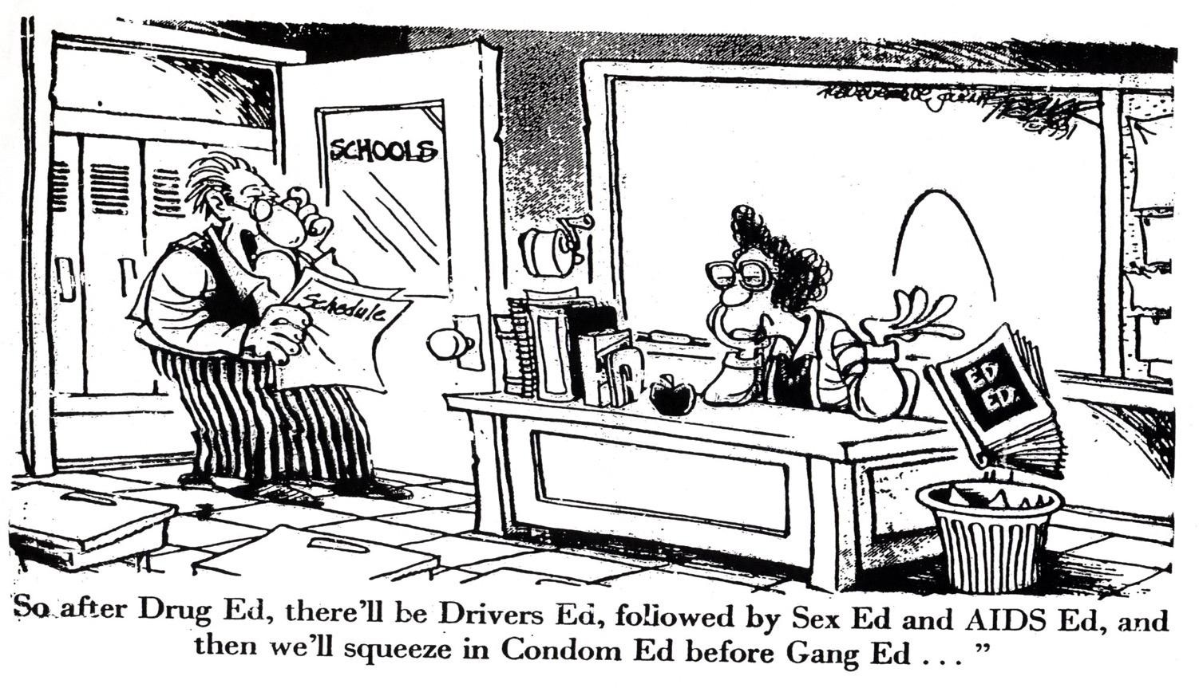
Can Educators Solve All The World’s Social Issues?

Slide 17
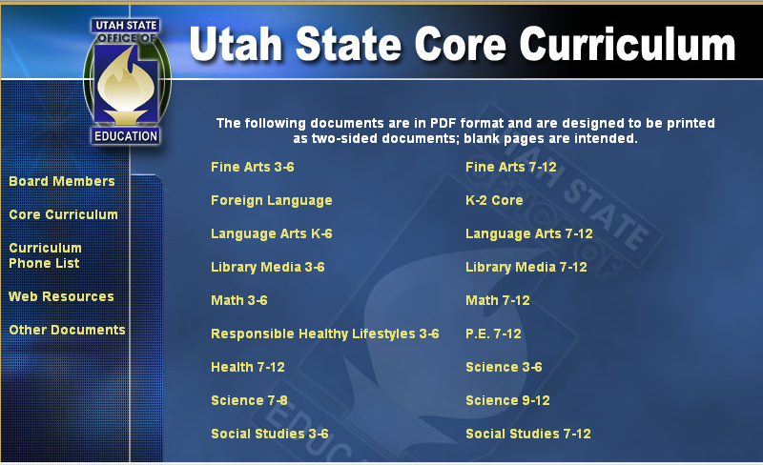
PD Teaches the Core!
Notes:
Another slide related to tying into the health core. Just as teachers are required to teach the math, language arts, science core they are also required to teach the health core and PD is the resource that can assist them with that.

Slide 18
Social and emotional learning
is an ongoing process…
“Through which a child acquires the skills to recognize and manage emotions, develop caring and concern for others, make responsible decisions, establish positive relationships and handle challenging situations effectively.”
Social Competence
…………………………………………………
Notes:
Social and emotional learning is a critical piece of the education puzzle.

Slide 19
Research-based Prevention
Can Impact Student’s Academics
Improved grades
Increased grade point average
Improved standardized test scores
Improved rates of next grade promotion
Improved rates of graduation
…………………………………………………
Notes:
If we do a good job with our prevention efforts, look at the success we have academically.

Slide 20
We are not here
to prepare students
for a life of tests.
However, we are here
to prepare students for
the tests of life.
…………………………………………………
Notes:
A quote which is critical for the teacher and others to examine how prevention is a necessary part of one’s education. Our influence on a child is tremendous and we can help them pass many, many test of life latter on as we prepared them now.

Slide 21
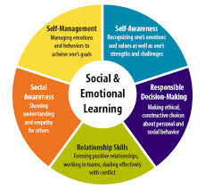
Discussion/Activity
Social Emotional Learning is Critical

Slide 22
Power of PD Video

Slide 23


Visit with the group about positive student outcomes in your school because of a teacher using Prevention Dimensions.
What could you do to use the power of Prevention Dimensions in your own classroom?

Slide 24
Things Change Video

Slide 25
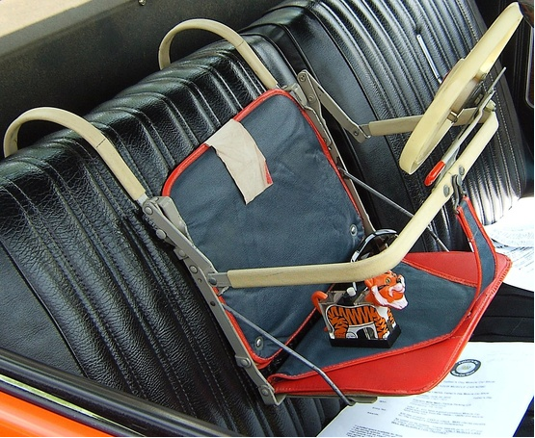
Car seat from the 1960’s

Slide 26
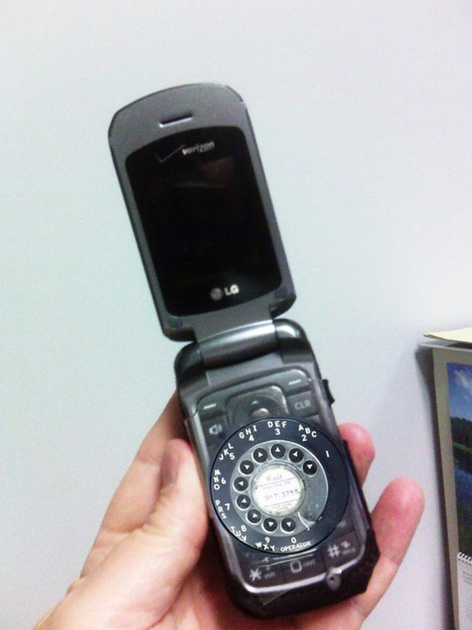
New Cell Phone For Seniors

Slide 27
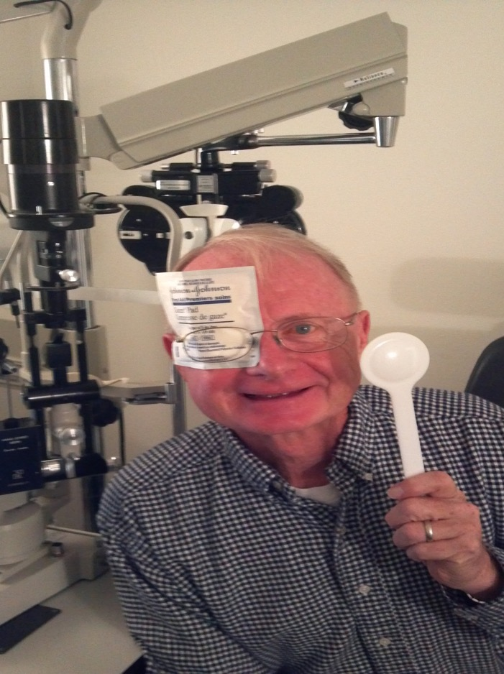
ipad For Seniors

Slide 28
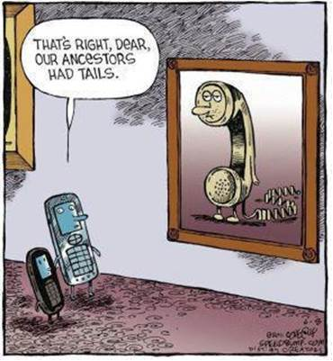
Things Have Changed.

Slide 29
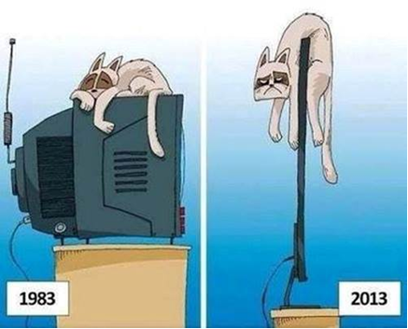
Things Have Changed.

Slide 30
History of Prevention Ideas
Don’t talk to the students about these things because…..
Give them all the information there is to know about drugs and what they will do….
Using scare tactics will surely get their attention…
Let’s have recovering people tell their stories and then……

Slide 31

PD Development and Revisions
1982-83 Developed
1990 Revised to better integrate lessons to Core
…………………………………………………
Notes:
Emphasize how PD assists teachers in providing a resource that helps teach the health core.

Slide 32
PD Development and Revisions
1982-83 Developed
1990 Revised to better integrate lessons to Core
1994 Inclusion of risk/protective factors
…………………………………………………
Notes:
Inclusion of Risk and Protective Factors came about. In Prevention anything we do should decrease a risk factor or promote a protective factor

Slide 33


PD Development and Revisions
1996 Inclusion of Music Component
32 songs to go with the lessons
School assemblies
Parent-focused concerts
…………………………………………………
Notes:
Recognizing the power of music in the learning process, music was added in 1996. PD consists of 32 songs which go along with various lessons. These songs help students internalize and remember key points of the lessons.

Slide 34
PD Development and Revisions
1982-83 Developed
1990 Revised to better integrate lessons to core
1994 Inclusion of risk/protective factors
1996 Music component
1999 Media literacy
2000-2001 Include research & tobacco lessons
…………………………………………………
Notes:
Recognizing how media influences youth, there was the inclusion of Media Literacy ideas. We the tobacco settlement dollars we included a strong tobacco component especially at the 4th and 5th grade.

Slide 35
PD Development and Revisions
1982-83 Developed
1990 Revised to better integrate lessons to core
1994 Inclusion of risk/protective factors
1996 Music component
1999 Media literacy
2000 - 2001 Include research & tobacco lessons
2002 – 2003 New design and formatting of lessons
…………………………………………………
Notes:
After recognition PD received a New Design and the Lessons were reformatted. Teachers received not only their grade level lessons but also Music CDs, songbooks, etc..

Slide 36



Prevention Dimensions
New Look
Notes:
PD is comprehensive and covers Kindergarten through 12th grade. Just as we learn math, language art, and reading each year, we also need to be learning life skills and social competency along with that.

Slide 37

PD Development and Revisions
2004 – 05 Developed new junior high materials
2008 – 09 Development of PD CD for high school students
2009 – 2010 Development of new foundation lessons for kindergarten – 6th grade
2013 – 2014 Rewrite 7th & 8th Grade Materials
…………………………………………………
Notes:
Junior High and High School came along next. Instead of providing hard copies of lessons for the high school we put the lessons with the accompanying materials on a CD which we give to the high school health teachers.

Slide 38

New Foundation Lessons Focus on the 3 Cs
Notes:
After recognition PD received a New Design and the Lessons were reformatted. Teachers received not only their grade level lessons but also Music CDs, songbooks, etc..

Slide 39
PD Steering Committee
State Office of Education
Division of Substance Abuse / Mental Health
Department of Health
Safe and Drug Free School Coordinators
Local Prevention Specialists
State PTA
Elementary and Secondary Teachers
Evaluators
Other State Agencies
…………………………………………………
Notes:
There is a PD Committee which consists of a variety of people representing various agencies which give input to the direction of PD. This is not just a brainstorm of one individual but key people with an interest in prevention moving things forward.

Slide 40


Distribution of PD Materials

Slide 41
Risk Factors/Protective Factors Video

Slide 42


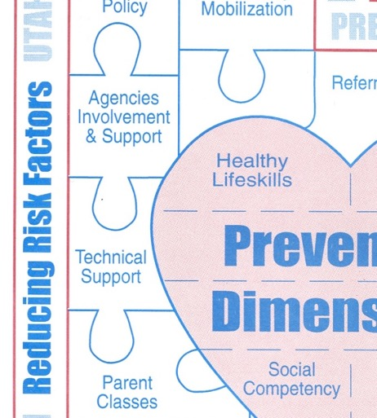
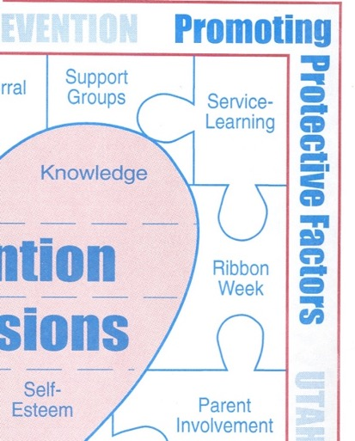
Works!
Prevention

Slide 43
Focus on Risk/Protective Factors
Family
Community
School
Peer/Individual
…………………………………………………
Notes:
This slide emphasizes the different domains for risk and protective factors.

Slide 44

Play Risk & Protective
Factor Game

Slide 45
Social Development Theory Video

Slide 46
The Social Development Strategy
The Goal…
Healthy Behaviors
…for all children and youth
Ensure…
Healthy Beliefs
and
Clear Standards
…in families, schools,
and peer groups
Bonding
–Attachment
–Commitment
Build…
…to families, schools,
and peer groups
By providing…
Opportunities
Skills
Recognition
…in families, schools,
and peer groups
Be Aware of…
Individual Characteristics
Notes:
©2000 Developmental Research and Programs, Inc.

Slide 47
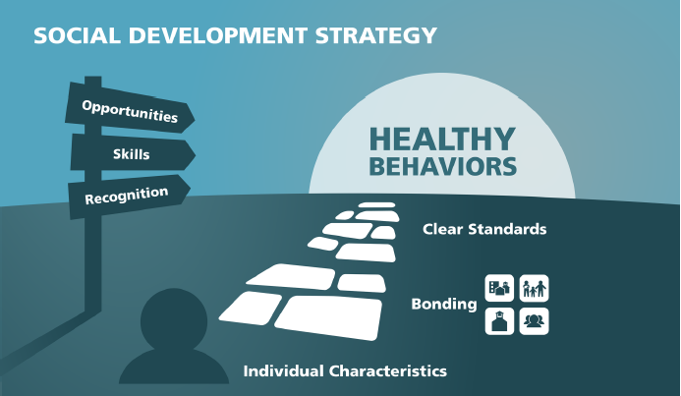

Slide 48
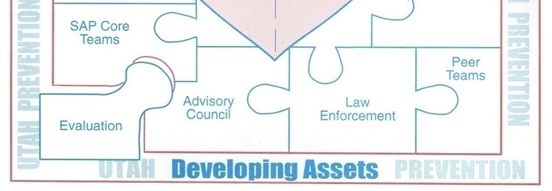
Works!
Prevention

Slide 49

Assets = Success
http://www.search-institute.org/

Slide 50
External Assets
(What We Surround Kids With!!)
Support
Empowerment
Boundaries/ Expectations
Structured Time Use

Slide 51
Internal Assets
(Comes From the Head and Heart!!!)
Educational Commitment
Positive Values
Social Competencies
Positive Identity

Slide 52
Delays Gratification
Overcomes Adversity
Exhibits Leadership
Resists Danger
Healthy Behaviors
Succeeds in School
Helps Others
Values Diversity
Maintains Good Health
Neighborhood Boundaries
Equality & Social Justice
School Boundaries
Integrity
Healthy Beliefs &
Clear Standards
Honesty
Responsibility
Sense of Purpose
Positive View of Personal Future
Community
Bonding
Individual/Peer
Caring Neighborhood
Religious Community
Adult Role Models
Safety
Positive Peer Influence
Family
School
Family Support
Positive Family Communication
Bonding to School
School Engagement
Achievement Motivation
Opportunities
Recognition
Skills
Other Adult Relationships
Service to Others
Creative Activities
Youth Programs
Youth as Resources
Time at Home
Parental Involvement
Reading for Pleasure
Homework
Community Values Youth
Youth Given Useful Roles
Caring School Climate
High Expectations
Personal Power
Cultural Competence
Family Boundaries
Interpersonal Competence
Peaceful Conflict Resolution
Planning & Decision Making
Resistance Skills
Individual Characteristics
Personal Control Self-Esteem
Restraint
(Hawkins, Catalano, Arthur & Brooke-Weiss, 2001).
Notes:
Hawkins, Catalano, and Benson developed this graphic representation of how Developmental Assets can fit into the Social Development Strategy (Hawkins, Catalano, Arthur & Brooke-Weiss, 2001). Neither endorses merging the models, but they agree that they can be used together for multiple purposes.

Slide 53
“No matter how much money is spent, how many elaborate programs are initiated, how many laws are passed or how many professionals are hired. The experiences of young people will not fundamentally change unless these individuals--Parents, youth, neighbors, friends, Grandparents & others--Take personal responsibility to contribute to young people’s healthy development.”

Slide 54
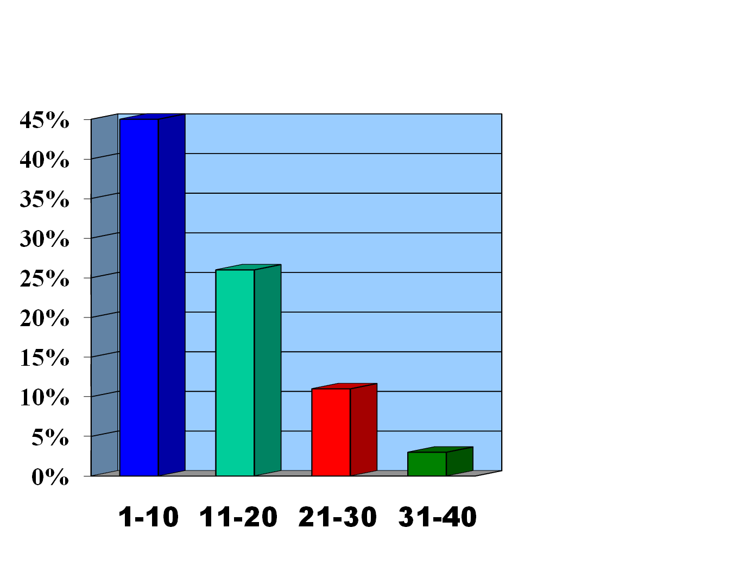
Protective Consequences of Developmental Assets
45%
26%
Alcohol
Use
11%
3%
Assets

Slide 55
Discussion/Activity

Slide 56
Prevention Dimensions Research Video

Slide 57

        2003-04 Prevention Dimensions Effectiveness Study
        Demonstrates Effects on Risk and Protective Factors
Good Job

Slide 58
        2003-04 Prevention Dimensions Effectiveness Study Demonstrates Effects on Risk and Protective Factors
Good Job

Slide 59
        2003-04 Prevention Dimensions Effectiveness Study Demonstrates Effects on Risk and Protective Factors
Good Job

Slide 60
PD Research & Evaluation History
1980’s - Teacher training & curriculum empower teachers to effectively teach lessons leading to significant delays in the onset of substance use for junior high school students (Haas)
Notes:
Recognizing how media influences youth, there was the inclusion of Media Literacy ideas. We the tobacco settlement dollars we included a strong tobacco component especially at the 4th and 5th grade.

Slide 61


PD Research & Evaluation History
1990’s A study showed significant reductions in risk factors for substance abuse among high-risk students receiving PD lessons compared to high-risk students not receiving PD (Tatchell & Durrant)

Slide 62
PD Research & Evaluation History
2000’s - Studies demonstrated significant improvements in problem solving and reductions in risk factors for favorable attitudes toward drug use
Significant increases in protective factors: opportunities & rewards for prosocial involvement

Slide 63
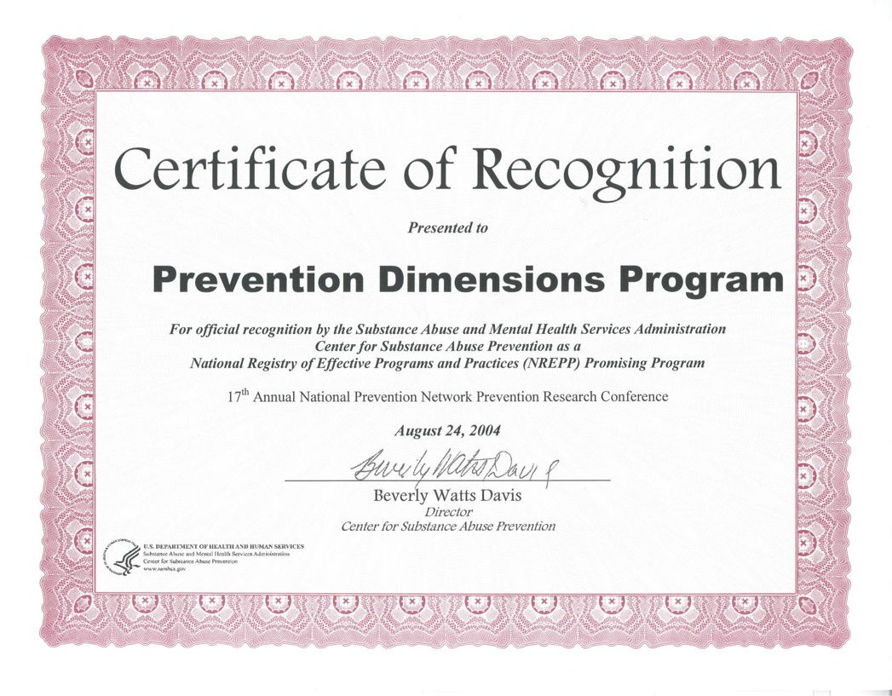
…………………………………………………
Notes:
May 17, 2001 Prevention Dimensions received an Exemplary Award and SAMHSA Exemplary Substance Abuse Prevention Programs Award Ceremony. After submitting additional evaluation information PD was recognized as an NREPP Promising Program.

Slide 64
…………………………………………………
2003 – 2004 Prevention Dimensions Effectiveness Study demonstrates effects on risk and protective factors
Good News
Notes:
Results of experimental / control group. Opportunities for Pro Social Involvement

Slide 65
…………………………………………………
2003 – 2004 Prevention Dimensions Effectiveness Study demonstrates effects on risk and protective factors
Good News
Notes:
Results of experimental / control group. Perceived Risk of Drug Use

Slide 66

Whole School Training Model vs. Traditional Training shows success
Teachers participating in the “whole-school” model report teaching more lessons per month than those teachers participating in the traditional training approach.

Slide 67
…………………………………………………
Prevention Dimensions 2012-13 Study shows teachers implement lessons with high degree of fidelity
Notes:
Results of experimental / control group. Knowledge of Problems Solving Skills.

Slide 68
Whole School Training Model vs. Traditional Training shows success
Staff report “whole school trainings positively impact school climate and culture by providing a common prevention language based on the 3 C’s”.
Notes:
Results of experimental / control group. Knowledge of Problems Solving Skills.

Slide 69
…………………………………………………
Whole School Trained Teachers vs. Traditional Trained Teachers
 | 2013-14 Traditional | 2013-14 Whole School
Lessons per month | 3.3 | 4.0
Fidelity: Adherence to lesson content | 78 | 85
Fidelity: Completing lesson objectives | 75 | 88
Fidelity: Student engagement | 85 | 88
Notes:
Results of experimental / control group. Knowledge of Problems Solving Skills.

Slide 70
Research-based Prevention
Can Impact Student’s Academics
Improved grades
Increased grade point average
Improved standardized test scores
Improved rates of next grade promotion
Improved rates of graduation
…………………………………………………
Notes:
If we do a good job with our prevention efforts, look at the success we have academically.

Slide 71
Affirmations Video

Slide 72

Review Video Clip
What are the values of teaching PD in the classroom?

Slide 73
Quilt Block Analogy Video

Slide 74
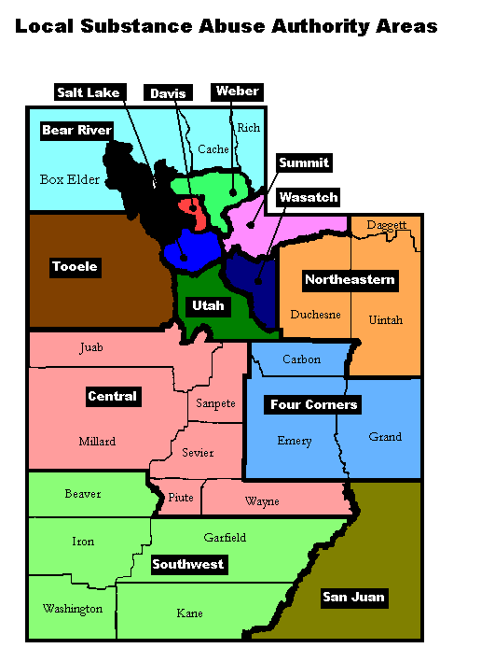
Local Substance Abuse
Authority (LSAA) Areas
Bear River (Box Elder, Cache, Logan, Rich)
Weber County (Weber, Ogden, Morgan)
Davis County (Davis)
Salt Lake County (Salt Lake, Jordan, Murray, Granite, Canyons)
Tooele County (Tooele)
Summit County (North & South Summit, Park City)
Wasatch County (Wasatch)
Utah County (Alpine, Nebo, Provo)
Central Utah (Juab, Millard, Piute, Sevier, Wayne, Tintic, North/South Sanpete)
Four Corners (Carbon, Emery, Grand)
Southwest Utah (Beaver, Garfield, Iron, Kane, Washington)
Northeastern Utah (Daggett, Duchesne, Uintah)
San Juan County (San Juan)
Notes:
This slide emphasizes the Statewide system to help promote and encourage use of PD. Divided into 13 Planning District. Have one or more school districts in each planning district who has a prevention coordinator and specialist which work with school personnel to guide prevention at the local level.
Quilt analogy. Think of this as putting the quilt together.

Slide 75
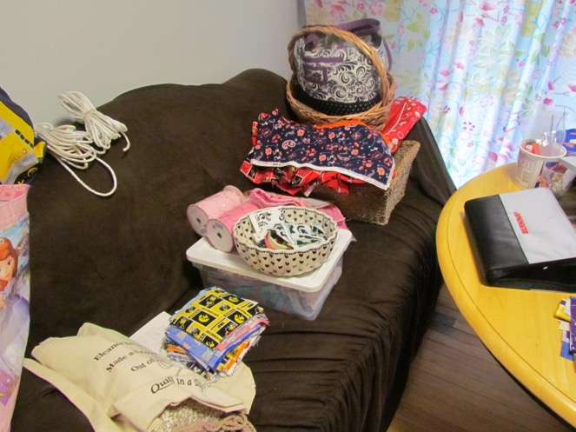
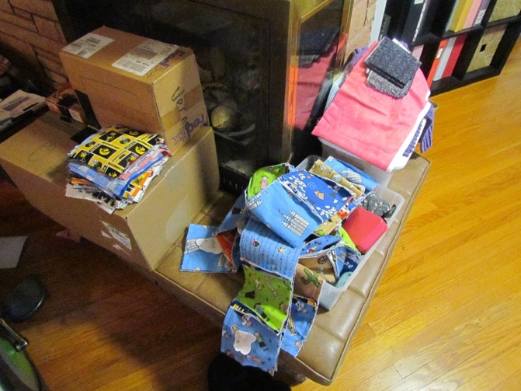
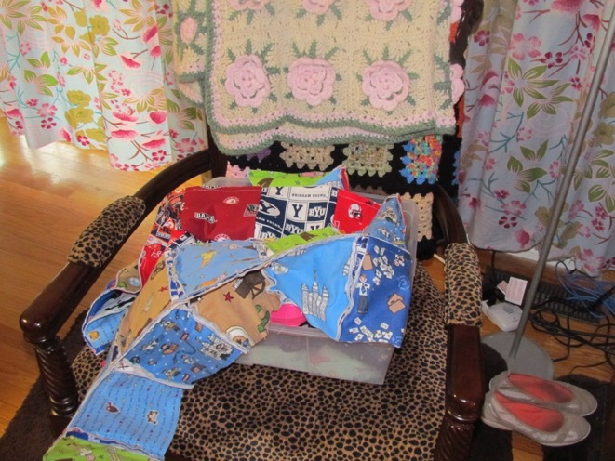
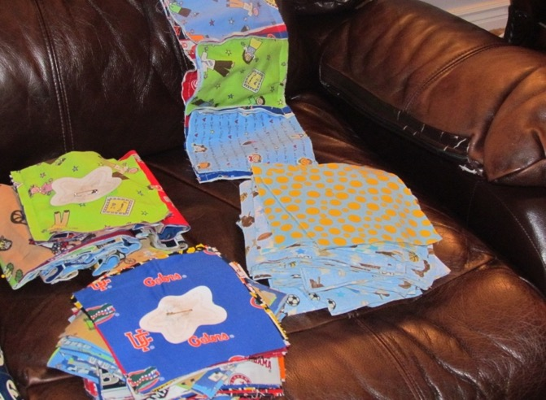
Quilt Analogy

Slide 76
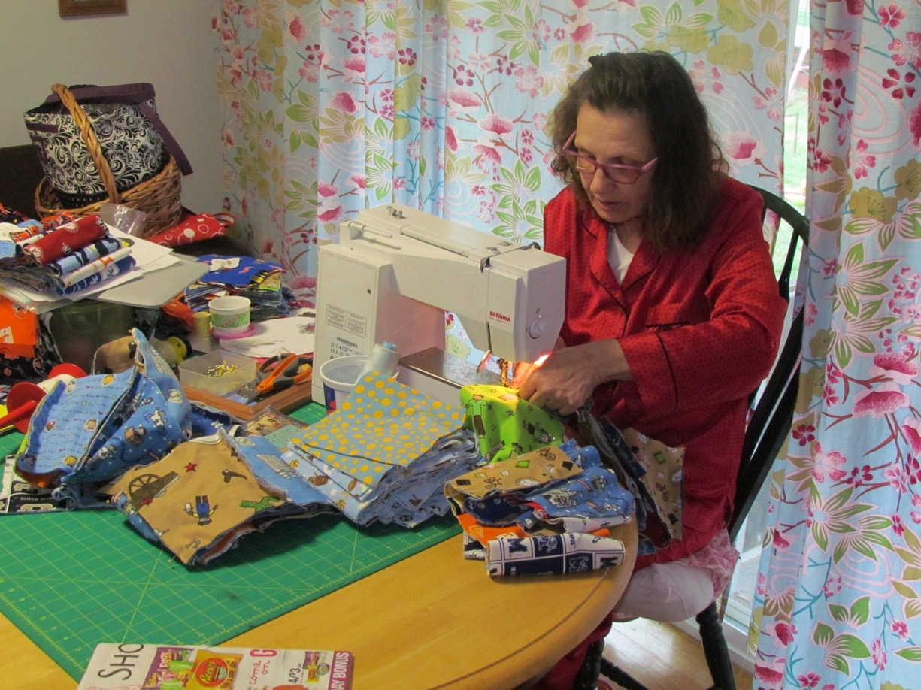
Putting Pieces Together

Slide 77
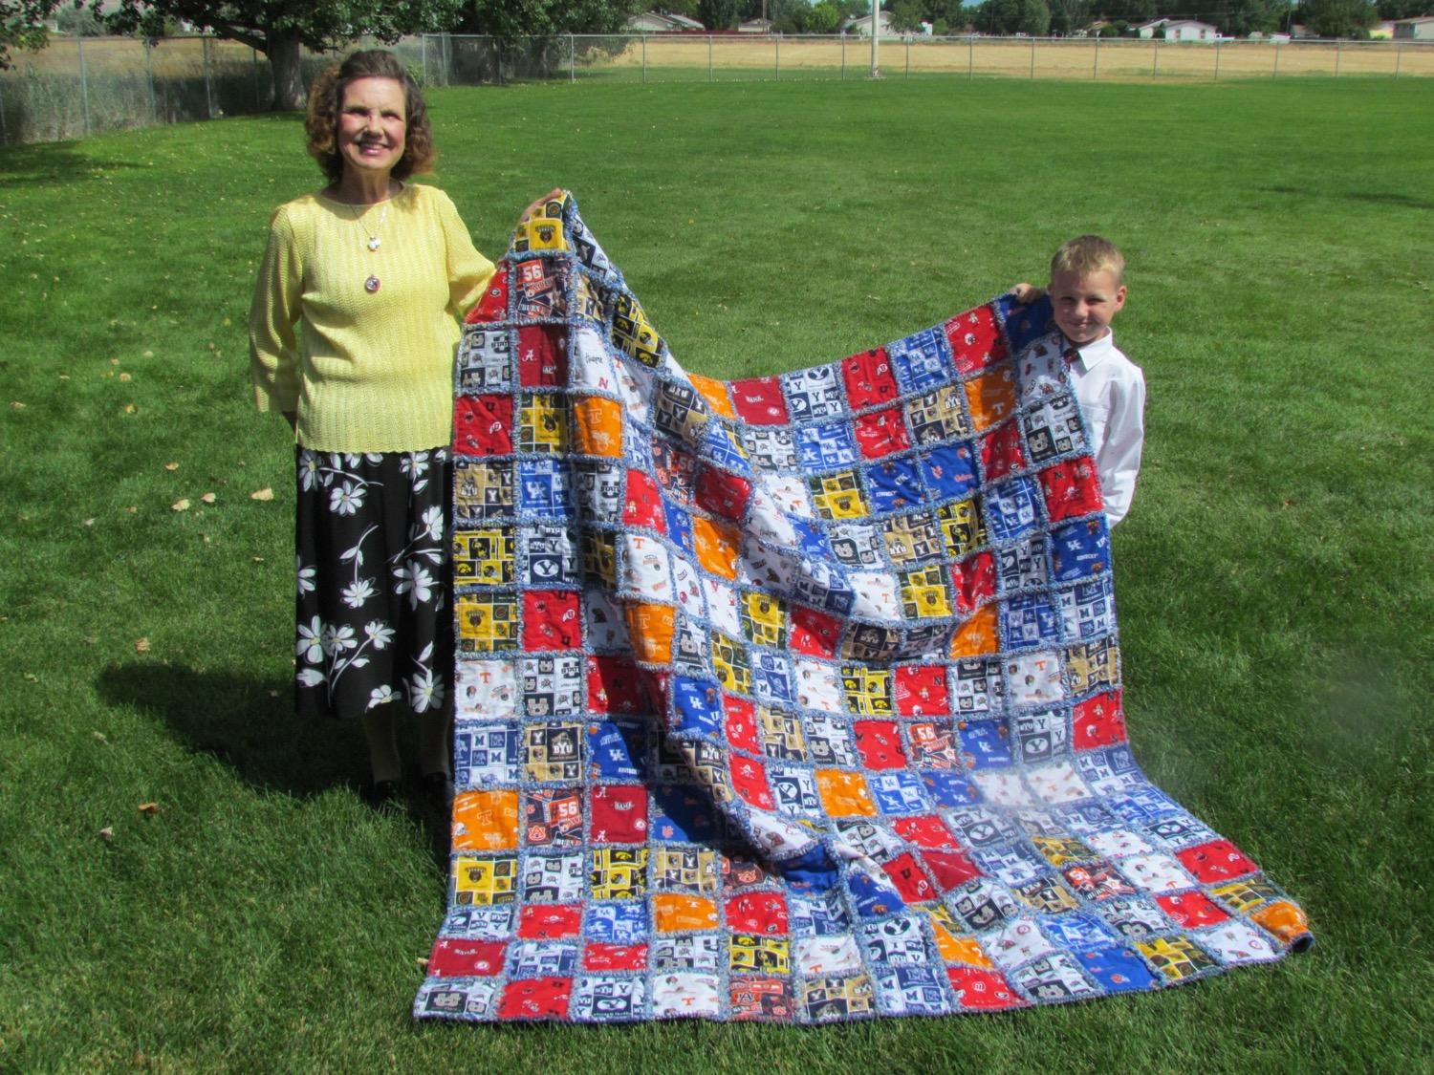

Slide 78
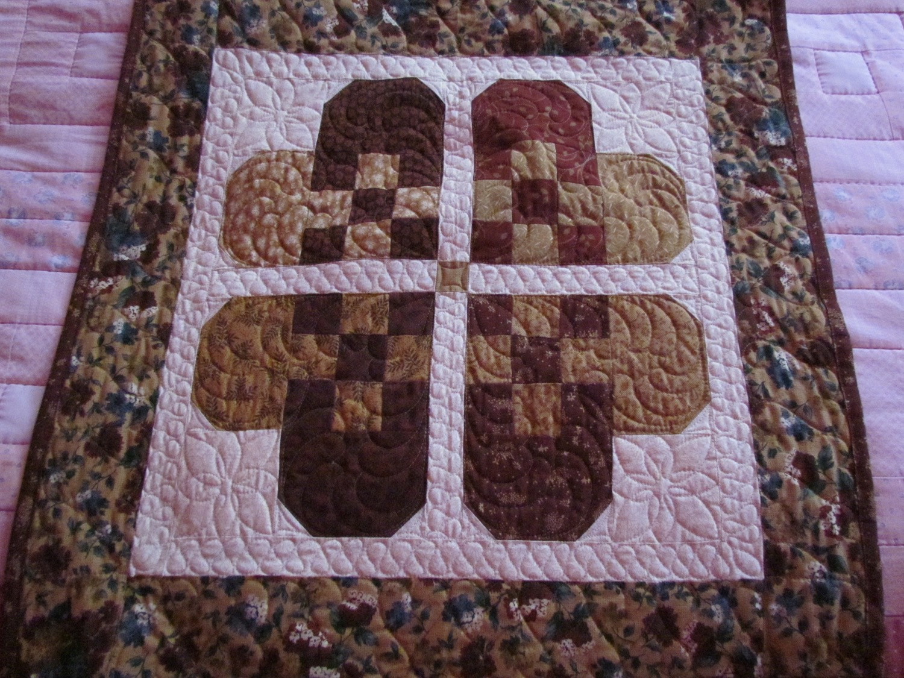

Slide 79
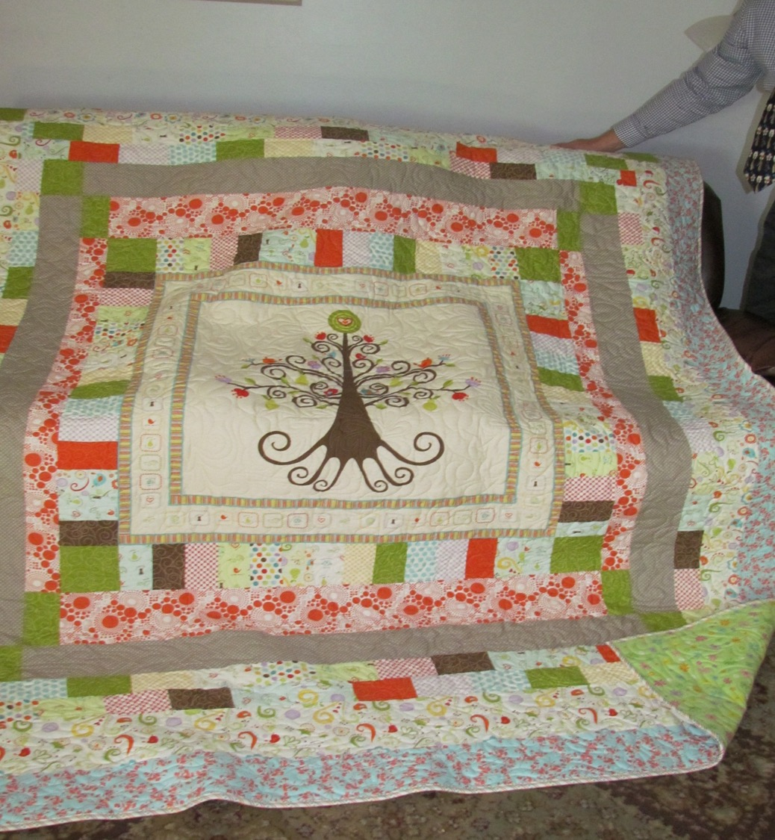

Slide 80
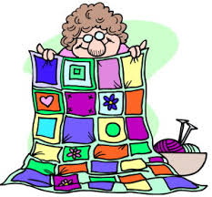
“I Am Part of a Bigger Picture” Worksheet

Slide 81
Integration Video

Slide 82
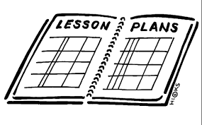
Discussion
How could teachers integrate PD life lessons into their classes.

Slide 83
Thank You/What’s Next Video

