Slide 1
Five Things You Didn’t Know About eMedia
uen.org/ucet

Slide 2
NEW Content
1
Math Shorts!
PBS – Daniel Tiger, Mathematica, Great Museums, Constitution USA with Peter Sagal, The National Parks
UIMC+ - Freedom Seekers, Trendmakers, Weston Woods

Slide 3
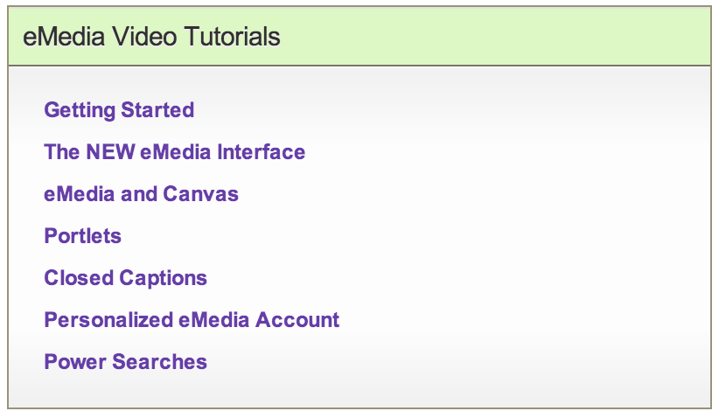
Tutorial Videos
2

Slide 4
Effective Teaching Strategies
3
uen.org/emedia
Preview videos for appropriateness
Take advantage of CC
Stop, pause and discuss
Use in a flipped model

Slide 5
Many Ways to Access
4
uen.org/emedia
Pioneer Online Library
Preschool Pioneer
my.uen
Canvas

Slide 6
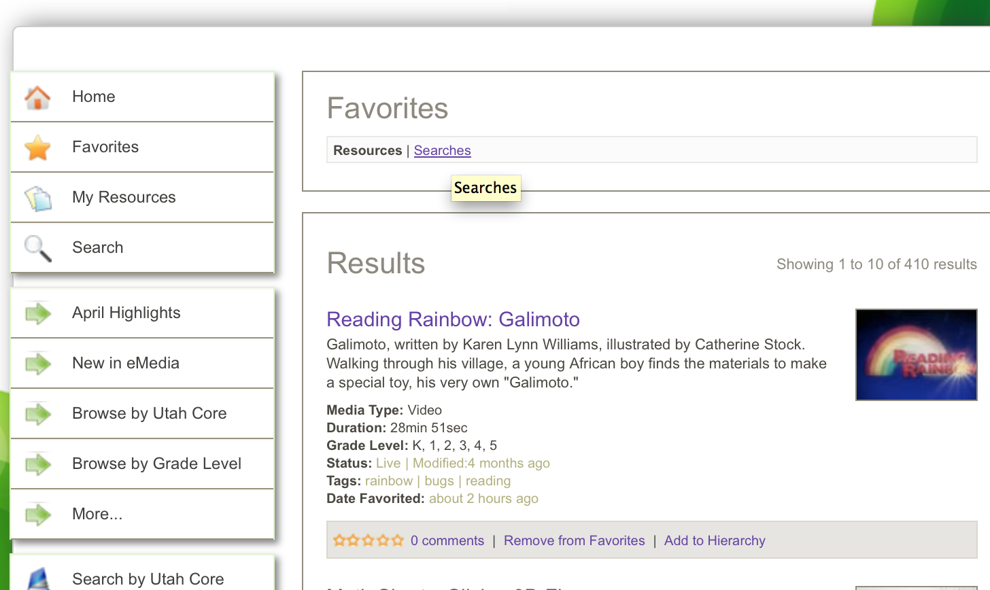
Save and Share Results
5

Slide 7
Notes:
Teachers always need time to discover and think about how to implement.

Slide 8
Katie Garrett
@katielgarrett
katie@uen.org
801-585-3286

