Slide 1
Launching Writing with the “Write” Tools
Day 2
Jennifer Throndsen, PreK-12 Literacy and Library Media Coordinator
Sara Wiebke, K-3 Literacy Specialist

Slide 2
Overview of Day 2
Writing Collection Project
Scoring Samples
Sorting Students into Instructional Groups to Plan Instruction
Article – A Path to Better Writing
Cognitive Demands
Prompt Analysis

Slide 3
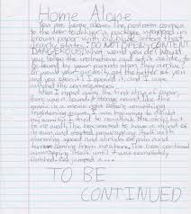
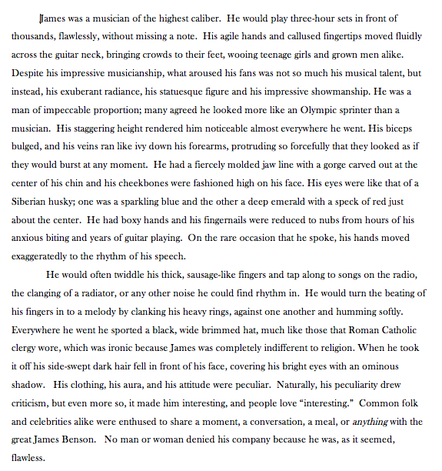
K-6 Writing Collection Project

Slide 4
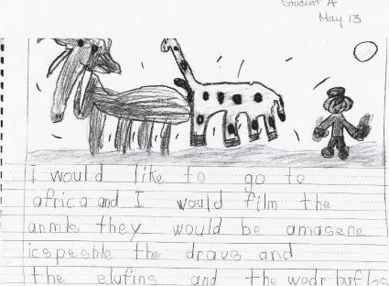
Writing Collection Project
Teaching & Learning Department and Assessment Department personnel designed writing prompts & text sets
Four school selected for high writing scores in multiple grades:
Ensign (Salt Lake City School District)
Jeremy Ranch (Park City School District)
Willow Springs (Canyons School District)
Endeavour (Davis School District)

Slide 5
Writing Collection Project
Administering the prompts
K-2 all hand-written
Grades 3-6: 50% hand-written; 50% typed
Collect and Score
K-2 USBE created rubrics
3-6 SAGE rubric
Time Allotments
K: 30 minutes
Grade 1: 40 minutes
Grade 2: 60 minutes
Grades 3 – 6: 90 minutes

Slide 6
Writing Collection Project
Steps:
Read the prompt
Text or text set
Read the text aloud
Read the prompt
Write, using best spelling
Grades K-1:
Word bank

Slide 7
Prompts & Text Sets
All K-6 prompts, text sets, annotated and unannotated samples are available online - http://www.uen.org/core/languagearts/writing-collection/
Argumentative samples have not been collected yet, but the prompt and text sets are online
K opinion & informative
1st opinion & informative
2nd opinion & informative
3rd opinion & informative
4th opinion & informative
5th opinion & informative
6th argumentative & informative

Slide 8
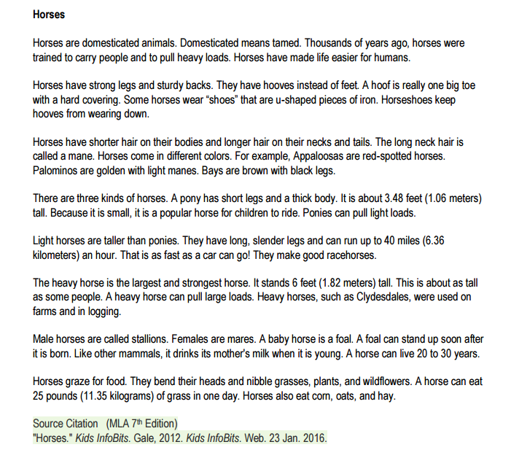
Scoring – 3rd Grade Informative
Materials
Prompt
Text
Unannotated Student Sample
Rubric
Checklist
Annotated Student Sample

Slide 9
Scoring – 3rd Grade Informative - Prompt

Slide 10
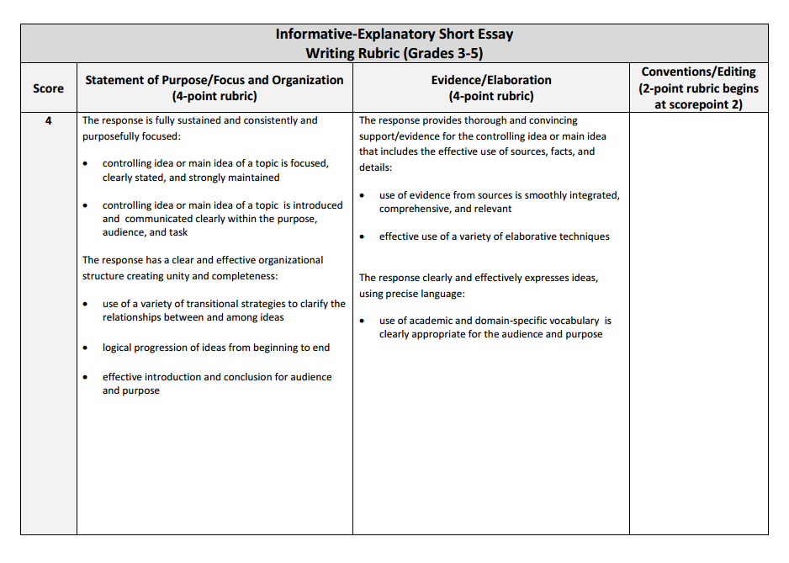
Scoring – 3rd Grade Informative Rubric
Purpose - scoring

Slide 11
Scoring – 3rd Grade Informative Checklist
Purpose:
Check which instructional pieces are missing from the writing sample
Create groups of students with similar deficits

Slide 12
Scoring – 3rd Grade Informative Student Sample

Slide 13
Scoring – 3rd Grade Informative - Introduction
Introduces the topic

Slide 14
Scoring – 3rd Grade Informative – Linking Words and Phrases
Uses linking words and phrases

Slide 15
Scoring – 3rd Grade Informative – Facts, Definitions, and Details
Develops the topics with facts, definitions, and details

Slide 16
Scoring – 3rd Grade Informative - Conclusion
Provides a concluding statement

Slide 17
Scoring – 3rd Grade Informative Rubric & Checklist

Slide 18
Rubrics
Grades 3 and up
Grades K-2
Scores (4, 3, 2, 1, 0, NS)
3 columns
Statement of Purpose/Focus & Organization (4-point rubric)
Evidence/Elaboration (4-point rubric)
Conventions/Editing (2-point rubric)
Scores (4, 3, 2, 1, 0, NS)
2 columns
Statement of Purpose/Focus & Organization (4-point rubric)
Conventions/Editing (2-point rubric)
Notes:
4 is above grade level
3 is proficient

Slide 19
Scoring…
Focus and Organization | Evidence and Elaboration | Conventions

Slide 20
Scoring – 3rd Grade Informative - Annotated

Slide 21
Activity
In pairs/small groups, choose a grade level to practice scoring the unannotated samples
Try to score at least 3-4 samples, younger grades may be able to score more

Slide 22
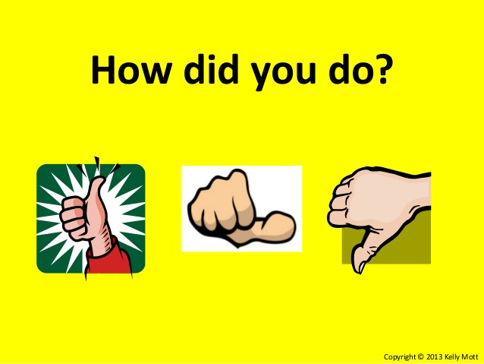
Scoring
Use the annotated samples to check your scores
Notes:
Its alright if your scores differ – it matters what you will do next in instruction

Slide 23
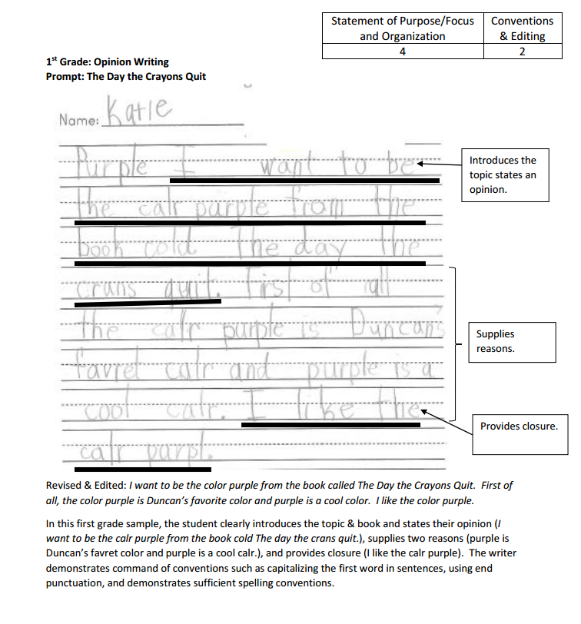
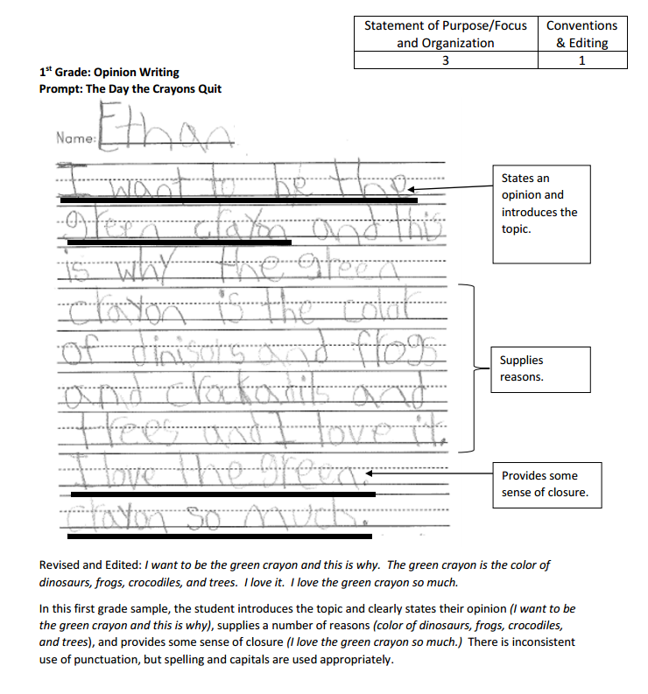
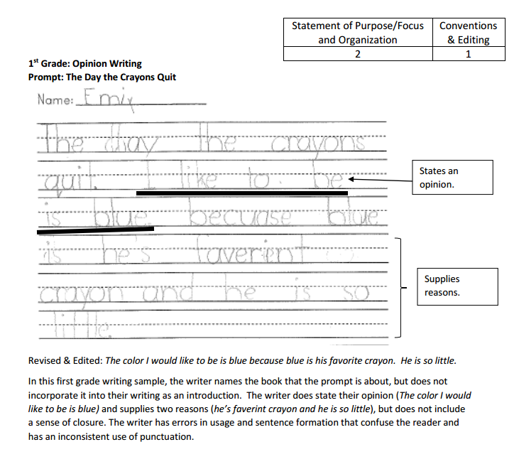
First Grade Opinion Sorting

Slide 24
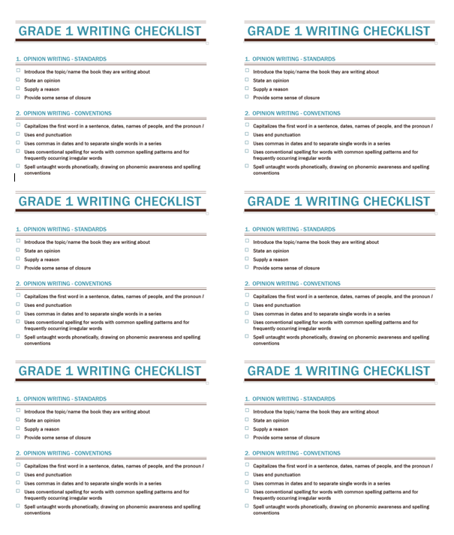
Sort Samples Based on Instructional Needs
Introduce the topic
State an opinion
Supply a reason
Provide closure
Conventions
Whole group – what does the majority of the class need support on?
Small group – what do a few students need support on?
Notes:
I do first few – then they do rest
Class of 15
60% (9/15) need support introducing the topic
40% (6/15) need support providing closure
67% (10/15) need support with conventions
1 student needs support in writing an opinion piece and attending to the prompt

Slide 25
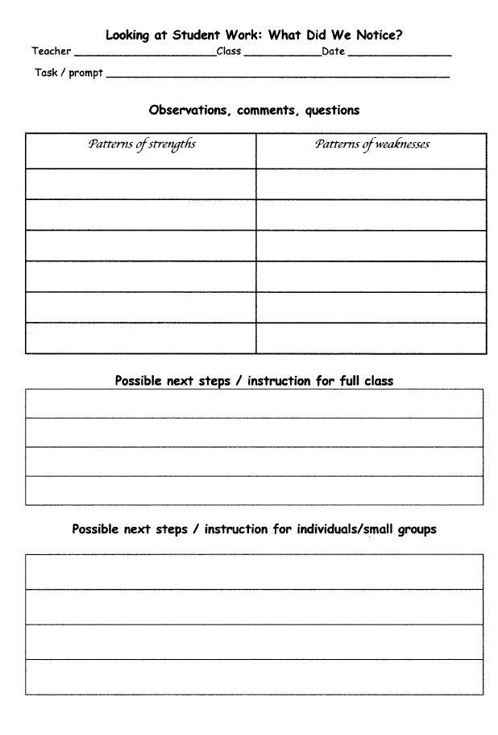
Planning Instruction
Notes:
Strengths and Weaknesses of the class, next steps?
Have the participants work with team members to identify strengths across the pieces as well as general areas for improvement. Then have them decide what their next steps for instruction would be. Have them share out with the group.
Connect this to how they could do similar work in their PLCs.

Slide 26
Grade Level Sorting
In small groups, sort your scored samples based on instructional needs
Use the checklist
Use the planning instruction handout
Whole group vs. small group instruction

Slide 27
Planning Instruction
Notes:
Strengths and Weaknesses of the class, next steps?
Have the participants work with team members to identify strengths across the pieces as well as general areas for improvement. Then have them decide what their next steps for instruction would be. Have them share out with the group.
Connect this to how they could do similar work in their PLCs.

Slide 28
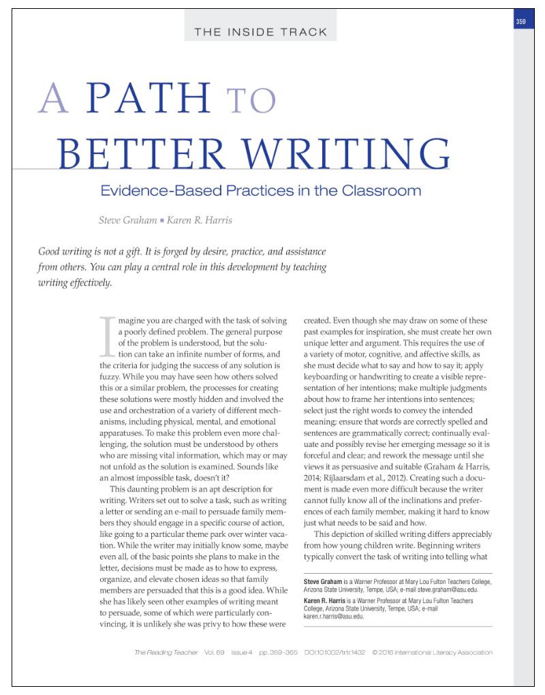
Read and discuss 6 evidence-based writing practices for teaching writing effectively and how teachers can use these practices in their classrooms.

Slide 29
Task: Read the introduction and discuss with a partner the complexity of writing and how to bridge the gap between beginning writing and skilled writing

Slide 30
Task:
In groups of 6, choose one practice, read the section, teach your colleagues about your practice, and use the notetaking guide
Evidence-Based Writing Practices:
Write
Write to Comprehend and Learn
Create a Pleasant and Motivating Writing Environment
Facilitate Students’ Writing as They Compose
Teach Critical Skills, Processes, and Knowledge
Use 21st-Century Writing Tools

Slide 31
Task: Read conclusion and discuss with a partner how you plan to use this knowledge in your context

Slide 32
Warm-Up: How Fluent is Your Handwriting?
Notes:
Time for non-dominant hand:
Time for dominant hand:

Slide 33
Low Level/High Level Skills in Writing
Lower-level Cognitive Skills
Higher-level Cognitive Demands
Physically forming letters using pencil on paper
Writing left to right.
Using a story structure or expository structure.
Varying sentence structure.
Spacing words on a page.
Sticking to the plan.
Spelling high-frequency irregular words.
Phonetically spelling unknown words.
Using topic sentences in paragraphs.
Notes:
On their note-taking guide have them work with a partner to draw arrows to show whether it is a high level or low level cognitive skill.

Slide 34
Low Level/High Level Skills in Writing
Lower-Level Cognitive skills
Higher-Level Cognitive Demands
Writing left to right.
Physically forming the letters using pencil on paper.
Spacing words on the page.
Spelling high-frequency irregular words.
Phonetically spelling unknown words.
Using uppercase letters as appropriate.
Using end punctuation.
Indenting paragraphs.
Using a story structure or expository structure.
Varying sentence structure.
Sticking to the plan.
Using topic sentences in paragraphs.
Keeping the goal of the composition in mind.
Keeping the audience’s need in mind.
Checking for insufficient or unnecessary detail.
Choosing precise vocabulary to express ideas.

Slide 35
Building Transcription Fluency
5-10 minute warm-up
Forming a few letters, using numbered arrow cues, tracing, verbalizing, or writing from memory, then evaluating accuracy.
Producing the alphabet, in sequence, one or two times per session, until fluency is achieved.
Writing graphemes for dictated phonemes (vowels and consonants), including letter combinations such as vowel teams and digraphs.
Combining onsets and rimes to write whole syllables.
Writing high-frequency words to dictation—a few at a time, singly, or in sentences—saying the letters while writing each word.
Notes:
In K-2, it is essential to provide short, daily practice in letter formation and writing high-frequency words

Slide 36
Cognitive Processes of Writing
Planning
Translating into Written Form
Reviewing and Revising
Notes:
Handout: Cognitive Writing Processes
Have them use their notetaking page and give them one part of the process to read—Planning, Translating, or Reviewing. Work in triads…one person reads each category and then they tell each other about that category and fill in some details on their graphic organizer

Slide 37
Prompt Analysis

Slide 38
Prompt Analysis
Develop an instructional process for breaking apart the prompt that allows each task to be addressed separately and coherently

Slide 39
Deconstructing a Prompt
Read the prompt aloud
Highlight the verbs or action words
Underline the task you are being asked to do
Circle the question you need to answer

Slide 40
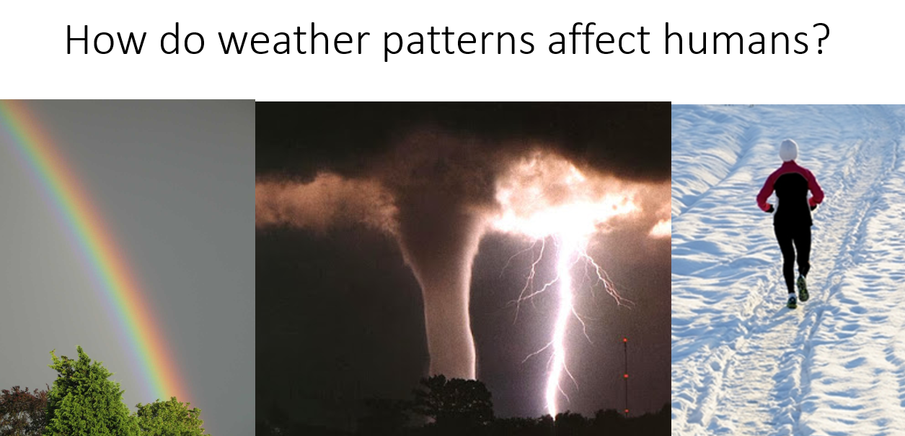
Highlight the Verbs
How do tornadoes affect humans? Using the Terrifying Tornadoes text, describe the power of tornadoes, the dangers, and how to stay safe. Be sure to introduce the topic, use facts and definitions, and a concluding statement.

Slide 41
Underline the task
How do tornadoes affect humans? Using the Terrifying Tornadoes text, describe the power of tornadoes, the dangers, and how to stay safe. Be sure to introduce the topic, use facts and definitions, and a concluding statement.

Slide 42
Circle the Question You Need to Answer
How do tornadoes affect humans? Using the Terrifying Tornadoes text, describe the power of tornadoes, the dangers, and how to stay safe. Be sure to introduce the topic, use facts and definitions, and a concluding statement.

Slide 43
Your Turn – Deconstruct the Prompt
To survive in the harsh arctic environment, animals need special adaptations. After reading Where Do Polar Bears Live?, describe in 1-2 paragraphs, using facts and definitions, how the polar bear is built to survive in the Arctic. Be sure to use evidence from the text to support your ideas.

Slide 44
Your Turn – Deconstruct the Prompt
To survive in the harsh arctic environment, animals need special adaptations. After reading Where Do Polar Bears Live?, describe in 1-2 paragraphs, using facts and definitions, how the polar bear is built to survive in the Arctic. Be sure to use evidence from the text to support your ideas.

Slide 45
Analyze Your Prompt from Day 1
Notes:
If they can’t find it – make a new one

Slide 46
Deconstructing a Prompt
Read the prompt aloud
Highlight the verbs or action words
Underline the task you are being asked to do
Circle the question you need to answer

Slide 47
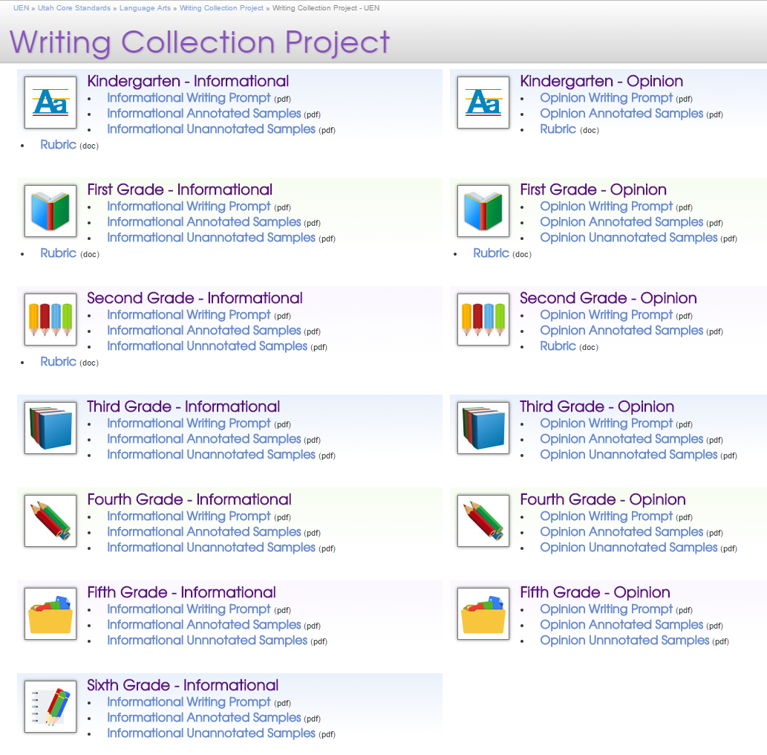
Resources
Writing Collection Project
K-6
Writing Prompts
Samples (Annotated and Unannotated)
Informational
Opinion
Rubrics
LDC Collaborative

