Slide 1
Theorists in Child Development
Information on how we can better understand and develop children!

Slide 2
TODAY
Bell Quiz, Song, and go over Unit 1 Rubric
Complete Development Section in Workbook and hand in.
Complete section D of your workbook.
Use the Growth and Development packet to do this.
When your name is called complete Assignment #6 and perform an observation in the center.
Complete Assignment #7.
See the instructions in your workbook.
See the samples.

Slide 3
Assignment #7 CHILD DEVELOPMENT COLLAGE
❶Fold a paper into 4 squares
❷Choose 3 areas of development (physical, emotional, cognitive, social, moral) and 1 of the theorists (Erickson or Piaget)
❸Find and attach a picture that shows the areas of development being developed.
Explain Why you chose this picture. What is being done in the picture to develop the area?
Explain how this activity is developing this area. What is the child learning in this picture?
For the theorist, attach a visual to help you remember each theorist’s theory.
Explain Why you chose this picture and how it will help you remember the theorist.
PUT YOUR NAME and PERIOD ON IT.

Slide 4
PIG DRAWING PERSONALITY ANALYSIS
If your pig is drawn:
Toward the top of the page, you are positive and optimistic.
Toward the middle of the page, you are a realist.
Toward the bottom of the page, you are pessimistic and have a tendency to behave negatively.
If your pig is drawn:
Facing left, you believe in tradition, you’re friendly and you remember important dates
Facing right, you are innovative and active, but you don’t have a strong sense of family and you have trouble remembering dates.
Facing front (looking at you), you are direct and enjoy playing devil’s advocate. You neither fear nor avoid discussions.
With many details, you are analytical, cautious, and distrustful.
With few details, you are emotional and naïve, care little for details, and like to take risks.
With 4 legs showing, you are secure, stubborn, and stick to you ideas.
With less than 4 legs showing, you are insecure and living through a period of major change.
The size of you pig’s ears indicates how good a listener you are – the bigger the better
The length of your pig’s tail tells the quality of your romantic life - the longer the better.

Slide 5
CHILD DEVELOPMENT IS……
The study of how a child grows and develops, from conception to age 18

Slide 6
5 STAGES OF CHILD DEVELOPMENT
1. Infancy – birth to 12 months
2. Toddler – 12 months to 3 years
3. Preschool – 3 years to 6 years
4. School age – 6 years to 12 years
5. Adolescents – 13 years to 18 years

Slide 7
GROWTH and DEVELOPMENT
Growth = a child’s physical increase in size or amount that is easily observed
Development = The ability of a child to do things that are complex and difficult

Slide 8
LAWS of GROWTH and DEVELOPMENT
1. Growth proceeds from head (cephalo) to foot (caudal)
First infant lifts head to see object, later gains muscle strength AND control to pick up an object, and later learns to move toward the object.
2. Growth proceeds from near (proximal) to far (distal)
First moves whole body, then it moves outward to arms, hands, and then fingers. Waving “Hi” = First they learn to wave with arms, then wave with their hand and wrist, and then wave with fingers.
3. Growth proceeds form simple to complex
Sleep and eat, later babbles and eats with fingers. First wave “Hi” and then say it

Slide 9
Identify 5 common generalizations of growth and development
a. Growth and development is similar for everyone.
b. Growth and development builds on earlier learning.
A Child moves on to the next level of difficulty after
mastering a task.
c. Growth and development proceeds at an individual rate
and time with each child.
d. Growth and development is all interrelated/ connected.
e. Growth and development is continual throughout life (aka- it NEVER ENDS!)

Slide 10
Development Quiz for SLO
Notes:
Holbrook edit: This is for the SLO I have to complete. Have the students do the pretest for areas of development at the beginning of the day, and then assess them again on it here.

Slide 11

Areas of Development: Easy Guide
Moral
Emotional
Cognitive
Social
Physical
Notes:
Holbrook edits:
Thumb= the difference between humans and other mammals, we have a double digit and can preform a pincher grasp motion.
Cognitive= have the students take their first finger and point to their head and go “aww-ha!”
Moral= middle finger, what happens if I chose to leave only this finger up? Is flipping you off right or wrong? What tells you so?
Emotional= Ring finger. Talk about the fact that every girl dreams of a particular day when her best friend takes her to the beach, hear the waves crashing, he will kneel to the ground, and then places something special on this finger that symbolizes a life of happy ever after.
Social= get a cup and have the students pretend that they are in Brittan and having tea, what does this finger do? Sticks out. It is socially acceptable.

Slide 12
AREAS of DEVELOPMENT
PHYSICAL DEVELOPMENT
▪Developing and controlling gross and fine motor skills
▪The child’s physical growth in size and in proportion.
Gross motor = large muscles (lift head, roll, sit up, crawl, walk)
Fine motor = small muscles (hands and fingers)
▪Development is most rapid during the first three years.
COGNITIVE / INTELLECTUAL DEVELOPMENT
▪The ability of the brain to take in and process information.
▪The people in the child’s environment are most important in building / creating a strong learning environment.
▪ A child recognizing their name, recognizing their parent, language, recognizing that when he shakes a rattle it makes noise

Slide 13
AREAS of DEVELOPMENT
SOCIAL DEVELOPMENT
▪A child learning and discovering the expectations and rules for learning to get along with and understand others.
▪Moving from being egocentric (self-centered) to being able to relate with others.
▪A child smiling at parent, child learning to share, imaginary friend
EMOTIONAL DEVELOPMENT
▪The ability to recognize and understand feelings and how to respond to them appropriately.
▪Jealousy, being afraid, smile, laugh, sad, showing empathy
MORAL DEVELOPMENT
▪Identifying personal values and learning right from wrong
▪Respecting human rights, behaving accordingly, developing principles to guide behavior, listening to their conscience.
▪Being a good example is the best way to build a child’s conscience.

Slide 14
ABRAHAM MASLOW
Basic needs must be met at each level or there is no advancement.
 MEMORY JOGGER:
Mas – LOW (get low in voice and in posture) HI -erarchy of needs (get high in voice and in posture)
1. Physiological Needs: air, food, drink, rest
2. Safety and Security: stability, freedom from fear and anxiety, weather
3. Love and Belonging: affection, intimacy from friends and family
4. Esteem needs: self-respect, respect for others, self-acceptance
5. Self-actualization: being able to think beyond one’s self, doing what one is suited for and capable of doing. Doing one’s best.

Slide 15
ERIK ERIKSON
Created the theory on The 8 Stages of man which studied the stages of personality development throughout the life cycle.
This is always redeveloping itself. Each level defines a new social awareness and interaction possible for the individual.
 MEMORY JOGGER: Letter E = Erikson, Eight, Emotional
Stage 1. Trust vs. Mistrust (Infancy)
The degree to which a child learns to trust or mistrust others. Determined by the type and amount of care the child receives.
Stage 2. Autonomy vs. Shame and Doubt (2-4 years)
The degree to which a child is allowed and encouraged freedom and self-direction
Stage 3. Initiative vs. Guilt (4-6 years)
The degree to which a child is allowed control of his/her body, choices, fantasy, motor activities, and language activities. Begins to develop social skills (cooperating, leading, following)

Slide 16
LAWRENCE KOHLBERG
Moral Development of CHILDREN  MEMORY JOGGER: KO MO Dude Knock Out is not a moral thing to do
Stage 1. Preconventional
Children begin life with no sense of right or wrong. Learn quickly the certain behaviors are punished and others rewarded Learn to avoid punishment and strive for behavior or acts rewarded
Stage 2. Conventional (about age 9)
Learn to behave according to a sense of what others need or want. They follow established rules and respect authority Begin to act in accordance with what is right and wrong.
Stage 3. Post Conventional (about age 16) Mature morally.
Respect human rights and develop individual principles to guide their behavior and choices.
Their motivation to act a certain way comes from within, not just to follow the rules.

Slide 17
JEAN PIAGET
He Researched and defined stages of the cognitive / Intellectual skills of children and how they learn.
 MEMORY JOGGER: Notice his last name ends with “Get” and he taught how children GET SMART – point to head and say “Get smart”
Stage 1. Sensorimotor (birth -2 years old)
 MEMORY JOGGER: Stick out your tongue to help you
Children (babies) learn about and experience the world through their senses (see, touch, hear, taste, and smell). This is why everything goes in their mouth.
Stage 2. Preoprational (2-7 years old)
 MEMORY JOGGER: The word operate is part of Preoperational and you Need smarts to OPERATE.
The child begins to form concepts (wondering about the reality of people like Santa Clause) and use symbols as words. This allows the child to communicate and gain language development
 (police) (nike)  (no smoking) ⓪①(bathroom)  (stop) M (McDonalds)

Slide 18
ARNOLD GESELL
PHYSICAL DEVELOPMENT of CHILDREN
Came up with physical development age norms.
(sit, stand, walk, …)
These standards are used today in medical profession to monitor.

Slide 19
Assignment #7 CHILD DEVELOPMENT COLLAGE
❶Fold a paper into 4 squares
❷Choose 3 areas of development (physical, emotional, cognitive, social, moral) and 1 of the theorists (Erickson or Piaget)
❸Find and attach a picture that shows the areas of development being developed.
Explain Why you chose this picture. What is being done in the picture to develop the area?
Explain how this activity is developing this area. What is the child learning in this picture?
For the theorist, attach a visual to help you remember each theorist’s theory.
Explain Why you chose this picture and how it will help you remember the theorist.
PUT YOUR NAME and PERIOD ON IT.

Slide 20
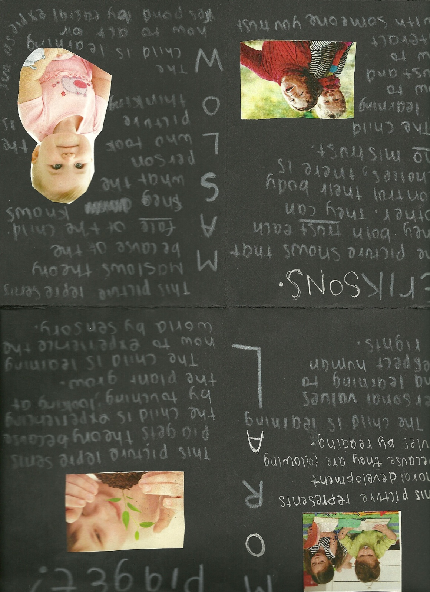

Slide 21
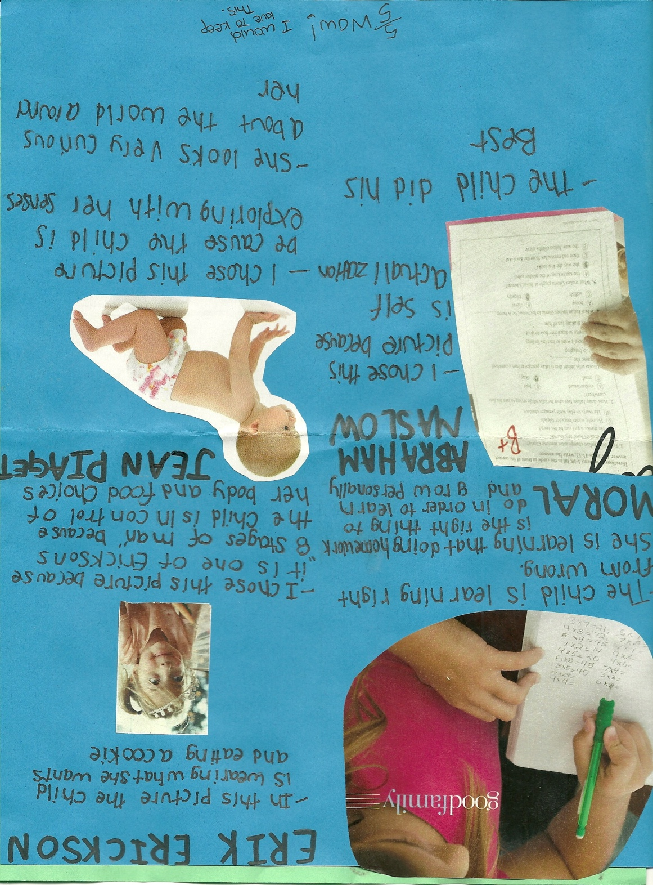

Slide 22
