Slide 1
Bell Quiz #5 Green section
Get out your Story/song evaluation! I have a story for you.
(Also, you should have your story that you wrote to your child ready to share)

Slide 2

Place the letters
A - CC (A, B, C, D…)
Randomly on your
Snakes and Ladders
game board.
Notes:
Instruments at the door. Hand out game card during bell quiz. Birds and the bees music is playing as they walk in. Sound is underneath this game slide.

Slide 4

Bell Quiz # 5
Story #7, unit 2 outline
Library passes
A-CC
Notes:
Fill in snakes and ladders, Correct bell quiz, story, hand out unit 2 outline, go over outline, play magic school bus and write library passes

Slide 5

Get on the magic school bus

Slide 6

Male & Female
Reproductive System
A-CC

Slide 7

Meet Seymour Sperm
Your Tour Guide

Slide 8

Female
Male
Fimbrae
Mons Pubis
Labia
Urethral opening
Perineum
Vagina
Cervix
Uterus
Endometrium
Fallopian tubes
Ovaries
Vaginal opening
Ovum
Menstruation
Scrotum
Testicle
Sperm
Epididymis
Vas Deferens
Seminal Vesicles
Prostate Gland
Cowper Gland
Ejaculation
Semen
Seminal Fluid
Urethra
Urinary Bladder
Penis

Slide 9
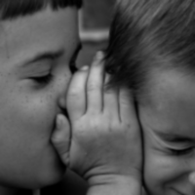
Notes:
“Let me tell you about the birds and the bees”

Slide 10
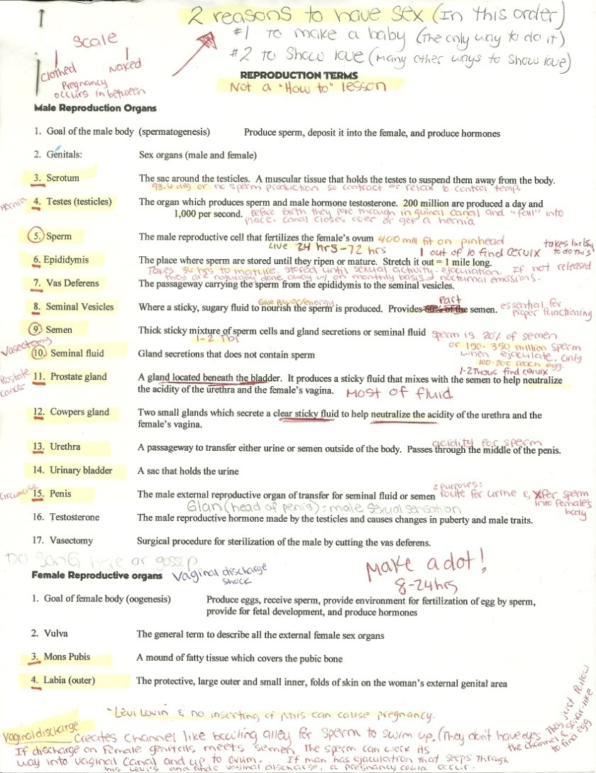
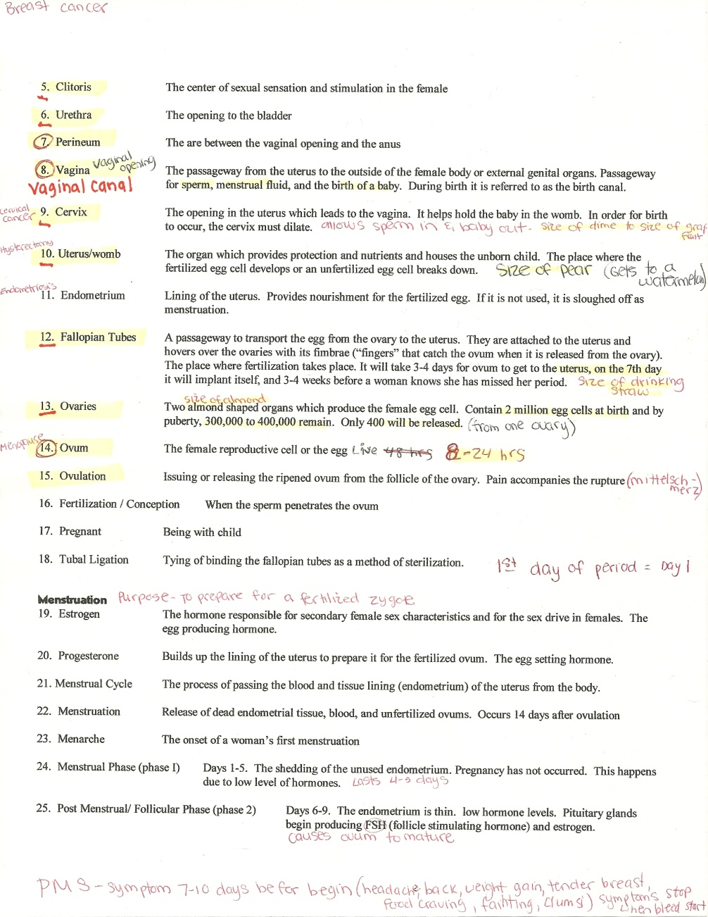
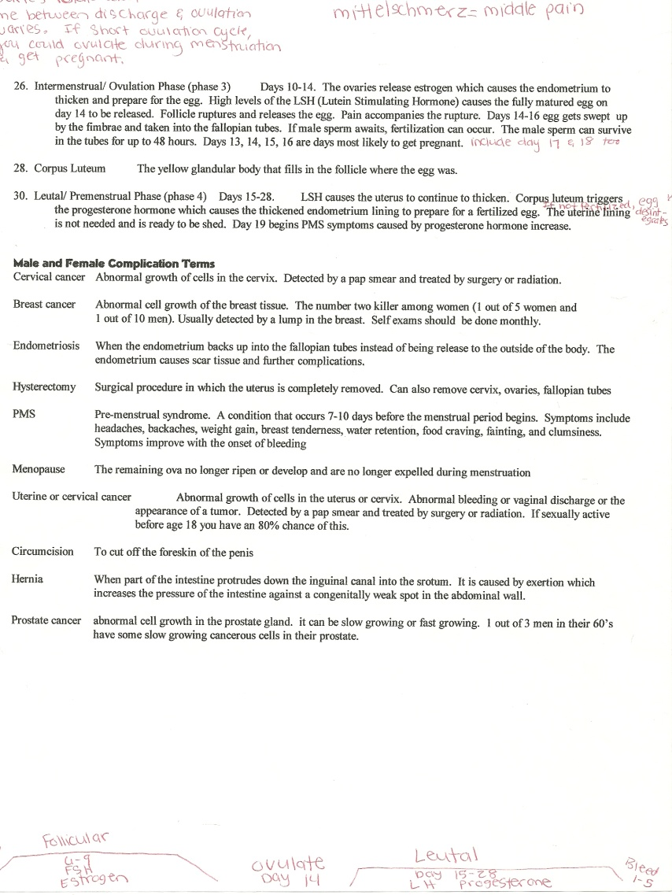

Slide 11
(J) Male sex cell or sperm
The sperm is a microscopic cell produced by the male's testicles and can fertilize the female's ovum.
400 million fit on a pin head which is enough sperm to re-populate the earth if each sperm fertilized an egg.
Sperm can live in the human body for 1-5 days (24-120 hours).
It is destroyed by warm body temperature, acidic environment.
Average swimming speed of a sperm: 8 inches per hour.
How to
play

Slide 12
The (F) penis is the male organ which allows the male to pass urine and semen from his body.
The purpose of the penis is to deposit semen in the vagina during sexual intercourse and a passageway for urine.
F. Penis

Slide 13
The (G) scrotum is a muscular sac-like pouch located behind the penis that holds each testes in a separate compartment and helps regulate body temperature for sperm production.
If the body gets above or below normal body temperature, sperm production is reduced. The scrotum changes the testicle’s positions to adjust the body heat.
G. Scrotum

Slide 14
The (I) testicles are the male sex gland that lie in the scrotum and produces both sperm and the male sex hormone testosterone.
1,000 sperm cells produced a second, 200 million produced a day, Four to five billion are produced each month.
Testosterone is the male reproductive hormone made by the testicles which causes the changes of puberty.
Testicles descend through the inguinal canal into the scrotum before birth.
The testicles are outside the body because the male sperm that is manufactured in the testes need cooler-than-body temperature for normal growth and development.
I. Testes

Slide 15
(H) Epididymis is a coiled tube system that forms a mass over the back and upper part of each testes in which sperm mature.
Sperm take about 36 hours to ripen to maturity.
Sperm are stored there for as long as six weeks.
If stretched out in a line, it would measure 1 mile long.
H. epididymis

Slide 16
(E) Vas deferens are two long, thin tubes that serve as a passageway for the travel of the sperm and seminal fluid or semen.
The contraction of the vas deferens along with the action of the cilia help transport the sperm through the vas deferens.
(K) Semen is 1-2 TBL of fluid that includes about 150 million sperm. (L) Seminal fluid does not include sperm.
Vasectomy: surgical procedure for sterilization of the male.
Any sperm not ejaculated are passed in the urine.
E. Vas deferens

Slide 17
(M) Urinary Bladder
The (M) urinary bladder is the organ that collects urine excreted by the kidneys before disposal by urination.
Urine leaves the bladder through another tube, the urethra. In men, it is longer, passing through the prostate gland and then the penis.

Slide 18
(A) Seminal Vesicles are two small glands that secrete a clear and sticky fluid that nourishes and enables the sperm to have energy and move.
The sugar in the seminal fluid is what nourishes the sperm.
A. Seminal Vesicles

Slide 19
B. Prostate Gland
The (B) prostate gland is located at the base of the bladder and surrounding the urethra.
It helps make up most of the seminal fluid.
The gland secretes an alkaline fluid that neutralizes the acid found in the male urethra and the female reproductive tract.
Without the secretions of the prostate gland, many sperm would die and fertilization of an ovum would be impossible.

Slide 20
(C) Cowpers glands are two small pea-sized glands located beneath the prostate gland on both sides of the base of the penis.
Produces alkaline neutralize fluid protecting it from acid to carry the sperm out of the male’s body upon (n) ejaculation.
C. Cowpers Gland

Slide 21
The (D) urethra is a dual purpose tube that connects with the vas deferens where both semen and urine pass through to leave the penis.
Semen and urine never mix. During urination, one sphincter will relax so that the pressure from the bladder will push urine out from the body. During ejaculation, another sphincter will relax so that semen can flow through the urethra to the outside of the body.
D. Urethra

Slide 22
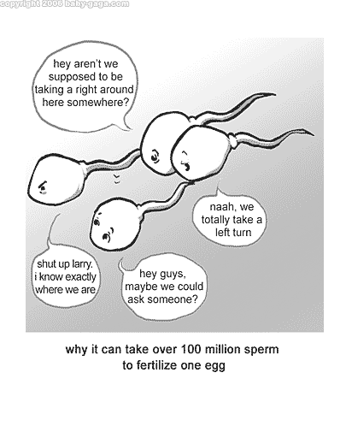
An (N) ejaculation is the passage of sperm from the penis and is a result of a series of muscular contractions.
About 150 million sperm are ejaculated; 20 million could be deformed.
Only 1 in 10 sperm (1-2 thousand) find the cervix
It takes about 1 hour and 15 minutes to reach the cervix.
Only 100 to 200 sperm, out of the 150 million, reach the ovum.

Slide 23
1. C
2. B
3. A
4. F
5. D
6. I
7. G
8. E
9. H
10. J
Extra: k, L, M, & N

Slide 24
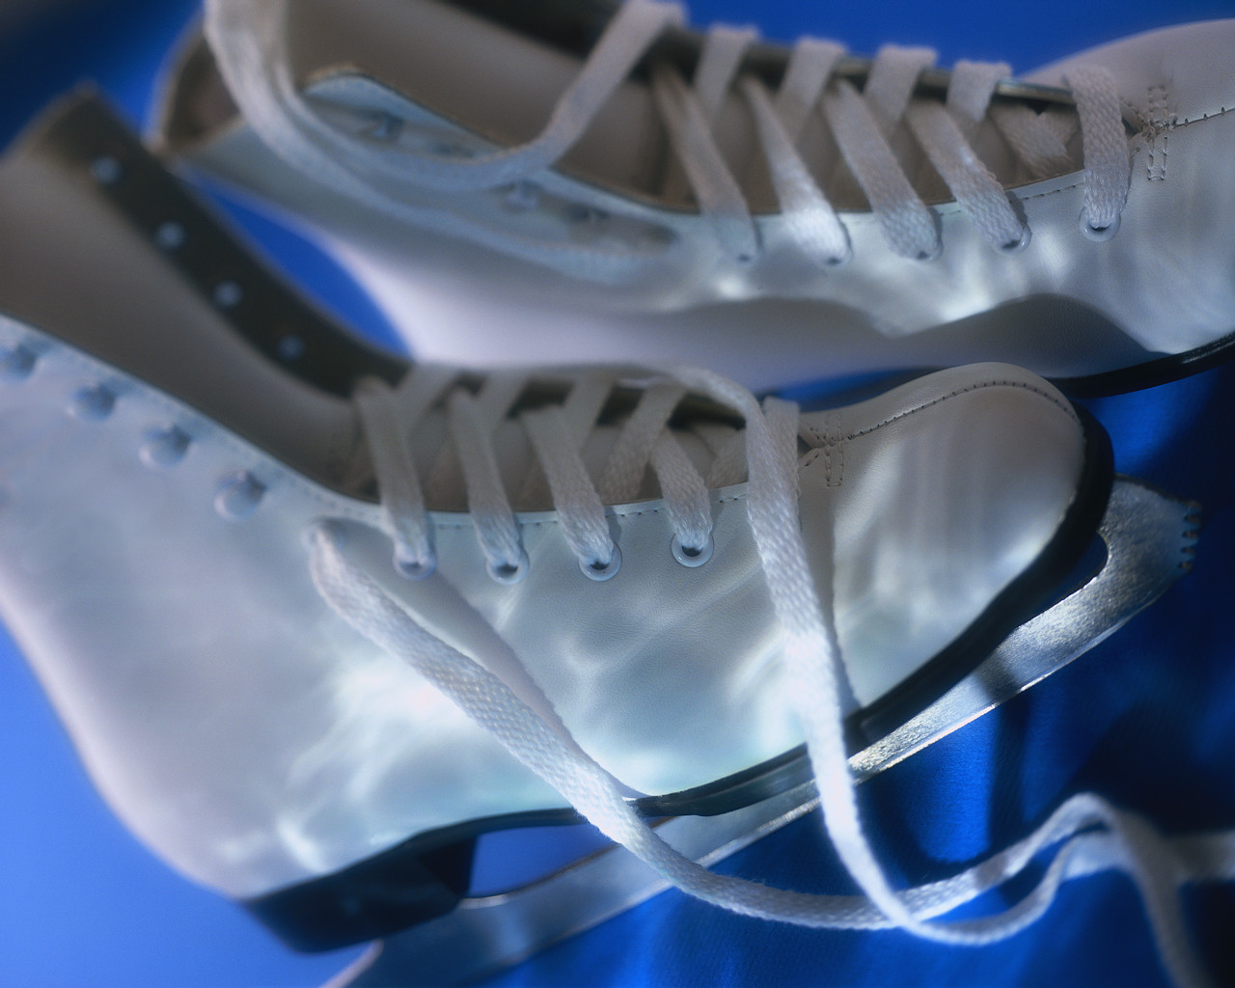

Sugarplum Fairy

Slide 25


Slide 26
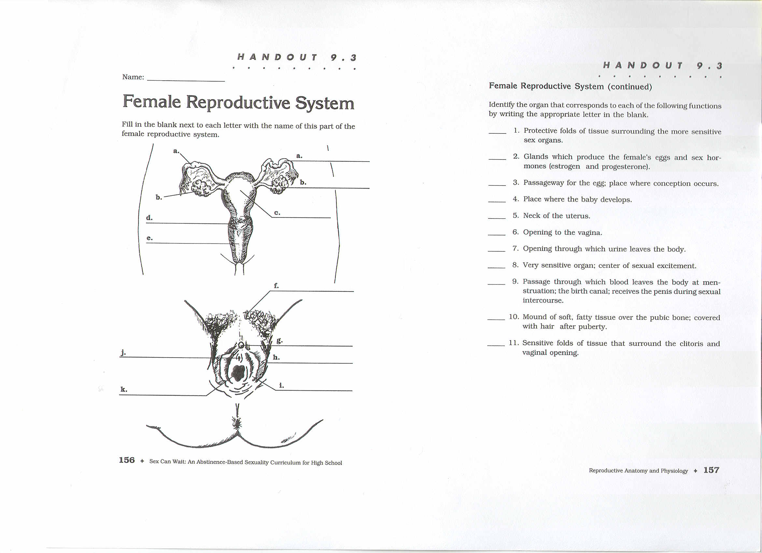
O. Mons Pubis
(O) Mons Pubis is a mound of soft, fatty tissue which covers the pubic bone and protects the reproductive organs.

Slide 27
(BB) Urethral opening is an external opening at the bottom of the urethra tube running between the bladder and the outside of a woman’s body.
Where urine leaves the body via the (CC) urethra which is a short tube that opens just in front of the vagina.
BB. Urethral opening

Slide 28
The (Y) vaginal opening is an external opening to the vagina. It leads to the vagina passageway running between the uterus and the vaginal opening.
Passageway for menstrual fluid, the birth of a baby, and sperm.
y. Vaginal opening

Slide 29
(X) Labia are protective folds of tissue running from the mons pubis to below the vaginal opening to cover and guard the vaginal opening from germs.
X. Labia Majora
and Labia Minora

Slide 30
The (W) perineum is the external surface area between the anus and the vulva, labia opening to the vagina.
Episiotomy is where the doctor will cut the perineum during delivery to widen the opening for the baby to come out.
w. Perineum

Slide 31
The (V) vagina (vaginal canal) is the passage through which menstrual fluid leaves the body, the passageway for the birth of a baby, and the channel directing the sperm to the internal reproductive organs.
During birth it is referred to as the birth canal.
v. Vagina

Slide 32
The (Q) cervix is the neck and opening into the uterus. If normal and healthy, it is the strongest muscle in the female body.
It is normally the size of a dime and the thickness of 10 saltine crackers. At birth it is the size of a grapefruit and thins (effacement) out to a single saltine cracker.
It helps hold the baby in the womb and must enlarge (dilate) to allow for birth to occur.
Q. Cervix
(CC) urethra

Slide 33
The (R) uterus is a hollow organ where an unfertilized ovum breaks down or a fertilized ovum develops.
It is shaped somewhat like an upside-down pear and about the size of a fist. At birth it stretches to the size of a watermelon.
It provides protection, nutrients, and houses the unborn baby while it develops.
It is called a womb when a baby is present.
R. Uterus

Slide 34
The (T) endometrium lining is vascular tissue lining of the uterus.
It provides a place for implantation and nutrients for the fertilized egg.
On the 7th day after conception, it implants itself into the endometrium lining and it will be 3-4 weeks before a woman realizes that she missed her period
If there is not a fertilized egg, it is sloughed off during (Z) menstruation.
It rebuilds itself and thickens each month in preparation for a fertilized egg.
Endometriosis is when the lining does not completely leave the uterus and becomes built up scar tissue. Could build up into the fallopian tubes. May be a reason for infertility.
T. Endometrium Lining

Slide 35
S. Fallopian tubes
AA. fimbrae
(S) Fallopian tube is a narrow passageway transporting the egg/ovum from the ovary to the uterus and sperm cells towards the egg cell. (AA) Fimbrae are on the end.
They are attached to the uterus and hover over the ovaries.
They are about 4” long and 3/16 inch in diameter (the size of a cooked spaghetti noodle).
The place where conception occurs. Usually in the upper third region.
It is a 3-4 day journey for the egg to get to the uterus.

Slide 36

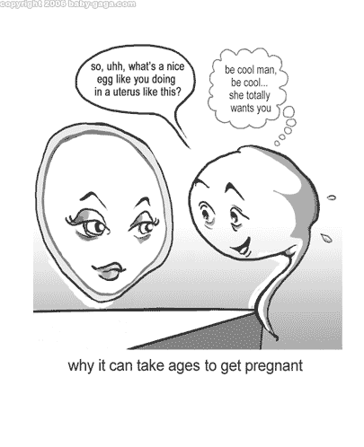
P. Ovum or egg
Female sex cell
The female reproductive cell.
The size of a pencil dot or a grain of sand.
The female baby is born with all the ova she will ever have (about 200,000 in each ovary).
About 400-500 ova mature and are released over a lifetime.
Lives for 8-12 hours after ovulation.
Once it is fertilized it is called a zygote.

Slide 37
The (U) ovaries are two almond shaped glands which produce, store, and release the female’s eggs/ovum/zygote and produces hormones.
The female hormones are progesterone and estrogen.
Progesterone builds up the lining of the uterus called the endometrium (uterine) lining in preparation for the fertilized ovum.
Estrogen is responsible for the secondary sex characteristics and the sex drive in females. It spurs the onset of puberty and is responsible for ovulation.
U. ovaries

Slide 38
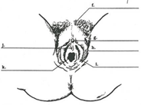
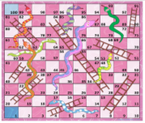
1. X
2. U
3. S
4. R
5. Q
6. Y
7. BB
8. V
9. O
10. T
11. P
12. W
Extra:
Z, AA, CC
Winners
on the top row?

Slide 39
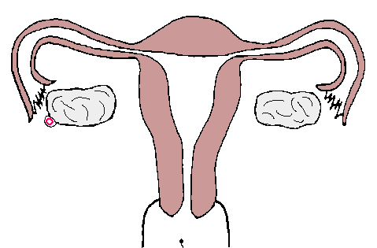
FERTILIZATION/ Conception
When the sperm penetrates the surface of the female sex cell, ovum, and enters inside to the nucleus .
The 23 chromosomes from each sex cell combine and begin to multiply to begin to form a new 46 chromosome human being.

Slide 40
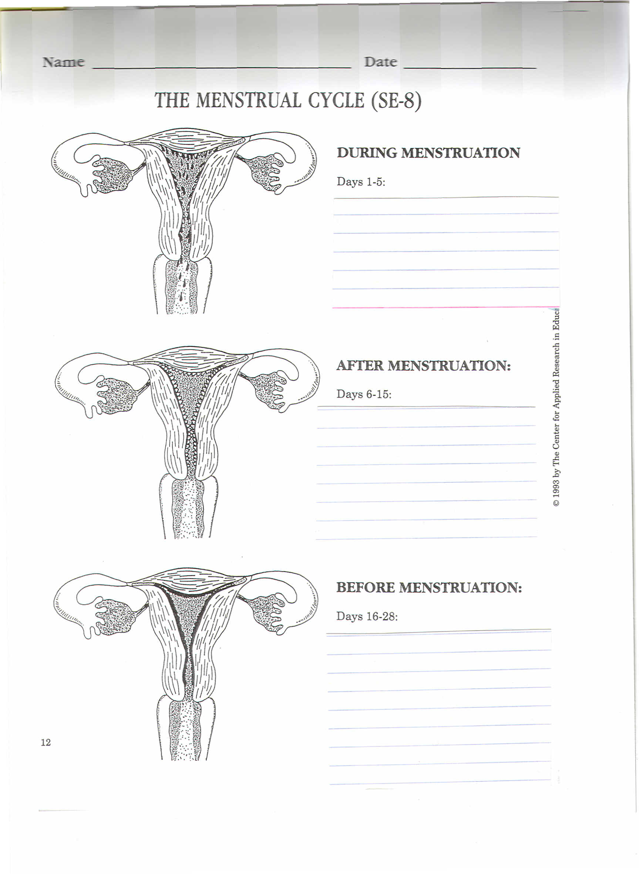

Slide 41
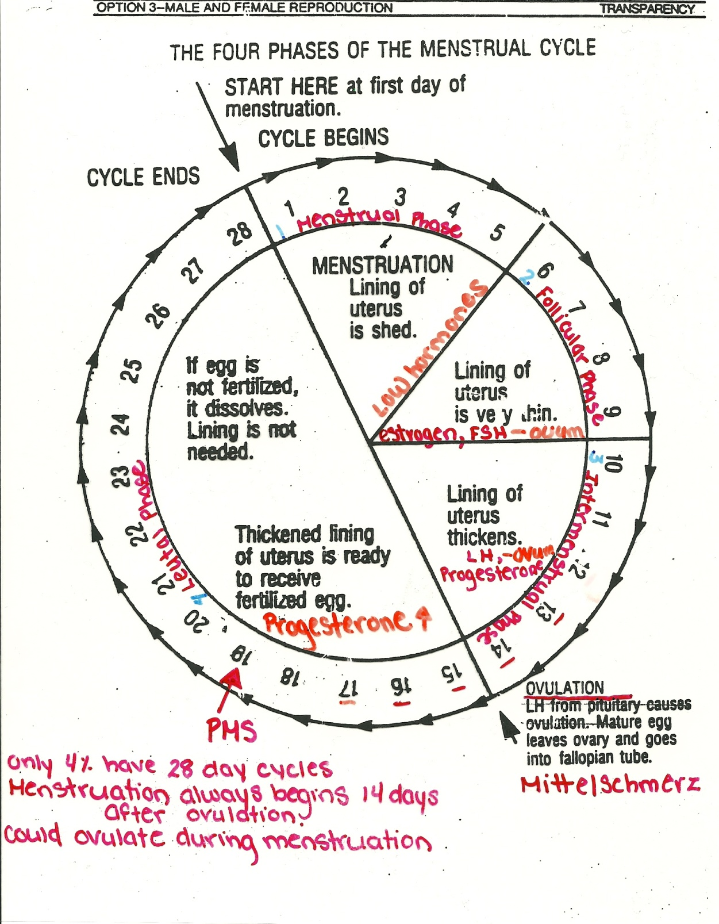

Slide 42
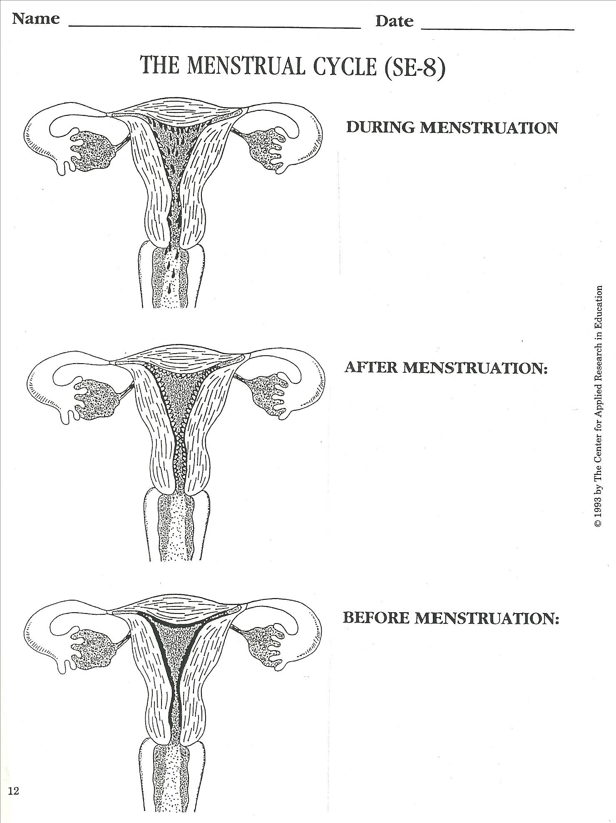
During Menstruation Days 1-5
Menstruation occurs and the endometrium lining of the uterus, with a small amount of blood, leaves the body.
At this time, another egg is maturing in the ovary.

Slide 43
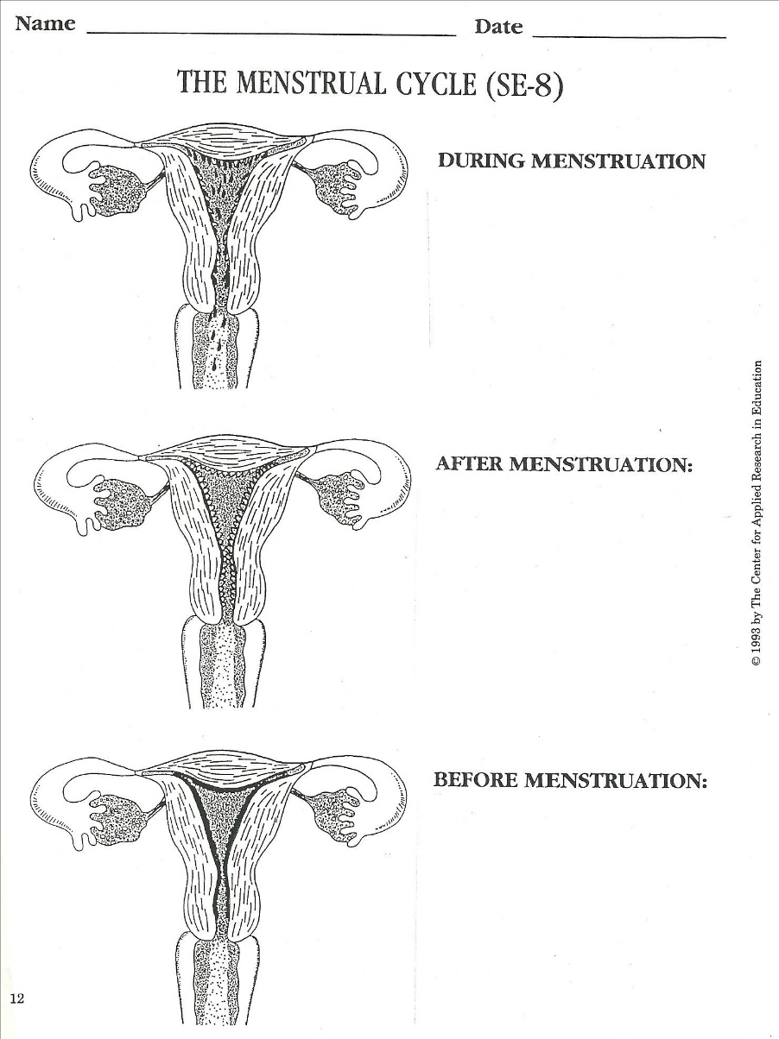
After Menstruation Days 6-15
The endometrium lining has thinned, the uterus begins to repairs itself to prepare for a fertilized egg, and the ovum is maturing.
12-16 days before your next period begins, ovulation occurs causing the ripened ovum to burst out of the ovary follicle.
Follicle-stimulating Hormone (FHS):
a substance which brings to life a few
of the ovum in one of the ovaries.
Luteinizing Hormone (LH): causes
the follicle to burst and allows ovum
to fall into the opening of the fallopian
tube.

Slide 44
Before Menstruation Days 16-28
Uterine lining continues to thicken.
If the egg is fertilized by the sperm cell, it travels down the fallopian tube and embeds itself into the thickened wall of the uterus (endometrium lining).
If the egg is not fertilized, the blood vessels in the wall of the uterus shrinks and breaks down.
PMS occurs 7-10 days before menstruation begins.
Headache, back pain, weight gain, bloating, food cravings, irritability, clumsy, fainting, etc.
Mittelschmerz-middle pain
And the cycle begins again

Slide 45
MENSTRUATION BEGINS OVER AGAIN
Days 1-5
Menstruation occurs and the lining of the uterus, with a small amount of blood, leaves the body.
At this time, another egg is maturing in the ovary.
Assignment SEYMOUR and OLIVIA STORY

